Slide 1
Decision Diagrams for Sequencing and Scheduling
Andre Augusto Cire
Joint work with David Bergman,
Willem-Jan van Hoeve, and John Hooker
Tepper School of Business
INFORMS 2013

Slide 2
Decision Diagrams for Optimization
Novel techniques for discrete optimization problems
C., van Hoeve: Multivalued Decision Diagrams for Sequencing Problems, Operations Research, to appear.
Bergman, C., van Hoeve, Hooker: Optimization Bounds from Binary Decision Diagrams. INFORMS J. Computing, to appear.
C., van Hoeve: MDD Propagation for Disjunctive Scheduling, ICAPS 2012
Bergman, C., van Hoeve, Hooker: Variable Ordering for the Application of BDDs to the Maximum Independent Set Problem. CPAIOR 2012: 34-49
Bergman, C., van Hoeve, Hooker: Decision Diagrams for Discrete Optimization. Under review, 2013.
...

Slide 3
Outline
Definition of a decision diagram
Application to timetable problems
Application to disjunctive scheduling

Slide 4
What is a decision diagram?
In our context:
A decision diagram is a graphical representation of a set of solutions to a problem

Slide 5
max ∑_{i} x_{i}
x₁ + x₂ ≤ 1
x₃ + x₆ ≤ 1
x₁ + x₄ + x₅ ≤ 1
x₄ + x₅ + x₆ ≤ 1
x₁,…, x₆ $∈$ {0,1}

Slide 6
: 0
r
: 1
max ∑_{i} x_{i}
x₁ + x₂ ≤ 1
x₃ + x₆ ≤ 1
x₁ + x₄ + x₅ ≤ 1
x₄ + x₅ + x₆ ≤ 1
x₁,…, x₆ $∈$ {0,1}
x₁
x₂
x₃
x₄
Layers: variables
Arc labels: variable values
Paths from root to terminal: solutions
x₅
x₆
t

Slide 7
: 0
r
: 1
max ∑_{i} x_{i}
x₁ + x₂ ≤ 1
x₃ + x₆ ≤ 1
x₁ + x₄ + x₅ ≤ 1
x₄ + x₅ + x₆ ≤ 1
x₁,…, x₆ $∈$ {0,1}
x₁
x₂
x₃
x₄
Layers: variables
Arc labels: variable values
Paths from root to terminal: solutions
x₅
x₆
t

Slide 8
: 0
r
: 1
max ∑_{i} x_{i}
x₁ + x₂ ≤ 1
x₃ + x₆ ≤ 1
x₁ + x₄ + x₅ ≤ 1
x₄ + x₅ + x₆ ≤ 1
x₁,…, x₆ $∈$ {0,1}
x₁
x₂
x₃
x₄
Arc weights: contribution to the objective function
Optimal solution: longest path from root to terminal
x₅
x₆
t

Slide 9
: 0
r
: 1
max ∑_{i} x_{i}
x₁ + x₂ ≤ 1
x₃ + x₆ ≤ 1
x₁ + x₄ + x₅ ≤ 1
x₄ + x₅ + x₆ ≤ 1
x₁,…, x₆ $∈$ {0,1}
x₁
x₂
x₃
x₄
Arc weights: contribution to the objective function
Optimal solution: longest path from root to terminal
x₅
x₆
t

Slide 10
Issue
Exactly representing all solutions requires exponentially-sized diagrams
Alternative: Limit its size to obtain a relaxation of the set of solutions instead
Limit the width of the diagram
Strength is controlled by the width

Slide 11
max ∑_{i} x_{i}
x₁ + x₂ ≤ 1
x₃ + x₆ ≤ 1
x₁ + x₄ + x₅ ≤ 1
x₄ + x₅ + x₆ ≤ 1
x₁,…, x₆ $∈$ {0,1}
x₁
x₂
x₃
x₄
x₅
x₆
Exact
Width = 4
Relaxed
Width = 3

Slide 12
max ∑_{i} x_{i}
x₁ + x₂ ≤ 1
x₃ + x₆ ≤ 1
x₁ + x₄ + x₅ ≤ 1
x₄ + x₅ + x₆ ≤ 1
x₁,…, x₆ $∈$ {0,1}
x₁
x₂
x₃
x₄
x₅
x₆
Exact
Width = 4
Relaxed
Width = 3

Slide 13
max ∑_{i} x_{i}
x₁ + x₂ ≤ 1
x₃ + x₆ ≤ 1
x₁ + x₄ + x₅ ≤ 1
x₄ + x₅ + x₆ ≤ 1
x₁,…, x₆ $∈$ {0,1}
x₁
x₂
x₃
x₄
x₅
Relaxation provides an upper bound of 4
x₆
Exact
Width = 4
Relaxed
Width = 3

Slide 14
Relaxed Diagrams
Provide bounds on the objective function
They can also be used for inference
Deduction of new constraints

Slide 15
Constructing Relaxed Diagrams
Incremental refinement
Constraints are processed one at a time
Refine phase
Filter phase

Slide 16
r
: 0
: 1
x₁
max ∑_{i} x_{i}
x₁ + x₂ ≤ 1
x₃ + x₆ ≤ 1
x₁ + x₄ + x₅ ≤ 1
x₄ + x₅ + x₆ ≤ 1
x₁,…, x₆ $∈$ {0,1}
x₂
x₃
x₄
x₅
Maximum Width: 2
x₆
t

Slide 17
r
: 0
Refine: constraint selects a node to split
: 1
x₁
max ∑_{i} x_{i}
x₁ + x₂ ≤ 1
x₃ + x₆ ≤ 1
x₁ + x₄ + x₅ ≤ 1
x₄ + x₅ + x₆ ≤ 1
x₁,…, x₆ $∈$ {0,1}
x₂
x₃
x₄
x₅
Maximum Width: 2
x₆
t

Slide 18
r
: 0
Refine: constraint selects a node to split
: 1
x₁
max ∑_{i} x_{i}
x₁ + x₂ ≤ 1
x₃ + x₆ ≤ 1
x₁ + x₄ + x₅ ≤ 1
x₄ + x₅ + x₆ ≤ 1
x₁,…, x₆ $∈$ {0,1}
x₂
x₃
x₄
x₅
Maximum Width: 2
x₆
t

Slide 19
r
: 0
Refine: constraint selects a node to split
: 1
x₁
max ∑_{i} x_{i}
x₁ + x₂ ≤ 1
x₃ + x₆ ≤ 1
x₁ + x₄ + x₅ ≤ 1
x₄ + x₅ + x₆ ≤ 1
x₁,…, x₆ $∈$ {0,1}
x₂
x₃
x₄
x₅
Maximum Width: 2
x₆
t

Slide 20
r
: 0
Filter: remove infeasible arcs
: 1
x₁
max ∑_{i} x_{i}
x₁ + x₂ ≤ 1
x₃ + x₆ ≤ 1
x₁ + x₄ + x₅ ≤ 1
x₄ + x₅ + x₆ ≤ 1
x₁,…, x₆ $∈$ {0,1}
x₂
x₃
x₄
x₅
Maximum Width: 2
x₆
t

Slide 21
r
: 0
Filter: remove infeasible arcs
: 1
x₁
max ∑_{i} x_{i}
x₁ + x₂ ≤ 1
x₃ + x₆ ≤ 1
x₁ + x₄ + x₅ ≤ 1
x₄ + x₅ + x₆ ≤ 1
x₁,…, x₆ $∈$ {0,1}
x₂
x₃
x₄
x₅
Maximum Width: 2
x₆
t

Slide 22
r
: 0
Filter: remove infeasible arcs
: 1
x₁
max ∑_{i} x_{i}
x₁ + x₂ ≤ 1
x₃ + x₆ ≤ 1
x₁ + x₄ + x₅ ≤ 1
x₄ + x₅ + x₆ ≤ 1
x₁,…, x₆ $∈$ {0,1}
x₂
x₃
x₄
x₅
Maximum Width: 2
x₆
t

Slide 23
r
: 0
Move to the next constraint and repeat...
: 1
x₁
max ∑_{i} x_{i}
x₁ + x₂ ≤ 1
x₃ + x₆ ≤ 1
x₁ + x₄ + x₅ ≤ 1
x₄ + x₅ + x₆ ≤ 1
x₁,…, x₆ $∈$ {0,1}
x₂
x₃
x₄
x₅
Maximum Width: 2
x₆
t

Slide 24
Key Observation
Constraints can be highly-structured
Suitable to scheduling
Two application examples
Timetable problems
Disjunctive scheduling

Slide 25
Timetable Problems
Example:
Allocate work days and rest days for an employee throughout the week
Each employee must have at least one rest day for every three consecutive days
Sequence constraint

Slide 26
Linear formulation:
Decision variable:
- x_{i} : 1 if employee works on day i, 0 otherwise
sun | mon | tue | wed | thu | fri | sat
x₁ | x₂ | x₃ | x₄ | x₅ | x₆ | x₇
x₁+x₂+x₃ ≤ 2
x₄+x₅+x₆ ≤ 2
x₂+x₃+x₄ ≤ 2
x₅+x₆+x₇ ≤ 2
x₃+x₄+x₅ ≤ 2
x₁+x₂+x₃ ≤ 2
x₂+x₃+x₄ ≤ 2
Typical sequence linear model
x₃+x₄+x₅ ≤ 2
x₄+x₅+x₆ ≤ 2
x₅+x₆+x₇ ≤ 2

Slide 27
Diagram Representation
: 0
: 1
r
sun | mon | tue | wed | thu
x₁ | x₂ | x₃ | x₄ | x₅
x₁
x₂
Layers: work allocation variables
Variable ordering in the diagram corresponds to day sequence
x₃
x₄
x₅
t

Slide 28
Filtering
: 0
: 1
(0, 0)
r
x₁
State information for each node:
Minimum and maximum work days up to that node
(0, 0)
(1, 1)
x₂
(0, 0)
(2, 2)
(1, 1)
x₃
(1, 1)
(0, 2)
(2, 3)
x₁ + x₂ + x₃ ≤ 2
x₄
(1, 1)
(0, 2)
(1, 4)
x₅
(0, 5)
t

Slide 29
: 0
: 1
(0, 0)
r
x₁
(0, 0)
(1, 1)
0 ≤ $x_{1}$≤ 2
x₂
(0, 0)
(2, 2)
(1, 1)
0 ≤ $\sum_{i=1}^{2}{x_{i}}$ ≤ 2
x₃
(2, 2)
1 ≤ $\sum_{i=1}^{3}{x_{i}}$ ≤ 2
(1, 1)
(2, 2)
x₄
1 ≤ $\sum_{i=1}^{4}{x_{i}}$ ≤ 3
(1, 1)
(2, 2)
(3, 3)
x₅
t
2 ≤ $\sum_{i=1}^{3}{x_{i}}$ ≤ 4
(2, 4)

Slide 30
Experimental Results
Hard randomly generated instances
50 days
5 sequence constraints
Inference was incorporated into a state-of-the-art constraint-based scheduler (ILOG CP Optimizer)
New type of global constraint

Slide 31
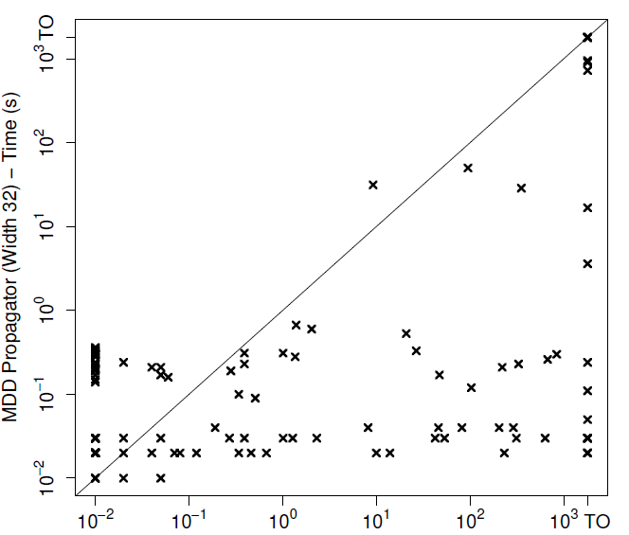
Results

Slide 32
Disjunctive Scheduling
Sequencing and scheduling of activities on a resource
Activities
Processing time: p_{i}
Release time: r_{i}
Deadline: d_{i}
Resource
Nonpreemptive
Process one activity at a time
0
1
2
3
4
Activity 1
Activity 2
Activity 3

Slide 33
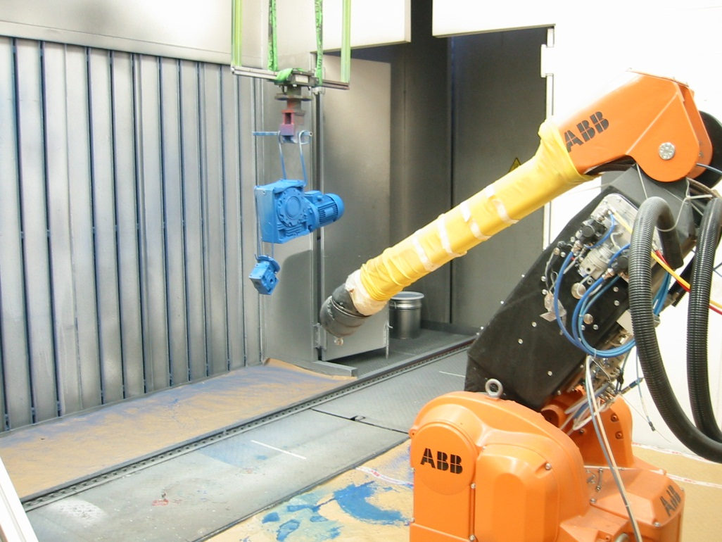
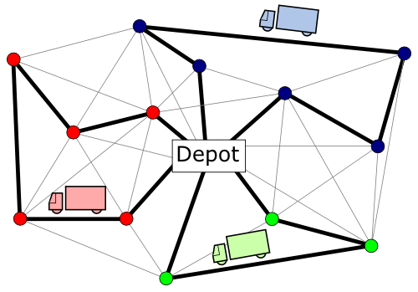
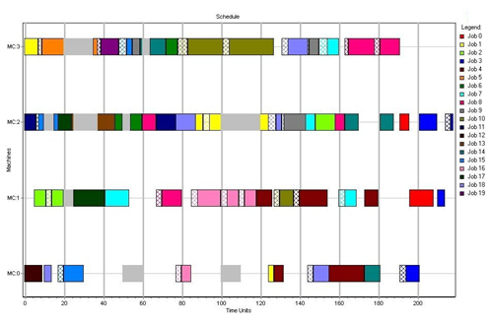
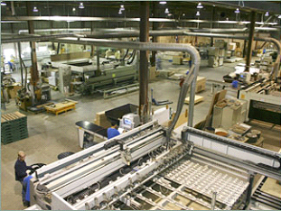

Slide 34
Diagram Representation
Natural representation as permutation diagram
Every solution can be written as a permutation π
π₁, π₂ , π₃, …, π_{n} : activity sequencing in the resource
Schedule is implied by a sequence:
$${{start}_{π_{i}} ≥start}_{π_{i−1}}+p_{π_{i−1}} i=2,…,n$$

Slide 35
Diagram Representation
Act | r_{i} | p_{i} | d_{i}
1 | 0 | 2 | 3
2 | 4 | 2 | 9
3 | 3 | 3 | 8
π₁
{1}
{2}
{3}
π₂
Path {1} – {3} – {2} :
0 ≤ start₁ ≤ 1
6 ≤ start₂ ≤ 7
3 ≤ start₃ ≤ 5
{3}
{2}
π₃

Slide 36
Filtering
r
{1,2}
{3}
π₁
Example of state information:
Earliest starting time
{3}
{1,2}
{1}
π₂
{1}
{2}
π₃
{3}
…
{1,3,5,…}
π₄

Slide 37
Filtering: Earliest Start Time
0
Assume all release dates are zero, and:
r
{1,2}
{3}
π₁
2
5
Act | p_{i} | d_{i}
1 | 2 | 12
2 | 3 | 6
3 | 5 | 18
{3}
{1,2}
8
{1}
π₂
4
7
{1}
{2}
π₃
{3}
Node labels:
Earliest Start Time
…
{1,3,5,…}
π₄

Slide 38
Filtering: Earliest Start Time
0
Assume all release dates are zero, and:
r
{1,2}
{3}
π₁
2
5
Act | p_{i} | d_{i}
1 | 2 | 12
2 | 3 | 6
3 | 5 | 18
{3}
{1,2}
8
{1}
π₂
4
7
{1}
{2}
π₃
{3}
Node labels:
Earliest Start Time
…
{1,3,5,…}
π₄

Slide 39
Inference
Theorem: Given the exact diagram M, we can deduce all implied activity precedence in polynomial time in the size of M
For a node v,
$A_{u}^{↓}$: values in all paths from root to u
$A_{u}^{↑}$: values in all paths from node u to terminal
Precedence relation $i≪j$ holds if and only if
for all nodes u in M
Same technique applies to relaxed MDD
r
i
u
j
t

Slide 40
Precedence relations can be used to:
Guide search
As an inference technique
Mathematical Programming: linear constraints
Constraint-based scheduling: reduce domains
Conversely, precedence relations can also be used to filter the permutation diagram

Slide 41
Experiments
Decision diagram incorporated into IBM ILOG CPLEX CP Optimizer 12.4 (CPO)
State-of-the-art constraint based scheduling solver
Uses a portfolio of inference techniques and LP relaxation
Added as user-defined propagator

Slide 42
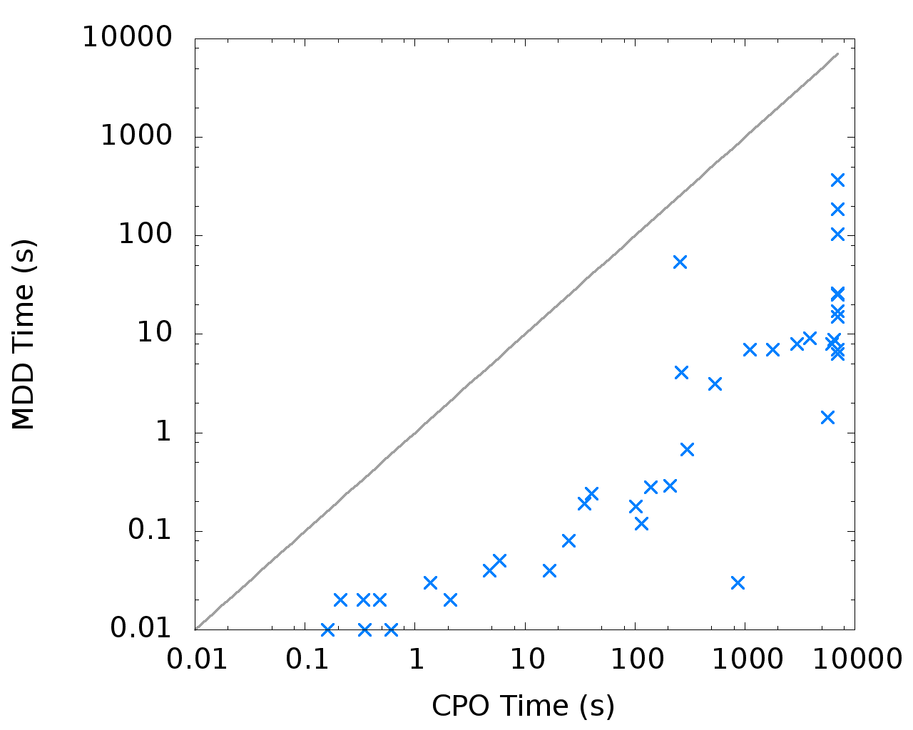
TSP with Time Windows
Dumas/Ascheuer instances
- 20-60 jobs
- lex search
- MDD width: 16
Pure MDD time (s)
CPO time (s)

Slide 43
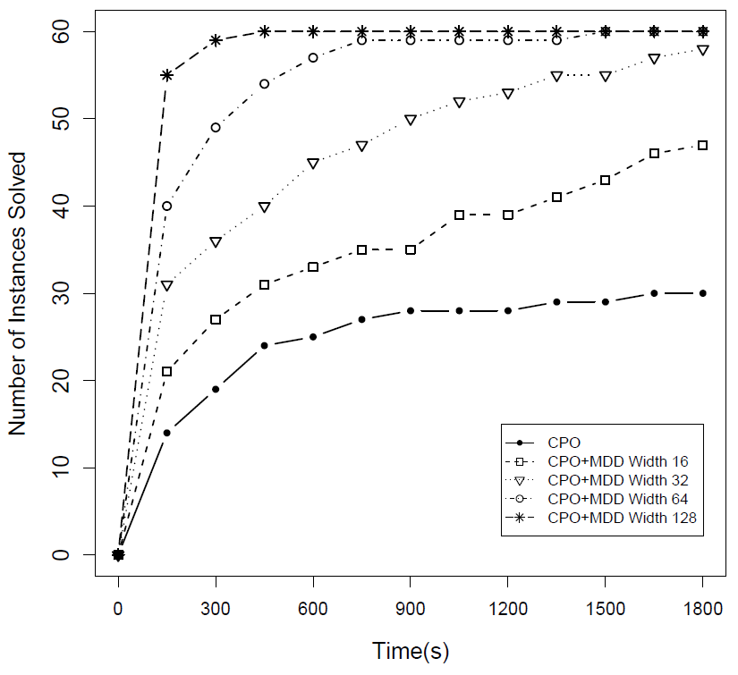
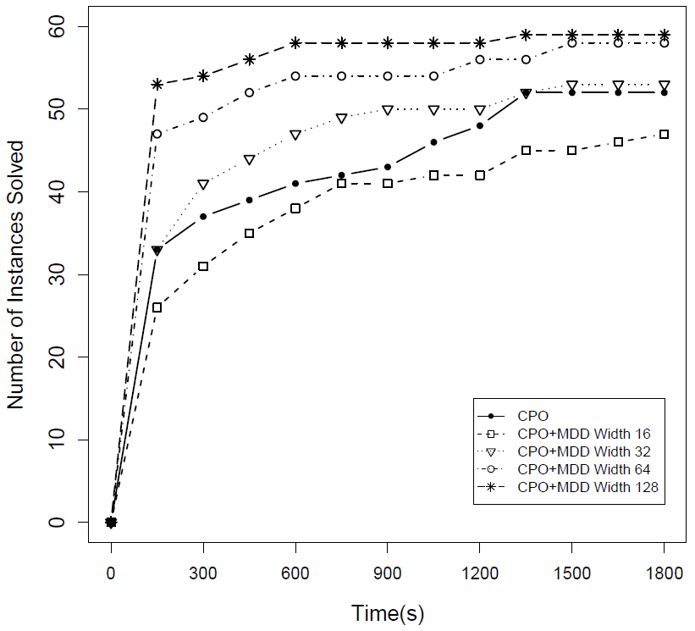
Total Tardiness Results
MDD-128
MDD-128
MDD-64
MDD-64
MDD-32
MDD-32
CPO
MDD-16
MDD-16
CPO
total tardiness
total weighted tardiness

Slide 44
Other results
Asymmetric TSP with Precedence Constraints
Closed 3 open instances
Similar results to more complex problems
Example: Machine deterioration

Slide 45
Final Remarks
New approach for scheduling applications
Orders of magnitude speed-ups
Bounding mechanism
Provide highly-structured information that can be sent to existing solvers

Slide 46
Thank you!

Slide 47
Scheduling:
Allocation of resources to tasks over time
≈ 60 years of research
Still a fundamental component in supply chain management and optimization

Slide 48
Recent Franz Elderman Award Winners
TNT Express, 2012
Network routing and scheduling
Netherland Railways, 2008
Timetable
Warner Robin Air Logistics, 2006
Allocation of repair tasks
...

Slide 49
How are they being solved?
Combination of techniques:
Specialized Heuristics
Large-scale instances, but hard to maintain
Mathematical Programming
Advanced solvers
Constraint-based scheduling
Inference
Several problems still hard to model and solve
Over-reliance on specialized heuristics
Model-based

Slide 50
Scheduling:
Allocation of resources to tasks over time
≈ 60 years of research
Still a fundamental component in supply chain management and optimization

Slide 51
A new approach
Application of decision diagrams to scheduling
Quick highlights:
Modeling paradigm close to dynamic programming
Technique can be incorporated into constraint-based schedulers, mathematical programming solvers, or heuristics
Orders of magnitude speed-ups in several problem classes

Slide 52
Decision Diagrams for Optimization
Novel techniques for discrete optimization problems:
C., van Hoeve: Multivalued Decision Diagrams for Sequencing Problems, Operations Research, to appear.
Bergman, C., van Hoeve, Hooker: Optimization Bounds from Binary Decision Diagrams. INFORMS J. Computing, to appear.
Bergman, C., van Hoeve, Hooker: Variable Ordering for the Application of BDDs to the Maximum Independent Set Problem. CPAIOR 2012: 34-49
Bergman, C., van Hoeve, Yunes: BDD-Based Heuristics for Binary Optimization. Under review, 2013.
Bergman, C., van Hoeve, Hooker: Decision Diagrams for Discrete Optimization. Under review, 2013.
...

