Slide 1
Unhacking
Ted Pham
Information Security Engineer
Information Security Office

Slide 2
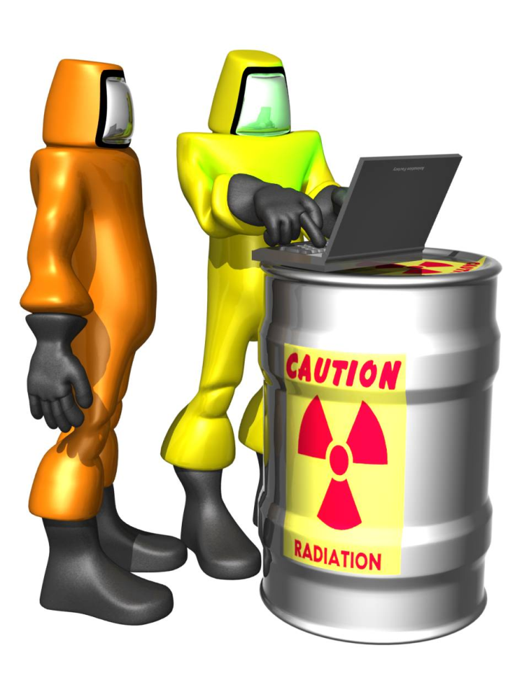
What You Will Learn
Why malware has become so insidious
When to Unhack instead of
Nuking from Orbit
How to Unhack a malware
infection
References for further research

Slide 3
Why Has Malware Become So Insidious?
Computer hacking and spying is a FOR-PROFIT INDUSTRY
Run by organized crime
Your computer is the battlefield
Identity Fraud
In 2007, 8.4 million Americans victimized - $49.3 billion in fraud (http://www.privacyrights.org/ar/idtheftsurveys.htm)
Adware Advertising
Estimated $0.5 to $2 billion in
revenues (in 2004)
Spamming

Slide 4
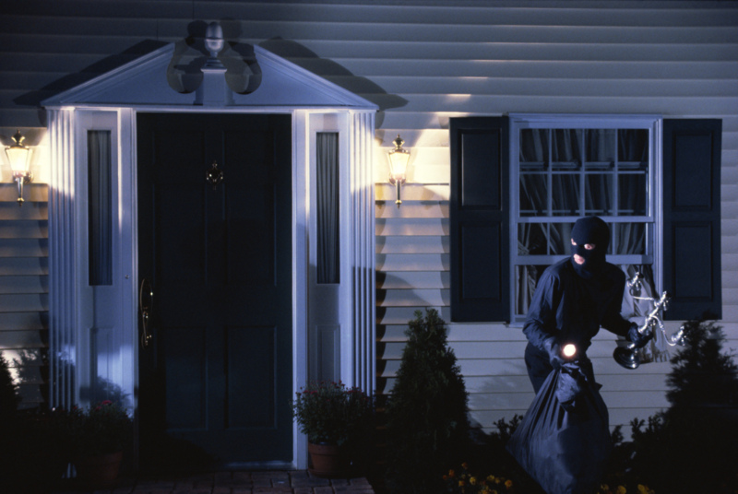
What If I Find A Compromised Machine?
If a computer contains sensitive data belonging to Carnegie Mellon & someone gained unauthorized interactive access to the machine,
Follow Procedure for Responding to a Compromised Computer
ISO will:
Determine if sensitive
data was exposed
Coordinate notification
if required

Slide 5
When Do I Clean Instead of Nuking From Orbit?
Trade-off between time, risk, & skill
Sometimes rebuilding takes much longer
Keeping good backups = HARD
The majority of malware you will see
is adware or a drive-by zombie (botnet) infection
If the machine contains aggregate personal/high value/sensitive data,
or is re-infected, re-format/re-install

Slide 6
Terminology 1 of 2
Program – Organized list of instructions that, when executed, cause a computer to behave in a predetermined manner
Process – Running instance of a program including variables and state

Slide 7
Terminology 2 of 2
Dynamic Link Library (DLL) – File containing executable code and data bound to a program at load time or run time, rather than during linking/compiling.
Windows Registry – Central settings database

Slide 8
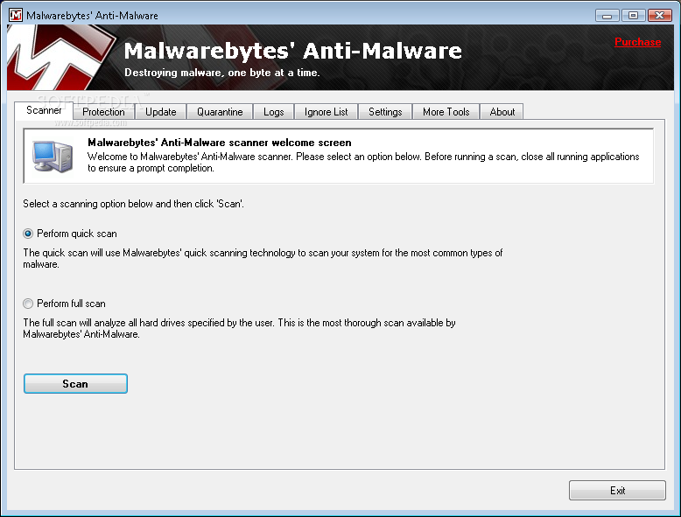
How Do I Unhack a Malware The Easy Way ?
MalwareBytes AntiMalware – Free Edition
http://www.malwarebytes.org/
ComboFix
http://www.combofix.org/

Slide 9
How Do I Unhack a Malware Infection Classic?
Follow the Three Rs:
1. Realize
2. Recognize
3. Remove

Slide 10
Unhack Step 1: Realize
Viruses (malware) no longer infect individual files
Malware now focus on the operating system Auto-load entries to gain total control
Maintaining persistence across reboots and resisting removal is the new modus operandi

Slide 11
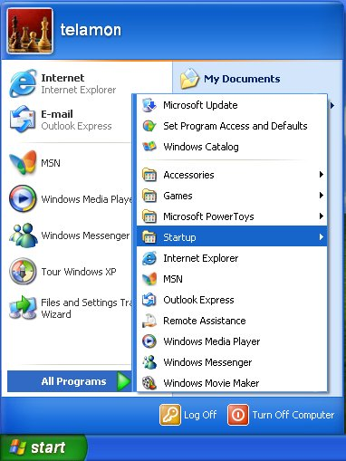
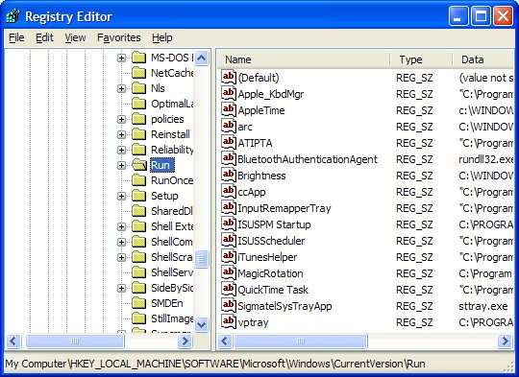
So What Are the Auto-load Entries?
The Classics
Startup Group
Registry Run Key

Slide 12
You Mean There Are More Auto-load Entries?
Yes, there are many,
many, many, many, many,
many, many, many, many,
many, many, many, many,
many, many, many, many,
many, many, many, many, many, many, many,
many, many, many, many, many, many, many,
many, many, many, many, many, many, more.
See Microsoft TechNet AutoRuns.

Slide 13
Windows XP Boot Process

Slide 14
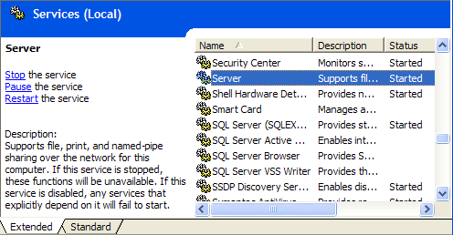
Common Auto-load Entries 1 of 8
Services – Support processes that run at boot
Registry Keys:
HKLM\System\CurrentControlSet\Services

Slide 15
Common Auto-load Entries 2 of 8
Run, RunOnce, RunOnceEx family – Programs started on user login
RunOnce and RunOnceEx entries are deleted after execution
Registry Keys:
HKLM\Software\Microsoft\Windows\CurrentVersion\Run
HKLM\Software\Microsoft\Windows\CurrentVersion\RunOnce
HKLM\Software\Microsoft\Windows\CurrentVersion\RunOnceEx
HKCU\Software\Microsoft\Windows\CurrentVersion\Run
HKCU\Software\Microsoft\Windows\CurrentVersion\RunOnce
HKCU\Software\Microsoft\Windows\CurrentVersion\RunOnceEx

Slide 16
Common Auto-load Entries 3 of 8
Browser Help Objects – Extension libraries loaded into Internet Explorer AND Windows Explorer
Registry Keys:
HKLM\Software\Microsoft\Windows\CurrentVersion\Explorer\Browser Helper Objects
Entries are CLSID values
Cross-reference to HKEY_LOCAL_MACHINE\SOFTWARE\Classes\CLSID

Slide 17
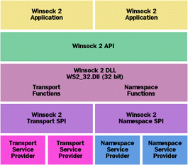
Common Auto-load Entries 4 of 8
Winsock Layered Service Provider (LSP) Chain – Network transport and name resolution filters/extenders
Registry Keys:
HKEY_LOCAL_MACHINE\SYSTEM\CurrentControlSet\Services\WinSock2\Parameters\Protocol_Catalog9
See Unraveling the Mysteries of Writing a Winsock 2 Layered Service Provider

Slide 18
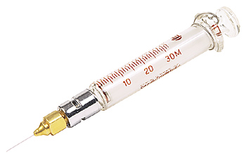
Common Auto-load Entries 5 of 8
AppInit_Dlls – Extension libraries injected into EVERY process
Registry Key:
HKEY_LOCAL_MACHINE\SOFTWARE\Microsoft\Windows NT\CurrentVersion\Windows\AppInit_DLLs

Slide 19
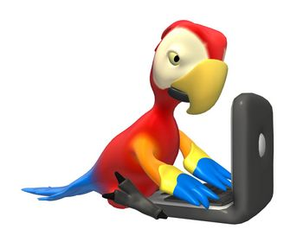
Common Auto-load Entries 6 of 8
Userinit – What program Winlogon should launch to begin a user login session
Registry Key:
HKEY_LOCAL_MACHINE\SOFTWARE\Microsoft\Windows NT\CurrentVersion\Winlogon\Userinit

Slide 20
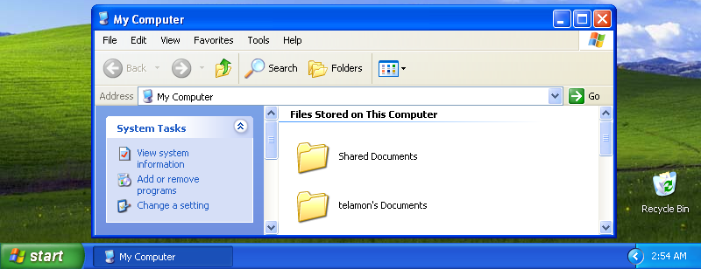
Common Auto-load Entries 7 of 8
Shell – What user interface Userinit should launch to complete the user login
Registry Key:
HKEY_LOCAL_MACHINE\SOFTWARE\Microsoft\Windows NT\CurrentVersion\Winlogon\Shell

Slide 21
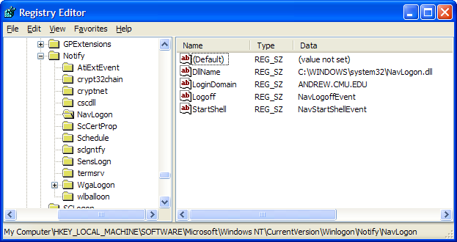
Common Auto-load Entries 8 of 8
Winlogon Notification Packages – Libraries that receive and handle events generated by Winlogon. Perform processing upon logon and/or logoff
Registry Key:
HKEY_LOCAL_MACHINE\SOFTWARE\Microsoft\Windows NT\CurrentVersion\Winlogon\Notify

Slide 22
Unhack Step 2: Recognize
Examine the Auto-load Entries and decide which ones are legitimate vs. malware

Slide 23
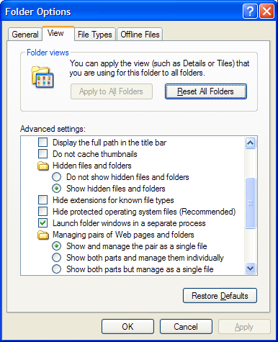
Show Hidden & System Files
Open Control Panels
Switch to Classic View (if not already)
Open Folder Options
Set the View tab as pictured.

Slide 24
Look Through The Registry Manually, Are You Crazy?
If you’re a purist, you can just use Regedit.
OR
“Use tools, feel human.”

Slide 25
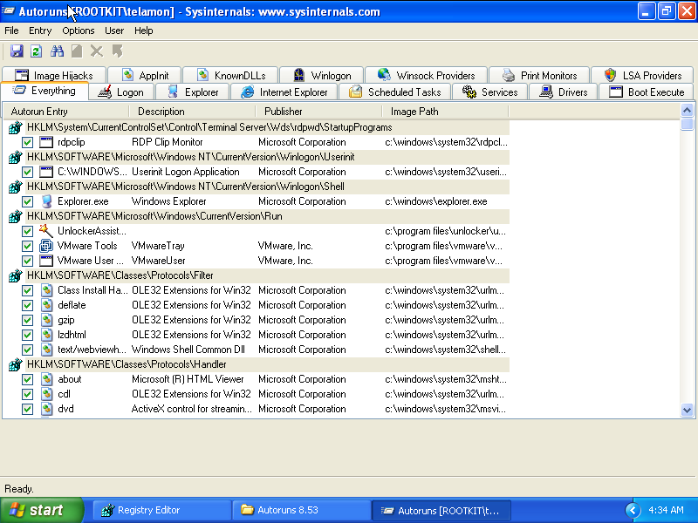
Microsoft TechNet Autoruns
http://technet.microsoft.com/en-us/sysinternals/bb963902.aspx

Slide 26
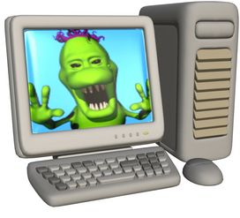
How Do I Tell What Entries Are Malware?
Know what your machine looks like under normal circumstances
Run Autoruns and save log files after installing software/hardware
Telltale signs of a malware file
Nonsensical names e.g. qioueoiqw.dll
Missing publisher information
Unfamiliar publisher information
Missing version information
Misspelled Windows system files e.g. scvhost.exe

Slide 27
How Else Can I Tell What Entries Are Malware?
Lookup suspicious filenames online
Google.com
VirusTotal.com
Norman Sandbox
Autoruns features:
Right-click item choose Google
Verify Code Signatures option
Hide Signed Microsoft Entries option

Slide 28
Unhack Step 3: Remove
Use Task Manager to end malware processes before attempting removal
Use Services Snap-in to stop service before removal
Disable first, reboot, check functionality, then delete

Slide 29
Autoruns Removal Demo
Very easy to see which files have publisher information
Can be information overload
Use Verify Code Signatures option & Hide Signed Microsoft Entries option

Slide 30
Avoiding Non-Bootable Systems: Userinit & Shell
If you delete a file referenced by Userinit or Shell entries, you MAY need to fix the registry before rebooting
Invalid Userinit and Shell entries will cause boot/login failures
Userinit default = C:\WINDOWS\system32\userinit.exe,
Shell default =
Explorer.exe

Slide 31
Repairing Broken Networking: Winsock LSP
Winsock LSP registry entries form a chain
If you remove an entry, the other entries must be re-numbered
Otherwise networking will fail
Use LSPfix to renumber the remaining entries
Can also remove entries
http://www.cexx.org/lspfix.htm

Slide 32
Intermediate Removal: Browser Helper Objects
BHOs are loaded into Windows Explorer AND Internet Explorer
Removal will FAIL if all Explorer processes are not ended
Solution:
Run Autoruns
When ready to remove, use Task Manager to kill all explorer.exe and iexplore.exe
Start Menu will disappear (that’s ok)
Perform the removal via Autoruns
Use Task Manager to start explorer.exe, Start Menu reappears

Slide 33
Advanced Removal: Winlogon Notification Packages
DLLs load into Winlogon.exe
Locked and cannot be deleted
Winlogon.exe cannot be terminated
If DLLs are deleted without fixing registry entries, Windows may fail to boot
Solution needed to delete file
and edit registry while not booted
into Windows

Slide 34
Advanced Removal: Rootkits
Rootkit – set of software tools intended to conceal running processes, files or system data, thereby helping an intruder to maintain access to a system whilst avoiding detection
Hooks into kernel APIs to filter file, registry, and process listings
Can be completely invisible to anti-virus/anti-spyware

Slide 35
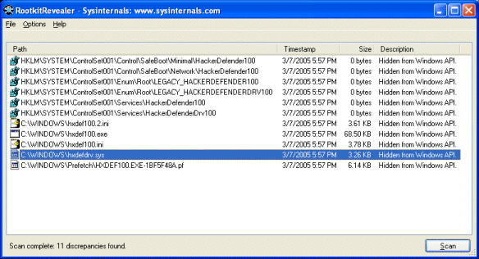
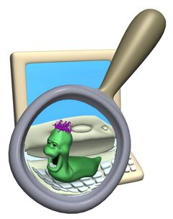
Sysinternals Rootkit Revealer
Tool for finding rootkits (not removing)
Compares raw registry and file reads against API calls

Slide 36
ISO Reatogo Demo
Based on Windows Preinstallation Environment (WinPE) and BartPE
Full NTFS read/write capability
Modify a Windows install without
booting from it
Run Autoruns against local harddrive with registry redirection
Useful for many other types of OS repairs

Slide 37
Removal Shortcut: Registry Restore Demo
Some malware will alter registry settings that are hard to locate (without analyzing the malware thoroughly)
Need to restore a backup copy of the registry
Windows System Restore maintains these backups in System Volume Information
ISO Reatogo has a GUI tool for registry restore

Slide 38
Registry Restore - Drawbacks
System Restore doesn’t always work after registry is restored this way
Need to have System Restore enabled
Need to know when last known good condition was

Slide 39
Repairing Microsoft Update, Firewall, & System Restore
Some malware will remove the Service entries for Automatic Update, Windows Firewall, and System Restore
Export the entry from a working machine and import into the infected machine
Automatic Update: HKEY_LOCAL_MACHINE\SYSTEM\CurrentControlSet\Services\wuauserv
Windows Firewall:
HKEY_LOCAL_MACHINE\SYSTEM\CurrentControlSet\Services\SharedAccess
System Restore: HKEY_LOCAL_MACHINE\SYSTEM\CurrentControlSet\Services\srservice

Slide 40
Novel Infections – 1/2
Rustock Rootkit
Replaces ndis.sys
Contains compressed version of the original to serve up when requested
Causes USB storage devices not to be recognized
http://www.prevx.com/blog/116/Learning-from-Rustock-rootkit.html

Slide 41
Novel Infections – 2/2
W32/Crimea.dr
Replaces imm32.dll with modified header to load another dll
http://vil.nai.com/vil/content/v_142626.htm

Slide 42
Thank you, and stay safe!
Questions, Concerns, Feedback?
telamon@cmu.edu
Practice Safe Computing
http://www.cmu.edu/iso/aware/pledge

