Slide 1
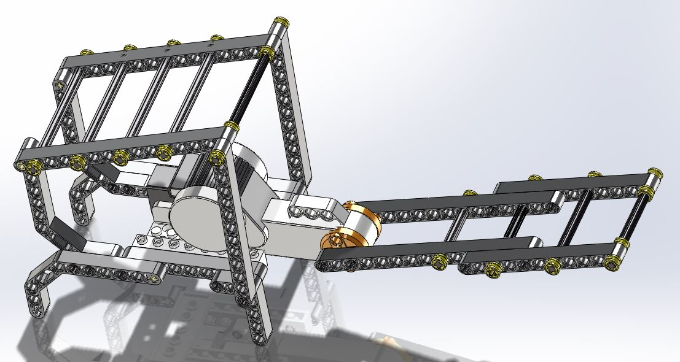
Lever-Arm Robot Assembly Instructions

Slide 2
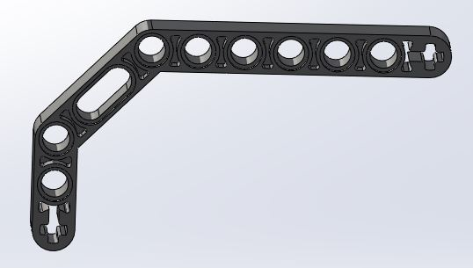
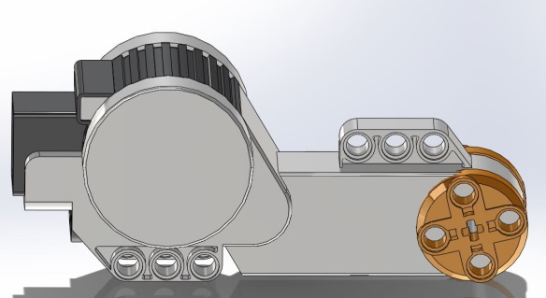
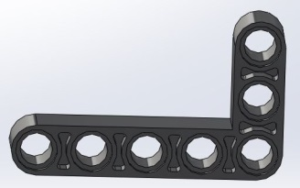
What you’ll need:
x
24x
2x
4x
1x
2x
4x
1x
2x
2x
2x
1x
4x
4x
3x
2x
1x
22x

Slide 3
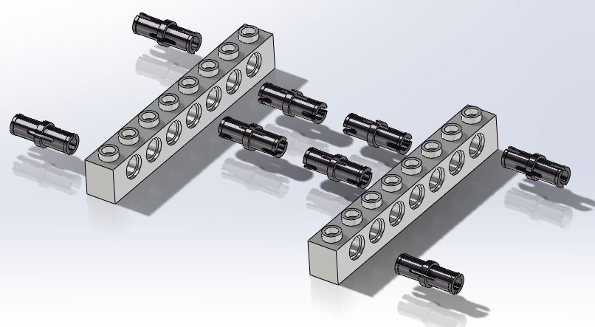
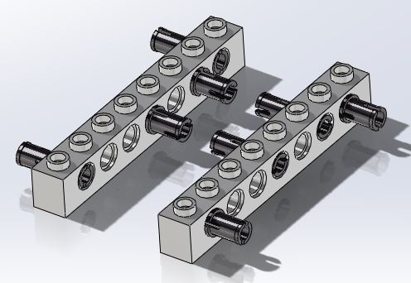
Step 1:
Needs:
8x
2x

Slide 4
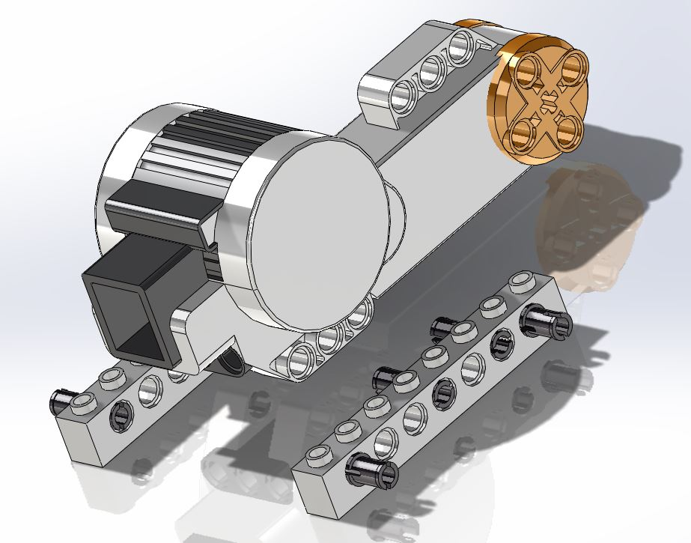
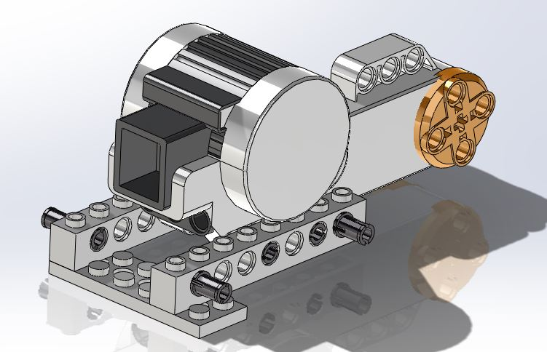
Step 2:
Needs:
Step 1
1x
1x

Slide 5
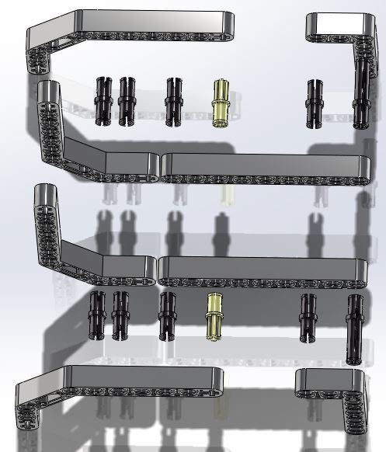
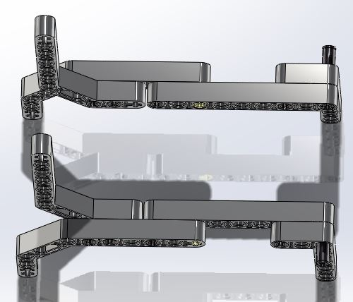
Step 3:
Needs:
4x
8x
2x
2x
2x
2x

Slide 6
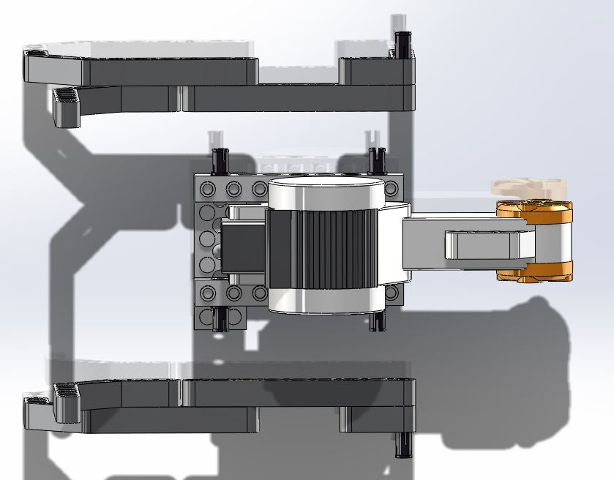
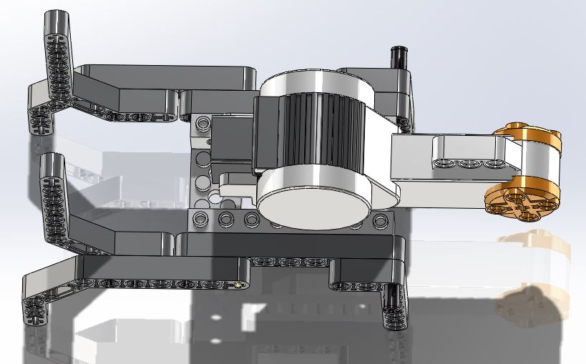
Step 4:
Needs:
Step 2
Step 3

Slide 7
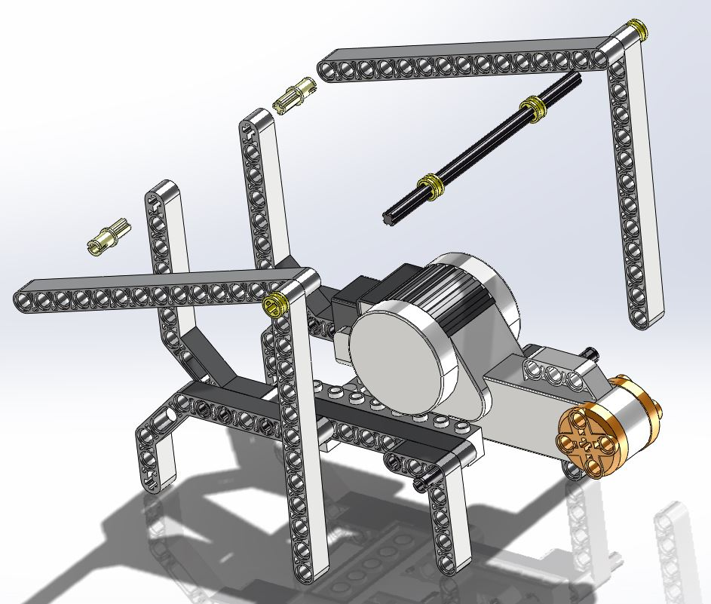
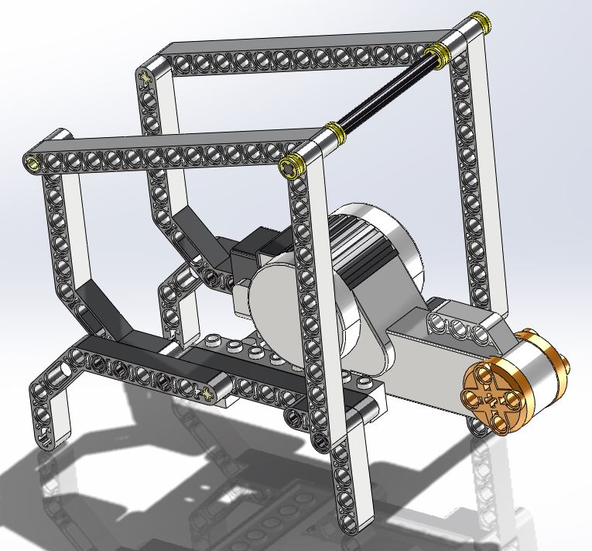
Step 5:
Needs:
Step 4
2x
2x
2x
4x
1x

Slide 8
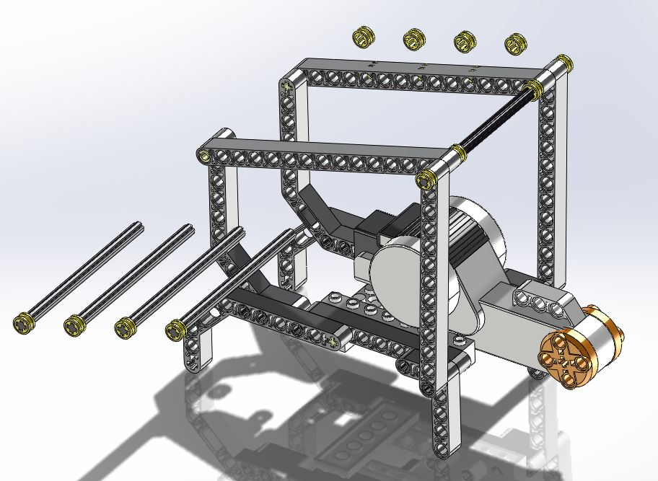
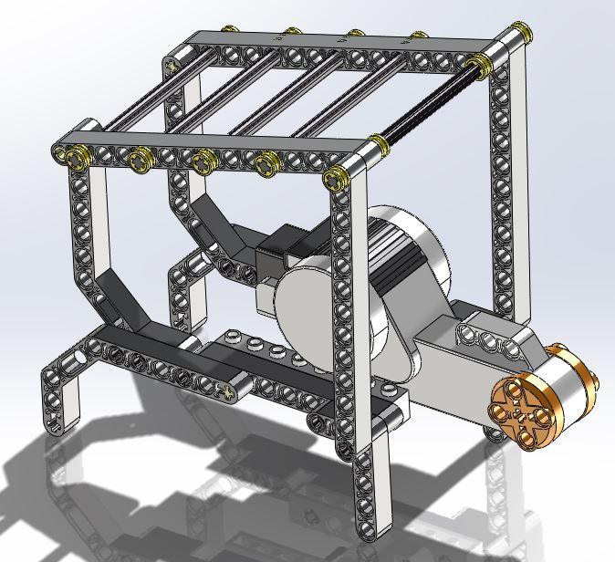
Step 6:
Needs:
Step 5
8x
4x

Slide 9
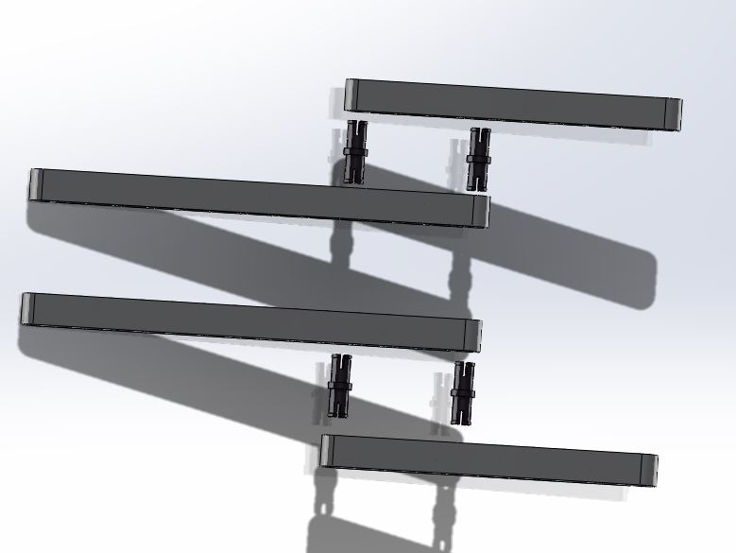
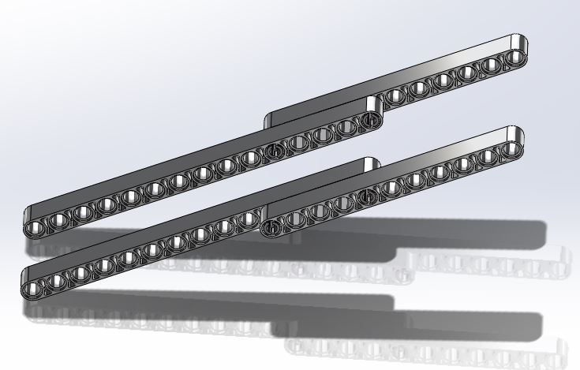
Step 7:
Needs:
2x
2x
4x

Slide 10
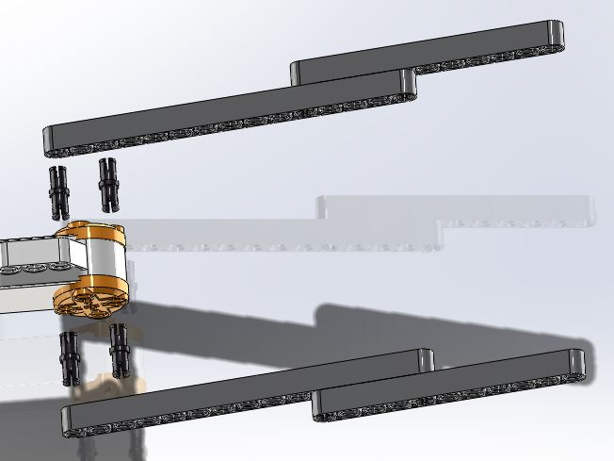
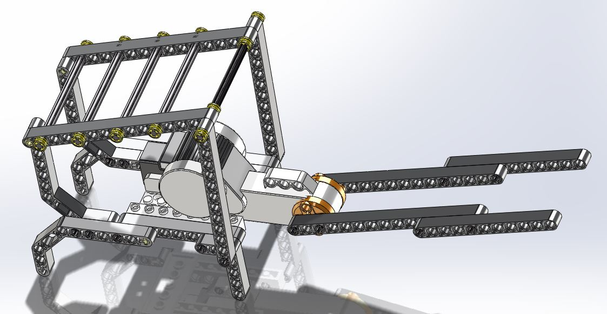
Step 8:
Needs:
Step 6
Step 7
4x

Slide 11
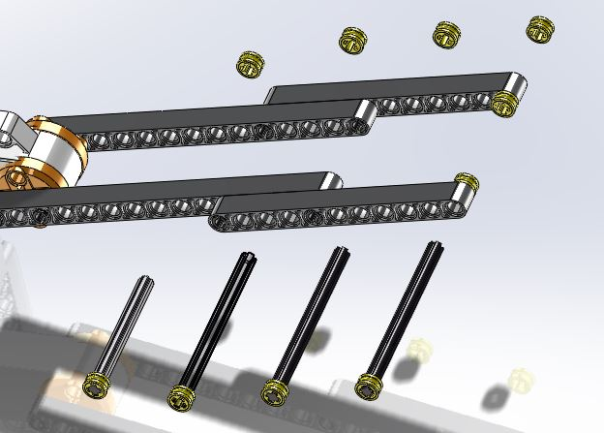
Step 9:
Needs:
Step 8
1x
3x
10x
DONE!

