Slide 1
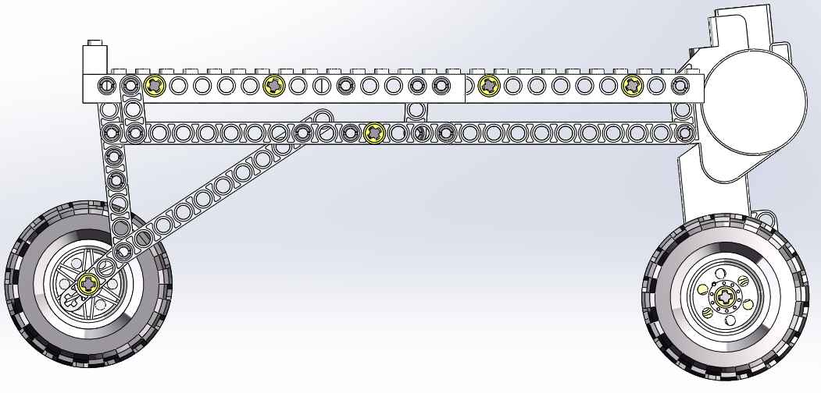
Hill Climbing Robot Assembly Instructions

Slide 2
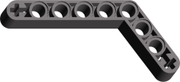
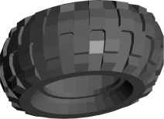
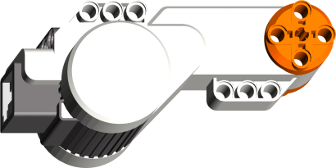
Parts Needed
x 1
x 2
x 4
x 28
x 2
x 18
x 4
x 6
x 2
x 3
x 3
x 2
x 4
x 1
x 1
x 1
x 1

Slide 3
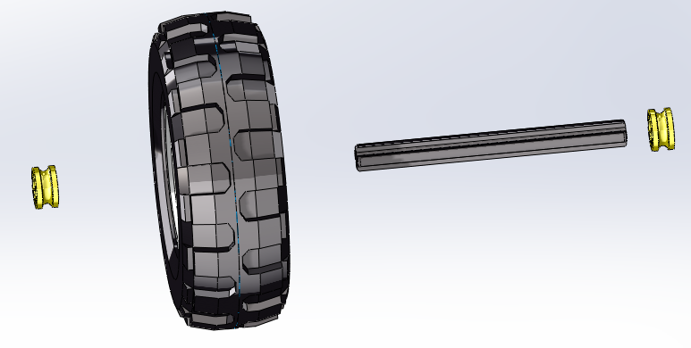
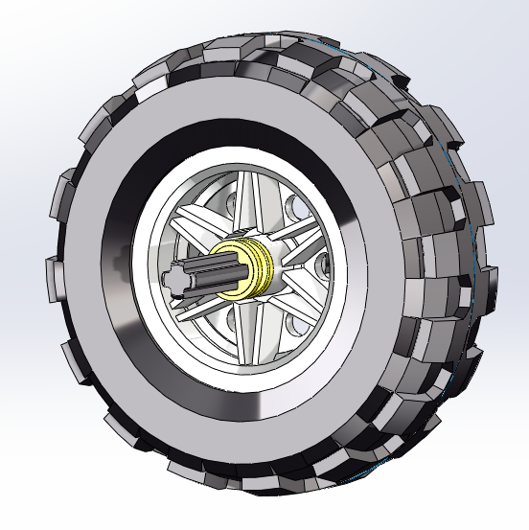
Front Wheel
1.
x 1
x 1
x 2
x 1

Slide 4
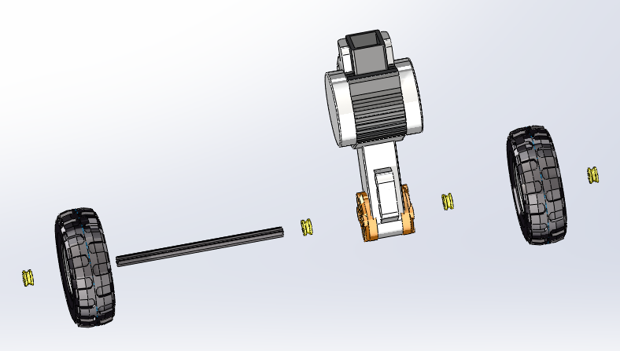
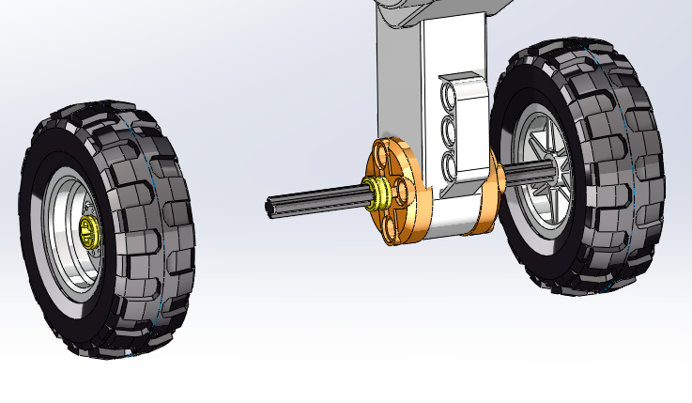
Back Wheel
1.
x 2
x 2
x 1
x 1
x 4

Slide 5
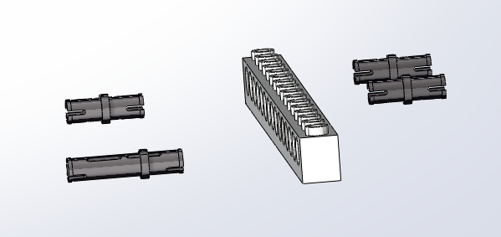
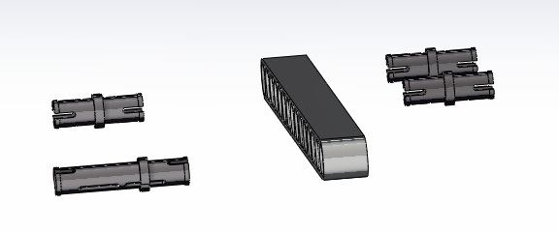
Main Body Right Side
1.
x 1
x 1
x 3
2.
x 1
x 1
x 3

Slide 6
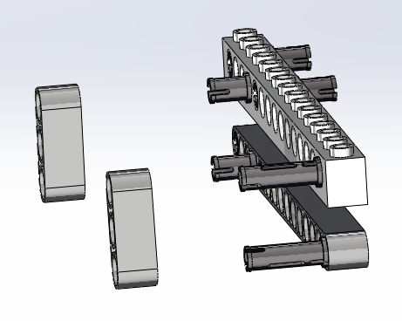
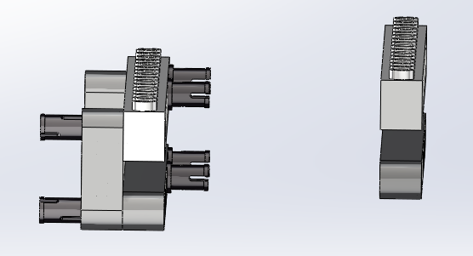
3.
x 2
4.
x 1
x 1

Slide 7
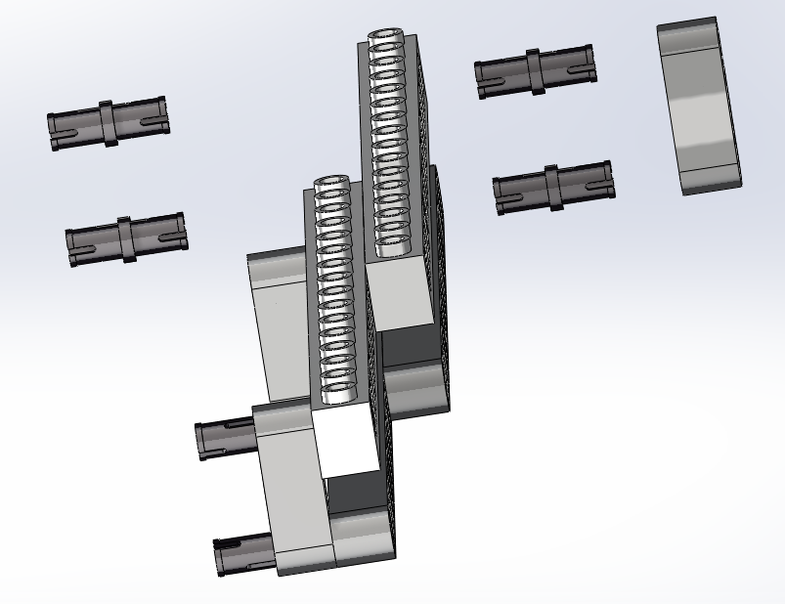
5.
x 1
x 4

Slide 8
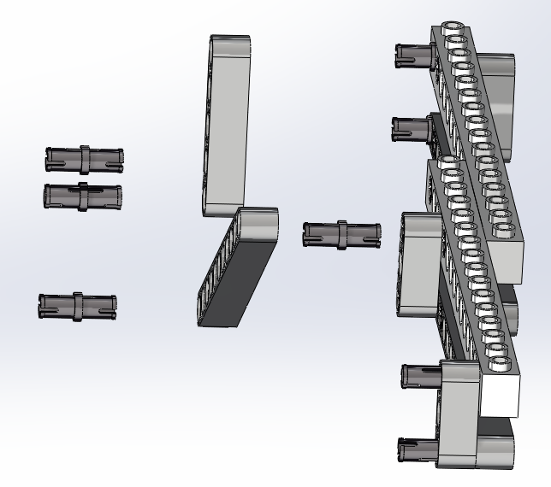
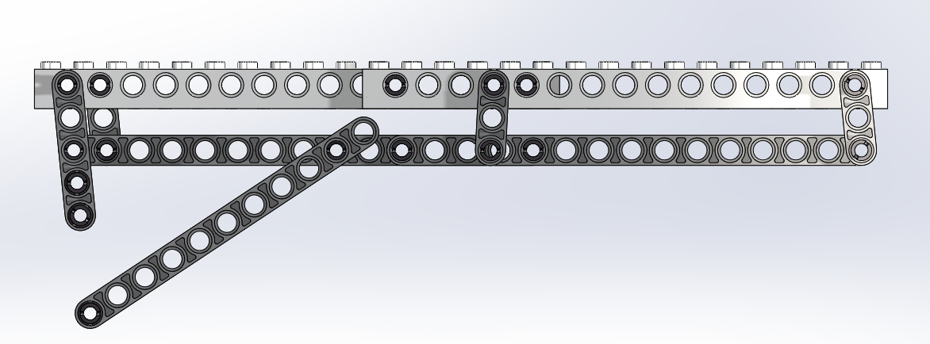
6.
x 1
x 4
x 1

Slide 9
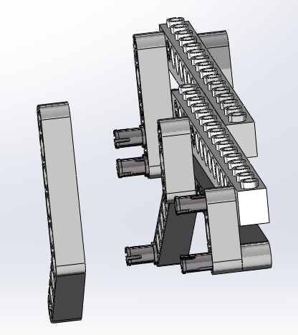
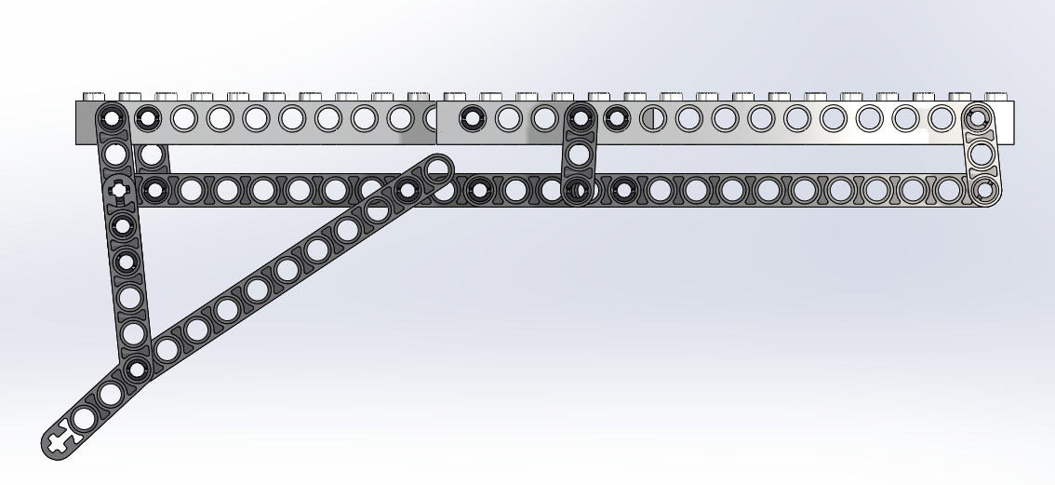
7.
x 1

Slide 10
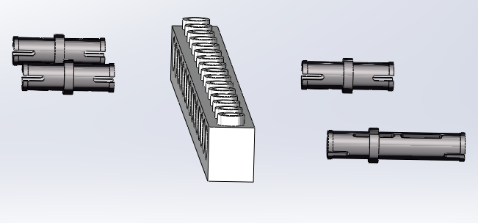
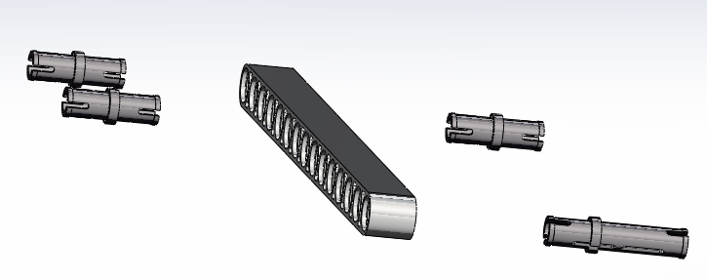
Main Body Left Side
1.
x 1
x 3
x 1
2.
x 1
x 3
x 1
x 1
x 1
x 3

Slide 11
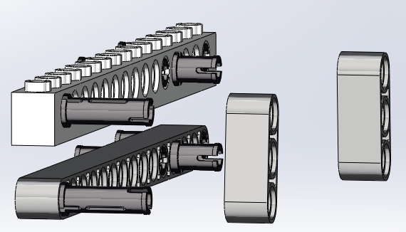
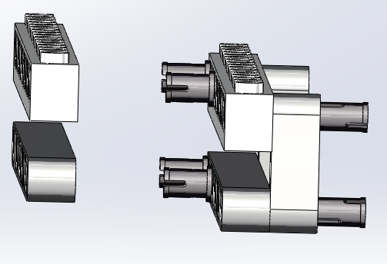
3.
x 2
4.
x 1
x 1

Slide 12
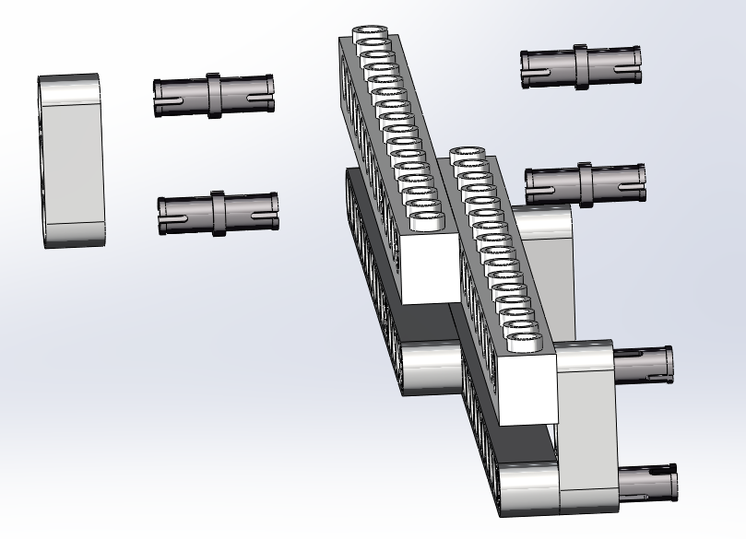
5.
x 1
x 4

Slide 13
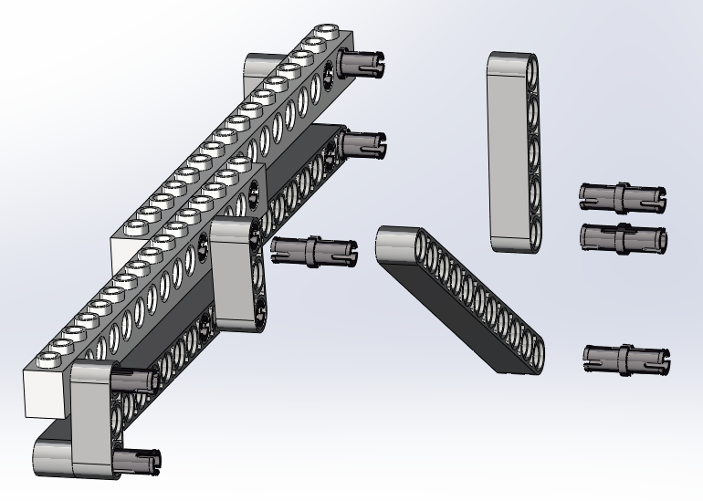
6.
x 1
x 4
x 1

Slide 14
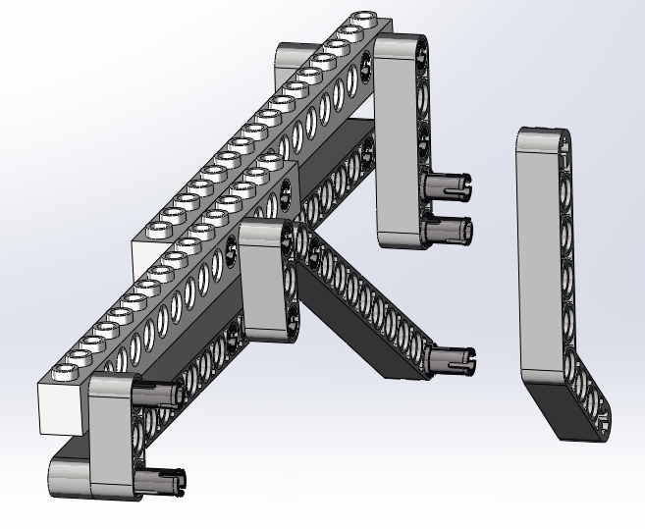
7.
x 1

Slide 15
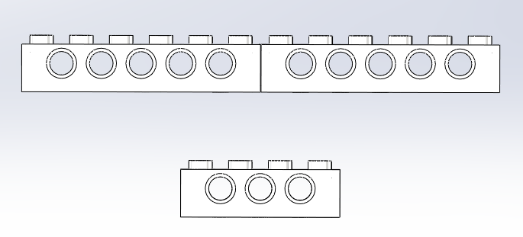
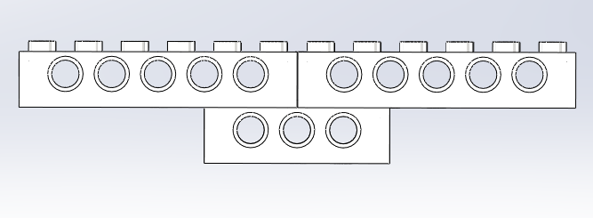
Main Body Front Connector
1.
x 2
x 1

Slide 16
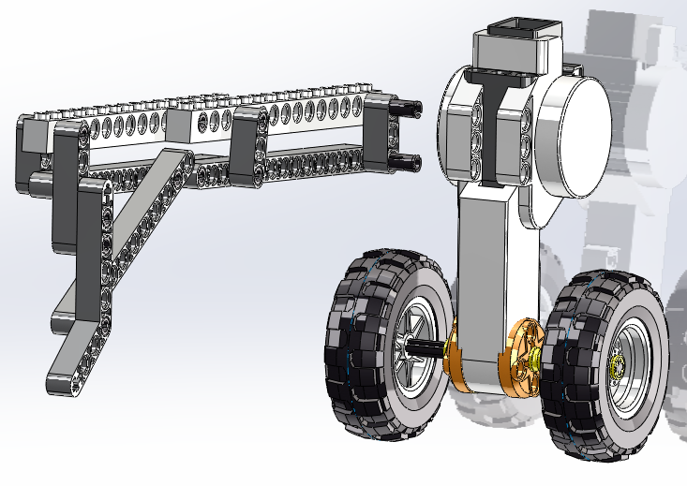
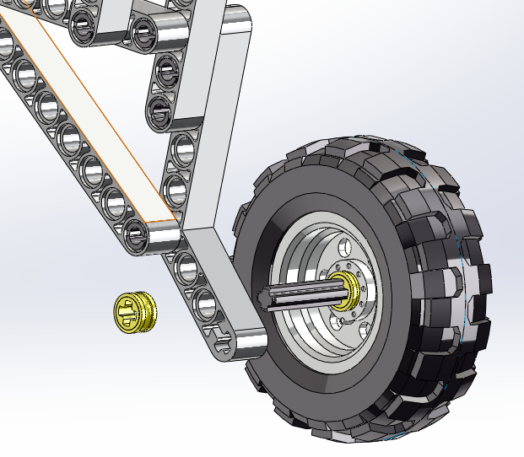
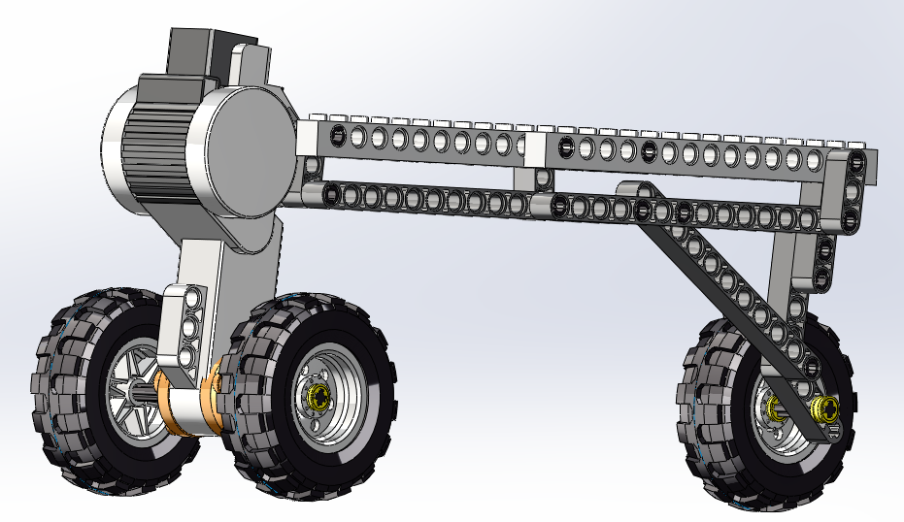
Assembly
1.
x 1

Slide 17
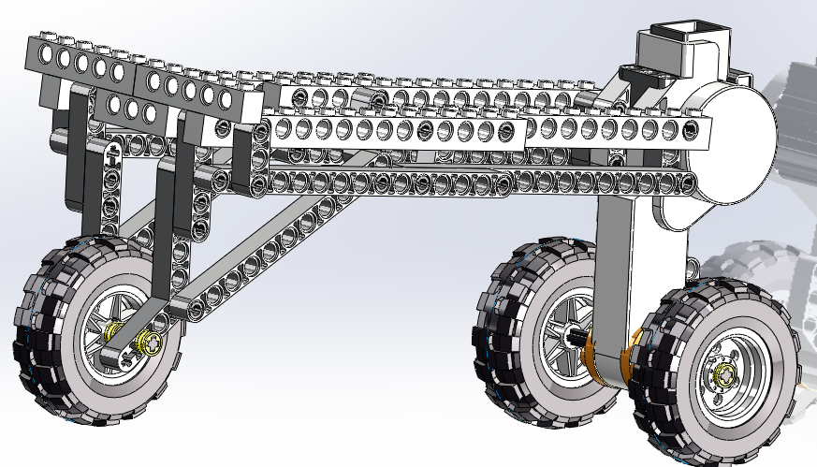
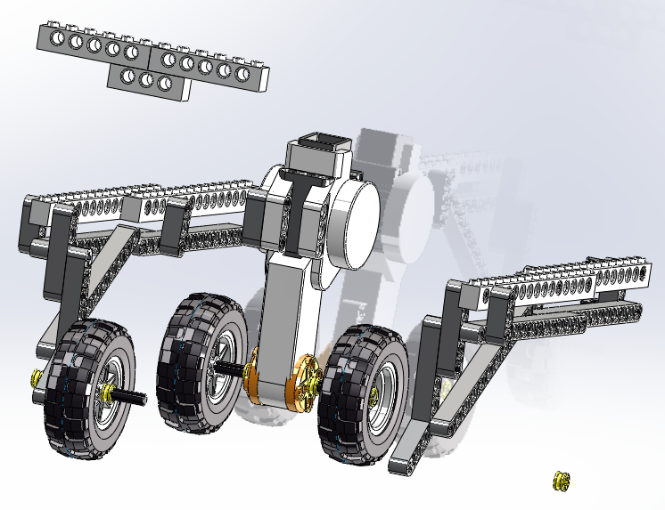
2.
x 1

Slide 18
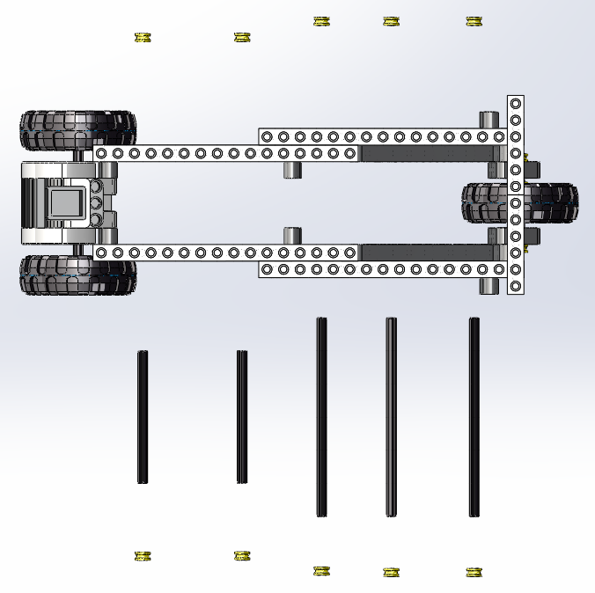
3.
x 10
x 3
x 3

