Slide 1
Statics for engineers: from diagnosis of students difficulties to a statics concept inventory and an open course
Paul S. Steif
Carnegie Mellon University

Slide 2
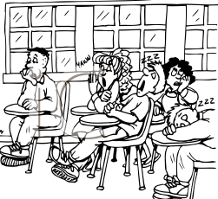
Do we communicate?
lecture
homework

Slide 3
It’s not about what we (instructors) say…
… it’s about what they (students) learn
So we have to listen…but only after we ask the right question
How should we debrief students?

Slide 4
Assessment Triangle (Knowing What Students Know, 2001)
Observations
Interpretation
(what we ask them)
(what sense we make of their answer)
Cognition
(what they should know)

Slide 5
Statics – Typical Problem

Slide 6
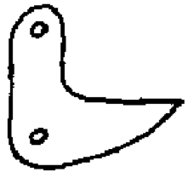
Determine the forces between bodies
150 N
C_{x}
AB
E
C_{y}
E
C_{y}
AB
C_{x}
E
E
D_{x}
AB
D_{y}
D_{y}
AB
D_{x}
150 N

Slide 7
What is “Cognition” for Statics?
Many little bits of knowledge: principles, concepts, skills… what to choose?
Are there certain ideas that, if mastered, give students leverage on other ideas?
Are there errors students consistently make or ideas they seem not to grasp?

Slide 8
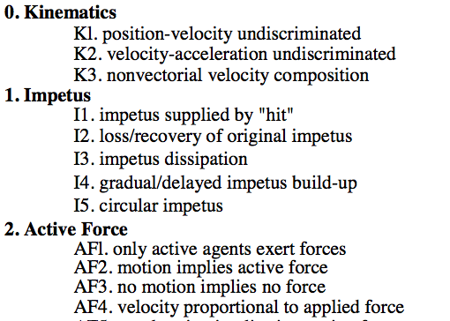
Taxonomy of Misconceptions in Newtonian Physics
from Hesthenes, Wells, Swackhamer (1992)
…
…

Slide 9
Field Studies of Statics Problem Solving
Mechanical engineering students at early stage of 2nd year statics course
Had completed physics (Newtonian mechanics), and 3 week segment on Statics in a freshman mechanical engineering course

Slide 10
Typical Student Solution with Errors

Slide 11
Many student solutions ➔ Common Errors
Steif (2004)

Slide 12
Impractical for all instructors to study their students problems in depth
Data of interest is too sparse, time consuming to find
Errors could be attributed to multiple causes
Many errors are common across students
Wanted: Dense data, easily interpreted and attributed, actionable

Slide 13
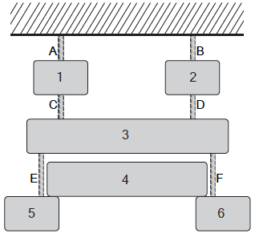
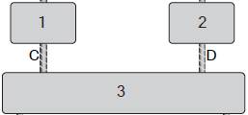
Questions addressing single concept
What is the correct free body diagram?

Slide 14
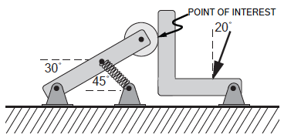

Slide 15
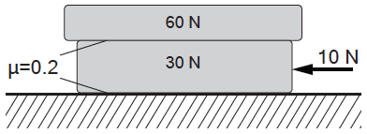

Slide 16
How might students answer questions?
Let students answer question
Interview students on their answer
Note typical errors from field studies

Slide 17
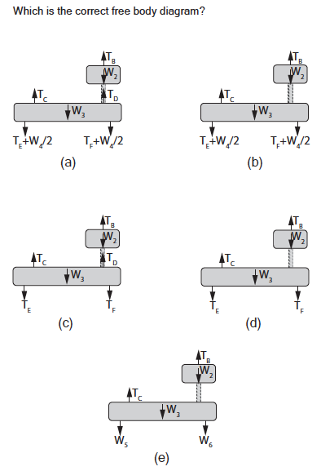

Slide 18
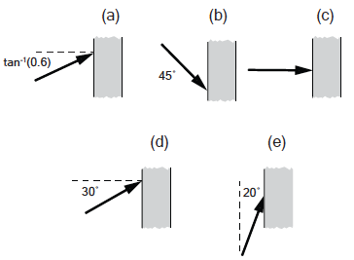

Slide 20
How to Judge Quality of Questions?
Reasonable range of difficulty
Questions discriminate (ideally between knowing and not knowing)
Most wrong answers seem plausible to some students

Slide 21
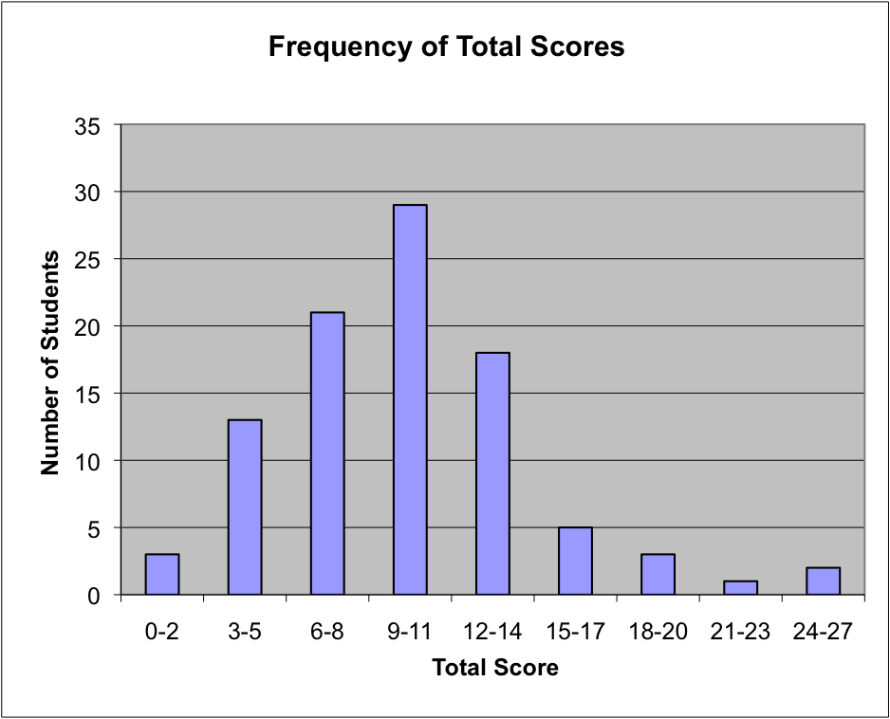
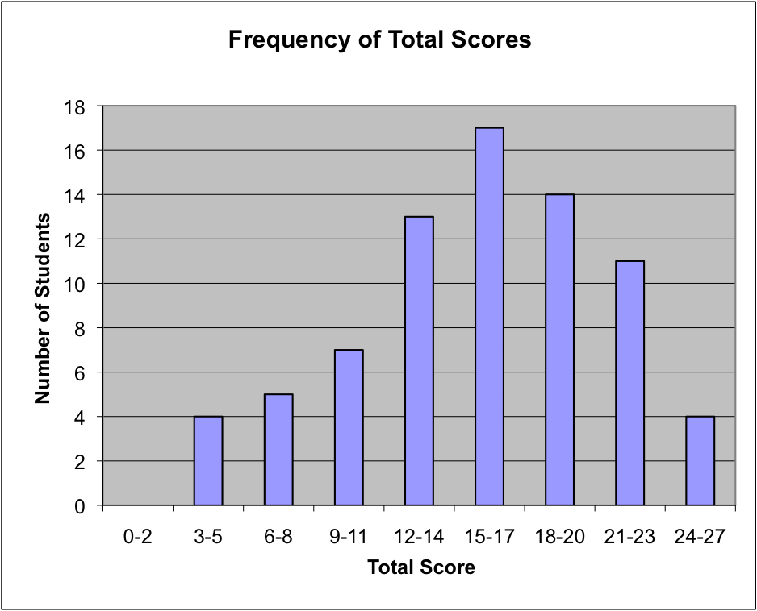
Difficulty: total score distribution
Means vary from 30% to 70%
School 1
School 2

Slide 22
Discrimination Index of Question
= Percentage correct of top students
- Percentage correct of bottom students
0.25–0.4 Good, 0.4-1.0 Excellent

Slide 23
How to Interpret Test?
What do scores mean in terms of student understanding?
Is that understanding more broadly valuable?

Slide 24
What understanding implied by results?
Total not meaningful - except as comparison with past and other schools
3 questions on each concept; 9 concepts
Reliability: multiple questions for each concept can remove signal from noise (guessing)

Slide 25
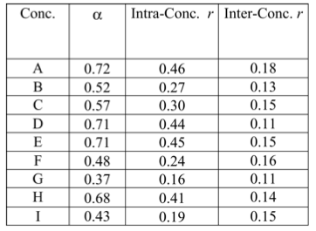
Correlations (r): Reliability of concept
Alpha: 0.7 – 0.8 good reliability for whole test

Slide 26
Test results of broader relevance?
Correlations between concept test and class examinations (multiple institutions)
(Fall 2004-Spring 2005)
Class | 1 | 2 | 3 | 4 | 5
r | 0.62 | 0.59 | 0.24 | 0.48 | 0.41
(Fall 2005)
Class | 1 | 2 | 3 | 4 | 5 | 6
r | 0.39 | 0.53 | 0.54 | 0.58 | 0.60 | 0.61
What would be a high correlation?

Slide 27
(Fall 2004-Spring 2005)
Class | 1 | 2 | 3 | 4 | 5
r | 0.62 | 0.59 | 0.24 | 0.48 | 0.41
(Fall 2005)
Class | 1 | 2 | 3 | 4 | 5 | 6
r | 0.39 | 0.53 | 0.54 | 0.58 | 0.60 | 0.61
Correlations between different exams in same class (Fall 2004-Spring 2005)
Class | Correlations r between course examinations
1 | 0.65, 0.66, 0.63, 0.59, 0.63, 0.71
2 | 0.57, 0.34, 0.42, 0.55, 0.71, 0.73
3 | 0.42, 0.33, 0.66, 0.13, 0.25, 0.47
4 | 0.32, 0.44, 0.49, 0.48, 0.48, 0.59

Slide 28
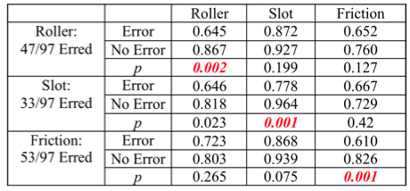
Compare errors on exam with success in particular group of concept questions

Slide 29
How can students benefit from test?
Instructor studies test results, modifies course for following year, and re-tests
Results obtained before end of semester; review session to discuss most problematic questions before final exam
Should students have experience answering these types of questions earlier?

Slide 30
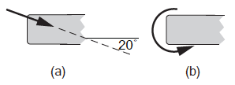
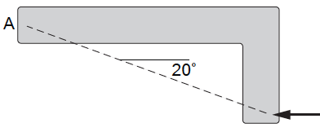
“Warm-ups”: During term, students given task to perform outside of class (Newcomer)
Give answer choice and explain your reasoning
Which of the following could represent the load(s) exerted by the gripping hand?
The member is subjected to the force at the lower right corner, and is maintained in equilibrium by a hand (not shown) gripping the end A.

Slide 31
Processing of student input
Instructor collects the answers and rationales (submitted on-line) and reviews them
Class discussion paves way for teaching the subject – thinking prior to class opens up students to topic
Course which gave students practice with such questions ended up with high scores on test at term end
Still have high correlations between test and final exam in course

Slide 32
Assess students and provide better feedback during semester
(on conceptual matters and generally)
Inside class:
interactive engagement in classroom
Outside class:
interactive activities on-line

Slide 33
Peer Teaching (Eric Mazur)
Shocked by his students’ (Harvard) performance on physics conceptual test (Force Concept Inventory)
Engaged students more in class – but on conceptual questions

Slide 34
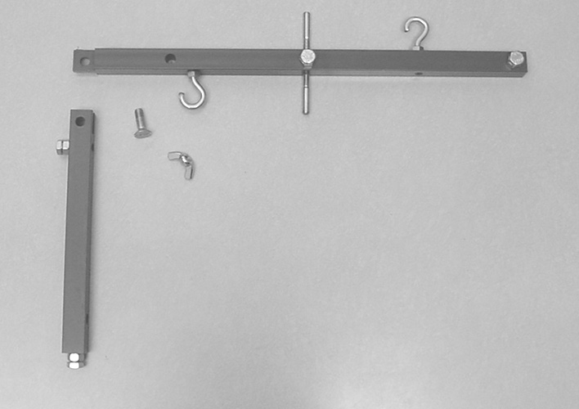
How to choose questions for statics?
Physics misconception – only active agents exert forces. So keep it real: learn key concepts in statics by balancing simple physical objects

Slide 35
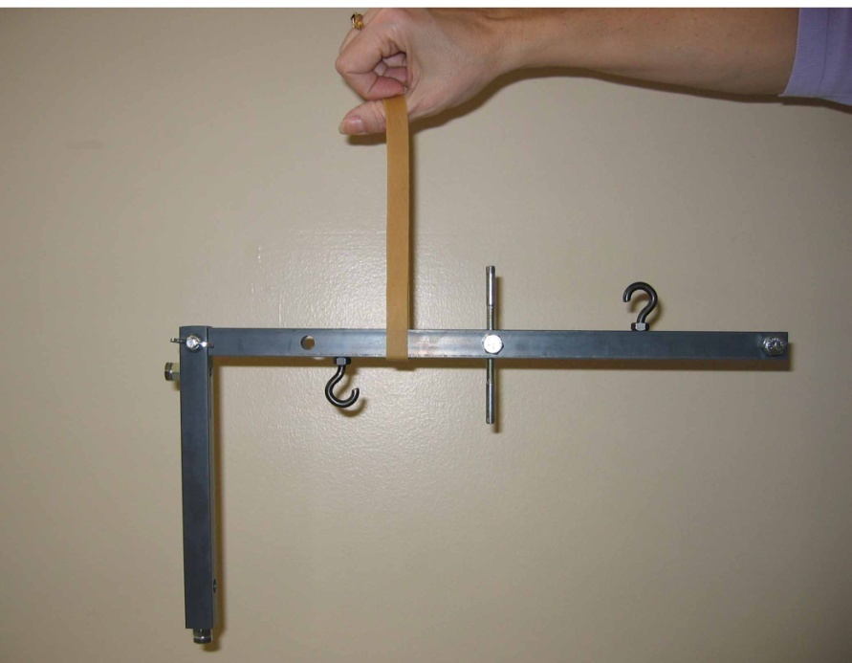
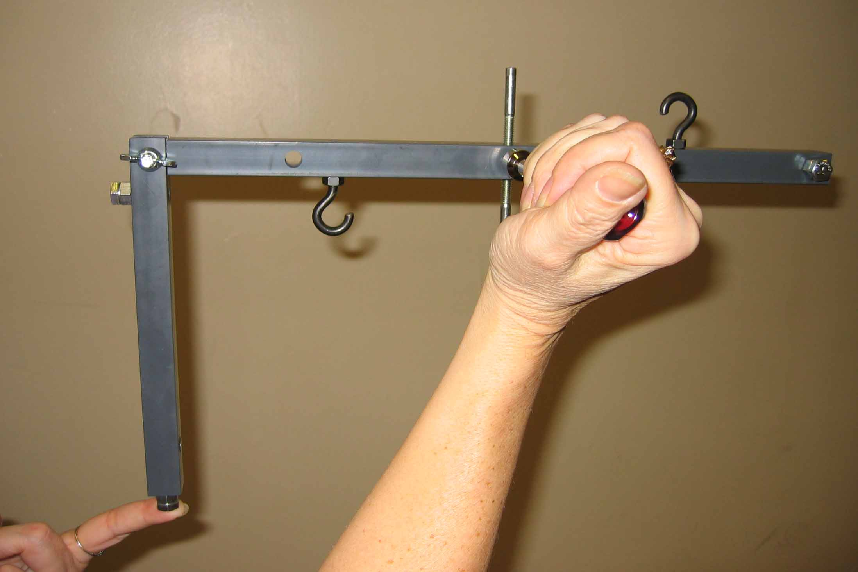
Learning through balancing objects
2h
x
x=h
Gr
h
Equilibrium with forces and couples
Center of gravity

Slide 36
Consider supporting the member in the vertical plane using two smooth rods.
2h
B
C
A
Yes
Gr
Can the body be supported by:
one rod placed in region A and one rod placed in region B?
No
Pi
Can the body be supported by:
one rod placed in region A and one rod placed in region C?
Yes
Gr
No
Pi

Slide 37
Consider supporting the member in the vertical plane using three smooth rods.
Which combination of rods will keep the body in equilibrium?
Gr
Bl
Pi

Slide 38
Majority of time spent outside of class – how to better assess learning outside?
Interactive exercises that take advantage of computer and web connection
Exercises offer hints and feedback appropriate to student input
Blend exercises with text, diagrams, simulations
Partially replace written homework

Slide 39
http://oli.web.cmu.edu/openlearning/

Slide 40
Examples of Activities

Slide 41
“Inverted Classroom”
Traditionally: US engineering students don’t prepare for class – see material for first time
New Approach: demand students work through on-line materials before class
Each student decides which activities to work through, but must take end-of-module quiz
System tracks students’ work and reports back to instructor who uses that information to inform lecture

Slide 42
Conclusions (concepts)
Some concepts commonly difficult (equilibrium & static equiv. with forces & couples; friction)
Early focus on concepts can boost concept test scores and still have broader relevance to class exams
Some concepts (engineering connections) have good scores, but questions are superficial

Slide 43
Conclusions (on-line learning)
Computer best for practicing concepts or skills in isolation. Hard for computer to give students free reign to cobble together solution of complex problem.
Even when working on narrow tasks that computer is good at, on-line exercises raise many questions and can frustrate students. Very stimulating, unrelieved.
Instructor is still critical!

Slide 44
Extra Material

Slide 45
