Slide 1
Foundations in Biomedical Sciences
Hydrogen bonds
  Polar versus non-polar bonds
  Hydrogen bonding in biochemistry
Water
  Structure and acid-base
pH
  Measurement of pKa by titrations
  Generation of buffer solutions
Amino acids
  Calculation of protein concentration
  Effect of pH on charge, calculation of charge.
  Interpretation of fluorescence changes
  UV absorption
Protein Structure and stability
  Primary & secondary structure
Gordon Rule
Department of Biological Sciences
Carnegie Mellon University
rule@andrew.cmu.edu

Slide 2
Polar Bonds & Molecules
Covalent Bond: Electron are shared between two atoms.
Polar Bond: A bond is polar if there is a significant difference in the electronegativities of the participating atoms, giving appreciable partial charges on the atoms.
The partial charges are proportional to the difference in the electronegativities of the two atoms: ∆e = e_{A}-e_{B}
Electronegativities increase across the periodic table due to increased nuclear charge.
1 H 2.1 |  |  |  |  |  |  | 2 He
3 | 4 | 5 | 6 | 7 | 8 | 9 | 10
Li | Be | B | C | N | O | F | Ne
1.0 | 1.5 | 2.0 | 2.5 | 3.0 | 3.5 | 4.0
Reflection: How do we know which bonds are polar?

Slide 3
Hydrogen Bonds
H-bonds are primarily (90%) an electrostatic attraction between:
  Electropositive hydrogen, attached to an electronegative atom is the hydrogen bond donor (i.e. NH).
  Electronegative hydrogen bond acceptor (e.g. the lone pairs of oxygen, or C=O group of an amide).
The energy released when an H-bond forms depends on the distance and angle of the bond.
  Typical distance between electronegative atoms ~3.5 A
  Favorable geometry when donor atoms and acceptor are linear (angle = 180º)
A “bond” implies electron sharing – about 10% of the electron is shared from one molecule to the next in the case of H-bonds
Usually hydrogen bonds are exchanged, resulting in small net energy differences:
Note that the proton is NOT transferred to the acceptor, it remains covalently bonded to the donor atom. The Hydrogen Bond is the interaction between the X-H donor and electronegative acceptor.

Slide 4
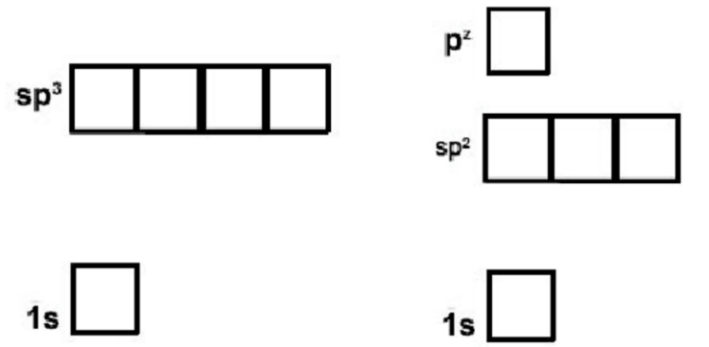
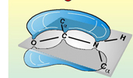
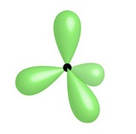
How to Identify Hydrogen Bond Donor and Acceptors
O-H and N-H are always donors
Sp2 is used in amides, allowing favorable overlap of the full pz orbital with the pz on C and O
The lone pair in the nitrogen pz is shared with the pz electrons on carbon and oxygen.
Due to electron sharing, there is only a slight neg. charge and the group does not accept an H-bond.
N in a delocalized system:
Will not accept from above or below the plane of the system, because the lonepair is delocalized.
Can accept in the plane of the ring if there is no attached hydrogen, via lone pair in sp2 orbital
N – 7 electrons
Sp3
Sp3 is used in ammonia, keeping the three hydrogen atoms as far from the full lonepair. The fourth sp3 orbital is full, with two electrons (lone pair).
The lone pair is an excellent acceptor.
Sp2
Nitrogen can form two types of hybrid orbitals, sp3 (tetrahedral geometry) or sp2 (planer) + pz

Slide 5
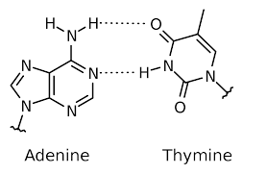
How to Identify Hydrogen Bond Donor and Acceptors
N in a delocalized system:
Will not accept from above or below the plane of the system, because the lonepair is delocalized.
Can accept in the plane of the ring if there is no attached hydrogen, via lone pair in sp2 orbital
The pz orbital holds one electron, used to form double bonds
The non-bonding sp2 contains the lone pair, an excellent electron acceptor.
The pz orbital holds two electrons since each sp2 has one to form the single bonds.
Although the pz orbital contains two electrons (lone pair), these are delocalized (shared) over the rings. Therefore not an acceptor.
N – 7 electrons
In planer aromatic rings the nitrogen must use sp2
Sp2

Slide 6
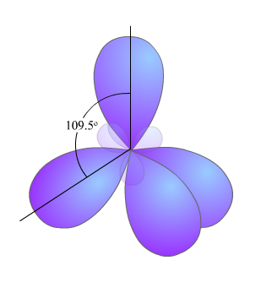
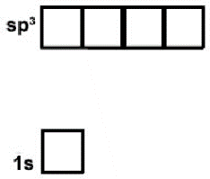
Structure of Water
Oxygen has 8 electrons. The molecular orbitals in water are complex, however much of the behavior of water can be understood by assuming that oxygen form sp3 hybrid orbitals.
Sp3 hybrid orbitals are generated from the 2s and the three 2p orbitals, the orbitals point towards the corner of a tetrahydron.
The orbitals in oxygen are populated such that two orbitals are filled and two contain one electron each.
The filled orbitals cannot form bonds and are often called lone pairs.
The half-filled orbitals participate in the formation of a sigma bond between oxygen and hydrogen.

Slide 7
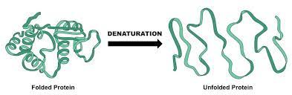
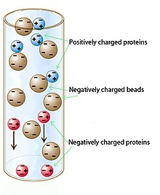
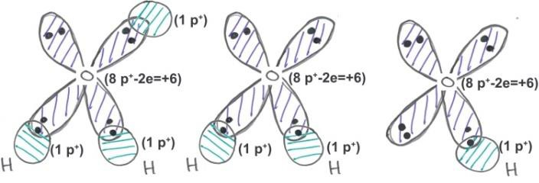


Acid-Base Chemistry
Learning Goals:
Compare relative acid strength based on pKa values of weak acids.
Predict protonation state given pH of the solution and the pKa of the acid.
Understand effect of chemical structure on pK_{a} values of acids in biochemical molecules
Why pH is important in Biochemistry.
i) Molecular interactions can be sensitive to pH.
ii) Biological activity can be sensitive to pH
iii) Proteins can unfold at extremes of pH.
iv) Protein purification by ion exchange is affected by pH
-
+
Enzyme
Enzyme
Active
Inactive
Changing the pH can change the charge on ionized groups.
Ionization Properties of Water:
Water can gain a proton on one of its lone pair orbitals to become a hydronium ion H3O⁺, or it can lose a proton to become a hydroxide ion (OH⁻).
The hydronium ion is usually
abbreviated H⁺ or “proton”.
Water
Hydronium ion
Hydroxide ion

Slide 8
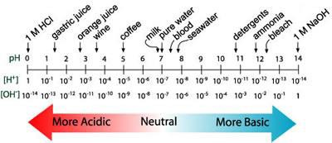
How to represent the hydronium ion concentration?
pH: pH is measured as the -log[H⁺],
smaller pH, more acidic the solution, higher [H⁺].
Neutral pH is 7.0. At this pH there are an equal number of H⁺ and OH⁻ ions in solution. [H⁺]=10⁻⁷ M.
pH is a property of the solution, and can be changed by the addition of acids (e.g. HCl) or bases (e.g. NaOH) to any desired value.
Ionization or dissociation of the proton from the acid:
Lone pair electron on O (water) forms bond with hydrogen
Electron in O-H bond on acid is transferred to oxygen
Overall - hydrogen is transferred to water. Acid – , Hydronium +
Acids and Bases:
Acid: can donate protons to water, forming its conjugate base and a hydronium ion.
Strong acid – always completely ionized/deprotonated (pKa <= 2).
Weak acid – mixture of protonated and deprotonated species exist over some pH range.
Base: can accept protons (we will refer to bases as weak acid)
A simpler notation, by removing water from each side:
Nomenclature:

Slide 9
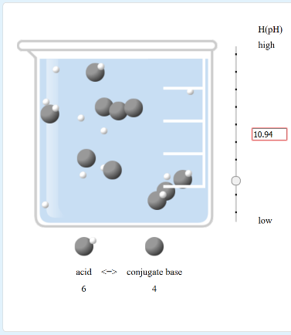
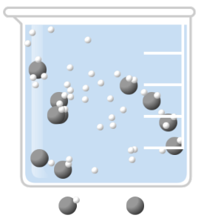
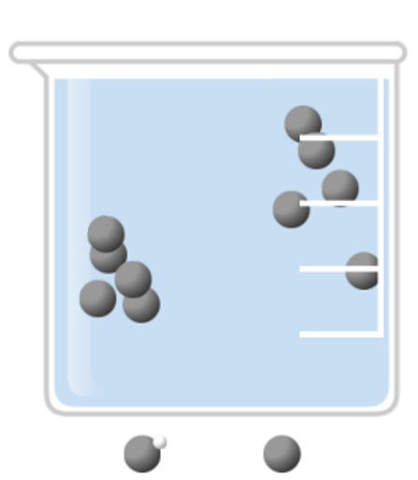
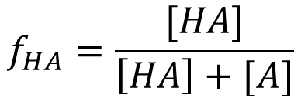
Key Concepts:
We (or the cell) set the pH!
The weak acid does not affect the pH of the solution by deprotonation or protonation.
The weak acid responds to the pH (hydrogen ion concentration) by changing its protonation state to reflect the pH of the solution
How does pH affect Protonation?
$$f_{HA}=\frac{[HA]}{\left[HA\right]+[A]}$$
Le Chatelier’s Principle
pH=0
pH=6
pH=12
A system responds to excess reactant (product) by creating more product (reactant) to maintain equilibrium.
10
0
5
5
0
10
# Collisions

Slide 10



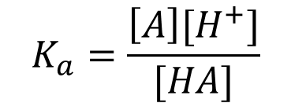
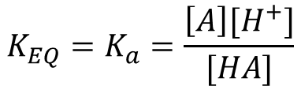
Characterization of Acid Strength Using pKa.
HA ↔ A⁻ + H⁺
The equilibrium constant for that dissociation:
Why?
Compare acids
Predict ionization, given pH of solution
Equilibrium Constants: Why is the ratio of products to reactants a constant when a system is at equilibrium?
Consider a simple reaction:
$$K_{EQ}=K_{a}=\frac{\left[A\right][H^{+}]}{[HA]}$$
Equations that describe the rate of change of [A]:
The equilibrium constant for acid dissociation is given a special name, the 'k-a', or 'k-acidity'. The acidity constant, Ka is a fundamental property of the acid, it does not depend on the pH of the solution.
$$\frac{d[A]}{dt}=−k_{For}\left[A\right]+k_{Rev}[B]$$
[A] decreases at a rate k_{For}[A]
[A] increases at a rate of k_{Rev}[B]
at equilibrium d[A]/dt=0 (d[B]/dt=0)
The pKa is experimentally measured (more later).
The pKa is a constant for a group, but depends on (more later):
the chemical structure of the group.
the electrostatic environment of the acidic group.
$$0 =−k_{For}{[A]}_{eq}+k_{Rev}{[B]}_{eq}$$
$$\frac{k_{For}}{k_{Rev}}= \frac{{[B]}_{eq}}{{[A]}_{eq}}= K_{eq}$$
Which acid has the lower pKa?
Red (solid) Blue (dashed)
Which acid is more deprotonated at pH 7 (stronger acid)?
Red (solid) Blue (dashed)
When the [H⁺] = Ka, then exactly ½ of the acid is protonated.
$$K_{a}=\frac{\left[A\right][H^{+}]}{[HA]}$$
pKa: Since the pH scale is used to characterize [H⁺], it is useful to express the acidity constant on the same scale, by taking its negative log, giving the “p-K-a”: pKa = - log Ka
When the pH = pKa, then exactly ½ of the acid is protonated.
A lower pKa indicates a stronger acid

Slide 11
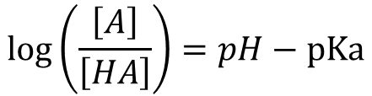
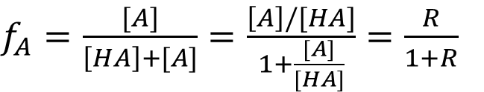
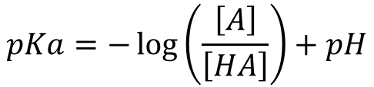
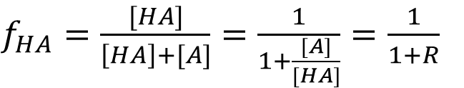
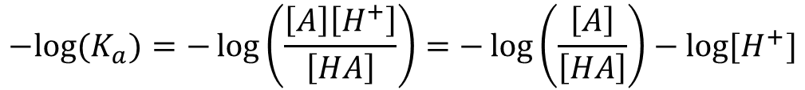
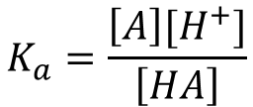
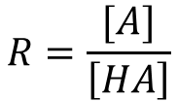
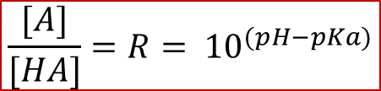
Prediction of Protonation State at any pH:
In many cases only one of the two species (protonated or deprotonated) may be biologically active.
Given the pKa of the ionizable group, and the pH of the
solution, we would like to determine how pH affects the activity of the molecule.
We want to calculate the following:
The fraction that is protonated: fHA.
The fraction that is deprotonated: fA-
Defining Fraction Protonated (f_{HA})/Deprotonated(f_{A})
$f_{HA}=\frac{[HA]}{\left[HA\right]+[A]}=\frac{1}{1+\frac{[A]}{[HA]}}=\frac{1}{1+R}$
$$R=\frac{[A]}{\left[HA\right]}$$
$f_{A}=\frac{[A]}{\left[HA\right]+[A]}=\frac{\left[A\right]/[HA]}{1+\frac{[A]}{[HA]}}=\frac{R}{1+R}$
We need to know R in terms of pH and pKa.
Beginning with the equilibrium constant for ionization:
$$K_{a}=\frac{\left[A\right][H^{+}]}{\left[HA\right]}$$
$${−log⁡(K}_{a})=−\log\left(\frac{\left[A\right]\left[H^{+}\right]}{\left[HA\right]}\right)=−\log\left(\frac{\left[A\right]}{\left[HA\right]}\right)−log⁡[H^{+}]$$
pKa = 6
$$pKa=−\log\left(\frac{\left[A\right]}{\left[HA\right]}\right)+pH$$
$$\log\left(\frac{\left[A\right]}{\left[HA\right]}\right)=pH−pKa$$
$$\frac{[A]}{[HA]}=R= {10}^{(pH−pKa)}$$

Slide 12
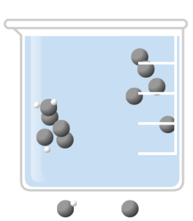
How does pH affect f_{HA} (& Activity)
pKa = 6
pH | _{R=10}(pH-pKa) | FHA=1/(1+R) | Δ=pH-pKa
4 | _{R = 10} (4 - 6) ₌ ₁₀-2 | FHA = 1/(1 + 0.01) = 0.99 | -2
5 | _{R = 10} (5 - 6) ₌ ₁₀-1 | FHA = 1/(1 + 0.10) = 0.91 | -1
6 | R = 10 ⁽⁶ ⁻ ⁶⁾ = 10⁰ | FHA = 1/(1 + 1) = 0.5 | 0
7 | _{R = 10} (7 - 6) ₌ ₁₀+1 | FHA = 1/(1 + 10) = 0.091 | +1
8 | _{R = 10} (8 - 6) ₌ ₁₀+2 | FHA = 1/(1 + 100) = 0.01 | +2
Important general features to note:
when pH = pKa - 2, fHA = 0.99
when pH = pKa -1, fHA = 0.91
when pH = pKa fHA = fA- = 0.5
when pH = pKa + 1 fHA = 0.09
When pH = pK_{a} + 2 f_{HA} = 0.01
pH=0
pH=6
pH=7
10
0
5
5
1
9

Slide 13
Charge Calculations:
^{q}total ⁼ ∑^{( f} HA ^{⋅ q}HA ^{+ f} A− ^{⋅ q}A− ⁾
The overall charge on a molecule as a function of pH can be calculated by summing the contribution from each ionizable group, as indicated in the equation on the right.
Knowledge of the overall charge on proteins is important:
For designing protein purification schemes.
Predicting inter-molecular interactions
+
Charge
0
pI
Approach:
Identify all ionizable groups on the molecule & their charge when protonated and deprotonated (number of terms in the sum).
Use the known pKa of each group to determine the fraction protonated (fHA) and deprotonated (fA-) at the required pH.
Calculate the overall charge by summing the contribution of each group.
-
pI : pH when the net charge =0

Slide 14
Charge Calculations
Example: What is the net (average) charge on glycine at pH=8?
^{q}total ⁼ ∑^{( f} HA ^{⋅ q}HA ^{+ f} A− ^{⋅ q}A− ⁾
Group | f_{HA} | q_{HA} | f_{A} | q_{A} | q
-COOH pKa=2 | ( ) x | ( ) + | ( ) x | ( ) =
-NH3 pKa = 9 | ( ) x | ( ) + | ( ) x | ( ) =

Slide 15
10%
90%
100%
100%
100%
10%
90%
Important Definition
Isoelectric pH (pI) pH where the net charge is zero (pH = 5.5 in this case).

Slide 16
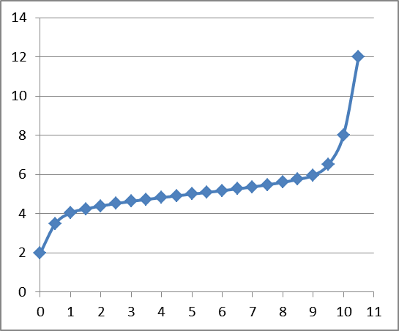
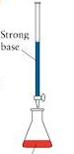
Titration Curves – pKa Measurement & pH Buffers
Ka values, or acidity constants, must be measured by direct experiment - with a pH titration. Known amounts of a strong base are added to a solution of the weak acid. The response of the weak acid to the added base can be measured by:
i) Changes in the pH of the solution for simple compounds,
ii) Spectroscopic methods for molecules with many ionizable groups.
Titration Curve:
As the base is added it removes the proton from the acid and the change in protonation of the weak acid affects the pH.
At the beginning of the titration all of the weak acid is protonated (f_{HA} = 1)
At the equivalence point enough base has been added to fully deprotonate the weak acid, i.e. f_{HA} = 0.
½ through the titration f_{HA}=0.5 and f_{A} =0.5, pH = pK_{a}
At the half-equivalence point enough base has been added to deprotonate ½ of the weak acid ([HA]=[A]), therefore.
Weak acid
ml NaOH
Buffers: A pH buffer is an acid that resists changes in the solution pH by absorbing or releasing protons.

Slide 17
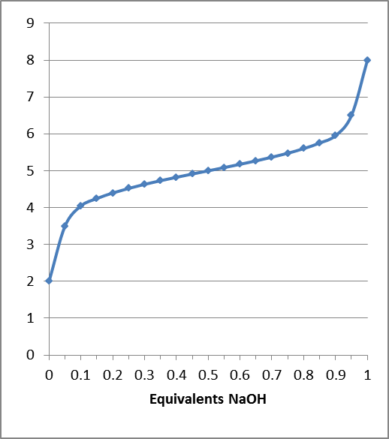
Why Weak Acids are Buffers
Equivalents NaOH =
moles NaOH/mole of weak acid
9
8
7
6
5
4
3
2
1
0
C
B
A
A
B
C
pH
Buffering range/region
0 0.2 0.4 0.6 0.8 1
Fraction Protonated
Change in weak acid protonation through titration:
^{f}HA
1
0.9
0.7
0.5
0.3
0.1
0.0
Buffering capacity: Total moles of a strong acid or base that can be absorbed by a buffer solution and keep the pH within the buffer region. It depends on the concentration of the weak acid, and where the pH is relative to the edges of the buffer region. The higher concentration of weak acid, the higher the capacity.
0.0
0.1
0.3
0.5
0.7
0.9
1
Predominant reactions in:
  Region A: Added OH- removes H+ from solution, raising pH
  Region B: As OH- is added, weak acid deprotonated, released proton contributes to the pH, reducing the change in pH
  Region C: Added OH- removes H+ from solution, raising pH
f_{A}

Slide 18
pH = pK_{A}
[ A⁻ ]
Buffers Construction: Need to determine the ratio of [A-] to [HA] (=R) to give desired pH of the solution.
Typical Problems - Monoprotic Buffer:
log
[HA]
concentration [AT] , [AT] = [HA] + [A]
volume V, pH
List of weak acids and their pKa values.
Method:
Select a weak acid whose pKa is within one pH unit of the desired pH.
Calculate the fraction protonated and deprotonated at the desired pH, fHA & fA-.
Obtain this ratio of [HA] to [A⁻] in solution by one of the following methods:
  Mix the indicated concentration of the weak acid (HA) and its conjugate base (NaA) to give the desired pH: moles (HA)= fHA × [AT]× V moles (A) = fA- × [AT] × V
Use [AT] amount of the acid form of the weak acid and add sufficient strong base (e.g. NaOH) to make the required concentration of [A⁻] to attain the desired pH. You are titrating starting from the left side and converting enough of the fully protonated acid to give the correct amount of the deprotonated acid. The added base converts HA to A⁻.
The amount of strong base to add is fA- equivalents. moles NaOH = fA- × [AT] × V
Use [AT] amount of the conjugate base form of the weak acid (e.g. Na salt) and add sufficient strong acid (e.g. HCl) to make the required concentration of [HA] to attain the desired pH. You are protonated the fully deprotonated acid by just the right amount to give the correct amount of the protonated acid. The added strong acid converts A to HA. The amount of strong acid to add is fHA equivalents. moles HCl = fHA × [AT] × V

Slide 19


Example: Make 1L of 1 M buffer solution at pH 5.0 using either imidazole (pKa~6), or pyruvate (pKa~2.5). You have both the protonated and deprotonated species (e.g. Na salt) in hand.
1. Which buffer would you use, why?
2. Determine fraction protonated and deprotonated at the desired pH:
$$R={10}^{(pH−pKa)}$$
$$f_{HA}=\frac{1}{1+R} f_{A}=\frac{R}{1+R}$$
3. Since we have both forms (HA), (A) we can use any of the three methods to make the buffer:
Method i: Mix the acid and the conjugate base.
  moles (HA)= fHA × [AT]× V moles (A) = fA- × [AT] × V

Slide 20
Method ii: Start with the fully protonated acid and add NaOH.
Use [AT] amount of the acid form of the weak acid and add sufficient strong base (e.g. NaOH) to make the required concentration of [A⁻] to attain the desired pH.
You are titrating starting from the left side and converting enough of the fully protonated acid to give the correct amount of the deprotonated acid. The added base converts HA to A^{-.}
The amount of strong base to add is fA- equivalents. moles NaOH = fA- × [AT] × V

Slide 21
Method iii: Start with the full deprotonated acid (conjugate base) and add HCl.
Use [AT] amount of the conjugate base form of the weak acid and add sufficient strong acid (e.g. HCl) to make the required concentration of [HA] to attain the desired pH.
You are protonated the fully deprotonated acid by just the right amount to give the correct amount of the protonated acid. The added strong acid converts A to HA.
The amount of strong acid to add is fHA equivalents. moles HCl = fHA × [AT] × V

Slide 22
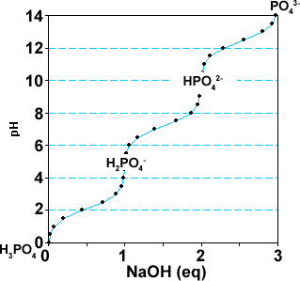
Polyprotic Buffers:
Any of the pKas in a poly-protic acid can be used to buffer the solution. For example, phosphate has three pKas and therefore three buffer regions.
The overall approach in generating buffers using polyprotic acids is:
Select the pKa that corresponds to the required buffer region
Do all of the calculations using that pKa, giving f_{HA} and f_{A}
Make the buffer using one of three ways:
Example: Assuming pH is in the 2nd buffer region.
Method i:
  Use the form of the compound that is present at the beginning of the buffer region as “HA”, e.g. H₂PO₄⁻.
  Moles of HA = f_{HA} x [A_{T}] x V
  Use the form of the compound that is present at the end of the buffer region as “A”, e.g. HPO₄²⁻.
  Moles of A = f_{A} x [A_{T}] x V
Method ii:
  Use the fully protonated form of the acid (H₃PO₄) to start.
  Moles of H₃A = [A_{T}] x V
  Equivalents of NaOH = 1 + f_{A}
  Moles of NaOH = eq NaOH x [A_{T}] x V
Method iii:
  Use the fully deprotonated form of the acid (Na3PO4) to start.
  Moles of Na₃A = [A_{T}] x V
  Equivalents of HCl = 1 + f_{HA}
  Moles of HCl = eq HCl x [A_{T}] x V

Slide 23
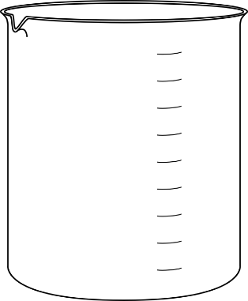
Example: Make 1L of a 0.2M phosphate buffer with a pH = 8.0. pKa values are 2.1, 7.2, and 12.7 for phosphoric acid.
Use pKa closest to desired pH.
pK2 should be used.
Calculate fHA and fA-.(Note: “HA” = H2PO4, “A”=HPO4)
R=10^{(pH-pKa)} ₌ 10^{(8.0 – 7.2)} ₌ 10^{0.8} ₌ 6.31
fHA = 1/(1+6.31) = 1/7.31 = 0.137 fA = (1-f_{HA}) = 0.863
Select one of the following three methods:
i) Use the chemical forms of “(HA)” and “(A-)” that represent the species present at the pKa you used, in this case:
NaH2PO4 = “HA” , Na2HPO4=”A”.
moles NaH2PO4=
fHA x [AT] x V = 0.137x0.2 mole/L x 1 L
moles Na2HPO4=
fA x [AT] x V = 0.863x0.2 mole/L x 1 L

Slide 24
Methods ii & iii may require adjustments to equivalents due to additional equivalence points/buffer regions that have to be crossed to get to the desired pH.
fHA = 0.137 fA = 0.863
at desired pH = 8
ii) Starting from completely protonated form (H₃PO₄). Add sufficient whole equivalents (n) to reach the buffer region you are using, plus an additional f_{A-} to reach the pH within that buffer region.
eq NaOH = 1 + fA = 1+ 0.863 moles NaOH = eq x V x AT
The first equivalent of NaOH that is added converts all of the H₃PO₄ to H₂PO₄
  Starting from completely ionized form (Na3PO4). Add sufficient whole equivalents (n) to reach the buffer region you are using, plus and additional fAH equivalents of HCl to get to the desired pH in that buffer region.
eq HCl = 1 + fAH =1+0.137 moles HCl = eq HCl x V x AT
The first equivalent of HCl that you add protonates all of the PO₄ to HPO₄

Slide 25
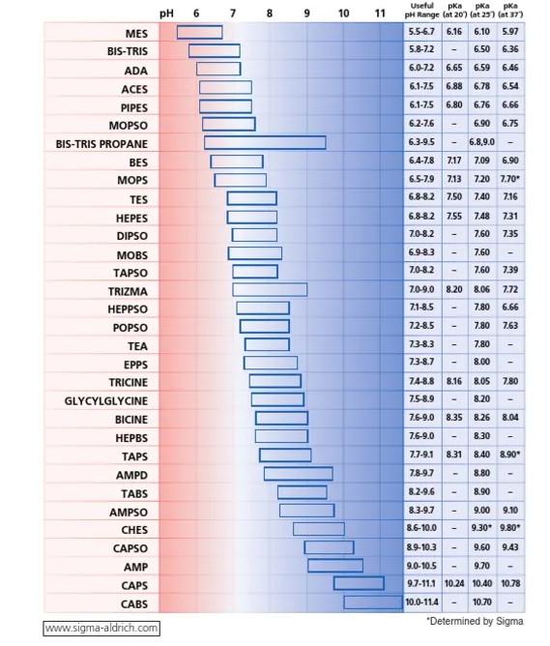
Useful Biochemical Buffers
Protein friendly organic buffers that span a large pH range are available.
Note many show a large temperature effect on their pKa

Slide 26
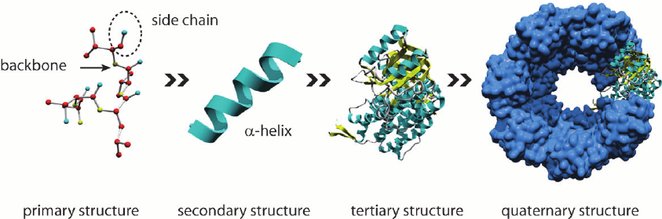
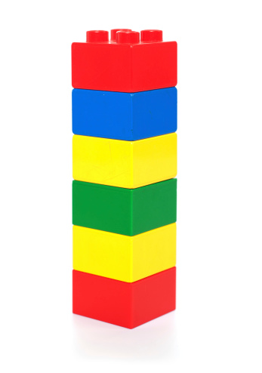
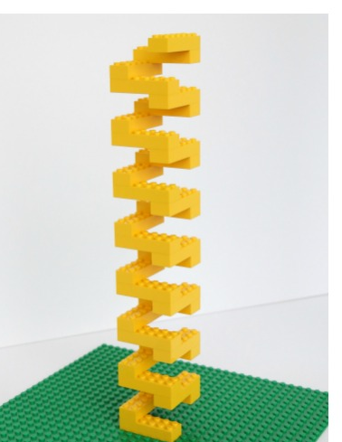
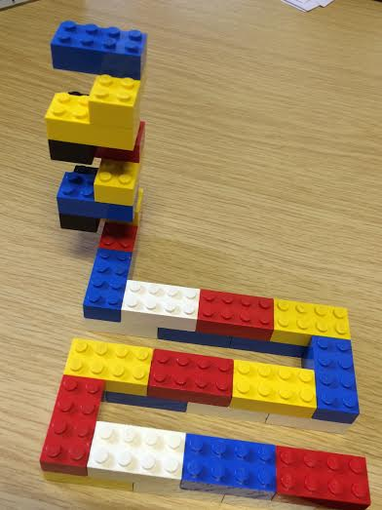
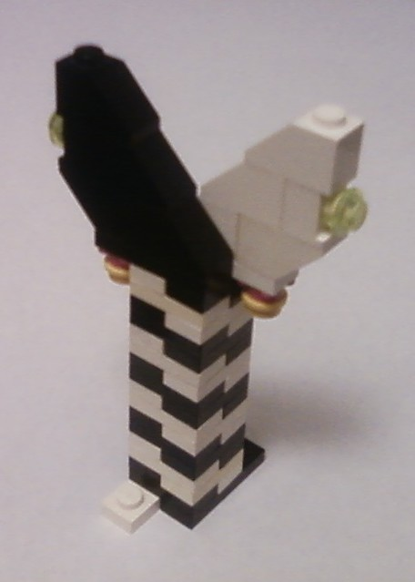
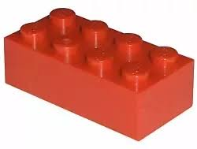
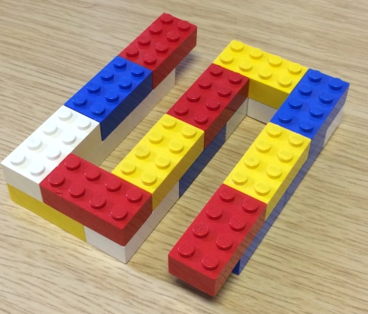
Structural Hierarchy of Proteins
Primary - sequence of amino acids, no 3D structural information
Secondary - local structural elements, only mainchain atoms involved
Tertiary - 3D position of all atoms, functional form of many proteins.
Quaternary - multiple chains – multiple chains often required for function.
(White and black represent two different chains)
Biological Function

Slide 27
Amino Acids: Structure and Properties
An amino acid is a carboxylic acid with an amino group. The first carbon after the carbonyl carbon is the α-carbon. Most biological amino acids are α-amino acids - the amino group is attached to the α -carbon.
There are 20 amino acids that are common, they differ only in the group (sidechain) attached to the Cα carbon.
The N, Cα, Hα, C=O, C-OH atoms are the same in each of the 20 commonly found amino acids. The N, Cα, Hα, C=O will be the repeating unit in the protein polymer, making the “mainchain” or “backbone”.
The sidechain atoms are unique to each amino acid and give rise to the unique properties of that amino acid.
The sidechain atoms are designated with Greek letters, based on the nomenclature for carboxylic acids.
β
δ
β
δ
α
α
γ
ε
γ
ε
Notes:
Need to see how AA are polymerized to understand mainchain and sidechain.

Slide 28
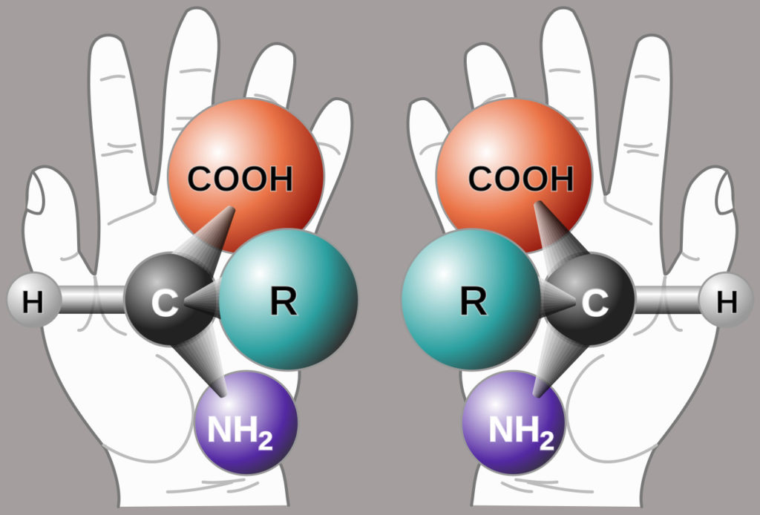
Chirality & Optical Activity:
In all amino acids (except glycine) the α-carbon is chiral because it is attached to four different groups.
Importance of chirality in Biology: Usually only one enantiomer is active in biological systems. As indicated above, only L-amino acids are used to make proteins on the ribosome. Amino acids of the other enantiomer (D) are generally harmless.
This means that the mirror images of these compounds cannot be superimposed. The two mirror images are called enantiomers.
A binding pocket for Alanine – which will bind better L or D? Why?
Most common amino acids have an S configuration. An older, but very much used, notation is D and L. This notation is based on the chirality of a reference compound and all amino acids that are found in proteins that are ribosomal in origin are L.

Slide 29
Primary Structure
Amino acids are joined together to form linear polymers by the formation of a peptide bond between the carboxyl of one amino acids and the amino group of the next.
This reaction releases water: a dehydration reaction.
The peptide bond can be broken (lysis) by the addition of water = hydrolysis.
Incorporated amino acid = residue (atoms are lost when the peptide bond is formed).
Polarity of chain direction – amino (N) terminus to carboxy(C) terminus = order of amino acids = sequence = primary structure
Mainchain (or backbone) – linear atoms of the polymer
Sidechain – atoms off the Ca carbon
  Primary Structure – Expectations
  Draw chemical structure from sequence.
  Determine the seq. from structure.
  Distinguish/identify:
    Mainchain & Sidechain atoms,
    Residue = aa in polymer,
    N & C terminus,
    Peptide bond(s).
Tripeptide
(Peptide = protein <50 AA)

Slide 30
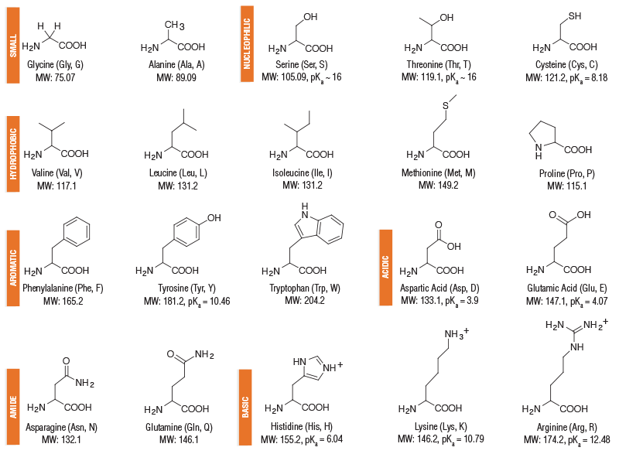
Amino Acids – Structure and Properties
Polar sidechains
Non-polar sidechains
Ionizable sidechains
Polar sidechains
Ionizable sidechains

Slide 31
Amino Acids with Unique Structural Properties
Cysteine:
Forms disulfide bond by oxidation of the sulfur – covalent crosslink stabilizes proteins.
Proline:
No H-bond donor when incorporated into proteins.
Cysteine Cys
disulfide bond
Proline Pro
no NH
in protein
Ring reduces flexibility of sidechain and the mainchain atoms.

