Slide 1
Foundations in Biomedical Sciences – Lecture 2b
Gordon Rule
Department of Biological Sciences
Carnegie Mellon University
rule@andrew.cmu.edu
Quaternary Structure
Protein Purification Methods
Affinity chromatography
Ion exchange
Size exclusion
Expression of Recombinant Proteins
Transcription and Translation
E. Coli and T7 RNA Polymerase
Lac operon as a control system
pET vectors
Restriction enzymes & DNA Ligase

Slide 2
Quaternary Structure
Combinations of polypeptide subunits (combinations of tertiary structures).
Chains associate by non-covalent interactions between R groups on the different chains.
Additional stabilization can be provided by disulfide bonds, usually in extra-cellular proteins.
Proteins can be a dimer, trimer, tetramer, pentamer, etc.
If the chains are the same, called homo__________. If chains are different, hetero_______
Quaternary structure of Antibody
two light chains are identical
two heavy chains are identical
heterotetramer held together by non-covalent forces & disulfide bonds
Antibodies bind two antigens at the top of the Y.

Slide 3
Protein Purification.
Overall Expectations:
Describe overall process of column chromatography
Understand separation process of:
Size exclusion chromatography (gel filtration) (Native MW)
Cation exchange (+ charged proteins)
Anion exchange (- charged proteins)
Affinity chromatography (ligand, antibody)
Tags (his-tag), genetically encoded.
3. Understand how different components of SDS-PAGE work:
Electrophoretic migration: v = q/m
Role of SDS: uniform charge to mass ratio -> separation by size only.
Multi-step Purification:
Intact cells
Cleared
Lysate
(centrifugation to remove debris)
Lysate
Step 1
(e.g. metal ion affinity)
Step 2
(e.g. ion exchange chrom.)
Pure Protein

Slide 4
Typical Purification Methods & Their Prevalence
Selective precipitation of proteins by ammonium sulfate:
Advantage was being able to handle very large volumes of lysate from natural sources
Disadvantage is relatively poor resolution (separation of similar proteins from another)
Seldom used in the era of recombinant DNA expression of target protein
2. Column Chromatography – separation by size, charge, tags, selective affinity
Very scalable (mg to gms)
High capacity
High resolution (easier to separate similar proteins)
Types of Column Chromatography & Their Frequency of Use
Method | Separation by | Frequency of Use
Metal-ion affinity | Tagged with6 His residues = HisTag | Extremely common (95%)
Maltose and glutathione (GSH) affinity chromatography | Tagged with maltose binding protein or glutathione transferase | Somewhat common (4%)
Ion-exchange chromatography | Charge | Very common 2nd step (70%)
Size exclusion chromatography | Size | Somewhat common 2nd step (30%)
Antibody affinity chromatography | Binding to specific antibody | Relatively rare
Ligand based affinity chromatography | Binding to specific ligand | Targeted to particular classes of enzymes
Hydrophobic affinity chromatography | Polarity of protein surface | Rare

Slide 5
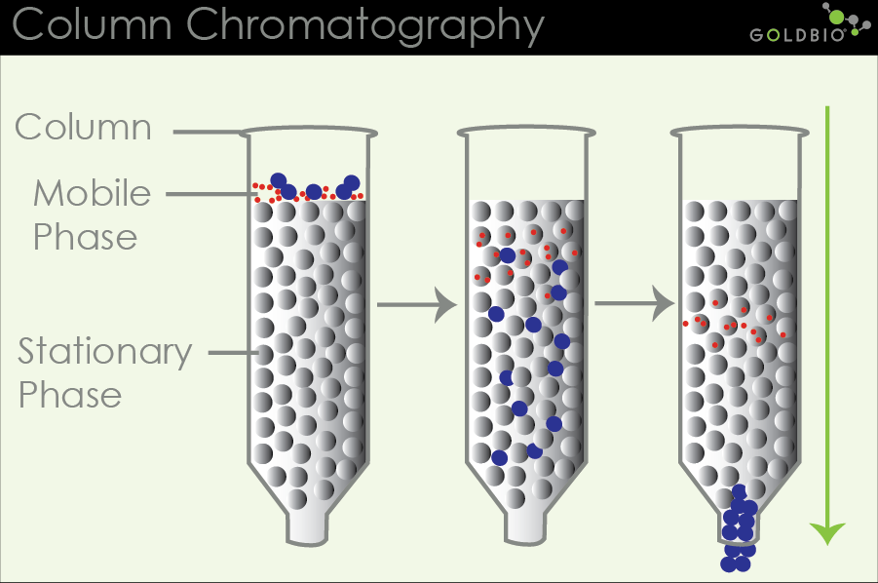
Column Chromatography
Chromatography is performed in long glass tubes filled with a matrix or resin (particle size similar to fine sand).
The liquid is a buffered salt solution to keep the proteins in their native (folded) form.
The mixture of proteins is added to the top of this column and buffer is allowed to flow through the column.
As the buffer flows through the column the mixture of proteins is drawn down through the column and interacts with the resin. The actual mode of separation depends on the nature of the resin.
The protein elutes from the column at a specific volume (V_{e}) at a specific time.
The elution volume is divided into separate fractions (e.g. separate test-tubes)
Usually, several different chromatographic steps are performed with different resins, sequentially, during a purification scheme.
Different resins allow separation by:
Affinity (Metal ions for HisTag)
Charge (ion exchange)
Size (size exclusion/gel filtration)

Slide 6
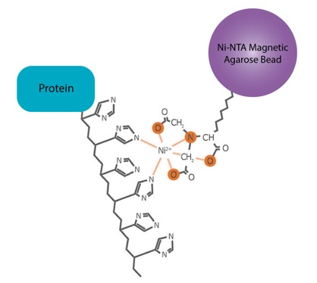
His-Tags – The most common Affinity Tag
A His-tag is the addition of 6-10 Histidine residues to either the N-terminus or the C-terminus of the target protein.
The tag has to be added by changing the DNA sequence of the target protein.
The His residues will cause the tagged protein to stick to immobilized Ni ions on a resin bead.
The impurities can be washed away, and the tagged protein released by adding a high concentration of imidazole. The imidazole will compete for the His and bind to the Ni ions.
Original DNA/protein sequence:
-ATGCCCGGC--
MetProGly--
Modified DNA/tagged protein sequence:
-ATGCACCACCACCACCACCACCCCGGC--
MetHisHisHisHisHisHisProGly--
SDS-PAGE
Lysate Wash Elute

Slide 7
Ion Exchange - Effect of pH on Net Charge of Proteins
https://web.expasy.org/protparam/
pI (Isoelectic pH)- pH at which proteins have no net charge:
Proteins become positively charged for pH < pI
Proteins have a negative charged if pH > pI.
Therefore, the charge on a protein can be changed by altering the pH, increasing or decreasing the binding to ion exchange resins.
pI = 5.43.
The pI can be predicted from the amino acid sequence using the same charge calculation that we used earlier:
$$\left\langle q\right\rangle ={\sum_{i=1}^{n}{f_{A}×q_{A}+f_{HA}×q_{HA}}}^{}$$
1. What is the charge on this protein at pH=5.43?
2. What is the sign of the charge on this protein at pH=7?
negative or positive
and finding the pH value where the charge is zero.
This calculation can be done by web-servers.

Slide 8
Types of Resins – Ion Exchange
Type
Resin
Principal of Separation
How to Elute the Protein

Slide 9
Ion Exchange - Column Chromatography
Cation exchange resin, binds + charge ions.
Low Salt Buffer (50 mM NaCl)
High Salt Buffer (1 M NaCl)
Mixture contains:
+ Charge (green)
Neutral (gray)
- Charge (red)
Resin
Elution Volume:
Volume that has dripped out of the column.
Fraction: Collection of liquid that drips out the bottom of the column – i.e. the total amount of liquid is fractionated into separate fractions.
Fractions that contain the protein of interest are pooled (combined) before next step.
Fraction vol = 2.5 ml

Slide 10
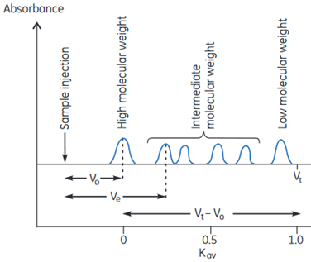
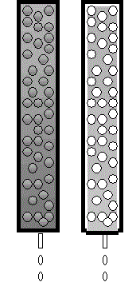
Separation by Size - Size Exclusion (aka Gel Filtration)
Fractional Elution
$$K_{AV}=\frac{\left(V_{e}−V_{o}\right)}{\left(V_{t}−V_{0}\right)}$$
$$V_{e}−V_{o}$$
V_{o}
V_{t}
$$V_{t}−V_{o}$$
V_{e} = volume that peak elutes (exits column)
V_{t} = total column volume, accessible to small proteins.
V_{o} = void volume, the volume outside the beads, this amount of liquid has to come through the column before any proteins can elute - volume accessible to large proteins. (Typically ~30% of the total column volume)
V_{t} - V₀ = volume available for separation
The volume available depends on the MW:
Huge protein – V_{o} is the available volume, V_{e} = V_{o}
Tiny protein – V_{t} is the available volume, V_{e} = V_{t}

Slide 11
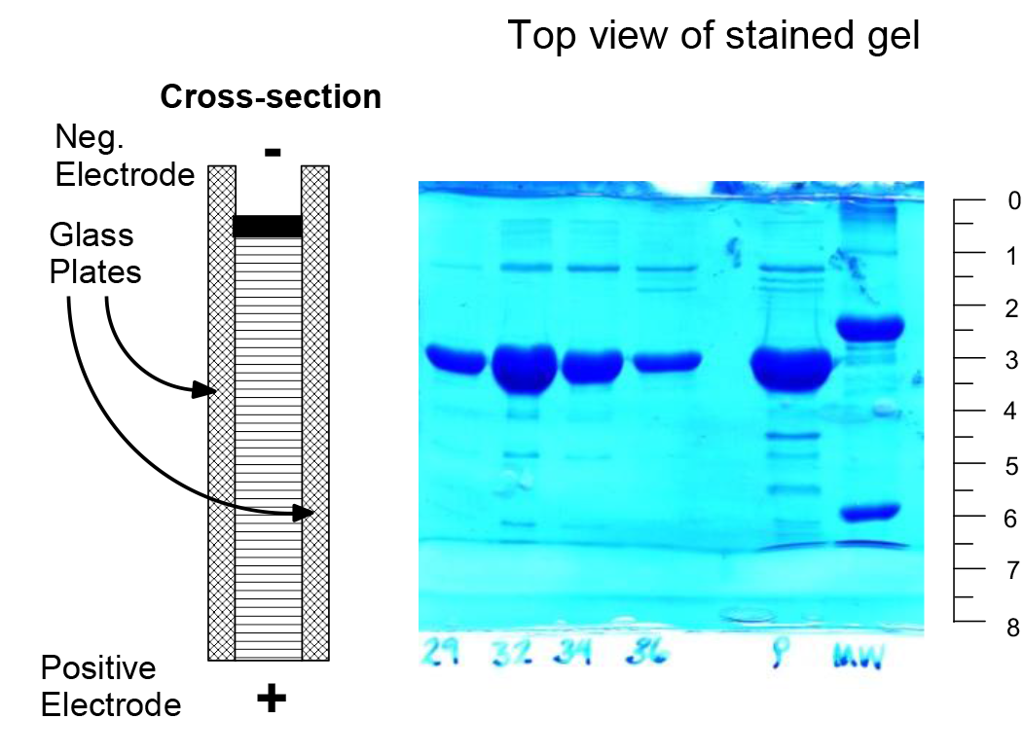
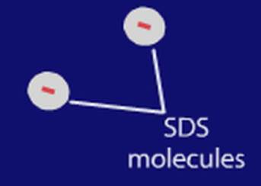
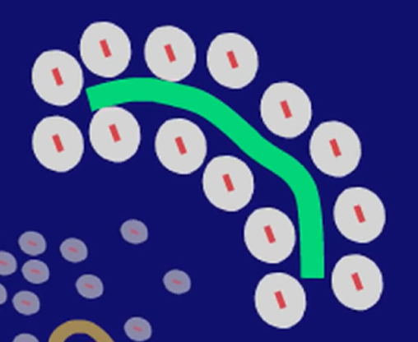
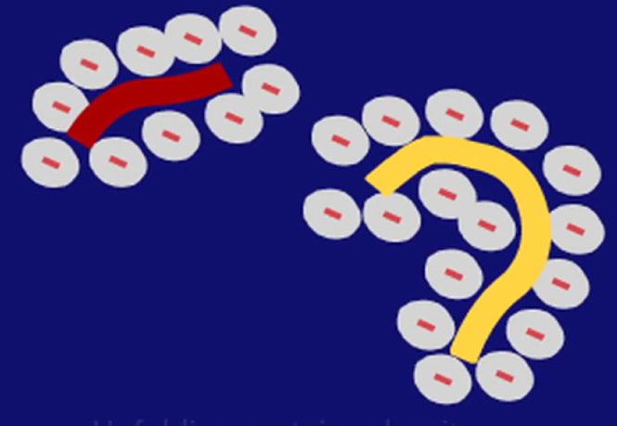
Evaluating Final Purity
After the protein is purified, its purity can be monitored by:
a) SDS-page gel electrophoresis (most common)
b) Mass spectrometry (sometimes)
c) Amino terminal sequencing (rare)
d) Isoelectric focusing (separation by pI) (rare)
SDS-polyacrylamide gel electrophoresis (SDS-PAGE)
Electrophoresis = movement of charged molecules in an electric field: velocity ∝ (q/M) x V (V, volts)
Denatured proteins are pulled through a polymer gel by electrophoresis, separating them solely by size (ideally).
Top View of Gel
Lanes (multiple samples)
Based on the video:
What happened to all proteins when interacting with SDS?
What happened to the protein with two chains, after interacting with SDS?

Slide 12
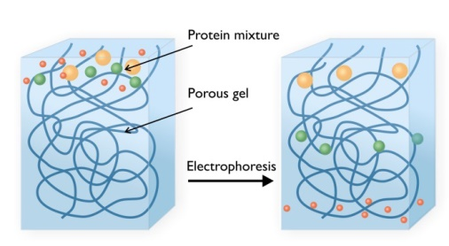
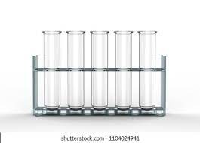
SDS-polyacrylamide gel electrophoresis (SDS-PAGE)
SDS – denatures proteins, giving them:
a negative charge
a uniform charge to mass ratio
All proteins migrate in the same direction.
Separate only by size as they pass through the gel (Smaller proteins move faster)
V
Yellow, green, orange + SDS = - charge
Magenta + SDS = - charge
Charge (q) | Mass (M) | v = q/M
6 | 3 | 2 = 6/3
29 30 31 32 P MW
Gels are stained with a stain that is specific for protein. Most commonly used stain is Coomassie blue. Gel shows four fractions (#29, #30, #31, #32) obtained from chromatography, an empty lane, pooled fractions (P), molecular weight standards (MW).

Slide 13
Measuring Denatured Molecular Weight With SDS-PAGE.
A. Molecular Weight Determination – distance migrated ~ $∝$ log(MW).
i) Load molecular weight standards on one lane (right lane in above gel)
ii) load unknown(s) in other lane (left lane), apply voltage.
iii) Measure the distance migrated of each band.
iv) Plot log(MW) versus d for standards, generating a calibration curve. This is fit to a polynomial function e.g. $log\left(MW\right)=αd^{2}+βd+ γ$.
v) Use calibration curve to get logMW of unknown.
Top of Gel
d=2.8cm
d=3.5cm
Unknown
Standards
d=6.4cm
Obtaining MW
1. Analytical Solution (better)
Log(MW) = -0.1942 x d + 5.5436
d = 3.5 for unknown
Log(MW) = 4.86
MW = 10^{4.86} = ~ 73,100 Da
Standards
S1: MW 100,000, distance = 2.8 cm
S2: MW 20,000, distance =6.4
Unknown: Distance =3.5
2. Graphical solution
Sketch calibration curve using known MW (standards)
Find intersection of line for d=3.5
Read log(MW) from y-axis

Slide 14
Production of Recombinant Proteins
The Goal: To produce any desired protein in in E. coli (a widely used bacteria) using recombinant DNA methods.
The overall procedure is as follows:
Obtain the codons for the desired protein:
PCR from native source
Chemical synthesis of gene.
2) Insert the codons into a bacterial expression vector (a specialized form of a DNA plasmid) using restriction endonucleases and DNA ligase.
3) Transformation of the bacteria with the plasmid.
4) Growth of the transformed bacteria, production of the recombinant protein.
5) Purification of the recombinant protein.
6) Structure determination
7) Biochemical studies, e.g. rational drug design, enzyme mechanism

Slide 15
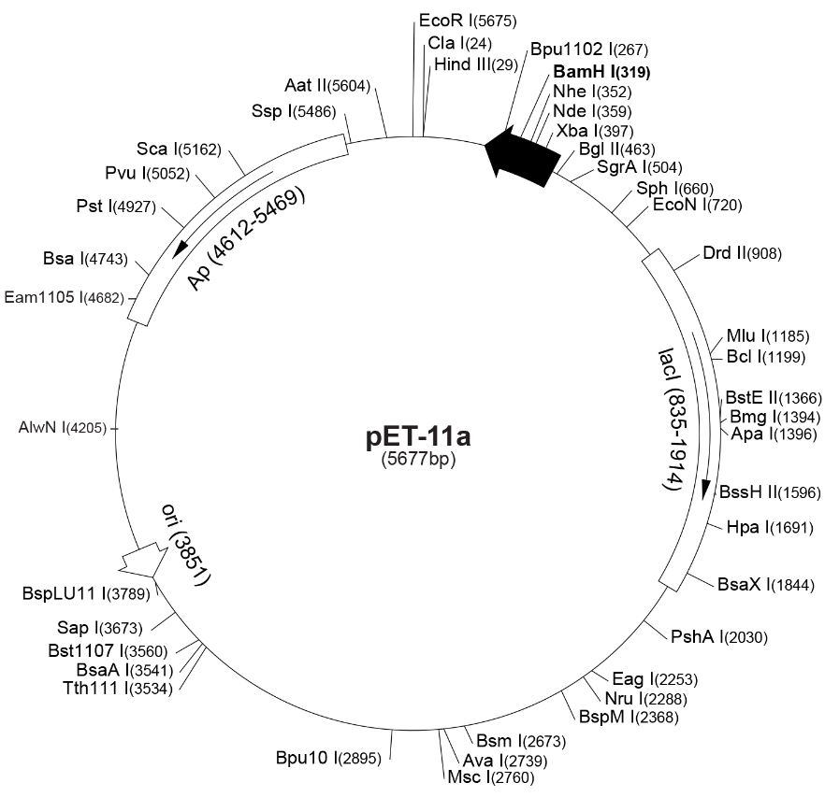
Properties of Expression Vectors
Common Required Features:
a) Provide antibiotic resistance to the host bacteria, such that only bacteria containing the plasmid will grow in the presence of the antibiotic.
b) An origin of DNA replication so that the plasmid will be replicated with the bacterial DNA
c) DNA sequences that cause the production of mRNA, copying the information in the DNA to mRNA, including a regulated promotor (e.g. lac operator).
d) Sequences in the resultant mRNA that start and stop the production of the recombinant protein.
e) Coding region for protein to be expressed.
Optional features on some vectors:
a) His6 tag for affinity purification on a Ni column.
b) Sequences (pelB leader) that cause the recombinant protein to be exported out of the cell, to facilitate purification.
Gene for protein to be expressed inserted by restriction digest of insert & plasmid, mix & ligate.

Slide 16
Insertion of DNA into Expression Plasmid
STEPS:
Obtain DNA segment that codes for desired protein
Cut DNA segment & plasmid with restriction enzymes
Ligate (join DNA together)
Transform
Transcription
Translation
2
1
C-A-T-A-T-G-----C-T-C-G-A-G
G-T-A-T-A-C-----G-A-G-C-T-C
Coding information for expressed protein
2
3
4
5
C-A T-A-T-G-----C T-C-G-A-G
G-T-A-T A-C-----G-A-G-C-T C
-----C-A T-A-T-G-----C T-C-G-A-G---
-----G-T-A-T A-C-----G-A-G-C-T C---
-----C-A T-A-T-G-----C T-C-G-A-G---
-----G-T-A-T A-C-----G-A-G-C-T C---
6
Ligate
-----C-A-T-A-T-G-----C-T-C-G-A-G---
-----G-T-A-T-A-C-----G-A-G-C-T-C---
3

Slide 17
Information Transfer In Biology
(DNA Sequence)
.ATATGCCCATGTGGTAA..
RNA Polymerase (Transcription)
(mRNA Sequence)
.AUAUGCCCAUGUGGUAA..
.U-AUG-CCC-AUG-UGG-UAA
Translation
Punctuation into 3-base codons – Selecting Reading Frame
Ribosome
Met-Pro-Met-Trp
(Protein Sequence)
Codon = 3 bases that code for an amino acid.
Notes:
Methionine is also the codon for a start sequence

Slide 18
DNA/RNA sequence to Amino Acid Sequence – Codon Table
5' Base | Middle Base |  |  |  | 3'
 | T | C | A | G
T | Phe | Ser | Tyr | Cys | T
 | Phe | Ser | Tyr | Cys | C
 | Leu | Ser | Term | Term | A
 | Leu | Ser | Term | Trp | G
C | Leu | Pro | His | Arg | T
 | Leu | Pro | His | Arg | C
 | Leu | Pro | Gln | Arg | A
 | Leu | Pro | Gln | Arg | G
A | Ile | Thr | Asn | Ser | T
 | Ile | Thr | Asn | Ser | C
 | Ile | Thr | Lys | Arg | A
 | Met | Thr | Lys | Arg | G
G | Val | Ala | Asp | Gly | T
 | Val | Ala | Asp | Gly | C
 | Val | Ala | Glu | Gly | A
 | Val | Ala | Glu | Gly | G
The codon TGG = ____?
Start codon selection sets the correct reading frame
Frame 1
Frame 2
Frame 3
ATGGATGCATGGTATAG…
MetAspAlaTrpTyr…
MetHisGlyIle…
MetVal…
Amino acid on 3’-OH
3’
5’
Anticodon loop
Expectations:
Concept of reading frame
Converting codons to AA
3’
5’
Codon

Slide 19
mRNA Synthesis (Transcription) – Important Signals
DNA
codons
Stop Codon
T7 promoter
Start of mRNA
RBS
Start Codon
mRNA Term
TTAATACGACTCACTATAGGGAGAC......GGTTTCCCTCTAGAAATAATTTTGTTTAACTTTAAGAAGGAGATATACATATGCCTCAGATC...CACTGA..GGGGTTTTTTGC-
AATTATGCTGAGTGATATCCCTCTG......CCAAAGGGAGATCTTTATTAAAACAAATTGAAATTCTTCCTCTATATGTATACGGAGTCTAG...GTGACT..CCCCAAAAAACG-
Lac operator
Transcription
mRNA
GAAAUAAUUUUGUUUAACUUUAAGAAGGAGAUAUACAUAUGCCUCAGAUCACUCUUUGGCAA.CACUGA...GGGG
MetProGlnIleThrleuTrpGln.
Translation
Protein off ribosome
MetProGlnIleThrLeuTrpGln...His

Slide 20
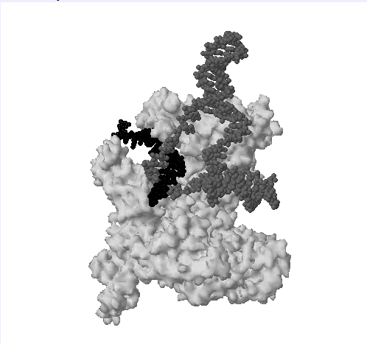
E. Coli RNA Polymerase:
Holoenzyme: σ + α₂ββ’
Binds to promoter (P) sequence in a base specific manner via σ subunit.
Core polymerase = α₂ββ’ – sufficient for elongation (sigma factor falls off core enzyme)
DNA template
mRNA
Sequence specific protein-DNA interactions
Optimal E. coli promoter
Start of mRNA
TTGACA -------17 bp--------TATAAT-- 6 bp- -A(or G)—mRNA---------
AACTGT-----------------------ATATTA-------------T(or C)--template stand
-35 region -10 region
Sigma
-35 = 35 bases from start site
RNA polymerase

Slide 21
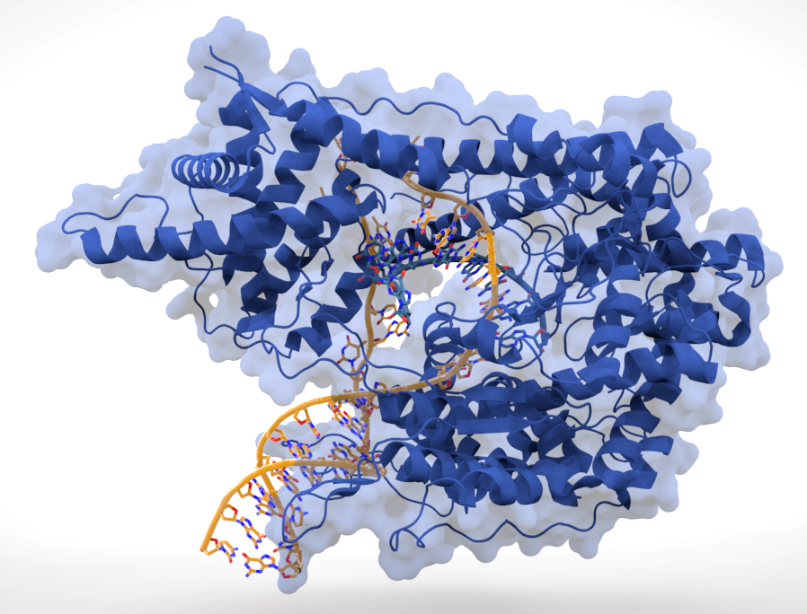
T7 RNA Polymerase
Isolated from a bacterial virus called T7
A single chain polymerase
Recognizes a different promoter sequence – will only transcribe genes with a T7 promoter – selective synthesis of one gene (the one on the plasmid)
T7 is a more robust RNA polymerase than E. coli, seldom stalls during transcription – gives more mRNA and therefore more protein. It is typically used when expressing recombinant proteins from plasmids.
T7 Promoter: TAATACGACTCACTATAGGGAGA
E. Coli Prom: TTGACA -------17 bp-------------TATAAT-

Slide 22
Protein Synthesis
(DNA Sequence)
.ATATGCCCATGTGGTAA..
RNA Polymerase (Transcription)
(mRNA Sequence)
.AUAUGCCCAUGUGGUAA..
.U-AUG-CCC-AUG-UGG-UAA
Translation
Punctuation into 3-base codons – Selecting Reading Frame
Ribosome
Met-Pro-Met-Trp
(Protein Sequence)
Codon = 3 bases that code for an amino acid.
Notes:
Methionine is also the codon for a start sequence

Slide 23
Protein Synthesis – Important Signals
codons
DNA
Stop Codon
T7 promoter
Start of mRNA
RBS
Start Codon
mRNA Term
TTAATACGACTCACTATAGGGAGAC......GGTTTCCCTCTAGAAATAATTTTGTTTAACTTTAAGAAGGAGATATACATATGCCTCAGATC...CACTGA..GGGGTTTTTTGC-
AATTATGCTGAGTGATATCCCTCTG......CCAAAGGGAGATCTTTATTAAAACAAATTGAAATTCTTCCTCTATATGTATACGGAGTCTAG...GTGACT..CCCCAAAAAACG-
Lac operator
Transcription
2. Start codon: AUG codes for the 1st amino acid, defines reading frame, once selected.
mRNA
GAAAUAAUUUUGUUUAACUUUAAGAAGGAGAUAUACAUAUGCCUCAGAUCACUCUUUGGCAA.CACUGA...GGGG
MetProGlnIleThrleuTrpGln.
Translation
3. Stop codon
Protein off ribosome
MetProGlnIleThrLeuTrpGln...His
1. Ribosome Binding Site (RBS): (Shine-Dalgarno [SD] sequence)[Prok only]
Positions mRNA on the ribosome so that the correct start codon is used.
The optimal spacing between the SD sequence and the AUG is 6-9 bases.

Slide 24
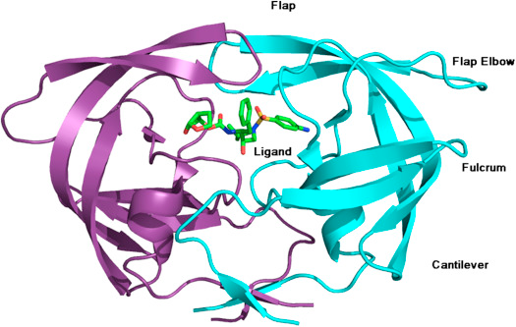
Regulation of Transcription by Lac Repressor
The constitutive expression of high levels of almost any protein is toxic to the bacteria:
Protein may be toxic (e.g protease)
Production completes for valuable cellular resources.
Cell death can occur due to metabolic stress.
An ON/OFF switch is essential.
Expression of the recombinant protein occurs when desired, i.e. when sufficient cell growth has been attained.
The most common ON/Off switch is the lac repressor-operator system.
The addition of an inducer (IPTG) will start the production of the protein on the plasmid

Slide 25
Transcriptional Regulation: The lac Operon – A Natural ON/OFF Switch
Lactose metabolism in bacteria requires 2 proteins – produced from the lac operon (operon is a cluster of protein coding sequences that are produced from a single mRNA, generated from a single promoter)
Galactoside permease to allow the lactose to enter the cell, coded by the lac Y gene
Galactosidase to split lactose into glucose and galactose, coded by the lac Z gene
Lac repressor protein
-cgttgacaccatcgaatggcgcaaaacctttcgcggtatggcatgatagcgcccgATTGTGAGCGGATAACAATTgcgcga-
-35 -10 Lac operator
The production of these proteins is regulated by the lac repressor.
The repressor is a protein that binds to a specific DNA sequence (lac operator) and prevents transcription of lacZ and lac Y by blocking E. coli RNA polymerase from moving off the promoter.
The lac repressor is produced from a separate lac I gene (not part of the operon), which has its own promoter.
The lac repressor is made all of the time.
Why? The costly synthesis of enzymes that are required for lactose metabolism are only made when lactose is present in the growth media.
Notes:
Lac I gene produces an inhibitor that exerts negative control, it was thought to bind near the promoters for lac z and lacy. The repressor is the parking brake, Lactose releases the parking brake.

Slide 26
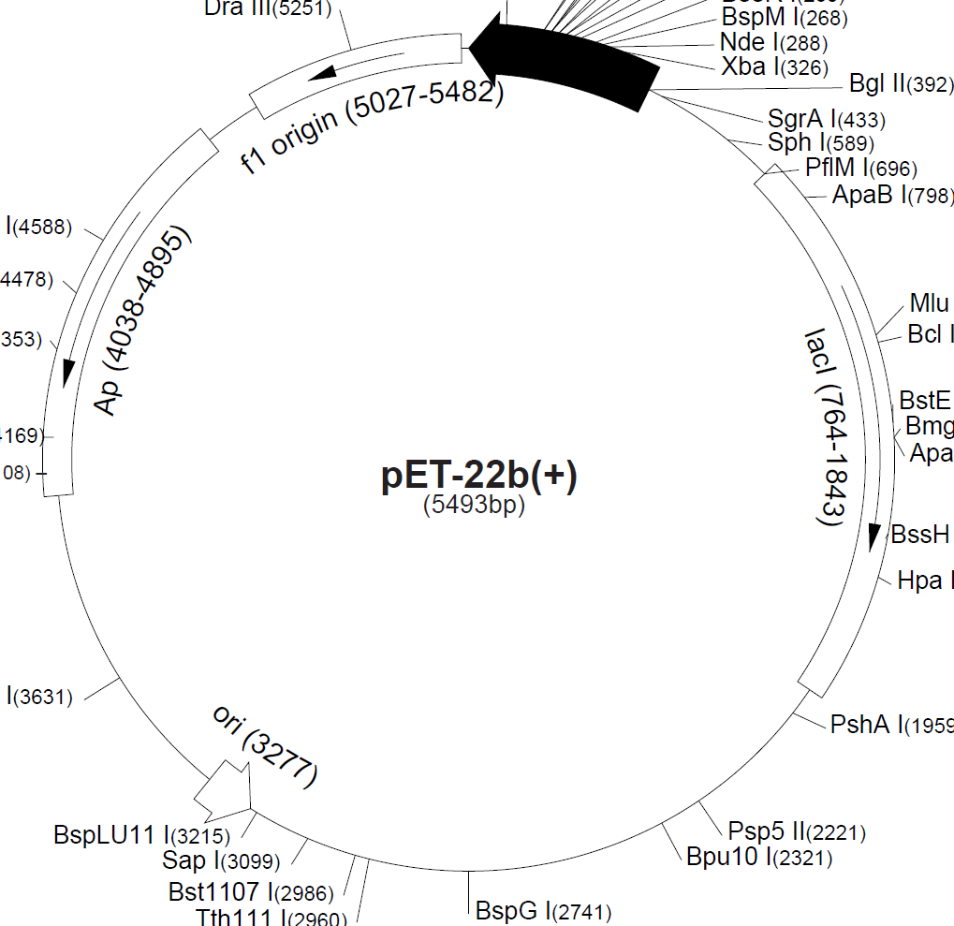
How do we use this control machinery?
Place the lac operator sequence between the T7 promotor and the gene we want to control.
HIV Protease
Since there are multiple copies of the plasmid, and not enough lac repressor to go around, the lac I gene is also placed on the plasmid.
Notes:
Lac I gene produces an inhibitor that exerts negative control, it was thought to bind near the promoters for lac z and lacy. The repressor is the parking brake, Lactose releases the parking brake.

Slide 27
The lac Operon
Lactose or IPTG
Lactose is the Inducer in nature
Isopropylthiogalactoside (IPTG) is used in the lab.
It is a non-hydrolysable inducer that will not be degraded by the cell.
IPTG (and lactose) induce an allosteric change in the lac repressor protein.
R (high DNA affinity) → T (low DNA affinity)
IPTG
Notes:
Lac I gene produces an inhibitor that exerts negative control, it was thought to bind near the promoters for lac z and lacy. The repressor is the parking brake, Lactose releases the parking brake.

Slide 28
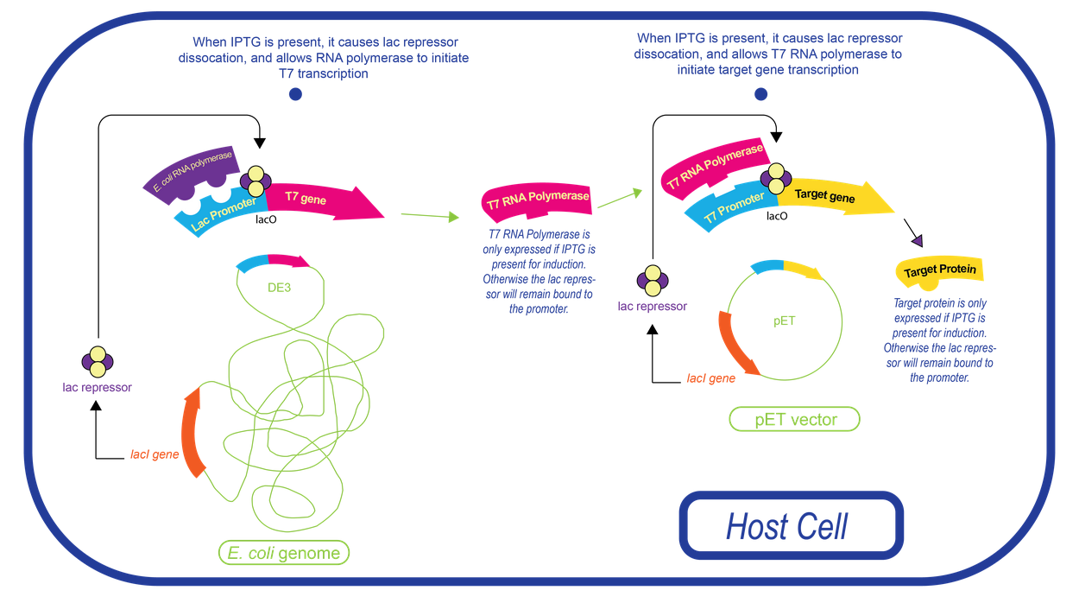
Expression of Recombinant Proteins utilizing the T7 Promotor/Lac Operon
T7 RNA polymerase gene – on the chromosome and under control of lac promoter and repressor.
T7 promoter – on plasmid, upstream from the gene to be expressed. Usually regulated by lac (shown here).
The lac repressor is always produced from the lacI gene (chromosome) and from the lacI gene on the plasmid.
The lac repressor is initially bound to operator sites, on the chromosome (and the plasmid if regulated)
Addition of IPTG causes lac repressor to leave lac operator, upstream from the T7 gene on the chromosome.
E. coli RNA polymerase now makes T7 RNA polymerase, using a standard E. coli promoter.
T7 RNA polymerase binds to the T7 promoter on the plasmid.
2
5
3
4
6
1
1
Plasmid (pET vector)
Host Cell:
DE3 insertion in its chromosome
Chromosome
6. T7 RNA polymerase transcribes gene on plasmid, using the T7 promoter. HIV protease mRNA is produced, which is then used by the ribosome to make the mutant HIV protease.

Slide 29
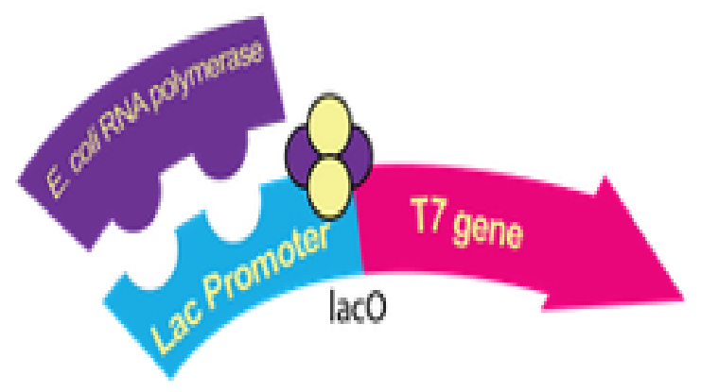
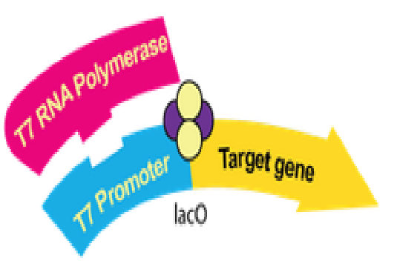
DE3 Sequence Element – Chromosomal: Synthesis of T7 RNA polymerase under lac control
E. Coli RNAP
AAATTGACAxxxxxxxxxxxxxxxxTATAATGGGGAATTGTGAGCGGATAACAATTCC….AAGGAGATATACATATG..T7 RNA Poly…
|-35 -E.coli Lac Promoter -10 | |-------Lac operator-------------------| RBS
T7 – Plasmid: Synthesis of the target protein by T7 RNA polymerase. Usually under lac control
T7 RNAP
AAATTAATACGACTCACTATAGGGGAATTGTGAGCGGATAACAATTCC….AAGGAGATATACATATG..HIV Prot…
|---T7 promoter--------| |-------Lac operator-------------------| RBS

Slide 30
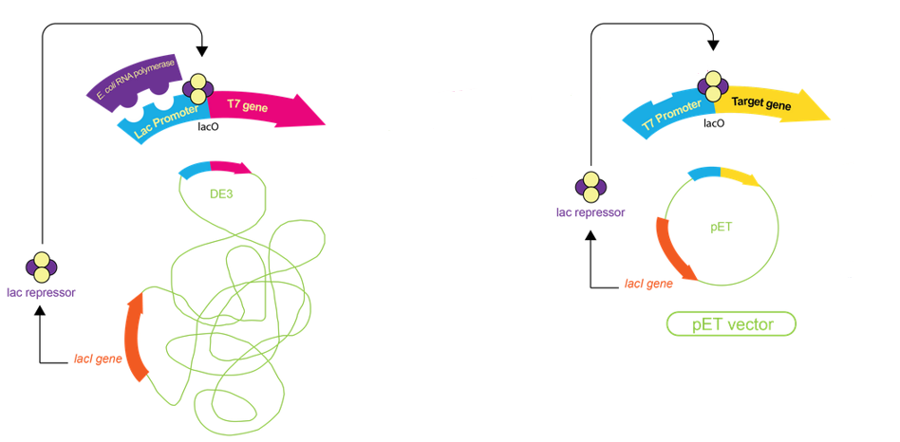
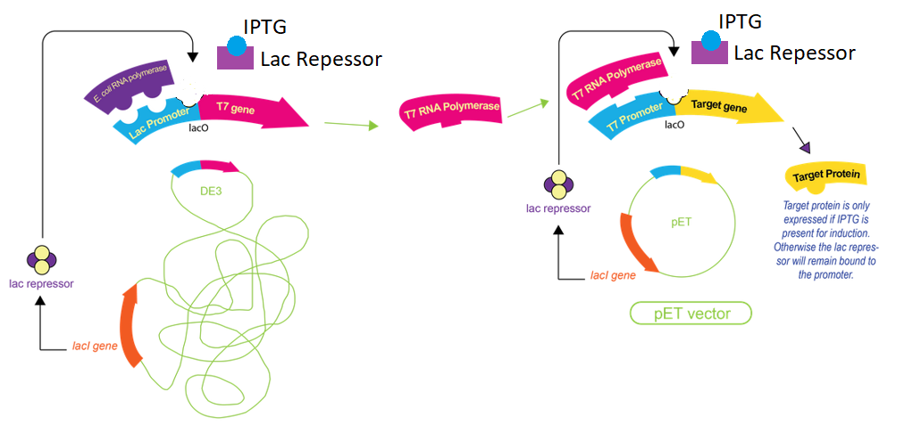
No Inducer
T7 RNA Pol is not made – its transcription is blocked by lac repressor
No expression of gene on the plasmid since its promotor is a T7 promoter and there is no polymerase.
Lac repressor
Lac I gene
With Inducer (IPTG or Lactose)
Lac repressor binds IPTG, dissociates from its operator, on both the chromosome & the plasmid.
E. Coli RNA polymerase makes mRNA for T7 RNA polymerase, producing T7 RNAP
T7 RNAP will generate a mRNA of the gene on the plasmid, producing the target protein.
1
3
2

Slide 31
Regulation of T7 Transcription by Lac Repressor
Events on Chromosome
1
2
Addition of IPTG causes:
Production of mRNA for T7 RNA polymerase from the chromosome.
Translation of mRNA to produce T7 RNA polymerase.
T7 RNA polymerase produces mRNA from gene on the plasmid.
mRNA is translated to final target protein.
Events on Plasmid
3
4

