Slide 1
Lecture 5b Drugs & Genome Editing
Drugs that inhibit key processes
How do you edit the genome of an organism

Slide 2
Antibiotics That Inhibit Prokaryotic Translation

Slide 3
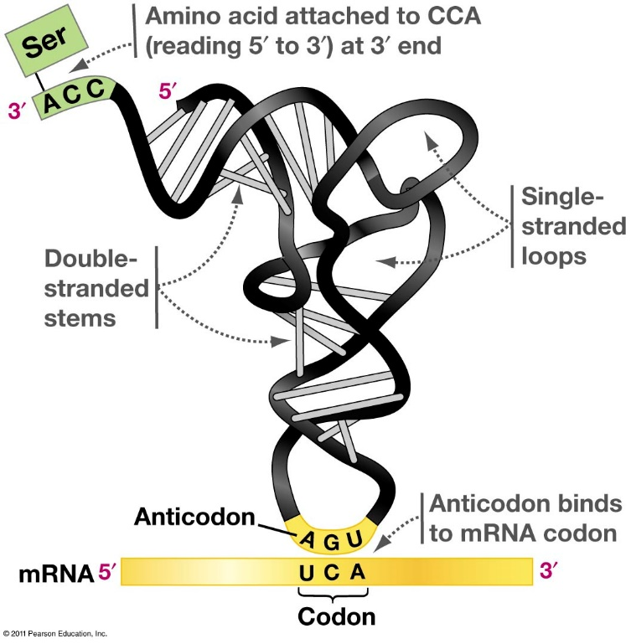
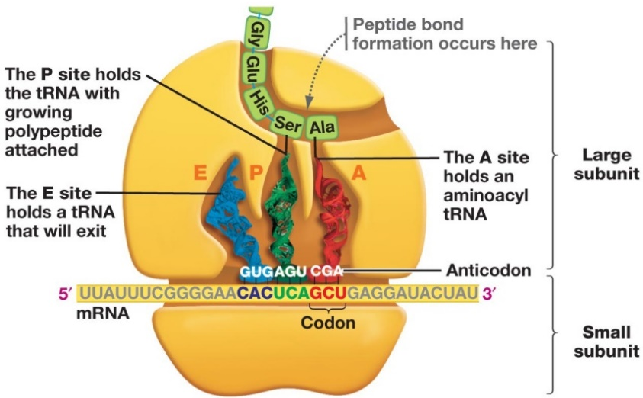
Protein Synthesis – tRNA & Ribosomes
tRNAs
The adapter molecules are called transfer RNAs or tRNAs.
Contain a CCA sequence at 3’ end where the amino acid is attached
a triplet anticodon to form base pairs with the appropriate mRNA codon
Role of different Ribosomal subunits
30S (Small) – RBS & mRNA codon/anticodon
50S (Large) – Peptide bond synthesis
Exit tunnel – new protein emerges
tRNA sites:
A – aminoacyl – next tRNA-AA binds
P – 1st tRNA-Met & growing peptide
E – empty tRNA leave from here
Initiation:
1. mRNA binds to 30S
2. fMet-tRNA binds to P site
3. 50s binds to complete initiation complex
Elongation:
1. New AA-tRNA in A site
2. Peptide bond formation (amino acid in A site added to C-term of peptide in P site)
3. Translocation (tRNA-peptide moves to P site)
4. tRNA exits
Termination:
1. Stop codon at A site
2. Termination factor (protein) adds water to cleave peptide from last tRNA

Slide 4
Antibiotics that Inhibit Protein Synthesis
6. Erythromycin (macrolide, blocks exit tunnel)
4. Chloramphenicol (peptide bond formation)
2. Tetracycline
(binding of charged tRNA)
5. Viomycin
(blocks translocation)
3. Kanamycin (Aminoglycoside)
(codon/anticodon pairing – wrong amino acid gets added)
1. Linezolid (blocks 70s formation from two subunits)
Notes:
Linezolid – blocks formation of 70S – binds to 50S subunit, cannot initiate
Tetracycline – blocks binding of charged tRNA to A site, cannot add amino acids
Kanamycin – binds to 30S, affects mRNA-tRNA pairing causing codon misreading
Chloramphenicol – binds to the peptidyl transferase site, preventing peptide bond formation
Viomycin – blocks translation of the ribosome
Erythromycin – blocks exit tunnel
https://jamboard.google.com/d/1bnzal_X5sQQ-QqV4x8sAt95icyQEHVq8RLEHWQBEfaw/edit?usp=sharing

Slide 5
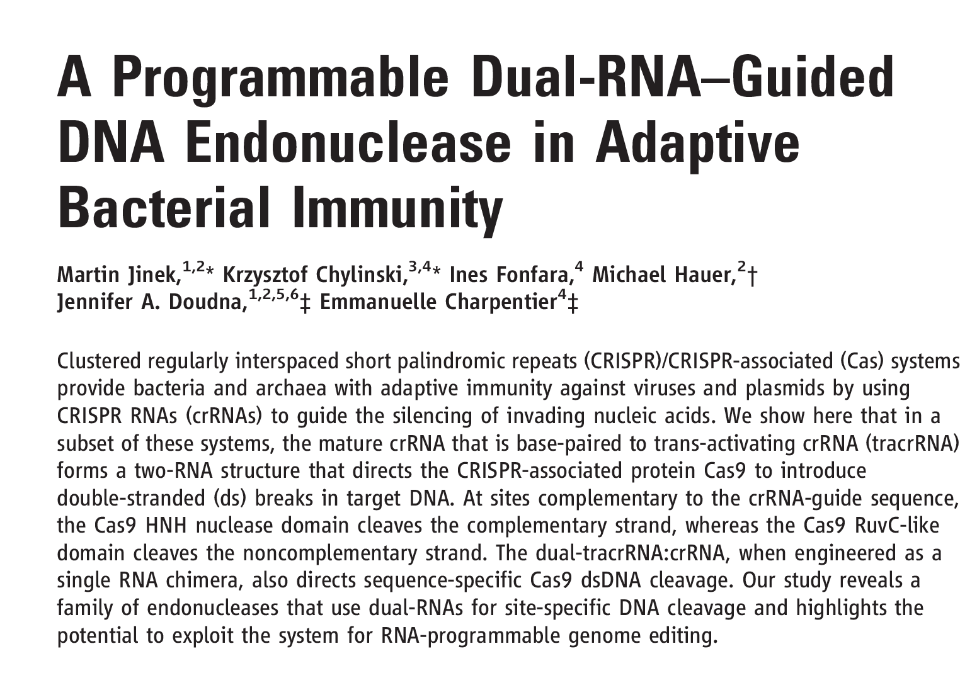
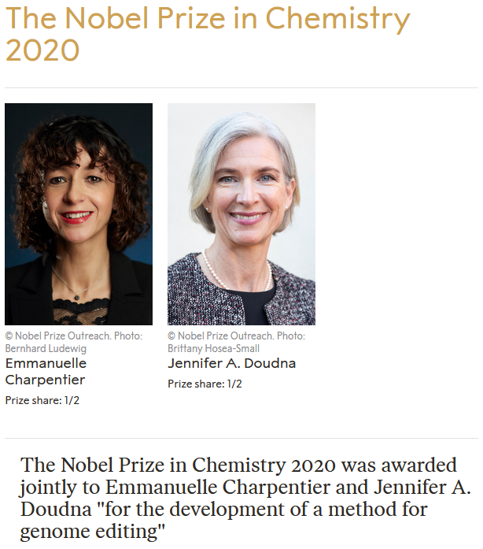
Genome Editing – CRISPR Cas9

Slide 6
Key Concepts in Genome Editing
Repair of a targeted double strand break = modification of the genome at a defined location.
A B C D E F G
Genomic DNA (A, B, C, D, E, F, G represent short sequences)
Genomic DNA with double stranded break
Nuclease (sequence specific)
Original Sequence
--ATG......GGGTGGCCGATT...CGATAA—
--Met......GlyTrpProIle...Arg
Non-Homologous End Joining
(NHEJ)
Deletion of one base
Repair Method I: Addition or deletion of bases
--ATG......GGGTGCCGATT...CGATAA—
--Met......GlyCysArgLeu.ArgIle...
A B C E F G
Indels:
+/- 3n = addition or loss of amino acids
+/- 1 or 2 bases = Frame shift. changes the amino acid sequence after the indel. The ribosome considers three bases (codon) relative to the start codon.
Deletion
together called “Indels”
A B C D X Y Z E F G
Insertion
A B C D E F G
Restoration (undetected)

Slide 7
Key Concepts in Genome Editing
Repair method II – replacement of a segment of DNA
Cut site
A B C D E F G
Original Sequence
Genomic DNA
-AATGCGATGCAAAGGCTGATGGGTACCTAGATGCC-
-TTACGCTACGTTTCCGACTACCCATGGATCTACGG-
Nuclease
C
D
E
Genomic DNA with double stranded break
Template sequence
Template
C Z E
Homology-Directed Repair
(HDR)
GCGATGCAAATTTTTTTCCTAGAT
CGCTACGTTTAAAAAAAGGATCTA
C
Z
E
Template
C
Z
E
G-DNA
w/DS
break
Final Sequence
A B C Z E F G
Genomic DNA with staggered nicks (rapidly ligated)
-AATGCGATGCAAATTTTTTTCCTAGATGCC-
-TTACGCTACGTTTAAAAAAAGGATCTACGG-

Slide 8
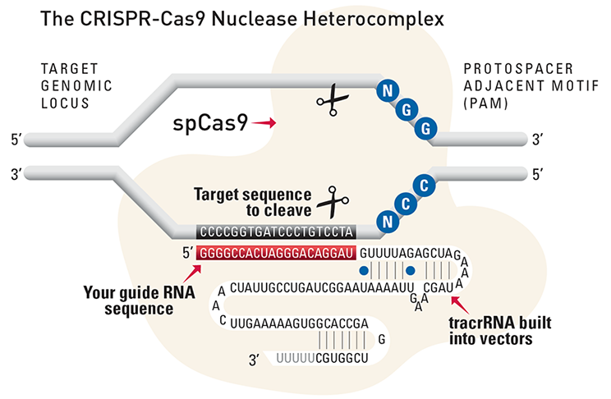
How to Cut at a Defined Location - Cas9 + Guide RNA
Cas9-RNA complex
Cas9 – nuclease that cuts DNA after activation
Guide RNA:
5’ end complementary to target sequence
3’ end required for Cas9 activity (tracrRNA)
Double stranded break
(3 bases from PAM)
Step 1. Cas9 Binds to PAM, then checks if RNA is complimentary to DNA sequence 5’ to PAM.
Step 2. After PAM recognition by Cas9, guide RNA unwinds DNA, by pairing with one DNA strand.
Step 3. Cas9 cleaves both strands near site, generating a double strand break.
Step 4. Double stranded break triggers DNA repair, using injected replacement DNA for homologous repair

Slide 9
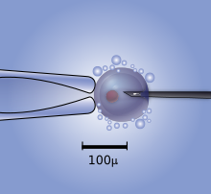
Altering the Genome Sequence with Cas9-CRISPR
Components to microinject:
1. Cas9 enzyme (nuclease)
2. Guide RNA, specific for site of cleavage, bound to the Cas9 protein
3. Copy of replacement DNA sequence (dsDNA)
1. Guide RNA directs Cas9 to desired site, by pairing with one DNA strand.
2. CRISPR cleaves both strands near site, generating a double strand break.
3. Double stranded break triggers DNA repair, using injected replacement DNA for homologous repair
(Video originally from Nature)
Also view:
https://wyss.harvard.edu/media-post/gene-editing-mechanism-of-crispr-cas9/

Slide 10
Using CRISPR-Cas9 to Correct Genetic Diseases
Human growth hormone (hGH)
Pituitary Dwarfism
Components to microinject:
1. Cas9 enzyme (nuclease)
2. Guide RNA, specific for site of cleavage, bound to the Cas9 protein
3. Copy of replacement DNA sequence (dsDNA)
Between one in 14,000 and one in 27,000 babies born each year have some form of dwarfism.
1860 William Harrison and Charles Stratton - comedians and performers.
Notes:
Pituitary gland produces several important biomolecules including protein that stimulates growth, just 191 amino acids long called HGH and coded for by GH1. By studying the pedigrees of families in which dwarfism was common, they determined it was an autosomal recessive trait. Grow more slowly reach puberty 2-10 years later than average. 1860 Willian Harrison and Charles Stratton comedians and performers.

Slide 11
CRISPR Repair of Grown Hormone Gene
Human growth hormone gene
>M13438.1:497-2129 Human growth hormone gene (HGH-N), complete cds
AGGATCCCAAGGCCCAACTCCCCGAACCACTCAGGGTCCTGTGGACAGCTCACCTAGCTGCAATGGCTAC 70 AGGTAAGCGCCCCTAAAATCCCTTTGGCACAATGTGTCCTGAGGGGAGAGGCAGCGACCTGTAGATGGGA 140 CGGGGGCACTAACCCTCAGGGTTTGGGGTTCTGAATGTGAGTATCGCCATCTAAGCCCAGTATTTGGCCA 210
ATCTCAGAAAGCTCCTGGCTCCCTGGAGGATGGAGAGAGAAAAACAAACAGCTCCTGGAGCAGGGAGAGT 280 GTTGGCCTCTTGCTCTCCGGCTCCCTCTGTTGCCCTCTGGTTTCTCCCCAGGCTCCCGGACGTCCCTGCT 350
CCTGGCTTTTGGCCTGCTCTGCCTGCCCTGGCTTCAAGAGGGCAGTGCCTTCCCAACCATTCCCTTATCC 420 AGGCTTTTTGACAACGCTATGCTCCGCGCCCATCGTCTGCACCAGCTGGCCTTTGACACCTACCAGGAGT 490 TTGTAAGCTCTTGGGGAATGGGTGCGCATCAGGGGTGGCAGGAAGGGGTGACTTTCCCCCGCTGGAAATA 560 AGAGGAGGAGACTAAGGAGCTCAGGGTTTTTCCCGACCGCGAAAATGCAGGCAGATGAGCACACGCTGAG 630 CTAGGTTCCCAGAAAAGTAAAATGGGAGCAGGTCTCAGCTCAGACCTTGGTGGGCGGTCCTTCTCCTAGG 700 AAGAAGCCTATATCCCAAAGGAACAGAAGTATTCATTCCTGCAGAACCCCCAGACCTCCCTCTGTTTCTC 770 AGAGTCTATTCCGACACCCTCCAACAGGGAGGAAACACAACAGAAATCCGTGAGTGGATGCCTTCTCCCC 840 AGGCGGGGATGGGGGAGACCTGTAGTCAGAGCCCCCGGGCAGCACAGCCAATGCCCGTCCTTGCCCCTGC 910 AGAACCTAGAGCTGCTCCGCATCTCCCTGCTGCTCATCCAGTCGTGGCTGGAGCCCGTGCAGTTCCTCAG 980 GAGTGTCTTCGCCAACAGCCTGGTGTACGGCGCCTCTGACAGCAACGTCTATGACCTCCTAAAGGACCTA 1050 GAGGAAGGCATCCAAACGCTGATGGGGGTGAGGGTGGCGCCAGGGGTCCCCAATCCTGGAGCCCCACTGA 1120 CTTTGAGAGACTGTGTTAGAGAAACACTGGCTGCCCTCTTTTTAGCAGTCAGGCCCTGACCCAAGAGAAC 1190 TCACCTTATTCTTCATTTCCCCTCGTGAATCCTCCAGGCCTTTCTCTACACTGAAGGGGAGGGAGGAAAA 1260 TGAATGAATGAGAAAGGGAGGGAACAGTACCCAAGCGCTTGGCCTCTCCTTCTCTTCCTTCACTTTGCAG 1340 AGGCTGGAAGATGGCAGCCCCCGGACTGGGCAGATCTTCAAGCAGACCTACAGCAAGTTCGACACAAACT 1410 CACACAACGATGACGCACTACTCAAGAACTACGGGCTGCTCTACTGCTTCAGGAAGGACATGGACAAGGT 1480 CGAGACATTCCTGCGCATCGTGCAGTGCCGCTCTGTGGAGGGCAGCTGTGGCTTCTAGCTGCCCGGGTGG 1550 CATCCCTGTGACCCCTCCCCAGTGCCTCTCCTGGCCCTGGAAGTTGCCACTCCAGTGCCCACCAGCCTTG 1620 TCCTAATAAAATTAAGTTGCATCATT
The cut site needs to be close to site of mutation so that the injected dsDNA repair template can be as short as possible.
A NGG (PAM site) is needed for Cas9 to bind.
There are four possible PAM sites in the DNA sequence on the bottom left. The PAM site closest to the mutation was selected so that the cut site is close to mutation site.
Possible PAM Sites
Location of mutation
Isoleucine (I) to Asparagine (N)
Wild type (normal)
R L E D G S P R T G Q I F K Q T Y S
-CTTTGCAGAGGCTGGAAGATGGCAGCCCCCGGACTGGGCAGATCTTCAAGCAGACCTACAGCAA-
-GAAACGTCTCCGACCTTCTACCGTCGGGGGCCTGACCCGTCTAGAAGTTCGTCTGGATGTCGTT-
Mutant (growth hormone non-functional)
R L E D G S P R T G Q N F K Q T Y S
-CTTTGCAGAGGCTGGAAGATGGCAGCCCCCGGACTGGGCAGAACTTCAAGCAGACCTACAGCAA-
-GAAACGTCTCCGACCTTCTACCGTCGGGGGCCTGACCCGTCTTGAAGTTCGTCTGGATGTCGTT-

Slide 12
CRISPR Repair of Grown Hormone Gene
The PAM site closest to the mutation was selected so that the cut site is close to mutation site.
The targeting section of the guide RNA should have the same sequence as 5’ to the XGG, 18 bases are required:
5’AGAUGGCAGCCCCCGGAC---------- plus additional RNA needed for Cas9 function
This RNA would cause cleavage of both the wild-type or mutant sequence since they are identical in this region. This is OK since the repair DNA will contain the wild-type sequence.
The site of Cas9 cleavage is between the PAM and the guide RNA sequence.
The injected DNA contains sequences on both sides of the ds break, causing the replacement of the sequences at the double stranded break due to repair.
Injected dsDNA for Homologous Repair
CTTTGCAGAGGCTGGAAGATGGCAGCCCCCGGACTGGGCAGATCTTCAAGCAGACCTACAG
GAAACGTCTCCGACCTTCTACCGTCGGGGGCCTGACCCGTCTAGAAGTTCGTCTGGATGTC
Possible PAM Sites
homology regions required for repair
DNA cuts by cas9
Wild type (normal)
R L E D G S P R T G Q I F K Q T Y S
-CTTTGCAGAGGCTGGAAGATGGCAGCCCCCGGACTGGGCAGATCTTCAAGCAGACCTACAGCAA-
-GAAACGTCTCCGACCTTCTACCGTCGGGGGCCTGACCCGTCTAGAAGTTCGTCTGGATGTCGTT-
Mutant (growth hormone non-functional)
R L E D G S P R T G Q N F K Q T Y S
-CTTTGCAGAGGCTGGAAGATGGCAGCCCCCGGACTGGGCAGAACTTCAAGCAGACCTACAGCAA-
-GAAACGTCTCCGACCTTCTACCGTCGGGGGCCTGACCCGTCTTGAAGTTCGTCTGGATGTCGTT-
Note that Cas9 will cut both the wild-type and the mutant, but repair will insert the wild-type sequence.

Slide 13
Mutant (growth hormone non-functional)
-AGGCTGGAAGATGGCAGCCCCCGGACTGGGCAGAACTTCAAGCAGACCTACAGCAA-
-TCCGACCTTCTACCGTCGGGGGCCTGACCCGTCTTGAAGTTCGTCTGGATGTCGTT-
1
AGATGGCAGCCCCCGGAC
guide RNA
Cas9
2
Editing Steps:
Cas9 binds to NGG (PAM)
Opens DNA if RNA is complementary to DNA
Cas9 cuts both strands
Double stranded break causes repair.
Injected template is used to repair, changing the DNA sequence between the two homologous regions.
AAGATGGCAGCCCCCGGACTGGGC
-AGGCTGG AGAACTTCAAGCAGACCTACAGCAA-
-TCCGACC TCTTGAAGTTCGTCTGGATGTCGTT-
TTCTACCGTCGGGGGCCTGACCCG
AGATGGCAGCCCCCGGAC
3
AAGATGGCAGCCCCCG GACTGGGC
-AGGCTGG AGAACTTCAAGCAGACCTACAGCAA-
-TCCGACC TCTTGAAGTTCGTCTGGATGTCGTT-
TTCTACCGTCGGGGGC CTGACCCG
AGATGGCAGCCCCCGGAC
4
-AGGCTGGAAGATGGCAGCCCCCG GACTGGGCAGAACTTCAAGCAGACCTACAGCAA-
-TCCGACCTTCTACCGTCGGGGGC CTGACCCGTCTTGAAGTTCGTCTGGATGTCGTT-
DNA Repair
GGCTGGAAGATGGCAGCCCCCGGACTGGGCAGATCTTCAAGCAGACCTACAG
CCGACCTTCTACCGTCGGGGGCCTGACCCGTCTAGAAGTTCGTCTGGATGTC
5
-AGGCTGGAAGATGGCAGCCCCCGGACTGGGCAGATCTTCAAGCAGACCTACAGCAA-
-TCCGACCTTCTACCGTCGGGGGCCTGACCCGTCTAGAAGTTCGTCTGGATGTCGTT-

