Slide 1
Lecture 5 Immunology & Drugs & Genome Editing
(and a little on PCR)
PCR
Immunotherapies
Drugs that inhibit key processes
How do you edit the genome of an organism

Slide 2
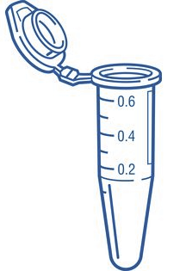
Polymerase Chain Reaction
PCR is an in vitro DNA synthesis reaction in which a specific section of DNA is replicated over and over generating exponentially large amounts of a specific piece of DNA from trace amounts of starting material (template).
Template can be trace amounts of DNA from a drop of blood, a single hair follicle, or a cheek cell.
The region of DNA that is copied is specified by the sequence of two primers, which are short ssDNA that initiate polymerase activity. The primers are in vast excess over the DNA.
The location of the amplified segment is defined by two primers (left = upstream, right = downstream):
they anneal to their templates according to Watson-Crick pairing rules (A-T, G-C),
initiate polymerization from those sites,
they are incorporated into the final PCR product.
Left primer = sequence of top strand at left boundary
Right primer = sequence of bottom strand at right boundary
The primers are DNA and are synthesized chemically, they can be any desired sequence.
If there is no homology between the primers and the input DNA, then no PCR product will be formed.
Each PCR cycle consists of three steps:
Denaturation of the DNA to make it single stranded (2 min at 98 C)
Lowering of temperature to let the primers form double-stranded DNA (1 min at 55 C)
Elongation by DNA polymerase (1 min/kb at 78 C)

Slide 3
PCR Applications – Identification of Individuals
Regions of DNA have variable numbers of repeated DNA sequences (Short tandem repeats, STR). The number of STR can differ from one person to the next and can change over time due to replication errors (repeat expansion disease).
STR
--TGCCGACTCGTAGGCCAGGCCAGGCCAGGCCACTGGTGAGGTACG--
--ACGGCTGAGCATCCGGTCCGGTCCGGTCCGGTGACCACTCCATGC--
5’-CCGACTC
Individuals will inherit one copy of the repeat from each parent. The length of the inherited DNA can be the same or different, depending on the number of repeats in each parent.
PCR Primers are designed to be outside the repeated region, so that they will anneal to a single location on the chromosome and then amplify the region containing the STR
PCR Product length = primer lengths + number of tandem repeats (+ any DNA between the primers and the repeats). Individuals can be differentiated by the length of the PCR product if they have different numbers of STR
CTCCATG-5’
CCGACTCGTAGGCCAGGCCAGGCCAGGCCACTGGTGAGGTAC
GGCTGAGCATCCGGTCCGGTCCGGTCCGGTGACCACTCCATG
Which individual has the shortest PCR product?
Which has the longest?

Slide 4
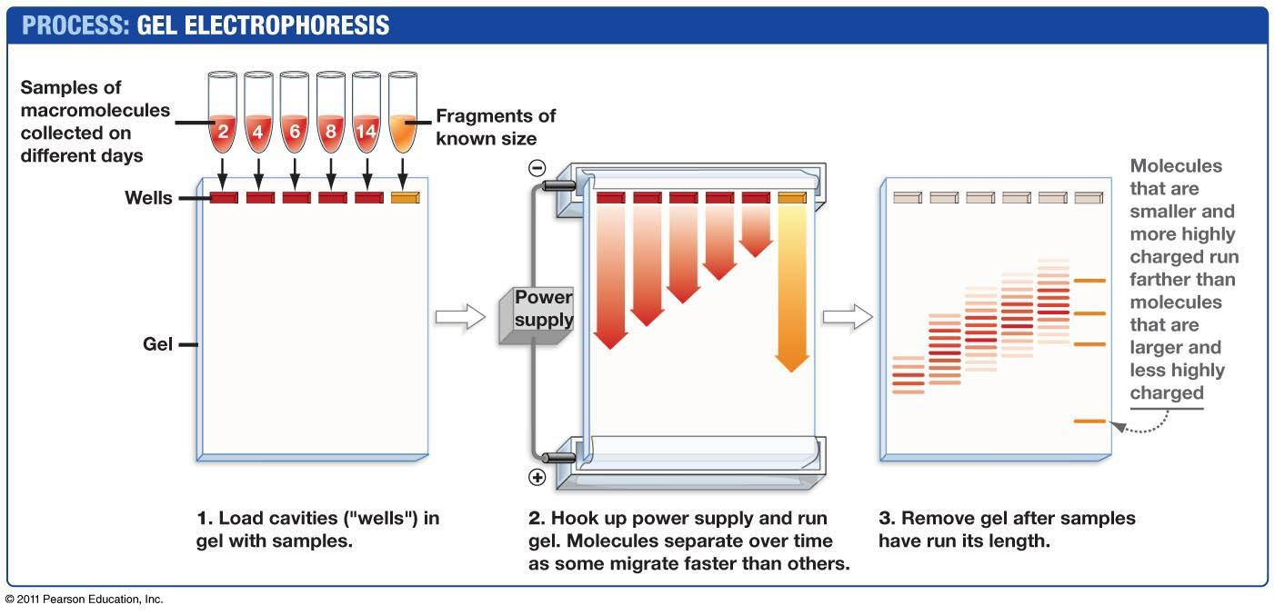
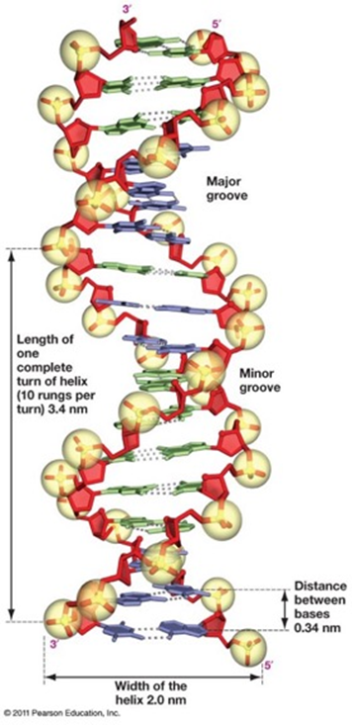
Size Determination of PCR products - Agarose Gel Electrophoresis.
https://dnalc.cshl.edu/resources/animations/gelelectrophoresis.html
Which are the smallest PCR fragments?

Slide 5
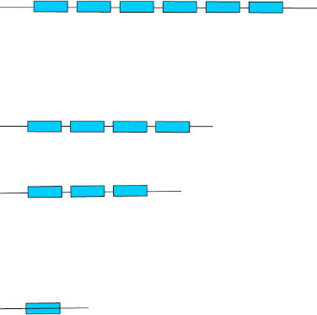
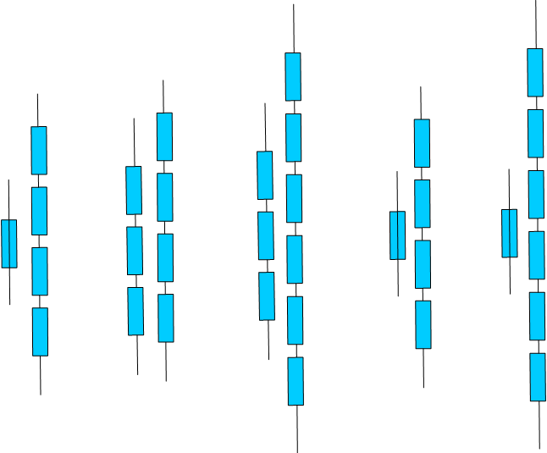
Short Tandem Repeats to Test Paternity
1. DNA samples (blood, cheek cells) would be obtained from:
Mother
Child
Candidate fathers.
2. PCR would be preformed using primers that amplify a segment of the chromosome containing repeats.
3. Each individual would show 2 bands on the gel, corresponding to the PCR product from each chromosome (we have two copies of each chromosome).
4. The child would inherit one copy from the mother and the other from the father:
One of the child’s PCR product would match one of the mothers.
The other PCR product from the child would match one of the PCR products from the father.
Top
PCR products
PCR primers:
Gel
Repeat:
Lane 1: Child
Lane 2: Mother
Lanes A, B, C: Possible Fathers
1 2 A B C
For the child, which PCR product is from the mother? From the father?
Who is not the father?
Who may be the father?
Child
Potential
Fathers

Slide 6
Introduction to Immunology
Branches of the immune system (Innate and acquired)
Properties of antibodies (Quaternary structure, antigen recognition)
How diverse antibodies are produced:
Genome DNA changes
4. How antibodies eliminate pathogens
Key Questions:
1. Why is the innate system important?
2. What is the origin of diversity in acquired immunity?

Slide 7
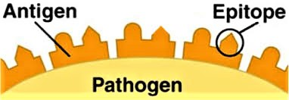
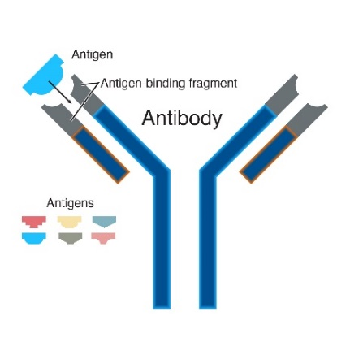
Some Important Definitions:
Antigen = something that is recognized by the immune system, e.g. bacteria, virus, pollen.
Epitope = the part of the antigen that is contacted by the antibody.
Antibody (Ab) = Y-shaped protein that recognizes antigens, found on the surface of B-cells or secreted by plasma cells. When bound to antigen, it can initiate a process that results in the destruction of the antigen. Specificity is high due to AA sequence in the variable segments.
Immunoglobulin (Ig) = antibody.
B-cell = involved in antibody production and recognition of pathogen. Has antibody molecule on its surface (as part of the B-cell receptor). Develops into plasma cells after activation by T_{H} cells. Called B-cells because they are generated in the organ called the Bursa in birds.
Plasma cell = derived from B-cell after activation of the B-cell, produces secreted antibodies with the same specificity as the original B-cell.
T_{H} cell = T-helper: Required to activate both B and T_{C} cells, as well as other cells in the immune system.
Called T-cells because they mature in the thymus.
T_{c} cell = T-cellular: Involved in defense against viruses and cancer.
TCR = T-cell receptor – found on the surface of T-cells, recognizes MHC proteins + bound peptide, RTK.
T_{c} cell = recognizes MHC I + peptide
T_{H} cell = recognizes MHC II + peptide
MHC = major histocompatibility complex – required for acquired immunity (basis of transplant rejection)
MHC I = protein found on the surface of all cells, “presents” peptides derived from the proteins that were made by the cell. The MHC-peptide complex is recognized by T_{c} cells. Only foreign peptides produce a response.
MHC II = on the surface of B-cells, macrophages, and dendritic cells. Presents external peptides to T_{H} cells, leading to activation of the cell by T_{H} cells. Only foreign peptides produce a response.

Slide 8
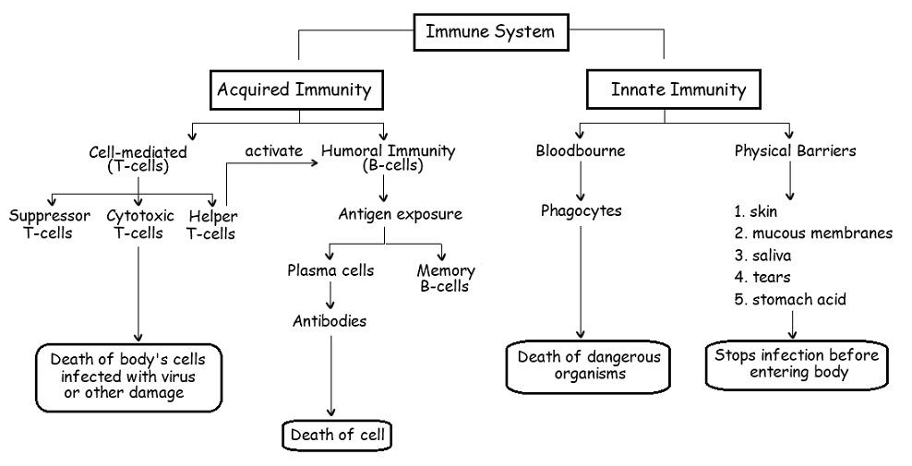
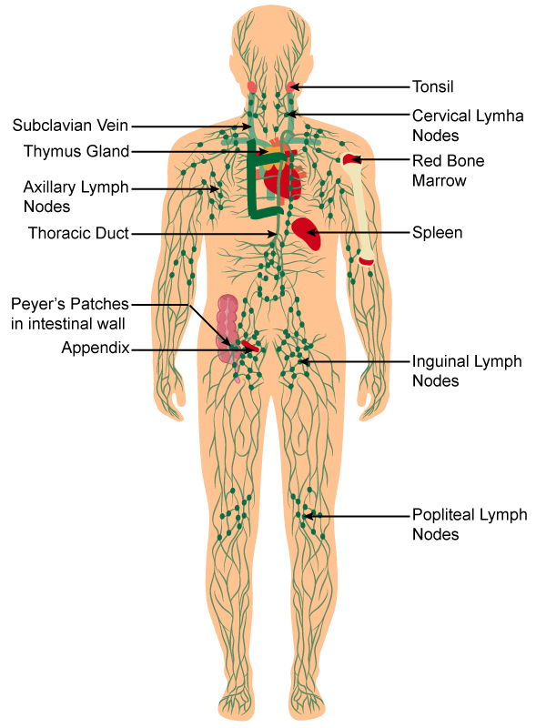
Branches of the Immune System
http://ibbiologyhelp.com/AnimalPhysiology/antibodyproduction.html
Neutrophil
Macrophage
Dendritic cell
Why is the innate system essential?
A pathogen doubles every hour.
It takes 7 days to produce antibody (after 1st exposure)
Uncontrolled growth would produce many bacteria: 2 ^{24 x 7} = 3.7 x 10⁵⁰ (~10³⁰ kg)
Important primary lymphatic organs: bone marrow (B), thymus (T)-Generate all immune cell.
Important secondary lymphatic organs: lymph nodes, spleen, Peyer’s patches – Activation of immune cells.
https://www.topperlearning.com/
Notes:
3.7 e 50 cells

Slide 9
B-Cell Biology - From Stem Cells to Pathogen Killing.
1. Generation of high diversity of chains during development of stem cells to B-cells in bone marrow.
DNA rearrangements to generate functional exons for variable segments of both light and heavy chain.
2. Molecular & cellular biology of membrane bound antibodies on cell surface = B-cell receptor (BCR)
Transcriptional enhancers, mRNA splicing
Light chain and heavy chain exported to surface of B-cells.
3. Self tolerance test to prevent autoimmune diseases, autoreactive B-cells eliminated.
4. Encounter and capture of antigen in lymph nodes
5. Activation of B-cells by T_{H} cells
Peptides from pathogen presented (displayed) on major histocompatibility proteins (MHC II).
T-cell activation by tyrosine kinase receptors (T-cell Receptor, TCR), secretion of signaling molecules.
6. Development of
Plasma cells - Production of soluble antibodies of the same specificity as the parent B-cell.
B-memory cells (basis of immunity)
T-memory cells (basis of immunity)
7. Destruction of Pathogens
Fc region of antibody binds to Fc Receptor on NK cells, neutrophiles, macrophages
Pathogen internalized and destroyed.
BCR – B-cell receptor = antibody + signaling chains.
TCR – T cell receptor = MHC-peptide recognition + signaling.

Slide 10
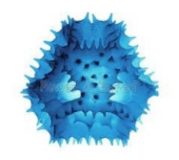
Antibody Structure and Diversity
Each Antibody:
Two identical light chains
Two identical heavy chains
First ~100 Amino acids on each chain are called the variable region and differ from antibody to antibody.
Unique sequence for variable region of both heavy and light chains – defines specificity – different antibodies bind different antigens.
Constant regions - same protein sequence for all.
Light chain sequences:
M..TSERTQYESTTY..RGEC
M..AAFQRTYESTTY..RGEC
1.....110.........210
Coded by different exons
(one letter AA code)
Heavy chain sequences:
M...AGLLITWHIKLPA...SPGK
M...FPREYAWHIKLPA...SPGK
1......120...........449
Coded by different exons

Slide 11
Production of Antibodies by B-cells & Plasma Cells
B- Cells & B-cell Receptor (BCR)
Each B-cell has only one type of antibody as part of its BCR (B-cell receptor), i.e. the 10⁵ BCRs are homogeneous on the same cell.
Approximately 10⁸ different specificities at any one time. i.e. 10⁸ different B-cells!
Plasma Cells:
After activation, a B-cell develops into a plasma cell.
The antibody is secreted.
The same light chains are produced.
The heavy chains differ only in the absence of the transmembrane domains.
Antigen-
binding site
Heavy
chains
Antigen-
binding site
Antigen-
binding site
Heavy
chains
Antigen-
binding site
Light chain
Light chain
Light chain
Light chain
Disulfide bond
Disulfide bond
mRNA that codes for antibodies contains two types of sequences:
Exons – contain codons for the amino acids
Introns – removed before translation
Different exons are used to produce membrane bound or soluble antibodies.
RTK – Receptor tyrosine kinase – signaling domain.
Transmembrane domains

Slide 12
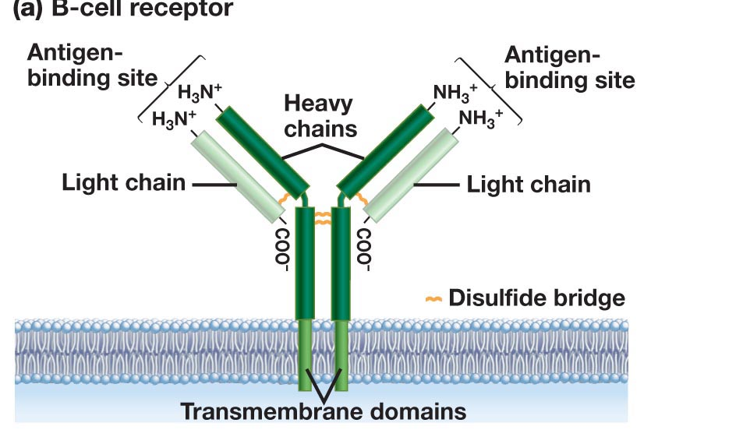
Antibody Production – From Stem Cells to B-Cells
Stem Cell
B-Cell
Rearranged light chain gene
Rearranged heavy chain gene
Transcription
mRNA Splicing (introns removed)
Translation
Export to cell surface (ER -> golgi -> Membrane)

Slide 13
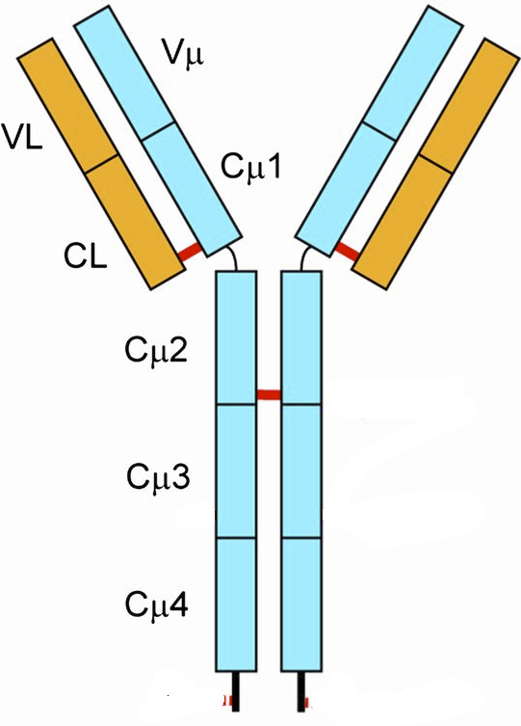
Antibody Genes are Assembled From DNA Segments: Giving Many Different Sequences.
Production of Heavy Chain Gene:
V_{H} exon = V+D+J segment (selected at random)
The mRNA coding for antibodies contains 5 exons.
Germline/Stem cell DNA
←300→
D-J joining
Random selection of D & J segments
L = leader (signal)
V = variable segment
D = diversity segment
J = joining segment
V joining to (DJ)
Random selection of V-segment
Heavy chains have different V-sequences.
B-cell DNA
V_{H} exon differs from one cell to the next.
Heavy chains have the same constant sequences in all B-cells.
Stem cells -> B-cells
The exon that codes for the variable region of the heavy chain is generated by the random joining of a V, D, and J DNA segments.
Each B-cell will generate a unique sequence for its heavy and light chain DNA.
This is a permanent change to the DNA (genome) of the B-cell.
1. If there are 300 possible V-heavy segments, 10 possible D segments, and 6 possible J segments, how many different heavy chains can be made?

Slide 14
Light-chain Genes are Assembled From DNA Segments: Giving many different sequences.
Production of Light Chain Gene
Germline/Stem cell DNA
←100→
B-cell DNA
Light chains have different V-sequences in different B-cells.
Light chains have the same constant sequences in all B-cells.
Antibody Diversity
1. If there are 100 possible V-heavy segments and 5 possible J segments, how many different light chains can be made?
Stem cells -> B-cells
In the case of the light chain, the variable region is generated by VJ joining.
Each B-cell will generate a unique sequence for its heavy and light chain DNA.
This is a permanent change to the DNA (genome) of the B-cell.
2. If any heavy chain that is generated can pair with any light chain that is generated, how many different antibodies can be generated (assuming there are 10,000 possible heavy chains and 500 different light chains) ?

Slide 15
Cell Based Acquired Immunology
Key Questions:
1. How does your immune system fight viruses?
2. How does your immune system detect and destroy cancer cells?
3. How can the immune response be engineered to fight cancer?
T_{C}
T_{CTL}
Activation of Tc cells requires:
Recognition of foreign peptide on MHC I.
Assistance from T-helper cells.
T_{C} Memory
Cell Types:
T_{H}
T_{C}, T_{CTL}
MHC = major histocompatibility complex
Membrane bound protein that “Presents” or displays peptides to T-cells:
MHC I – T_{C} cells
MHC II – T_{H} cells
A single MHC can present many different peptides (low specificity)
Peptide + MHC recognized by T-cell (T-cell receptor)
Responsible for transplantation rejection.
Activated Tc cell becomes a cytotoxic T-lymphocyte T_{CTL}
T_{CTL}
Kill virally infected cells
Kill cancer cells

Slide 16
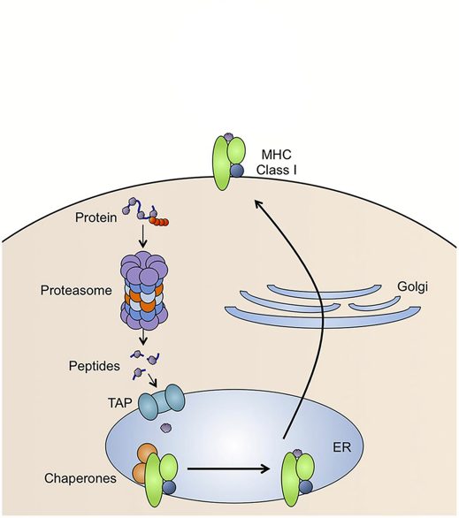
T_{c} Detection of Diseased/Cancer Cells - Role of MHC I
MHC I present peptides
Peptides are generated from of all of the proteins that are made in the cell, both self and foreign from pathogens.
Steps for Presentation
protein targeted for degradation by ubiquitin
Protein digested by proteasome
Peptides transported into endoplasmic reticulum (ER)
Peptides loaded on to MHC I
Peptide/MHC complex transported to cell membrane.
Only foreign peptides activate T-cells
Foreign Peptide Source:
1. From replication of viruses in the cell
2. New coding sequences in cancer cells due to genetic changes (e.g. mutations in p53 lead to novel sequences).
p53 Protein Sequence
Zn Fingers (DNA binding)
10 20 30 40 50 MEEPQSDPSV EPPLSQETFS DLWKLLPENN VLSPLPSQAM DDLMLSPDDI 60 70 80 90 100 EQWFTEDPGP DEAPRMPEAA PPVAPAPAAP TPAAPAPAPS WPLSSSVPSQ 110 120 130 140 150 KTYQGSYGFR LGFLHSGTAK SVTCTYSPAL NKMFCQLAKT CPVQLWVDST 160 170 180 190 200 PPPGTRVRAM AIYKQSQHMT EVVRRCPHHE RCSDSDGLAP PQHLIRVEGN 210 220 230 240 250 LRVEYLDDRN TFRHSVVVPY EPPEVGSDCT TIHYNYMCNS SCMGGMNRRP 260 270 280 290 300 ILTIITLEDS SGNLLGRNSF EVRVCACPGR DRRTEEENLR KKGEPHHELP 310 320 330 340 350 PGSTKRALPN NTSSSPQPKK KPLDGEYFTL QIRGRERFEM FRELNEALEL 360 370 380 390 KDAQAGKEPG GSRAHSSHLK SKKGQSTSRH KKLMFKTEGP DSD
1
5
2
3
4
EVVRRCPHHE Normal seq., ignored by TCR
EVVGGCPHHE Mutant seq. in cancer,
detected by TCR

Slide 17
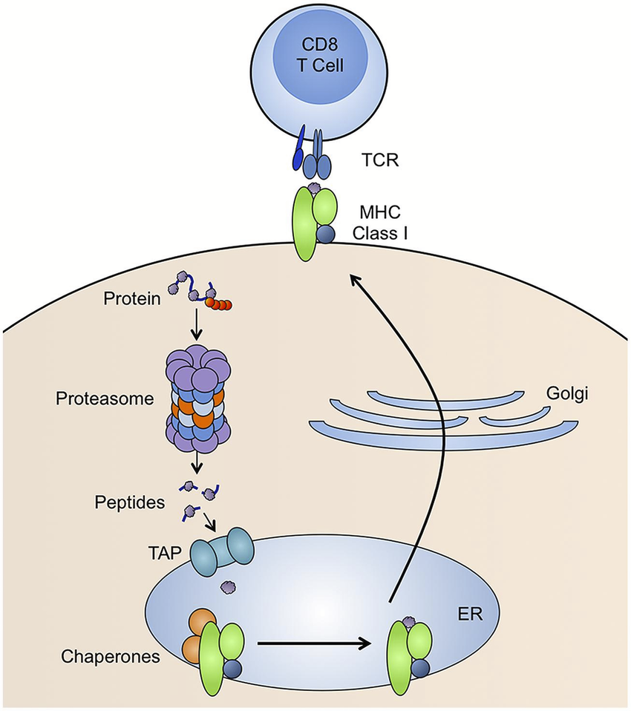
T_{c} Detection of Diseased/Cancer Cells

Slide 18
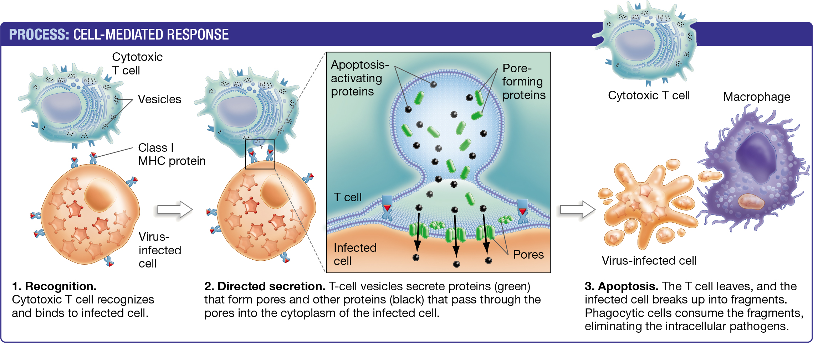
T_{C} Cells: Detection and Killing of Virally Infected or Cancer Cells
(T_{CTL})
Cancer cell or
Infected cell
Granzymes enter through perforin pore and cause cell undergo programmed cell death (apoptosis)

Slide 19
Cancer Evasion Mechanism - Loss of MHC I on Tumor Cell
Loss of MHC I expression means that T_{CTL} cells can no longer recognize and kill cancer cells because T-cell activation requires recognition of the MHC-peptide complex.
How to re-establish T_{C} contact with tumor cell and activation of the T-cell so that the cancer cell is killed?
Cancer
Cell

Slide 20
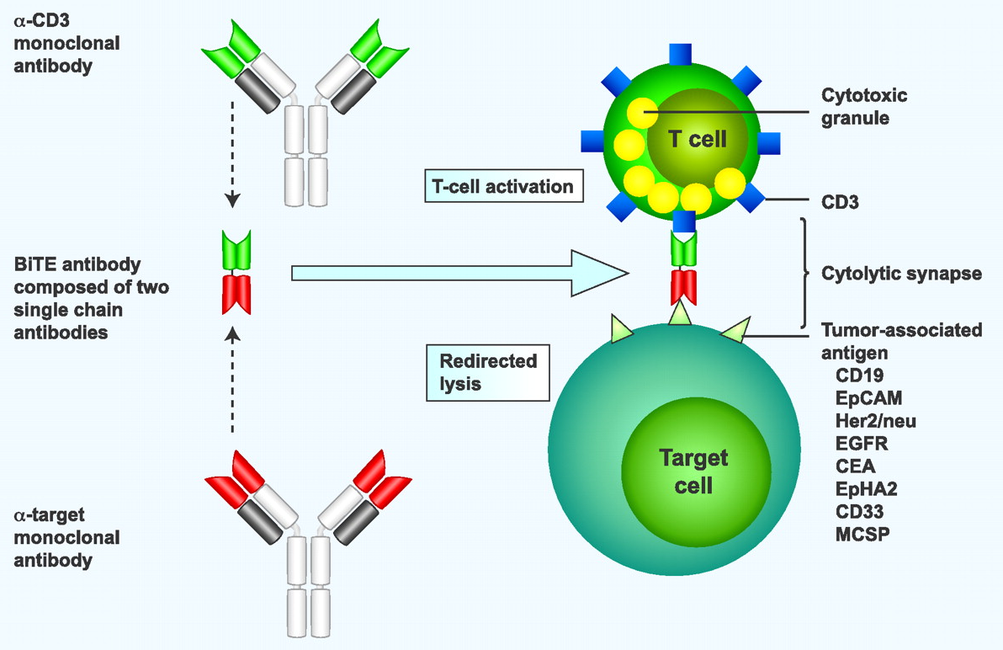
Cancer Treatment with Antibodies - Cancer Evasion - Loss of MHC I on Tumor Cell
Tumor-associated antigen: An antigen that is found only on tumor cells:
Up-regulation
Mutation
Cancer cell
Cancer
Cell
Bispecific antibodies are generated from two separate antibodies:
One recognizes CD3, which is part of the T-cell receptor (TCR)
Other recognizes a tumor antigen.
The two variable regions are linked into a single polypeptide chain by construction of a synthetic DNA molecule.
The dual binding event mimics the original MHC-I TCR interaction.

Slide 21
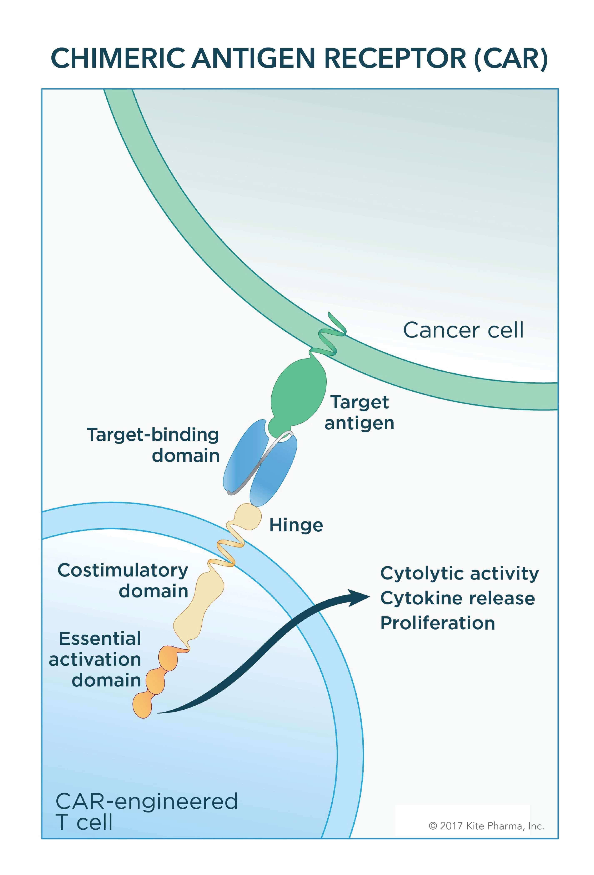
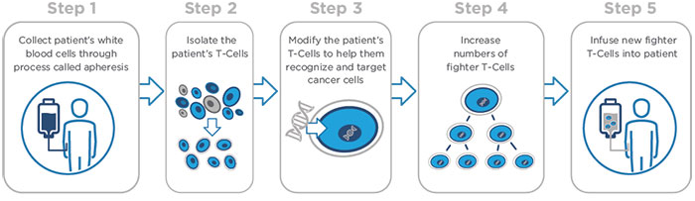
Chimeric Antigen Receptor T-cells = CAR T-Cells
Obtain antibodies against cancer antigen, isolate genes that code for light and heavy chains for those antibodies.
Fuse coding region for variable light and heavy domains to signaling on T-cells = CAR-T gene.
Heavy chain gene
Light chain gene
RTK gene
ATG……………….…………..TAA
ATG…………..TAA
ATG…………………..TAA
RTK – receptor tyrosine kinase
Signaling domain on T-cells
V_{H}
V_{L}
RTK
ATG……………….…………………………..TAA
Introduce gene for CAR-T cell into Patient
D. What happens when cancer cell is encountered by CarT cell?
Obtain white blood cells from patient
Isolate T-cells
Introduce DNA into T-cells
Obtain large amounts of T-cells by cell culture
Inject CAR-T cells into cancer patient.
Tumor cell

Slide 22
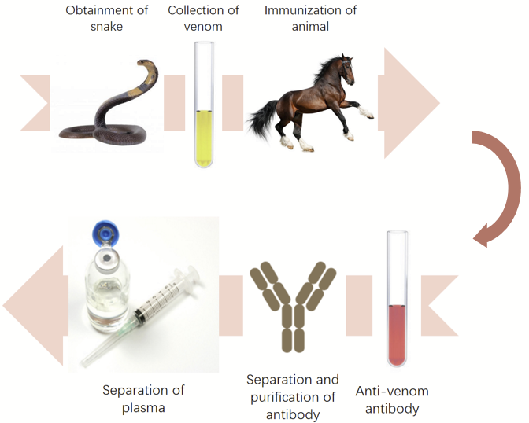
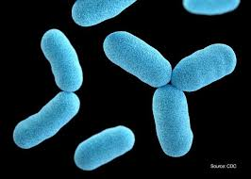
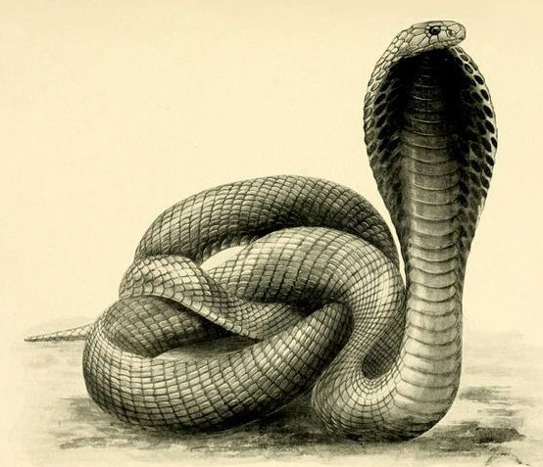
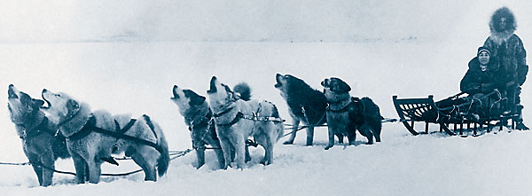
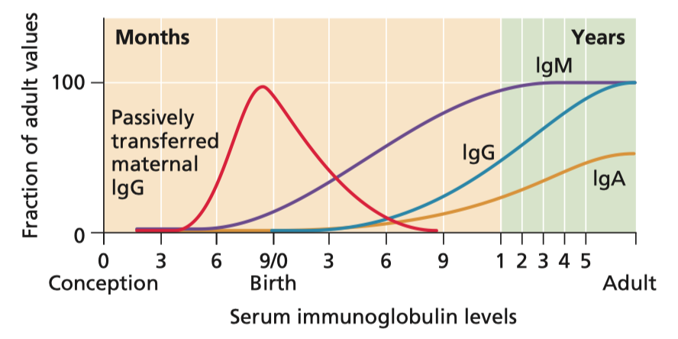
Vaccination
Diphtheria
Types of vaccines:
1. Passive (Ab injected)
2. Active (Antigen Provided)
Breast feeding provides IgA to the newborn.

Slide 23
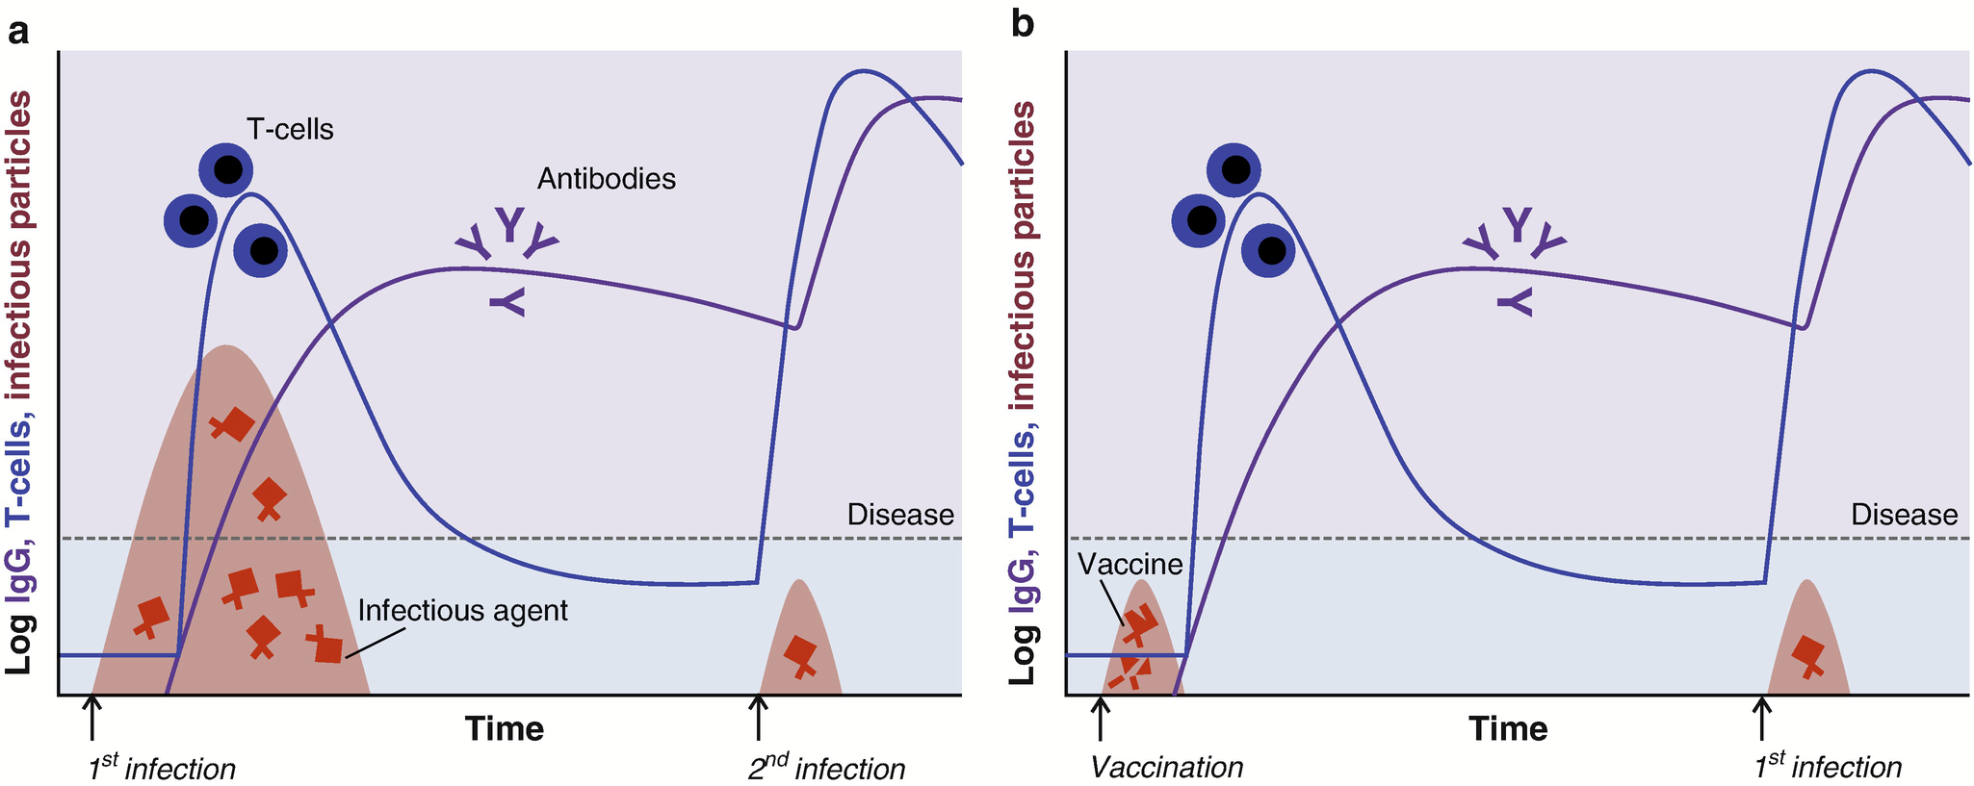
Primary and Secondary Response & Protection by Vaccines
Not Vaccinated
Vaccinated
Large number of pathogens during first (primary) infection causes disease symptoms
Antigen from pathogen prompts acquired immune response.
Generates long-lived memory cells.
More rapid & intense secondary response prevents extensive pathogen growth – no symptoms.
Vaccine: antigen induces primary response = memory B and T (T_{H} and T_{C}) cells specific for that antigen.
More rapid & intense secondary response prevents extensive pathogen growth – no symptoms.
Notes:
Jiskoot W., Kersten G.F.A., Mastrobattista E., Slütter B. (2019) Vaccines. In: Crommelin D., Sindelar R., Meibohm B. (eds) Pharmaceutical Biotechnology. Springer, Cham. https://doi.org/10.1007/978-3-030-00710-2_14

Slide 24
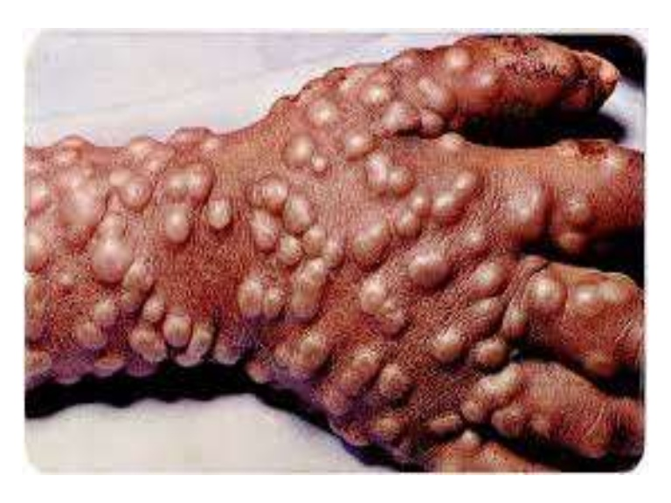
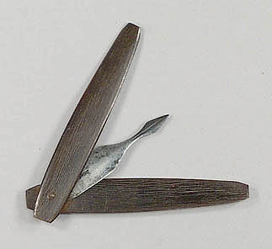
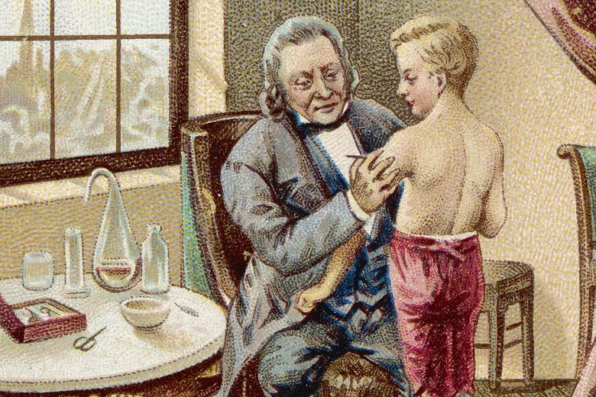
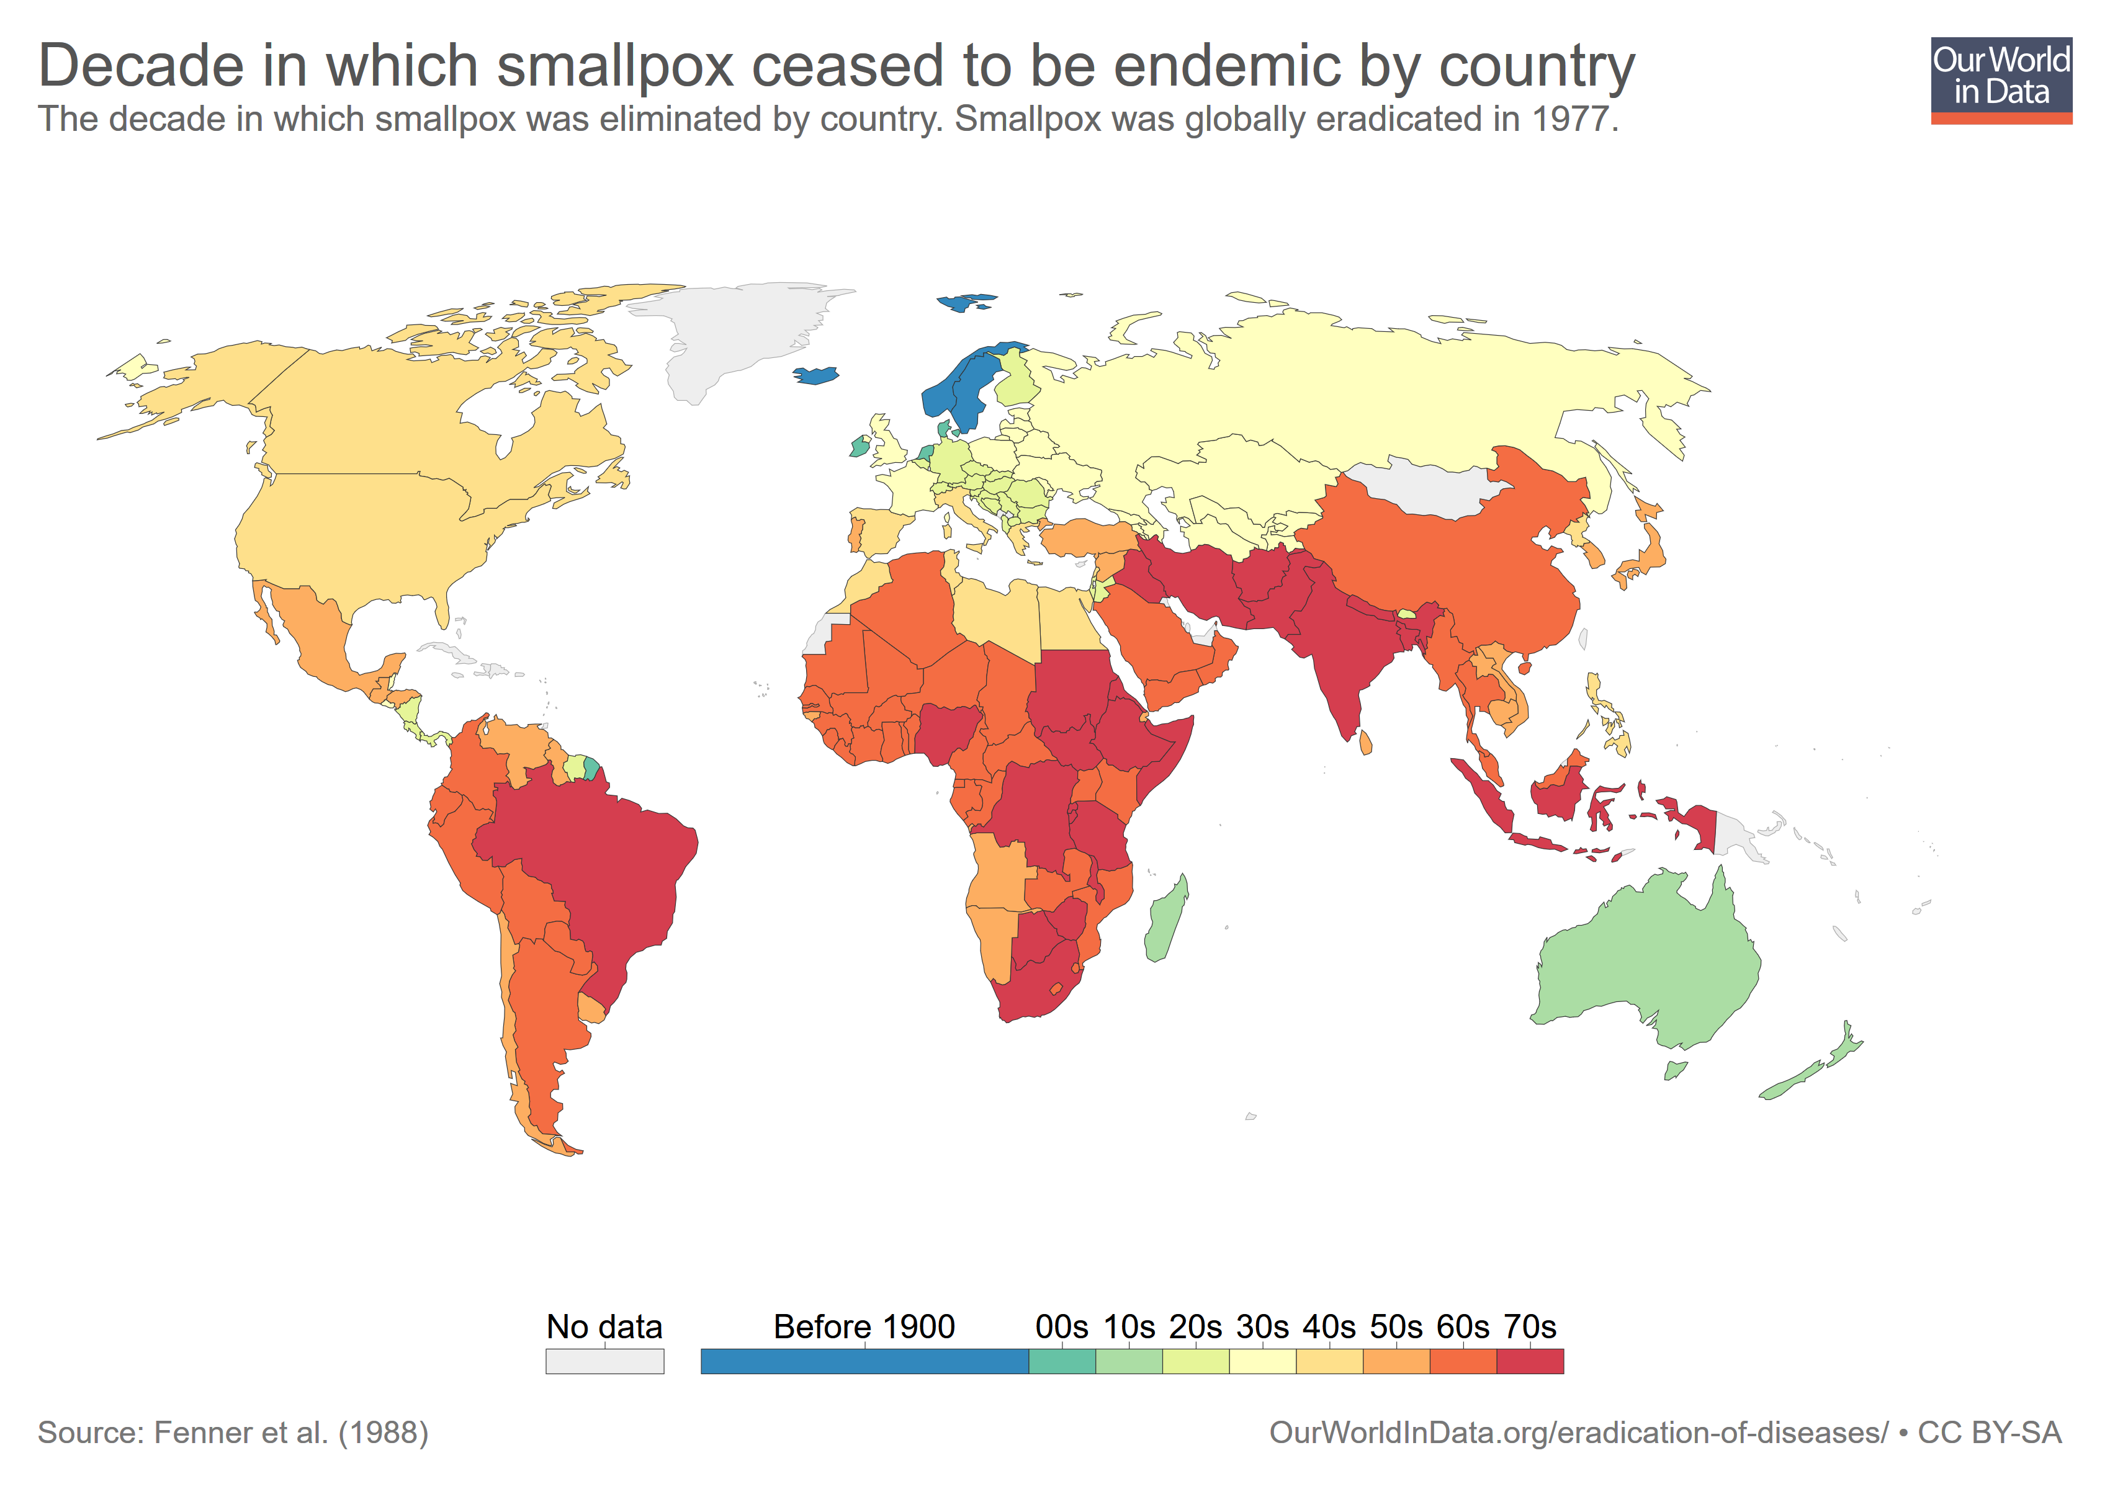
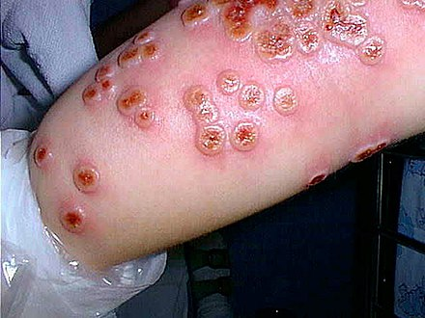
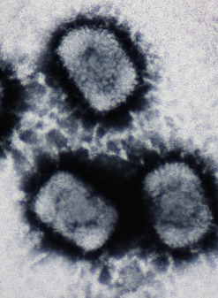
Smallpox - A Success Story for Vaccination
Variolation (1670) provided protection by exposing people to small amounts of smallpox virus (obtained from blisters on infected people). Practice spread from Istanbul to Europe.
Risky because smallpox was used to vaccinate (2% risk of death)
10,000 BC Smallpox – 20-90% lethality
Decade in which smallpox ceased to be endemic
Cowpox virus:
Not lethal
Similar to smallpox virus
Causes production of cross-reactive antibodies that can bind to smallpox
Jenner was the first to use cowpox to vaccinate against smallpox (1796)
Vaccinated with cowpox (ill for 9 days)
Infected with smallpox (2 months later)
Subject did not develop smallpox
Vaccinia virus (similar to smallpox) is one form of the current vaccine.

Slide 25
Types of Vaccines
A. Subunit Vaccine:
A protein from the pathogen is used to induce memory cells, e.g. spike protein from the virus. The protein can be produced by recombinant DNA technology.
A
B. Inactivated Virus
The virus is chemically inactivated before administration. Peptides from virus activate B and T cells.
B
C. Virus Like Particles:
Proteins isolated from the virus form virus-like-particles, without the genetic material of the virus
C

Slide 26
D. Live Attenuated
The virus is grown under conditions that select for mutant viruses that:
Induce memory cells in humans
Do not cause disease symptoms
D
D
E. Recombinant Virus:
A “safe virus” is used (e.g. cold virus)
Gene for a protein from a pathogen is inserted into the DNA of the virus.
When virus grows it produces the protein from the pathogen generating immunity.
Also includes vaccines that are a mixture of genetic material from human and animal viruses (reassortment viruses)
E
F. RNA Vaccines (Pfizer Covid Vaccines)
RNA coding for a viral protein is introduced into cells. The RNA is used by the cell to make viral proteins, inducing an immune response.
F

Slide 27
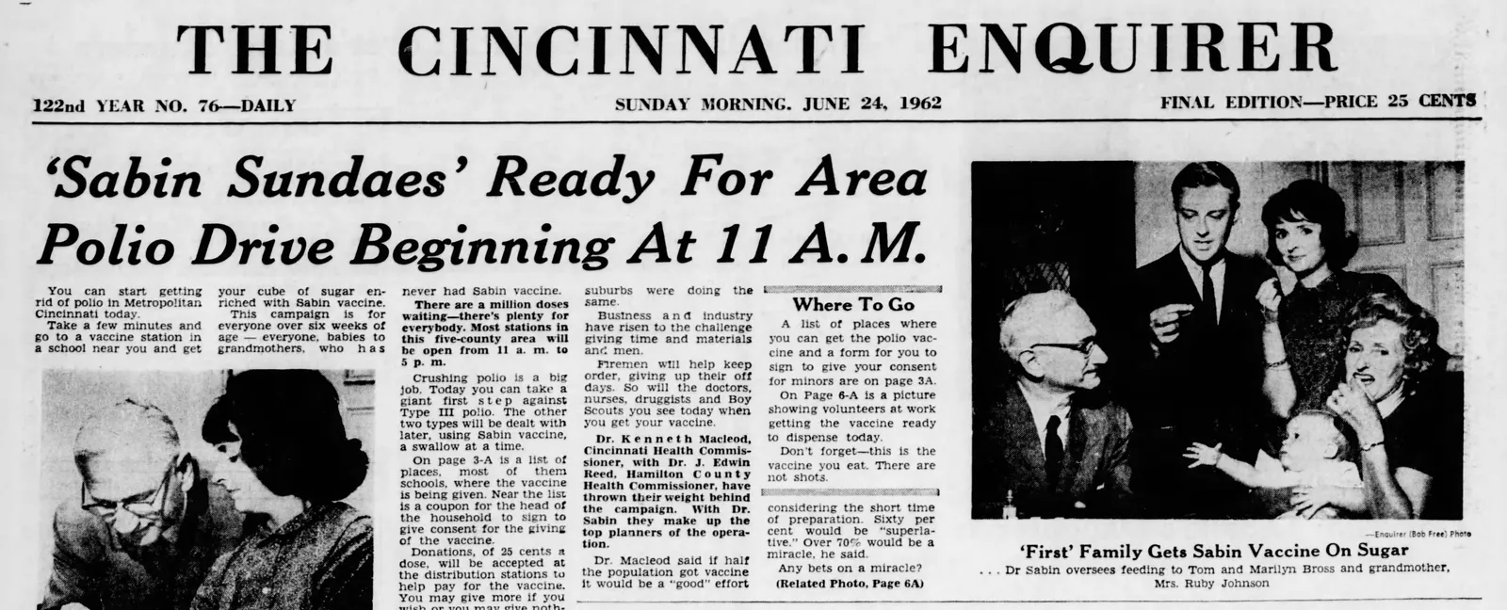
D. Attenuated – Sabin Polio Vaccine
Attenuation Process Requires Mutations  Change growth characteristics on human cells.

Slide 28
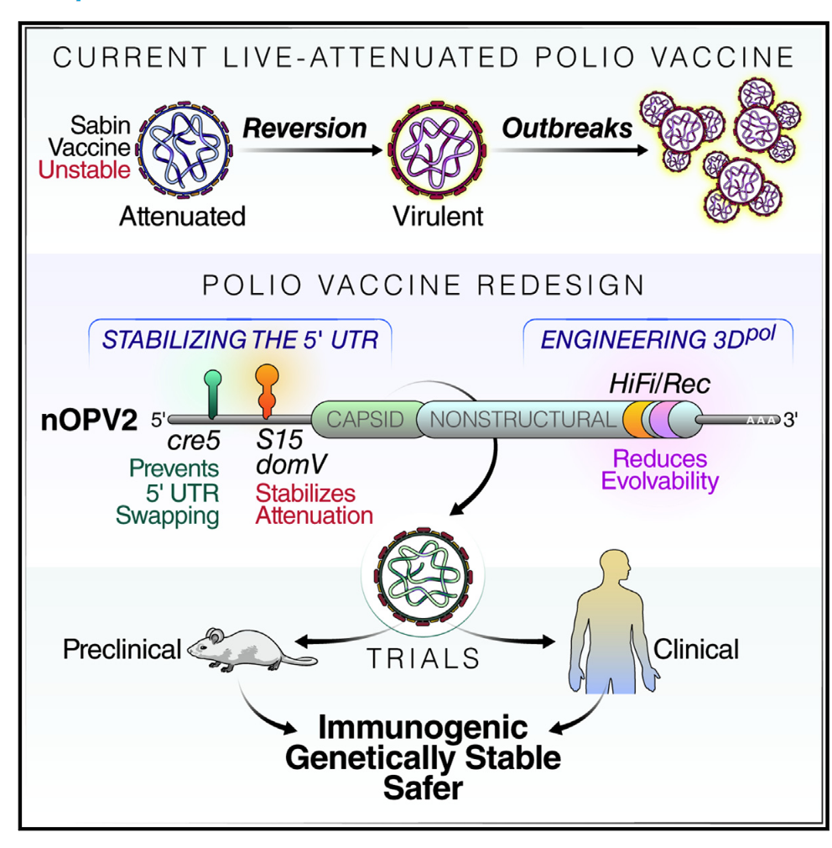
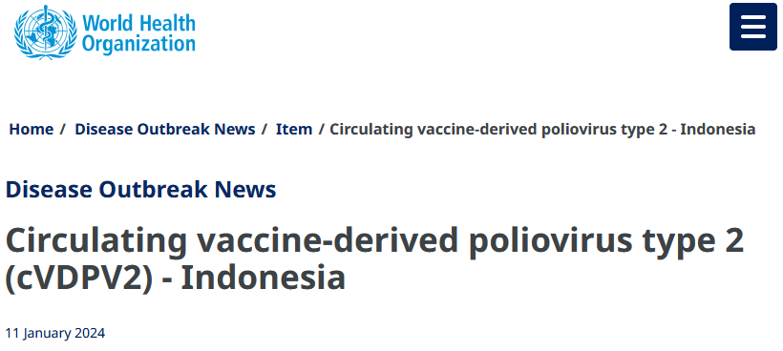
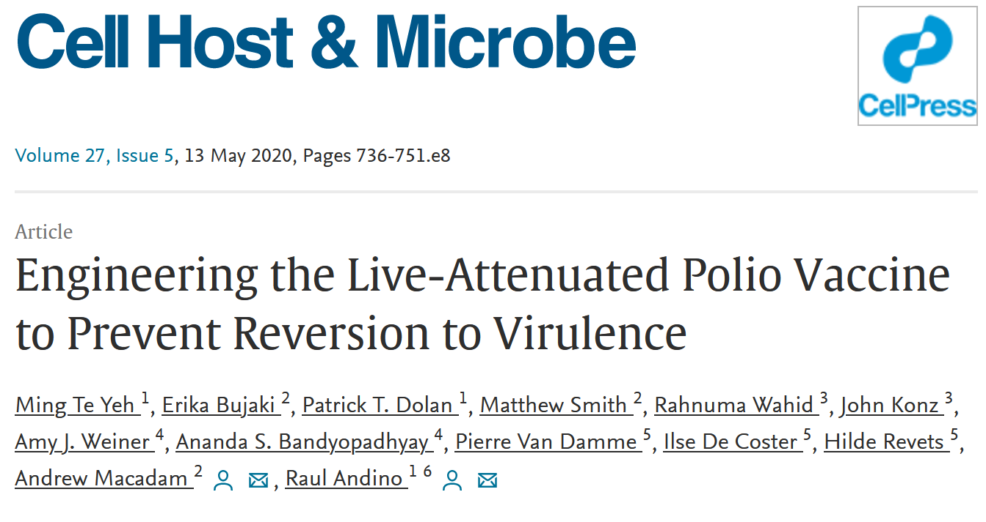
C. Attenuated Viruses – Return to Virulence by Reversion
Mutations that attenuated the virus revert to the original sequence during infection.
This is not surprising because growth of the virus in infected humans will select for viruses that grow better in humans.

Slide 29
Summary Questions for Immunology:
What are the two major branches of the immune system? Why are both important?
What are the roles of different cell types in each system, e.g. what would happen if T_{H}-cells disappeared?
What is the quaternary structure of an antibody? Can you sketch an antibody and indicate where the antigen binds?
What part of the antibody defines the specificity?
What are the steps in the production of antibody genes, at the molecular level:
How do DNA rearrangements produce functional heavy and light chain genes
What is the difference between the heavy chain for B-cells versus plasma cells.
Can you describe how antibodies kill/inactivate pathogens
How are virally infected cells and tumor cells recognized by Tc cells?
How does the Tc cell kill those cells?
What evasion mechanisms are used by cancer cells and how have these been addressed by antibody therapy?
What was the origin of the idea for vaccination?
What was one of the first “safe” vaccines? What disease has now been eradicated due to this vaccine?
Can you describe one way to generate a vaccine for a pathogen? Do you know the pros and cons for that method?

Slide 30
Enzyme Inhibitors as Drugs
Types of inhibitors
Covalent
Competitive
HIV drug therapy
Antibiotics – inhibitors of RNA and protein synthesis

Slide 31
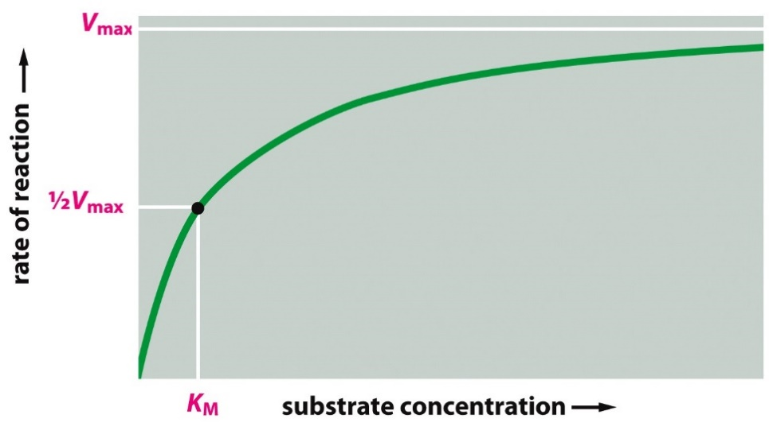
Key Points:
S₃
$$\left(E\right)+\left(S\right) ⇄ \left(ES\right) \underset{→}{ k_{CAT}} \left(EP\right) ⟶\left(E\right)+(P)$$
[P]
S₂
S₁
time
Kinetics
Rate = dP/dt, proportional to [ES].
V_{max} = measured velocity at saturating substrate:
V_{max} = k_{CAT} x E_{total}
K_{M}:
Substrate concentration to ½ saturate the enzyme, v = Vmax/2
Measure of substrate affinity, lower K_{M}, better binding (K_{M} is very similar to K_{D}).

Slide 32
Enzyme Inhibitors
Covalent
Studies on Inhibitors are useful for:
1. Mechanistic studies to learn about how enzymes interact with their substrates.
2. Understanding the role of inhibitors in enzyme regulation.
3. Drugs if they inhibit aberrant biochemical reactions:
penicillin, ampicillin, etc. interfere with the synthesis of bacterial cell walls, acting as suicide inhibitors.
4. Understanding the role of biological toxins.
Amino acid analogs - useful herbicides (i.e. roundup)
Insecticides - chemicals targeted for insect nervous system.
Competitive
Types of Inhibitors:
Covalent – inhibitor covalently modifies enzyme, usually in active site, these are generally irreversible – the enzyme is dead! Example – Sarin gas (Tokyo subway 1995)
Competitive – inhibitor blocks substrate, binds reversibly to active site. Enzyme activity returns when drug is removed.
Allosteric (mixed type) – inhibitor causes allosteric (different shape) change, distorting the active site. Binds reversibly to a different location. Enzyme activity returns when drug is removed.
Allosteric (Mixed type)

Slide 33
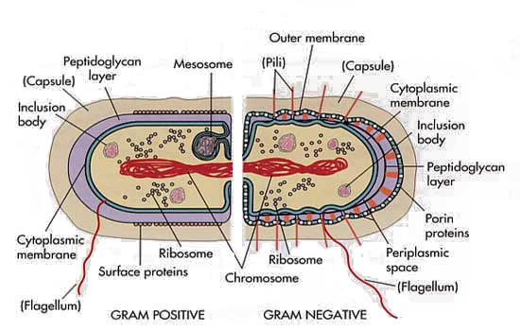
Bacterial Cell Wall
Mechanism of Penicillin – A Covalent Inhibitor
Synthesis of bacterial cell wall – generation of protein crosslink
Serine breaks peptide bond between terminal D-Ala residues
Covalent intermediate formed
Amino group of glycine forms peptide linkage with D-Ala = crosslink
Bacterial cell wall:
Linear polymers of alternating NAM (N-acetylmuramic acid) and NAG (N-acetylglucosamine), beta(1-4) linkage
NAM units on adjacent strands are linked via a peptide linker.
Crosslinking catalyzed by serine-containing transpeptidase.

Slide 34
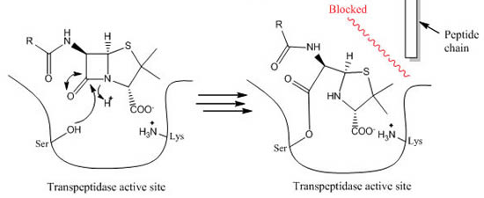
Mechanism of Penicillin
Mechanism of Action of Penicillin:
Penicillin inhibits the transpeptidase enzyme that is responsible for crosslinking the Gly₅ chain to alanine (circled on diagram).
The crosslinking of the cell wall is broken, making the bacteria fragile to breakage.
Inhibition is by formation of a chemical bond between penicillin and the enzyme (covalent inhibitor).
Penicillin

Slide 35
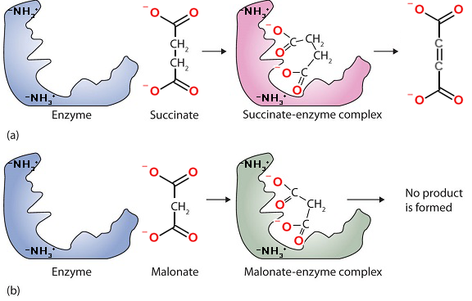
Competitive Inhibitors
Succinate dehydrogenase converts succinate to fumarate by removal of two hydrogens.
Malonate is a competitive inhibitor, because:
It is similar in structure to the substrate – so it binds in active site – substrate cannot bind at the same time.
Malonate cannot undergo the chemical reaction – it is not possible to remove two hydrogens without leaving carbon with too few bonds.
Fumarate
(product)
Substrate
Inhibitor
Notes:
Most cell functions depend on proteins

Slide 36
Quantification of Inhibitor Binding
Fractional Saturation of Enzyme by Inhibitor
$$K_{I}=K_{D}=\frac{\left[E][I\right]}{\left[EI\right]}$$
K_{I} = equilibrium constant for dissociation of inhibitor from enzyme
Low K_{I} = higher affinity (same principle as K_{D})
K_{I} can be determined by measuring the effect of inhibitor on the enzyme kinetics.

Slide 37
Effect of Competitive Inhibitor on Steady-State Kinetics:
A competitive inhibitor reduces the amount of [E] by the formation of [EI] complex.
The inhibitor cannot affect the [ES] complex since the inhibitor can no longer bind.
There are two consequences of a competitive inhibitor binding on the kinetics of the enzyme:
V_{MAX} is unchanged: At high levels of substrate all of the inhibitor is displaced by substrate, so [ES]=E_{TOTAL}, and v_{MAX} = k_{CAT}[E_{TOT}].
The observed K_{M} is increased: It requires more substrate to reach 1/2 maximal velocity because some of the enzyme is complexed with inhibitor.
K_{M}^{OBS} = αK_{M}
The change in K_{M} can be used to determine how well the inhibitor binds to the free enzyme, if we know how α is related to K_{I}.
v = k_{cat} [ES], k_{cat} =1
$$α=1+\frac{[I]}{K_{I}}$$
No inhibitor
Comp inhibitor

Slide 38
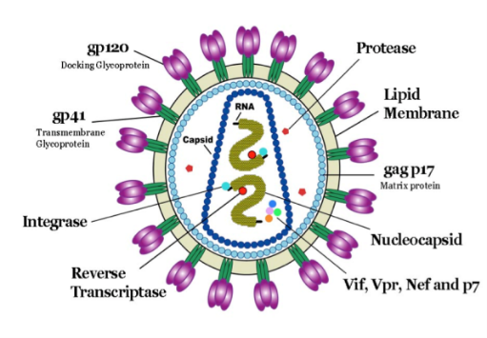
HIV Drug Therapy
Retroviruses & Inhibitors - HIV Protease.
Identify potential drug targets, based on viral life cycle.
Measure inhibitor binding to characterize drug efficiency.
Rational drug design in response to mutations.
Human Immunodeficiency Virus (HIV)
Infects specialized cells in the immune system – T-helper cells (T_{H}) cells, killing them.
T_{H} cells are required for activation of the immune response to all pathogens (bacteria, virus)
Killing of T_{H} cells by the HIV virus causes AIDS (acquired immunodeficiency), making the individual susceptible to serious infection by many otherwise harmless bacteria as well as developing rare cancers.
Viral particle contains enzymes required for the replication of the virus:
Reverse Transcriptase: Copies viral RNA to DNA
Integrase: Integrates viral DNA into host chromosome. This DNA is used to make new copies of the viral RNA as well as mRNA to make viral proteins.
HIV Protease: Cleaves immature viral protein to produce smaller mature proteins.

Slide 39
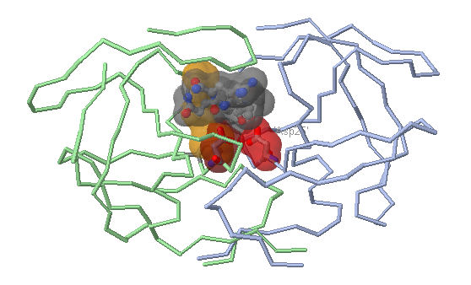
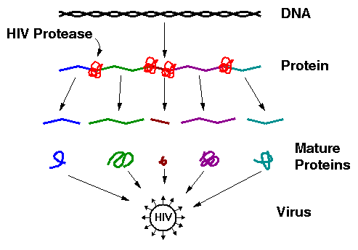
HIV Protease (Aspartyl protease)
The original viral protein is a long pre-protein containing many smaller mature proteins.
HIV Protease cleaves the pre-protein, releasing the smaller mature proteins.
HIV Protease:
1. An essential enzyme in the maturation of the HIV virus. If inhibited, the virus cannot replicate.
2. Prefers hydrophobic substrates (e.g. Phe) due to Val82 plus other non-polar residues in its active site (Pro81, Leu23).
3. Cleaves peptide bond after large non-polar residues

Slide 40
Inhibition of HIV Protease (HIV Drugs):
Most drugs are small peptide-like analogs with non-cleavable bonds that resemble peptide bonds. These are competitive inhibitors because:
They bind to the active site (similar to substrate)
They are unreactive (no peptide bond)
Drug Design: Compounds A (Isobutyl) and B (cyclohexane) are candidates for HIV protease inhibitors. Which of the two drugs will be more effective at inhibiting the wild-type protease?
Answer: We will assume that these are competitive inhibitors. Therefore, we need to compare the K_{I} values for each inhibitor binding to the protease.

Slide 41
Measuring K_{I} for both Drugs:
a) Acquire velocity versus substrate, no inhibitor.
b) Acquire velocity versus substrate, fixed inhibitor.
Analysis:
i) Plot velocity versus [S]
ii) Obtain α from the observed Km values
[S] | no inh | A | B
0 | 0 | 0 | 0
1 | 17 | 9 | 2
2 | 29 | 17 | 4
3 | 38 | 23 | 5
4 | 44 | 29 | 7
5 | 50 | 33 | 8
10 | 67 | 50 | 15
20 | 80 | 67 | 27
40 | 89 | 80 | 42
60 | 92 | 86 | 52
100 | 95 | 91 | 65
Data | Km | Alpha (K_{M}^{obs}/K_{M}) | K_{I} =[I]/(α-1) ([I]= 10 nM)
No Inh | 5
Inh A | 10 | 2 | K_{I} = 10/(2-1) = 10 nM
Inh B | 54 | 10.8 | K_{I} = 10/(10.8-1)=1.1 nM
The units of velocity are μmoles product/sec.
Once the α values are found, we can calculate the K_{I} for each inhibitor using the formula: K_{I}=[I]/(α-1).

Slide 42
Explain the difference in K_{I} based on the molecular interactions between each inhibitor
Potential Interaction | Drug A (K_{I} = 10 nM) | Drug B (K_{I} = 1.1 nM)
Van der Waals
Hydrophobic effect
Rational Drug Design.
Which Drug would be more effective if the virus, via errors in replication, replaced Val82 with Phe?

Slide 43
Antibiotics That Inhibit Prokaryotic Translation

Slide 44
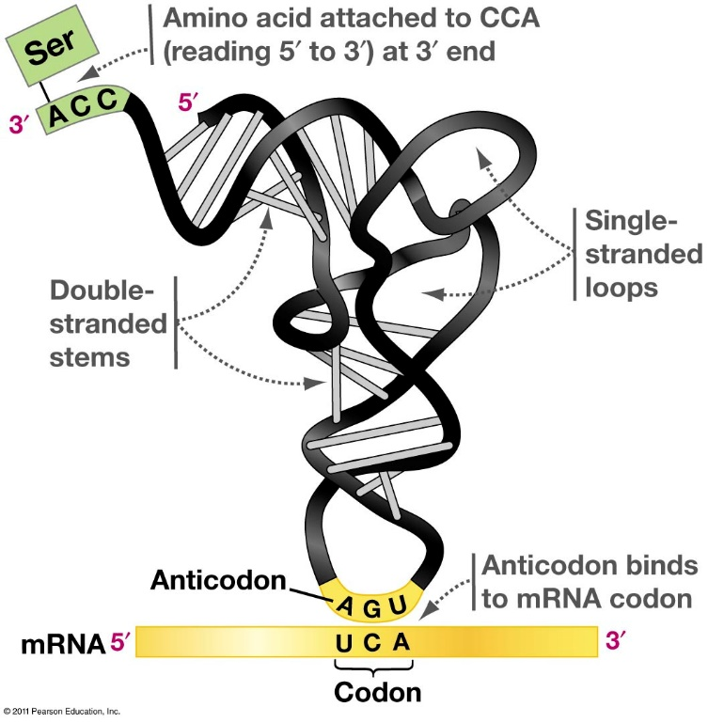
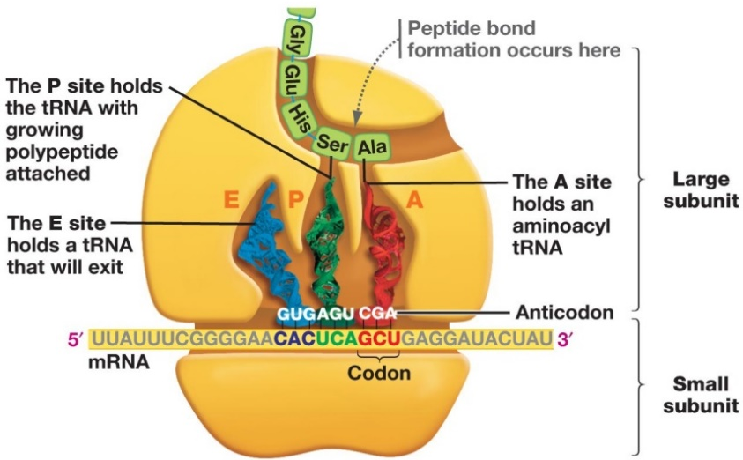
Protein Synthesis – tRNA & Ribosomes
tRNAs
The adapter molecules are called transfer RNAs or tRNAs.
Contain a CCA sequence at 3’ end where the amino acid is attached
a triplet anticodon to form base pairs with the appropriate mRNA codon
Role of different Ribosomal subunits
30S (Small) – RBS & mRNA codon/anticodon
50S (Large) – Peptide bond synthesis
Exit tunnel – new protein emerges
tRNA sites:
A – aminoacyl – next tRNA-AA binds
P – 1st tRNA-Met & growing peptide
E – empty tRNA leave from here
Initiation:
1. mRNA binds to 30S
2. fMet-tRNA binds to P site
3. 50s binds to complete initiation complex
Elongation:
1. New AA-tRNA in A site
2. Peptide bond formation (amino acid in A site added to C-term of peptide in P site)
3. Translocation (tRNA-peptide moves to P site)
4. tRNA exits
Termination:
1. Stop codon at A site
2. Termination factor (protein) adds water to cleave peptide from last tRNA

Slide 45
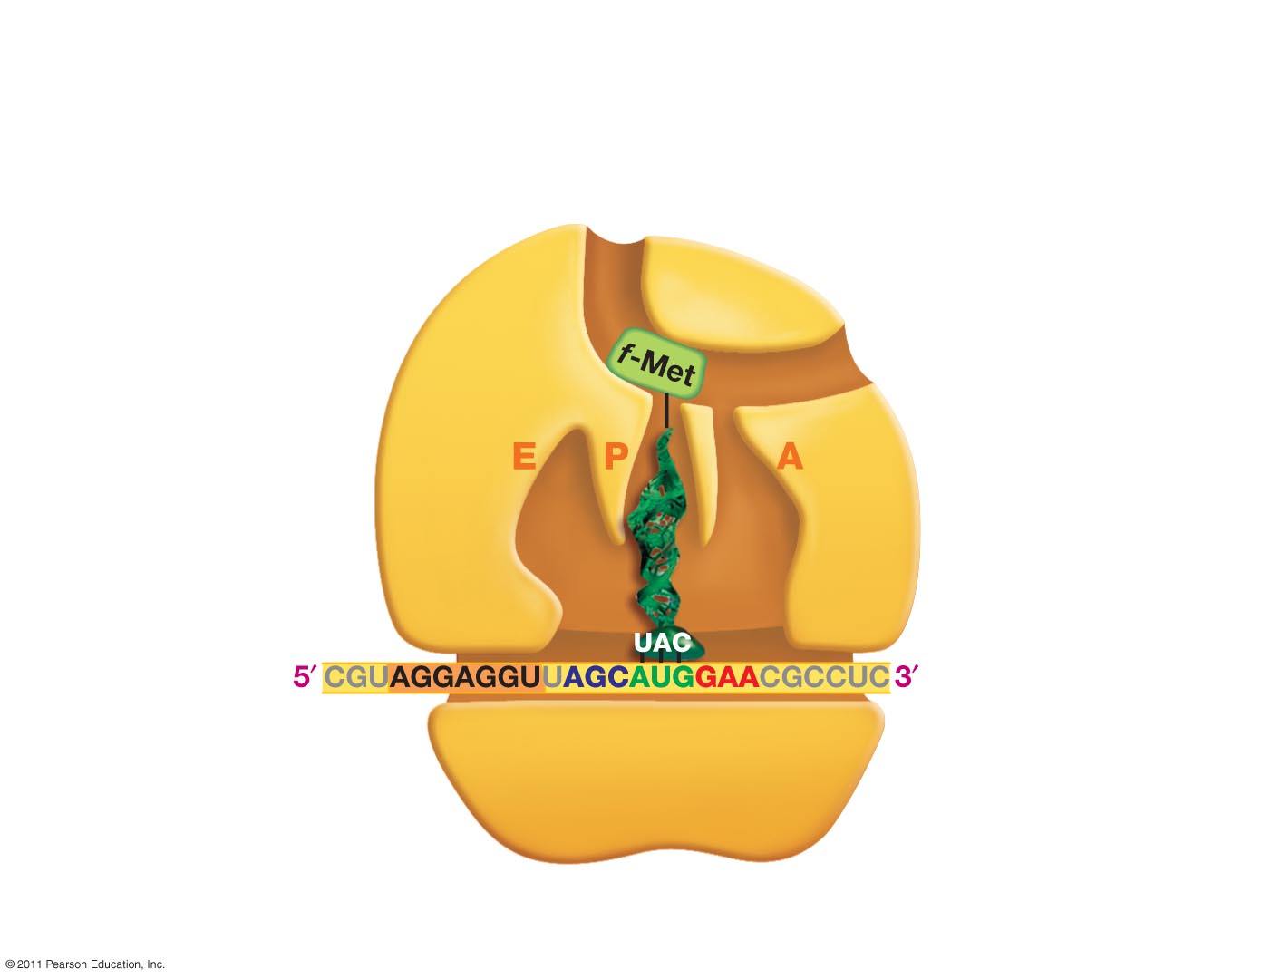
Exit tunnel
First amino acid
Large
subunit of
ribosome
Start Codon
Ribosome Binding Site
Second Codon
Initiation 3. Large subunit binds completing the complex
Notes:
What is the name of a codon where the message begins? Start codon AUG found usually at the beginning on mRNA. Begins when rRNA binds to a section of mRNA called the ribosome binding site about 6 NT upstream of start sequence. Proteins called iniation factors help the two to associate. In eukaryotes bind to 5’ cap.

Slide 46
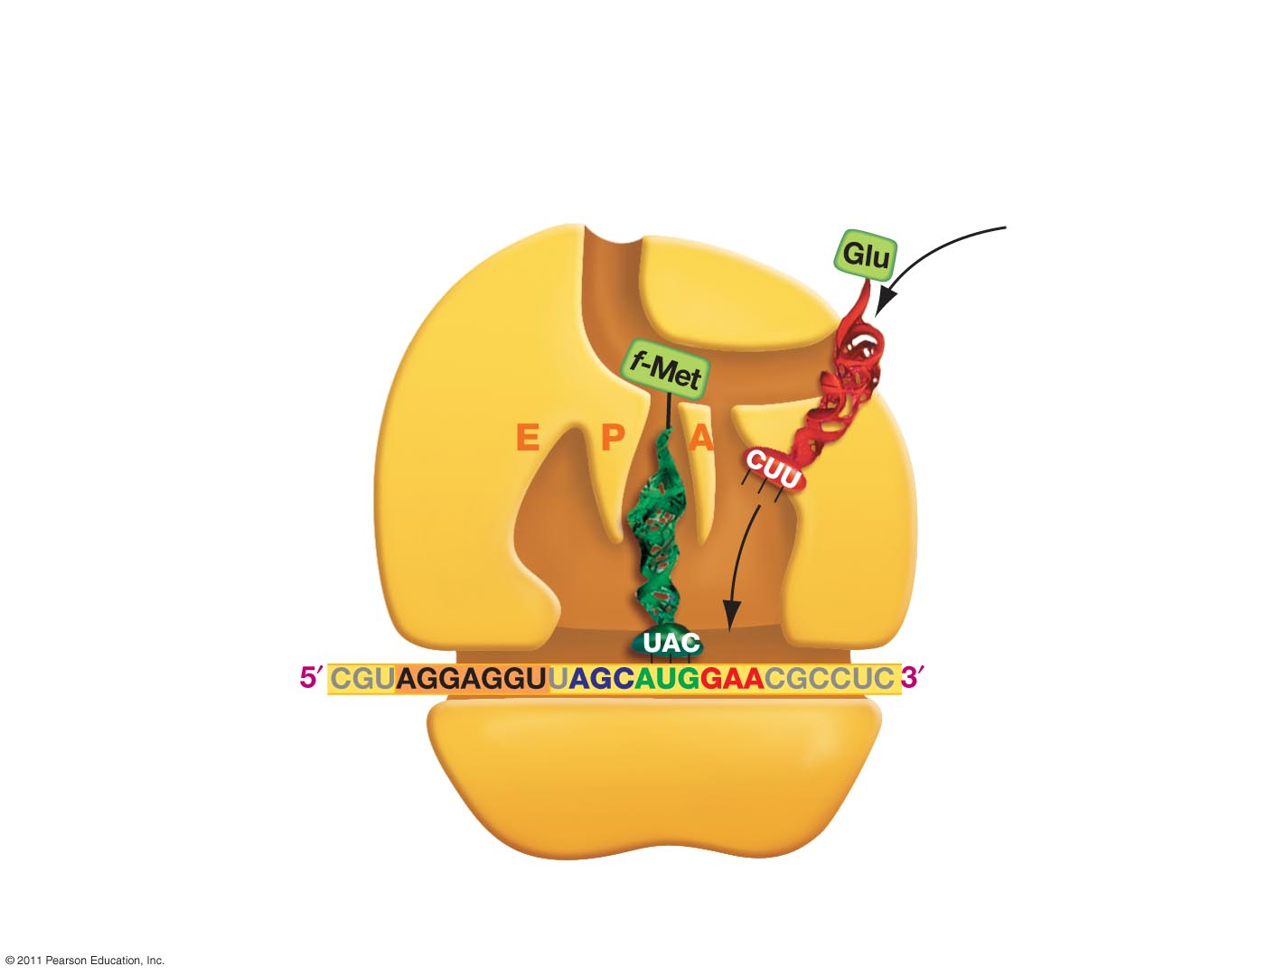
Step 2 - Elongation
Ribosome
Peptidyl
site
tRNA
Exit site
Aminoacyl site
mRNA
Start
codon
4. Incoming aminoacyl tRNA arrives and binds in A site
Notes:
Because it is in the P site, protein sysntehsis is ready to begin with the addition of the next charged tRNA to the A site.

Slide 47
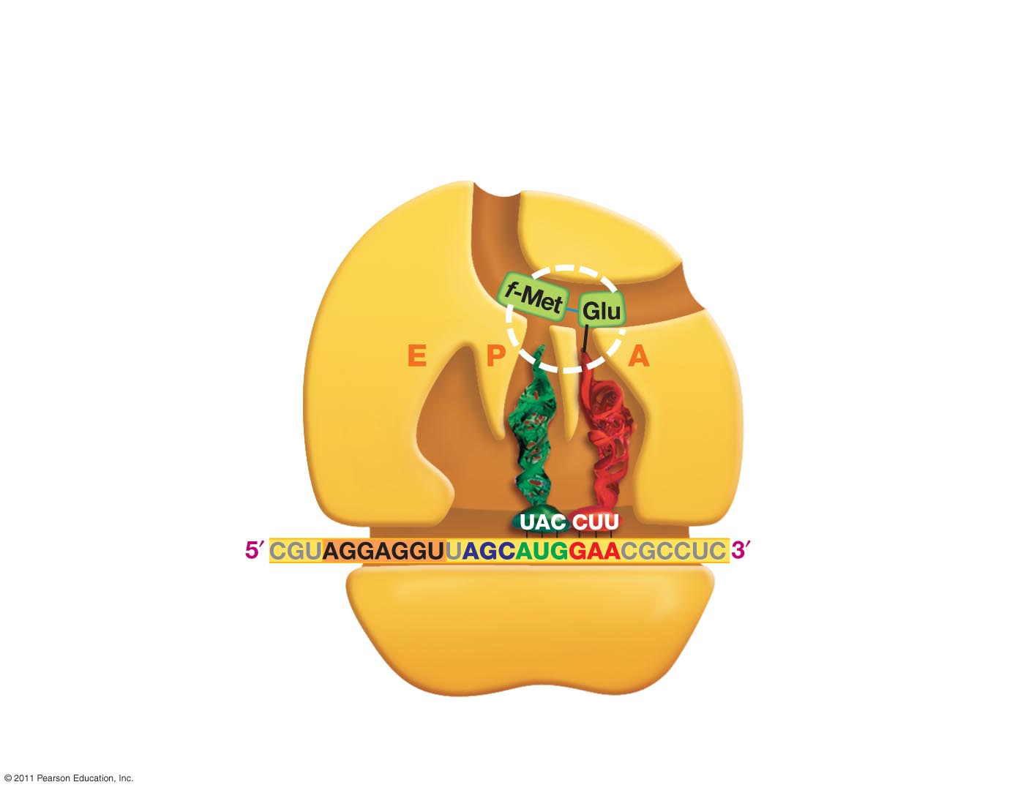
Peptide
bond
Ribosome’s
active site
5. Peptide bond formation
Notes:
Figure 16.15 (Step Edit)
Initiation Proteins Manage Assembly of Ribosomes and mRNAs.
Figure 16.16 (Step Edit)
During Elongation, Peptide Bond Formation Occurs inside the Ribosome.
Figure 16.17 (Step Edit)
Release Factors Manage Translation Termination.

Slide 48
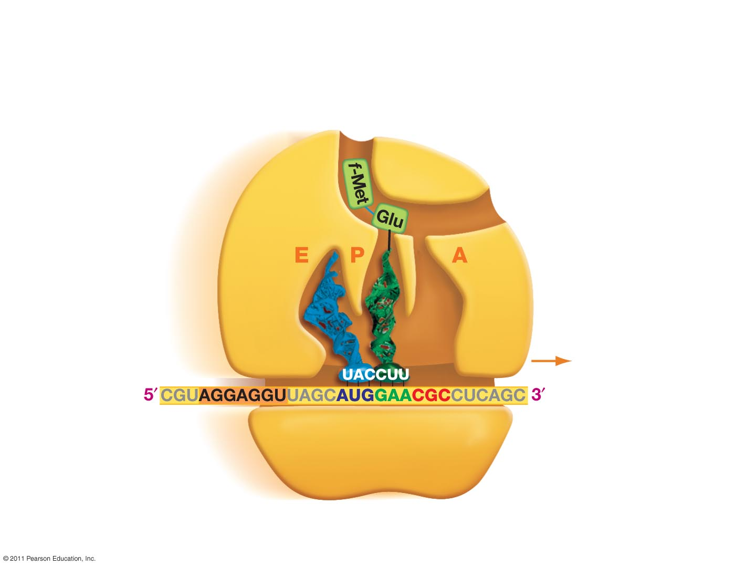
6. Translocation
Notes:
Transloation, as the mRNA moves or is racheted in the 5’ to 3’ direction is an energy-demanding event that requires GTP.

Slide 49
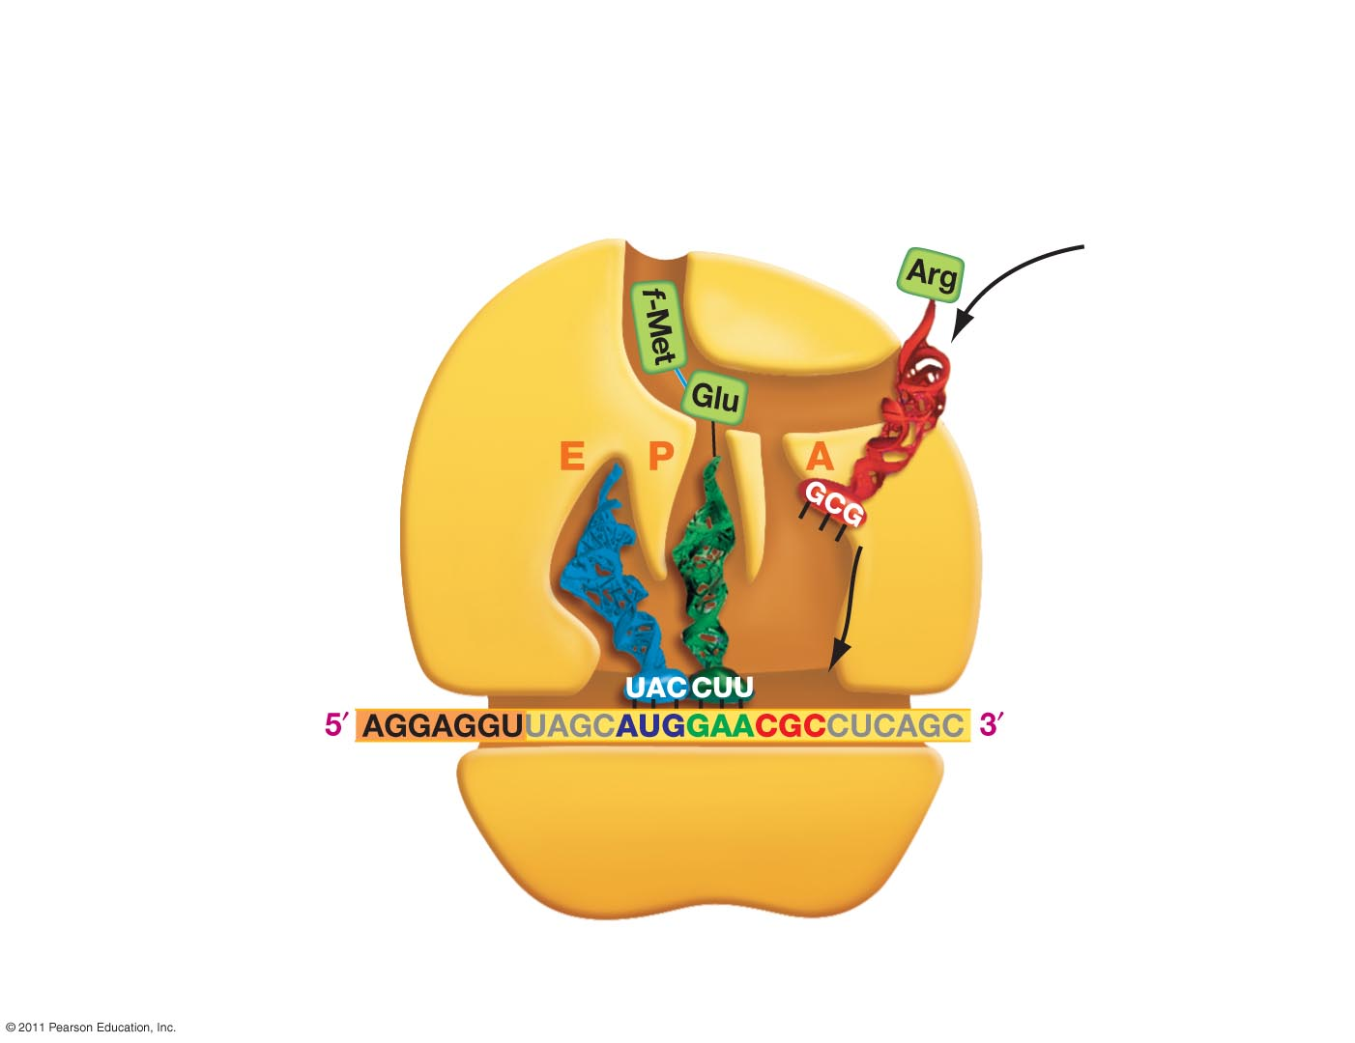
7. Incoming aminoacyl tRNA arrives and binds in A site
Notes:
Figure 16.15 (Step Edit)
Initiation Proteins Manage Assembly of Ribosomes and mRNAs.
Figure 16.16 (Step Edit)
During Elongation, Peptide Bond Formation Occurs inside the Ribosome.
Figure 16.17 (Step Edit)
Release Factors Manage Translation Termination.

Slide 50
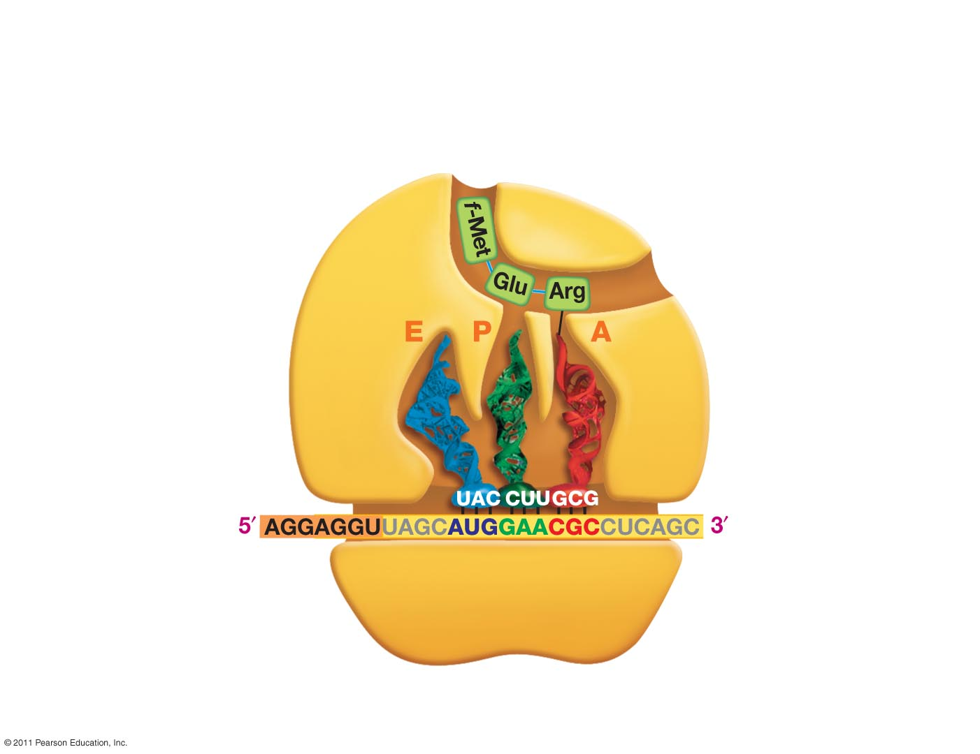
8. Peptide bond formation
Notes:
Figure 16.15 (Step Edit)
Initiation Proteins Manage Assembly of Ribosomes and mRNAs.
Figure 16.16 (Step Edit)
During Elongation, Peptide Bond Formation Occurs inside the Ribosome.
Figure 16.17 (Step Edit)
Release Factors Manage Translation Termination.

Slide 51
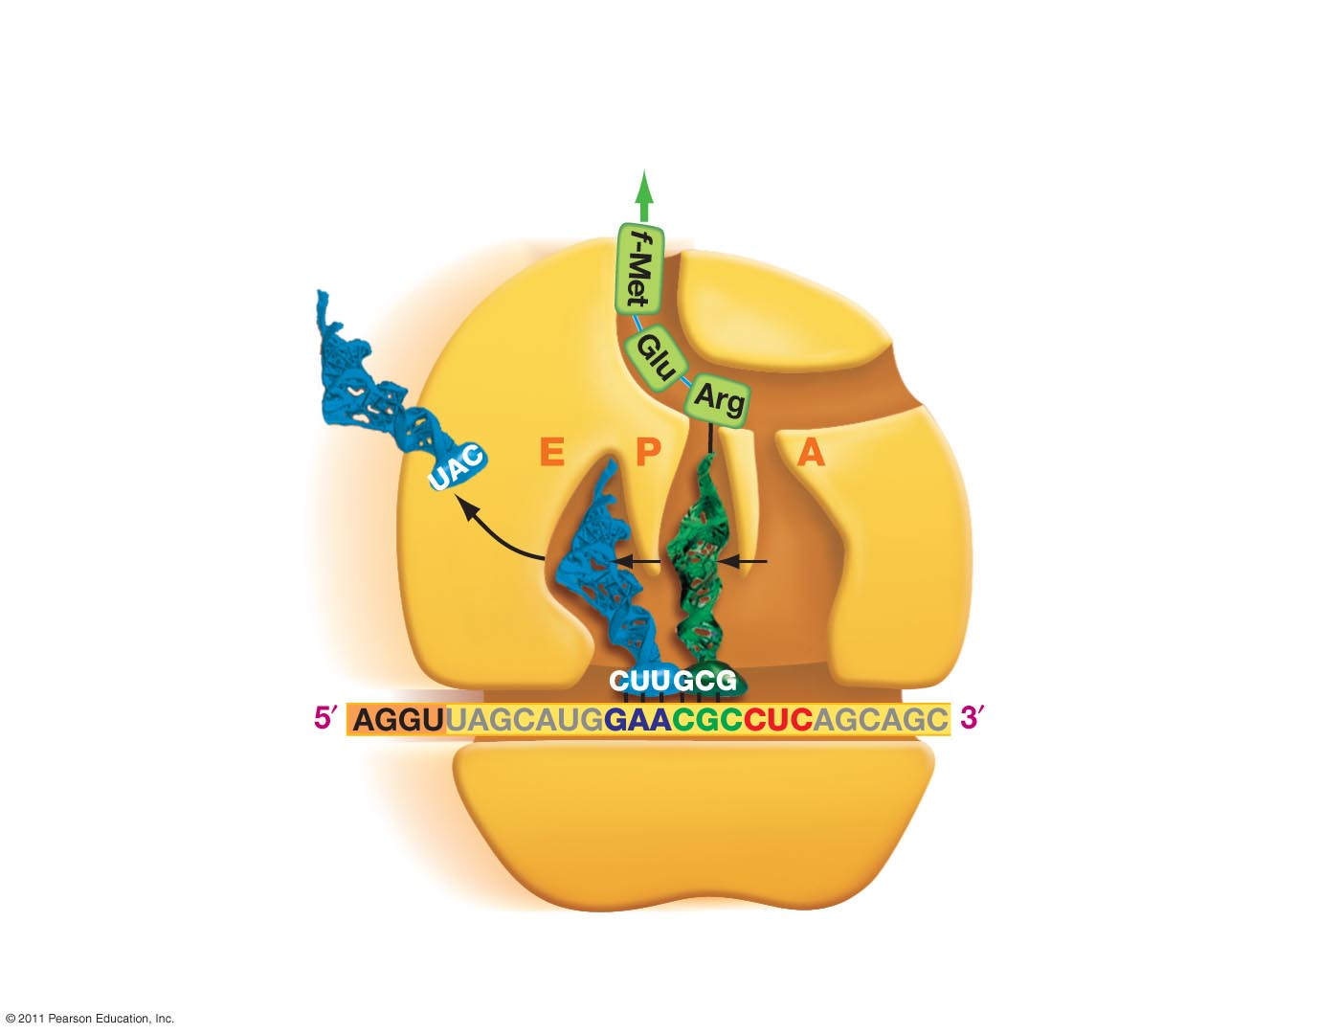
Exit tunnel
Elongation cycle
continues
9. Translocation
Notes:
Figure 16.15 (Step Edit)
Initiation Proteins Manage Assembly of Ribosomes and mRNAs.
Figure 16.16 (Step Edit)
During Elongation, Peptide Bond Formation Occurs inside the Ribosome.
Figure 16.17 (Step Edit)
Release Factors Manage Translation Termination.

Slide 52
Step 3 - Termination
When translocation opens the A site and exposes a stop codons, a protein called release factor fills the A site. This hydrolyzes the bond linking the tRNA in the P site to the polypeptide chain, releasing the protein.
Hydrolysis of
bond linking
tRNA and
polypeptide
tRNA
Release
factor
mRNA
STOP
codon
10. Release factor binds to stop codon
Notes:
Release factors do not carry an amino acid. Frees the polypetide. They are tRNA like.

Slide 53
mRNA
11. Polypeptide is released
Notes:
Figure 16.15 (Step Edit)
Initiation Proteins Manage Assembly of Ribosomes and mRNAs.
Figure 16.16 (Step Edit)
During Elongation, Peptide Bond Formation Occurs inside the Ribosome.
Figure 16.17 (Step Edit)
Release Factors Manage Translation Termination.

Slide 54
Antibiotics that Inhibit Protein Synthesis
6. Erythromycin (macrolide, blocks exit tunnel)
4. Chloramphenicol (peptide bond formation)
2. Tetracycline
(binding of charged tRNA)
5. Viomycin
(blocks translocation)
3. Kanamycin (Aminoglycoside)
(codon/anticodon pairing – wrong amino acid gets added)
1. Linezolid (blocks 70s formation from two subunits)
Notes:
Linezolid – blocks formation of 70S – binds to 50S subunit, cannot initiate
Tetracycline – blocks binding of charged tRNA to A site, cannot add amino acids
Kanamycin – binds to 30S, affects mRNA-tRNA pairing causing codon misreading
Chloramphenicol – binds to the peptidyl transferase site, preventing peptide bond formation
Viomycin – blocks translation of the ribosome
Erythromycin – blocks exit tunnel
https://jamboard.google.com/d/1bnzal_X5sQQ-QqV4x8sAt95icyQEHVq8RLEHWQBEfaw/edit?usp=sharing

Slide 55
Genome Editing – CRISPR Cas9

Slide 56
Key Concepts in Genome Editing
Repair of a targeted double strand break = modification of the genome at a defined location.
A B C D E F G
Genomic DNA (A, B, C, D, E, F, G represent short sequences)
Genomic DNA with double stranded break
Nuclease (sequence specific)
Original Sequence
--ATG......GGGTGGCCGATT...CGATAA—
--Met......GlyTrpProIle...Arg
Non-Homologous End Joining
(NHEJ)
Deletion of one base
Repair Method I: Addition or deletion of bases
--ATG......GGGTGCCGATT...CGATAA—
--Met......GlyCysArgLeu.ArgIle...
A B C E F G
Indels:
+/- 3n = addition or loss of amino acids
+/- 1 or 2 bases = Frame shift. changes the amino acid sequence after the indel. The ribosome considers three bases (codon) relative to the start codon.
Deletion
together called “Indels”
A B C D X Y Z E F G
Insertion
A B C D E F G
Restoration (undetected)

Slide 57
Key Concepts in Genome Editing
Repair method II – replacement of a segment of DNA
Cut site
A B C D E F G
Original Sequence
Genomic DNA
-AATGCGATGCAAAGGCTGATGGGTACCTAGATGCC-
-TTACGCTACGTTTCCGACTACCCATGGATCTACGG-
Nuclease
C
D
E
Genomic DNA with double stranded break
Template sequence
Template
C Z E
Homology-Directed Repair
(HDR)
GCGATGCAAATTTTTTTCCTAGAT
CGCTACGTTTAAAAAAAGGATCTA
C
Z
E
Template
C
Z
E
G-DNA
w/DS
break
Final Sequence
A B C Z E F G
Genomic DNA with staggered nicks (rapidly ligated)
-AATGCGATGCAAATTTTTTTCCTAGATGCC-
-TTACGCTACGTTTAAAAAAAGGATCTACGG-

Slide 58
How to Cut at a Defined Location - Cas9 + Guide RNA
Cas9-RNA complex
Cas9 – nuclease that cuts DNA after activation
Guide RNA:
5’ end complementary to target sequence
3’ end required for Cas9 activity (tracrRNA)
Double stranded break
(3 bases from PAM)
Step 1. Cas9 Binds to PAM, then checks if RNA is complimentary to DNA sequence 5’ to PAM.
Step 2. After PAM recognition by Cas9, guide RNA unwinds DNA, by pairing with one DNA strand.
Step 3. Cas9 cleaves both strands near site, generating a double strand break.
Step 4. Double stranded break triggers DNA repair, using injected replacement DNA for homologous repair

Slide 59
Altering the Genome Sequence with Cas9-CRISPR
Components to microinject:
1. Cas9 enzyme (nuclease)
2. Guide RNA, specific for site of cleavage, bound to the Cas9 protein
3. Copy of replacement DNA sequence (dsDNA)
1. Guide RNA directs Cas9 to desired site, by pairing with one DNA strand.
2. CRISPR cleaves both strands near site, generating a double strand break.
3. Double stranded break triggers DNA repair, using injected replacement DNA for homologous repair
(Video originally from Nature)
Also view:
https://wyss.harvard.edu/media-post/gene-editing-mechanism-of-crispr-cas9/

Slide 60
Using CRISPR-Cas9 to Correct Genetic Diseases
Human growth hormone (hGH)
Pituitary Dwarfism
Components to microinject:
1. Cas9 enzyme (nuclease)
2. Guide RNA, specific for site of cleavage, bound to the Cas9 protein
3. Copy of replacement DNA sequence (dsDNA)
Between one in 14,000 and one in 27,000 babies born each year have some form of dwarfism.
1860 William Harrison and Charles Stratton - comedians and performers.
Notes:
Pituitary gland produces several important biomolecules including protein that stimulates growth, just 191 amino acids long called HGH and coded for by GH1. By studying the pedigrees of families in which dwarfism was common, they determined it was an autosomal recessive trait. Grow more slowly reach puberty 2-10 years later than average. 1860 Willian Harrison and Charles Stratton comedians and performers.

Slide 61
CRISPR Repair of Grown Hormone Gene
Human growth hormone gene
>M13438.1:497-2129 Human growth hormone gene (HGH-N), complete cds
AGGATCCCAAGGCCCAACTCCCCGAACCACTCAGGGTCCTGTGGACAGCTCACCTAGCTGCAATGGCTAC 70 AGGTAAGCGCCCCTAAAATCCCTTTGGCACAATGTGTCCTGAGGGGAGAGGCAGCGACCTGTAGATGGGA 140 CGGGGGCACTAACCCTCAGGGTTTGGGGTTCTGAATGTGAGTATCGCCATCTAAGCCCAGTATTTGGCCA 210
ATCTCAGAAAGCTCCTGGCTCCCTGGAGGATGGAGAGAGAAAAACAAACAGCTCCTGGAGCAGGGAGAGT 280 GTTGGCCTCTTGCTCTCCGGCTCCCTCTGTTGCCCTCTGGTTTCTCCCCAGGCTCCCGGACGTCCCTGCT 350
CCTGGCTTTTGGCCTGCTCTGCCTGCCCTGGCTTCAAGAGGGCAGTGCCTTCCCAACCATTCCCTTATCC 420 AGGCTTTTTGACAACGCTATGCTCCGCGCCCATCGTCTGCACCAGCTGGCCTTTGACACCTACCAGGAGT 490 TTGTAAGCTCTTGGGGAATGGGTGCGCATCAGGGGTGGCAGGAAGGGGTGACTTTCCCCCGCTGGAAATA 560 AGAGGAGGAGACTAAGGAGCTCAGGGTTTTTCCCGACCGCGAAAATGCAGGCAGATGAGCACACGCTGAG 630 CTAGGTTCCCAGAAAAGTAAAATGGGAGCAGGTCTCAGCTCAGACCTTGGTGGGCGGTCCTTCTCCTAGG 700 AAGAAGCCTATATCCCAAAGGAACAGAAGTATTCATTCCTGCAGAACCCCCAGACCTCCCTCTGTTTCTC 770 AGAGTCTATTCCGACACCCTCCAACAGGGAGGAAACACAACAGAAATCCGTGAGTGGATGCCTTCTCCCC 840 AGGCGGGGATGGGGGAGACCTGTAGTCAGAGCCCCCGGGCAGCACAGCCAATGCCCGTCCTTGCCCCTGC 910 AGAACCTAGAGCTGCTCCGCATCTCCCTGCTGCTCATCCAGTCGTGGCTGGAGCCCGTGCAGTTCCTCAG 980 GAGTGTCTTCGCCAACAGCCTGGTGTACGGCGCCTCTGACAGCAACGTCTATGACCTCCTAAAGGACCTA 1050 GAGGAAGGCATCCAAACGCTGATGGGGGTGAGGGTGGCGCCAGGGGTCCCCAATCCTGGAGCCCCACTGA 1120 CTTTGAGAGACTGTGTTAGAGAAACACTGGCTGCCCTCTTTTTAGCAGTCAGGCCCTGACCCAAGAGAAC 1190 TCACCTTATTCTTCATTTCCCCTCGTGAATCCTCCAGGCCTTTCTCTACACTGAAGGGGAGGGAGGAAAA 1260 TGAATGAATGAGAAAGGGAGGGAACAGTACCCAAGCGCTTGGCCTCTCCTTCTCTTCCTTCACTTTGCAG 1340 AGGCTGGAAGATGGCAGCCCCCGGACTGGGCAGATCTTCAAGCAGACCTACAGCAAGTTCGACACAAACT 1410 CACACAACGATGACGCACTACTCAAGAACTACGGGCTGCTCTACTGCTTCAGGAAGGACATGGACAAGGT 1480 CGAGACATTCCTGCGCATCGTGCAGTGCCGCTCTGTGGAGGGCAGCTGTGGCTTCTAGCTGCCCGGGTGG 1550 CATCCCTGTGACCCCTCCCCAGTGCCTCTCCTGGCCCTGGAAGTTGCCACTCCAGTGCCCACCAGCCTTG 1620 TCCTAATAAAATTAAGTTGCATCATT
The cut site needs to be close to site of mutation so that the injected dsDNA repair template can be as short as possible.
A NGG (PAM site) is needed for Cas9 to bind.
There are four possible PAM sites in the DNA sequence on the bottom left. The PAM site closest to the mutation was selected so that the cut site is close to mutation site.
Possible PAM Sites
Location of mutation
Isoleucine (I) to Asparagine (N)
Wild type (normal)
R L E D G S P R T G Q I F K Q T Y S
-CTTTGCAGAGGCTGGAAGATGGCAGCCCCCGGACTGGGCAGATCTTCAAGCAGACCTACAGCAA-
-GAAACGTCTCCGACCTTCTACCGTCGGGGGCCTGACCCGTCTAGAAGTTCGTCTGGATGTCGTT-
Mutant (growth hormone non-functional)
R L E D G S P R T G Q N F K Q T Y S
-CTTTGCAGAGGCTGGAAGATGGCAGCCCCCGGACTGGGCAGAACTTCAAGCAGACCTACAGCAA-
-GAAACGTCTCCGACCTTCTACCGTCGGGGGCCTGACCCGTCTTGAAGTTCGTCTGGATGTCGTT-

Slide 62
CRISPR Repair of Grown Hormone Gene
The PAM site closest to the mutation was selected so that the cut site is close to mutation site.
The targeting section of the guide RNA should have the same sequence as 5’ to the XGG, 18 bases are required:
5’AGAUGGCAGCCCCCGGAC---------- plus additional RNA needed for Cas9 function
This RNA would cause cleavage of both the wild-type or mutant sequence since they are identical in this region. This is OK since the repair DNA will contain the wild-type sequence.
The site of Cas9 cleavage is between the PAM and the guide RNA sequence.
The injected DNA contains sequences on both sides of the ds break, causing the replacement of the sequences at the double stranded break due to repair.
Injected dsDNA for Homologous Repair
CTTTGCAGAGGCTGGAAGATGGCAGCCCCCGGACTGGGCAGATCTTCAAGCAGACCTACAG
GAAACGTCTCCGACCTTCTACCGTCGGGGGCCTGACCCGTCTAGAAGTTCGTCTGGATGTC
Possible PAM Sites
homology regions required for repair
DNA cuts by cas9
Wild type (normal)
R L E D G S P R T G Q I F K Q T Y S
-CTTTGCAGAGGCTGGAAGATGGCAGCCCCCGGACTGGGCAGATCTTCAAGCAGACCTACAGCAA-
-GAAACGTCTCCGACCTTCTACCGTCGGGGGCCTGACCCGTCTAGAAGTTCGTCTGGATGTCGTT-
Mutant (growth hormone non-functional)
R L E D G S P R T G Q N F K Q T Y S
-CTTTGCAGAGGCTGGAAGATGGCAGCCCCCGGACTGGGCAGAACTTCAAGCAGACCTACAGCAA-
-GAAACGTCTCCGACCTTCTACCGTCGGGGGCCTGACCCGTCTTGAAGTTCGTCTGGATGTCGTT-
Note that Cas9 will cut both the wild-type and the mutant, but repair will insert the wild-type sequence.

Slide 63
Mutant (growth hormone non-functional)
-AGGCTGGAAGATGGCAGCCCCCGGACTGGGCAGAACTTCAAGCAGACCTACAGCAA-
-TCCGACCTTCTACCGTCGGGGGCCTGACCCGTCTTGAAGTTCGTCTGGATGTCGTT-
1
AGATGGCAGCCCCCGGAC
guide RNA
Cas9
2
Editing Steps:
Cas9 binds to NGG (PAM)
Opens DNA if RNA is complementary to DNA
Cas9 cuts both strands
Double stranded break causes repair.
Injected template is used to repair, changing the DNA sequence between the two homologous regions.
AAGATGGCAGCCCCCGGACTGGGC
-AGGCTGG AGAACTTCAAGCAGACCTACAGCAA-
-TCCGACC TCTTGAAGTTCGTCTGGATGTCGTT-
TTCTACCGTCGGGGGCCTGACCCG
AGATGGCAGCCCCCGGAC
3
AAGATGGCAGCCCCCG GACTGGGC
-AGGCTGG AGAACTTCAAGCAGACCTACAGCAA-
-TCCGACC TCTTGAAGTTCGTCTGGATGTCGTT-
TTCTACCGTCGGGGGC CTGACCCG
AGATGGCAGCCCCCGGAC
4
-AGGCTGGAAGATGGCAGCCCCCG GACTGGGCAGAACTTCAAGCAGACCTACAGCAA-
-TCCGACCTTCTACCGTCGGGGGC CTGACCCGTCTTGAAGTTCGTCTGGATGTCGTT-
DNA Repair
GGCTGGAAGATGGCAGCCCCCGGACTGGGCAGATCTTCAAGCAGACCTACAG
CCGACCTTCTACCGTCGGGGGCCTGACCCGTCTAGAAGTTCGTCTGGATGTC
5
-AGGCTGGAAGATGGCAGCCCCCGGACTGGGCAGATCTTCAAGCAGACCTACAGCAA-
-TCCGACCTTCTACCGTCGGGGGCCTGACCCGTCTAGAAGTTCGTCTGGATGTCGTT-

