Slide 1
Lecture 4 Nucleic Acids & Immunology
(and a little polysaccharides)
Nucleic Acid Technologies
Immunotherapies
Please view the posted video on Enzyme Kinetics before our next class.

Slide 2
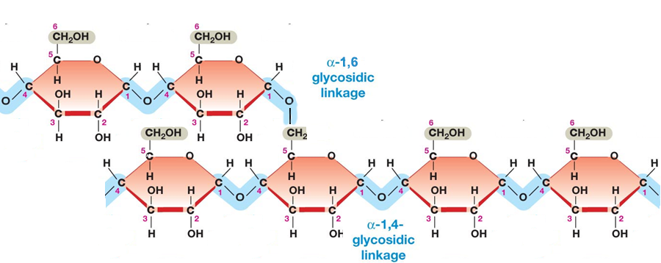
Polysaccharides as Energy Storage – Glycogen Storage Disease
Glycogen and is made entirely of glucose units and is used for glucose storage.
Glycogen Levels are regulated by hormones secreted due to blood glucose levels.
Glucagon – low blood sugar
Insulin – high blood sugar
Two enzymes degrade or synthesize glycogen
Glycogen phosphorylase – releases glucose from glycogen
Glycogen synthase – stores glucose in glycogen
Branch point
α-1,6- glycosidic linkage
α-1,4- glycosidic linkage
Notes:
GSD III – debranching enzyme required since phosphorylase stops when 4 glucose are remaining. 3 of them are transferred to a new glycogen, and then the a(1-6) is removed. Autosomal recessive, 1:100,000

Slide 3
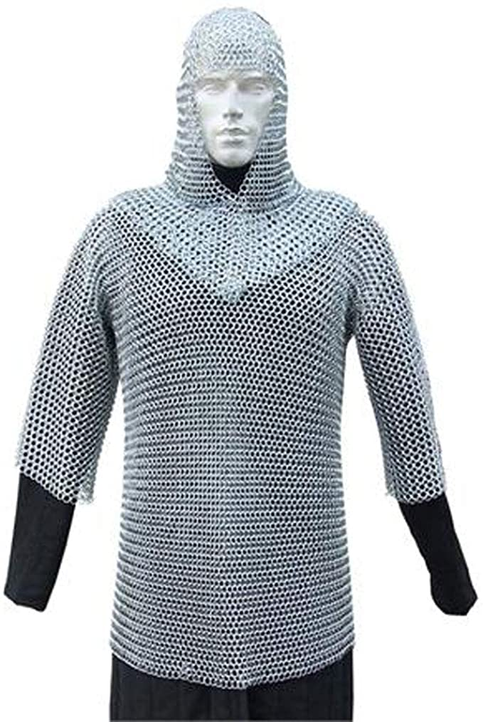
Polysaccharides as Structural Molecules
Peptidoglycan (protein + sugar) in bacterial cell wall
D-Amino acids
Many antibiotics interfere with cell wall synthesis (e.g. penicillin)
Protein Crosslink
Peptidoglycan (Bacterial Cell Wall)

Slide 4
Nucleic Acid Technologies
Review of DNA Structure
Review of DNA Polymerase activity
Nucleic Acid Technologies – PCR & Sequencing

Slide 5
Nucleic Acid Structure
Monomeric Units
Nucleoside triphosphates are the building blocks of nucleic acids (dNTP = dATP, dGTP, dCTP, dTTP)
The base ("sidechain") is connected to the C1' of the sugar ("mainchain") by an N-linked glycosidic bond.
Base + sugar = nucleoside.
Base + sugar + n-phosphates = nucleotide
The carbon atoms on the sugar are numbered 1' to 5'. The primes distinguish the atoms on the sugar from those on the base.
DNA differs from RNA in the sugar (deoxyribose versus ribose) and one base.
Four different monomers, A, G, C, T in DNA. U replaces T in RNA.

Slide 6
DNA and RNA are Polynucleotides:
Two phosphates are lost during polymer formation.
The phosphodiester backbone is comprised of deoxyribose (DNA) or ribose (RNA) sugars bridged by one phosphate between the 3' and 5' positions of the sugars. Be able to draw this structure.
The phosphates are always ionized (pK_{a}~1), nucleic acids are polyanions. The negative charge is important for protein interactions (and electrophoresis).
Note the polarity: 5' → 3'. Be able to identify the 5’ and 3’ ends:
Start at the end atom and move down the chain. The first carbon you find defines the end.
Sequence of nucleotide bases is written in the 5'-3' direction.

Slide 7
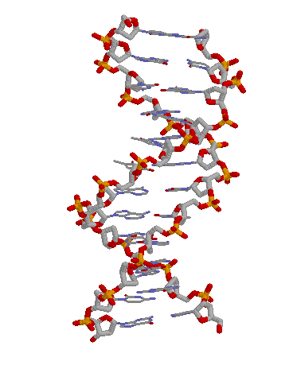
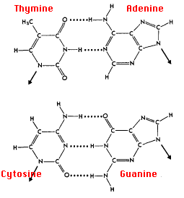
Nomenclature
5’ AGT 3’
3’ TCA 5’
= AGT
TCA
https://www.andrew.cmu.edu/user/rule/jsmol/nucleic.html
Double Helical Structures: B-DNA
a) The helix is right-handed; the chains are antiparallel.
b) 10 bp/turn.
c) The helix interior is filled with stacked base, phosphates and deoxyriboses on the outside.
d) T pairs with A via two "Watson-Crick H-bonds"
e) C pairs with G via three "Watson-Crick hydrogen bonds"
f) Opposite strand termed “complimentary strand”. Top strand is always written 5’->3’, lower strand 3’ -> 5’.

Slide 8
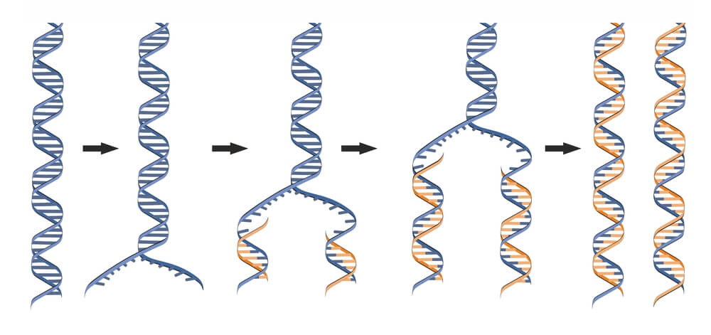
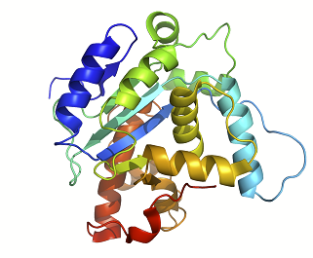
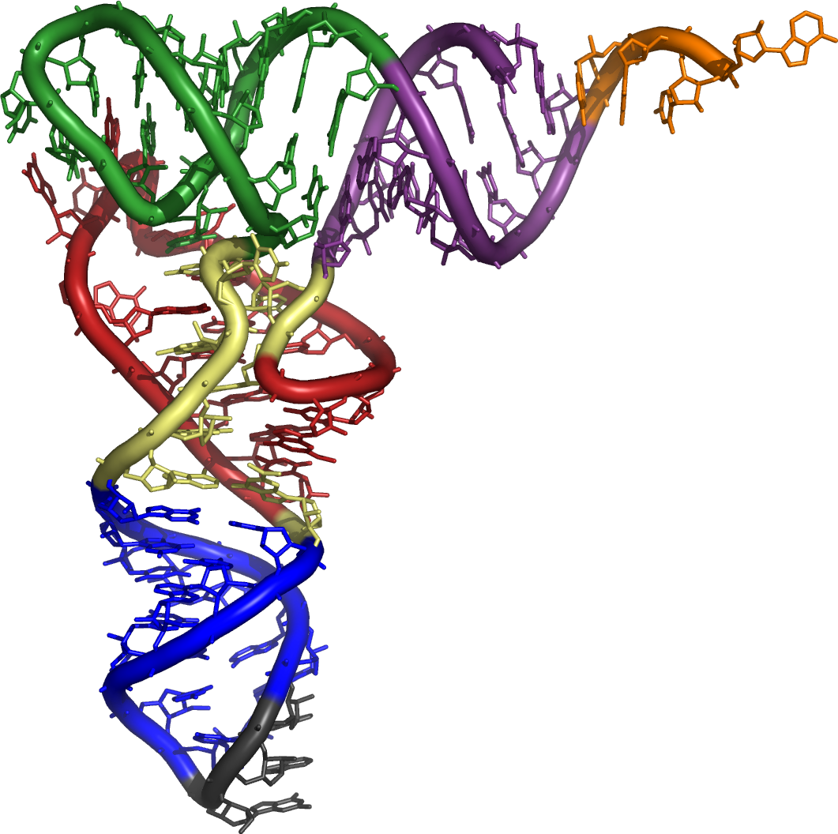
Introduction to Central Dogma
Genome: Entire DNA content of an organism, contains all of the instructions for life. Single circular molecule in Proks, multiple linear molecules (chromosomes) in Euks. The genome is replicated when cells divide.
Gene – a segment of DNA that is converted (transcribed) to RNA. A promoter (P) sequence on the DNA is the minimal requirement for the production of RNA.
P
P
Non-coding RNA
Transcription
Coding RNA
RNA molecules are processed in Eukaryotic cells before they are functional. Processing includes:
Splicing – removal of introns, joining exons to generate protein coding region.
5’ capping
3’ polyA tail
mRNA Processing (Euks only)
Possible functions
meG
AAAAA
miRNA
(euk)
rRNA
(p syn)
Proks
Splicing
(euk)
tRNA
(p syn)
Translation
Telomerase
(euk)
protein
mRNA are translated to a protein.
Many RNAs are functional on their own
ribosome

Slide 9
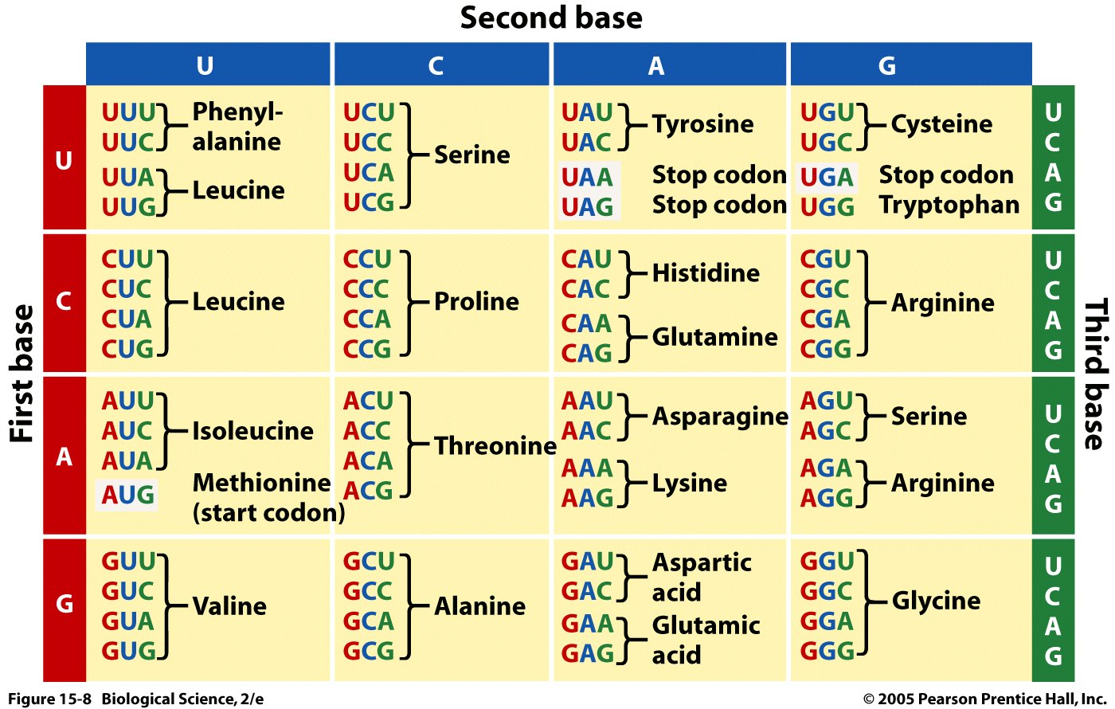
The Genetic Code – Converting a DNA/RNA Sequence to a Protein
Codon = 3 bases that code for an amino acid
....ATATGCCCATGTGGTAA..
(DNA Sequence)
...AUAUGCCCAUGUGGUAA..
(mRNA Sequence)
..U-AUG-CCC-AUG-UGG-UAA
(Punctuated RNA sequence – how the ribosome interprets the sequence)
Each codon codes for one amino acid.
Many amino acids are coded by more than one codon.
Most organisms use the same codon table – some codons have different meanings in some organisms.
________-________-________-_______
Special Codons:
AUG = Is used to begin almost all proteins that are synthesized on the ribosome, codes for methionine when found internally.
UAA, UAG, UGA = stop codons, terminate synthesis
(Protein Sequence)
Notes:
Methionine is also the codon for a start sequence

Slide 10
DNA Polymerases – Used in DNA Sequencing and PCR
DNA polymerases utilize a template to direct the order of added bases,
The enzyme will continue to the end of the template.
Require a basepaired primer with a 3’OH. Primer can be DNA or RNA, DNA is used for laboratory work, RNA is used by the cell during replication
New dNTP added to the 3' hydroxyl of the existing polymer, elongation in the 5’ to 3’ direction.
Pyrophosphate (PP) is released and hydrolyzed to two inorganic phosphates.
^{5'}A-T^{3’OH} ^{5'}A-T-C^{3'OH} ^{5'}A-T-C-C^{3'OH}
^{3'}-C-T-A-G-G-T- ^{3'}-C-T-A-G-G-T- ^{3'}-C-T-A-G-G-T-
Expectations: Know the features of this reaction.

Slide 11
DNA Polymerase – Fundamental Activity.
5’ A-T-C-A
3’A-T-G-C-C-G-T-A-G-T-C-G-T-A-C-A-G-T-A-C-G-T-G-C-A
1 2 3 4 5 6 7 8 9 0 1 2 3 4 5 6 7 8 9 0 1 2 3 4 5
1 2
A short 4 base primer (ATCA) is added to a template, and the temperature is lowered to allow annealing (basepairing) of the primer to the template.
Where (what position) will this primer anneal?
What is the first base added by the polymerase? A G C T
What is the last base added by the polymerase? A G C T

Slide 12
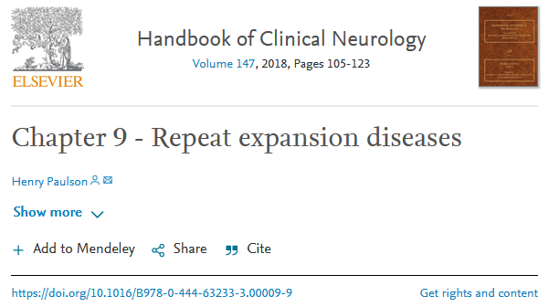
Repeat Expansion Diseases – Errors in DNA Replication
Repeats in coding regions of genes will generate long stretches of the same amino acid.
CAGCAGCAG = GluGluGlu
Repeats outside of coding regions can affect gene expression by changing binding of transcription factors.
These repeats can grow due to slippage of primer during replication
More repeats = more chance of developing disease.
• CAG – at least 10 diseases (Huntington disease, spinal and bulbar muscular atrophy, dentatorubral-pallidoluysian atrophy and seven SCAs)
• CGG – fragile X, fragile X tremor ataxia syndrome, other fragile sites (GCC, CCG)
• CTG – myotonic dystrophy type 1, Huntington disease-like 2, spinocerebellar ataxia type 8, Fuchs corneal dystrophy
• GAA – Friedreich ataxia
• GCC – FRAXE mental retardation
• GCG – oculopharyngeal muscular dystrophy
• CCTG – myotonic dystrophy type 1
• ATTCT – spinocerebellar ataxia type 10
• TGGAA – spinocerebellar ataxia type 31
• GGCCTG – spinocerebellar ataxia type 36
• GGGGCC – C9ORF72 frontotemporal dementia/amyotrophic lateral sclerosis
• CCCCGCCCCGCG – EPM1 (myoclonic epilepsy)
The number of repeats can be detected by:
DNA sequencing
PCR

Slide 13
Repeat Expansions – How Do They Grow?
Original Sequence - 3 repeats (CAG)
Replication continues
A
-TATATCCAGCAGCAGAGTATA-
-ATATAGGTCGTCGTCTCATAT-
C
G
-TATATCCAGCAGCAGAGTATA-
-ATATAGGTCGTCGTCTCATAT-
During Replication in the cell
-TA
-ATATAGGTCGTCGTCTCATAT-
Next replication (upper strand as the template)
-TATATCCAGCAGCAG
-ATATAGGTCGTCGTCTCATAT-
-TATATCCAGCAGCAGCAGAGTATA-
TCATAT-
3’ end comes loose (primer slippage)
CAGCAG
4 repeats
-TATATCCAG
-ATATAGGTCGTCGTCTCATAT-
-TATATCCAGCAGCAGCAGAGTATA-
-ATATAGCTCGTCGTCGTCTCATAT-
Looped out DNA
A
C
G
-TATATCCAGCAG
-ATATAGGTCGTCGTCTCATAT-

Slide 14
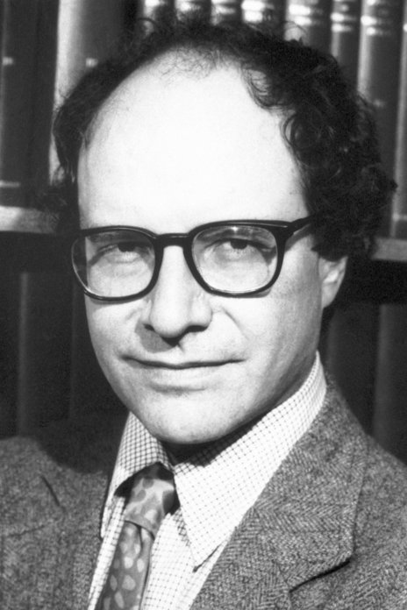
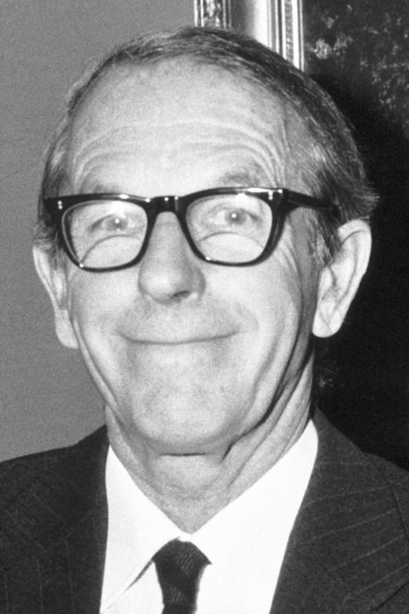
DNA Sequencing – Sanger (dideoxy) Sequencing
DNA Sequencing - Determining the Order of Bases in the DNA.
Maxim & Gilbert: Chemical cleavage, no prior sequence information required. This method was not widely adopted because it used hydrazine (rocket fuel)
Sanger Sequencing:
Second method to generate long (~1000 base) sequence information (Sanger was awarded his 2nd Nobel prize for this work in 1980, shared with Gilbert.
Requires knowledge of some sequence for priming.
Determine the position of all four bases in a DNA strand = Sequence (video)
Sanger Sequencing:
Primer
^{5’}C-A-T-A-T-G^{OH}
Template
3’G-A-A-G-T-C-G-A-A-G-G-T-A-T-A-C-C-A-T-T-A-G-G-C-C-A-T-G-C-A-C-G-T----
Known Seq (plasmid)
Unknown sequence (insert)
Sequenced region (~1000 bases)
5’C-A-T-A-T-G-G-T-A-A-T-C-C-G-G-T-A-C-G-T-G-C-A----
Template
3’G-A-A-G-T-C-G-A-A-G-G-T-A-T-A-C-C-A-T-T-A-G-G-C-C-A-T-G-C-A-C-G-T----

Slide 15
DNA Sequencing - Determining the Order of Bases Added by DNA Polymerase
The DNA to be sequenced is inserted into a circular piece of double stranded DNA called a plasmid. The DNA sequence of the plasmid is known.
The insertion is often accomplished using restriction enzymes that generate single stranded overhangs that allow DNA molecules to be efficiently joined.
Restriction sites can be added to any DNA fragment using a number of techniques:
Addition of a short linker (same site on both ends)
PCR (different sites on each end)
Restriction Enzymes
Recognize a specific sequence in the DNA
Sequence has 2-fold symmetry – same on the top and bottom strand
Cuts both strands, most generate single-stranded DNA (sticky ends).
Complementary sticky ends can bind to each other.
C-A-T-A-T-G-----C-T-C-G-A-G
G-T-A-T-A-C-----G-A-G-C-T-C
Sticky end
C-A T-A-T-G-----C T-C-G-A-G
G-T-A-T A-C-----G-A-G-C-T C
Key Point 1. Start sequencing at known location with primer that anneals at a unique location on the plasmid, “upstream” from the region to be sequenced.
-----C-A T-A-T-G-----C T-C-G-A-G---
-----G-T-A-T A-C-----G-A-G-C-T C---
All DNA molecules begin here.
First base is added here.
-----C-A T-A-T-G-----C T-C-G-A-G---
-----G-T-A-T A-C-----G-A-G-C-T C---
DNA Ligase – reform phosphodiester bond
^{5’}C-A-T-A-T-G^{OH}
3’-A-G-G-T-A-T-A-C-C-A-T-T-A-G-G-C-C-
-----C-A-T-A-T-G-----C-T-C-G-A-G---
-----G-T-A-T-A-C-----G-A-G-C-T-C---
Known Seq (plasmid)
Unknown sequence
(insert)

Slide 16
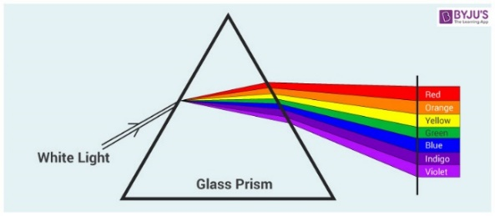
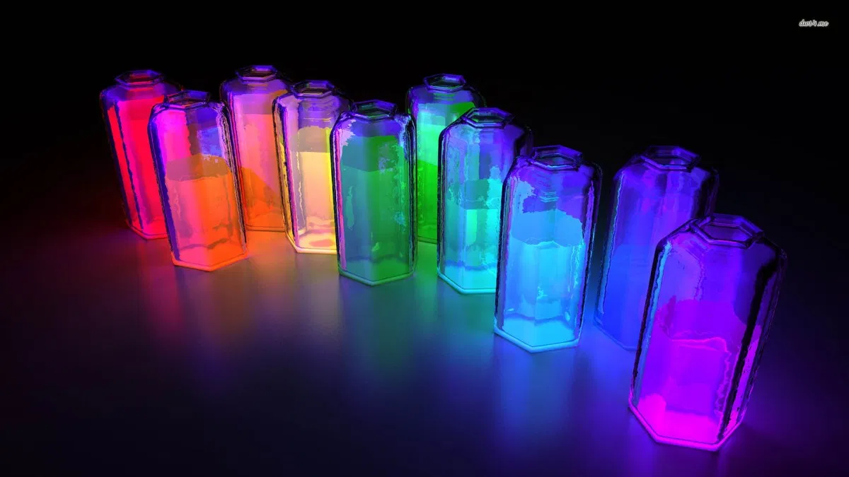
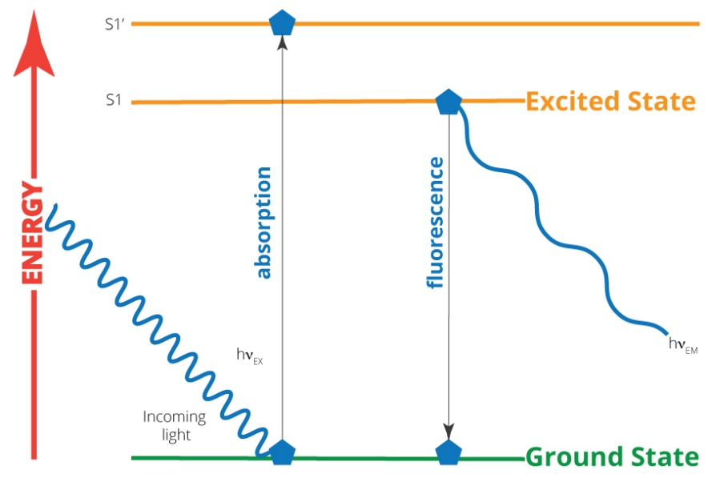
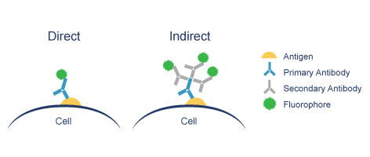
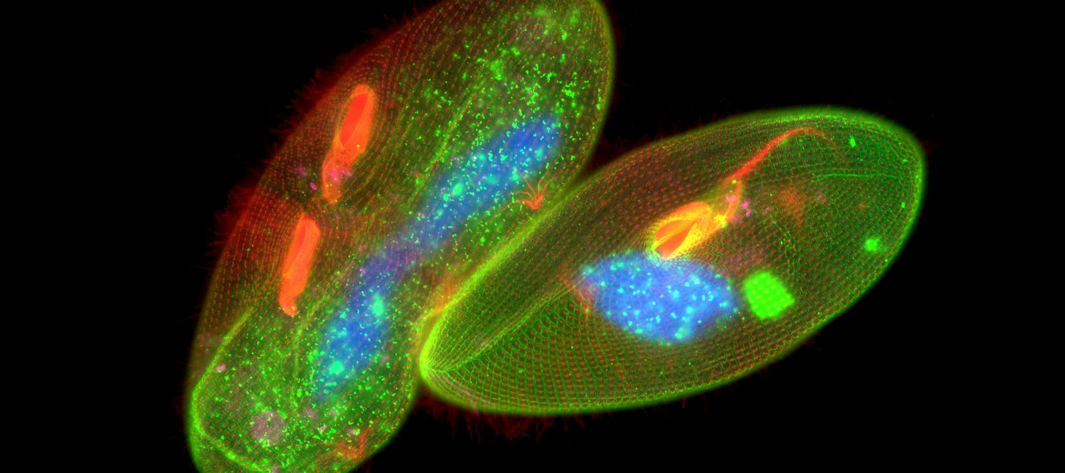
DNA Sequencing Methods Use Fluorescent Bases - What is Fluorescence?
When molecules absorb light an electron goes from a lower shell to a higher shell. This is where the energy from the light goes.
In most molecules the electron goes back down to its original shell with the release of heat.
Fluorescent molecules emit the energy as light of a longer wavelength (different color).
The color that is emitted depends on the molecule.
Fluorescently tagged antibodies can be used to stain components of cell with fluorophores.

Slide 17
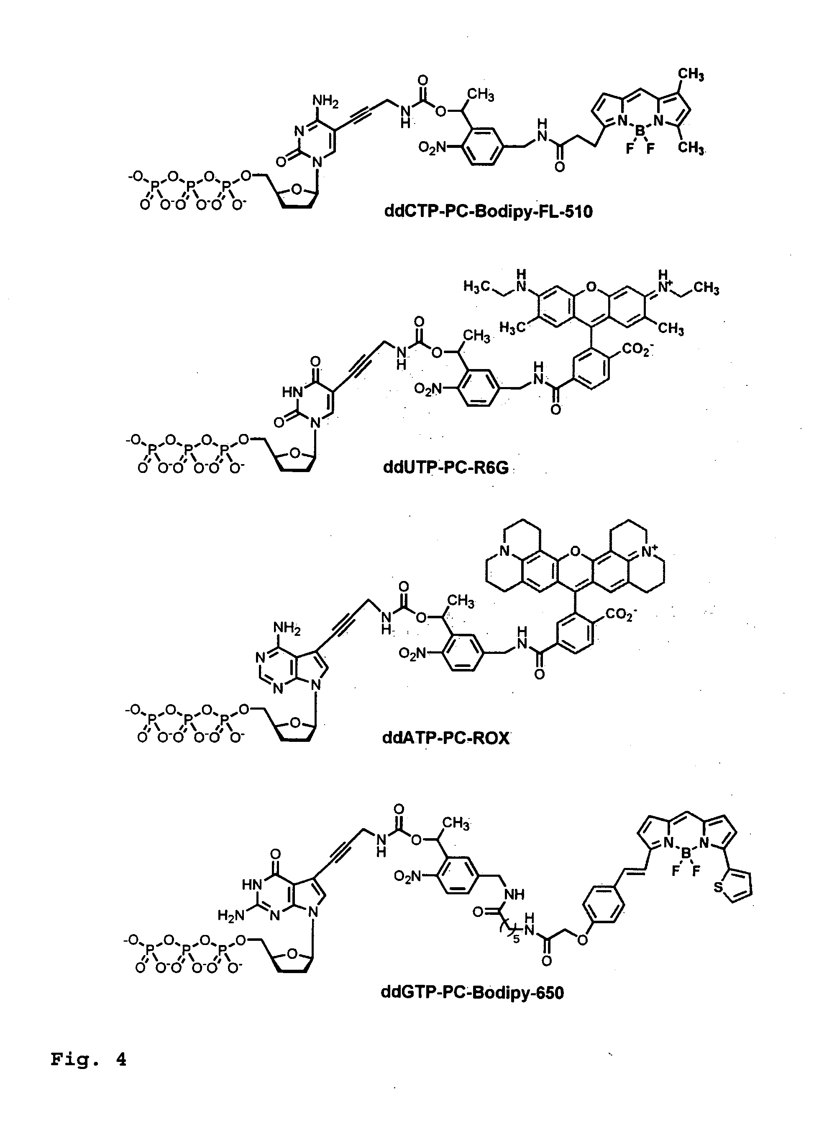
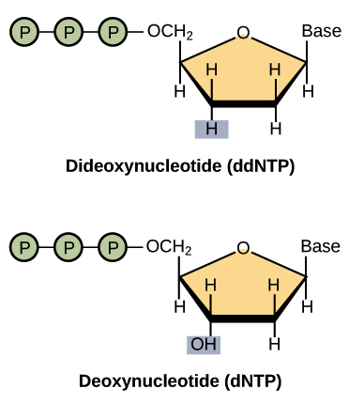
DNA Sequencing - Determining the Order of Bases Added by DNA Polymerase
Key point 2. Use a mixture of normal bases (dNTPs) and dideoxy bases (ddNTP) for polymerization. Ratio of dNTP to ddNTP is (100:1), most of the time elongation occurs.
ddNTPs can be added to the DNA since they have a 5’-triphosphate but terminate the chain due to the lack of a 3’-OH. ~ 1 in 100 chains terminate at each base addition
Key point 3. The ddNTPs are color coded by different fluorescent emission wavelengths.
The ddNTP that terminated the chain is known from its fluorescent color.
ddCTP^{H}
After
ddTTP incorporated
ddTTP^{H}
ddATP^{H}
After
dTTP incorporated
ddGTP^{H}

Slide 18
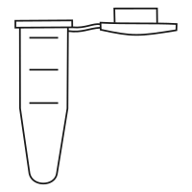
Template
Primer
DNA Pol
dTNP, ddNTP
DNA Sequencing – Generation of Fluorescent Fragments
Length=7, Black fluor.
All Possible Fragments are Made:
Each begins with the primer
Each ends with a known ddNTP, based on the color of the fluorescence.
Each is one longer than the previous.
(10)
5’-C-A-T-A-T-G-G^{H}
3’-A-G-G-T-A-T-A-C-C-A-T-T-A-G-G-C
5’-C-A-T-A-T-G
3’-A-G-G-T-A-T-A-C-C-A-T-T-A-G-G-C
(990)
5’-C-A-T-A-T-G-G^{OH}
3’-A-G-G-T-A-T-A-C-C-A-T-T-A-G-G-C
(1000 molecules)
Length=8, Red fluor.
(10)
5’-C-A-T-A-T-G-G^{OH}
3’-A-G-G-T-A-T-A-C-C-A-T-T-A-G-G-C
5’-C-A-T-A-T-G—G-T^{H}
3’-A-G-G-T-A-T-A-C-C-A-T-T-A-G-G-C
(980)
(990 molecules)
5’-C-A-T-A-T-G—G-T^{OH}
3’-A-G-G-T-A-T-A-C-C-A-T-T-A-G-G-C
Length=9, Green fluor
C-A-T-A-T-G-G
C-A-T-A-T-G-G-T
C-A-T-A-T-G-G-T-A
C-A-T-A-T-G-G-T-A-A
C-A-T-A-T-G-G-T-A-A-T
C-A-T-A-T-G-G-T-A-A-T-C
C-A-T-A-T-G-G-T-A-A-T-C-C
C-A-T-A-T-G-G-T-A-A-T-C-C-G
(10)
5’-C-A-T-A-T-G—G-T^{OH}
3’-A-G-G-T-A-T-A-C-C-A-T-T-A-G-G-C
5’-C-A-T-A-T-G—G-T-A^{H}
3’-A-G-G-T-A-T-A-C-C-A-T-T-A-G-G-C
(980 molecules)
(970)
5’-C-A-T-A-T-G—G-T-A^{OH}
3’-A-G-G-T-A-T-A-C-C-A-T-T-A-G-G-C
5’-C-A-T-A-T-G—G-T-A^{OH}
3’-A-G-G-T-A-T-A-C-C-A-T-T-A-G-G-C
Primer
Added by Pol.

Slide 19
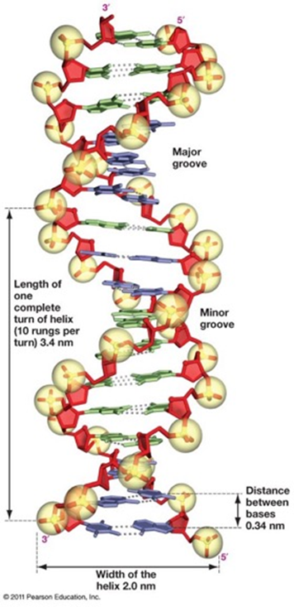
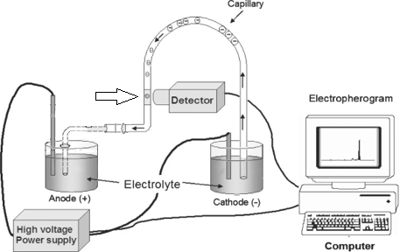
Size Determination of Fragments from DNA Sequencing Capillary Electrophoresis
Capillary
Sample loaded
Fluorescence excitation
DNA has a negative charge.
It will migrate towards the anode.
Capillary is filled with a gel that causes separation by size.
DNA molecules that are smaller migrate _____________.

Slide 20
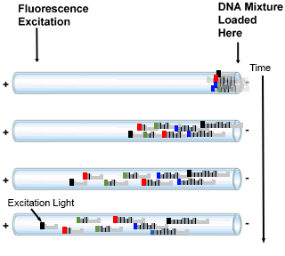
DNA Sequencing – Analysis of Fragments to Determine Order of Addition
4. Capillary Gel Electrophoresis
Migration due to the voltage because of the neg. charge on DNA phosphates
Separation of DNA molecules by size, smaller travel through gel faster.
Fragments reach the detector in the order of their length: primer+1 first, primer+2 second, etc.
At the detector, a laser excites the fluorescence.
Only fluorescent DNA molecules (terminated with ddNTP) give a signal.
The color of the emitted fluorescence gives the dideoxy base at the 3’ end of the DNA fragment.
The order of peaks gives the sequence that is complementary to the template (= strand with primer).
Fluor.
Detector
C-A-T-A-T-G-G
C-A-T-A-T-G-G-T-A-A-T-C-C
C-A-T-A-T-G-G-T-A-A-T-C
C-A-T-A-T-G-G-T-A-A
C-A-T-A-T-G-G-T-A-A-T-C-G
C-A-T-A-T-G-G-T
C-A-T-A-T-G-G-T-A-A-T
C-A-T-A-T-G-G-T-A
Fluorescent output over time.
G-T-A-A-T-C-C-G
5’-C-A-T-A-T-G
3’-A-G-G-C-T-A-T-A-C-C-A-T-T-A-G-G-C
Time

Slide 21
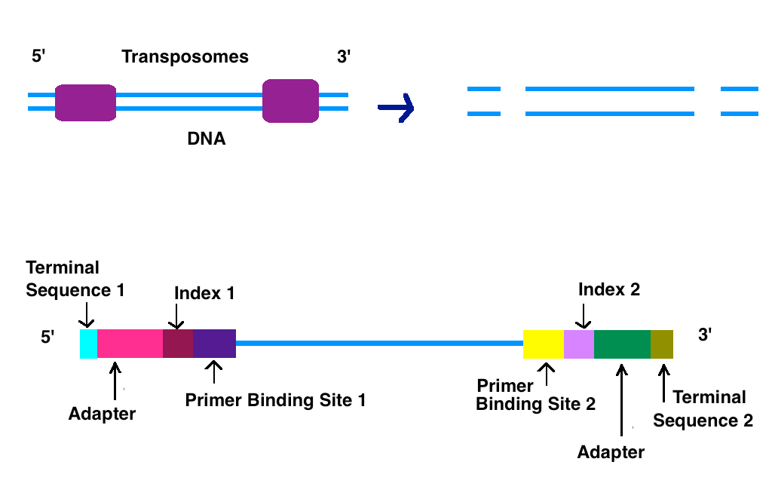
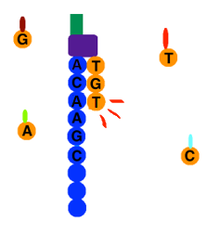
Newer Sequencing Methods-Illumina Dye Sequencing – Next Generation High Throughput
A. Obtaining the DNA
B. Sequencing by synthesis – Fluorescent labeling & reversible 3’-OH blocking
Addition of T
The entire genome can be sequenced.
The DNA is fragmented into small 100 base pieces.
Synthetic DNA is added to the ends (sites for primers for sequencing)
Different fragments are bound to different location on a solid surface (chip).
All fragments are sequenced at the same time on the chip.
Only one base is added at a time (3’-OH is blocked)
The base that is added is determined by the color of the fluorescent base.
3’-OH blocking group and the fluorescent group are removed prior to the next addition. ~100 cycles can be performed.

Slide 22
Next Generation - Data
Primer anneals
Add dNTPs (3’blocked) + Polymerase
Wash to remove unincorporated dNTPs
Detect which base was added to each cluster using fluorescent emission
Unblock 3’-OH to allow the next base to add.
Repeat.
B
A
C
A
A
T
T
G
G C C T
T
T
A
A
C
A
A
T
T
G
G C A C
T
T
A
A
C
A
A
T
T
G
A G T G
T
T
A
A
C
Cluster A:
Comparison of Sanger and Next-Gen
Method | Read Length | Samples Processed
Sanger | ~1000 | 1
Illumina | ~200 | ~10,000s

Slide 23
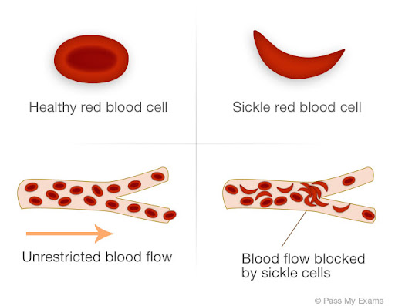
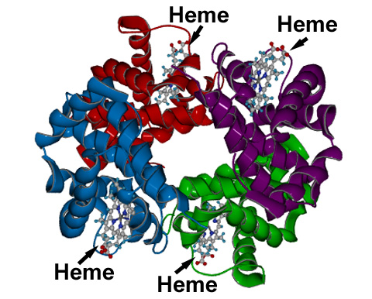
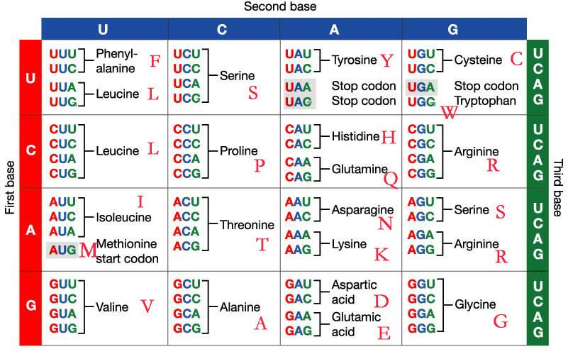
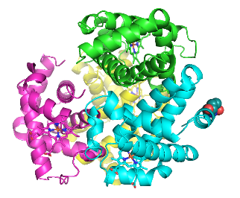
Genotyping at the Molecular Level with DNA Sequencing.
Sickle cell anemia is caused by a single mutation in the beta chain of hemoglobin
This mutation causes the hemoglobin to form long polymers that distort the shape of the red blood cell.
Determining whether someone has the mutation can be useful for treatment.
The 5’ end of the Hb gene is shown on the right (ATG=start). Using GGTGCCAG as a sequencing primer gives the following sequences for the normal and mutant genes:
First dd-base added by polymerase
GGTGCCAGaggatggtgcacctgactcctgaggagaagtc..
CCACGGTCtcctaccacgtggactgaggactcctcttcag..
Sequencing data for the normal beta chain is:
aggatggtgcacctgactcctgaggagaagtctgccgttact...
MetValHisLeuThrProGluGluLysSerAlaValThr...
Glu6
Sequencing data for the mutation:
False color code:
A=Green
G=Black
T=Red
C=Blue
Aggatggtgcacctgactcctgtggagaagtctgccgttact...
MetValHisLeuThrProValGluLysSerAlaValThr...
Val6

Slide 24
Sequencing Summary
Sanger Sequencing:
Gives the sequence that is complementary to the template strand = “top” strand, same strand at the primer.
The start of the sequencing information is defined by a primer that anneals to the template (therefore some of the sequence has to be known, how this is done will be described later)
Dideoxy sequencing is carried out by adding both dideoxynucleotide triphosphates (ddNTPs) and deoxyribonucleotide triphosphates (dNTPs) to the synthesis reactions, at a ratio of 1:100. Most growing chains do not terminate.
ddNTPs are identical to dNTPs except that they lack the 3' hydroxyl group. Because of the missing 3’-OH, DNA polymerization stops once one ddNTP is added to a growing strand.
The type of the added base is determined by “color coding” each base.
The location of added bases is determined by measuring the size of the DNA fragment that was terminated by the ddNTP.
It is possible to sequence approximately 1000 bases by this method.
Next Gen-Sequencing:
Simultaneous sequencing of a large number of fragments
Shorter “reads” 100 versus 1000 bases/template
gcagatgatacagtattagaagaaatgaGtttgccaggaaGatggaaaccaaaaatgata....

Slide 25
Polymerase Chain Reaction - PCR
In 1983, Kary Mullis developed the molecular biology technique that has since revolutionized genetic research, earning him the Nobel Prize in 1993.
PCR had an impact on four main areas of biotechnology: gene mapping, cloning, DNA sequencing, and gene detection (e.g. coronavirus).
PCR is now used as a medical diagnostic tool to detect specific mutations that may cause genetic disease, in criminal investigations and courts of law to identify suspects on a molecular level, and in the sequencing of the human genome.
Expectations:
Be able to explain how PCR works to amplify a segment of DNA.
Be able to give the left and right primers.
Apply PCR approaches to determine genotype and detection of viruses.

Slide 26
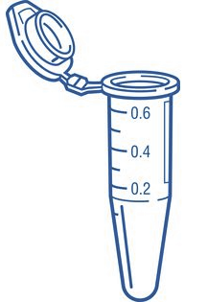
Polymerase Chain Reaction
PCR is an in vitro DNA synthesis reaction in which a specific section of DNA is replicated over and over generating exponentially large amounts of a specific piece of DNA from trace amounts of starting material (template).
Template can be trace amounts of DNA from a drop of blood, a single hair follicle, or a cheek cell.
The region of DNA that is copied is specified by the sequence of two primers, which are short ssDNA that initiate polymerase activity. The primers are in vast excess over the DNA.
The location of the amplified segment is defined by two primers (left = upstream, right = downstream):
they anneal to their templates according to Watson-Crick pairing rules (A-T, G-C),
initiate polymerization from those sites,
they are incorporated into the final PCR product.
Left primer = sequence of top strand at left boundary
Right primer = sequence of bottom strand at right boundary
The primers are DNA and are synthesized chemically, they can be any desired sequence.
If there is no homology between the primers and the input DNA, then no PCR product will be formed.
Each PCR cycle consists of three steps:
Denaturation of the DNA to make it single stranded (2 min at 98 C)
Lowering of temperature to let the primers form double-stranded DNA (1 min at 55 C)
Elongation by DNA polymerase (1 min/kb at 78 C)

Slide 27
PCR – Primer Design
Before a region of DNA can be amplified, one must identify and determine the sequence of a piece of DNA upstream and downstream of the region of interest.
These areas are then used to determine the sequence of oligonucleotide primers that will be synthesized and used as starting points for DNA replication.
Primers are complimentary to the up- and down-stream regions of the sequence to be amplified, so they stick, or anneal, to those regions.
Left primer = sequence of top strand on the left. This primer will anneal to the bottom strand.
Right primer = sequence of bottom strand on the right. This primer will anneal to the top strand.
Primers are in large excess over the template DNA, they are never used up.
The primers are incorporated into the final PCR product.
Amplified region
Amplified region
5’--AAGCTGACTAGTCGATGCGAATGTGCGGTGC—3’
3’--TTCGACTGATCAGCTACGCTTACACGCCACG—5’
^{5’}CTGAC
ACACG5’ = 5’GCACA
Know these rules!
CTGACTAGTCGATGCGAATGTGC
GACTGATCAGCTACGCTTACACG
Note: Actual primer lengths are 20-30 bases, in the illustrations here and on problem sets, much shorter primers are used.

Slide 28
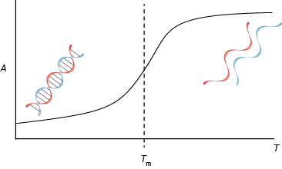
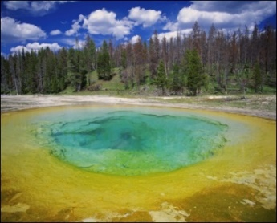
PCR Step 1 - Thermal Stability of Double Stranded DNA (dsDNA)
5’ A-T-C-A
3’A-T-G-C-C-G-T-A-G-T-C-G-T-A-C-A-G-T-A-C-G-T-G-C-A
Polymerase Characteristics
Since the first step of each cycle (D) requires heating to high temperature, a thermostable polymerase is required.
The first polymerase, Taq, was isolated from Thermus Aquaticus, a bacterial living in hot springs (Yellowstone National Park)
A number of different polymerases with improved properties have been developed.
5’ A-T-C-A
3’A-T-G-C-C-G-T-A-G-T-C-G-T-A-C-A-G-T-A-C-G-T-G-C-A

Slide 29
PCR Animation
Watch Me!
Notes:
2 ½ min

Slide 30
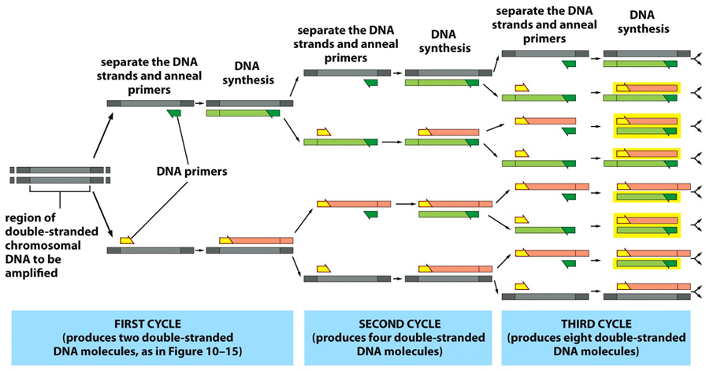
Three PCR Cycles
Other end of PCR product is defined by starting at the primer, using the new DNA as the template.
One end of PCR product is defined by starting at the primer.
After 30 cycles there will be 2³⁰, or over 1 billion times more copies than at the beginning!!!

Slide 31
Detailed Events During First Three PCR Cycles
Note:
Polymerization starts at the primer (add to 3’-OH)
Polymerase always goes to the end of the template.
Cycle I
Cycle II
Template
--AAGCTGACTAGTCGATGCGAATGTGCGGTGC--U
--TTCGACTGATCAGCTACGCTTACACGCCACG--L
--AAGCTGACTAGTCGATGCGAATGTGCGGTGC-U
--TTCGACTGATCAGCTACGCTTACACG5’
5’CTGACTAGTCGATGCGAATGTGCGGTGC--
--TTCGACTGATCAGCTACGCTTACACGCCACG-L
Left primer
Denature & Anneal
5’CTGAC
--AAGCTGACTAGTCGATGCGAATGTGCGGTGC-U
ACACG5’
5’CTGAC
--TTCGACTGATCAGCTACGCTTACACGCCACG-L
Denature & Anneal
Right primer
--AAGCTGACTAGTCGATGCGAATGTGCGGTGC--
5’CTGAC
--TTCGACTGATCAGCTACGCTTACACG5’ L strand
5’CTGACTAGTCGATGCGAATGTGCGGTGC– U Strand
ACACG5’
--TTCGACTGATCAGCTACGCTTACACGCCACG--
5’GCACA
Polymerase
--AAGCTGACTAGTCGATGCGAATGTGCGGTGC-U
<-TTCGACTGATCAGCTACGCTTACACG5’
5’CTGACTAGTCGATGCGAATGTGCGGTGC->
--TTCGACTGATCAGCTACGCTTACACGCCACG-L
Polymerase
--AAGCTGACTAGTCGATGCGAATGTGCGGTGC--
5’CTGACTAGTCGATGCGAATGTGC
--TTCGACTGATCAGCTACGCTTACACG5’
5’CTGACTAGTCGATGCGAATGTGCGGTGC--
GACTGATCAGCTACGCTTACACG5’
--TTCGACTGATCAGCTACGCTTACACGCCACG--
Now have one strand of the product
So far - defined one end of the product
Final Product
CTGACTAGTCGATGCGAATGTGC
GACTGATCAGCTACGCTTACACG

Slide 32
Detailed Events during first Three PCR Cycles
Example – follow the PCR cycles for the following template with primers 5’ AATT (left) and 5’ GGCC (right)
Cycle 3
5’CTGACTAGTCGATGCGAATGTGC
--TTCGACTGATCAGCTACGCTTACACG5’
5’CTGACAGTCGATGCGAATGTGCGGTGC--
GACTGTCAGCTACGCTTACACG5’
----AATT-------------------------GGCC----
----TTAA-------------------------CCGG----
Denature & Anneal
5’CTGACTAGTCGATGCGAATGTGC
ACACG5’
--TTCGACTGATCAGCTACGCTTACACG5’
5’CTGACAGTCGATGCGAATGTGCGGTGC--
5’CTGAC
GACTGTCAGCTACGCTTACACG5’
Now have complete PCR product.
The product will double in each of the following cycles.
Note that the primers are the first bases at the ends of each strand of the PCR product.
Polymerase
5’CTGACTAGTCGATGCGAATGTGC
GACTGATCAGCTACGCTTACACG5’
--TTCGACTGATCAGCTACGCTTACACG5’
5’CTGACAGTCGATGCGAATGTGCGGTGC--
5’CTGACAGTCGATGCGAATGTGC
GACTGTCAGCTACGCTTACACG5’
AATT-------------------------GGCC
TTAA-------------------------CCGG

Slide 33
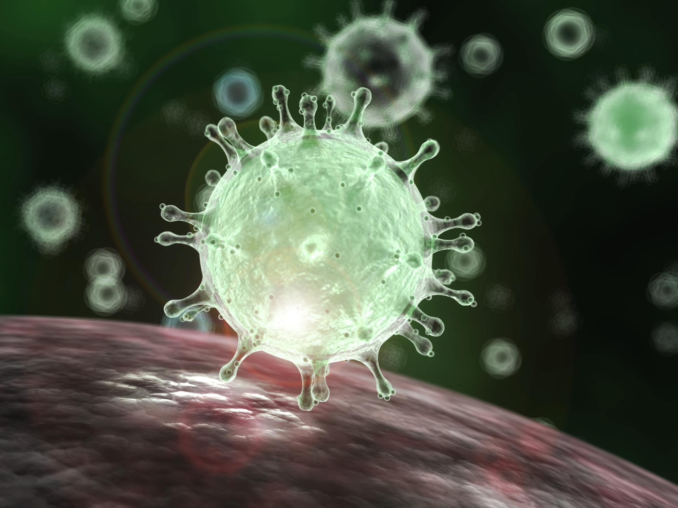
PCR Applications - Detection of Viruses
Sequence of Covid-19 (top strand only)
Coronavirus
1 attaaaggtt tataccttcc caggtaacaa accaaccaac tttcgatctc ttgtagatct
61 gttctctaaa cgaactttaa aatctgtgtg gctgtcactc ggctgcatgc ttagtgcact
121 cacgcagtat aattaataac taattactgt cgttgacagg acacgagtaa ctcgtctatc
181 ttctgcaggc tgcttacggt ttcgtccgtg ttgcagccga tcatcagcac atctaggttt
28261 cgaacaaact aaaatgtctg ataatggacc ccaaaatcag cgaaatgcac cccgcattac
28321 gtttggtgga ccctcagatt caactggcag taaccagaat ggagaacgca gtggggcgcg
28381 atcaaaacaa cgtcggcccc aaggtttacc caataatact gcgtcttggt tcaccgctct
28441 cactcaacat ggcaaggaag accttaaatt ccctcgagga caaggcgttc caattaacac
29701 gggaggactt gaaagagcca ccacattttc accgaggcca cgcggagtac gatcgagtgt
29761 acagtgaaca atgctaggga gagctgccta tatggaagag ccctaatgtg taaaattaat
29821 tttagtagtg ctatccccat gtgattttaa tagcttctta ggagaatgac aaaaaaaaaa
29881 aaaaaaaaaa aaaaaaaaaa aaa
CDC Recommended PCR Primers
dsSeq of above bold & circled region
28271 aaaatgtctgataatggaccccaaaatcagcgaaatgcaccccgcattacgtttggtggaccctcagattcaactggcagtaaccagaatggagaacgca
ttttacagactattacctggggttttagtcgctttacgtggggcgtaatgcaaaccacctgggagtctaagttgaccgtcattggtcttacctcttgcgt
PCR Product
GACCCCAAAATCAGCGAAATGCACCCCGCATTACGTTTGGTGGACCCTCAGATTCAACTGGCAGTAACCAGA CTGGGGTTTTAGTCGCTTTACGTGGGGCGTAATGCAAACCACCTGGGAGTCTAAGTTGACCGTCATTGGTCT
Will PCR generate products if the viral DNA is not present?

Slide 34
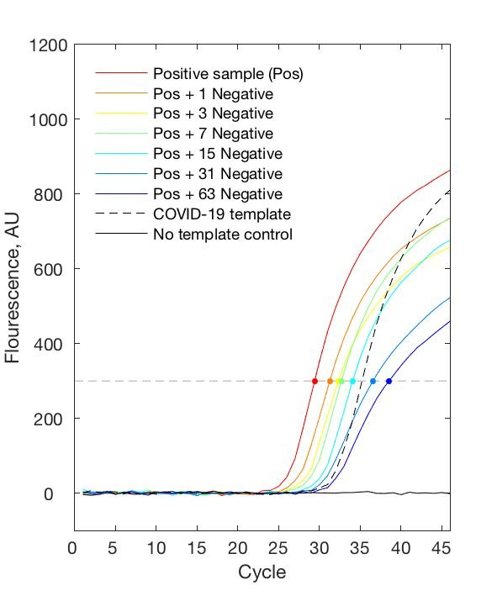
Covid 19 PCR Test: Detection of the PCR Product.
https://www.medrxiv.org/content/10.1101/2020.03.26.20039438v1
Production of PCR products (double stranded DNA) causes an increase in signal (fluorescence)
Signal above 300 considered to be positive (dashed gray line)
Dots represent when a sample crosses the fluorescence threshold.
Red curve (Positive sample) shows a threshold level of PCR product after 27 cycles.
- - - is a positive control amount of Covid template. It shows that you can detect a PCR product if the covid genome is present.
Solid black line is a negative control, no Covid DNA. It shows that addition of covid template will lead to a signal.
Other samples are the positive sample mixed with up to 63 negative samples, showing that it is possible to test pooled samples.
Amount of PCR Product
Number of PCR Cycles

Slide 35
PCR Applications – Identification of Individuals
Regions of DNA have variable numbers of repeated DNA sequences (Short tandem repeats, STR). The number of STR can differ from one person to the next.
STR
--TGCCGACTCGTAGGCCAGGCCAGGCCAGGCCACTGGTGAGGTACG--
--ACGGCTGAGCATCCGGTCCGGTCCGGTCCGGTGACCACTCCATGC--
Individuals will inherit one copy of the repeat from each parent. The length of the inherited DNA can be the same or different.
PCR Primers are designed to be outside the repeated region, so that they will anneal to a single location on the chromosome and then amplify the region containing the STR
PCR Product length = primer lengths + number of tandem repeats (+ any DNA between the primers and the repeats). Individuals can be differentiated by the length of the PCR product if they have different numbers of STR
5’-CCGACTC
CTCCATG-5’
CCGACTCGTAGGCCAGGCCAGGCCAGGCCACTGGTGAGGTAC
GGCTGAGCATCCGGTCCGGTCCGGTCCGGTGACCACTCCATG
Which individual has the shortest PCR product?
Which has the longest?

Slide 36
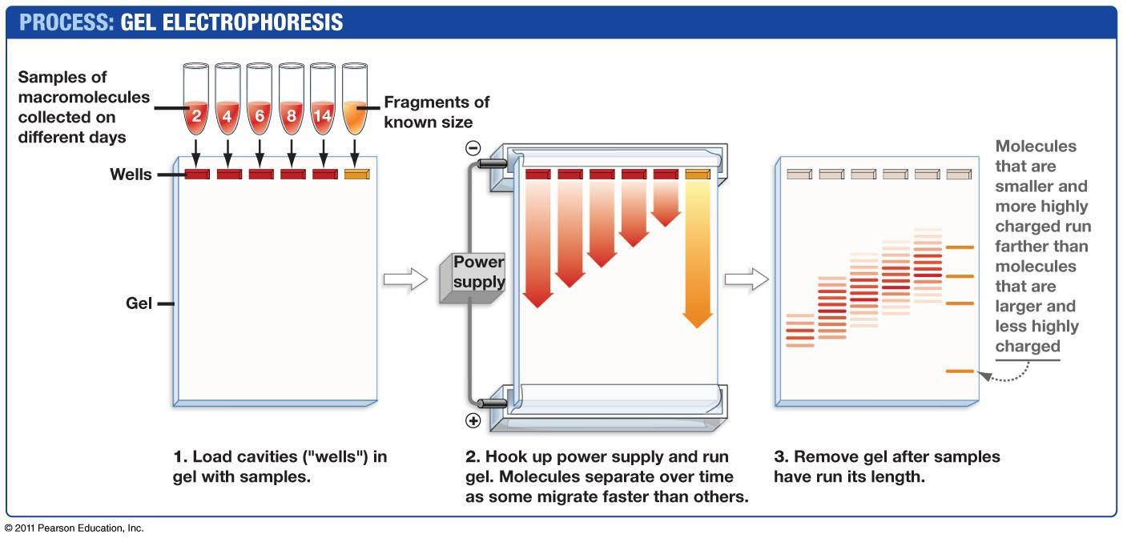
Size Determination of PCR products - Agarose Gel Electrophoresis.
https://dnalc.cshl.edu/resources/animations/gelelectrophoresis.html
Which are the smallest PCR fragments?

Slide 37
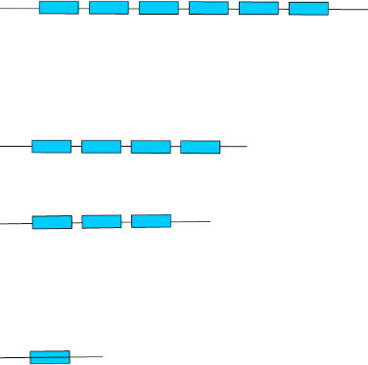
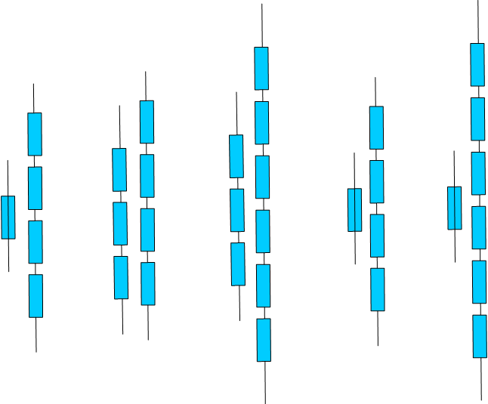
Short Tandem Repeats to Test Paternity
1. DNA samples (blood, cheek cells) would be obtained from:
Mother
Child
Candidate fathers.
2. PCR would be preformed using primers that amplify a segment of the chromosome containing repeats.
3. Each individual would show 2 bands on the gel, corresponding to the PCR product from each chromosome (we have two copies of each chromosome).
4. The child would inherit one copy from the mother and the other from the father:
One of the child’s PCR product would match one of the mothers.
The other PCR product from the child would match one of the PCR products from the father.
Top
PCR products
PCR primers:
Gel
Repeat:
Lane 1: Child
Lane 2: Mother
Lanes A, B, C: Possible Fathers
1 2 A B C
Which PCR product is from the mother? From the father?
Who is not the father?
Who may be the father?
Child
Potential
Fathers

Slide 38
Introduction to Immunology
Branches of the immune system (Innate and acquired)
Properties of antibodies (Quaternary structure, antigen recognition)
How antibodies are produced:
Genome DNA changes
mRNA splicing
4. How antibodies eliminate pathogens
Key Questions:
1. Why is the innate system important?
2. What is the origin of diversity in acquired immunity?
3. How are antibodies made.

Slide 39
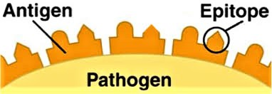
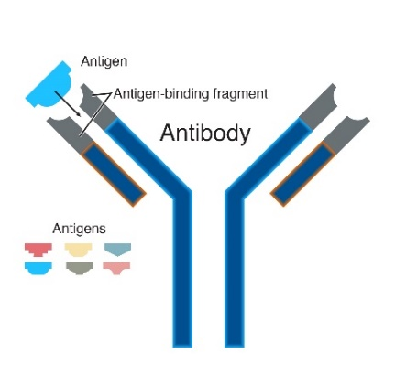
Some Important Definitions:
Antigen = something that is recognized by the immune system, e.g. bacteria, virus, pollen.
Epitope = the part of the antigen that is contacted by the antibody.
Antibody (Ab) = Y-shaped protein that recognizes antigens, found on the surface of B-cells or secreted by plasma cells. When bound to antigen, it can initiate a process that results in the destruction of the antigen. Specificity is high due to AA sequence in the variable segments.
Immunoglobulin (Ig) = antibody.
B-cell = involved in antibody production and recognition of pathogen. Has antibody molecule on its surface (as part of the B-cell receptor). Develops into plasma cells after activation by T_{H} cells. Called B-cells because they are generated in the organ called the Bursa in birds.
Plasma cell = derived from B-cell after activation of the B-cell, produces secreted antibodies with the same specificity as the original B-cell.
T_{H} cell = T-helper: Required to activate both B and T_{C} cells, as well as other cells in the immune system.
Called T-cells because they mature in the thymus.
T_{c} cell = T-cellular: Involved in defense against viruses and cancer.
TCR = T-cell receptor – found on the surface of T-cells, recognizes MHC proteins + bound peptide, RTK.
T_{c} cell = recognizes MHC I + peptide
T_{H} cell = recognizes MHC II + peptide
MHC = major histocompatibility complex – required for acquired immunity (basis of transplant rejection)
MHC I = protein found on the surface of all cells, “presents” peptides derived from the proteins that were made by the cell. The MHC-peptide complex is recognized by T_{c} cells. Only foreign peptides produce a response.
MHC II = on the surface of B-cells, macrophages, and dendritic cells. Presents external peptides to T_{H} cells, leading to activation of the cell by T_{H} cells. Only foreign peptides produce a response.

Slide 40
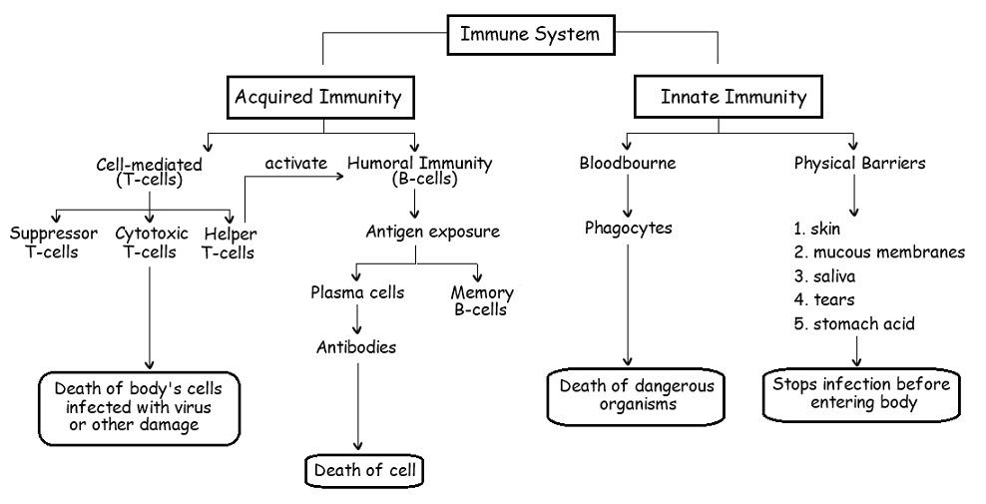
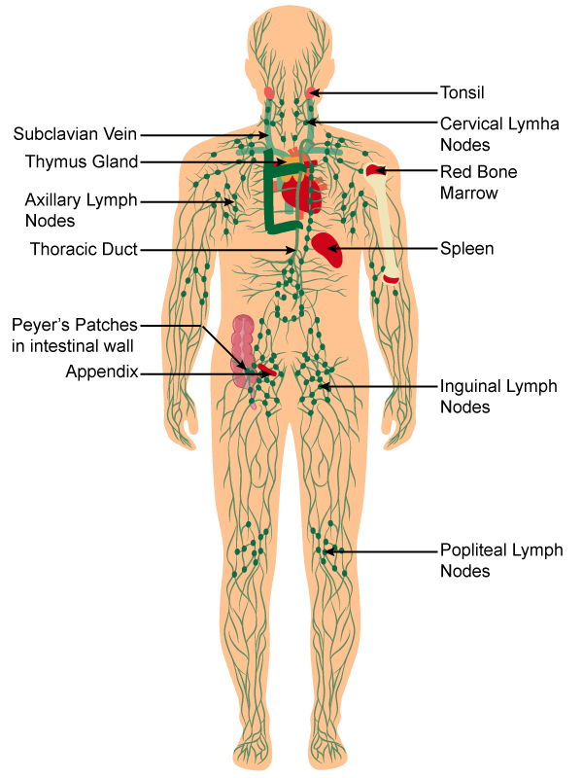
Branches of the Immune System:
http://ibbiologyhelp.com/AnimalPhysiology/antibodyproduction.html
Neutrophil
Macrophage
Dendritic cell
Why is the innate system essential?
A pathogen doubles every hour.
It takes 7 days to produce antibody (after 1st exposure)
Uncontrolled growth would produce many bacteria: 2 ^{24 x 7} = 3.7 x 10⁵⁰ (~10³⁰ kg)
Important primary lymphatic organs: bone marrow (B), thymus (T)-Generate all immune cell.
Important secondary lymphatic organs: lymph nodes, spleen, Peyer’s patches – Activation of immune cells.
https://www.topperlearning.com/
Notes:
3.7 e 50 cells

Slide 41
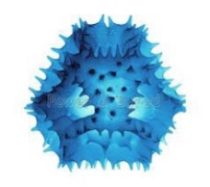
Antibody Structure and Diversity
Each Antibody:
Two identical light chains
Two identical heavy chains
First ~100 Amino acids on each chain are called the variable region and differ from antibody to antibody.
Unique sequence for variable region of both heavy and light chains – defines specificity – different antibodies bind different antigens.
Constant regions - same protein sequence for all.
Light chain sequences:
M..TSERTQYESTTY..RGEC
M..AAFQRTYESTTY..RGEC
1.....110.........210
Coded by different exons
(one letter AA code)
Heavy chain sequences:
M...AGLLITWHIKLPA...SPGK
M...FPREYAWHIKLPA...SPGK
1......120...........449

Slide 42
Production of Antibodies by B-cells & Plasma Cells
B- Cells & B-cell Receptor (BCR)
Each B-cell has only one type of antibody as part of its BCR (B-cell receptor), i.e. the 10⁵ BCRs are homogeneous on the same cell.
Approximately 10⁸ different specificities at any one time. i.e. 10⁸ different B-cells!
Plasma Cells:
After activation, a B-cell develops into a plasma cell.
The antibody is secreted.
The same light chains are produced.
The heavy chains differ only in the absence of the transmembrane domains.
Antigen-
binding site
Heavy
chains
Antigen-
binding site
Antigen-
binding site
Heavy
chains
Antigen-
binding site
Light chain
Light chain
Light chain
Light chain
Disulfide bond
Disulfide bond
mRNA that codes for antibodies contains two types of sequences:
Exons – contain codons for the amino acids
Introns – removed before translation
Different exons are used to produce membrane bound or soluble antibodies.
RTK – Receptor tyrosine kinase – signaling domain.
Transmembrane domains

Slide 43
B-Cell Biology - From Stem Cells to Pathogen Killing.
1. Generation of high diversity of chains during development of stem cells to B-cells in bone marrow.
DNA rearrangements to generate functional exons for variable segments of both light and heavy chain.
2. Molecular & cellular biology of membrane bound antibodies on cell surface = B-cell receptor (BCR)
Transcriptional enhancers, mRNA splicing
Light chain and heavy chain exported to surface of B-cells.
3. Self tolerance test to prevent autoimmune diseases, autoreactive B-cells eliminated.
4. Encounter and capture of antigen in lymph nodes
5. Activation of B-cells by T_{H} cells
Peptides from pathogen presented on major histocompatibility proteins (MHC II).
T-cell activation by tyrosine kinase receptors (T-cell Receptor, TCR), secretion of signaling molecules.
6. Development of
Plasma cells - Production of soluble antibodies of the same specificity as the parent B-cell.
B-memory cells (basis of immunity)
T-memory cells (basis of immunity)
7. Destruction of Pathogens
Fc region of antibody binds to Fc Receptor on NK cells, neutrophiles, macrophages
Pathogen internalized and destroyed.
BCR – B-cell receptor = antibody + signaling chains.
TCR – T cell receptor = MHC-peptide recognition + signaling.

Slide 44
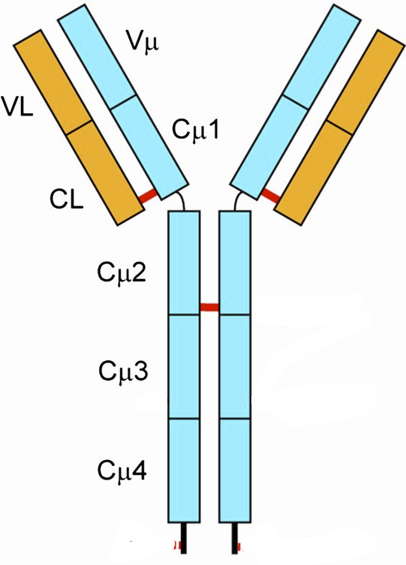
Antibody Genes are Assembled From DNA Segments: Giving many different sequences.
Production of Heavy Chain Gene:
V_{H} exon = V+D+J segment (selected at random)
The mRNA coding for antibodies contains 5 exons.
Germline/Stem cell DNA
←300→
D-J joining
Random selection of D & J segments
L = leader (signal)
V = variable segment
D = diversity segment
J = joining segment
V joining to (DJ)
Random selection of V-segment
Heavy chains have different V-sequences.
B-cell DNA
V_{H} exon differs from one cell to the next.
Heavy chains have the same constant sequences in all B-cells.
Stem cells -> B-cells
The exon that codes for the variable region of the heavy chain is generated by the random joining of a V, D, and J DNA segments.
Each B-cell will generate a unique sequence for its heavy and light chain DNA.
This is a permanent change to the DNA (genome) of the B-cell.
1. If there are 300 possible V-heavy segments, 10 possible D segments, and 6 possible J segments, how many different heavy chains can be made?

Slide 45
Light-chain Genes are Assembled From DNA Segments: Giving many different sequences.
Production of Light Chain Gene
Germline/Stem cell DNA
←100→
B-cell DNA
Light chains have different V-sequences in different B-cells.
Light chains have the same constant sequences in all B-cells.
Antibody Diversity
1. If there are 100 possible V-heavy segments and 5 possible J segments, how many different light chains can be made?
Stem cells -> B-cells
In the case of the light chain, the variable region is generated by VJ joining.
Each B-cell will generate a unique sequence for its heavy and light chain DNA.
This is a permanent change to the DNA (genome) of the B-cell.
2. If any possible heavy chain can pair with any possible light chain, how many different antibodies can be generated, assuming there are 10,000 possible heavy chains and 500 different light chains?

Slide 46
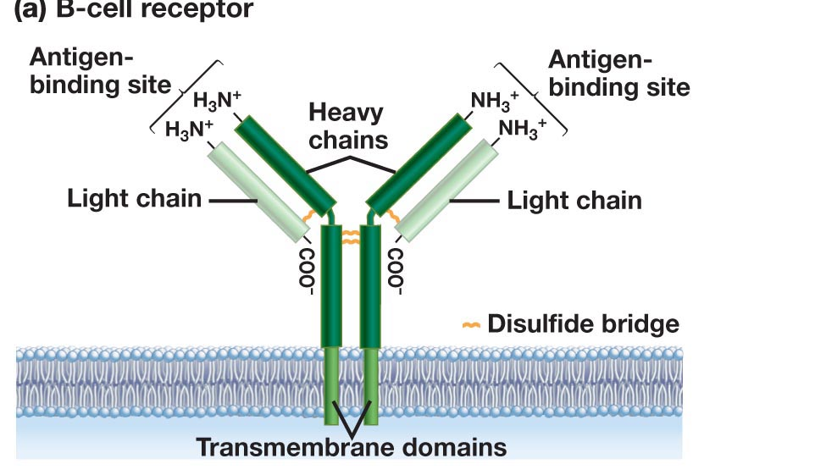
Antibody Production – From Stem Cells to B-Cells
Stem Cell
B-Cell
Rearranged light chain gene
Rearranged heavy chain gene
Transcription
mRNA Splicing (introns removed)
Translation
Export to cell surface (ER -> golgi -> Membrane)

Slide 47
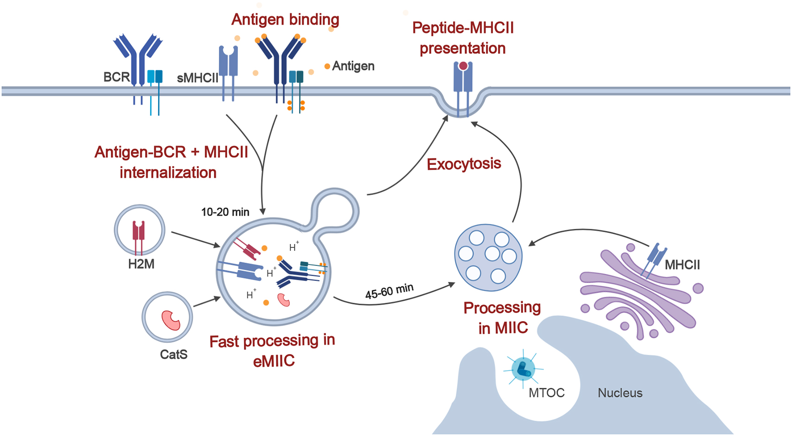
Antigen Capture by B-Cells - Endocytic Pathways
Endocytosis of bacteria by a B-cell
1
4
Bacteria labeled with Green fluorescent protein.
Capture of the bacteria
Internalization (endocytosis)
Degradation of the bacterial proteins, producing peptides.
Antigen binds to variable domains of antibody on the BCR (B-cell receptor)
Antigen is internalized and digested into peptides
Peptides are loaded on to class II MHC
Peptide-MHC displayed on membrane for presentation to T-cells
2
3
Journal of Cell Science doi: 10.1242/jcs.235192

Slide 48
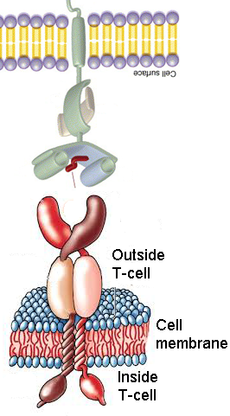
Activation of B cells by Antigen - Lymph Node
B-cells develop into antibody secreting plasma cells.
B and T-helper cells develop into memory cells, that are long-lived and are quickly activated by the same pathogen. This is the basis of vaccination.
B-cell
MHC II - Major histocompatibility complex
Peptide from pathogen
(foreign peptide)
T-cell Receptor (TCR)
T_{H} cell
Events:
Recognition of MHC II-peptide by TCR
Tyrosine kinase signaling in T_{H} cell
Cytokines (protein messengers) produced.
Cytokines activate B-cells.
Soluble antibody from plasma cells has the same light and heavy chains as the original B-cell.
Membrane anchors are missing, so antibody is secreted outside the cell.

Slide 49
Can you:
Describe how the genes for the heavy and light chain are generated, and how this give rise to many different antibodies?
Do you understand the process of B-cell activation, including presentation of foreign peptides on MHC II and the role of the T-helper cell.
Describe how antibodies inactivate pathogens?

Slide 50
Cell Based Acquired Immunology
Key Questions:
1. How does your immune system fight viruses?
2. How does your immune system detect and destroy cancer cells?
3. How can the immune response be engineered to fight cancer?
T_{C}
T_{CTL}
Activation of Tc cells requires:
Recognition of foreign peptide on MHC I.
Assistance from T-helper cells.
T_{C} Memory
Cell Types:
T_{H}
T_{C}, T_{CTL}
Activated Tc cell becomes a cytotoxic T-lymphocyte T_{CTL}
T_{CTL}
Kill virally infected cells
Kill cancer cells

Slide 51
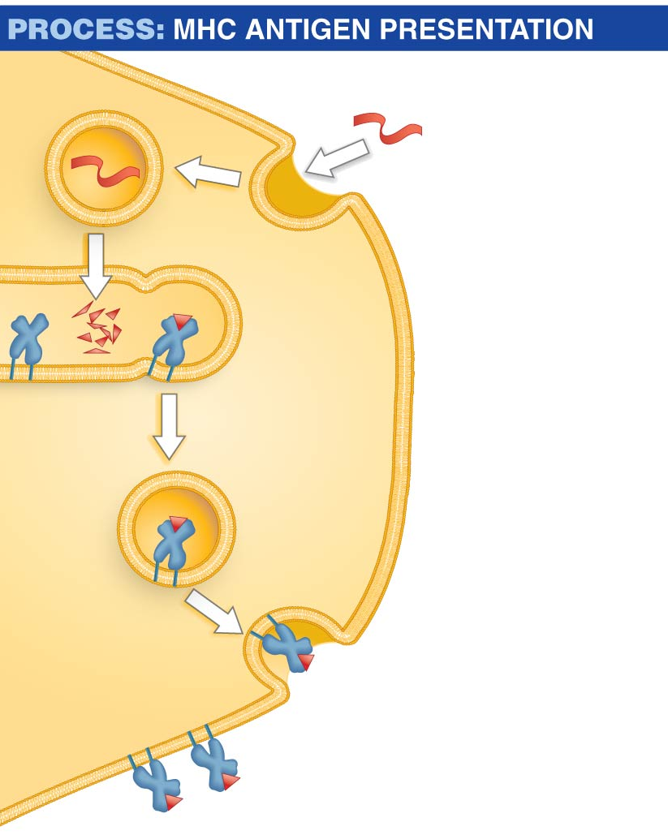
Activation of Tc-Cells A. Dendritic Cells Acquire Antigen from Viruses and Cancerous Cells
Antigen
1. Dendritic cell ingests antigen via phagocytosis (intact virus, cell debris from cancer cell).
Peptide
fragment
2. Enzymes break antigen proteins into peptide fragments.
Major
histocompatibility
(MHC) protein
Endosome
3. Peptide fragments are loaded onto both class I and class II MHC proteins in endosomes.
4. MHC I & II –peptide complex is transported to cell surface.
Dendritic cell
MHC protein
5. MHC protein presents peptide fragment on cell
Surface to T-H and T-C cells.
Peptide
fragment
Notes:
At first, cells known as dendritic cells attack the antigen
The dendritic cells contain proteins called MHC (major histocompatibility) proteins, antigen-presenting proteins that have a groove where small peptide fragments, typically 8 to 20 amino acids in length, bind
There are two MHC classes:
​Class I MHC proteins bind antigens inside the ER
​Class II MHC proteins bind antigens inside endosomes
Dendritic cells process protein antigens and load the peptide fragments onto class II MHC proteins:
Dendritic cells ingest antigens present at the wound
The antigen is moved from the phagosome to an endosome, where enzymes breakdown antigens
Some of the peptides are bound to the grooves of class II MHC proteins
The MHC–peptide complexes are exported from the endosomes and transported to the cell surface
The MHC–antigen complex is displayed on the cell surface

Slide 52
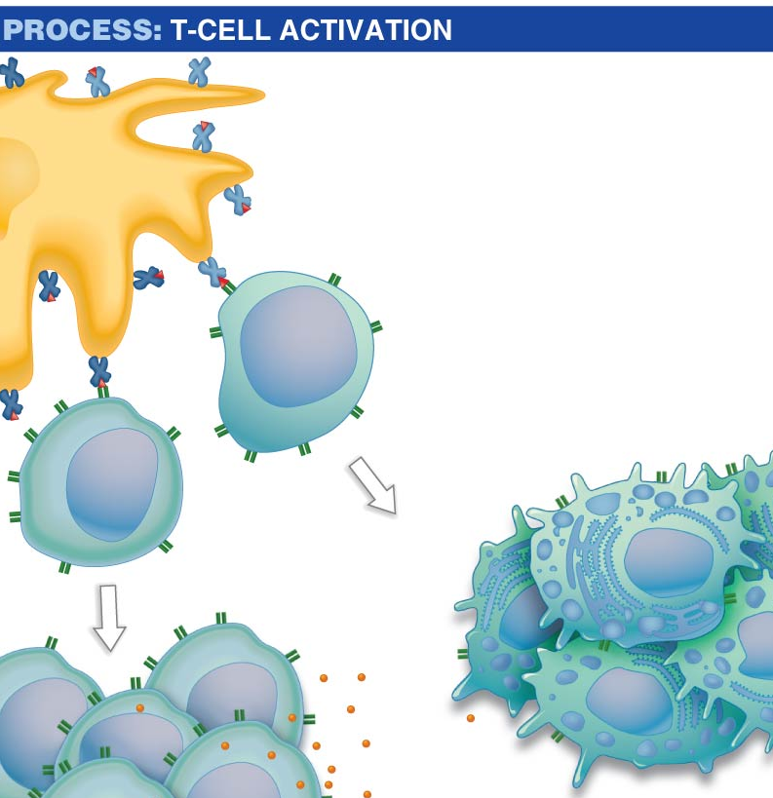
Activation of Tc-Cells B. Dendritic Cells Activate T_{H} and T_{C} cells.
Activation of Tc cells requires:
Recognition of foreign peptide on MHC I by TCR on Tc cell
Assistance from T-helper cells via secreted messengers (small proteins called cytokines)
Only foreign proteins on self-MHC are recognized by T-cells
Dendritic cell
Class I MHC
+ peptide
Class II MHC + peptide
T_{H} interaction
1
T_{C} cell
Cytotoxic T cells
=T_{CTL}
T_{H} cell
2
Notes:
At first, cells known as dendritic cells attack the antigen
The dendritic cells contain proteins called MHC (major histocompatibility) proteins, antigen-presenting proteins that have a groove where small peptide fragments, typically 8 to 20 amino acids in length, bind
There are two MHC classes:
​Class I MHC proteins bind antigens inside the ER
​Class II MHC proteins bind antigens inside endosomes
Dendritic cells process protein antigens and load the peptide fragments onto class II MHC proteins:
Dendritic cells ingest antigens present at the wound
The antigen is moved from the phagosome to an endosome, where enzymes breakdown antigens
Some of the peptides are bound to the grooves of class II MHC proteins
The MHC–peptide complexes are exported from the endosomes and transported to the cell surface
The MHC–antigen complex is displayed on the cell surface

Slide 53
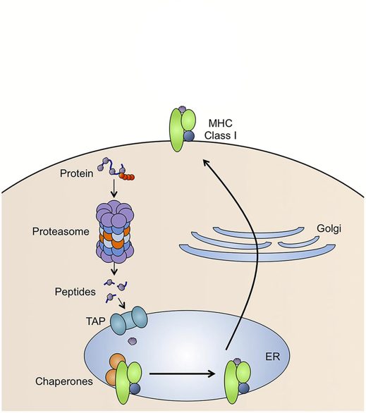
T_{c} Detection of Diseased/Cancer Cells - Role of MHC I
Foreign Peptide Source:
1. From replication of viruses in the cell
2. From replication of intracellular bacteria (e.g. TB)
3. New coding sequences in cancer cells due to genetic changes (e.g. mutations in p53 lead to novel sequences).
MHC I present peptides
Peptides are generated from of all of the proteins that are made in the cell.
Steps:
protein targeted for degradation by ubiquitin
Protein digested by proteasome
Peptides transported into ER
Peptides loaded on to MHC I
Peptide/MHC complex transported to cell membrane.
Only foreign peptides activate T-cells
p53 Protein Sequence
Zn Fingers (DNA binding)
10 20 30 40 50 MEEPQSDPSV EPPLSQETFS DLWKLLPENN VLSPLPSQAM DDLMLSPDDI 60 70 80 90 100 EQWFTEDPGP DEAPRMPEAA PPVAPAPAAP TPAAPAPAPS WPLSSSVPSQ 110 120 130 140 150 KTYQGSYGFR LGFLHSGTAK SVTCTYSPAL NKMFCQLAKT CPVQLWVDST 160 170 180 190 200 PPPGTRVRAM AIYKQSQHMT EVVRRCPHHE RCSDSDGLAP PQHLIRVEGN 210 220 230 240 250 LRVEYLDDRN TFRHSVVVPY EPPEVGSDCT TIHYNYMCNS SCMGGMNRRP 260 270 280 290 300 ILTIITLEDS SGNLLGRNSF EVRVCACPGR DRRTEEENLR KKGEPHHELP 310 320 330 340 350 PGSTKRALPN NTSSSPQPKK KPLDGEYFTL QIRGRERFEM FRELNEALEL 360 370 380 390 KDAQAGKEPG GSRAHSSHLK SKKGQSTSRH KKLMFKTEGP DSD
1
5
2
3
4
EVVRRCPHHE Normal seq., ignored by TCR
EVVGGCPHHE Mutant seq. in cancer,
detected by TCR

Slide 54
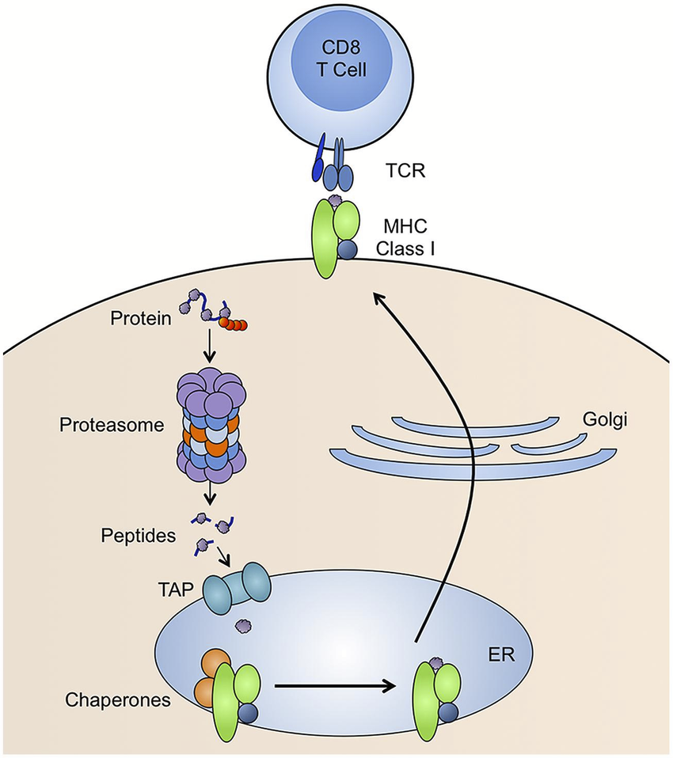
T_{c} Detection of Diseased/Cancer Cells - Role of MHC I
Foreign Peptide Source:
1. From replication of viruses in the cell
2. From replication of intracellular bacteria (e.g. TB)
3. New coding sequences in cancer cells due to genetic changes (e.g. mutations in p53 lead to novel sequences).
MHC I present peptides
Peptides are generated from of all of the proteins that are made in the cell.
Steps:
protein targeted for degradation by ubiquitin
Protein digested by proteasome
Peptides transported into ER
Peptides loaded on to MHC I
Peptide/MHC complex transported to cell membrane.
p53 Protein Sequence
Zn Fingers (DNA binding)
10 20 30 40 50 MEEPQSDPSV EPPLSQETFS DLWKLLPENN VLSPLPSQAM DDLMLSPDDI 60 70 80 90 100 EQWFTEDPGP DEAPRMPEAA PPVAPAPAAP TPAAPAPAPS WPLSSSVPSQ 110 120 130 140 150 KTYQGSYGFR LGFLHSGTAK SVTCTYSPAL NKMFCQLAKT CPVQLWVDST 160 170 180 190 200 PPPGTRVRAM AIYKQSQHMT EVVRRCPHHE RCSDSDGLAP PQHLIRVEGN 210 220 230 240 250 LRVEYLDDRN TFRHSVVVPY EPPEVGSDCT TIHYNYMCNS SCMGGMNRRP 260 270 280 290 300 ILTIITLEDS SGNLLGRNSF EVRVCACPGR DRRTEEENLR KKGEPHHELP 310 320 330 340 350 PGSTKRALPN NTSSSPQPKK KPLDGEYFTL QIRGRERFEM FRELNEALEL 360 370 380 390 KDAQAGKEPG GSRAHSSHLK SKKGQSTSRH KKLMFKTEGP DSD
1
5
2
3
4
EVVRRCPHHE Normal seq., ignored by TCR
EVVGGCPHHE Mutant seq. in cancer,
detected by TCR

Slide 55
T_{C} Cells: Detection and Killing of Virally Infected or Cancer Cells
(T_{CTL})
Cancer cell or
Infected cell
Granzymes enter through perforin pore and cause cell undergo programmed cell death (apoptosis)

Slide 56
Summary Questions for Immunology:
What are the two major branches of the immune system? Why are both important?
What are the roles of different cell types in each system, e.g. what would happen if T_{H}-cells disappeared?
What is the quaternary structure of an antibody? Can you sketch an antibody and indicate where the antigen binds?
What defines the specificity of antibodies?
What are the steps in the production of antibody genes, at the molecular level:
How do DNA rearrangements produce functional heavy and light chain genes
How are is the mature mRNA generated in B-cells and Plasma cells.
What is the difference between the heavy chain export process for B-cells and plasma cells.
Can you describe how antibodies kill/inactivate pathogens
How are virally infected cells and tumor cells recognized by Tc cells?
How does the Tc cell kill those cells?

