Slide 1
Lecture 3 Protein Structure and Function, Carbohydrates, Nucleic Acids
Protein Structure and Stability
Ligand Binding
Proteins as enzymes (PKU disease)
Carbohydrates
Nucleic Acid Technologies

Slide 2
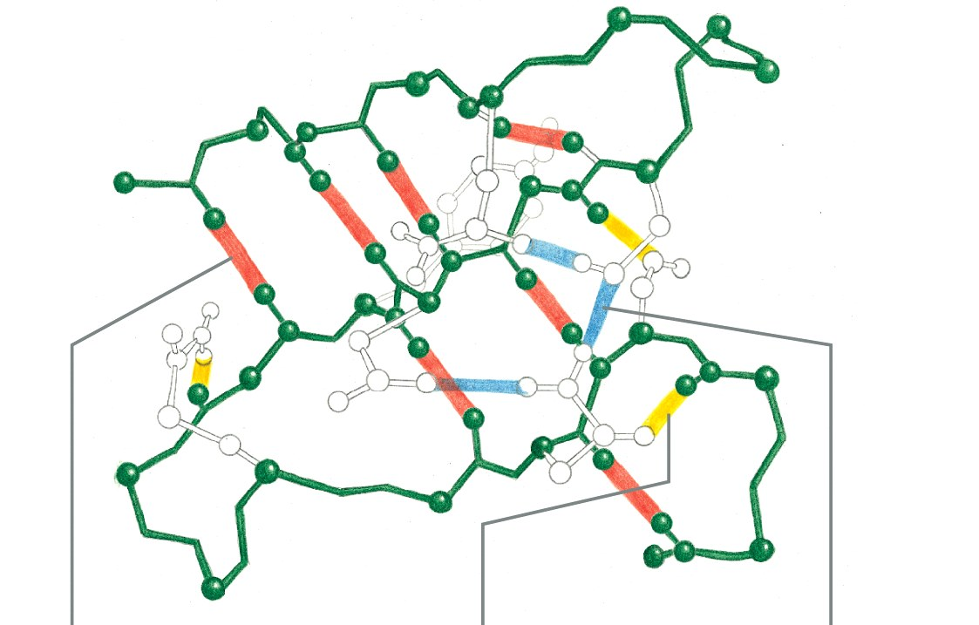
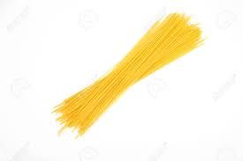
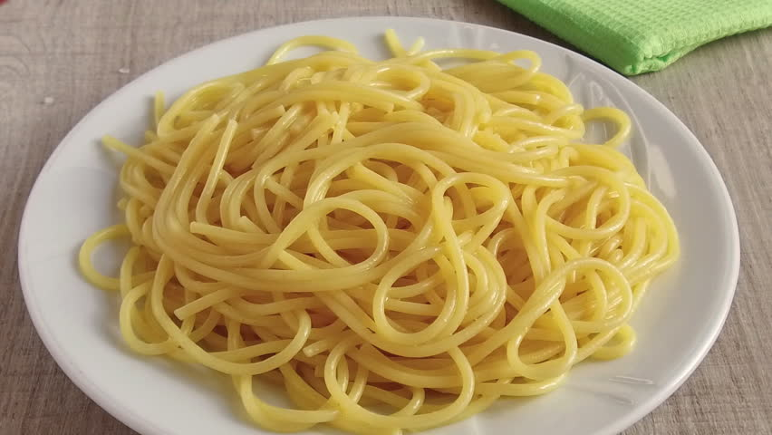
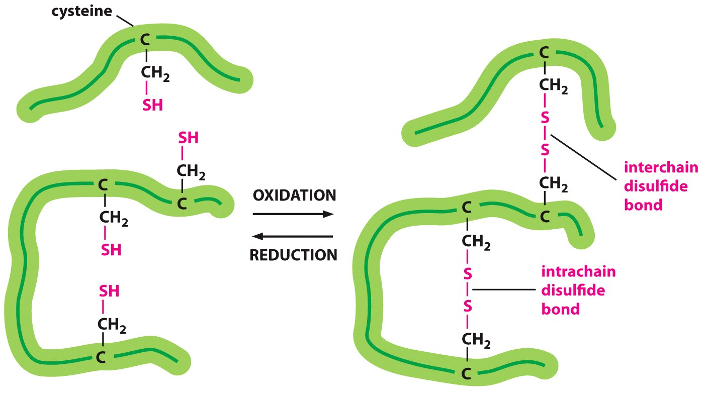
Summary - Interactions that Stabilize Folded Proteins.
H-bonds
van der Waals
Hydrophobic effect
Chain disorder
Hydrogen bonds form between hydrogen atoms (NH) and the carbonyl group in the peptide backbone (mainchain), and between and donors and acceptors on sidechains. Mainchain-mainchain H-bonds are responsible for secondary structures.
Hydrophobic interactions within a protein increase stability of the folded state by increasing entropy due to the release of water that was ordered by the exposed non-polar groups in the unfolded protein.
van der Waals interactions are optimized in the well packed core of the protein.
Covalent disulfide bonds form between sulfur-containing cysteine residues stabilizing them (usually only exported, secreted proteins).
Native
Unfolded
Notes:
Page 47 in the book

Slide 3
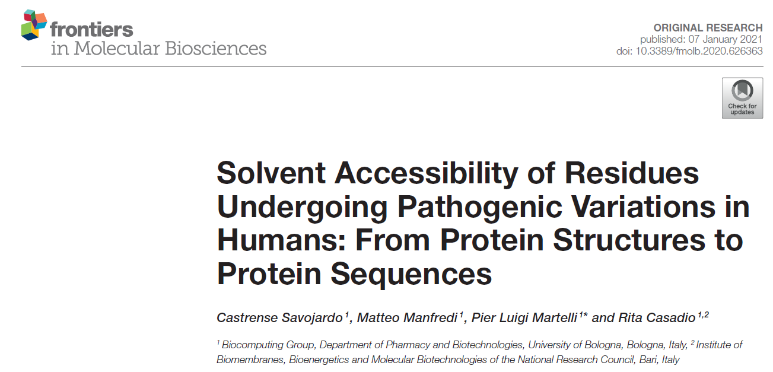
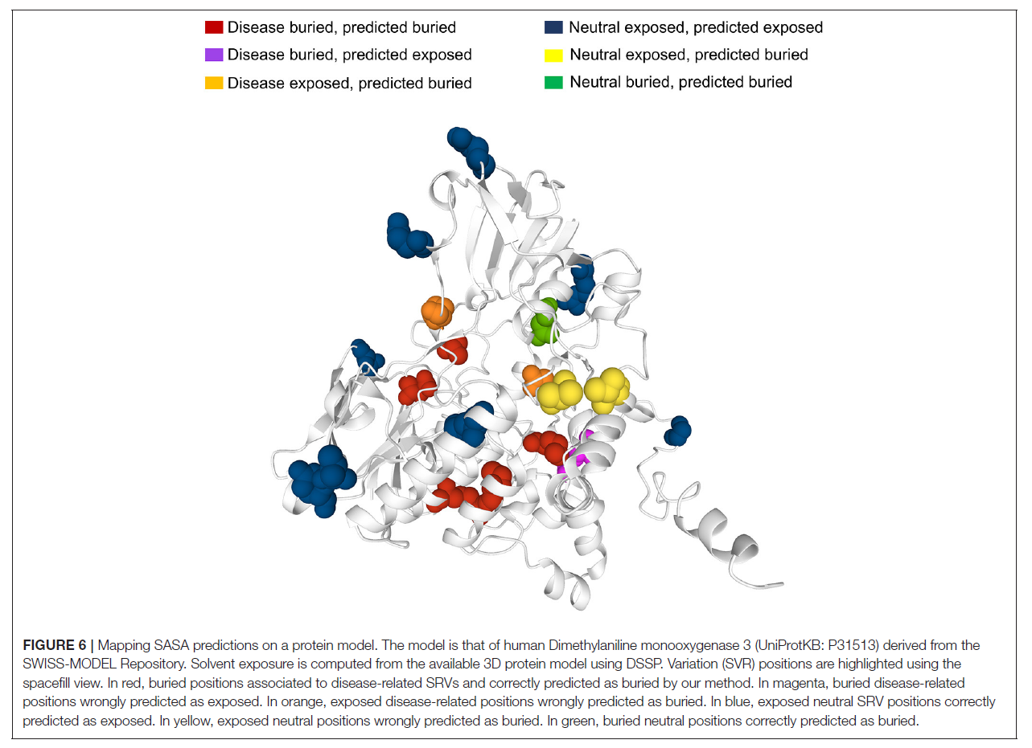
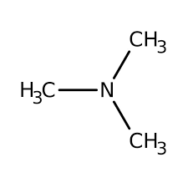
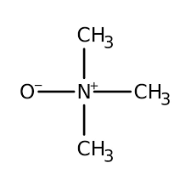
A single change in the amino acid sequence can change the function of a protein, and often affecting how it folds – Producing Inactive Proteins.
dimethylaniline monooxygenase 3
Mutations in dimethylaniline monooxygenase 3 cause trimethylaminuria (high levels of trimethylamine)

Slide 4
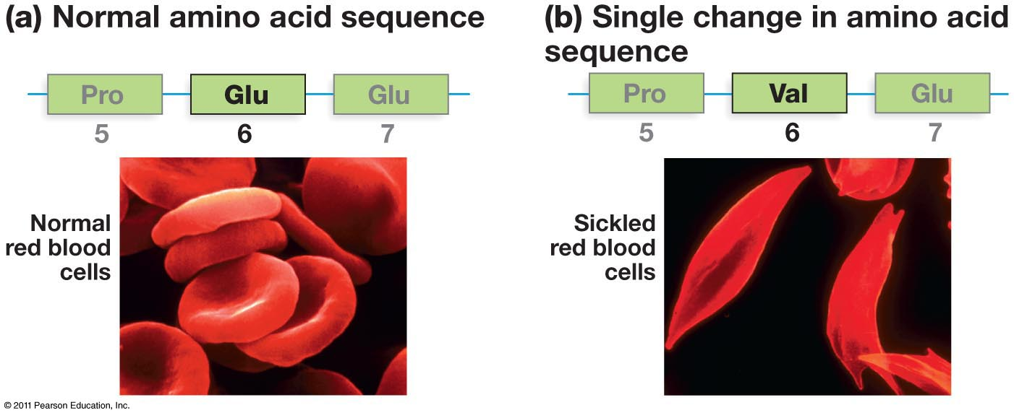
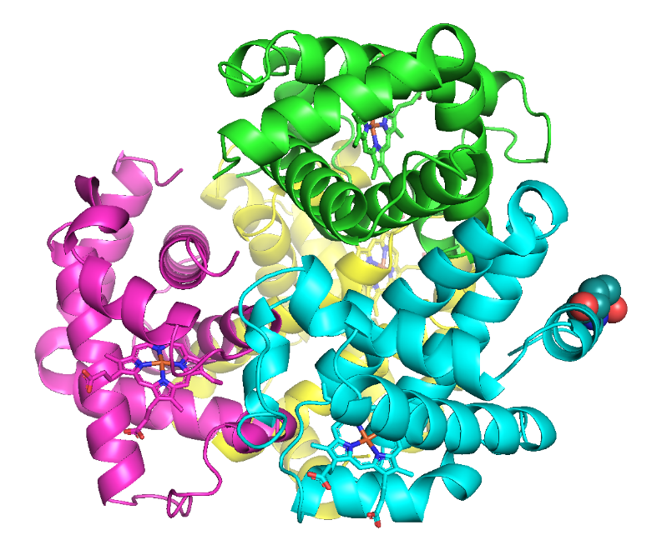
Surface Mutations May Also Lead to Disease
Effect of mutations on protein folding – sickle cell anemia
A single change in the amino acid sequence can change the function of a protein
Glu6
Notes:
Cells with normal hemoglobin and hemoglobin molecules of people with sickle cell anemia. Casues the red blood cells to change shape from a normal disk to sickled shape.

Slide 5
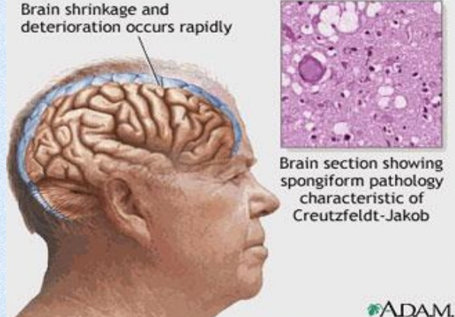
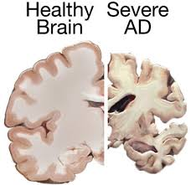
Prions are improperly folded proteins that cause neurodegenerative diseases
What Happens When Proteins Fold Into Different Structures?
Normal
Unfolded protein response (UPR):
The presence of unfolded proteins can trigger the UPR, which can turn off protein synthesis in the cell, leading to cell death.
Both forms are almost equally stable.
Unfolded
Misfolded prion protein
What is the effect on the brain?
Why do the brain cells die?
Notes:
Some improperly folded proteins act as infectious disease causing agents. Or proteinaceous infectious agents. Don’t differ in sequence from normal form of proteins but their shape is very different. B misfolded protein that causes mad cow disease in cattle sponge brain illness.

Slide 6
Protein Structure - Summary and Expectations
Primary Structure:
Can you describe the mechanism of peptide bond formation
Can you draw structure of peptides.
Can you identify amino terminus and give the sequence of amino acids, N -> C
Secondary structure:
Identify helical and sheet secondary structures,
know that they are stabilized by mainchain hydrogen bonds between N-H and O=C.
Location of H-bonds and sidechains
Tertiary Structure:
Can you describe and identify role of the following in stabilizing the folded state.
H-bonds,
van der Waals,
hydrophobic effect
Can you predict, based on sidechain, which amino acids are found in the core of the protein and which are found on the surface.
Quaternary Structure:
Multiple chains, stabilized by non-covalent and covalent (disulfide bonds) interactions.
Diseases related to protein structure:
Core mutations - affect folding
Surface mutations - affect protein-protein (and Protein-DNA) interactions
Stable isoforms – toxic to the cell

Slide 7
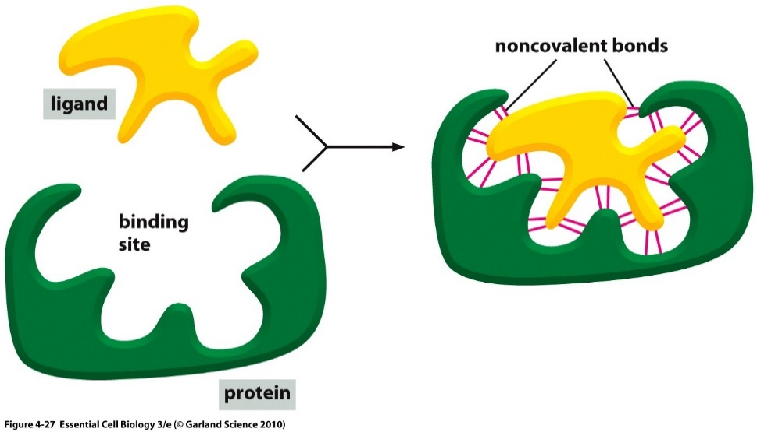
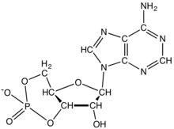
Ligand Binding: Most Proteins Bind to Other Molecules in Biological Interactions:
The bound ligand can be stabilized by any and all of the following interactions:
Interaction | Which stabilize cAMP Binding?
Electrostatic
van der Waals
H-Bonding
Hydrophobic effect
Ligand: Something that binds to a protein, usually small molecules (e.g. cyclicAMP, cAMP).
cAMP
Binding site allow a protein to interact with specific ligands
Binding site is generated by the folded form of the protein.
Notes:
Protein bound to cyclic AMP.

Slide 8
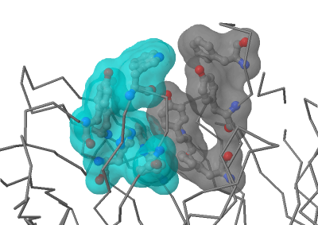
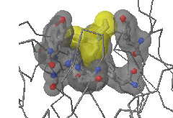
Hydrophobic Effect Drives Binding of Non-polar Ligands
Antibody
Antibody-PCP complex

Slide 9
[cAMP]
Ligand Binding & Saturation:
Define fraction saturated:
$$Y= \frac{[ML]}{\left[M\right]+[ML]}$$
[M] = free macromolecule (e.g. antibody with no antigen).
[ML] = macromolecule with ligand bound (e.g. antibody with antigen bound).
The boxes with circles represent proteins with no cAMP bound, each box (left to right) is at a higher [cAMP]. Filled circles indicate bound ligand.
1. How will the number of filled circles depend on the cAMP concentration?
2. Plot the fraction saturated data point for each box.
Key Points:
1. The binding sites saturate, when all are full no more ligand can bind.
2. There is a ligand concentration, [L], where ½ the sites are full. This [L] is K_{D}
3. K_{D} is the equilibrium constant for ligand dissociation:
$$K_{Eq}=\frac{[products]}{[reactants]}$$
$$\left(ML\right)⇌\left(M\right)+\left(L\right)$$
$$K_{D}=\frac{\left[M\right][L]}{[ML]}$$

Slide 10
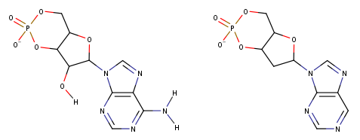
Using K_{D} to Compare Ligand Binding
Ligand 1 (cAMP)
Ligand 2
The binding of two different molecules to the same protein was measured and the data is shown on the right. L1 is cAMP, L2 is similar to cAMP
Which ligand has a K_{D} of 1? L1 or L2?
Which ligand has a K_{D} of 10? L1 or L2?
Which ligand binds more tightly to the protein (higher affinity)? L1 or L2?

Slide 11
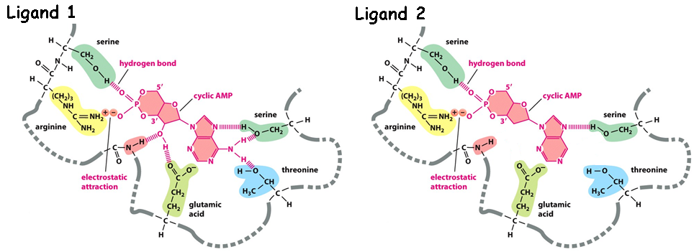
Why does L1 bind more tightly (higher affinity)?
What are the chemical differences between L1 and L2 (Upper diagram)
2. How do these differences affect the interactions with the protein (lower diagram)?
Ligand 1 (cAMP)
Ligand 2
3. How do the differences affect K_{D}?

Slide 12
Key Points:
Binding:
Folded proteins have binding sites that recognize other molecules (ligands) using any and all of the following:
H-bonds,
van der Waals,
Electrostatic,
Non-polar interactions (hydrophobic)
Binding is reversible
Binding is saturable
Binding ½ point (Y=0.5) occurs at K_{D}
The higher the affinity (strength of interaction), the lower the K_{D}

Slide 13
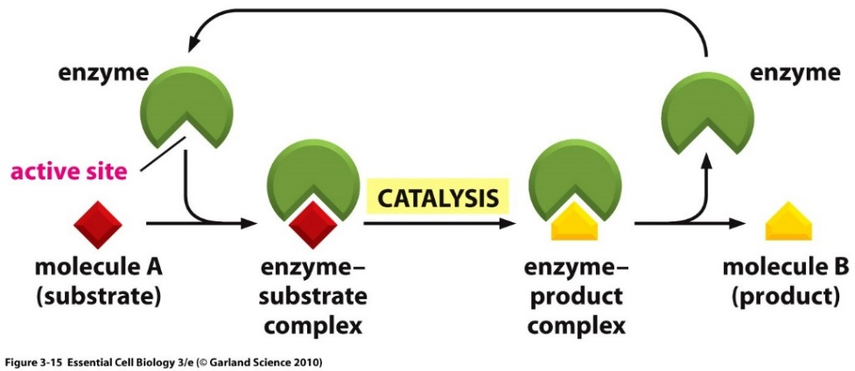
Enzymes
Enzymes are protein or RNA catalysts. They increase the rate of the reaction.
They bind “substrates” and convert them to “products”. Usually, the substrate undergoes a chemical reaction and is changed in its structure.
Most biological chemical reactions occur at meaningful rates only in the presence of an enzyme.
Substrates bind specifically to the enzyme’s active site, interacting with amino acid side chains (or RNA bases). Usually, an enzyme binds one substrate.
The chemical change caused by the enzyme is catalyzed by additional functional groups in the active site.
Many enzymes undergo a conformational change when the substrates are bound to the active site; this change is called an induced fit.
substrates
products

Slide 14
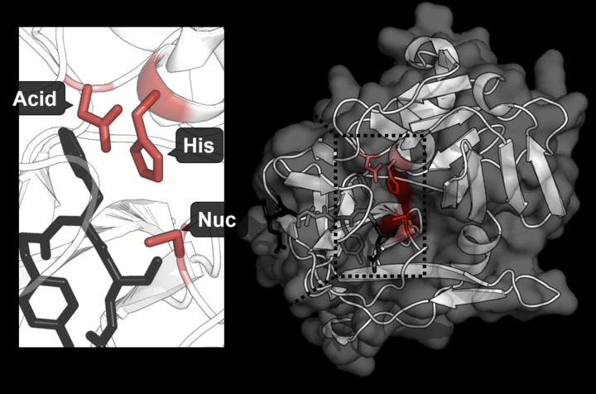
Example of Active Site Functional Groups:
Catalytic triad (Asp, His, Ser) in Protease Trypsin cleaves the peptide bond.
More active with Lys and Arg containing substrates because of a favorable interaction with an additional Asp residues in the enzyme.
Substrate Binding (Asp)
Substrate
https://shirleychemproject.weebly.com/
Products
Catalytic triad

Slide 15
Enzyme – Chemical Diversity
Most enzyme names end in “-ase”
Usually named by their substrates and the reactions they catalyse, i.e. glucose kinase

Slide 16
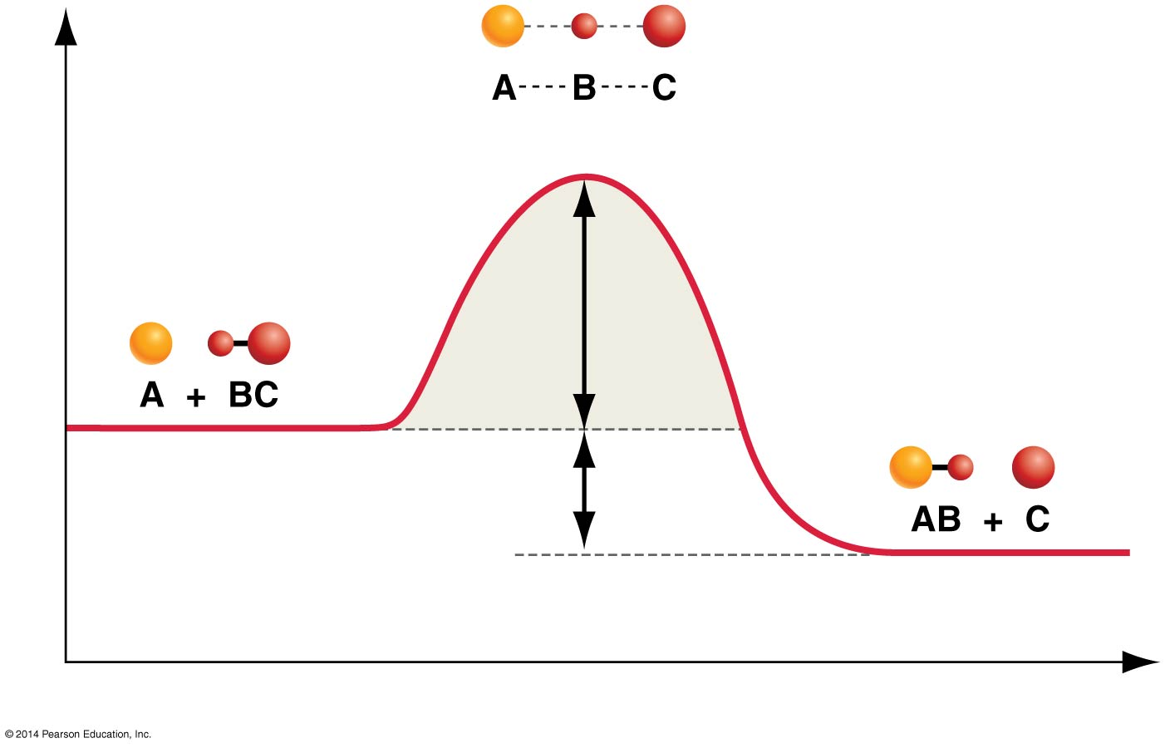
How Do Enzymes Increase Rates?
Enzyme
Transition state = high energy intermediate that occurs during the reaction.
Energy barrier is called the activation energy.
Rate of product formation depends on the concentration of the transition state.
|
N
|
H
B – contains H-bond acceptor
Low [X] = Slow reaction
Enzyme
|
N
|
H
Higher [EX] = Faster reaction
Activation Energy
Interactions between the enzyme and the substrate stabilize the transition state (X) and lower the activation energy required for the reaction to proceed.
Stabilization can include:
Pre- alignment of key groups in the active site, reducing entropy cost of organizing groups.
Direct interactions with just the transition state, e.g. formation of new H-bonds.

Slide 18
A model of transition state stabilization.
[S] = 15
[X] = 3
[EX] = 6
Lower energy of transition state allows more substrates to reach transition state due to their thermal energy.
How much faster will the rate be when the enzyme is present?

Slide 19
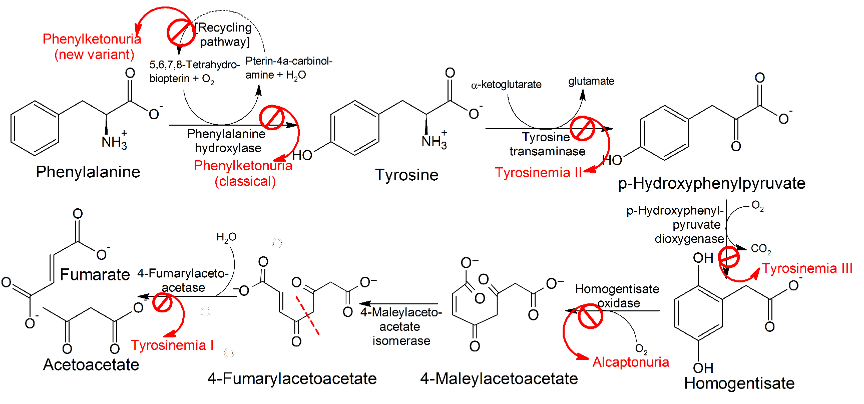
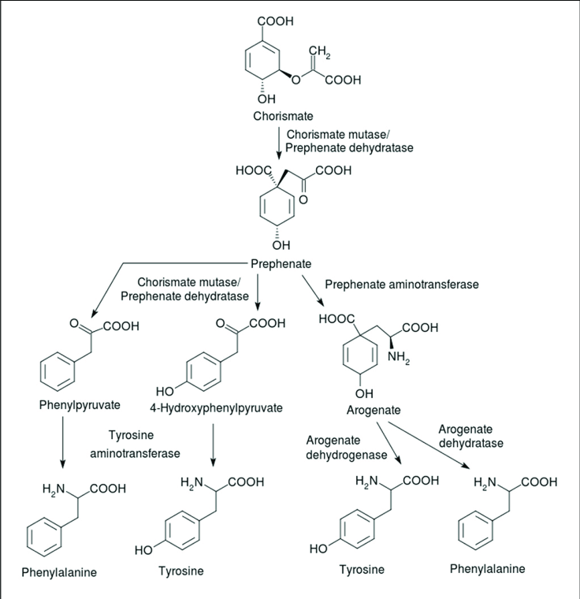
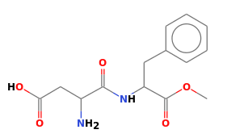
Enzymes, Metabolic Pathways, and Diseases
Synthetic Pathway for Phe, Tyr
(beginning with chorismite)
Each step catalyzed by an enzyme
Pathway for Degradation of Phenylalanine
PKU Disease:
Inactive phenylalanine hydroxylase
Phe levels become toxic:
Neurological problems
Intellectual disability
Developmental delays
Mental health disorders.
Aspartame (artificial sweetener)
Asp-Phe-CH₃

Slide 20
Key Points:
Enzymes:
Enzymes bind substrates (S), forming (ES) complex in active site, converting to P, releasing P.
Rate enhancement since the transition state complex (EX) forms more readily with enzymes due to:
Bringing substrates and functional groups on the enzyme together by binding (less entropy change)
Directly lowering energy of transition state (X) through favorable interactions that are unique to the transition state, such as forming unique hydrogen bonds.
Genetic diseases that lead to inactive metabolic enzymes can cause disease due to the build-up of toxic intermediates.

Slide 21
Carbohydrates
General structure of monomers
Disaccharides (e.g. lactose)
Glycogen (glucose storage)
Bacterial cell wall structure (antibiotic target)
Lactose intolerance
Glycogen storage disease
Polysaccharide

Slide 22
Carbohydrates
Functional groups:
Monosaccharides (one sugar),
oligosaccharides (few sugars)
polysaccharides (many sugars)
Chemical formula is (CH₂O)_{n} (e.g. hydrated carbon)
They are molecules with:
one aldehyde or ketone group, on 1st or 2nd carbon
-OH group on all other carbons, leading to a chiral carbon for most carbons.
Carbonyl group –> C=O
Only one of these is a carbohydrate, which one?
A B C

Slide 23
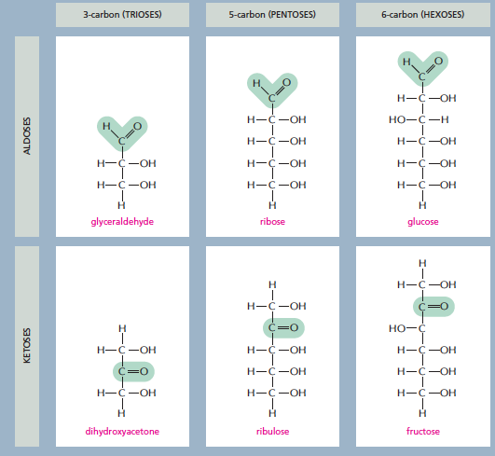
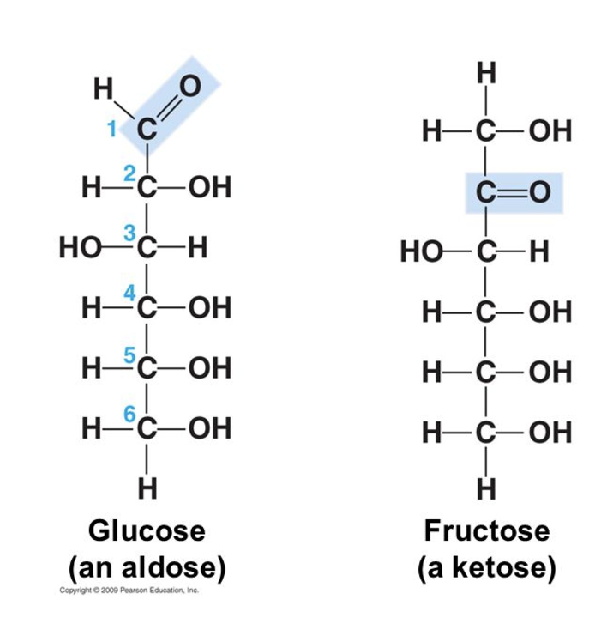
3 ways simple sugars (monosaccharides) differ from each other
1. Location of the carbonyl group
2. Number of carbons
3. Spatial arrangement of atoms (the position of the OH groups)
1. Location of the carbonyl group
2. Number of carbons
3. Spatial arrangement of atoms (the position of the OH groups)
Aldose: Carbonyl group is located on C₁
Numbering carbons:
Carbon 1 is at the end closest to the C=O group.
What carbon is the carbonyl?
Notes:
The C=O group is either on C1 (aldose) or on C2 (ketose).

Slide 24
3 ways simple sugars (monosaccharides) differ from each other
1. Location of the carbonyl group
2. Number of carbons
3. Spatial arrangement of atoms (the position of the OH groups)
Both have the same chemical formula C₆H₁₂O₆. Both are aldose sugars with 6 carbons.
Yet their functions are different.
Glucose can be used for energy immediately.
Galactose has to be converted to glucose before it can be used for energy.
They have different interactions with enzymes due to the different chirality at carbon 4.
OH is down in glucose
OH is up in galactose
Enzyme specific for a-glucose

Slide 25
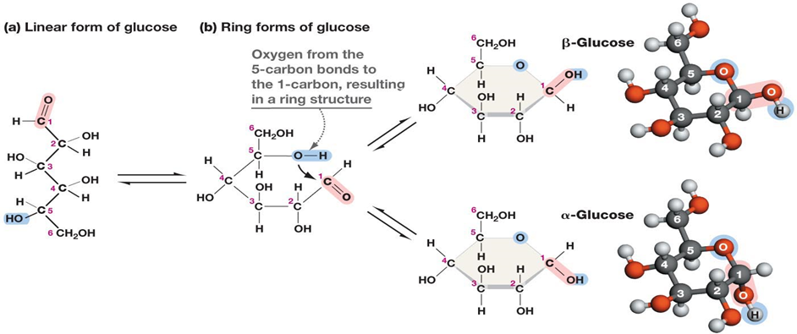
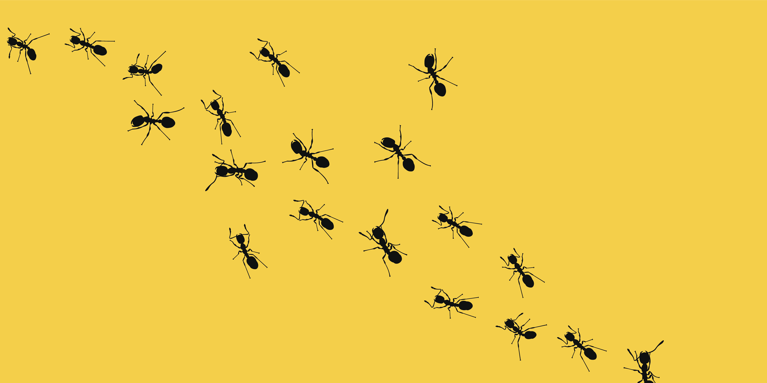
Ring formation in Monosaccharides:
C1 = “Anomeric Carbon”
In aqueous solution, a hydroxyl group reacts with the aldehyde or ketone group on the same molecule, closing the molecule into a ring, with a bridging oxygen
It is usually the 2nd to last -OH group, i.e. C5 in glucose, C4 in ribose.
Stable ring sizes are 5 atoms or 6 atoms
No atoms are lost or gained in this reaction.
The carbonyl carbon becomes chiral and is called the anomeric carbon.
The rings with different chirality at C1 are different:
α (new OH is down), β (new OH is up) “(ants are down, birds are up)”

Slide 26
Example Problem:
The linear form of ribose, a 5 carbon aldose is shown on the right. This sugar is found in RNA (ribonucleic acid).
Number the carbons.
Which carbons are chiral? Mark them with a *.
Draw the cyclic form of α-ribose

Slide 27
Disaccharides
Linkage of the anomeric carbon of one monosaccharide to the OH of another monosaccharide via a condensation reaction.
The bond is termed a glycosidic bond:
The anomeric carbon is the site of attack by another -OH group.
A water is released
Why is the anomeric carbon the preferred site for nucleophilic attack?
Nomenclature rules for linkage:
Orientation of the anomeric involved in the linkage (α oxygen is down, β oxygen is up)
Carbons involved in the linkage (e.g. 1-4)

Slide 28
Disaccharides
There are many possible ways to connect two sugars.
At least one anomeric is always involved.
1-1
1-2
1-3
1-6
1-4

Slide 29
Lactose (milk sugar)
Disaccharides
These kinks are not carbons but are drawn in this way to indicate that the chirality of the anomeric is beta (pointing up). The kinks allow the line to reach the downward pointing –OH on C4 in glucose.
β-galactopyranosyl-(1→4)-β-glucopyranose
Metabolism of Lactose
Lactose is the major sugar in mammalian milk.
Infants produce the enzyme lactase to hydrolyze the disaccharide to monosaccharides.
Lactase expression is turned off in some adults, depending on their genetic background.
Lactase
Galactose
Glucose
Cellular Energy

Slide 30
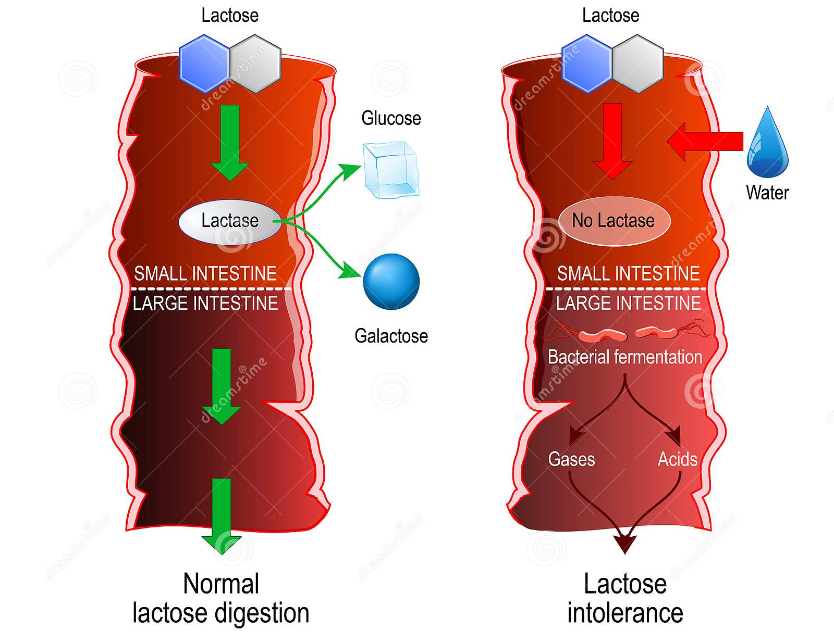
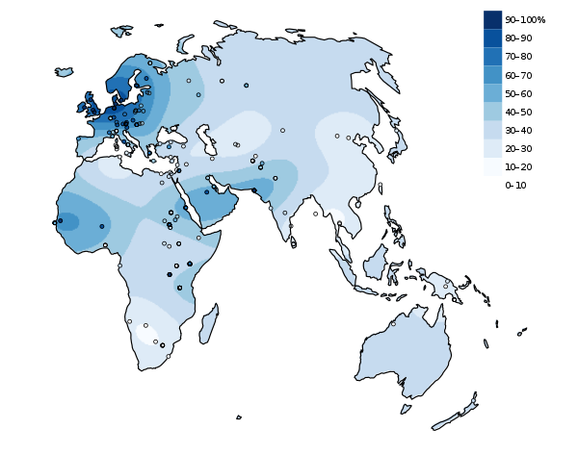
Lactose Intolerance
Lactase Persistence
In which region do most of the people still produce lactase as adults?
UK
South Africa
In an infant (lactase +):
lactose is broken down to glucose and galactose in the small intestine.
The two sugars are absorbed and used for energy
In a lactose intolerant individual (lactase -)
The lactose is not absorbed in the small intestine, but instead draws water into the intestine due to osmosis – leading to bloating and diarrhea.
Lactose enters the large intestine where gut bacteria use it as a carbon source, generating gas.

Slide 31
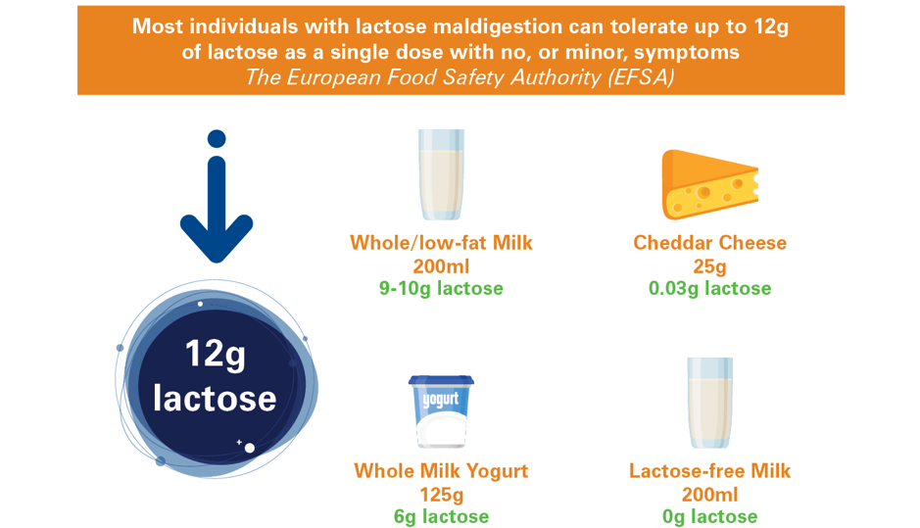
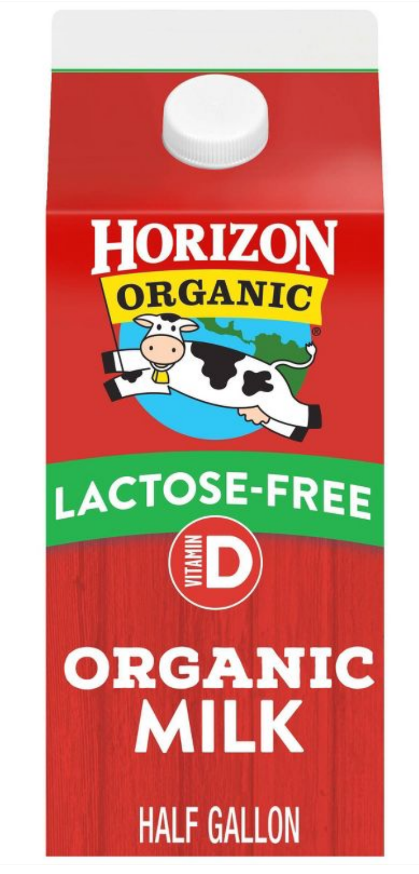
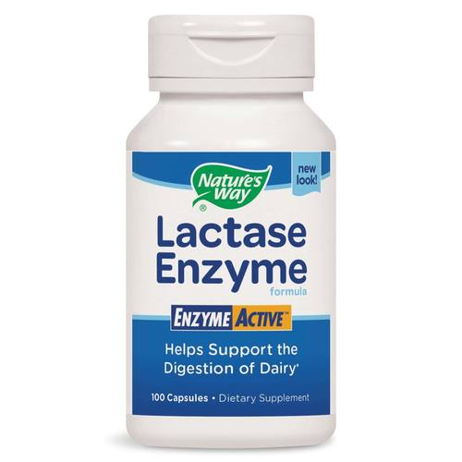
Lactose Intolerance
What to do if you are lactose intolerant:
A. Consume less lactose
B. Hydrolyze the lactose to glucose and galactose before consumption.

Slide 32
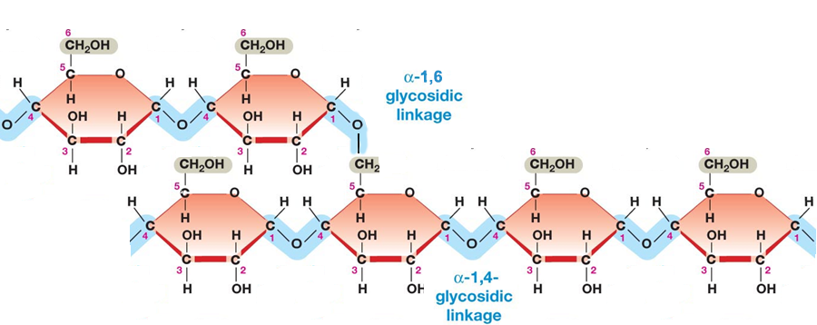
Polysaccharides as Energy Storage – Glycogen Storage Disease
Glycogen and is made entirely of glucose units and is used for glucose storage.
Glycogen Levels are regulated by hormones secreted due to blood glucose levels.
Glucagon – low blood sugar
Insulin – high blood sugar
Two enzymes degrade or synthesize glycogen
Glycogen phosphorylase – releases glucose from glycogen
Glycogen synthase – stores glucose in glycogen
Branch point
α-1,6- glycosidic linkage
α-1,4- glycosidic linkage
Notes:
GSD III – debranching enzyme required since phosphorylase stops when 4 glucose are remaining. 3 of them are transferred to a new glycogen, and then the a(1-6) is removed. Autosomal recessive, 1:100,000

Slide 33
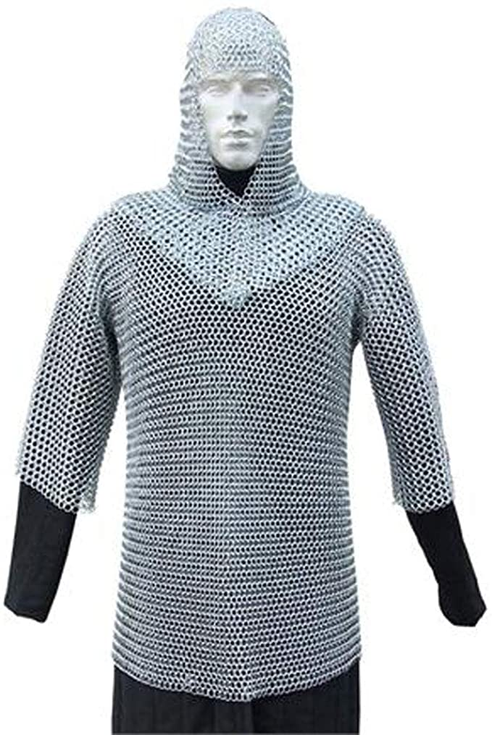
Polysaccharides as Structural Molecules
Peptidoglycan (protein + sugar) in bacterial cell wall
D-Amino acids
Many antibiotics interfere with cell wall synthesis (e.g. penicillin)
Protein Crosslink
Peptidoglycan (Bacterial Cell Wall)

Slide 34
Summary and Expectations for Carbohydrates
Key Points:
General structure of monosaccharides - be able to distinguish between aldose and ketose (and identify compounds that are not sugars).
Know how to number carbons on aldoses and ketoses
Be able to describe the linkage between two monosaccharides (configuration at the anomeric carbon, atoms linked)
Treatments for lactose intolerance
Be able to describe the linkage between glucose molecules in:
Glycogen (glucose storage)
Be able to describe the overall structure of the peptidoglycan in bacterial cell walls.

