Slide 1
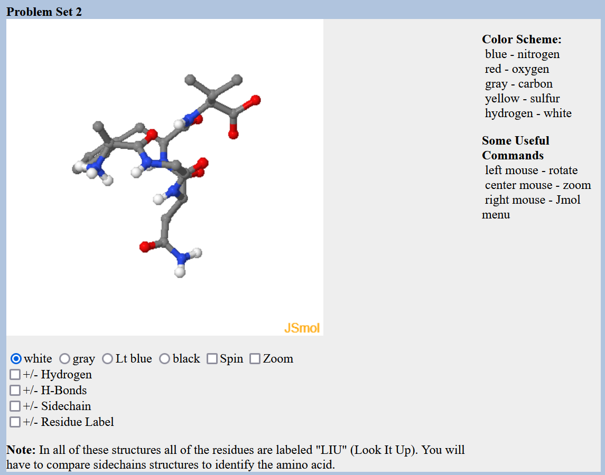
Lecture 2 Protein Structure and Function, Carbohydrates
Protein Structure and Stability
Ligand Binding
Proteins as enzymes (PKU disease)
Carbohydrates
Prior to lecture 3, please review the lecture material on introduction to nucleic acids (slides and video link posted on course web site)

Slide 2
Molecular Interactions
The energy change when two things come together can be approximated to be due to new inter-molecular interactions: $E_{A∪B}$.
$$∆E=E_{AB}−{(E}_{A}+E_{B})\sim E_{A∪B}$$
Interaction | Interaction | Energy (kJ/mol)
Electrostatic interactions (in water) | Full charges | ~5 kJ/mol/single interaction
Van der Waals: Dipole-Dipole | Perm. partial charges | ~0.05 kJ/A² x 100 A² = 5 kJ/mol for 100 A²
Van der Waals: Induced-dipole | Induced partial charges | ~0.02 kJ/A² x 100 A² = 2 kJ/mol for 100 A²
H-Bonds | Electrostatic + e sharing | ~20 kJ/mol gross, ~5 kJ/mol net

Slide 3
iv) Hydrogen Bonds
H-bonds are primarily (90%) an electrostatic attraction between:
Electropositive hydrogen, attached to an electronegative atom is the hydrogen bond donor (i.e. NH).
Electronegative hydrogen bond acceptor (e.g. the lone pairs of oxygen, or C=O group of an amide).
A “bond” implies electron sharing – about 10% of the electron is shared from one molecule to the next in the case of H-bonds
The energy released when an H-bond forms depends on the distance and angle of the bond.
Usually hydrogen bonds are exchanged, resulting in small net energy differences:
Note that the proton is NOT transferred to the acceptor, it remains covalently bonded to the donor atom. The Hydrogen Bond is the interaction between the X-H donor and electronegative acceptor.

Slide 4
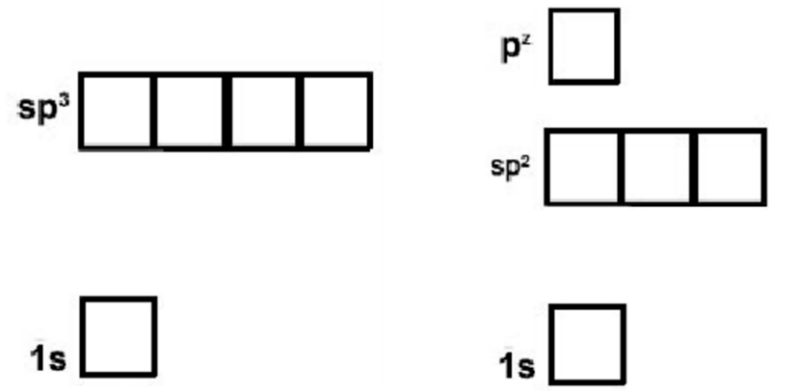
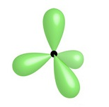
How to Identify Hydrogen Bond Donor and Acceptors
Exceptions, N in a delocalized system:
Will not accept from above or below the plane of the system, because the lonepair is delocalized.
Can accept in the plane of the ring if there is no attached hydrogen, via lone pair in sp2 orbital
Sp2 is used in amides, allowing favorable overlap of the full pz orbital with the pz on C and O
The lone pair in the pz is shared with the pz electrons on carbon and oxygen.
Due to electron sharing, there is only a slight neg. charge and the group does not accept an H-bond.
N – 7 electrons
Sp3 is used in ammonia, keeping the three hydrogen atoms as far from each other as possible. The fourth sp3 orbital is full with two electrons (lone pair).
The lone pair is an excellent acceptor.
Sp2
Sp3
Nitrogen in rings with three bonds can accept in the plane of the ring due to a filled lonepair orbital.
Hybrid orbitals are a mixture of atomic orbitals.
Nitrogen can form two types of hybrid orbitals, sp3 (tetrahedral geometry) or sp2 (planer) + pz

Slide 5
Indicate which atoms could donate an H-bond and which could accept and H-bond
ATOM | Donor(D)? | Acceptor(A)? | Neither (N)
1 (F)
2 (C_{aro}-H)
3 (N)
4 (-NH₂)
5 (C=O)
6 (O)
7 (O-H)
Can you?
Identify groups that can donate or accept hydrogen bonds?

Slide 6
Relative Energy of Interactions
Interaction | Interaction | Energy (kJ/mol)
Covalent Bond | Electron sharing | 200-400 kJ/mol
Electrostatic interactions (in water) | Full charges | ~5 kJ/mol/single interaction
VdW - Dipole-dipole (Keesom) | Perm. partial charges | ~0.05 kJ/A² x 100 A² = 5 kJ/mol for 100 A²
VdW – Induced dipole (London) | Induced partial charges | ~0.02 kJ/A² x 100 A² = 2 kJ/mol for 100 A²
H-Bonds | Electrostatic + e sharing | ~20 kJ/mol gross, ~5 kJ/mol net
How does the energy of the last four interactions compare to covalent bonds?
1. Stronger 2. Weaker 3. The Same
2. Which of these are closer to thermal energy, kT = 2.5 kJ/mol @ room temp.
3. Are there significant molecules with enough energy at room temperature to break the interaction?

Slide 7
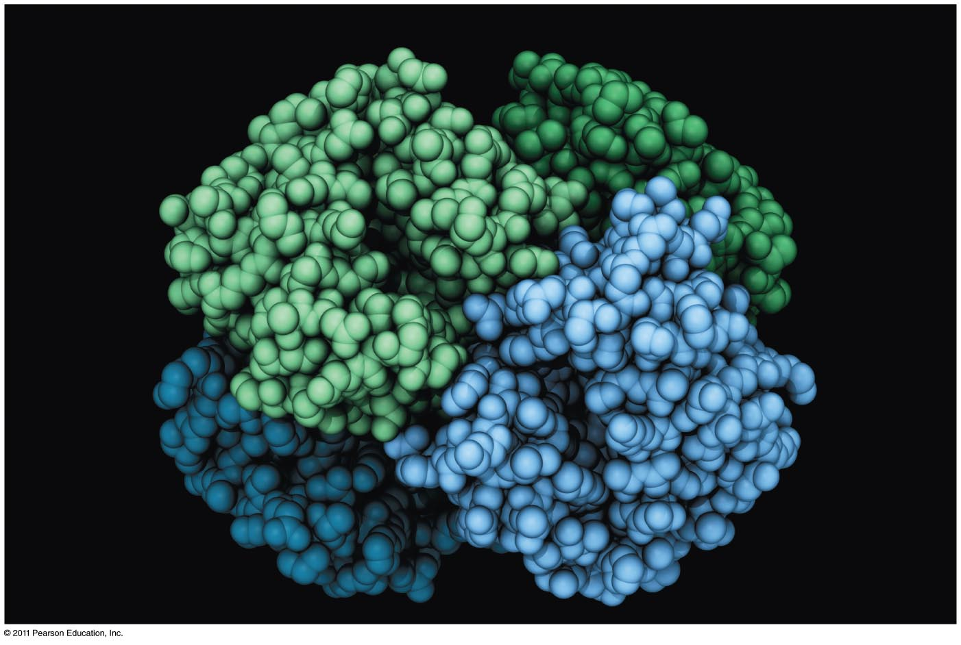
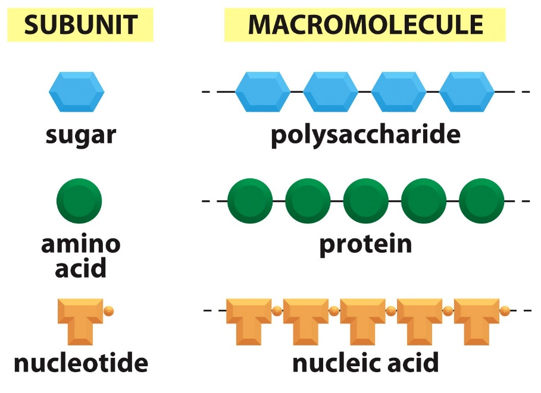
Proteins and Amino Acids

Slide 8
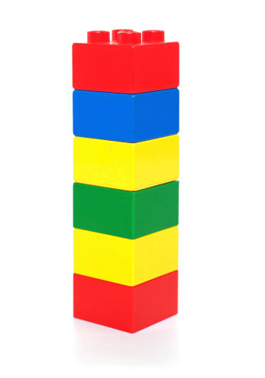
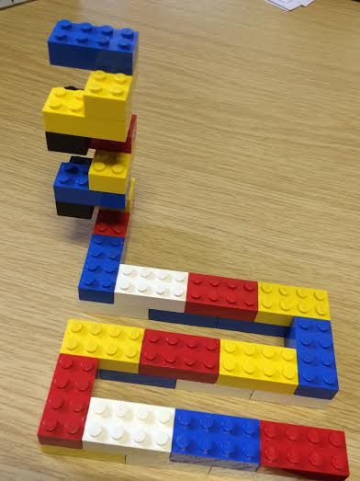
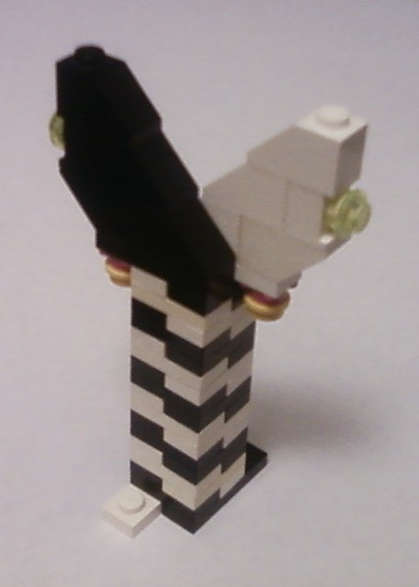
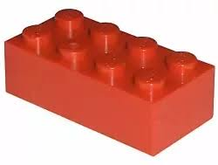
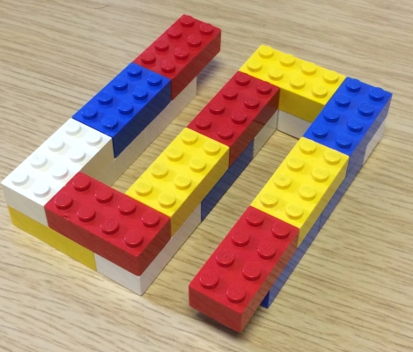
Structural Hierarchy of Proteins
Primary - sequence of amino acids, no 3D structural information
Secondary - local structural elements, only mainchain atoms involved
Tertiary - 3D position of all atoms, functional form of many proteins.
Quaternary - multiple chains – multiple chains often required for function.
Biological Function
(White and black represent two different chains)

Slide 10
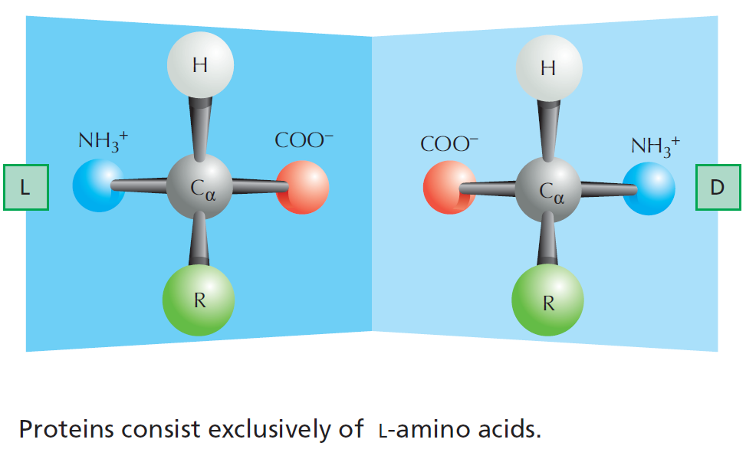
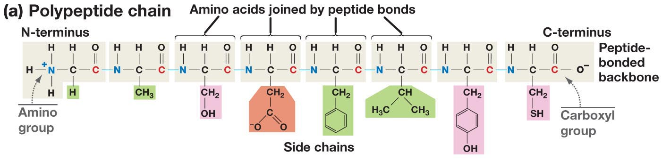
The Structure of Amino Acids and Proteins
Is there a chiral carbon on amino acids?
The amino group, Cα (and one hydrogen), and the carbonyl group are common to all amino acids
The N-Cα-C=O are the mainchain of the protein polymer.
The R groups are different –there are 20 common R groups they are the sidechain of the protein polymer – their sequence defines the properties of the protein.
(as does the ribosome that make them)

Slide 11
Primary Structure
Amino acids are joined together to form linear polymers by the formation of a peptide bond between the carboxyl of one amino acids and the amino group of the next.
This reaction releases water: a dehydration reaction.
The peptide bond can be broken (lysis) by the addition of water = hydrolysis.
Incorporated amino acid is called a residue (atoms are lost when the peptide bond is formed).
Polarity of chain direction – amino (N) terminus to carboxy(C) terminus = order of amino acids = sequence = primary structure
Mainchain (or backbone) – linear atoms of the polymer
Sidechain – atoms off the Ca carbon
Primary Structure – Expectations
Draw chemical structure given the sequence.
Determine the seq. from chemical structure.
Distinguish/identify:
Mainchain & Sidechain atoms,
Residue = aa in polymer,
N & C terminus,
Peptide bond(s).

Slide 12
Sidechain Functional Groups Affect Behavior (and the order is important)
Sidechains (R-groups) differ in their size, shape, reactivity, and interactions with water.
Nonpolar Sidechains: hydrophobic; do not form hydrogen bonds; coalesce in water - typically form the core of folded proteins.
Polar Sidechains: hydrophilic; form hydrogen bonds; readily dissolve in water
Ionizable Sidechains: Can be charged at certain pH values. Interact strongly with water.

Slide 13
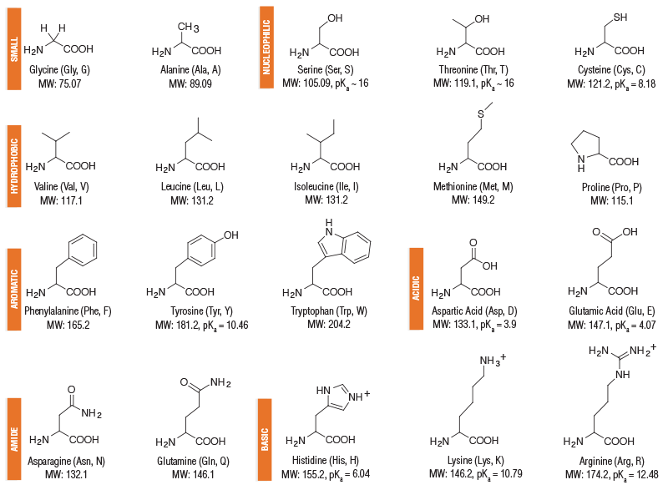
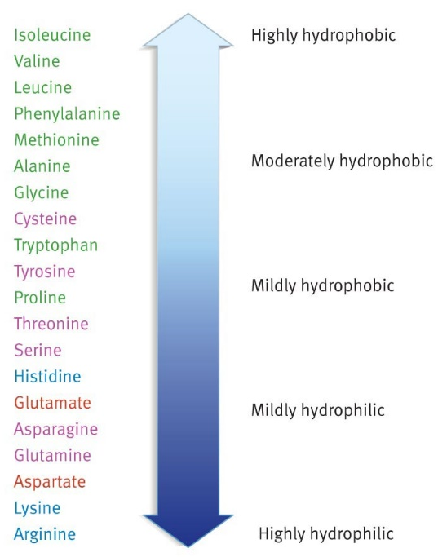
Amino Acids – Structure and Properties
Charge
Polar sidechains
Non-polar sidechains
Hydrophobicity
Aromatic sidechains
Ionizable sidechains
Polar sidechains
Ionizable sidechains

Slide 14
Secondary Structure
“Building blocks of proteins”
Hydrogen bonds between the mainchain carbonyl group of one amino acid and the mainchain amino group of another form a protein’s secondary structure.
A polypeptide must bend to allow this hydrogen bonding, forming:
α-helices
β-pleated sheets
The large number of hydrogen bonds in a protein’s secondary structure increases its stability - each hydrogen bond that is formed releases some energy.
All amino acids can be incorporated into either secondary structure
(However, some are found more frequently in one structure)
General Rule for Hydrogen Bonds:
X-H Y
X & Y are electronegative (N and O usually)
X-H = Donor of the hydrogen bond
Y = Acceptor of the hydrogen bond
Mainchain hydrogen bonds
N-H O=C
The NH is the hydrogen bond_________.
The C=O is the hydrogen bond __________.

Slide 15
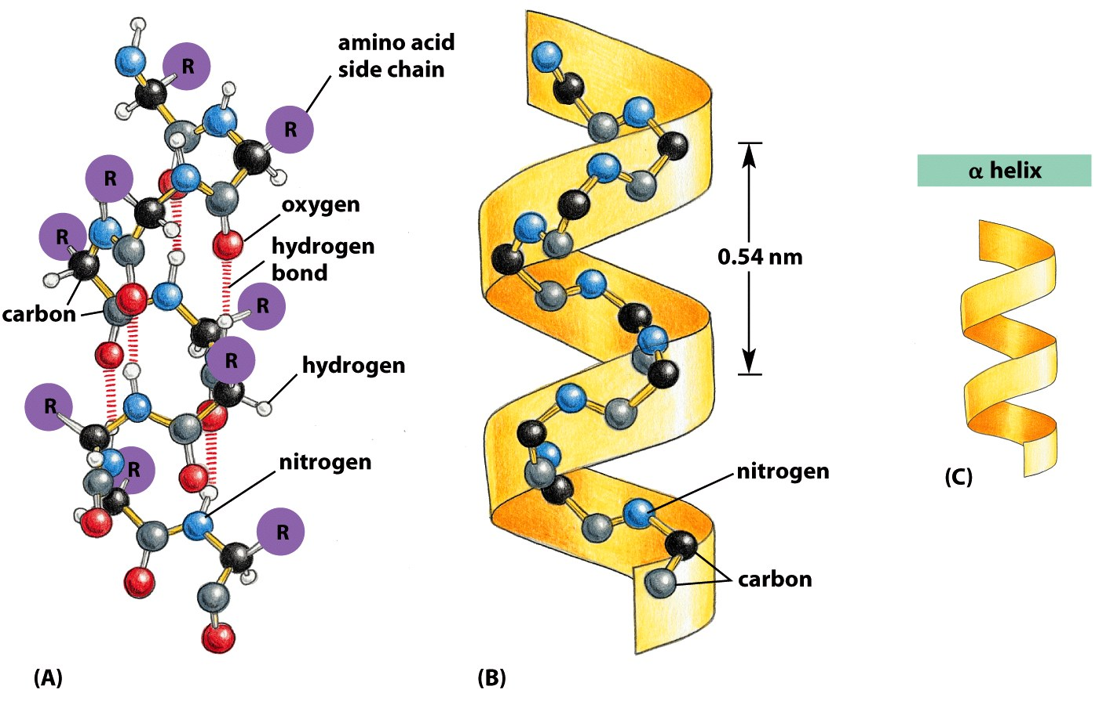
Alpha Helix
Spiral conformation (helix) in which every backbone N-H group donates a hydrogen bond to the backbone C=O group of the amino acid four residues earlier:
Intra-strand H-bonds, parallel to helix axis.
Side-chains project outwards.
Notes:
is a righthand-coiled or spiral conformation (helix) in which every backbone N-H group donates a hydrogen bond to the backbone C=O group of the amino acid four residues earlier (

Slide 16
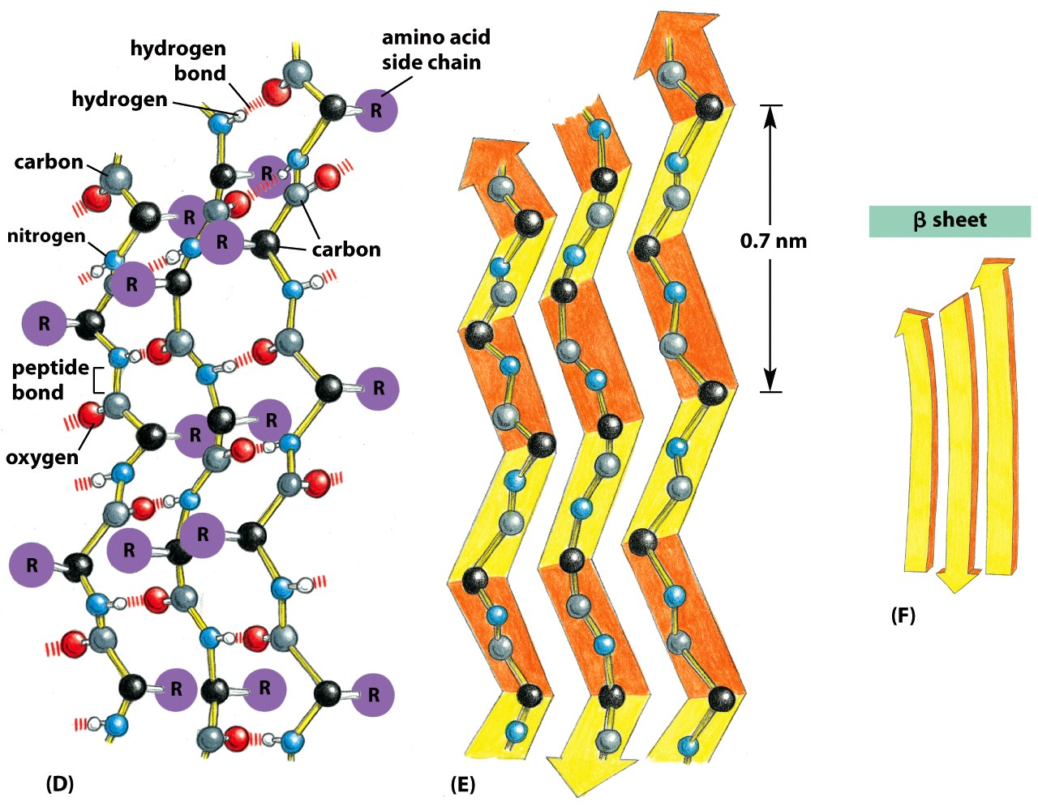
Beta Sheet
Beta-Strands connected laterally by backbone hydrogen bonds that are perpendicular to the strand, forming a generally twisted, pleated sheet.
Sheets can have two or more strands
Side-chains:
project up and down along a strand.
project in the same direction going from strand to strand across the sheet.
Notes:
strands connected laterally by at least two or three backbone hydrogen bonds, forming a generally twisted, pleated sheet.

Slide 17
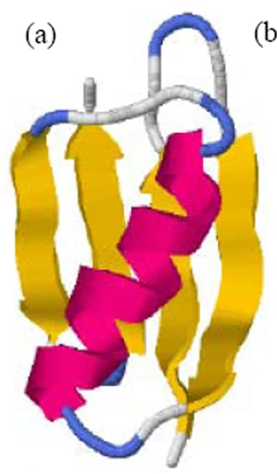
Tertiary Structure - Location of Residues in Globular Proteins
Red - amino acids with neg. sidechains (e.g. Asp)
Blue - amino acids with pos. sidechains (e.g. Lys)
Yellow – amino acids with polar sidechain (e.g. Asn)
Green - amino acids with hydrophobic side chains (e.g. Leu)
Amino Acid Type
 | Inside (I) | Surface (S)
Charged
Polar
Non-polar

Slide 18
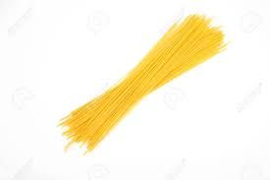
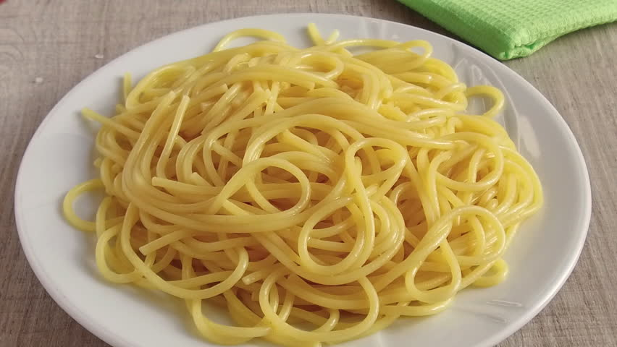
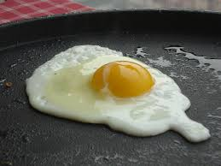
Protein Stability:
H-bonds
van der Waals
Hydrophobic effect
Chain disorder
Native
Unfolded
Protein Denaturation
Exposure to High Heat
Removal of Heat
Often, unfolded protein aggregate, which prevents refolding.

Slide 19
Unfolded Polypeptides Are Flexible – High Entropy stabilizes the Unfolded state
Exposure to High Heat
Energy and Entropy

Slide 20
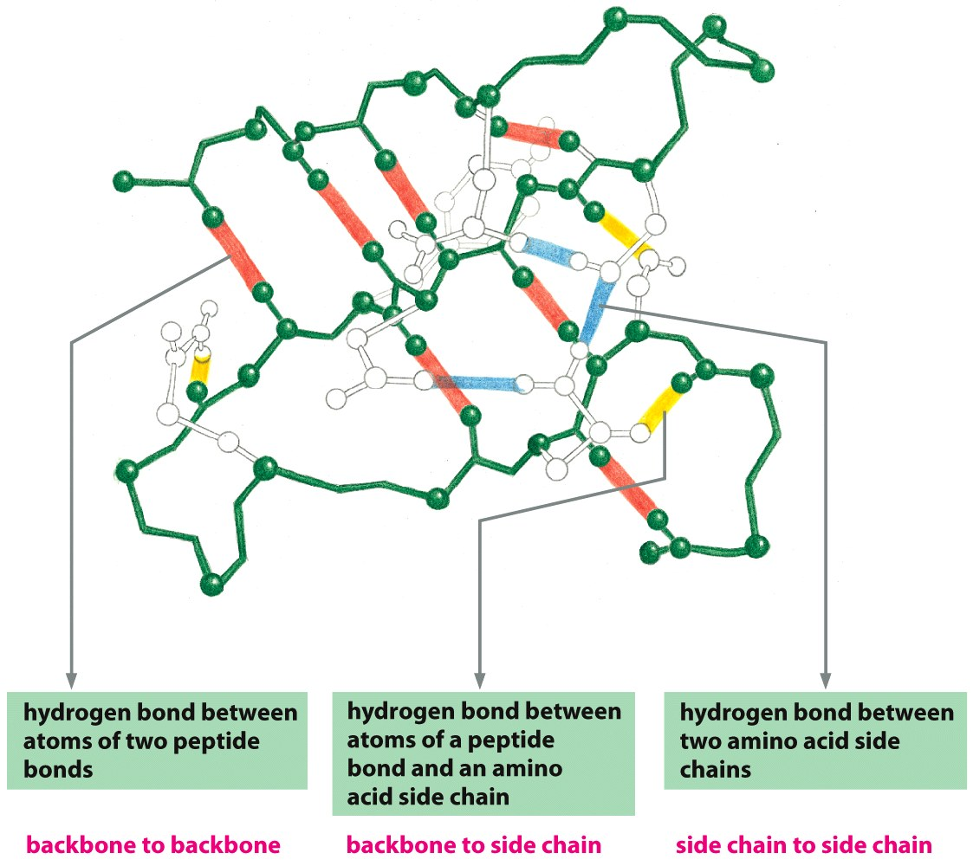
Hydrogen Bonding Stabilizes the Tertiary Structure
Hydrogen bonds form between hydrogen atoms and the carbonyl group in the peptide-bonded backbone – secondary structure
Hydrogen bonds are also found between hydrogen and electronegative atoms in side chains (sidechain-sidechain)
Sidechains can form hydrogen bonds to the mainchain too.
2^{ndy} Structure
3^{ry} Structure

Slide 21
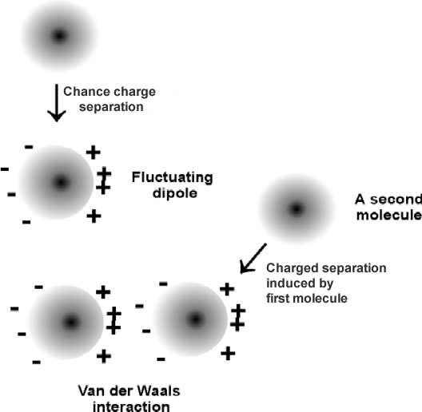
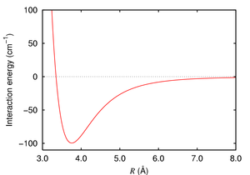
Van der Waals (VdW) interactions Stabilize the Folded State
VdW are weak electrostatic interactions between side chains due to temporary (fluctuating) charges.
Attractive from long distance
Distance at lowest energy is at the van der Waals radii of the atoms.
Optimized in the core of folded proteins by “knobs fitting into holes”
Strength proportional to contact area.
Notes:
van der Waals force (or van der Waals interaction), named after Dutch scientist Johannes Diderik van der Waals, is the sum of the attractive or repulsive forces between molecules (or between parts of the same molecule) other than those due to covalent bonds, the hydrogen bonds, or the electrostatic interaction of ionswith one another or with neutral molecules or charged molecules.^{[1]} The term includes:
force between two permanent dipoles (Keesom force)
force between a permanent dipole and a corresponding induced dipole (Debye force)
force between two instantaneously induced dipoles (London dispersion force).
London forces are exhibited by nonpolar molecules because of the correlated movements of the electrons in interacting molecules. Because the electrons in adjacent molecules "flee" as they repel each other, electron density in a molecule becomes redistributed in proximity to another molecule (see quantum mechanical theory of dispersion forces). This is frequently described as the formation of instantaneous dipoles that attract each other. London forces are present between all chemical groups, and usually represent the main part of the total interaction force in condensed matter, even though they are generally weaker than ionic bonds and hydrogen bonds.

Slide 22
Hydrophobic Interactions are Critical for Stabilizing the Folded Structure
Energy and Entropy
Ordered water hydrating a non-polar group
Hydrophobic interactions within a folded protein increase stability of the folded protein by releasing the ordered water that surrounded exposed non-polar groups in the unfolded protein. Folding increases the entropy of the water – favorable.

Slide 23
Fold Depends on Amino Acid Sequence
The position of non-polar residues (filled circles) mostly affects the final fold:
Which is more stable fold?
A
B
C
Which is the least stable fold?
A
B
C
Why?

Slide 24
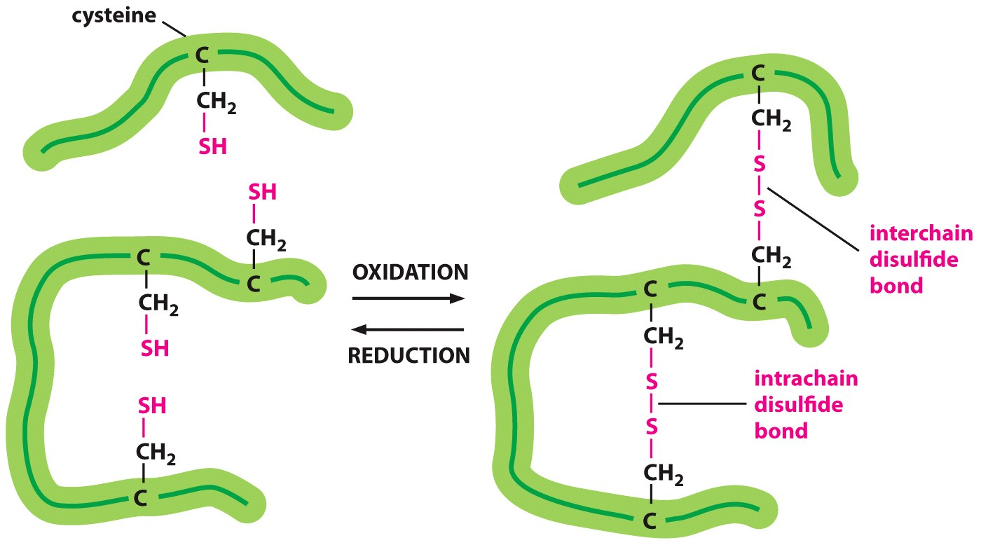
Disulfide Bonds Stabilize Some Proteins Outside the Cell (and body)
Trypsin – a digestive enzyme produced in the pancreas, exported to the small intestine – disulfide bonds within a single chain.
Human Insulin – interchain disulfide bonds

Slide 25
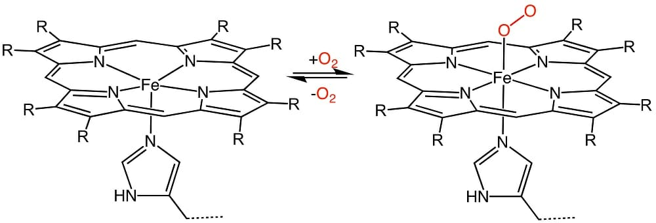
Quaternary Structure
Combinations of polypeptide subunits (combinations of tertiary structures).
May be held together by covalent bonds (disulfide), but usually non-covalent interactions between amino acids on the different chains.
Proteins can be a dimer, a tetramer, etc.
If the chains are the same, called homo__________. If chains are different, hetero_______
Quaternary structure of hemoglobin (oxygen transport protein):
two α chains
two β chains
Oxygen is carried on Fe²⁺ within heme groups:

Slide 26
Summary - Interactions that Stabilize Folded Proteins.
H-bonds
van der Waals
Hydrophobic effect
Chain disorder
Hydrogen bonds form between hydrogen atoms (NH) and the carbonyl group in the peptide backbone (mainchain), and between and donors and acceptors on sidechains. Mainchain-mainchain H-bonds are responsible for secondary structures.
Hydrophobic interactions within a protein increase stability of the folded state by increasing entropy due to the release of water that was ordered by the exposed non-polar groups in the unfolded protein.
van der Waals interactions are optimized in the well packed core of the protein.
Covalent disulfide bonds form between sulfur-containing cysteine residues stabilizing them (usually only exported, secreted proteins).
Native
Unfolded
Notes:
Page 47 in the book

Slide 27
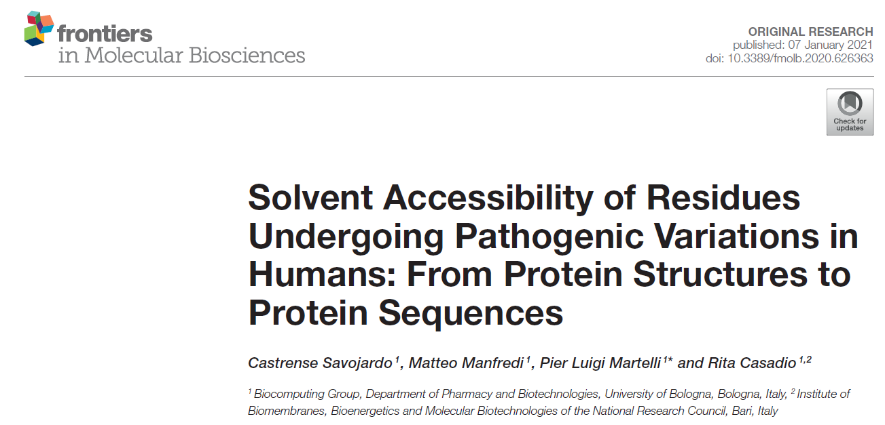
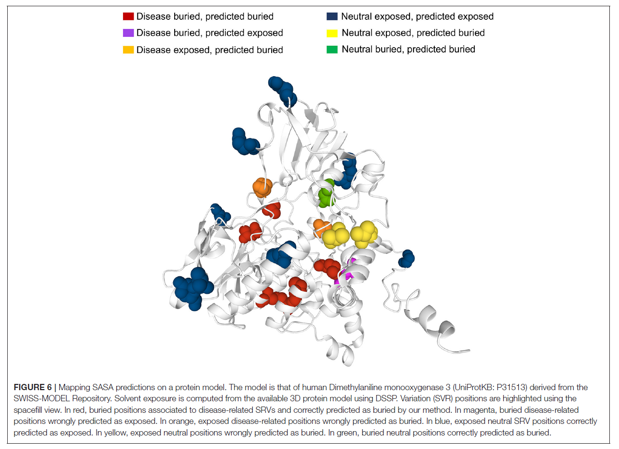
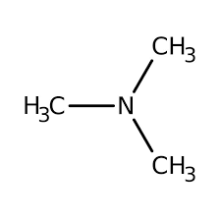
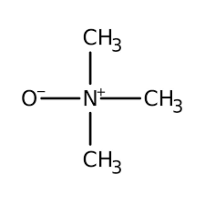
A single change in the amino acid sequence can change the function of a protein, and often affecting how it folds – Producing Inactive Proteins.
dimethylaniline monooxygenase 3
Mutations in dimethylaniline monooxygenase 3 cause trimethylaminuria (high levels of trimethylamine)

Slide 28
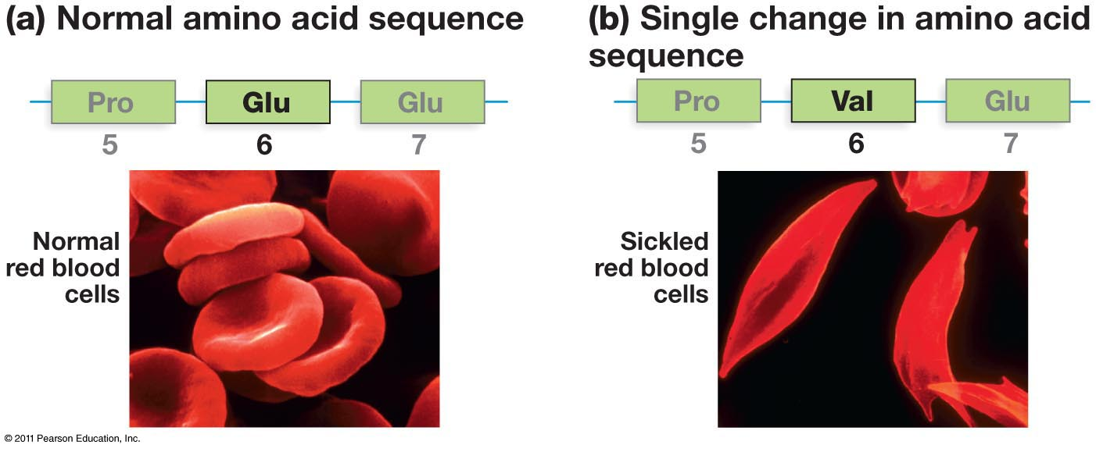
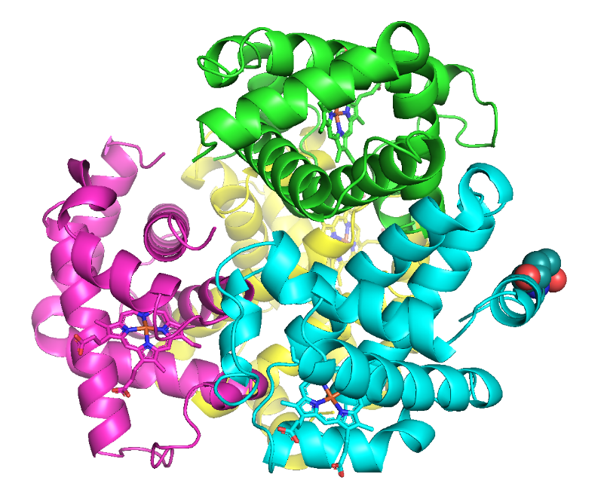
Surface Mutations May Also Lead to Disease
Effect of mutations on protein folding – sickle cell anemia
A single change in the amino acid sequence can change the function of a protein
Glu6
Notes:
Cells with normal hemoglobin and hemoglobin molecules of people with sickle cell anemia. Casues the red blood cells to change shape from a normal disk to sickled shape.

Slide 29
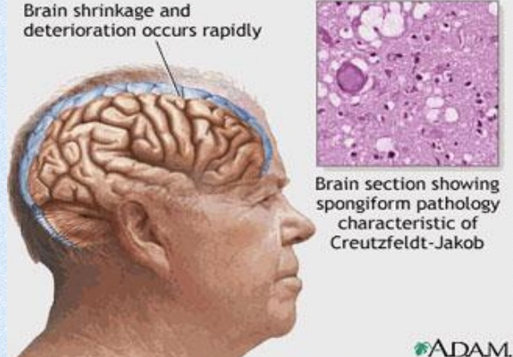
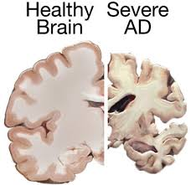
Prions are improperly folded proteins that cause neurodegenerative diseases
What Happens When Proteins Fold Into Different Structures?
Normal
Unfolded protein response (UPR):
The presence of unfolded proteins can trigger the UPR, which can turn off protein synthesis in the cell, leading to cell death.
Misfolded prion protein
Both forms are almost equally stable.
Unfolded
What is the effect on the brain?
Why do the brain cells die?
Notes:
Some improperly folded proteins act as infectious disease causing agents. Or proteinaceous infectious agents. Don’t differ in sequence from normal form of proteins but their shape is very different. B misfolded protein that causes mad cow disease in cattle sponge brain illness.

Slide 30
Protein Structure - Summary and Expectations
Primary Structure:
Can you describe the mechanism of peptide bond formation
Can you draw structure of peptides.
Can you identify amino terminus and give the sequence of amino acids, N -> C
Secondary structure:
Identify helical and sheet secondary structures,
know that they are stabilized by mainchain hydrogen bonds between N-H and O=C.
Location of H-bonds and sidechains
Tertiary Structure:
Can you describe and identify role of the following in stabilizing the folded state.
H-bonds,
van der Waals,
hydrophobic effect
Can you predict, based on sidechain, which amino acids are found in the core of the protein and which are found on the surface.
Quaternary Structure:
Multiple chains, stabilized by non-covalent and covalent (disulfide bonds) interactions.
Diseases related to protein structure:
Core mutations - affect folding
Surface mutations - affect protein-protein (and Protein-DNA) interactions
Stable isoforms – toxic to the cell

Slide 31
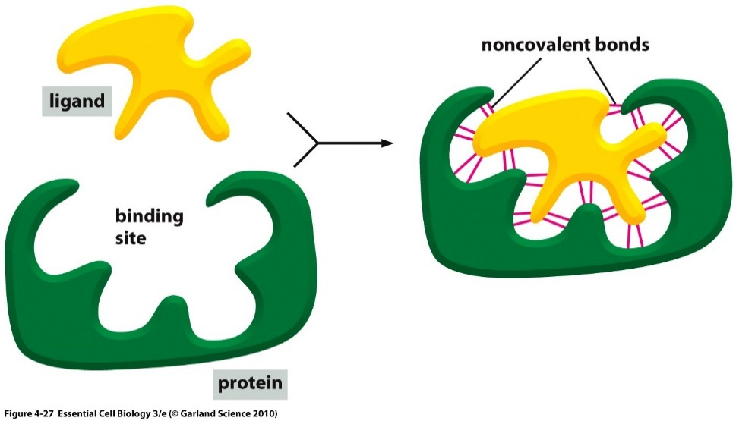
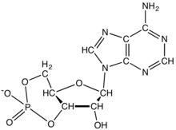
Ligand Binding: Most Proteins Bind to Other Molecules in Biological Interactions:
The bound ligand can be stabilized by any and all of the following interactions:
Interaction | Which stabilize cAMP Binding?
Electrostatic
van der Waals
H-Bonding
Hydrophobic effect
Ligand: Something that binds to a protein, usually small molecules (e.g. cyclicAMP, cAMP).
Binding site allow a protein to interact with specific ligands
Binding site is generated by the folded form of the protein.
cAMP
Notes:
Protein bound to cyclic AMP.

Slide 32
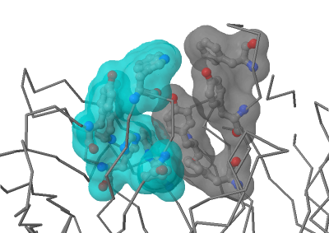
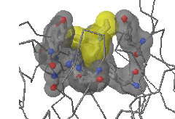
Hydrophobic Effect and Ligand Binding
Antibody
Antibody-PCP complex

Slide 33
[cAMP]
Ligand Binding & Saturation:
Define fraction saturated:
$$Y= \frac{[ML]}{\left[M\right]+[ML]}$$
[M] = free macromolecule (e.g. antibody with no antigen).
[ML] = macromolecule with ligand bound (e.g. antibody with antigen bound).
The boxes with circles represent proteins with no cAMP bound, each box (left to right) is at a higher [cAMP]. Filled circles indicate bound ligand.
1. How will the number of filled circles depend on the cAMP concentration?
2. Plot the fraction saturated data point for each box.
Key Points:
1. The binding sites saturate, when all are full no more ligand can bind.
2. There is a ligand concentration, [L], where ½ the sites are full. This [L] is K_{D}
3. K_{D} is the equilibrium constant for ligand dissociation:
$$K_{Eq}=\frac{[products]}{[reactants]}$$
$$\left(ML\right)⇌\left(M\right)+\left(L\right)$$
$$K_{D}=\frac{\left[M\right][L]}{[ML]}$$

Slide 34
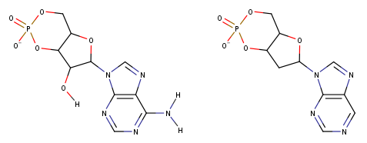
Using K_{D} to Compare Ligand Binding
Ligand 1 (cAMP)
Ligand 2
The binding of two different molecules to the same protein was measured and the data is shown on the right. L1 is cAMP, L2 is similar to cAMP
Which ligand has a K_{D} of 1? L1 or L2?
Which ligand has a K_{D} of 10? L1 or L2?
Which ligand binds more tightly to the protein (higher affinity)? L1 or L2?

Slide 35
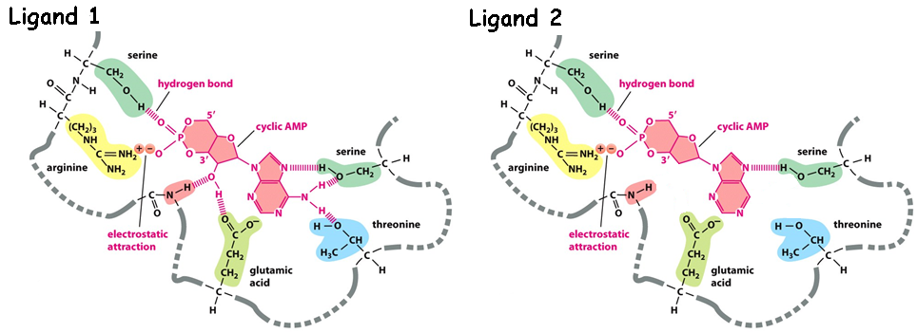
Why does L1 bind more tightly (higher affinity)?
What are the chemical differences between L1 and L2 (Upper diagram)
2. How do these differences affect the interactions with the protein (lower diagram)?
Ligand 1 (cAMP)
Ligand 2
3. How do the differences affect K_{D}?

Slide 36
Key Points:
Binding:
Folded proteins have binding sites that recognize other molecules (ligands) using any and all of the following:
H-bonds,
van der Waals,
Electrostatic,
Non-polar interactions (hydrophobic)
Binding is reversible
Binding is saturable
Binding ½ point (Y=0.5) occurs at K_{D}
The higher the affinity (strength of interaction), the lower the K_{D}

Slide 37
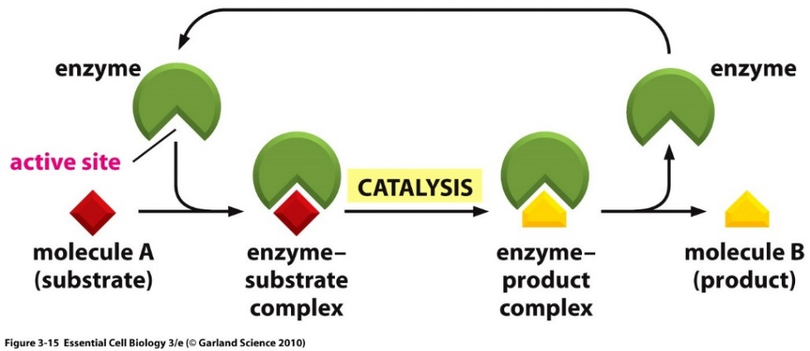
Enzymes
Enzymes are protein or RNA catalysts. They increase the rate of the reaction.
They bind “substrates” and convert them to “products”. Usually, the substrate undergoes a chemical reaction and is changed in its structure.
Most biological chemical reactions occur at meaningful rates only in the presence of an enzyme.
Substrates bind specifically to the enzyme’s active site, interacting with amino acid side chains (or RNA bases). Usually a single enzyme binds one substrate.
The chemical change caused by the enzyme is catalyzed by additional functional groups in the active site.
Many enzymes undergo a conformational change when the substrates are bound to the active site; this change is called an induced fit.
substrates
products

Slide 38
Enzyme – Chemical Diversity
Most enzyme names end in “-ase”
Usually named by their substrates and the reactions they catalyse, i.e. glucose kinase

Slide 39
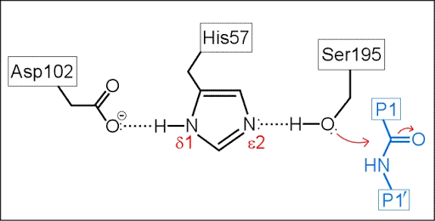
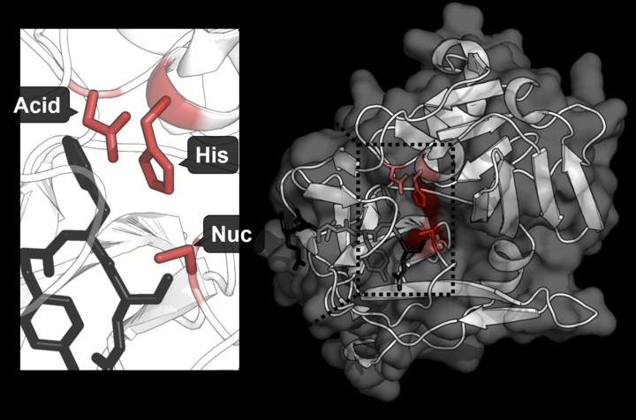
Example of Active Site Functional Groups:
Catalytic triad (Asp, His, Ser) in Protease Trypsin cleaves after Lys Residues
Catalytic triad
Substrate
https://shirleychemproject.weebly.com/
Disulfide bonds in trypsin
Products

Slide 40
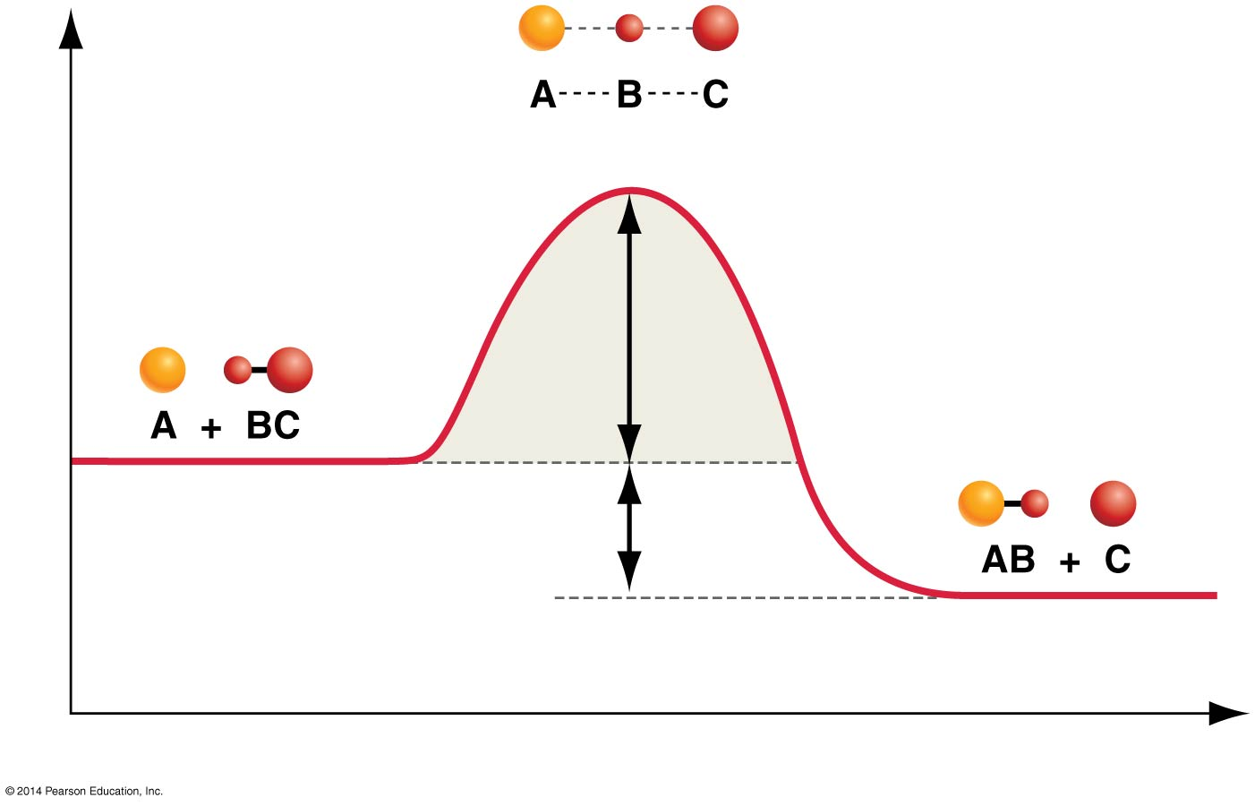
How Do Enzymes Increase Rates?
Enzyme
Transition state = high energy intermediate that occurs during the reaction.
Energy barrier is called the activation energy.
Rate of product formation depends on the concentration of the transition state.
|
N
|
H
B – contains H-bond acceptor
Low [X] = Slow reaction
Enzyme
|
N
|
H
Higher [EX] = Faster reaction
Activation Energy
Interactions between the enzyme and the substrate stabilize the transition state (X) and lower the activation energy required for the reaction to proceed.
Stabilization can include:
Pre- alignment of key groups in the active site, reducing entropy cost of organizing groups.
Direct interactions with the transition state (see diagram, N-H group interacts more favorably with the transition state)

Slide 41
A model of transition state stabilization.
Lower energy of transition state allows more substrates to reach transition state due to their thermal energy.
[S] = 15
[X] = 3
[EX] = 6
How much faster will the rate be when the enzyme is present?

Slide 42
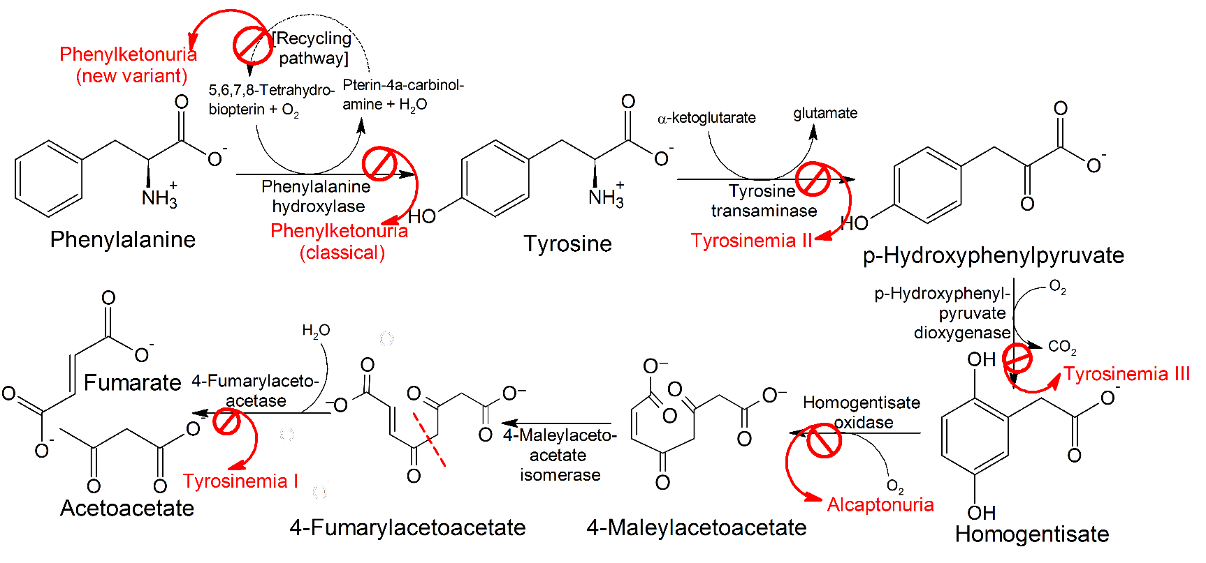
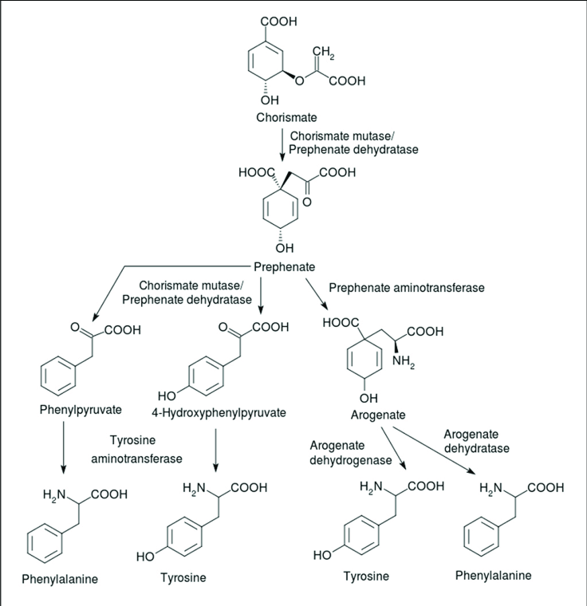
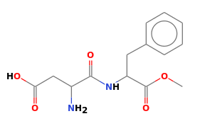
Enzymes, Metabolic Pathways, and Diseases
Synthetic Pathway for Phe, Tyr
(beginning with chorismite)
Each step catalyzed by an enzyme
Pathway for Degradation of Phenylalanine
PKU Disease:
Inactive phenylalanine hydroxylase
Phe levels become toxic:
Neurological problems
Intellectual disability
Developmental delays
Mental health disorders.
Aspartame (artificial sweetener)
Asp-Phe-CH₃

Slide 43
Key Points:
Enzymes:
Enzymes bind substrates (S), forming (ES) complex in active site, converting to P, releasing P.
Rate enhancement since the transition state complex (EX) forms more readily with enzymes due to:
Bringing substrates and functional groups on the enzyme together by binding (less entropy change)
Directly lowering energy of transition state (X) through favorable interactions that are unique to the transition state, such as forming unique hydrogen bonds.
Genetic diseases that lead to inactive metabolic enzymes can cause disease due to the build-up of toxic intermediates.

Slide 44
Carbohydrates
Polysaccharide
DNA (Nucleic Acid)

Slide 45
Carbohydrates
Functional groups:
Monosaccharides (one sugar),
oligosaccharides (few sugars)
polysaccharides (many sugars)
Chemical formula is (CH₂O)_{n} (e.g. hydrated carbon)
They are molecules with:
one aldehyde or ketone group, on 1st or 2nd carbon
-OH group on all other carbons, leading to a chiral carbon for most carbons.
Carbonyl group –> C=O
Only one of these is a carbohydrate, which one?
A B C

Slide 46
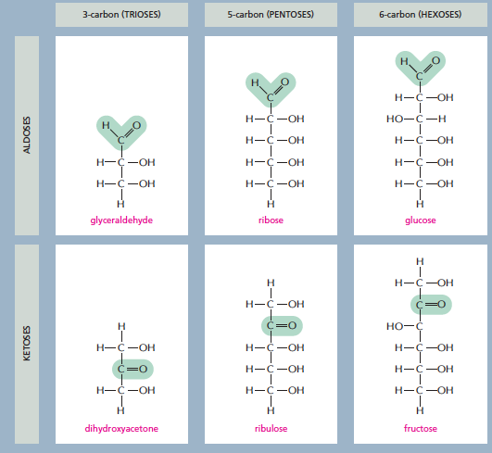
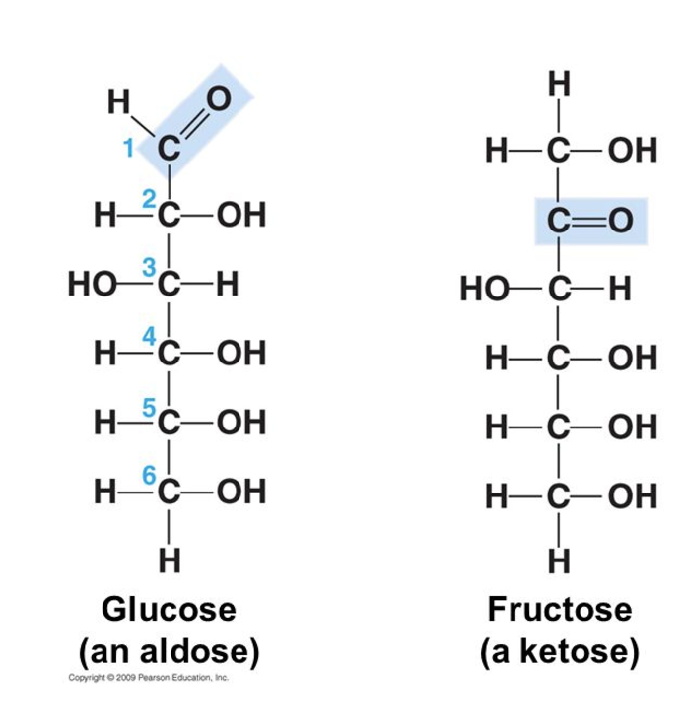
3 ways simple sugars (monosaccharides) differ from each other
1. Location of the carbonyl group
2. Number of carbons
3. Spatial arrangement of atoms (the position of the OH groups)
1. Location of the carbonyl group
2. Number of carbons
3. Spatial arrangement of atoms (the position of the OH groups)
Aldose: Carbonyl group is located on C₁
Numbering carbons:
Carbon 1 is at the end closest to the C=O group.
What carbon is the carbonyl?
Notes:
The C=O group is either on C1 (aldose) or on C2 (ketose).

Slide 47
3 ways simple sugars (monosaccharides) differ from each other
1. Location of the carbonyl group
2. Number of carbons
3. Spatial arrangement of atoms (the position of the OH groups)
Both have the same chemical formula C₆H₁₂O₆. Both are aldose sugars with 6 carbons.
Yet their functions are different.
Glucose can be used for energy immediately.
Galactose has to be converted to glucose before it can be used for energy.
They have different interactions with enzymes due to the different chirality at carbon 4.
OH is down in glucose
OH is up in galactose
Enzyme specific for a-glucose

Slide 48
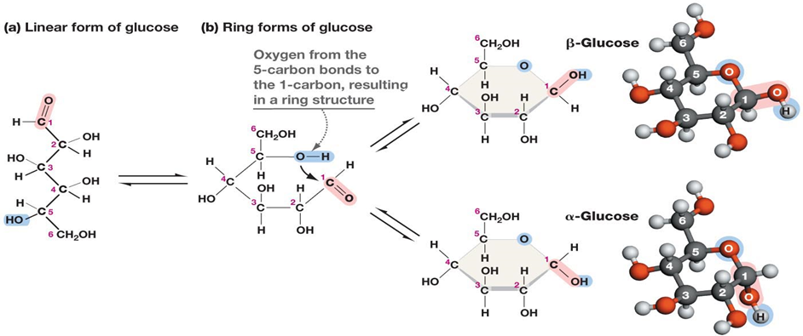
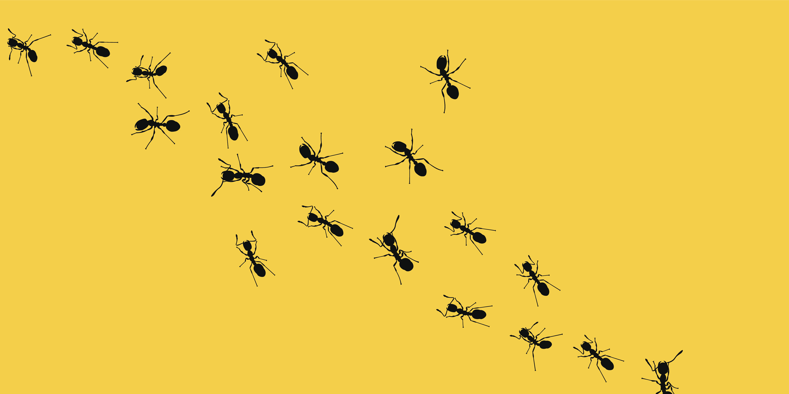
Ring formation in Monosaccharides:
C1 = “Anomeric Carbon”
In aqueous solution, a hydroxyl group reacts with the aldehyde or ketone group on the same molecule, closing the molecule into a ring, with a bridging oxygen
It is usually the 2nd to last -OH group, i.e. C5 in glucose, C4 in ribose.
Stable ring sizes are 5 atoms or 6 atoms
No atoms are lost or gained in this reaction.
The carbonyl carbon becomes chiral and is called the anomeric carbon.
The rings with different chirality at C1 are different:
α (new OH is down), β (new OH is up) “(ants are down, birds are up)”

Slide 49
Example Problem:
The linear form of ribose, a 5 carbon aldose is shown on the right. This sugar is found in RNA (ribonucleic acid).
Number the carbons.
Which carbons are chiral? Mark them with a *.
Draw the cyclic form of α-ribose

Slide 50
Disaccharides
Linkage of the anomeric carbon of one monosaccharide to the OH of another monosaccharide via a condensation reaction.
The bond is termed a glycosidic bond:
The anomeric carbon is the site of attack by another -OH group.
A water is released
Why is the anomeric carbon the preferred site for bond formation (nucleophilic attack)?
Nomenclature rules for linkage:
Orientation of the anomeric involved in the linkage (α oxygen is down, β oxygen is up)
Carbons involved in the linkage (e.g. 1-4)

Slide 51
Disaccharides
There are many possible ways to connect two sugars.
At least one anomeric is always involved.
1-1
1-2
1-3
1-6
1-4

Slide 52
Lactose (milk sugar)
Disaccharides
These kinks are not carbons but are drawn in this way to indicate that the chirality of the anomeric is beta (pointing up). The kinks allow the line to reach the downward pointing –OH on C4 in glucose.
β-galactopyranosyl-(1→4)-β-glucopyranose
Metabolism of Lactose
Lactose is the major sugar in mammalian milk.
Infants produce the enzyme lactase to hydrolyze the disaccharide to monosaccharides.
Lactase expression is turned off in some adults, depending on their genetic background.
Lactase
Galactose
Glucose
Cellular Energy

Slide 53
Lactose Intolerance
Lactase Persistence
In which region do most of the people still produce lactase as adults?
UK
South Africa
In an infant (lactase +):
lactose is broken down to glucose and galactose in the small intestine.
The two sugars are absorbed and used for energy
In a lactose intolerant individual (lactase -)
The lactose is not absorbed in the small intestine, but instead draws water into the intestine due to osmosis – leading to bloating and diarrhea.
Lactose enters the large intestine where gut bacteria use it as a carbon source, generating gas.

Slide 54
Lactose Intolerance
What to do if you are lactose intolerant:
A. Consume less lactose
B. Hydrolyze the lactose to glucose and galactose before consumption.

Slide 55
Polysaccharides as Energy Storage – Glycogen Storage Disease
Glycogen and is made entirely of glucose units and is used for glucose storage.
Glycogen Levels are regulated by hormones secreted due to blood glucose levels.
Glucagon – low blood sugar
Insulin – high blood sugar
Two enzymes degrade or synthesize glycogen
Glycogen phosphorylase – releases glucose from glycogen
Glycogen synthase – stores glucose in glycogen
Branch point
α-1,6- glycosidic linkage
α-1,4- glycosidic linkage
Notes:
GSD III – debranching enzyme required since phosphorylase stops when 4 glucose are remaining. 3 of them are transferred to a new glycogen, and then the a(1-6) is removed. Autosomal recessive, 1:100,000

Slide 56
Polysaccharides as Structural Molecules
Peptidoglycan (protein + sugar) in bacterial cell wall
D-Amino acids
Many antibiotics interfere with cell wall synthesis (e.g. penicillin)
Protein Crosslink
Peptidoglycan (Bacterial Cell Wall)

Slide 57
Summary and Expectations for Carbohydrates
Key Points:
General structure of monosaccharides - be able to distinguish between aldose and ketose (and identify compounds that are not sugars).
Know how to number carbons on aldoses and ketoses
Be able to describe the linkage between two monosaccharides (configuration at the anomeric carbon, atoms linked)
Treatments for lactose intolerance
Be able to describe the linkage between glucose molecules in:
Glycogen (glucose storage)
Be able to describe the overall structure of the peptidoglycan in bacterial cell walls.

