Slide 1
Drugs & Disease – Spring 2025
Course Overview:
Introductory Biochemistry
DNA, RNA, protein synthesis, biotechnology
Immunology & Immunotherapy
Drug Discovery – Enzyme Inhibitors
Genome Editing – CRISPR
Final presentations
My Story
Born in Ottawa Canada
Undergraduate: University of Waterloo, largely physics
MS: Penn State University
PhD: Carnegie Mellon
Post-doc: Stanford University
Faculty: University of Virginia then Carnegie Mellon
Research area:
Protein structure and dynamics
Drug discovery
Expectations:
5 Problem sets (First one posted)
One mid-class exam
Presentation (10 min, topic of choice)
Short paper (Same topic as presentation)
Take-home exercise:
Send me an email with a short paragraph describing why you took the course and what you hope to take away from the course.
Course materials:
https://www.andrew.cmu.edu/user/rule/Drugs_Disease/

Slide 2
Lecture 1 Chemistry and Biology Fundamentals
Chemical Bonding
Functional Groups
Chirality of carbon, chiral drugs
Molecular interactions
pH and charge
Protein Structure and Stability
Ligand Binding
Proteins as enzymes (PKU disease)
Notes:
The characteristics of substances including those in cells, depend on which atoms they contain.

Slide 3
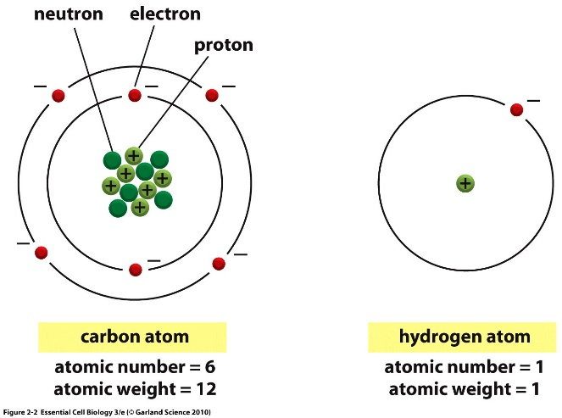
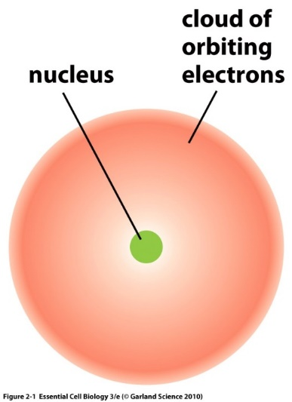
Atoms are composed of:
Protons – positively charged particles
Neutrons – neutral particles
Electrons – negatively charged particles
Protons and neutrons are located in the nucleus.
Electrons are found in orbitals surrounding the nucleus.
The overall charge on an element is neutral (#electrons = # protons).
Atomic number = # of protons = # electrons in element
Isotope = different # of neutrons = same bonding capability

Slide 4
Electron Orbitals
Electrons arranged around the nucleus in specific regions called orbitals.
Each orbital can only hold two electrons
Orbitals are grouped into electron shells
Numbered 1,2,3…
Lower numbers = shells closer to the nucleus
First shell can hold a maximum of 2 electrons
Second shell can hold up to 8
Third shell can also hold 8
Orbitals are usually filled from lowest energy (inner shell) to highest energy (outer shell)
Outer shell is the valence shell and is used for forming bonds with other elements via electron sharing.
The most stable configuration is a complete (full) outer shell.
Electron Configuration of Ne – an inert gas (10e)
Shells: 1st = 1s, 2nd = 2s + 2p, 3rd = 3s + 3p
Shell is a collection of orbitals with similar energy

Slide 5
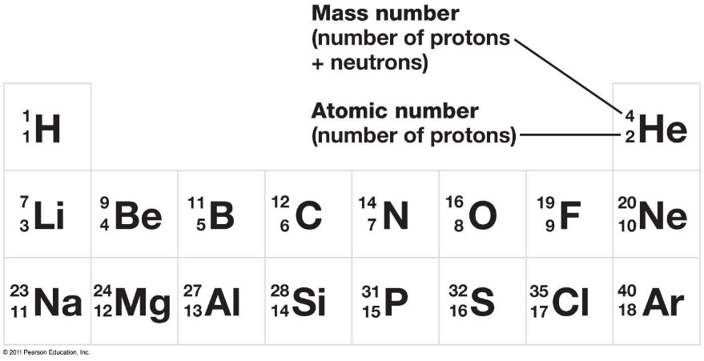
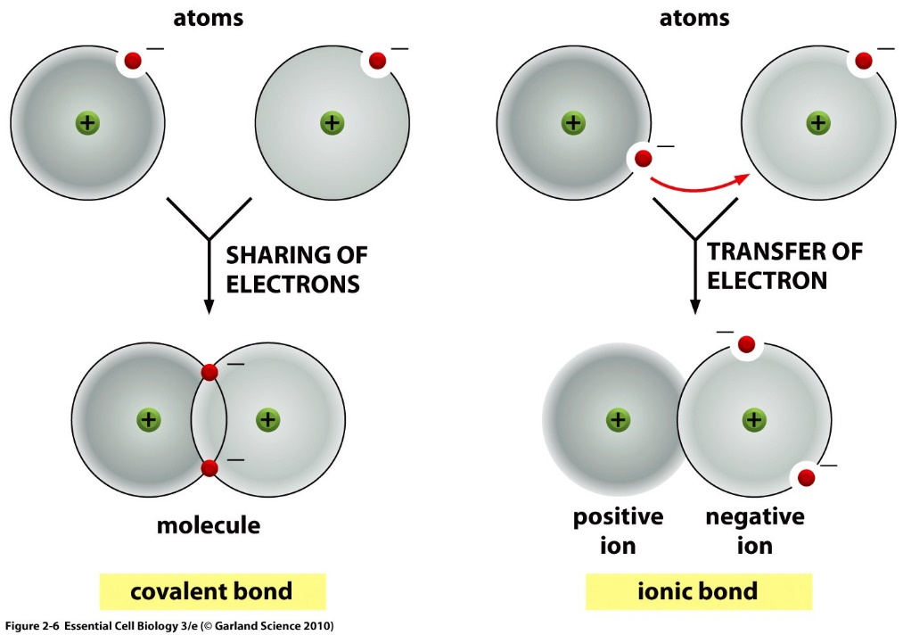
Ions or Covalent Chemical Bonds – What’s an Element going to do?
Elements like Li, Na, F, Cl, Mg, readily form ions to generate a complete outer shell.
Some elements cannot form stable ions because it would involve the loss or gain of too many electrons. This includes C, N, and O – which are common in biological systems.
Unfilled electron orbitals on elements like C, N, and O allow for the formation of covalent bonds, and atoms are most stable when each electron orbital is filled.
Each atom’s unpaired valence electrons are shared by both nuclei to fill their orbitals.
Substances held together by covalent bonds are called molecules
Example:
Li with 3 electrons

Slide 6
Covalent Bonds – Filling the Outer Shell by Sharing
The number of unpaired electrons in the outer shell determines the number of bonds an atom can make.
Multiple bonds form when atoms share multiple electrons.
The number of covalent bonds (valence) formed by common elements.
Oxygen = 2 bonds
Nitrogen = 3 bonds
Carbon = _________
Sulfur = 2 bonds (in biological systems)
Hydrogen = 1 bond
Phosphorous = 5 bonds in biological molecules
You must know these numbers.
Abbreviated Chemical Drawings:
“C” for carbon is not drawn, but carbons are found at the ends of lines and when lines join or “kink”
Hydrogens attached to carbon are not shown, you need to add them to complete to complete the valence of the carbon atoms.
You must know how to do this.
6e
o.s.
5e
o.s.
How many bonds will carbon form?
4e
o.s.
“C” for carbons
Complete valence with H

Slide 7
Representation of Molecules

Slide 8
Electron Sharing and Bond Polarity – Are All Bonds Equal?
Polar bonds = different electron density of each atom.
The polarity of a bond depends on the electronegativity of the atoms.
Electronegativity - ability of atoms to pull electrons from other atoms.
Atoms with higher electronegativity will develop a partial negative charge, the atom they are bonded will have a partial positive charge.
The order of electronegativity is:
H ~ C < N < O
Increased pos. charge of nucleus.
Electron Sharing Continuum

Slide 9
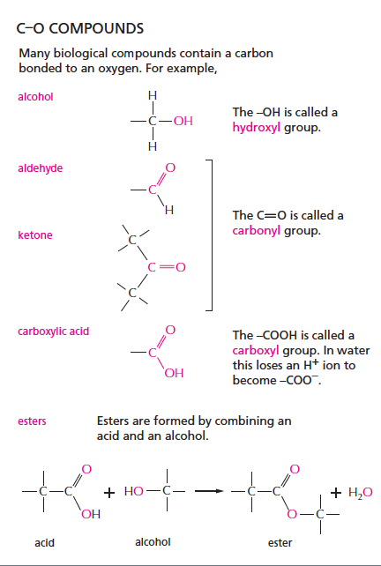
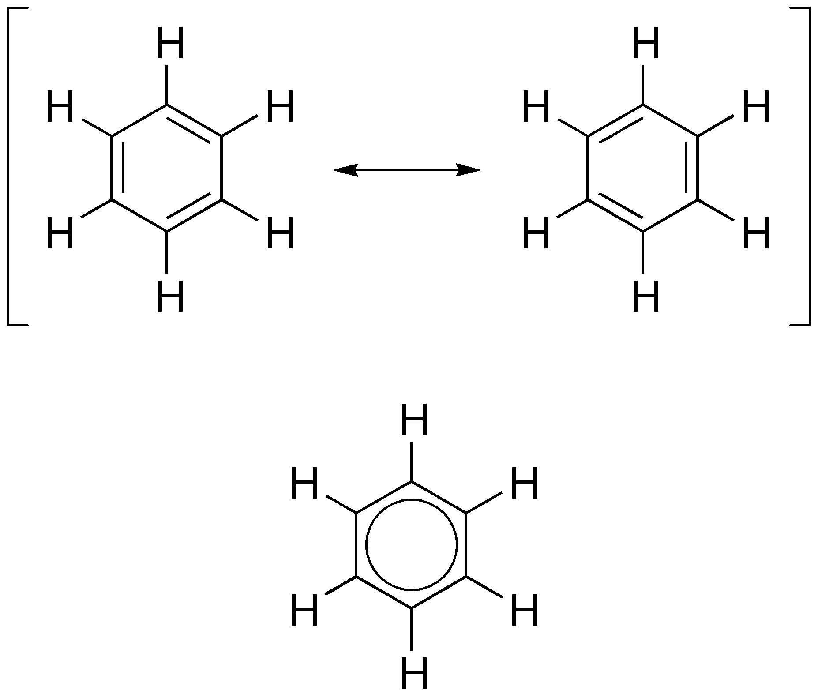
Functional Groups – You should Become Familiar with These
C–H Groups
(hydrophobic)
Methyl
Alanine (amino acid)
Aromatic – planer rings, alt double bonds
C–S Compounds
thiol
Phenyl
Phenylalanine (amino acid)
Cysteine (amino acid)

Slide 10
Key Points & Expectations
Chemistry
Number of bonds formed by common elements:
(N=3, C=4, O=2, S=2, H=1).
You should be able to complete chemical structures by adding hydrogens to carbons.
Predict degree of bond polarity based on electronegativies, N-H and O-H and C=O are polar, C-H is not.
Be able to draw the following functional groups & identify them on larger molecules.
Non-polar:
Methyl
Phenyl
Polar:
Alcohol (C-OH)
Thiol (C-SH)
Carboxylate (ketone, aldehyde) (C=O)
Ester
Carboxylic acid
Amide
Amino
A. Give the names of the functional groups on these two amino acids.
B. Which functional groups are common?
1.
2.
3.
1.
2.
3.

Slide 11
The Geometry of Simple Molecules
The shape of a molecule is determined by the geometry of its bonds.
Carbon, oxygen, and nitrogen often form bonds with a tetrahedral geometry

Slide 12
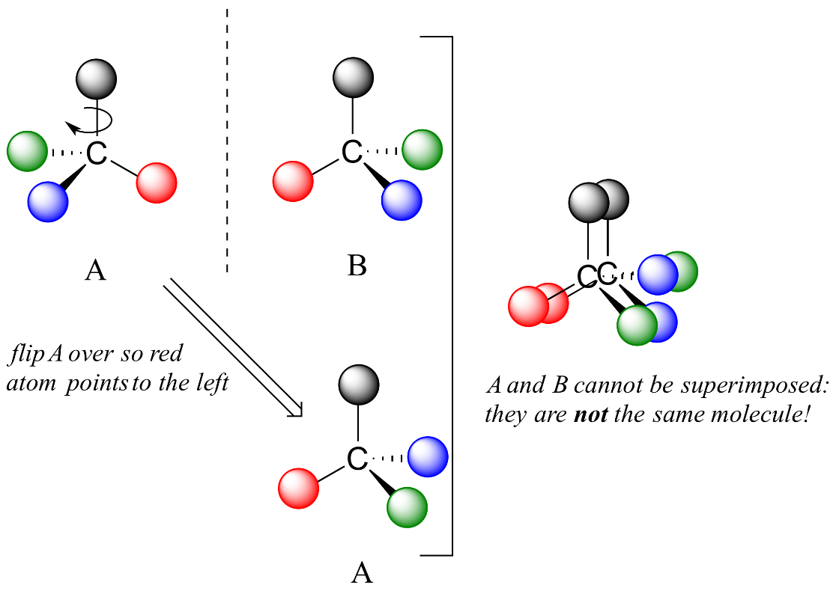
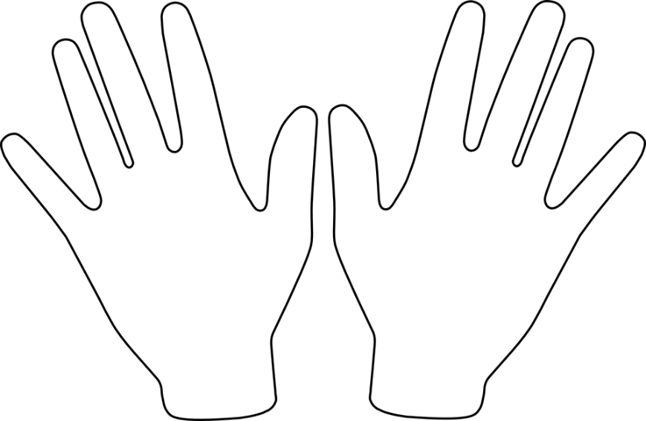
Unique Feature of Tetrahedral Carbon - Chirality
A single tetrahedral carbon atom can have four groups attached (group = collection of atoms)
If the four groups are different, then two forms of the molecule are possible, they are mirror images of each other.
The carbon that has four different groups is called a chiral carbon.
The two different mirror-image molecules are called enantiomers
These two cannot be superimposed on each other (superimposed = rotated so that the same atoms overlap)
A mixture of both enantiomers is called a racemic mixture.
One naming system to distinguish enantiomers is D & L

Slide 13
Identify the Chiral Centers on Threonine
Can you identify chiral centers?
Which carbon is chiral?
1 Yes or No?
2 Yes or No?
3 Yes or No?
4 Yes or No?
4
3
2
1

Slide 14
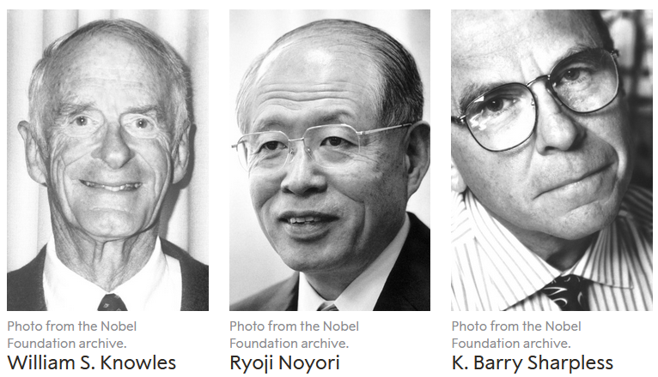
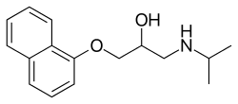
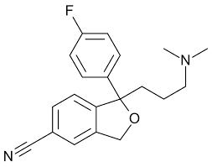
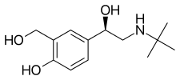
Drugs with Chiral Centers
Nobel Prize for Chiral Synthesis 2001
and a fun game:
https://educationalgames.nobelprize.org/educational/chemistry/chiral/game/game.html
levamisole
Propranolol
1. Racemic mixture is used to treat high blood pressure.
3. L-form used to treat parasitic worm infections
citalopram
levalbuterol
4. Antidepressent (escitalopram is L)
2. R-enantiomer used to treat asthma
Notes:
Propranolol – beta blocker – high blood pressure (racemic)
Valsrtan – aniotensin II receptor blocker – high blood pressure
Levalbuterol – b2-adrenergic receptor agonist – asthma – R-enantiomer
Levamisole – parasitic worm infections – L-form
Citalopram – antidepressant – racemic (Escitalopram is L)
Thalidomide – current use is cancer treatment, was originally prescribed as anxiety & morning sickness – causes birth defects.

Slide 15
Why Chirality Matters
Two Different enantiomers (L and D alanine) binding to the same receptor protein
L-Alanine binds better because of more favorable _______________ interactions.

Slide 16
pH, Strong Acids & Bases
pH = –log [H⁺] = -log[H₃O⁺]
The pH of a solution tells us how acidic the solution is.
The pH scale is used to transform the large range of possible [H+] values to more manageable numbers.
Note a low pH is a high [H+].
The pH is a property of the solvent (water) and can be changed by the addition of a strong acid or base, such as HCl or NaOH.
Acids release protons and will lower the pH of the solution, e.g.
HCl + H₂O H₃O⁺ + Cl⁻
Bases (e.g. ammonia, sodium hydroxide) will absorb protons and lower the hydrogen ion concentration. These increase the pH.
NaOH Na⁺ + OH⁻
OH⁻ + H₃O⁺ 2 H₂O
Hydronium ion
Water
Hydroxide ion
1. Which solution has a higher H⁺ concentration, pH=3 or pH 4.
2. How large is the difference?

Slide 17
Acids and Bases.
Strong acid – complete ionization in solution. e.g.
HCl H⁺ + Cl ⁻
Why this is important: protonation/deprotonation changes the charge on species, either creating or destroying strong electrostatic interactions!
Weak Acid – incomplete ionization in solution.
“HA”=protonated form
“A”=deprotonated form (conjugate base)

Slide 18
What Affects the Degree of Protonation?
1. The extent of protonation/deprotonation depends on the pH of the solution:
Low pH values will favor protonation of acids since there are many protons that will collide with (A) to make (HA).
High pH values will favor deprotonation of acids since there are fewer protons to protonate the acid.
What would you expect to happen to the fraction of the acid that is protonated (f_{HA}) as the pH of the solution is decreased?
$$f_{HA}=\frac{[HA]}{\left[HA\right]+[A]}$$
Fraction
protonated
2. The amount of protonated/deprotonated species also depends on the chemical properties of the acid.
Comparing acetic acid to a protonated amine. At neutral pH (7) most of the acetic acid will be deprotonated while most of the amine will be protonated.
Favored at pH=7
(stronger acid)
pH
99%
The pKa of an acid is the pH where equal amounts of protonated and deprotonated species are found.
Favored at pH=7
(weaker acid)
99%

Slide 19
Key Points & Expectations
Chemistry
Number of bonds formed by common elements:
(N=3, C=4, O=2, S=2, H=1).
You should be able to complete chemical structures by adding hydrogens to carbons.
Chiral carbon and enantiomers - different enantiomers can have different properties. You need to identify chiral carbons.
Polar (unequal charge distribution, e.g. N-H) versus non-polar bonds (e.g. C-H). You need to be able to identify polar and non-polar bonds.
H-bond - Partial charges due to X-H interacting with Y (X & Y electronegative)
H-bond - Identify donors and acceptors, partial charges
pH – be able to predict the charge on a group, given the pH of the solution and the pKa of the acid.
Notes:
Simplest cell
- no nucleus, but has genetic material (information storage and replication
-bounded by cell membrane.
- extracts energy from environment to fuel growth, machinery must be in the cytoplasm

Slide 20
Molecular Interactions
The energy change when two things come together can be approximated to be due to new inter-molecular interactions: $E_{A∪B}$.
$$∆E=E_{AB}−{(E}_{A}+E_{B})\sim E_{A∪B}$$
Interaction | Interaction | Energy (kJ/mol)
Electrostatic interactions (in water) | Full charges | ~5 kJ/mol/single interaction
Van der Waals: Dipole-Dipole | Perm. partial charges | ~0.05 kJ/A² x 100 A² = 5 kJ/mol for 100 A²
Van der Waals: Induced-dipole | Induced partial charges | ~0.02 kJ/A² x 100 A² = 2 kJ/mol for 100 A²
H-Bonds | Electrostatic + e sharing | ~20 kJ/mol gross, ~5 kJ/mol net

Slide 21
Electrostatic energy of point charges.
i) Electrostatics: The interaction energy between two charged particles is:
$$E=\frac{1}{D}\frac{1}{4πε_{o}}\frac{q_{1}q_{2}}{r}$$
The energy depends on the charges of the particles (q1, q2), distance (r)
between the two charges, and the dielectric constant (D) of the media.
How strong are electrostatic interactions?
Na⁺ Cl⁻ = ~ -700 kJ/mol in vacuum (D=1) when r = 2A
Water has a high dielectric constant of 80 due to its polar nature. How does this affect the energy of interaction?
Van Der Waals Forces:
ii) Dipole-dipole – an electrostatic interaction that involves permanent partial charges (these are sometimes called Keesom forces).

Slide 22
iii) Induced dipole (often referred to as London Dispersion)
E
d

Slide 23
iii) Induced dipole (often referred to as London Dispersion)
isobutane: 261 K
butane: 272 K
Although weak, the effects of van der Waals are easily observed: Boiling points of two hydrocarbons:
1. Same number of carbons, why the difference in boiling points?
3. Which of these will have the most favorable vdw interaction:
1 2 3
2. How will van der Waals interaction energies scale with contact area?
4. Which of these will have the least favorable vdw interaction:
1 2 3
E
0
Contact area (A²)

Slide 24
https://www.youtube.com/watch?v=uhfXbSSrabw

