Slide 1
Drugs & Disease – Spring 2025
Course Overview:
Introductory Biochemistry
DNA, RNA, protein synthesis, biotechnology
Immunology & Immunotherapy
Drug Discovery – Enzyme Inhibitors
Genome Editing – CRISPR
Final presentations
My Story
Born in Ottawa Canada
Undergraduate: University of Waterloo, largely physics
MS: Penn State University
PhD: Carnegie Mellon
Post-doc: Stanford University
Faculty: University of Virginia then Carnegie Mellon
Research area:
Protein structure and dynamics
Drug discovery
Expectations:
5 Problem sets (First one posted)
One mid-class exam
Presentation (10 min, topic of choice)
Short paper (Same topic as presentation)
Take-home exercise:
Send me an email with a short paragraph describing why you took the course and what you hope to take away from the course.
Course materials:
https://www.andrew.cmu.edu/user/rule/Drugs_Disease/

Slide 2
Lecture 1
Chemistry and Biology Fundamentals
Chemical Bonding
Functional Groups
Chirality of carbon, chiral drugs
Molecular interactions
pH and charge
Protein Structure and Stability
Ligand Binding
Proteins as enzymes (PKU disease)
Notes:
The characteristics of substances including those in cells, depend on which atoms they contain.

Slide 3
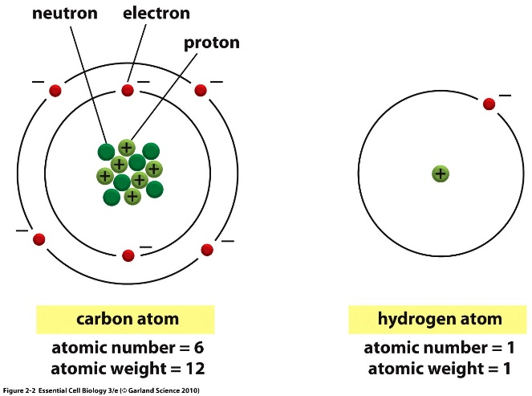
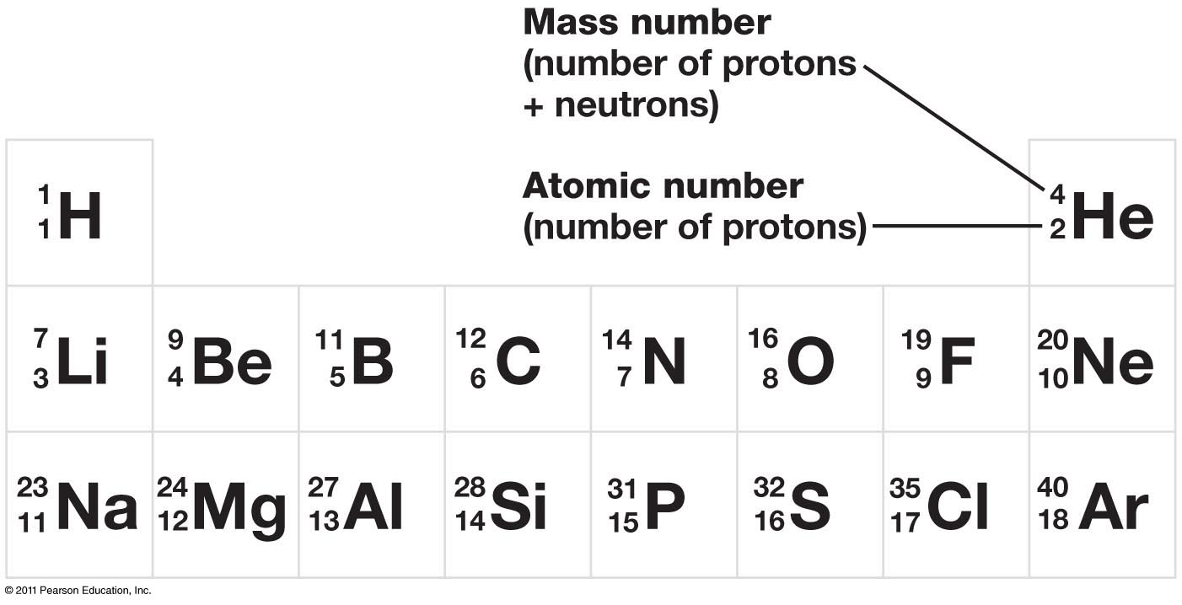
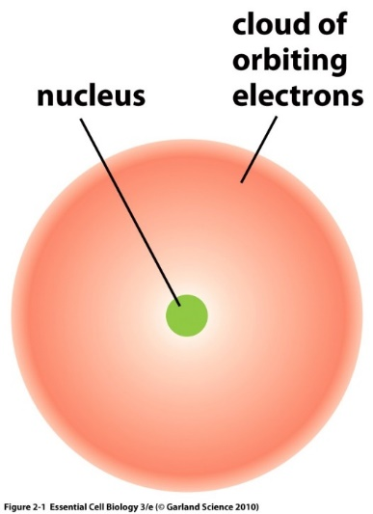
Atoms are composed of:
  Protons – positively charged particles
  Neutrons – neutral particles
  Electrons – negatively charged particles
Protons and neutrons are located in the nucleus.
Electrons are found in orbitals surrounding the nucleus.
The overall charge on an element is neutral (#electrons = # protons).
Atomic number = # of protons = # electrons in element
Isotope = different # of neutrons = same bonding capability

Slide 4
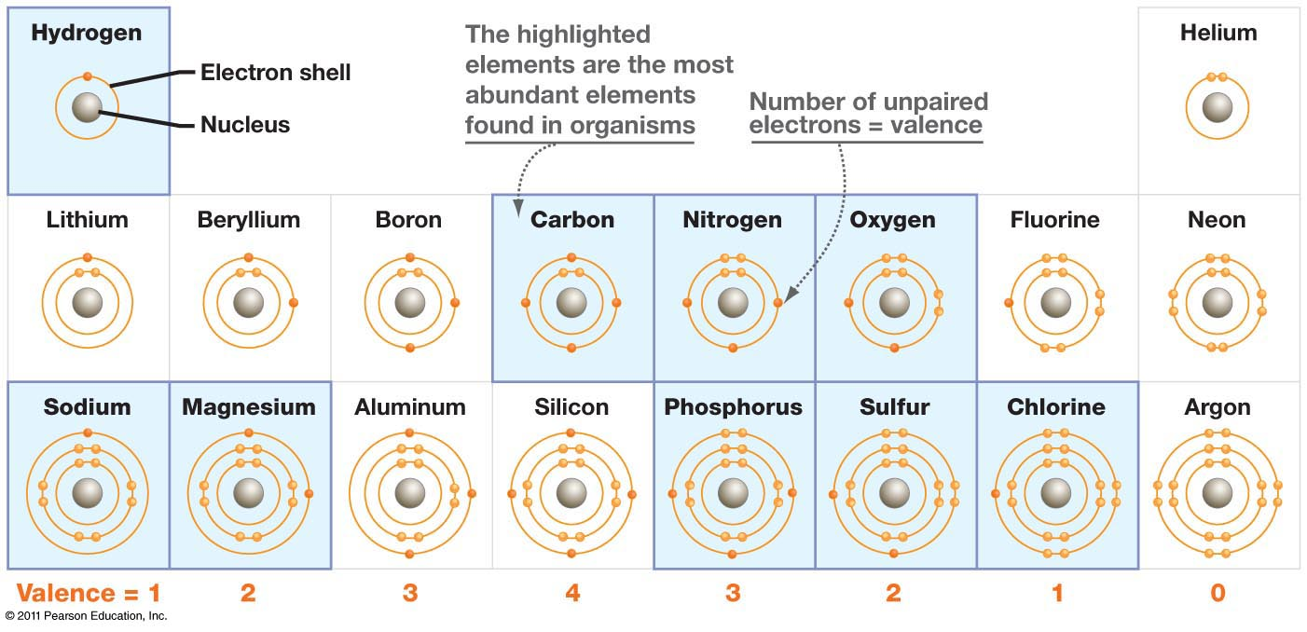
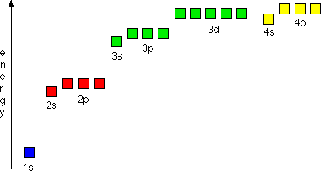
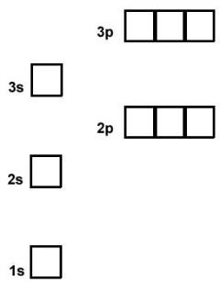
Electron Orbitals
Electrons arranged around the nucleus in specific regions called orbitals.
  Each orbital can only hold two electrons
Orbitals are grouped into electron shells
  Numbered 1,2,3…
  Lower numbers = shells closer to the nucleus
  First shell can hold a maximum of 2 electrons
  Second shell can hold up to 8
  Third shell can also hold 8
Orbitals are usually filled from lowest energy (inner shell) to highest energy (outer shell)
Outer shell is the valence shell and is used for forming bonds with other elements via electron sharing.
The most stable configuration is a complete (full) outer shell.
Electron Configuration of Ne – an inert gas (10e)
Shells: 1st = 1s, 2nd = 2s + 2p, 3rd = 3s + 3p
Shell is a collection of orbitals with similar energy

Slide 5

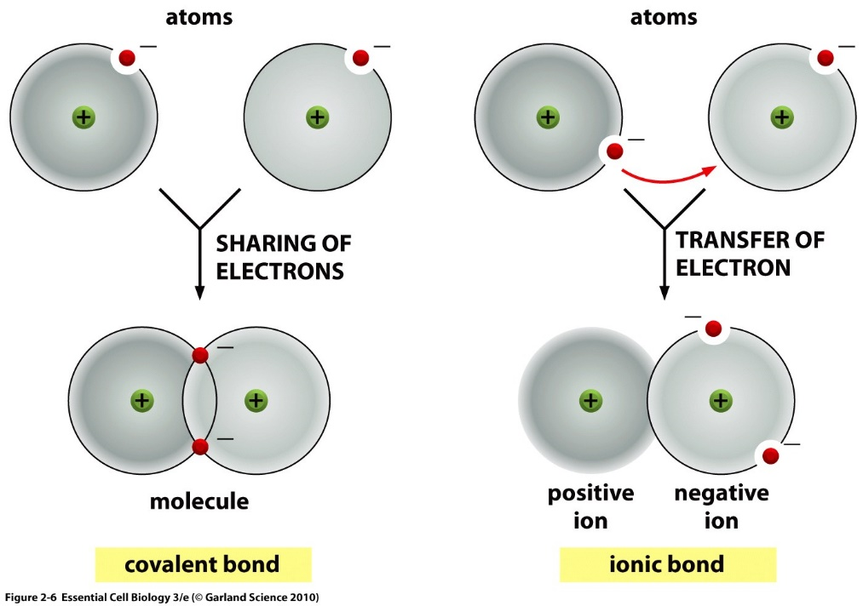
Ions or Covalent Chemical Bonds – What’s an Element going to do?
Elements like Li, Na, F, Cl, Mg, readily form ions to generate a complete outer shell.
Some elements cannot form stable ions because it would involve the loss or gain of too many electrons. This includes C, N, and O – which are common in biological systems.
Unfilled electron orbitals on elements like C, N, and O allow for the formation of covalent bonds, and atoms are most stable when each electron orbital is filled.
  Each atom’s unpaired valence electrons are shared by both nuclei to fill their orbitals.
  Substances held together by covalent bonds are called molecules
Example:
Li with 3 electrons

Slide 6
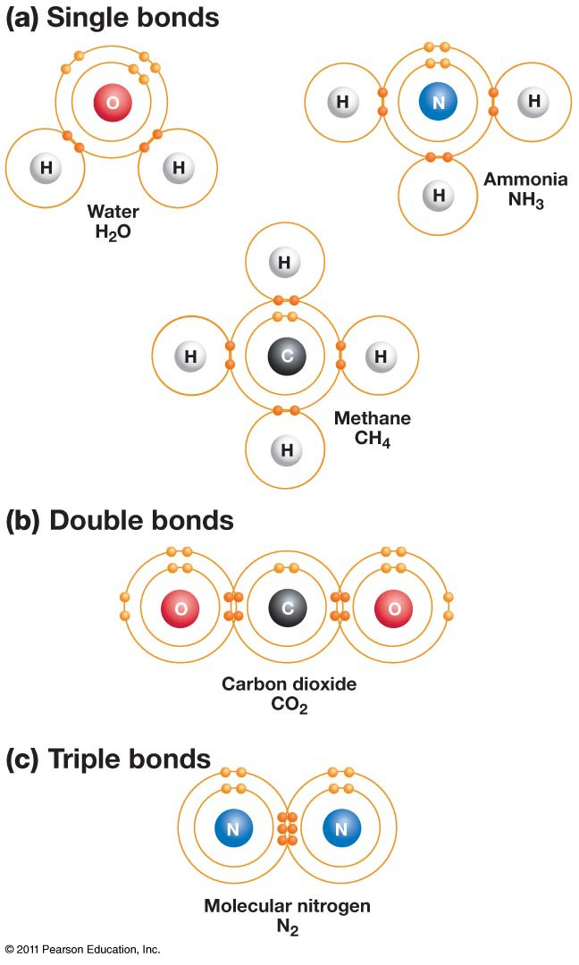
Covalent Bonds – Filling the Outer Shell by Sharing
The number of unpaired electrons in the outer shell determines the number of bonds an atom can make.
Multiple bonds form when atoms share multiple electrons.
The number of covalent bonds (valence) formed by common elements.
Oxygen = 2 bonds
Nitrogen = 3 bonds
Carbon = _________
Sulfur = 2 bonds (in biological systems)
Hydrogen = 1 bond
Phosphorous = 5 bonds in biological molecules
You must know these numbers.
Abbreviated Chemical Drawings:
“C” for carbon is not drawn, but carbons are found at the ends of lines and when lines join or “kink”
Hydrogens attached to carbon are not shown, you need to add them to complete to complete the valence of the carbon atoms.
You must know how to do this.
6e
o.s.
5e
o.s.
How many bonds will carbon form?
4e
o.s.
“C” for carbons
Complete valence with H

Slide 7
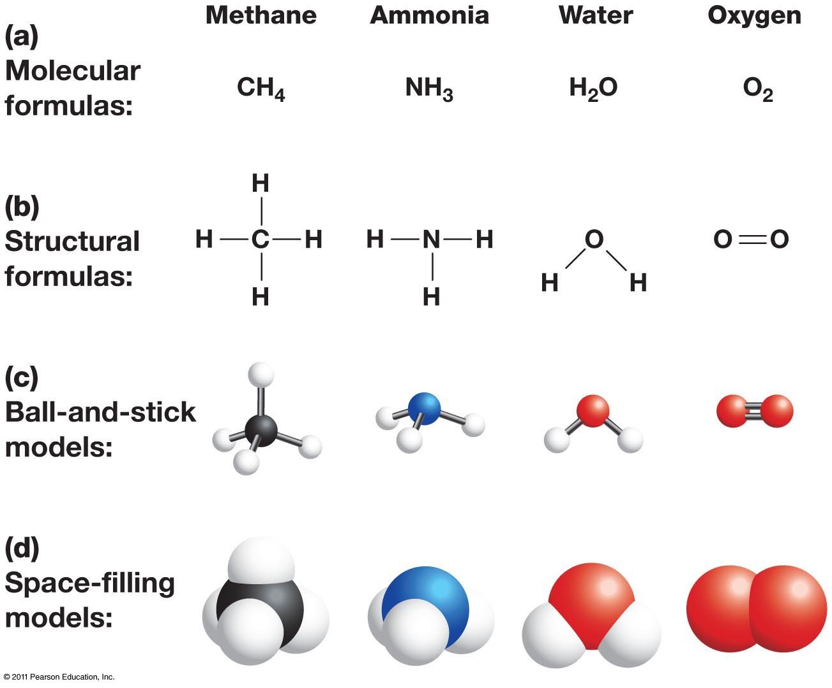
Representation of Molecules

Slide 8
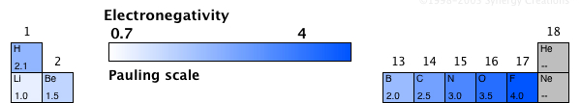
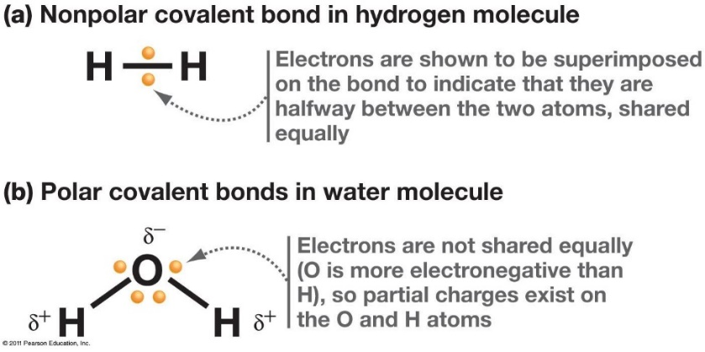
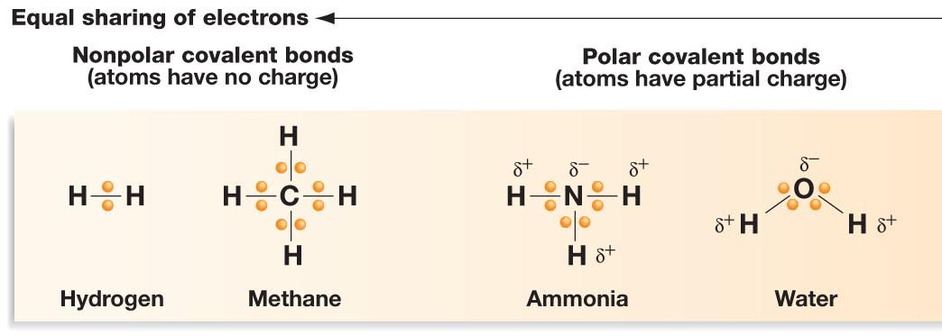
Electron Sharing and Bond Polarity – Are All Bonds Equal?
Polar bonds = different electron density of each atom.
The polarity of a bond depends on the electronegativity of the atoms.
Electronegativity - ability of atoms to pull electrons from other atoms.
Atoms with higher electronegativity will develop a partial negative charge, the atom they are bonded will have a partial positive charge.
The order of electronegativity is:
    H ~ C < N < O
Increased pos. charge of nucleus.
Electron Sharing Continuum

Slide 9
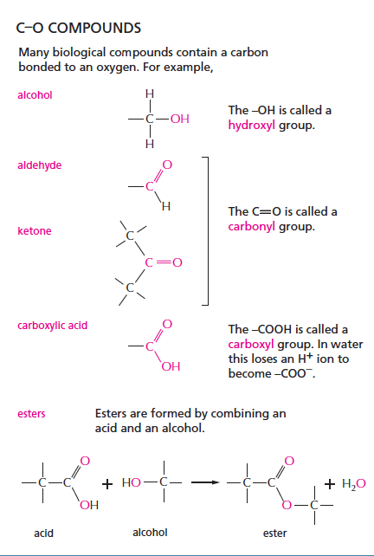
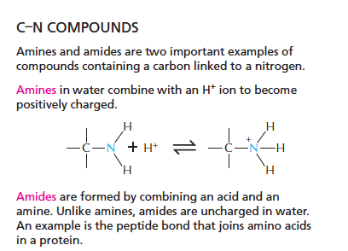
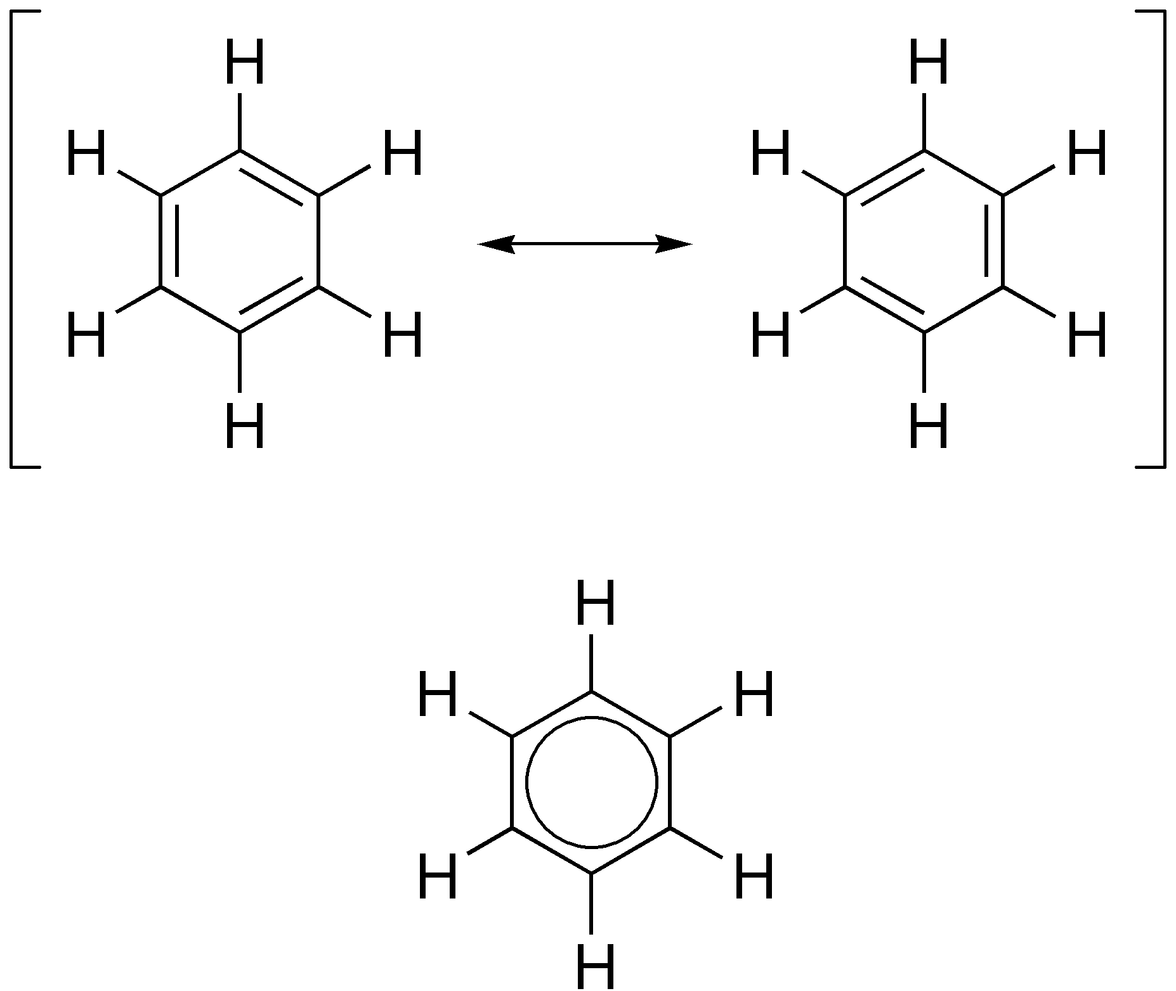
Functional Groups – You should Become Familiar with These
C–H Groups
(hydrophobic)
Methyl
Alanine (amino acid)
Aromatic – planer rings, alt double bonds
C–S Compounds
thiol
Phenyl
Phenylalanine (amino acid)
Cysteine (amino acid)

Slide 10
Key Points & Expectations
Chemistry
Number of bonds formed by common elements:
(N=3, C=4, O=2, S=2, H=1).
You should be able to complete chemical structures by adding hydrogens to carbons.
Predict degree of bond polarity based on electronegativies, N-H and O-H and C=O are polar, C-H is not.
Be able to draw the following functional groups & identify them on larger molecules.
  Non-polar:
    Methyl
    Phenyl
  Polar:
    Alcohol (C-OH)
    Thiol (C-SH)
    Carboxylate (ketone, aldehyde) (C=O)
    Ester
    Carboxylic acid
    Amide
    Amino
A. Give the names of the functional groups on these two amino acids.
B. Which functional groups are common?
1.
2.
3.
1.
2.
3.

Slide 11
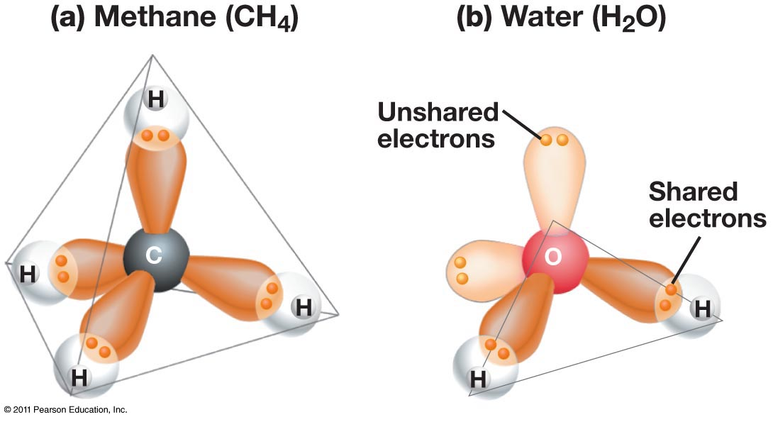
The Geometry of Simple Molecules
The shape of a molecule is determined by the geometry of its bonds.
Carbon, oxygen, and nitrogen often form bonds with a tetrahedral geometry

Slide 12
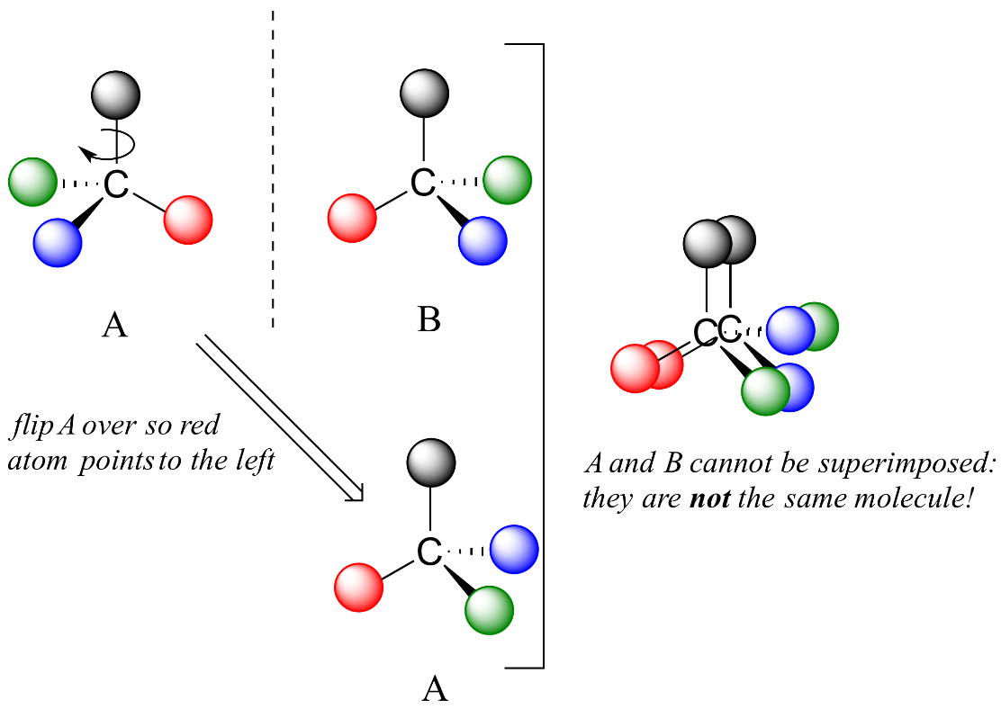
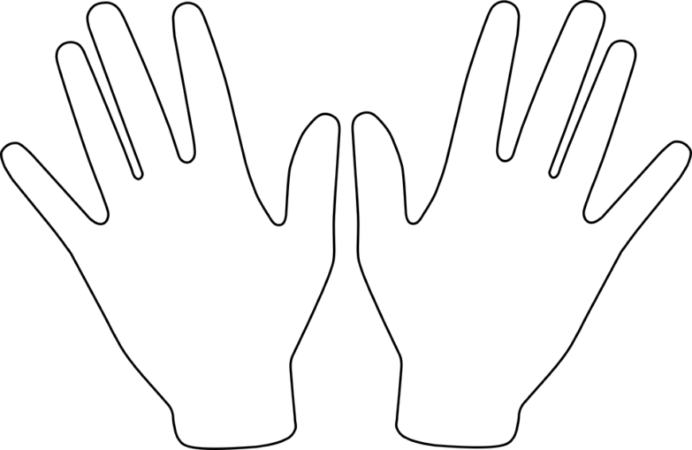
Unique Feature of Tetrahedral Carbon - Chirality
A single tetrahedral carbon atom can have four groups attached (group = collection of atoms)
If the four groups are different, then two forms of the molecule are possible, they are mirror images of each other.
The carbon that has four different groups is called a chiral carbon.
The two different mirror-image molecules are called enantiomers
These two cannot be superimposed on each other (superimposed = rotated so that the same atoms overlap)
A mixture of both enantiomers is called a racemic mixture.
One naming system to distinguish enantiomers is D & L

Slide 13
Identify the Chiral Centers on Threonine
Can you identify chiral centers?
Which carbon is chiral?
1 Yes or No?
2 Yes or No?
3 Yes or No?
4 Yes or No?
4
3
2
1

Slide 14
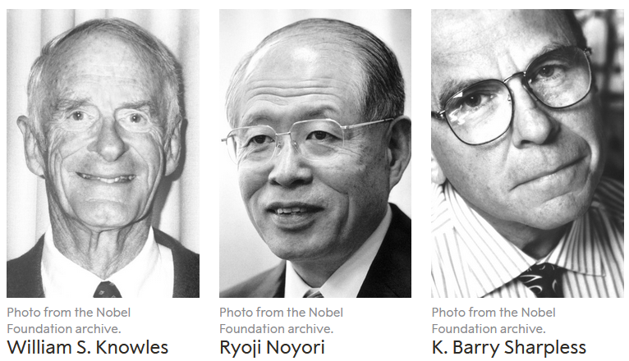

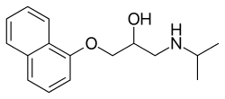
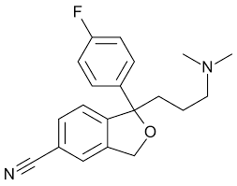
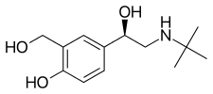
Drugs with Chiral Centers
Nobel Prize for Chiral Synthesis 2001
and a fun game:
https://educationalgames.nobelprize.org/educational/chemistry/chiral/game/game.html
levamisole
Propranolol
1. Racemic mixture is used to treat high blood pressure.
3. L-form used to treat parasitic worm infections
citalopram
levalbuterol
4. Antidepressent (escitalopram is L)
2. R-enantiomer used to treat asthma
Notes:
Propranolol – beta blocker – high blood pressure (racemic)
Valsrtan – aniotensin II receptor blocker – high blood pressure
Levalbuterol – b2-adrenergic receptor agonist – asthma – R-enantiomer
Levamisole – parasitic worm infections – L-form
Citalopram – antidepressant – racemic (Escitalopram is L)
Thalidomide – current use is cancer treatment, was originally prescribed as anxiety & morning sickness – causes birth defects.

Slide 15
Why Chirality Matters
Two Different enantiomers (L and D alanine) binding to the same receptor protein
L-Alanine binds better because of more favorable _______________ interactions.

Slide 16
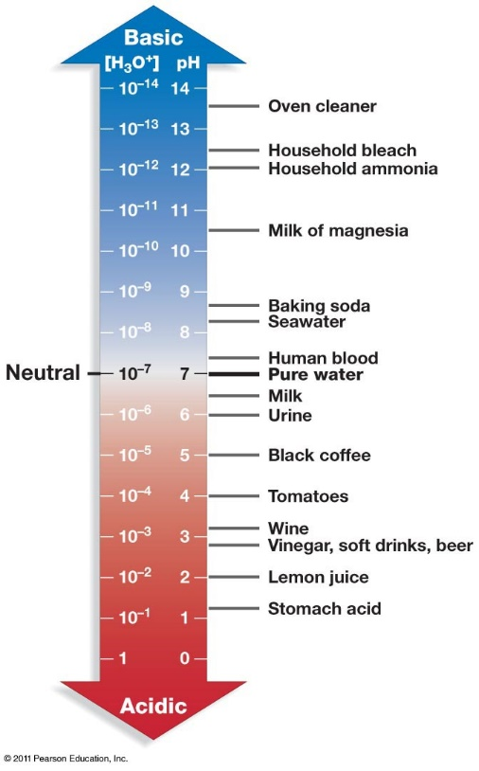
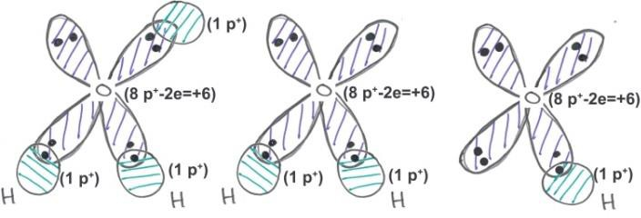


pH, Strong Acids & Bases
pH = –log [H⁺] = -log[H₃O⁺]
The pH of a solution tells us how acidic the solution is.
The pH scale is used to transform the large range of possible [H+] values to more manageable numbers.
Note a low pH is a high [H+].
The pH is a property of the solvent (water) and can be changed by the addition of a strong acid or base, such as HCl or NaOH.
Acids release protons and will lower the pH of the solution, e.g.
  HCl + H₂O H₃O⁺ + Cl⁻
Bases (e.g. ammonia, sodium hydroxide) will absorb protons and lower the hydrogen ion concentration. These increase the pH.
  NaOH Na⁺ + OH⁻
  OH⁻ + H₃O⁺ 2 H₂O
Hydronium ion
Water
Hydroxide ion
1. Which solution has a higher H⁺ concentration, pH=3 or pH 4.
2. How large is the difference?

Slide 17
Acids and Bases.
Strong acid – complete ionization in solution. e.g.
HCl H⁺ + Cl ⁻
Why this is important: protonation/deprotonation changes the charge on species, either creating or destroying strong electrostatic interactions!
Weak Acid – incomplete ionization in solution.
“HA”=protonated form
“A”=deprotonated form (conjugate base)

Slide 18
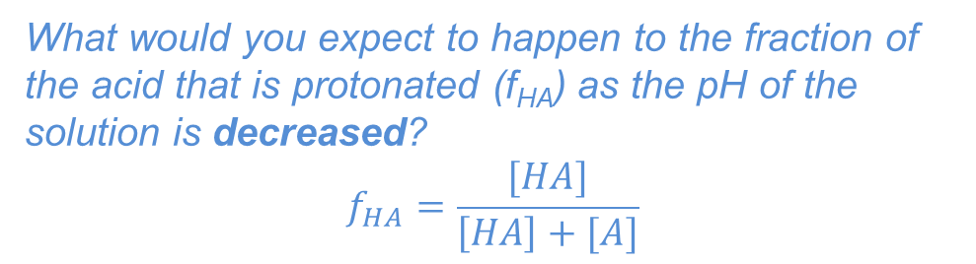
What Affects the Degree of Protonation?
1. The extent of protonation/deprotonation depends on the pH of the solution:
  Low pH values will favor protonation of acids since there are many protons that will collide with (A) to make (HA).
  High pH values will favor deprotonation of acids since there are fewer protons to protonate the acid.
What would you expect to happen to the fraction of the acid that is protonated (f_{HA}) as the pH of the solution is decreased?
$$f_{HA}=\frac{[HA]}{\left[HA\right]+[A]}$$
Fraction
protonated
2. The amount of protonated/deprotonated species also depends on the chemical properties of the acid.
Comparing acetic acid to a protonated amine. At neutral pH (7) most of the acetic acid will be deprotonated while most of the amine will be protonated.
Favored at pH=7
(stronger acid)
pH
99%
The pKa of an acid is the pH where equal amounts of protonated and deprotonated species are found.
Favored at pH=7
(weaker acid)
99%

Slide 19
Key Points & Expectations
Chemistry
Number of bonds formed by common elements:
(N=3, C=4, O=2, S=2, H=1).
You should be able to complete chemical structures by adding hydrogens to carbons.
Chiral carbon and enantiomers - different enantiomers can have different properties. You need to identify chiral carbons.
Polar (unequal charge distribution, e.g. N-H) versus non-polar bonds (e.g. C-H). You need to be able to identify polar and non-polar bonds.
H-bond - Partial charges due to X-H interacting with Y (X & Y electronegative)
H-bond - Identify donors and acceptors, partial charges
pH – be able to predict the charge on a group, given the pH of the solution and the pKa of the acid.
Notes:
Simplest cell
- no nucleus, but has genetic material (information storage and replication
-bounded by cell membrane.
- extracts energy from environment to fuel growth, machinery must be in the cytoplasm

Slide 20
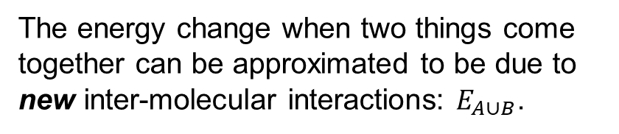

Molecular Interactions
The energy change when two things come together can be approximated to be due to new inter-molecular interactions: $E_{A∪B}$.
$$∆E=E_{AB}−{(E}_{A}+E_{B})\sim E_{A∪B}$$
Interaction | Interaction | Energy (kJ/mol)
Electrostatic interactions (in water) | Full charges | ~5 kJ/mol/single interaction
Van der Waals: Dipole-Dipole | Perm. partial charges | ~0.05 kJ/A² x 100 A² = 5 kJ/mol for 100 A²
Van der Waals: Induced-dipole | Induced partial charges | ~0.02 kJ/A² x 100 A² = 2 kJ/mol for 100 A²
H-Bonds | Electrostatic + e sharing | ~20 kJ/mol gross, ~5 kJ/mol net

Slide 21

Electrostatic energy of point charges.
i) Electrostatics: The interaction energy between two charged particles is:
$$E=\frac{1}{D}\frac{1}{4πε_{o}}\frac{q_{1}q_{2}}{r}$$
The energy depends on the charges of the particles (q1, q2), distance (r)
between the two charges, and the dielectric constant (D) of the media.
How strong are electrostatic interactions?
Na⁺ Cl⁻ = ~ -700 kJ/mol in vacuum (D=1) when r = 2A
Water has a high dielectric constant of 80 due to its polar nature. How does this affect the energy of interaction?
Van Der Waals Forces:
ii) Dipole-dipole – an electrostatic interaction that involves permanent partial charges (these are sometimes called Keesom forces).

Slide 22
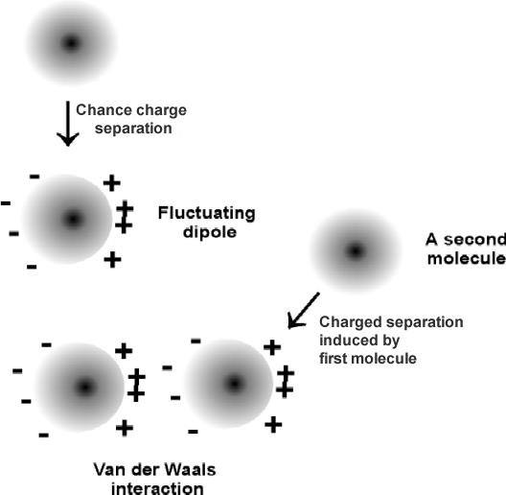
iii) Induced dipole (often referred to as London Dispersion)
E
d

Slide 23
iii) Induced dipole (often referred to as London Dispersion)
isobutane: 261 K
butane: 272 K
Although weak, the effects of van der Waals are easily observed: Boiling points of two hydrocarbons:
1. Same number of carbons, why the difference in boiling points?
3. Which of these will have the most favorable vdw interaction:
1 2 3
2. How will van der Waals interaction energies scale with contact area?
4. Which of these will have the least favorable vdw interaction:
1 2 3
E
0
Contact area (A²)

Slide 24
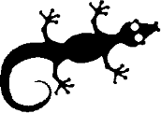
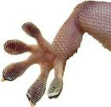
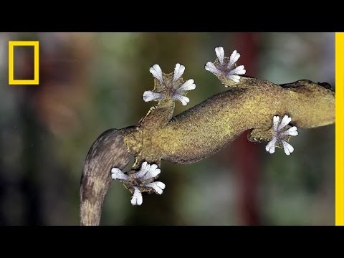
https://www.youtube.com/watch?v=uhfXbSSrabw

Slide 25
iv) Hydrogen Bonds
H-bonds are primarily (90%) an electrostatic attraction between:
  Electropositive hydrogen, attached to an electronegative atom is the hydrogen bond donor (i.e. NH).
  Electronegative hydrogen bond acceptor (e.g. the lone pairs of oxygen, or C=O group of an amide).
A “bond” implies electron sharing – about 10% of the electron is shared from one molecule to the next in the case of H-bonds
The energy released when an H-bond forms depends on the distance and angle of the bond.
Usually hydrogen bonds are exchanged, resulting in small net energy differences:
Note that the proton is NOT transferred to the acceptor, it remains covalently bonded to the donor atom. The Hydrogen Bond is the interaction between the X-H donor and electronegative acceptor.

Slide 26
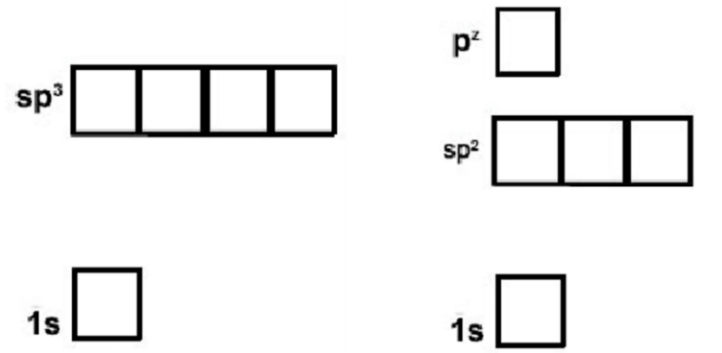
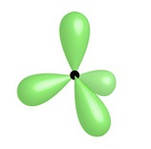
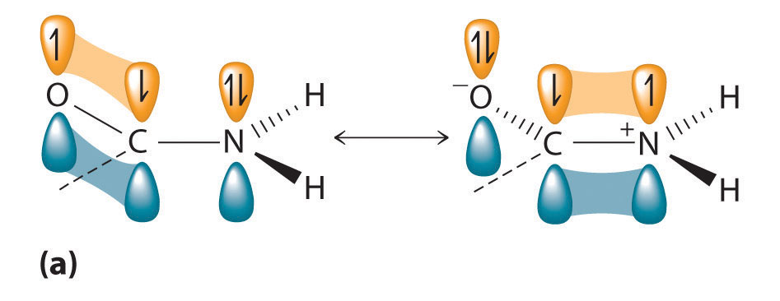
How to Identify Hydrogen Bond Donor and Acceptors
Exceptions, N in a delocalized system:
Will not accept from above or below the plane of the system, because the lonepair is delocalized.
Can accept in the plane of the ring if there is no attached hydrogen, via lone pair in sp2 orbital
Sp2 is used in amides, allowing favorable overlap of the full pz orbital with the pz on C and O
The lone pair in the pz is shared with the pz electrons on carbon and oxygen.
Due to electron sharing, there is only a slight neg. charge and the group does not accept an H-bond.
N – 7 electrons
Sp3
Sp3 is used in ammonia, keeping the three hydrogen atoms as far from each other as possible. The fourth sp3 orbital is full with two electrons (lone pair).
The lone pair is an excellent acceptor.
Sp2
Nitrogen can form two types of hybrid orbitals, sp3 (tetrahedral geometry) or sp2 (planer) + pz

Slide 27
Indicate which atoms could donate an H-bond and which could accept and H-bond
ATOM | Donor? | Acceptor? | Neither
1 (F)
2 (C_{aro}-H)
3 (N)
4 (-NH₂)
5 (C=O)
6 (O)
7 (O-H)
Can you?
Identify groups that can donate or accept hydrogen bonds?

Slide 28
Relative Energy of Interactions
Interaction | Interaction | Energy (kJ/mol)
Covalent Bond | Electron sharing | 200-400 kJ/mol
Electrostatic interactions (in water) | Full charges | ~5 kJ/mol/single interaction
VdW - Dipole-dipole (Keesom) | Perm. partial charges | ~0.05 kJ/A² x 100 A² = 5 kJ/mol for 100 A²
VdW – Induced dipole (London) | Induced partial charges | ~0.02 kJ/A² x 100 A² = 2 kJ/mol for 100 A²
H-Bonds | Electrostatic + e sharing | ~20 kJ/mol gross, ~5 kJ/mol net
How does the energy of the last four interactions compare to covalent bonds?
1. Stronger 2. Weaker 3. The Same
2. Which of these are closer to thermal energy, kT = 2.5 kJ/mol @ room temp.
3. What is the advantage of a weak interaction in biology?

Slide 29
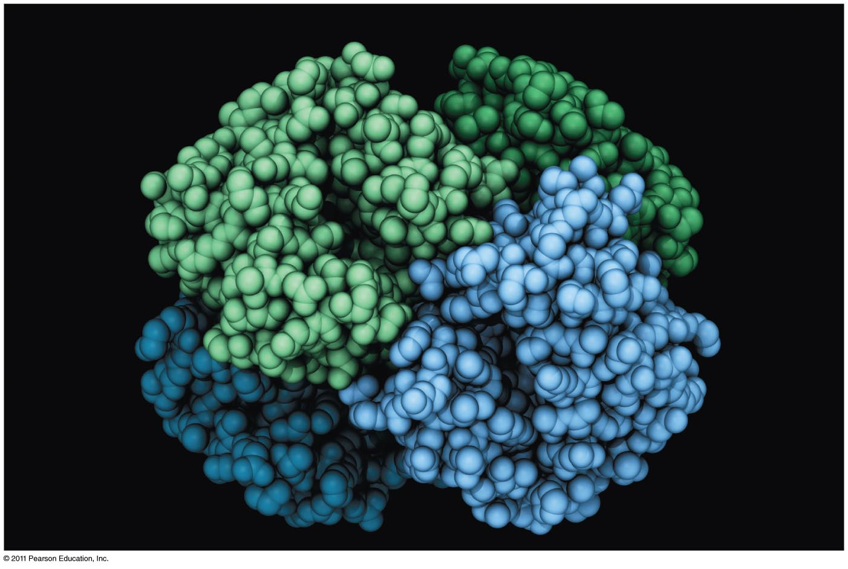
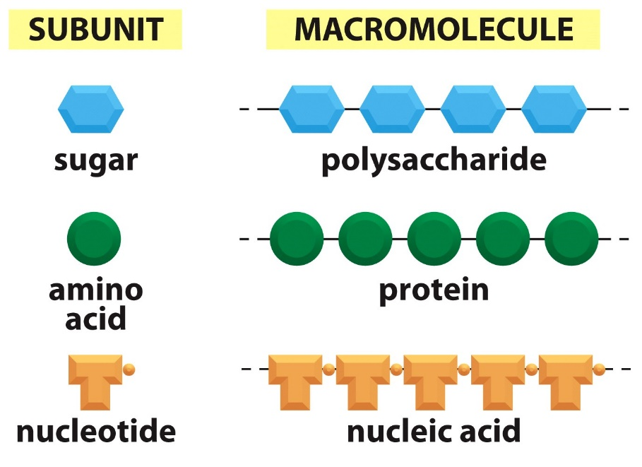
Proteins and Amino Acids

Slide 30
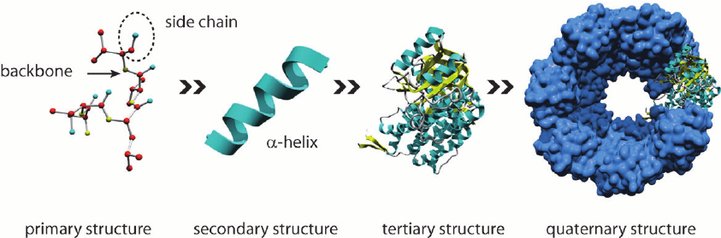
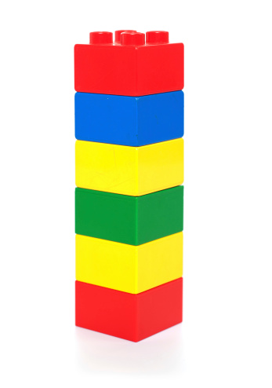
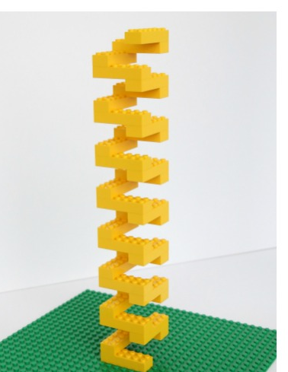
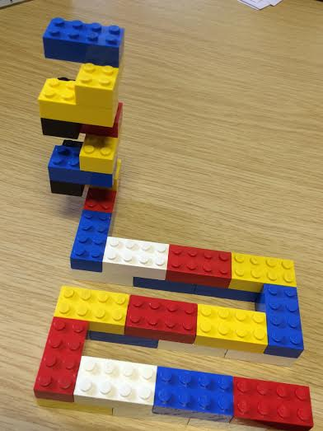
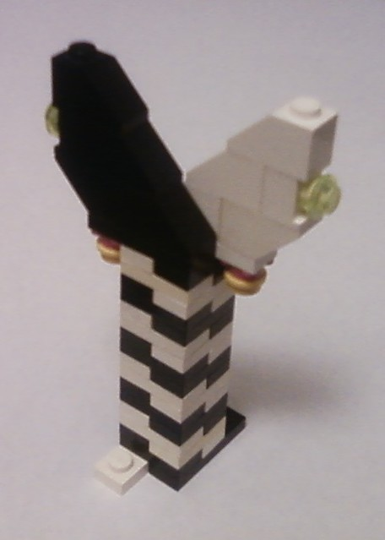
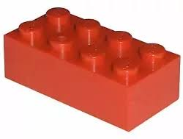
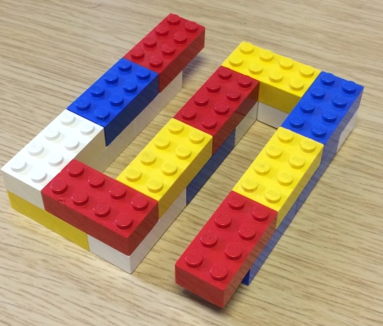
Structural Hierarchy of Proteins
Primary - sequence of amino acids, no 3D structural information
Secondary - local structural elements, only mainchain atoms involved
Tertiary - 3D position of all atoms, functional form of many proteins.
Quaternary - multiple chains – multiple chains often required for function.
Biological Function
(White and black represent two different chains)

Slide 31
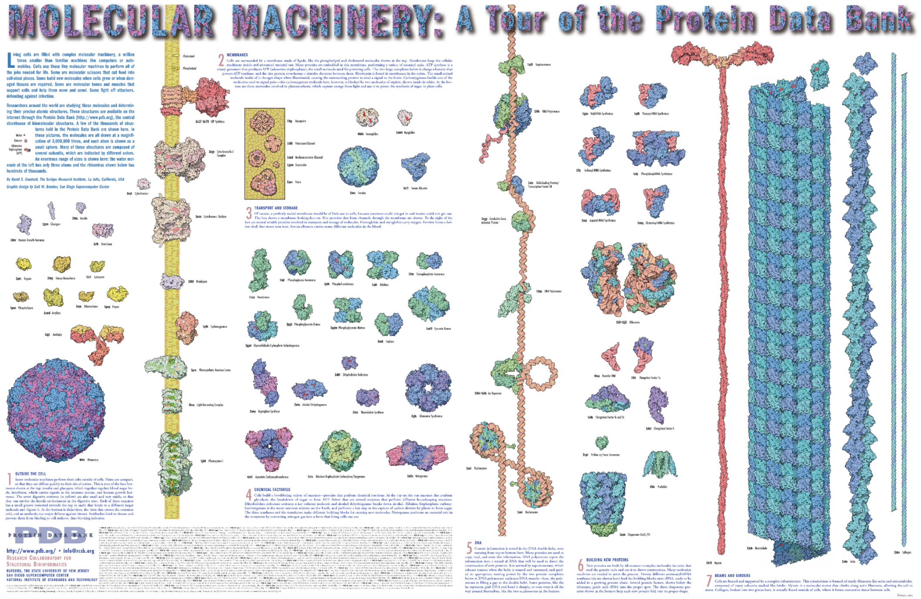

Slide 32
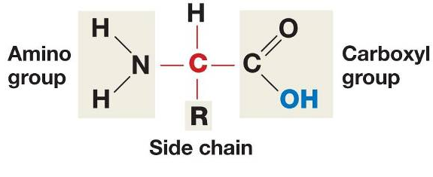
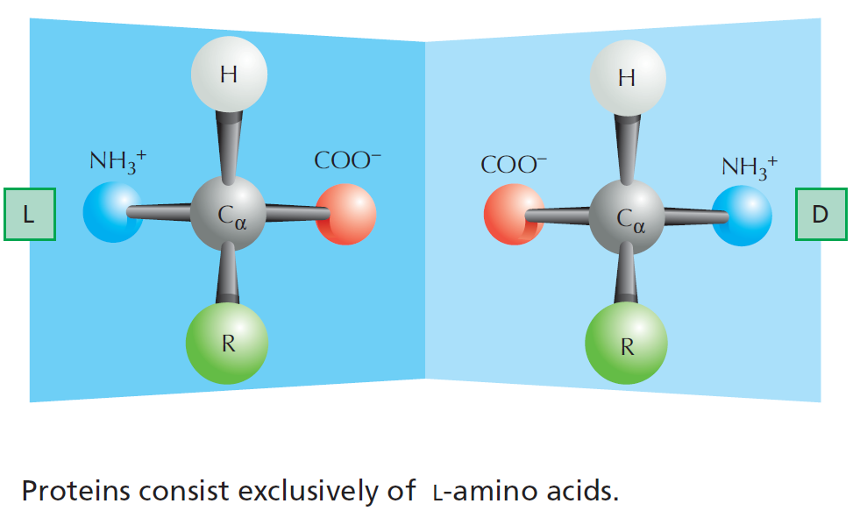
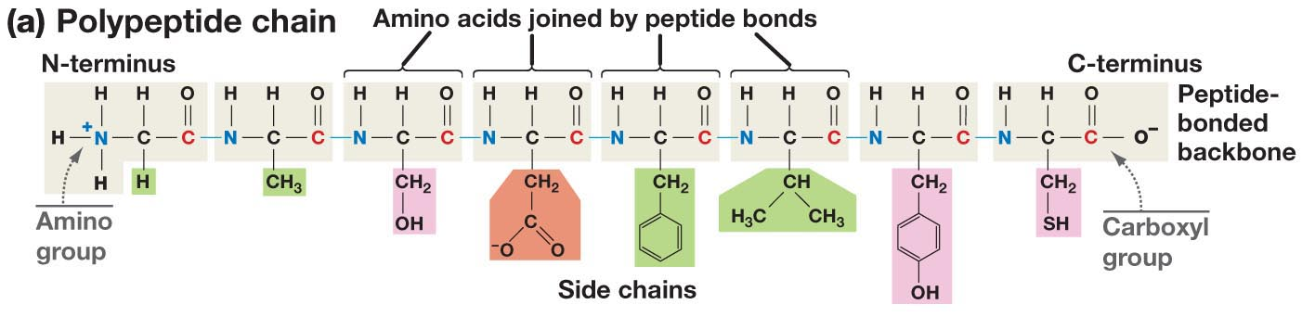
The Structure of Amino Acids and Proteins
Is there a chiral carbon on amino acids?
The amino group, Cα (and one hydrogen), and the carbonyl group are common to all amino acids
The N-Cα-C=O are the mainchain of the protein polymer.
The R groups are different –there are 20 common R groups they are the sidechain of the protein polymer – their sequence defines the properties of the protein.
(as does the ribosome that make them)

Slide 33
Primary Structure
Amino acids are joined together to form linear polymers by the formation of a peptide bond between the carboxyl of one amino acids and the amino group of the next.
This reaction releases water: a dehydration reaction.
The peptide bond can be broken (lysis) by the addition of water = hydrolysis.
Incorporated amino acid = residue (atoms are lost when the peptide bond is formed).
Polarity of chain direction – amino (N) terminus to carboxy(C) terminus = order of amino acids = sequence = primary structure
Mainchain (or backbone) – linear atoms of the polymer
Sidechain – atoms off the Ca carbon
  Primary Structure – Expectations
  Draw chemical structure given the sequence.
  Determine the seq. from chemical structure.
  Distinguish/identify:
    Mainchain & Sidechain atoms,
    Residue = aa in polymer,
    N & C terminus,
    Peptide bond(s).

Slide 34
Sidechain Functional Groups Affect Behavior
(and the order is important)
Sidechains (R-groups) differ in their size, shape, reactivity, and interactions with water.
  Nonpolar Sidechains: hydrophobic; do not form hydrogen bonds; coalesce in water - typically form the core of folded proteins.
  Polar Sidechains: hydrophilic; form hydrogen bonds; readily dissolve in water
  Ionizable Sidechains: Can be charged at certain pH values. Interact strongly with water.

Slide 35
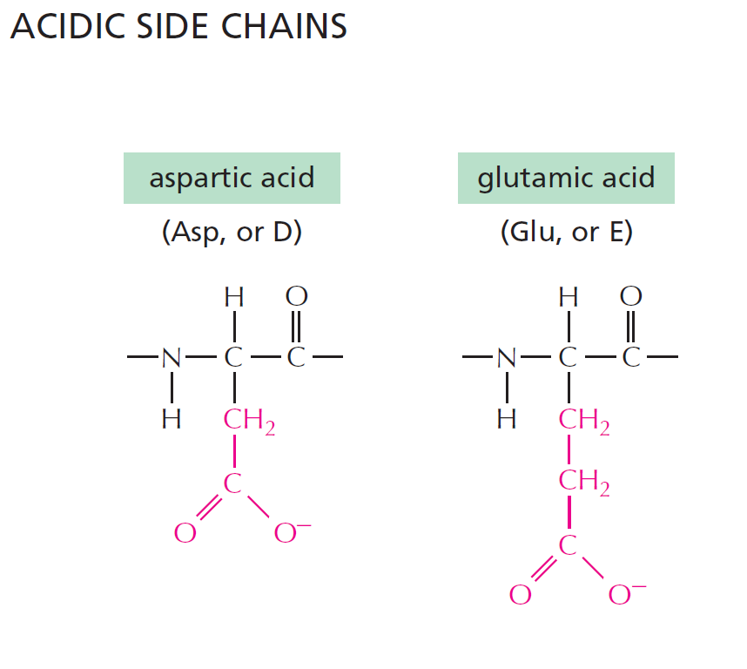
pK_{a} of sidechain ~ 4
pK_{a} of sidechain ~ 4
Have a net negative charge at pH 7.0
Notes:
Weak acids but still strong enough to give up its proton at pH = 7.0. Negative charges play an important role in proteins. Binding metal ions or acting in enzymatic reactions.

Slide 36
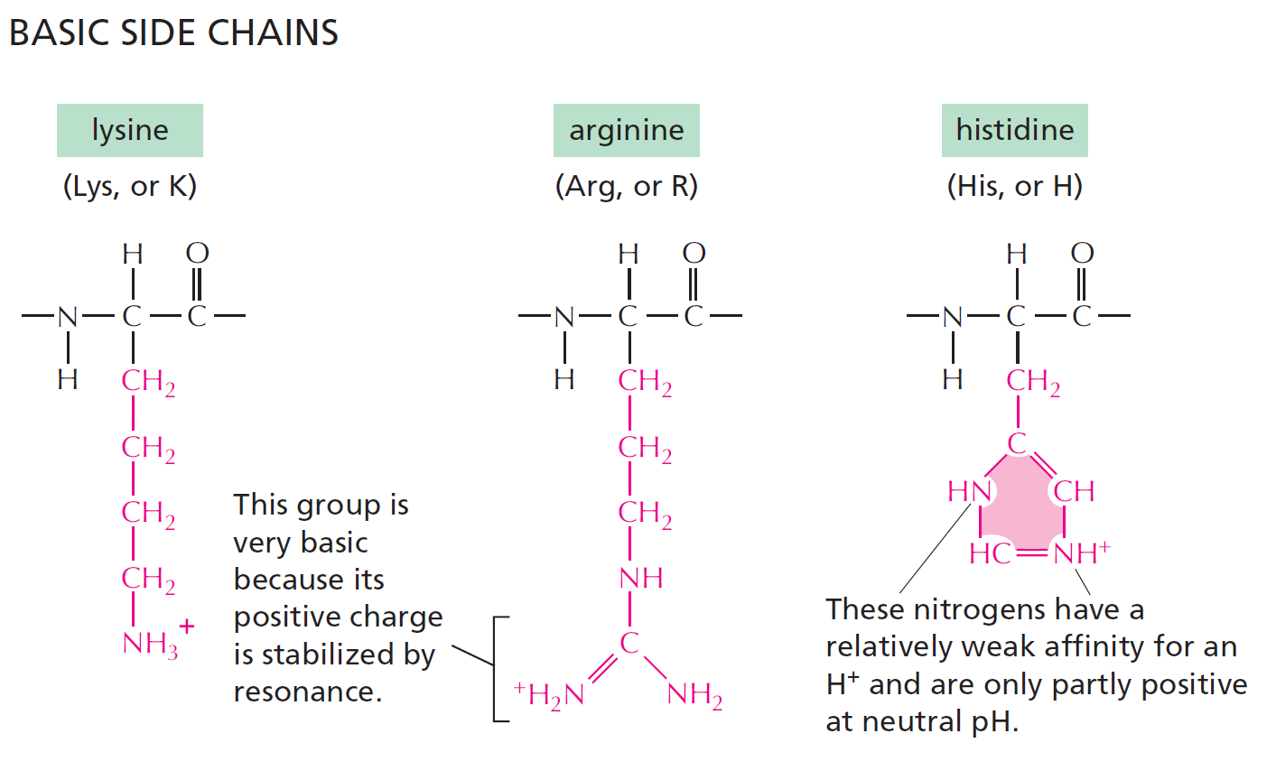
pK_{a} ~ 10
pK_{a} ~ 12
pK_{a} ~ 6
Have a net positive charge at pH 7.0
Positive charge when protonated
10% Protonated at pH 7.0
Notes:
Histidine is only 10% protonated at pH 7.0. With a pKa near neutral, plays an important role as a proton donor and acceptor in enzymatic reactions.

Slide 37
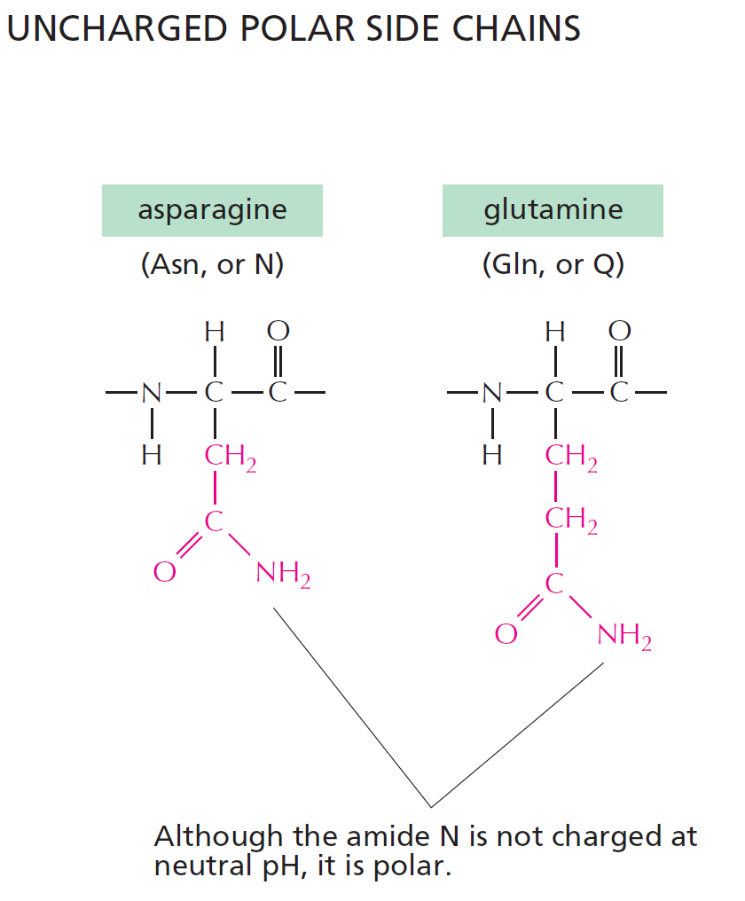
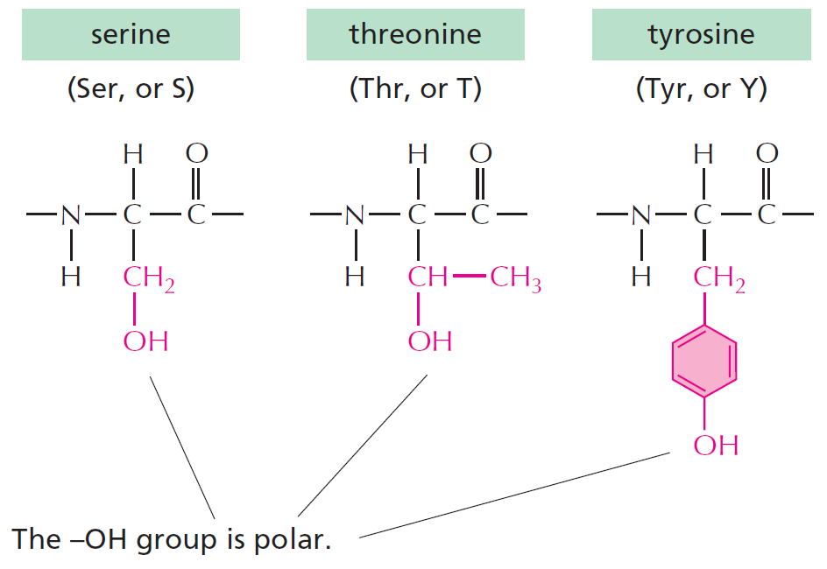

This is a significant
non-polar functionality
Forms weak H-bonds
Can ionize with a pK=8, forming thiolate ion (-S⁻)
Can form S-S disulfide bonds with other Cys residues
These can form what type of bond with water?

Slide 38

NONPOLAR SIDE CHAINS
H-bond donor
(polar functionality)
And lastly there is glycine:
Ring results in no NH group for H-bonding
No real functionality for its R group (H)
Only AA that is achiral

Slide 39

Summary of what you should know about amino acids:
Relative Hydrophobicity of Sidechains (one of many)
All amino acids have a carbon atom bonded to an amino group, a hydrogen atom and a carboxyl group. What makes each amino acid unique is its sidechain.
The common atoms will form the mainchain of the protein.
Most amino acids have at least one chiral center - the alpha carbon, exception is glycine, which is achiral.
You should be able to look at the functional groups on the side-chain and determine how they will interact with water:
  Polar
  Charged
  Non-polar (hydrophobic). You should be able to justify large differences in hydrophobicity, e.g. Val versus Ala

Slide 40

Secondary Structure
“Building blocks of proteins”
Hydrogen bonds between the mainchain carbonyl group of one amino acid and the mainchain amino group of another form a protein’s secondary structure.
  A polypeptide must bend to allow this hydrogen bonding, forming:
    α-helices
    β-pleated sheets
The large number of hydrogen bonds in a protein’s secondary structure increases its stability - each hydrogen bond that is formed releases some energy.
All amino acids can be incorporated into either secondary structure
  (However, some are found more frequently in one structure)
General Rule for Hydrogen Bonds:
X-H Y
X & Y are electronegative (N and O usually)
X-H = Donor of the hydrogen bond
Y = Acceptor of the hydrogen bond
Mainchain hydrogen bonds
N-H O=C
The NH is the hydrogen bond_________.
The C=O is the hydrogen bond __________.

Slide 41



Alpha Helix
Spiral conformation (helix) in which every backbone N-H group donates a hydrogen bond to the backbone C=O group of the amino acid four residues earlier:
Intra-strand H-bonds, parallel to helix axis.
Side-chains project outwards.
Notes:
is a righthand-coiled or spiral conformation (helix) in which every backbone N-H group donates a hydrogen bond to the backbone C=O group of the amino acid four residues earlier (

Slide 42



Beta Sheet
Beta-Strands connected laterally by backbone hydrogen bonds that are perpendicular to the strand, forming a generally twisted, pleated sheet.
Sheets can have two or more strands
Side-chains:
  project up and down along a strand.
  project in the same direction going from strand to strand across the sheet.
Notes:
strands connected laterally by at least two or three backbone hydrogen bonds, forming a generally twisted, pleated sheet.

Slide 43



Tertiary Structure - Location of Residues in Globular Proteins
Red - amino acids with neg. sidechains (e.g. Asp)
Blue - amino acids with pos. sidechains (e.g. Lys)
Yellow – amino acids with polar sidechain (e.g. Asn)
Green - amino acids with hydrophobic side chains (e.g. Leu)
Amino Acid Type
 | Inside (I) | Surface (S)
Charged
Polar
Non-polar

Slide 44





Protein Stability:
H-bonds
van der Waals
Hydrophobic effect
Chain disorder
Native
Unfolded
Protein Denaturation
Exposure to High Heat
Removal of Heat
Often, unfolded protein aggregate, which prevents refolding.

Slide 45

Unfolded Polypeptides Are Flexible – High Entropy stabilizes the Unfolded state
Exposure to High Heat

Slide 46

Entropy
Energy and Entropy

Slide 47


Hydrogen Bonding Stabilizes the Tertiary Structure
Hydrogen bonds form between hydrogen atoms and the carbonyl group in the peptide-bonded backbone – secondary structure
Hydrogen bonds are also found between hydrogen and electronegative atoms in side chains (sidechain-sidechain)
Sidechains can form hydrogen bonds to the mainchain too.
2^{ndy} Structure
3^{ry} Structure

Slide 48




Van der Waals (VdW) interactions Stabilize the Folded State
VdW are weak electrostatic interactions between side chains due to temporary (fluctuating) charges.
Attractive from long distance
Distance at lowest energy is at the van der Waals radii of the atoms.
Optimized in the core of folded proteins by “knobs fitting into holes”
Strength proportional to contact area.
Notes:
van der Waals force (or van der Waals interaction), named after Dutch scientist Johannes Diderik van der Waals, is the sum of the attractive or repulsive forces between molecules (or between parts of the same molecule) other than those due to covalent bonds, the hydrogen bonds, or the electrostatic interaction of ionswith one another or with neutral molecules or charged molecules.^{[1]} The term includes:
force between two permanent dipoles (Keesom force)
force between a permanent dipole and a corresponding induced dipole (Debye force)
force between two instantaneously induced dipoles (London dispersion force).
London forces are exhibited by nonpolar molecules because of the correlated movements of the electrons in interacting molecules. Because the electrons in adjacent molecules "flee" as they repel each other, electron density in a molecule becomes redistributed in proximity to another molecule (see quantum mechanical theory of dispersion forces). This is frequently described as the formation of instantaneous dipoles that attract each other. London forces are present between all chemical groups, and usually represent the main part of the total interaction force in condensed matter, even though they are generally weaker than ionic bonds and hydrogen bonds.

Slide 49

Hydrophobic Interactions are Critical for Stabilizing the Folded Structure
Energy and Entropy
Ordered water hydrating a non-polar group
Hydrophobic interactions within a folded protein increase stability of the folded protein by releasing the ordered water that surrounded exposed non-polar groups in the unfolded protein. Folding increases the entropy of the water – favorable.

Slide 50



Hydrophobic Interactions are Critical for Stabilizing Folded Proteins
Hydrophobic interactions within a folded protein increase stability of surrounding water molecules by releasing the ordered water that surrounded exposed non-polar groups when the protein is unfolded, increasing the entropy of the water – disorder is favorable.
Which amino acid is most likely to be found in the core of a folded protein:
Valine Serine

Slide 51

Fold Depends on Amino Acid Sequence
Effect of mutations on protein folding – sickle cell anemia
A single change in the amino acid sequence can change the function of a protein, and often affecting how it folds.
The position of non-polar residues (filled circles) mostly affects the final fold:
Notes:
Cells with normal hemoglobin and hemoglobin molecules of people with sickle cell anemia. Casues the red blood cells to change shape from a normal disk to sickled shape.

Slide 52



Disulfide Bonds Stabilize Some Proteins Outside the Cell (and body)
Trypsin – a digestive enzyme produced in the pancreas, exported to the small intestine – disulfide bonds within a single chain.
Human Insulin – interchain disulfide bonds

Slide 53


Quaternary Structure
Combinations of polypeptide subunits (combinations of tertiary structures).
May be held together by covalent bonds (disulfide), but usually non-covalent interactions between amino acids on the different chains.
Proteins can be a dimer, a tetramer, etc.
If the chains are the same, called homo__________. If chains are different, hetero_______
Quaternary structure of hemoglobin (oxygen transport protein):
two α chains
two β chains
Oxygen is carried on Fe²⁺ within heme groups:

Slide 54



Antibodies – Produced by the Adaptive Immune system to Fight Pathogens.
Antigen
Antigen
Antigen = ligand that binds to an antibody.
Properties of Antibodies:
  4 chains – two identical light (200 aa), two identical heavy (400 aa).
  Bind two identical antigens (pathogens, toxins)
  Chains crosslinked with disulfide bonds, increasing stability.

Slide 55

Summary - Interactions that Stabilize Folded Proteins.
H-bonds
van der Waals
Hydrophobic effect
Chain disorder
Hydrogen bonds form between hydrogen atoms (NH) and the carbonyl group in the peptide backbone (mainchain), and between and donors and acceptors on sidechains. Mainchain-mainchain H-bonds are responsible for secondary structures.
Hydrophobic interactions within a protein increase stability of the folded state by increasing entropy due to the release of water that was ordered by the exposed non-polar groups in the unfolded protein.
van der Waals interactions are optimized in the well packed core of the protein.
Covalent disulfide bonds form between sulfur-containing cysteine residues stabilizing them (usually only exported, secreted proteins).
Native
Unfolded
Notes:
Page 47 in the book

Slide 56



Prions are improperly folded proteins that cause neurodegenerative diseases
What happens when proteins don’t fold properly?
Normal
Unfolded protein response (UPR):
The presence of unfolded proteins can trigger the UPR, which can turn off protein synthesis in the cell, leading to cell death.
Misfolded prion protein
Both forms are almost equally stable.
Unfolded
What is the effect on the brain?
Why do the brain cells die?
Notes:
Some improperly folded proteins act as infectious disease causing agents. Or proteinaceous infectious agents. Don’t differ in sequence from normal form of proteins but their shape is very different. B misfolded protein that causes mad cow disease in cattle sponge brain illness.

Slide 57
Protein Structure - Summary and Expectations
Primary Structure:
Can you describe the mechanism of peptide bond formation
Can you draw structure of peptides.
Can you identify amino terminus and give the sequence of amino acids, N -> C
Secondary structure:
Identify helical and sheet secondary structures,
know that they are stabilized by mainchain hydrogen bonds between N-H and O=C.
Location of H-bonds and sidechains
Tertiary Structure:
Can you describe and identify role of the following in stabilizing the folded state.
  H-bonds,
  van der Waals,
  hydrophobic effect
Can you predict, based on sidechain, which amino acids are found in the core of the protein and which are found on the surface.
Quaternary Structure:
Multiple chains, stabilized by non-covalent and covalent (disulfide bonds) interactions.

Slide 58



Ligand Binding: Most Proteins Bind to Other Molecules in Biological Interactions:
The bound ligand can be stabilized by any and all of:
Interaction | Which stabilize cAMP Binding?
van der Waals
H-Bonding
Electrostatic
Hydrophobic effect
Ligand: Something that binds to a protein, usually small molecules (e.g. cyclicAMP, cAMP).
cAMP
Binding site allow a protein to interact with specific ligands
Binding site is generated by the folded form of the protein.
Notes:
Protein bound to cyclic AMP.

Slide 59


Hydrophobic Effect and Ligand Binding
Antibody
Antibody-PCP complex

Slide 60




[cAMP]
Ligand Binding & Saturation:
Define fraction saturated:
$$Y= \frac{[ML]}{\left[M\right]+[ML]}$$
[M] = free macromolecule (e.g. antibody with no antigen).
[ML] = macromolecule with ligand bound (e.g. antibody with antigen bound).
The boxes with circles represent proteins with no cAMP bound, each box (left to right) is at a higher [cAMP]. Filled circles indicate bound ligand.
1. How will the number of filled circles depend on the cAMP concentration?
2. Plot the location on the fraction saturated curve for each box.
Key Points:
1. The binding sites saturate, when all are full no more ligand can bind.
2. There is a ligand concentration, [L], where ½ the sites are full. This [L] is K_{D .}
3. K_{D} is the equilibrium constant for ligand dissociation:
$$K_{Eq}=\frac{[products]}{[reactants]}$$
$$\left(ML\right)⇌\left(M\right)+\left(L\right)$$
$$K_{D}=\frac{\left[M\right][L]}{[ML]}$$

Slide 61
Using K_{D} to Compare Ligand Binding
The binding of two different molecules to the same protein was measured and the data is shown on the right. L1 is cAMP, L2 is similar to cAMP
Which ligand has a K_{D} of 1? L1 or L2?
Which ligand has a K_{D} of 10? L1 or L2?
Which ligand binds more tightly to the protein (higher affinity)? L1 or L2?

Slide 62


Why does L1 bind more tightly (higher affinity)?
What are the chemical differences between L1 and L2 (Upper diagram)
2. How do these differences affect the interactions with the protein (lower diagram)?
Ligand 1 (cAMP)
Ligand 2
3. How do the differences affect K_{D}?

Slide 63

Key Points:
Binding:
  Folded proteins have binding sites that recognize other molecules (ligands) using any and all of the following:
  H-bonds,
  van der Waals,
  Electrostatic,
  Non-polar interactions (hydrophobic)
  Binding is reversible
  Binding is saturable
  Binding ½ point (Y=0.5) occurs at K_{D}
  The higher the affinity (strength of interaction), the lower the K_{D}

Slide 64


Enzymes
Enzymes are protein or RNA catalysts. They increase the rate of the reaction.
They bind “substrates” and convert them to “products”. Usually, the substrate undergoes a chemical reaction and is changed in its structure.
Most biological chemical reactions occur at meaningful rates only in the presence of an enzyme.
Substrates bind specifically to the enzyme’s active site, interacting with amino acid side chains (or RNA bases). Usually a single enzyme binds one substrate.
The chemical change caused by the enzyme is catalyzed by additional functional groups in the active site.
Many enzymes undergo a conformational change when the substrates are bound to the active site; this change is called an induced fit.
substrates
products

Slide 65

Enzyme – Chemical Diversity
Most enzyme names end in “-ase”
Usually named by their substrates and the reactions they catalyse, i.e. glucose kinase

Slide 66



Example of Active Site Functional Groups:
Catalytic triad (Asp, His, Ser) in Protease Trypsin cleaves after Lys Residues
Catalytic triad
Substrate
https://shirleychemproject.weebly.com/
Disulfide bonds in trypsin
Products

Slide 67


How Do Enzymes Increase Rates?
Enzyme
Transition state = high energy intermediate that occurs during the reaction.
Energy barrier is called the activation energy.
Rate of product formation depends on the concentration of the transition state.
|
N
|
H
B – contains H-bond acceptor
Low [X] = Slow reaction
Enzyme
|
N
|
H
Activation Energy
Higher [EX] = Faster reaction
Interactions between the enzyme and the substrate stabilize the transition state (X) and lower the activation energy required for the reaction to proceed.
Stabilization can include:
  Pre- alignment of key groups in the active site, reducing entropy cost of organizing groups.
  Direct interactions with the transition state (see diagram, N-H group interacts more favorably with the transition state)

Slide 68

A model of transition state stabilization.
Lower energy of transition state allows more substrates to reach transition state due to their thermal energy.
[S] = 15
[X] = 3
[EX] = 6
How much faster will the rate be when the enzyme is present?

Slide 69



Enzymes, Metabolic Pathways, and Diseases
Synthetic Pathway for Phe, Tyr
(beginning with chorismite)
Each step catalyzed by an enzyme
Pathway for Degradation of Phenylalanine
PKU Disease:
Inactive phenylalanine hydroxylase
Phe levels become toxic:
Neurological problems
  Intellectual disability
  Developmental delays
  Mental health disorders.
Aspartame (artificial sweetener)
Asp-Phe-CH₃

Slide 70
Key Points:
Enzymes:
  Enzymes bind substrates (S), forming (ES) complex in active site, converting to P, releasing P.
  Rate enhancement since the transition state complex (EX) forms more readily with enzymes due to:
    Bringing substrates and functional groups on the enzyme together by binding (less entropy change)
    Directly lowering energy of transition state (X) through favorable interactions that are unique to the transition state, such as forming unique hydrogen bonds.
  Genetic diseases that lead to inactive metabolic enzymes can cause disease.

