Slide 1
Lecture 3 – Pre-lecture Material Nucleic acid Structure and DNA Polymerases

Slide 2
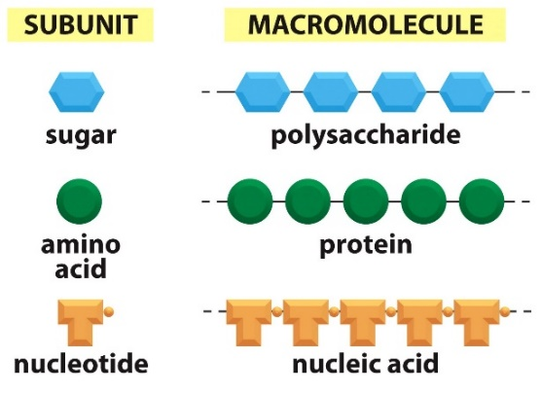
Nucleic Acids & Central Dogma
Double stranded DNA
Notes:
Most cell functions depend on proteins

Slide 3
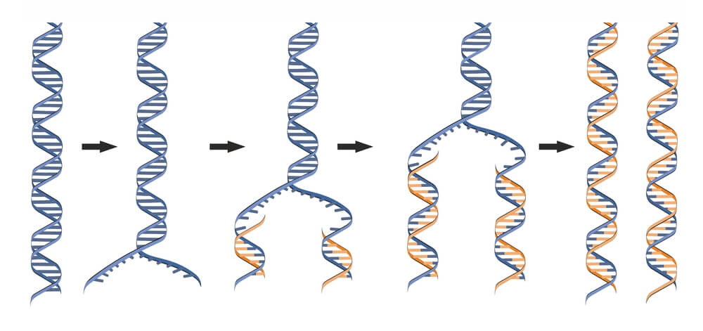
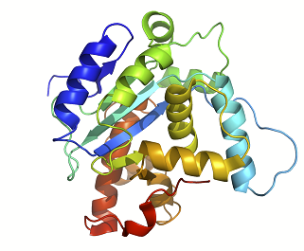
Introduction to Central Dogma
Genome: Entire DNA content of an organism, contains all of the instructions for life. Single circular molecule in Proks, multiple linear molecules (chromosomes) in Euks. The genome is replicated when cells divide.
Gene – a segment of DNA that is converted (transcribed) to RNA. A promoter (P) sequence on the DNA is the minimal requirement for the production of RNA.
P
P
Transcription
mRNA Processing (Euks)
RNA molecules are often processed in Eukaryotic cells before they are functional
Possible functions
G
AAAAA
miRNA
(euk)
rRNA
(p syn)
Translation
Splicing
(euk)
tRNA
(p syn)
Many RNAs are functional on their own
mRNA are translated to a protein.
Telomerase
(euk)

Slide 4
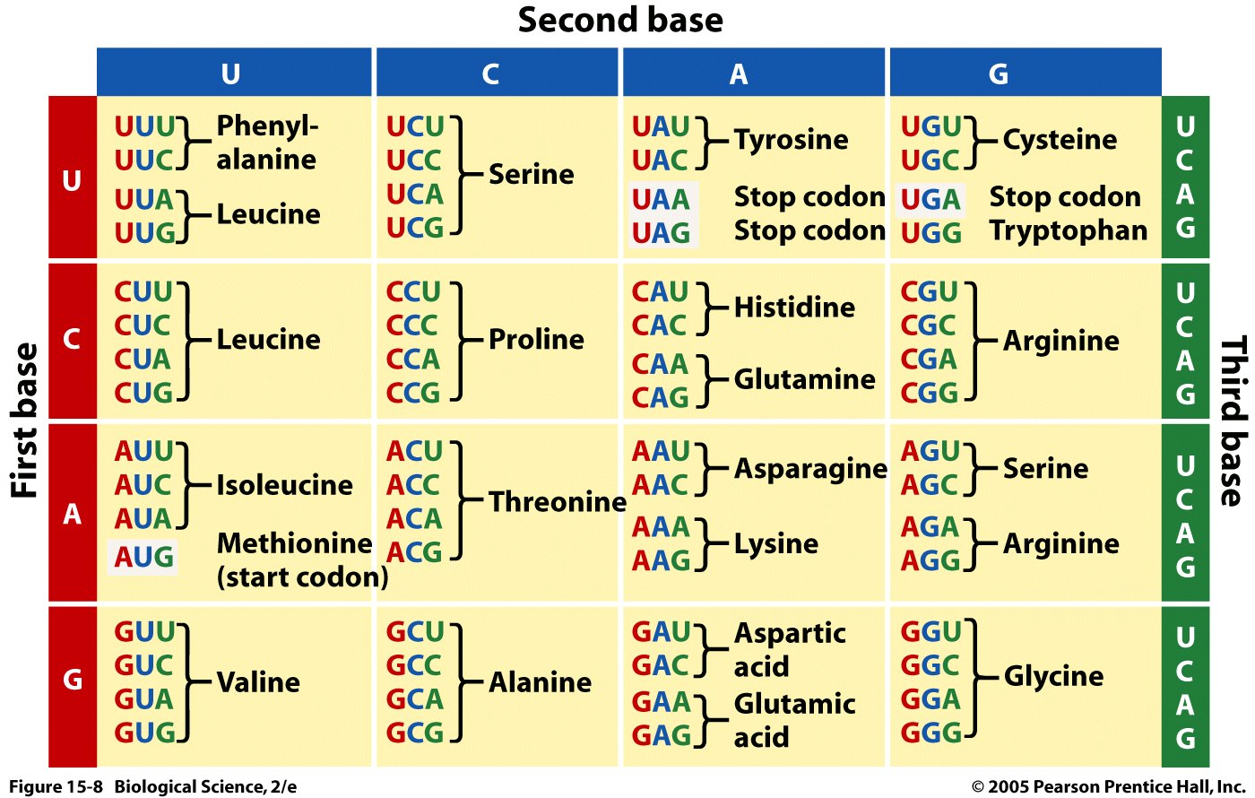
The Genetic Code
....ATATGCCCATGTGGTAA..
(DNA Sequence)
...AUAUGCCCAUGUGGUAA..
(mRNA Sequence)
..U-AUG-CCC-AUG-UGG-UAA
Note:
Each codon codes for one amino acid.
Many amino acids are coded by more than one codon.
Most organisms use the same codon table – some codons have different meanings in some organisms.
(Punctuated RNA sequence – how the ribosome interprets the sequence)
Special Codons:
AUG = Is used to begin almost all proteins that are synthesized on the ribosome, it also codes for methionine when found internally.
UAA, UAG, UGA = stop codons (do not code for any amino acids), terminate synthesis
(Protein Sequence)
________-________-________-_______
Notes:
Methionine is also the codon for a start sequence

Slide 5
Nucleic Acid Structure
1. Monomeric Units
Nucleoside triphosphates are the building blocks of nucleic acids (dNTP = dATP, dGTP, dCTP, dTTP)
The base ("sidechain") is connected to the C1' of the sugar ("mainchain") by an N-linked glycosidic bond.
Base + sugar = nucleoside.
Base + sugar + n-phosphates = nucleotide
The carbon atoms on the sugar are numbered 1' to 5'. The primes distinguish the atoms on the sugar from those on the base.
DNA differs from RNA in the sugar (deoxyribose versus ribose) and one base.
Four different monomers, A, G, C, T in DNA. U replaces T in RNA.

Slide 6
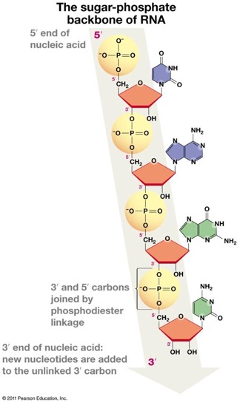
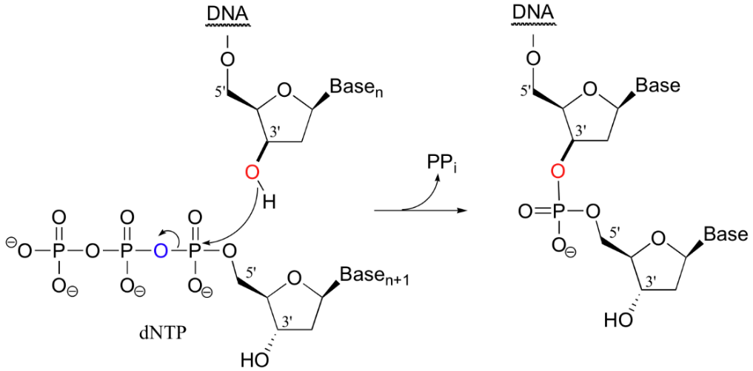
DNA (& RNA) are directional
How Triphosphates are added to the polymer.
U
A
5’
G
What are the two different ways we could write the sequence of this nucleic acid?
C
3’

Slide 7
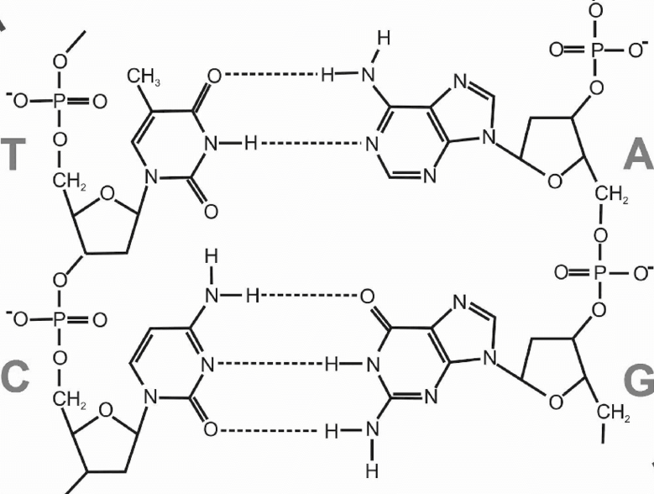
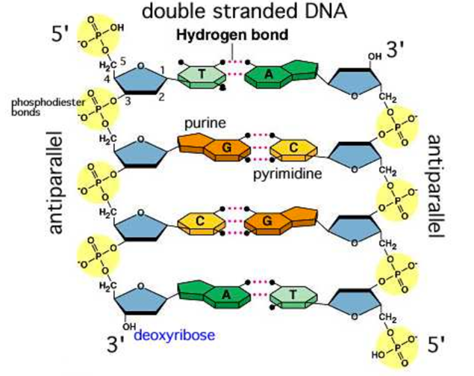
Double Stranded DNA structure
Complementary base pairing: Hydrogen bonds form between bases, thus linking the 2 stands with weak non-covalent interactions.
DNA twisted into double helix
Strands anti-parallel
Sugar-phosphate backbone outside
Nucleotide bases project inward.
Basepairs are stacked on each other.
Uniform width
H-bonds between bases:
A=T (two h-bonds)
G Ξ C (three h-bonds)
“WC” H-bonds
“WC” H-bonds”
How to indicate the sequence of ssDNA & dsDNA?

Slide 8
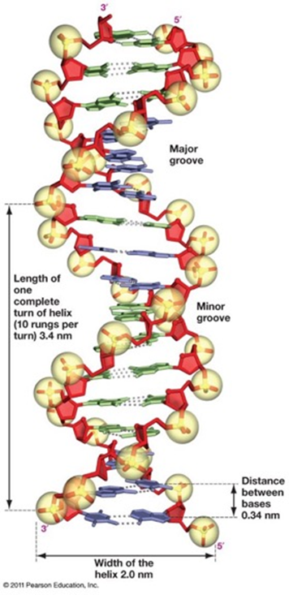
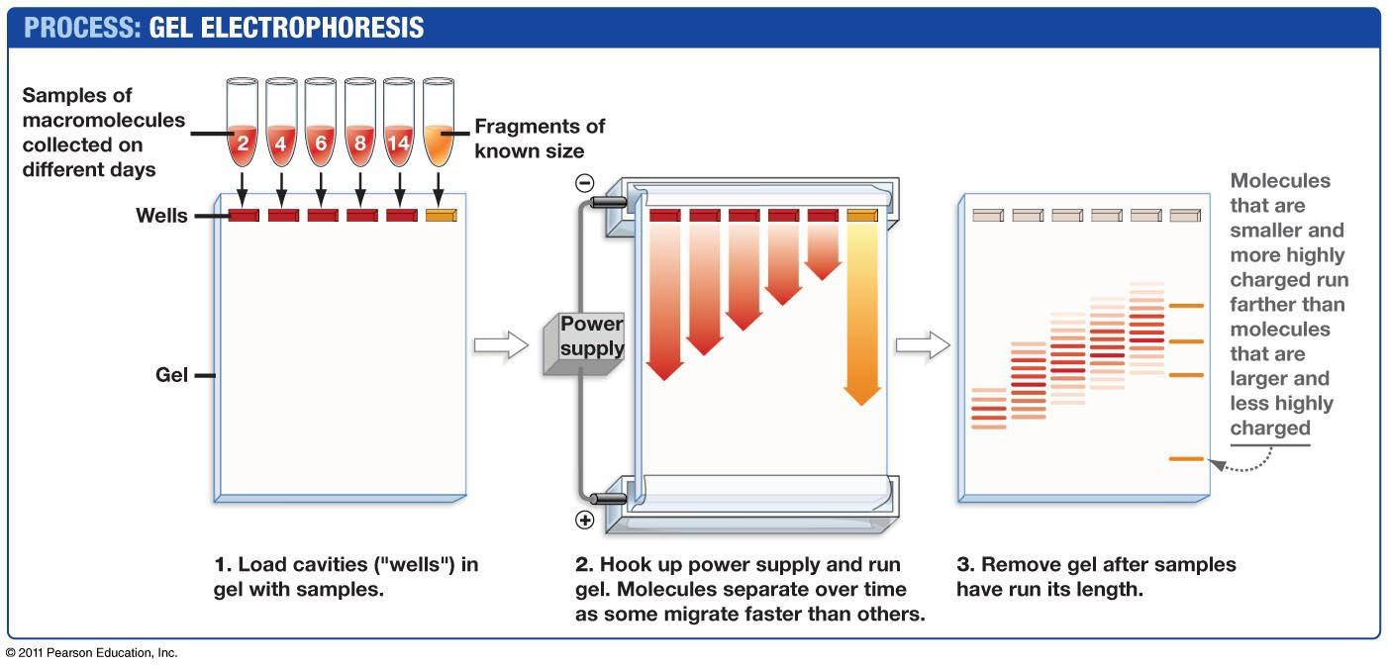
Size Determination of DNA - Agarose Gel Electrophoresis.
DNA has a neg charge on each phosphate
Separation is by size as the DNA strands are forced through the gel.
S3, S4 = unknowns.
MMR2 = standards, DNA fragments of known length.
Obtaining MW (length) of DNA fragments.
Plot log(basepair) versus distance for standards.
Obtain equation of curve.
Use distance for unknown to find its log(MW) (red arrows)
S3 3rd fragment migrated 623 mm, Log(MW)~2.92, MW ~ 820 bp
623 mm
1517
1200
1000
900
800
700
600
500
400
300
200
https://dnalc.cshl.edu/resources/animations/gelelectrophoresis.html

Slide 9
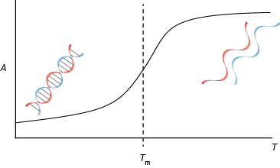
Thermal Stability of Double Stranded DNA (dsDNA)
5’ A-T-C-A
3’A-T-G-C-C-G-T-A-G-T-C-G-T-A-C-A-G-T-A-C-G-T-G-C-A
How does the DNA sequence affect T_{m}? Explain the difference in Tm for the following two DNAs:
Duplex A: Tm=16 C
AAAATTTT
TTTTAAAA
Duplex B: Tm= 32 C
GCGCGCGC
CGCGCGCG
5’ A-T-C-A
3’A-T-G-C-C-G-T-A-G-T-C-G-T-A-C-A-G-T-A-C-G-T-G-C-A

Slide 10
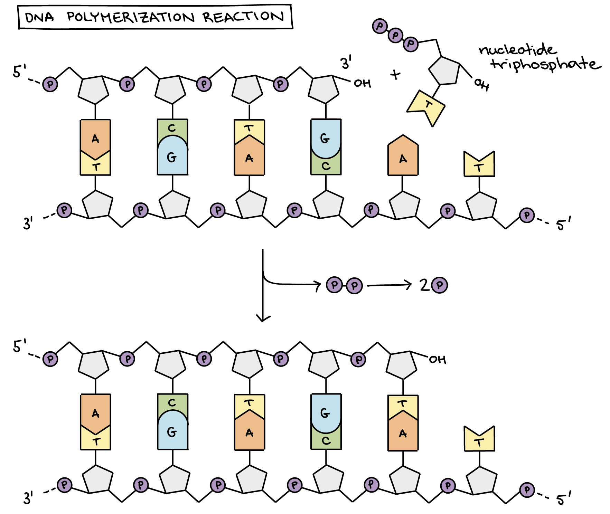
DNA Polymerase – Fundamental Activity.
5’ to 3’
polymerization
Where on the deoxyribose is the new base added?
2. What determines which base is to be added?
Phosphodiester linkage
ester linkage
pyrophosphate
Notes:
dNTP deoxyribonuceleoside triphosphate.

Slide 11
DNA Polymerase – Fundamental Activity.
Synthesize new polymers of DNA.
Require a short region of double stranded DNA to start synthesis – primer-template junction.
Primer can be a short DNA or RNA oligonucleotide (oligo) that is complementary to the DNA template.
RNA primers are used in DNA replication in the cell
DNA primers are used in other biotechnology applications (PCR, DNA Sequencing)
Require single stranded template to provide information on which base to add.
Add new dNTPs to 3’-OH of the primer, elongating in the 5’ to 3’ direction.
Elongation will go to the end of the template.
(1:48 syn starts)

Slide 12
DNA Polymerase – Fundamental Activity.
5’ A-T-C-A
3’A-T-G-C-C-G-T-A-G-T-C-G-T-A-C-A-G-T-A-C-G-T-G-C-A
1 2 3 4 5 6 7 8 9 0 1 2 3 4 5 6 7 8 9 0 1 2 3 4 5
1 2
Where (what position) will this primer (ATCA) anneal?
What base will be added first?
What is the last base added?

Slide 13
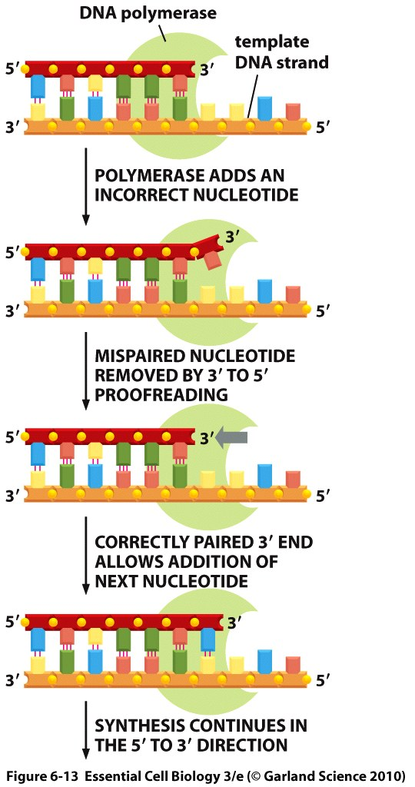
DNA Polymerase – Error Correction – 3’ Exonuclease
Incorrectly incorporated bases are removed by a 3’ exonuclease activity.
Most DNA polymerases have this activity.
The polymerase used by the HIV virus has no proofreading activity
The polymerase used by Covid-19 has limited proofreading activity.
Reflection: What are the consequences of poor error correction in HIV and Covid viruses?
Polymerase Expectations:
Identify where primer anneals to the template.
Predict order of base addition.
Explain the mechanism of dNTP addition by polymerases (addition of dNTP to 3’OH, release of P-P)
Explain how polymerases correct errors (3’ -> 5’ exonuclease)

Slide 14
Exercise
A cell acquires deoxyadenosine from the environment.
A. Indicate the (three) steps that have to occur before this base can get incorporated into DNA
B. Indicate the two steps that will result in this base becoming part of a DNA strand, after the events in part A.
C. What will happen to DNA synthesis if the base is missing the 3’-OH?

Slide 15
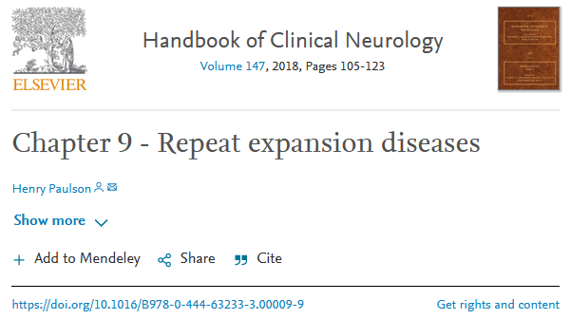
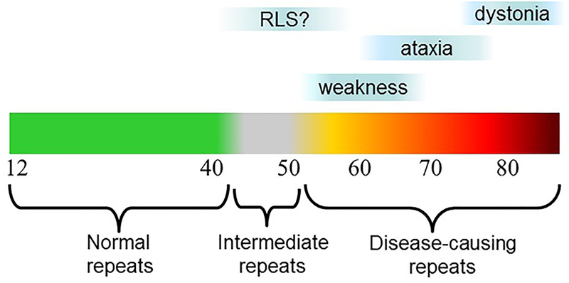
Repeat Expansions Related to Diseases
A small number of repeats is “normal”
If the number of repeats increases the individual may show disease symptoms.
These repeats can grow during replication in the cell due to “primer slippage”.
Longer repeats can be inherited from the parent
Longer repeats can also occur within cells of the individual
• CAG – at least 10 diseases (Huntington disease, spinal and bulbar muscular atrophy, dentatorubral-pallidoluysian atrophy and seven SCAs)
• CGG – fragile X, fragile X tremor ataxia syndrome, other fragile sites (GCC, CCG)
• CTG – myotonic dystrophy type 1, Huntington disease-like 2, spinocerebellar ataxia type 8, Fuchs corneal dystrophy
• GAA – Friedreich ataxia
• GCC – FRAXE mental retardation
• GCG – oculopharyngeal muscular dystrophy
• CCTG – myotonic dystrophy type 1
Why do they cause disease?
Additional amino acids if in protein coding region.
Affect binding of DNA regulatory proteins if outside the coding region.
Treatment:
None yet, except genetic counseling.

