Slide 1
95-843 Service Oriented Architecture
Service Enablement of Existing Systems

Slide 2
Service Enablement
Canonical Data Model pattern from EIP
Channel Adapter pattern from EIP
Overview of File and FTP adapters provided by Oracle SOA Suite 11 g

Slide 3
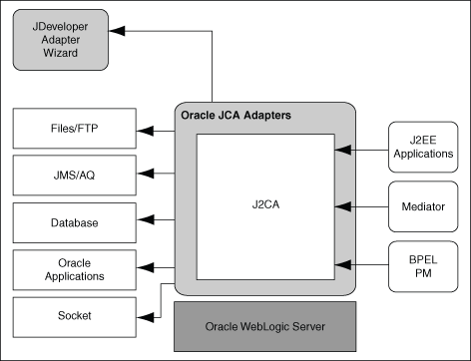
A Few of Oracle’s J2CA Adapters
From Oracle’s SOA
Documentation

Slide 4
At Run Time
Request-Response (Outbound Interaction) Service
Event Notification (Inbound Interaction) Service
From Oracle’s SOA Documentation

Slide 5
What Questions Will a Wizard (that Builds a File Adapter) Ask?
What is this service’s name?
Is it a read or write service?
Where will the file be found?
What file name patterns will be used?
Do we poll for the file. How often?
Do we respond to a trigger file? What’s its name?
Do we throttle the input?
What is the format of the file? What are the names and types of records and fields?

