Slide 1
Internet Technologies
Ruby and
Ruby on Rails

Slide 2
Notes on Ruby From Sebesta's "Programming The World Wide Web"
Designed in Japan by Yukihiro Matsumoto
Released in 1996
Designed to replace Perl and Python
Rails, a web application development
framework , was written in and uses Ruby
Ruby is general purpose but probably the
most common use of Ruby is Rails
Rails was developed by David Heinemeier
and released in 2004
Basecamp (project management) is written
in RoR

Slide 3
General Notes on Ruby(1)
Ruby is a pure object-oriented language.
All variables reference objects.
Every data value is an object.
References are typeless.
All that is ever assigned in an assignment statement is the
address of an object.
The is no way to declare a variable.
A scalar variable that has not been assigned a value has the value nil.
Ruby has implicit variables.

Slide 4
General Notes on Ruby(2)
Three categories of data types - scalars,
arrays and hashes
Two categories of scalars - numerics and
character strings
Everything (even classes) is an object
Numeric types inherit from the Numeric class
Float and Integer inherit from Numeric
Fixnum (32 bits) and Bignum inherit from
Integer
All string literals are String objects
The null string may be denoted as " or as '’”.
The String class has over 75 methods

Slide 5
Interactive Environment
$irb
>> miles = 1000
=> 1000
>> milesPerHour = 100
=> 100
>> "Going #{miles} miles at #{milesPerHour} MPH takes #{1/milesPerHour.to_f*miles} hours"
=> "Going 1000 miles at 100 MPH takes 10.0 hours"

Slide 6
More interactive Ruby
$irb
>> miles = 1000
=> 1000
>> s = "The number of miles is #{miles}"
=> "The number of miles is 1000"
>> s
=> "The number of miles is 1000"

Slide 7
The Math Module
>> y = Math.sin(0)
=> 0.0
>> y = Math.sin(Math::PI/2.0)
=> 1.0

Slide 8
Non-Interactive Ruby
Save as one.rb and run with ruby one.rb
a = "hi"
b = a
puts a
puts b
b = "OK"
puts a
puts b
Output
======
hi
hi
hi
OK

Slide 9
Fun with newlines
a = "He\nllo\n"
puts a
puts a
Output
======
He
llo
He
llo

Slide 10
Converting Case
a = "Hello"
a.upcase!
puts a
puts a
Output
======
HELLO
HELLO

Slide 11
Testing Equality
b = "Cool course" == "Cool course" # same content
puts b
b = "Cool course".equal?("Cool course") #same object
puts b
puts 7 == 7.0 # same value
puts 7.eql?(7.0) # same value and same type
Output
======
true
false
true
false

Slide 12
Reading The Keyboard
puts "Who are you?"
name = gets #include entered newline
name.chomp! #remove the newline
puts "Hi " + name + ", nice meeting you."
Interaction
===========
Who are you?
Mike
Hi Mike, nice meeting you.

Slide 13
Reading Integers
#to_i returns 0 on strings that are not integers
puts "Enter two integers on two lines and I'll add them"
a = gets.to_i
b = gets.to_i
puts a + b
Interaction
===========
Enter two integers on two lines and I'll add them
2
4
6

Slide 14
Conditions (1)
a = 5
if a > 4
puts "Inside the if"
a = 2
end
puts "a == " + a.to_s(10)
Output
======
Inside the if
a == 2

Slide 15
Conditions (2)
a = 5
unless a <= 4
puts "Inside the if"
a = 2
end
puts "a == " + a.to_s(10)
Output
======
Inside the if
a == 2

Slide 16
Conditions (3)
a = 5
if a <= 4
puts "Inside the if"
a = 2
else
puts "a == " + a.to_s(10)
end
Output
======
a == 5

Slide 17
Conditions (4)
a = 5
if a <= 4
puts "Inside the if"
a = 2
elsf a >= 10
puts "a == " + a.to_s(10)
puts "OK"
else
puts "Neither"
end
Output
======
Neither

Slide 18
Conditions (5)
a = 5
case a
when 4 then
puts "The value is 4"
when 5
puts "The value is 5"
end
Output
======
The value is 5

Slide 19
Conditions (6)
a = 2
case a
when 4 then
puts "The value is 4"
when 5
puts "The value is 5"
else
puts "OK"
end
Output
======
OK

Slide 20
Case/When with Range
a = 4
case a
when 4 then
# after a match we are done
puts "The value is 4"
when (3..500)
puts "The value is between 3 and 500"
else
puts "OK"
end
Output
======
The value is 4

Slide 21
Value of Case/When (1)
year = 2009
leap = case
when year % 400 == 0 then true
when year % 100 == 0 then false
else year % 4 == 0
end
puts leap
Output
======
false

Slide 22
Value of Case/When(2)
year = 2009
puts case
when year % 400 == 0 then true
when year % 100 == 0 then false
else year % 4 == 0
end
Output
======
false

Slide 23
While
top = 100
now = 1
sum = 0
while now <= top
sum = sum + now
now += 1
end
puts sum
Output
======
5050

Slide 24
Until
j = 100
until j < 0
j = j - 1
end
puts j
Output
======
-1

Slide 25
Arrays(1)
a = [1,2,3,4,5]
puts a[4]
x = a[0]
puts x
a = ["To","be","or","not","to","be"]
j = 0
while j < 6
puts a[j]
j = j + 1
end
Output
======
5
1
To
be
or
not
to
be

Slide 26
Arrays(2)
a = [1,2,3,4,5]
j = 0
while j < 5
a[j] = 0
j = j + 1
end
puts a[1]
Output
======
0

Slide 27
Arrays(3)
somedays = ["Friday","Saturday","Sunday","Monday"]
puts somedays.empty?
puts somedays.sort
Output
======
false
Friday
Monday
Saturday
Sunday

Slide 28
Arrays and Ranges(1)
# Create an array from a Ruby range
# Create range
a = (1..7)
puts a
#create array
b = a.to_a
puts b
Output
======
1..7
1
2
3
4
5
6
7

Slide 29
Arrays and Ranges(2)
#Ranges are objects with methods
v = 'aa'..'az'
u = v.to_a
puts v
puts u
Output
======
aa..az
aa
ab
ac
:
:
aw
ax
ay
az

Slide 30
Hashes
# Hashes are associative arrays
# Each data element is paired with a key
# Arrays use small ints for indexing
# Hashes use a hash function on a string
kids_ages = {"Robert" => 16, "Cristina" =>14, "Sarah" => 12, "Grace" =>8}
puts kids_ages
Output
======
Sarah12Cristina14Grace8Robert16

Slide 31
Hashes Indexing
kids_ages = {"Robert" => 16, "Cristina" =>14, "Sarah" => 12, "Grace" =>8}
puts kids_ages["Cristina"]
Output
======
14

Slide 32
Hashes Adding & Deleting
kids_ages = {"Robert" => 16, "Cristina" =>14, "Sarah" => 12, "Grace" =>8}
kids_ages["Daniel"] = 15
kids_ages.delete("Cristina")
puts kids_ages
Output
======
Daniel15Sarah12Grace8Robert16

Slide 33
Hashes Taking The Keys
kids_ages = {"Robert" => 16, "Cristina" =>14, "Sarah" => 12, "Grace" =>8}
m = kids_ages.keys
kids_ages.clear
puts kids_ages
puts m
Output
======
Sarah
Cristina
Grace
Robert

Slide 34
Methods
# Methods may be defined outside classes
# to form functions or within classes to
# form methods. Methods must begin with lower case
# letters.
# If no parameters then parentheses are omitted.
def testMethod
return Time.now
end
def testMethod2
Time.now
end
puts testMethod
puts testMethod2
Output
======
Tue Feb 10 22:12:44 -0500 2009
Tue Feb 10 22:12:44 -0500 2009

Slide 35
Methods Local Variables
def looper
i = 0
while i < 5
puts i
i = i + 1
end
end
looper
Output
======
0
1
2
3
4

Slide 36
Scalers Are Pass By Value
#scalers are pass by value
def looper(n)
i = 0
while i < n
puts i
i = i + 1
end
end
looper(3)
Output
======
0
1
2

Slide 37
Arrays and Hashes Are Pass By Reference
def coolsorter(n)
n.sort!
end
n = [5,4,3,2,1]
coolsorter(n)
puts n
Output
======
1
2
3
4
5

Slide 38
Classes
#Classes and constants must begin with
#an uppercase character.
#Instance variable begin with an "@" sign.
#The constructor is named initialize
class Student
def initialize(n = 5)
@course = Array.new(n)
end
def getCourse(i)
return @course[i]
end
def setCourse(c,i)
@course[i] = c
end
end
individual = Student.new(3)
individual.setCourse("Chemistry", 0)
puts individual.getCourse(0)
Output
======
Chemistry

Slide 39
Simple Inheritance
class Mammal
def breathe
puts "inhale and exhale"
end
end
class Cat<Mammal
def speak
puts "Meow"
end
end
class Dog<Mammal
def speak
puts "Woof"
end
end
peanut = Dog.new
sam = Cat.new
peanut.speak
sam.speak
sam.breathe
Output
======
Woof
Meow
inhale and exhale

Slide 40
Modules
Modules group together methods and constants.
A module has no instances or subclasses.
To call a module’s method, use the module name,
followed by a dot, followed by the name of the method.
To use a module’s constant, use the module name,
followed by two colons and the name of the constant

Slide 41
Code Blocks
#Introductory code blocks
4.times {puts "Yo!"}
#A block with a parameter
#and using the each iterator
list = [2,4,6,8]
list.each {|v| puts v}
Output
======
Yo!
Yo!
Yo!
Yo!
2
4
6
8

Slide 42
Pattern Matching
#Pattern matching using regular expressions
line = "http://www.andrew.cmu.edu"
loc = line =~ /www/
puts "www is at position #{loc}"
Output
======
www is at position 7

Slide 43
Regular Expressions
#split based on a space,period,comma followed
#by zero or more whitespace
line2 = "www.cmu.edu is where it's at."
arr = line2.split(/[ .,]\s*/)
puts arr
Output
======
www
cmu
edu
is
where
it's
at

Slide 44
Ruby On Rails
Definition from Sebesta:
“A framework is a system in which much of the more or
less standard parts are furnished by the framework, so
that they do not need to be written by the application
developer.”
Like Tapestry and Struts, Rails is based on the Model View
Controller architecture for applications.
MVC developed at XeroxPARC by the Smalltalk group.

Slide 45
Model View Controller
From Sebesta:
The Model is the data and any enforced constraints on
the data.
The View prepares and presents results to the user.
The Controller performs required computations and
controls the application.

Slide 46
Model View Controller
Rails is a web-application and persistence framework.
MVC splits the view into "dumb" templates that are
primarily responsible for inserting pre-built data in
between HTML tags.
The model contains the "smart" domain objects (such
as Account, Product, Person.
The model holds all the business logic and knows how to
persist itself to a database.
The controller handles the incoming requests (such as
Save New Account, Update Product, Show Person)
by manipulating the model and directing data to the view.
From the Rails README

Slide 47
Model View Controller
browser
controller
view
model
RDBMS

Slide 48
Rails Tools
Rails provides command line tools.
The following command creates many directories
and subdirectories including models, views, and
controllers.
$rails greet
$ruby script/generate controller say
Rails may be used from within popular IDE’s such as
Eclipse and Netbeans.

Slide 49
Rails Directories
greet
app
controllers views models helpers
http://localhost/say/hello
say => controller
hello => method in controller
say_controller.rb
def hello
say
hello.html.rb

Slide 50
Three Examples From Sebesta
Hello world application
Processing Forms
Rails and Databases

Slide 51
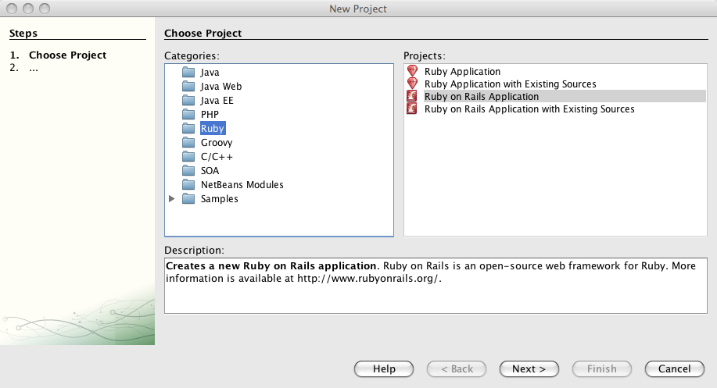
Using Netbeans

Slide 52
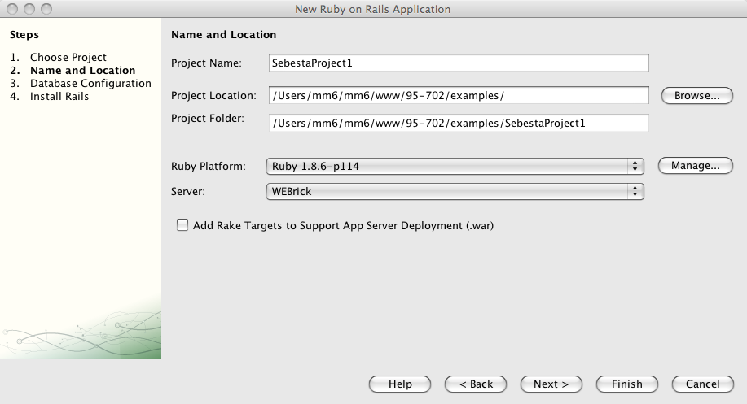
Create an RoR Project

Slide 53
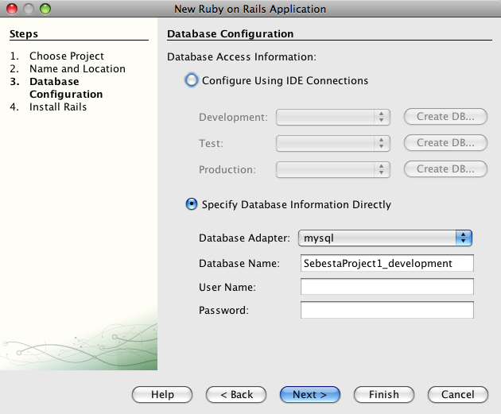
Select MySQL

Slide 54
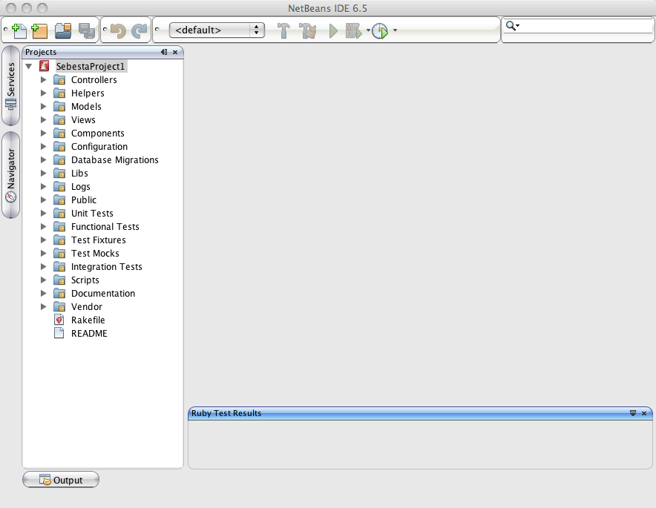
Models Views and Controllers

Slide 55
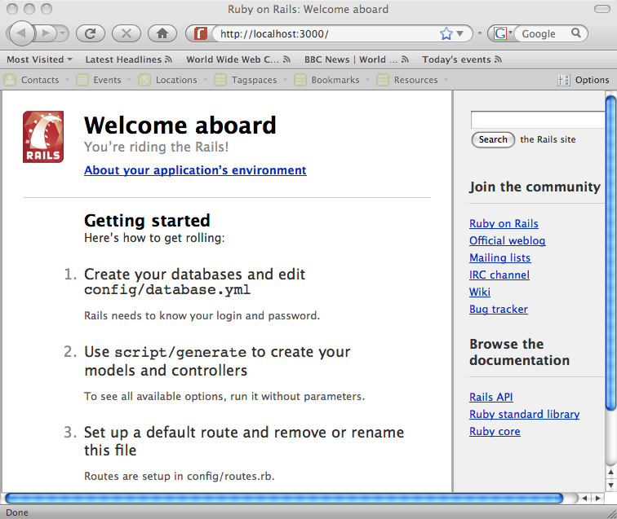
Run And Visit Rails

Slide 56
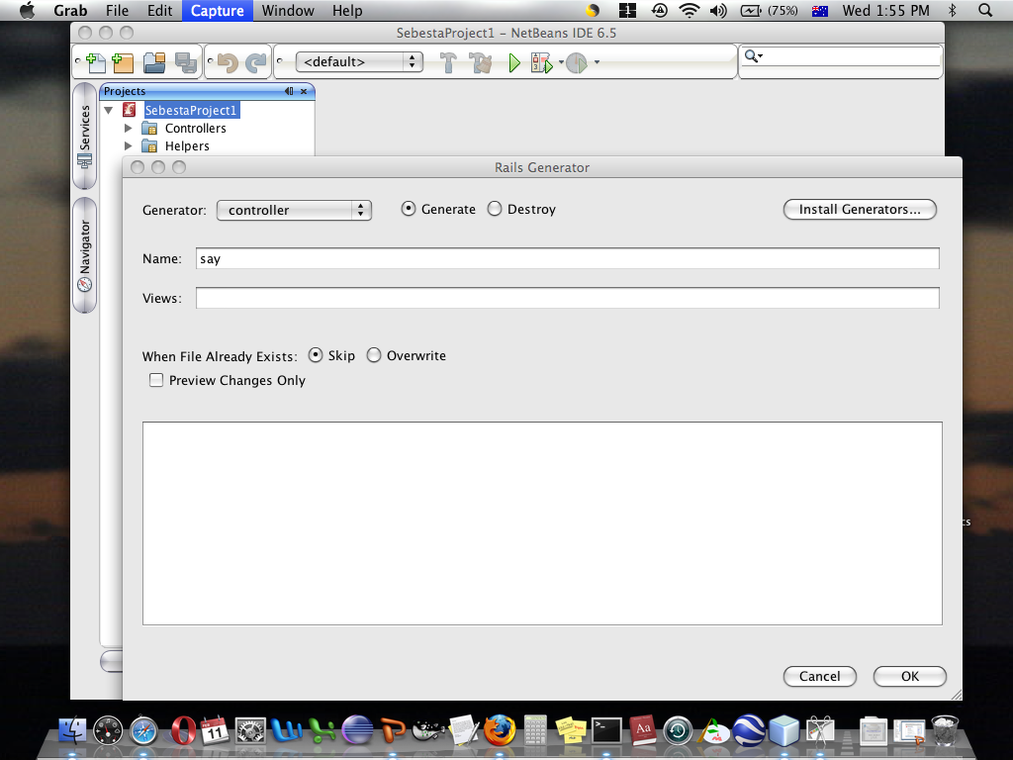
Generate A Controller

Slide 57
Modify The Default Controller
# The program say_controller.rb is the specific controller
# for the SebestaProject1 project.
# Add the definition of the hello method.
class SayController < ApplicationController
def hello
end
end
“hello” becomes part of the URL and
tells the controller about the view.

Slide 58
Enter The View
Select SebestaProject1/Views/Say
Right Click
New RHTML file
File name hello.rhtml
<html>
<!– all instance variables of the controller are visible here. - - >
<body>
<b>Ruby says "Yo Mike".</b>
<%a = 32%>Ruby is <%=a%> degrees cool.
</body>
</html>

Slide 59
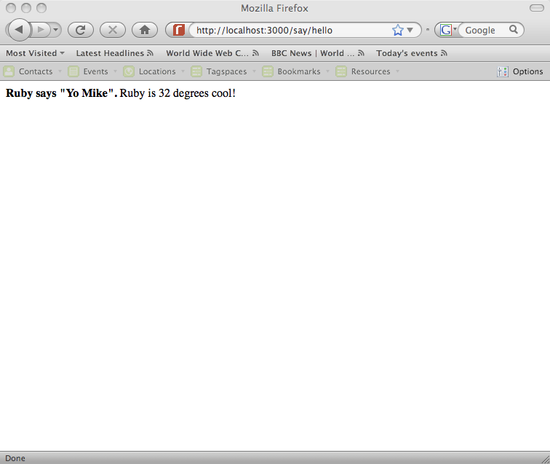
Run And Visit The Application
So far, no model.

Slide 60
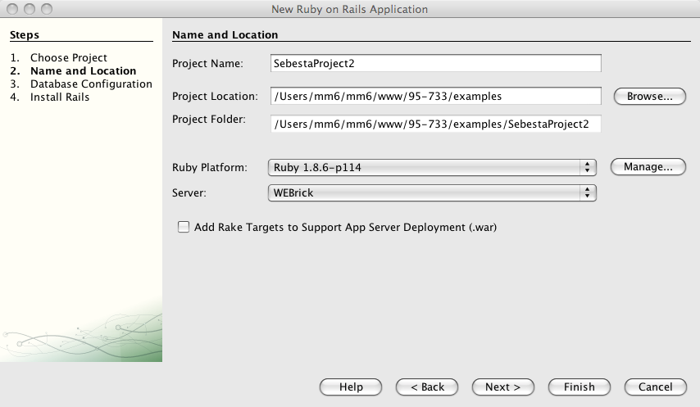
Processing Forms

Slide 61
Select Database

Slide 62
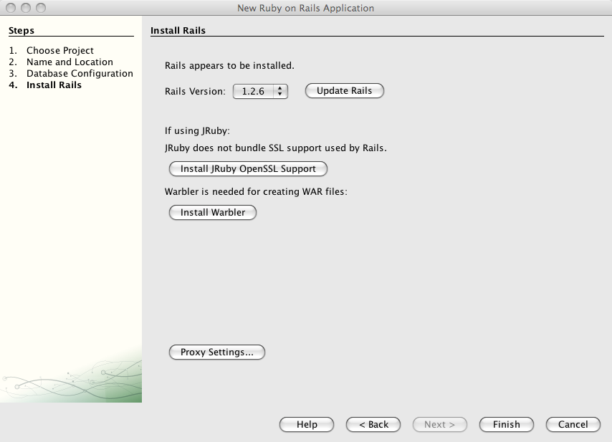
Select Rails Version

Slide 63
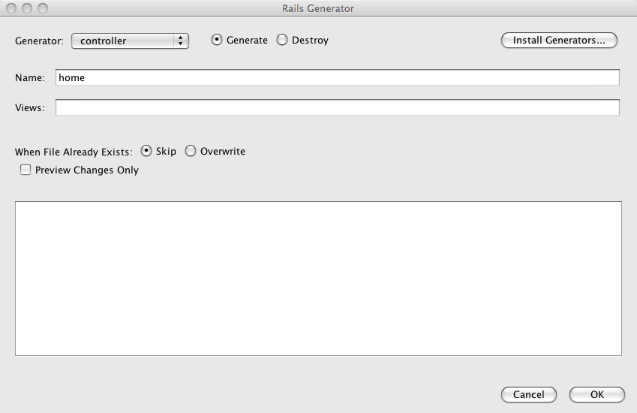
From Project Generate Controller

Slide 64
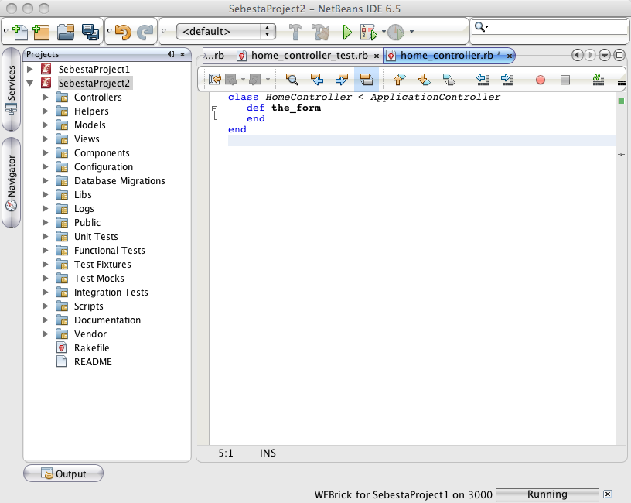
The First Action Method is the_form

Slide 65
Add A View
Select Views/Home Right Click for a New RHTML
document.
Use the RHTML code from chapter 2 but with a different
opening form tag. The data will be arriving with names on the form.
<!-- Popcorn.html
Popcorn sales form document
-->
<html xmlns="http://www.w3.org/1999/xhtml">
<head>
<title>Popcorn Sales Form</title>
</head>
<body>
<h2>Welcome to popcorn sales</h2>
<form action = "result" method = "post">
<table>
<tr>
<td>Buyer's Name:</td>
<td>
<input type="text" name="name" size ="30" />
</td>
</tr>

Slide 66
Add A View
Select Views/Home Right Click for a New RHTML
document.
Use the RHTML code from chapter 2 but with a different
opening form tag. The data will be arriving with names on the form.
This form (the_form.rhtml) is submitted to result.
<!-- Popcorn.html
Popcorn sales form document
-->
<html xmlns="http://www.w3.org/1999/xhtml">
<head>
<title>Popcorn Sales Form</title>
</head>
<body>
<h2>Welcome to popcorn sales</h2>
<form action = "result" method = "post">
<table>
<tr>
<td>Buyer's Name:</td>
<td>
<input type="text" name="name" size ="30" />
</td>
</tr>
We need to handle this in the controller.
Data is named.

Slide 67
Modify The Controller(1)
class HomeController < ApplicationController
def the_form
end
def result
@unpop = params[:unpop].to_i
@caramel = params[:caramel].to_i
@caramelnut = params[:caramelnut].to_i
@toffeynut = params[:toffeynut].to_i
@name = params[:name]
@street = params[:street]
@city = params[:city]
puts @city
@payment = params[:payment]
After these
computations pass the
results to the view
(result.rhtml).

Slide 68
Modify The Controller(2)
@unpop_cost = 3.0 * @unpop
@caramel_cost = 3.5 * @caramel
@caramelnut_cost = 4.5 * @caramelnut
@toffeynut_cost = 5.0 * @toffeynut
@total_price = @unpop_cost + @caramel_cost + @caramelnut_cost +
@toffeynut_cost
@total_items = @unpop + @caramel + @caramelnut + @toffeynut
@total_price = sprintf("%5.2f",@total_price)
@unpop_cost = sprintf("%5.2f",@unpop_cost)
@caramel_cost = sprintf("%5.2f",@caramel_cost)
@caramelnut_cost = sprintf("%5.2f",@caramelnut_cost)
@toffeynut_cost = sprintf("%5.2f",@toffeynut_cost)
end
end

Slide 69
result.rhtml (1)
<?xml version="1.0" encoding = "utf-8" ?>
<!DOCTYPE html PUBLIC "-//W3C//DTD XHTML 1.1//EN"
"http://www.w3.org/TR/xhtml11/DTD/xhtml11.dtd">
<html xmlns="http://www.w3.org/1999/xhtml">
<head>
<title>result.rhtml</head>
<body>
<h4>Customer:</h4>
<%= @name %> <br/> Values are read from the
<%= @street %> <br/> controller.
<%= @city %>
<p/><p/>

Slide 70
result.rhtml (2)
<table border="border">
<caption>Order Information</caption>
<tr>
<th>Product</th>
<th>Unit Price</th>
<th>Quantity</th>
<th>Item Cost</th>
</tr>
<tr align ="center">
<td>Unpopped Corn</td>
<td>$3.00</td>
<td><%= @unpop %> </td>
<td><%= @unpop_cost %> </td>
See Sebesta for rest of code…

Slide 71
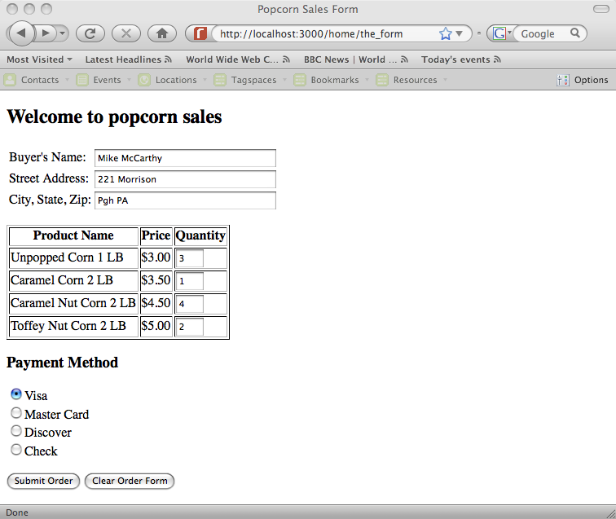
Initial Visit on the_form

Slide 72
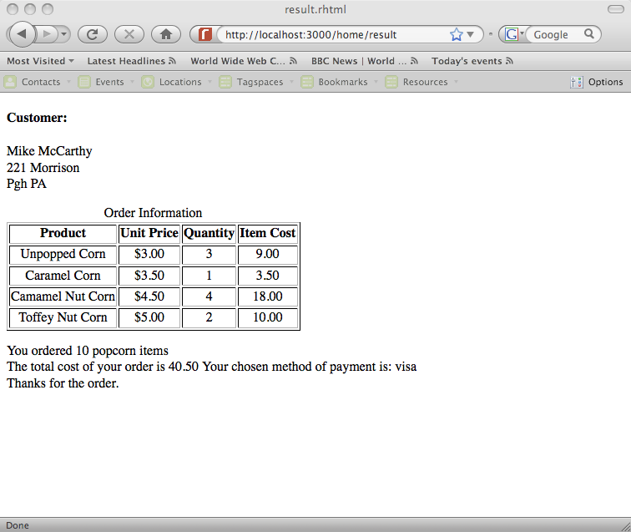
Form Submitted to result

Slide 73
The Model (1)
Rails uses Active Record for object-relational mapping.
Database rows are mapped to objects with methods.
In Java’s Hibernate, you work from Java’s object model.
Hibernate is a mapping framework.
Active Record is a wrapping framework.
In Active Record, you work from an SQL schema.
Active Record exploits metaprogramming and convention
over configuration.

Slide 74
The Model (2)
This example is from Bruce Tate at IBM.
See http://www.ibm.com/developerworks/
java/library/j-cb03076/index.html.

Slide 75
The Model (3)
Beginning from a database schema:
CREATE TABLE people ( id int(11) NOT NULL auto_increment,
first_name varchar(255),
last_name varchar(255),
email varchar(255),
PRIMARY KEY (id) );
Create a Ruby class:
class Person < ActiveRecord::Base
end

Slide 76
The Model (4)
This type of programming is now possible:
person = Person.new ;
person.first_name = "Bruce" ;
person.last_name = "Tate”;
person.email = bruce.tate@nospam.j2life.com;
person.save ;
person = Person.new;
person.first_name = "Tom”;
person.save
The Base class adds attributes to your person class
for every column in the database. This is adding code
to your code – metaprogramming.

Slide 77
Convention Over Configuration
Model class names such as Person are in
CamelCase and are English singulars.
Database table names such as people use
underscores between words and are English plurals.
Primary keys uniquely identify rows in relational databases.
Active Record uses id for primary keys.
Foreign keys join database tables. Active Record uses foreign
keys such as person_id with an English singular and an _id suffix.

Slide 78
Model Based Validation
class Person < ActiveRecord::Base
validates_presence_of :email
end

Slide 79
Relationships(1)
CREATE TABLE addresses ( id int(11) NOT NULL auto_increment,
person_id int(11),
address varchar(255),
city varchar(255),
state varchar(255),
zip int(9),
PRIMARY KEY (id) );
We are following the conventions, so we write…

Slide 80
Relationships(2)
class Person < ActiveRecord::Base
has_one :address # add an instance variable
# of type address
validates_presence_of :email
end
class Address < ActiveRecord::Base
belongs_to :person
end
Note that “belongs_to:person” is a metaprogramming
method with a symbol parameter.

Slide 81
Relationships(3)
person = Person.new;
person.email = bruce@tate.com;
address = Address.new ;
address.city = "Austin”;
person.address = address;
person.save;
person2 = Person.find_by_email “bruce@tate.com”;
puts person2.address.city;
Output "Austin" ;

Slide 82
Relationships(4)
Other relationships are possible:
class Person < ActiveRecord::Base
has_many :addresses # must be plural
validates_presence_of :email
End
has_many adds an array of addresses to Person.

Slide 83
Relationships(5)
load 'app/models/person.rb’ ;
person = Person.find_by_email bruce@tate.com;
address = Address.new;
address.city = "New Braunfels”;
person.addresses << address;
person.save;
puts Address.find_all.size
Output => 2

