Slide 1

95-733 Internet of Things
HTTP Webhooks
1

Slide 2
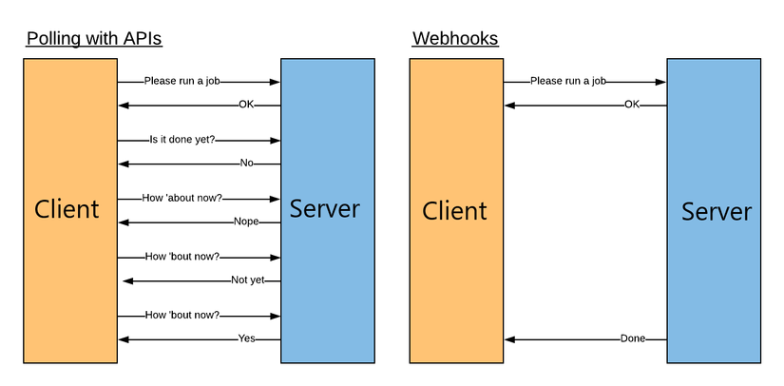
Why Use Webhooks?

Slide 3
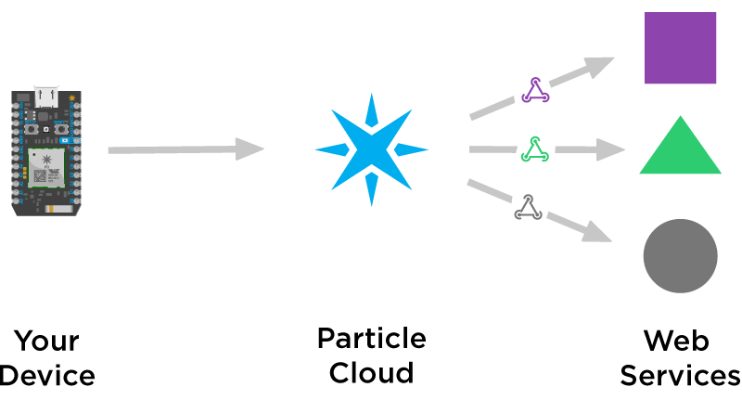

Slide 4
Device publishes events to the cloud
void loop() {
String temp = String(random(60, 80));
Particle.publish("temp", temp, PRIVATE);
delay(30000);
}
Private implies the event is not available to the world.

Slide 5
Webhooks in the cloud
Upon request by the device
- The Particle cloud makes an HTTP request to a predefined URL.
- The URL was established by a subscriber earlier.
- Particle may receive an HTTP response.
- That response may also be received by the device.

Slide 6
Device subscribing to an event in the cloud
void setup() {
// Subscribe to the webhook response event
Particle.subscribe("hook-response/get_temp", myHandler, MY_DEVICES);
}
void myHandler(const char *event, const char *data) {
// Handle the webhook response
}
We are subscribing to a webhook’s - HTTP response.

