Slide 1
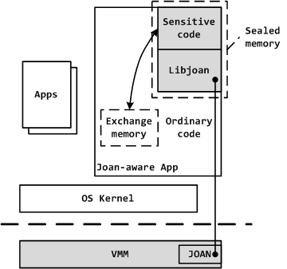
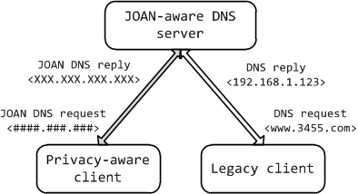
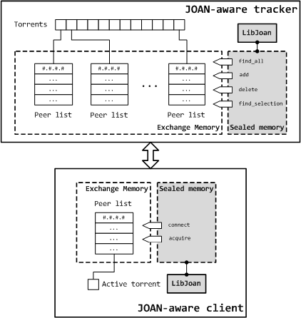
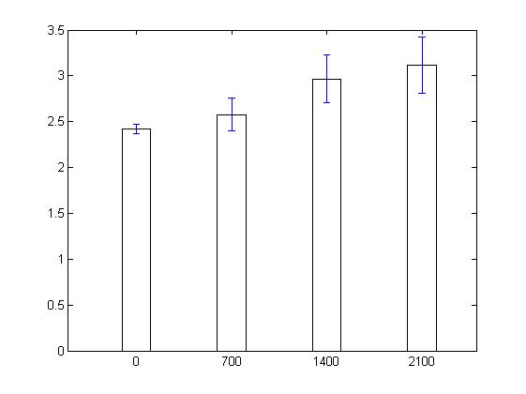
JOAN: shepherd application privacy with virtualized special purpose memory
Mingyuan Xia, Miao Yu, Zhengwei Qi, Haibing Guan
Shanghai Jiao Tong University
http://202.120.40.124/index.php/VM:Joan_project
Get a card for brief
Motivation Networked applications are ubiquitous in home, enterprise, commercial and government. The privacy of networked applications faces risks from its own robustness, operating system that runs beneath them and peers that they exchange sensitive data with. The expanded TCB suggests that they will not achieve adequate privacy assurance.
Background Existing virtualization-based security systems do not address the problem of program vulnerability or confine the programming flexibility of sensitive code. To fully employ the strong isolation of virtualization to protect program data secrecy, user should be able to assign programming friendly protection policy to configurable TCB.
Design We propose a virtualization-based system JOAN, which utilizes memory virtualization to expose two privacy aware memory primitives (see the architecture depicted in the figure on the right). On high level, the sealed memory ensures the sensitive code integrity and reduces the TCB size, while the exchange memory protects the integrity and privacy of sensitive data. With both virtualized memories, privacy-critical applications can maintain small TCB size and achieve flexible data exchange semantics.
Contribution
We reduce the TCB to include only user-selected sensitive code and the hypervisor, which is a few order of magnitude smaller than operating system components.
We exploit memory virtualization to provide privacy aware memory primitives. Privacy-critical application can exploit these programming friendly memory primitives to fully integrate with our system while enjoy flexible and secure sensitive data exchange.
We deploy our system in off-shelf hardware environment and enhance the privacy of various practical networked applications. (see below)
JOAN architecture: The grey part is the TCB. We enforce two kinds of virtualized special memory:
Sealed memory: content visible only to sensitive code, used to store sensitive code pages.
Exchange memory: present encrypted view to untrusted code, allow verbatim copy but no modification. Used to exchange sensitive data.
Case 1: DNS
Case 2: BT
Case 3: FTP
Legacy DNS services are distributed with plain text UDP packet. JOAN-aware version bridge a secure and private channel and circumvent potential request trace with exchange memory.
JOAN-aware tracker protects peer lists from being exposed to privacy-unaware clients. So privacy-aware will not risk sharing files with peers that may disclose privacy information.
FTP software stands for bandwidth-sensitive application. Legacy FTP software transmits plain text file content over network without privacy consideration. JOAN-aware FTP client uses exchange memory as transmission buffer to interchange encrypted data stream securely.
JOAN FTP vs FTP variations
JOAN FTP throughput speed vs different exchange memory size

