Slide 1
VGRIS: Virtualized GPU Resource Isolation and
Scheduling in Cloud Gaming
Miao Yu¹, Chao Zhang², Zhengwei Qi², Jianguo Yao², Yin Wang³ and Haibing Guan²
¹Carnegie Mellon University
²Shanghai Jiao Tong University
³HP Labs

Slide 2
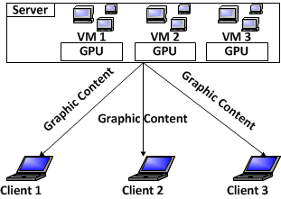


Background
What is Cloud Gaming Platform
  Goal: Distribute Game Experience to Multiple Clients
Advantage:
  Cheap Client Hardware
  Easier to Maintain & Distribute Games
Notes:
Cloud gaming is a game service that executes the game programs and renders the graphics on the server side, while players stream the video through broadband connection using thin clients. Nowadays, more and more game companies embrace cloud gaming platform to sell their game experience.
Advantage:
Allows easy access to games without owning a console or high-end graphics cards or Graphics Processing Unit (GPU)
Game distribution and maintenance become much easier
In a traditional scenario, the cloud gaming server exclusively assign GPU to each VM, which runs one game inside to ensure the Service Level Agreement

Slide 3
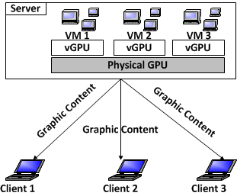
Background
GPU Virtualization
  Goal: Improve GPU Resource Usage [SIGOPS OSR’09]
Advantage:
  Less GPUs are needed
  Lower Server Hardware Cost
Notes:
More Recent work

Slide 4


When Considering About the Fact
For Human, 30 ~ 60 FPS is smooth, >60 FPS makes the same.
(Refresh Rate)max for Most LCD Displays = 60 FPS
Game | FPS | GPU Usage | CPU Usage
DiRT 3 | 67.14 | 56.14% | 39.61%
Portal 2 | 212.70 | 94.77% | 85.42%
Shogun 2 | 64.76 | 84.33% | 29.48%
Call Of Duty 7 | 68.97 | 73.48% | 69.09%
NBA 2012 | 104.57 | 69.50% | 86.45%
It should be OK to run several of them
at the SAME time, at 30 ~ 60 FPS.
Notes:
Table: Game performance on Intel Core7 2600K + HD6750 (we get their performance on one mid-end CPU with one mid-end GPU)
GameSpot on November the 10th, 2011. The version of the graphics library is Direct3D 9.

Slide 5
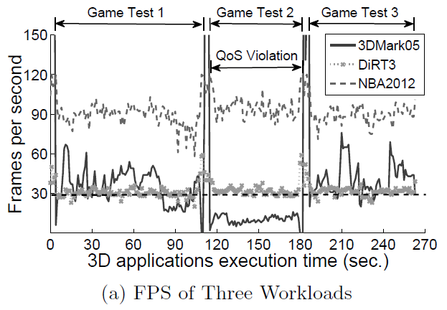
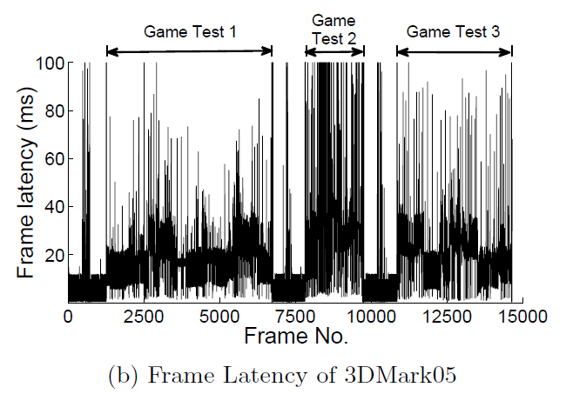
Problems
However…When run them concurrently on the same GPU
  Not well studied ––– How to Schedule
Notes:
1. (Experiment) 3 Guests: 1x Dirt3 + 1x 3DMark05 + 1x NBA2012
(FPS Problem) NBA2012 >70 FPS, while 3DMark ~15 FPS
2. (Experiment) 2 Guests: 1x PostProcess (100% GPU Workload) + 1x 3DMark05
( Latency Problem) Uneven and high latency of 3DMark05.

Slide 6
Contribution
VGRIS – A Scheduling Framework
  For GPU ParaVirtualization
  Only Change 3D API Library (OpenGL, Direct3D)
Three Scheduling Algorithms
  Service-Level Agreement (SLA) Aware Scheduling → Ensure SLA
  Proportional Resource Sharing
  → Improve GPU Utilization
  Hybrid – performance and fairness trade-offs
  → Eliminate Inappropriate GPU Resource Slice
By using VGRIS, Cloud Gaming Services can enjoy GPU-PV and cut GPU Amounts
SIGNIFICANTLY
Notes:
Challenge: A challenge of resources management on GPU is that graphics processing such as frame rendering is executed in an asynchronous and non-preemptive manner.
Motivate 3 algorithms

Slide 7
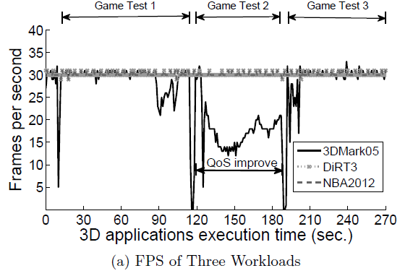
Our Result – SLA Aware Scheduling
SLA-Aware: Solved the Unfair FPS Problem
  Average FPS for GT2: 65.05% After Scheduling
Notes:
We set the FPS bar to be 30

Slide 8
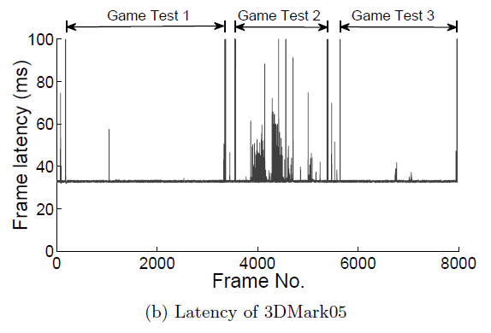
Our Result – SLA Aware Scheduling
Significantly Smooth and Decrease the Latency
  Max. Latency: 388.82ms 131.27ms

Slide 9
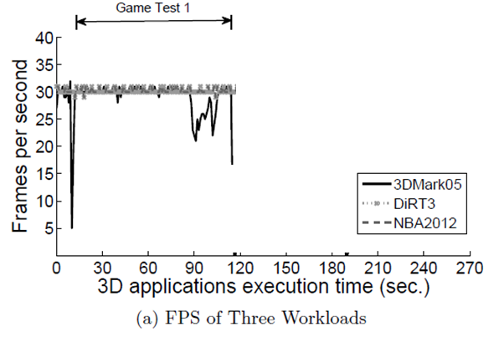
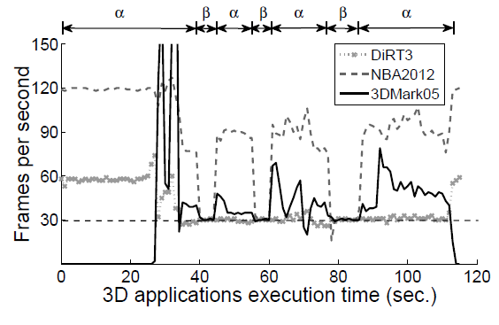
Our Result – Hybrid Scheduling
Improve GPU Usage Further
  No Upper FPS Bar for the Games
Notes:
In this figure, “a” represents proportional-share, “b” stands for SLA-aware scheduling,
At the time of 40 second, the VM running DiRT3 has not got sufficient GPU resource to maintain its SLA for the most recent time which is 5 seconds according to the administrator’s setting.

Slide 10
VGRIS Architecture

Slide 11
SLA-Aware Scheduling
Goal: Ensure FPSVM = 30
Where to Delay?
  May Introduce Side-Effect Latency
Notes:
Side-Effect Latency: Put sleep after SwapBuffer() causes Side-Effect Latency. Reason: Latency is the time between two SwapBuffer(). If we put sleep in the last, then the latency includes the last round sleep time and this round computation time. This results in the worst case even worse.

Slide 12
SLA-Aware Scheduling
Goal: Ensure FPSVM = 30
Avoid Side-Effect Latency
    While(1)
    {
    DrawShapes(&VGA_Buffer);
Sleep(remain_time);
    SwapBuffer(); // Tell GPU to
    display the buffered content.
    }
  Challenge: Predict SwapBuffer Cost
Notes:
Side-Effect Latency: Put sleep after SwapBuffer() causes Side-Effect Latency. Reason: Latency is the time between two SwapBuffer(). If we put sleep in the last, then the latency includes the last round sleep time and this round computation time. This results in the worst case even worse.

Slide 13
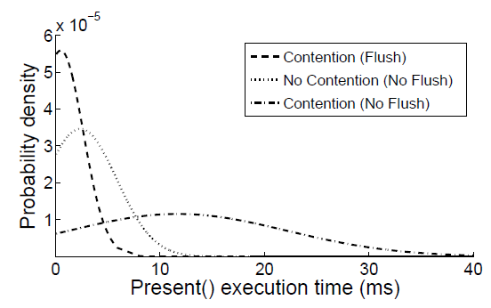
SLA-Aware Scheduling
Prediction
  GPU (and API Lib): Asynchronous (Only blocked when the command queue is full!)
Approach:
  Flush
  Calculate Average Cost

Slide 14

Proportional Resource Scheduling
Goal: Solve GPU Resource Under-utilization Problem
Same with TimeGraph [UsenixATC’11]
  But we do not need any source code information
  → Better compatibility

Slide 15
Hybrid Scheduling
Goal: Avoid Inappropriate Weights in Proportional Resource Scheduling
  This problem can cause starvation.
Approach:
  Automatically choose either of the SLA-Aware or Proportional Resource Scheduling according to current situation.
Notes:
SLA-aware scheduling may result in low GPU utilization with an insufficient number of VMs. On the other hand, proportional-share scheduling can maximize utilization but inappropriate weights can lead to starvation of some VM

Slide 16
Hybrid Scheduling
Algorithm:
  While each second do
    If (CurrentAlgo = PropShare) and (FPS < FPSthres for Time sec).
    then
      CurrentAlgo ← SLAAware
    Else if (CurrentAlgo = SLAAware) and (GPUTotalUsage < GPUthres for Time sec).
    then
      CurrentAlgo ← PropShare
      CalcShareForAllVMs()
Notes:
SLA-aware scheduling may result in low GPU utilization with an insufficient number of VMs. On the other hand, proportional-share scheduling can maximize utilization but inappropriate weights can lead to starvation of some VM

Slide 17


Evaluations
Prediction
  No Contention: ≤ 0.4ms error margin
  Contention with Real Games: only 1.95% of the frames fails in prediction. Max. error: 91.32ms
Notes:
SLA-aware scheduling may result in low GPU utilization with an insufficient number of VMs. On the other hand, proportional-share scheduling can maximize utilization but inappropriate weights can lead to starvation of some VM

Slide 18
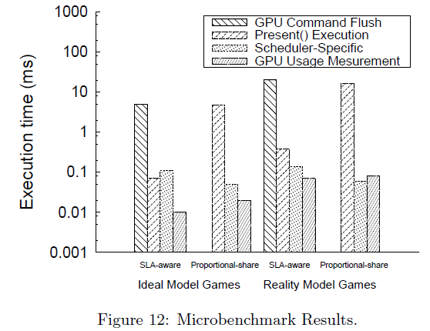
Evaluations
Overhead
  VGRIS GPU Performance Overhead: ≤ 5.53%
Notes:
SLA-aware scheduling may result in low GPU utilization with an insufficient number of VMs. On the other hand, proportional-share scheduling can maximize utilization but inappropriate weights can lead to starvation of some VM

Slide 19
Future Work
QoS for GPU Computing
  CUDA and OpenAL
Support Multi-GPUs and Cluster
  On-Top Load Balancing
GPU Memory Resource Management
Notes:
19

Slide 20
Thank you

Slide 21
Demo: http://bit.ly/12cmNpz
Contact Info (Miao Yu)
  Email: superymk@cmu.edu
  Website: http://www.contrib.andrew.cmu.edu/~miaoy1/

