Slide 1
Trusted Display on Untrusted Commodity Platforms
Miao Yu, Virgil D. Gligor, and Zongwei Zhou
CyLab and ECE Department
Carnegie Mellon University
{miaoy1, virgil}@andrew.cmu.edu, zongwei@alumni.cmu.edu
ACM CCS
Denver, Colorado
October 14, 2015

Slide 2
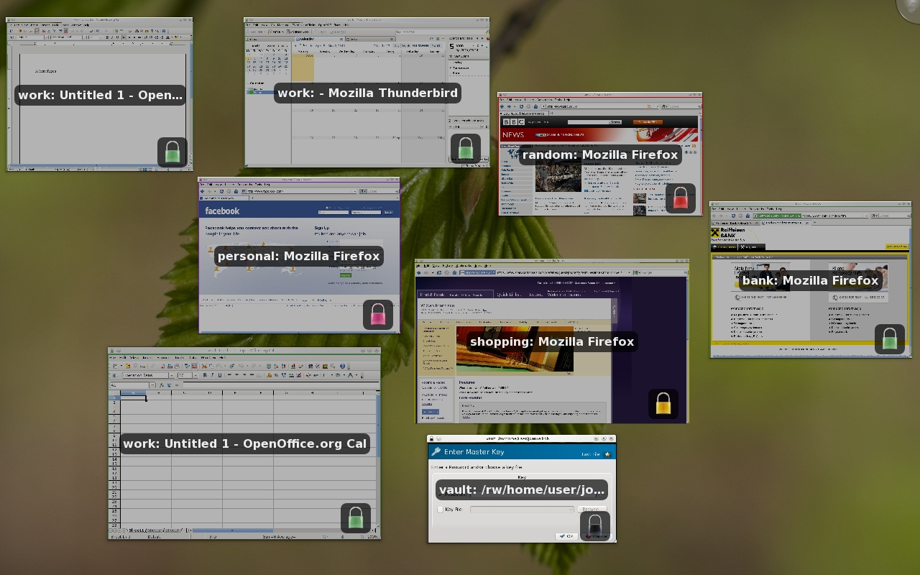
Secure Display Sharing
Sensitive
Application
(SecApp)
Sensitive
Application
(SecApp)
Insensitive
Application
(App)
Insensitive
Application
(App)
Sensitive
Application
(SecApp)
Sensitive
Application
(SecApp)
Sensitive
Application
(SecApp)
Security: no malicious scrapping/painting of SecApps output
on Shared Displays
Sensitive
Application
(SecApp)
Picture: GEEK.COM. http://www.geek.com/wp-content/uploads/2010/04/qubesOS_many-appvms.jpg
Notes:
Trusted display is about secure display sharing.
As shown in this desktop example (, and also mentioned by the previous speaker), users run both insensitive and sensitive applications.
Since the advent of windowing systems in the late ‘80s, designers have known that “users need to be able to view a screen with information at different (sensitivity) levels.”
<click> Thus, a trusted display service must ensure that …
** Scrapping: no unauthenticated read to the SecApp’s display output. Consequently, insecure OS/Apps cannot violate SecApps’ display secrecy.
** Painting: no unauthenticated write to overlap the SecApp’s display output. Consequently, insecure OS/Apps cannot violate SecApps’ display integrity.

Slide 3


Ideal Trusted Display
App
…
Sec-
App 1
Sec-
App 2
Operating
System
(unmodified)
Security
while maintaining:
Trusted Computing Base
Graphics Processing Unit (GPU)
Compatibility
Graphics Processing Unit (GPU)
Assurance
SecApp
SecApp
App
App
User Perception
SecApp
SecApp
SecApp
SecApp
Notes:
An ideal trusted display service needs to achieve 4 properties.
1. Security: protect the confidentiality and authenticity of SecApps’ display output.
(“Threat Model”) In particular, we assume that an attacker can compromise commodity OS/Apps, or even providing his own SecApp.
2. Compatibility: (means) no modification to commodity OS/Apps code or devices, like GPU.
3. Assurance: (means) it must preserve existing proofs of the underlying trusted computing base, which manages the GPU. Note that the trusted computing base can use different security components, such as security kernels, or micro-hypervisors.
4. maintains user's perception: (means) it uses different windows for Apps/SecApps. So users can rely on easily identifiable screen geometry

Slide 4

Related Work
GPU Managed by:
App
…
Sec-
App 1
Sec-
App 2
Full
Virtualization
Hypervisor
Commodity OS
TCB
Operating
System
(unmodified)
Security
while maintaining:
Compatibility
Assurance
User Perception
X
X
Full Virtualization Hypervisor
Trusted Computing Base (TCB)
✓
Graphics Processing Unit (GPU)
Graphics Processing Unit (GPU)
X
Graphics Processing Unit (GPU)
X
X
SecApp
SecApp
App
✓
App
SecApp
SecApp
SecApp
SecApp
Notes:
However, none of the previous work has achieved such IDEAL Trusted Display.
First, a GPU cannot be managed by the Untrusted OS because security would be lost.
Second, we discovered that previous full GPU virtualization approaches cannot isolate GPU memory.
**As I will show in the next few slides**, GPU Hardware LACKS SUPPORT for address space separation, and hence security is lost.
Furthermore, multiplexing the GPU among multiple Virtual Machines is very complex and the CODEBASE becomes very large and UNVERIFIABLE
Third, requiring a Trusted Computing Base to encapsulate and protect the GPU is incompatible with commodity OS/Apps,
and the TCB loses its assurance due to requiring large GPU codebase.

Slide 5
Background: GPU
Objects
CPU
Programs (e.g., drivers, Apps)
GPU
GPU Address Spaces
Commands
Instructions
Config. Registers
Data (e.g., frame buffers)
Global Page
Table (GGTT)
Local Page Tables
Notes:
To better understanding full GPU virtualization, I’ll introduce a little GPU background.
CPU programs (such as GPU drivers and Apps) control GPU execution via GPU objects.
Among these objects.
(1**) Configuration registers: configs all GPU functions
(2**) Commands: (are) executed by GPU to config the GPU with correct parameters, such as specifying the entry of GPU instructions
(3) GPU page tables: (include) One GPU global page table, and multiple GPU local page tables to serve different applications.
(4) (next) Instructions: perform computations on GPU cores.
(5) (next) frame buffers hold the data to be displayed
(“Data: stores contents for GPU processing
Config registers: configs all GPU functions”)
(“Data and config registers are similar with those on other devices.”)
(“Commands: (are) executed by GPU to configure the GPU with correct parameters, such as specifying the entry of GPU instructions.”)

Slide 6

Background: GPU
Objects
Engines
CPU
Programs (e.g., drivers, Apps)
GPU
GPU Address Spaces
Commands
Instructions
Config. Registers
Data (e.g., frame buffers)
Global Page
Table (GGTT)
Local Page Tables
Display Engine
Processing Engine
Other
Engines
Notes:
GPU engines provide GPU functions.
(1) GPU engines reference GPU memory via GPU page tables. Note that the display engine uses GPU global page table only.
(2) And only the processing engine uses GPU instructions.
(“Display engine: which provides display functions”)
(“Processing engine: which accelerates graphic computations)
(Backup: MI_REPORT_PERF_COUNT goes to perf engine, MI_DISPLAY_FLIP goes to display engine)
(“And other engines include performance measurement and power management.”)

Slide 7
Background: Full GPU Virtualization
Multiplexes GPU among VMs => Access mediation & emulation for
GPU objects, e.g. GPU configuration registers
Reduces complexity => “address space ballooning”
VM 1
VM 2
Ballooned
Ballooned
GPU Global Page Table (GGTT)
* Derived from Figure 7 of Tian et al. “A Full GPU Virtualization Solution with Mediated Pass-Through”
Notes:
Full GPU virt. is a promising candidate to offer trusted display.
(1) To be compatible with commodity platforms, full GPU virt. multiplexes all GPU functions among VMs. To do that, full GPU virt. mediates and emulates the accesses to GPU objects, such as the ones to all GPU config registers.
(2) Existing GPU virt. approaches reduce their complexity with GPU “address space ballooning”. GPU address space ballooning reduces GPU address translation overhead in isolating GPU memory. With this technique, each VM has the knowledge of GPU memory partition. Thus, the GPU can directly access memory at GPU addresses provided by guest VMs.
(“in the high level idea, memory ballooning is about memory reclamation. The GPU address space ballooning is similar in the high level idea and approaches, but used in a different scenario. That is, reduces the address translation overhead in isolating GPU memory”)

Slide 8
Background: Full GPU Virtualization
Multiplexes GPU among VMs => Access mediation & emulation for
GPU objects, e.g. GPU configuration registers
Reduces complexity => “address space ballooning”
=> non-contiguous GPU address space
VM 1
VM 2
Ballooned
Ballooned
GPU Global Page Table (GGTT)
* Derived from Figure 7 of Tian et al. “A Full GPU Virtualization Solution with Mediated Pass-Through”
Notes:
Note that, (with GPU “address space ballooning”), Each VM owns non-contiguous GPU memory space. One memory block is shared between CPU and GPU, while the other one is used by GPU only.

Slide 9
Insecurity of Full GPU Virtualization
GPU instructions could be malicious => base & bound registers
Inadequate GPU HW
- single register pair for non-contiguous address spaces
High
High
VM2
VM1
VM1
Bound
Bound
VM2
VM2
Base
Base
VM1
Low
GGTT
Low
GGTT
Notes:
But, as I mentioned In the earlier slides, existing full GPU virtualization approaches cannot isolate GPU memory.
(1) Previous approaches do not verify GPU instructions. Worse, the GPU instructions could be malicious. (As shown in the left), a malicious instruction can perform “out-of-bound” access, to access VM1’s memory. <click> To prevent such attack, Intel GPUs support a single pair of “base-and-bound” registers. Thus, the“out-of-bound” access can be blocked.
(2) However, the non-contiguous memory blocks in GPU “address space ballooning” void the protection. (As shown in the right), because of the non-contiguous memory blocks, <click> the single address bound of VM2 must include all VM2’s memory blocks, to support the GPU functions using multiple VM2’s memory blocks. Thus, the malicious instruction can access VM1’s GPU memory in the middle.

Slide 10
In Summary
Insecure: Inadequate GPU HW
- malicious GPU instructions break
GPU address space separation
Lacks assurance: unverifiable code base
  - multiplexing GPU among VMs is complex
    e.g., emulating accesses to all GPU configuration
    registers
Full GPU
Virtualization
  Incompatible with commodity OS/Apps
    - require OS/Apps redesign
Trusted Computing Base
  TCB loses its assurance
  - code becomes large and complex
Notes:
In summary,
With full GPU virtualization,
(1) Existing GPU protection is inadequate. As we demonstrated, …
(2) The trusted code base would be unverifiable, because for example, emulating accesses to all GPU configuration registers is complex
With previous trusted computing base approaches,
(1) (these approaches are) incompatible with commodity OS/Apps.
(2) (and also,) these approaches lose assurance, (** for example, the code size quadruples for security kernels, such as HiStar **), due to protecting the whole GPU in their code bases.
(“Why Complex”: (1) the numbers are great. And they have different state machines in deciding the expected return value)

Slide 11
GPU Separation Kernel (GSK)
Step 1: Separate
Step 2: Mediate
Step 3: Emulate
Notes:
In our work, our main contribution is the GPU separation kernel, which we call GSK for short.
GSK performs three steps.
(1) first, it separates all GPU objects and their accesses.
Then during the runtime:
(1) it mediates and emulates accesses to sensitive GPU objects.
In the next, I’ll go into the details.

Slide 12
GSK: Separation
Separate security-sensitive from insensitive GPU objects
=> security model (informal)
Apps
Apps
App 1
OS
(unmodified)
GPU
Notes:
The first step, separation.
(“Idea”) The idea of Separation is to completely separate all GPU objects and their accesses, according to their security impact to trusted display only. This step serves as the security basis of our trusted display service, and forms the informal security model. As a result, each of the GPU objects is either security sensitive, or security insensitive.

Slide 13
GSK: Separation
Separate security-sensitive from insensitive GPU objects
=> security model (informal)
Apps
Apps
App 1
OS
(unmodified)
Insensitive
(vast majority)
Sensitive
(very few)
GSK
Addressed:
Large and complex (unverifiable) code base
GPU
Sensitive Object
Insensitive Object
Notes:
Sensitive GPU objects decides the security of trusted display. For example, trusted display frame buffers are sensitive, and the GPU instructions can access the frame buffers by GPU are also sensitive.
In contrast, insensitive GPU objects are those that can never affect the security of trusted display.
As shown in the bottom of the figure, most GPU objects are insensitive, and their accesses are passed through to the GPU directly. Only a few GPU objects are sensitive. <click> And their accesses must be routed via the GSK.
<click>
In this way, we can address the problem of “large and complex code base”, because we do not need to multiplex all GPU functions.

Slide 14
GSK: Mediation
ALL accesses to security-sensitive objects by ALL GPU instructions
  inadequate GPU HW for mediation and complex instruction behavior
Apps
Apps
App 1
SecApp 1
OS
(unmodified)
Access Mediation
GSK
GPU
Interfaces for
trusted display
Notes:
The next step, mediation
the GSK mediates all sensitive GPU accesses of OS/Apps. In particular, the GSK needs to mediate ALL accesses to sensitive GPU objects by ALL GPU instructions. However, modern GPU HW is inadequate to mediate these accesses, and has complex GPU instruction behaviors.
(“SecApps generate their display content on the CPU, and uses GSK to display their graphics.”)

Slide 15
GSK: Mediation
Inadequate GPU HW & complex behaviors
Instructions
Solutions
cannot be intercepted
by GPU during execution
can access global memory
via global page table (GGTT)
  can access all frame buffers
have complex behaviors when
accessing sensitive objects
Assign GPU instructions to
separate address spaces
Prevent GPU instruction
access to sensitive objects while
maintaining compatibility.
Map GPU instruction behaviors
to Read/Write & Config. Change
accesses.
Enforce access invariants.
Notes:
(1) GPU instructions cannot be intercepted by GPU during their execution. (“Solution”) Thus, the GSK assigns GPU instructions to separate address spaces before GPU instructions execute.
(2) GPU instructions …, and hence they can access sensitive frame buffers. Thus, the GSK must …
(3) GPU instructions have complex behaviors when accessing sensitive objects. Thus, we analyze the behaviors of GPU instructions first. Then the GSK maps GPU instruction behaviors to GPU memory read/write & GPU configuration register updates. After that, the GSK defines and enforces the access invariants to secure trusted display.
(“GPU instructions has unknown capabilities. For example, if there was a screen pixel reading instruction, it would be insecure to avoid verifying GPU instructions. (“Solution”) Thus, we analyze the capabilities of GPU instructions, and find that the best attack of an adversary is to manipulate memory accesses. So the GSK confine GPU memory accesses of GPU instructions.”)

Slide 16
GPU Address Space Separation
GPU Instructions
Global Page Table (GGTT)
Physical
Memory
Sensitive Object
Insensitive Object
Notes:
The GSK uses the novel “GPU address space separation” to avoid verifying GPU instructions. The high level idea is to limit the GPU memory accessible to GPU instructions.
<click> As we know that, GPU instructions access GPU memory via GPU global page table. <click> For a piece of benign GPU instructions, it should always access the insensitive GPU memory only.

Slide 17
GPU Address Space Separation
GPU Instructions
Global Page Table (GGTT)
Physical
Memory
Sensitive Object
Insensitive Object
Notes:
However, because GPU global page table also maps the sensitive GPU memory of trusted display, malicious GPU instructions can compromise the security of trusted display.

Slide 18
GPU Address Space Separation
GPU Instructions
Global Page Table (GGTT)
Shadow GGTT (GGTT’)
Physical
Memory
Addressed:
Inadequate GPU HW and access mapping
Sensitive Object
Insensitive Object
Notes:
To prevent such attack, the GSK shadows the GPU global page table in a local GPU page table, and forces the GPU instructions reference memory via shadow GPU page table instead.
Especially, the shadow GPU page table maps all previously mapped insensitive GPU memory, but never maps any of the sensitive GPU memory. → Thus, the GPU instructions are unable to access sensitive memory under all circumstances. And this rule serves as one of the access invariants in the GSK.
(“End”) In this way, we do not need to verify GPU instructions, and preserve their original functions. <click> And we can address “…”

Slide 19
GSK: Emulation
Preserves compatibility of access to shared objects
  e.g., both OS/Apps and GSK access the frame buffer base register
Apps
Apps
App 1
SecApp 1
OS
(unmodified)
Access Mediation
Emulation
GSK
Addressed:
Incompatibility with commodity platforms
GPU
Interfaces for
trusted display
Notes:
The third step, emulation
(“Idea”) The idea of emulation is to preserve compatibility of access to shared objects. The shared objects are those used by both OS/Apps and the GSK.
Whenever OS/Apps access shared GPU objects, the GSK returns the expected results, without accessing the real GPU objects. The results are defined in the GPU specifications.
Thus, it addresses the problem of …

Slide 20
GSK: Design
Relies on existing primitives of formally verified μHV
- access control to CPU physical memory
Apps
Apps
App 1
SecApp 1
OS
(unmodified)
Access Mediation
Emulation
GSK
micro-Hypervisor
GPU
Addressed:
Maintain assurance of underlying code
Notes:
And in the GSK’s design, the GSK only requires …, such as …
As a result, the GSK achieves the property of …

Slide 21

GSK: Design
Screen Overlay: displays SecApps over OS/Apps
OS/Apps
frame buffer
SecApps’
frame buffer
Screen
Addressed:
Maintain Users’ Perception
Notes:
The GSK further provides screen overlay to display SecApps over untrusted OS/Apps.
In order to do that, the GSK always merges SecApps’ frame buffer over OS/Apps frame buffer. As a result, the user can see that the SecApps are displayed over untrusted OS/Apps.
Thus, the GSK achieves “”

Slide 22
Evaluation: Size & Complexity
Only few GPU objects require mediation
GPU Object | All Objects | Mediation in
 |  | Full GPU Virtualization | GSK
Data (e.g., frame buffer, input/output for processing) | 2 GB | data “out-of-the-VM” | ~6 MB
Configuration Registers | 625 | 711 | 39
Page Table | All
Commands | 269 | 43 | 21
Instructions | 66 | 14 (Ignored) | 0
Much smaller trusted code size
  GSK + μHV << Full GPU Virtualization
  ~36K SLoC >10M SLoC
Notes:
For the evaluation, we first evaluate the number of GPU objects require access mediation on one Intel GPU.
As shown in the table, <click> among all GPU objects, <click> existing full GPU virtualization approaches need to mediate a large portion of all GPU objects, and ignored verifying GPU instructions. In comparison, the GSK mediates the accesses to much fewer GPU objects.
Our evaluation also shows that our code size is much smaller than full GPU virtualization. We use a non-virtualizing micro-hypervisor as the underlying trusted code in the current prototype. The GSK and micro-hypervisor in our solution takes less than 40K SLoC in total, while full GPU virtualization takes more than 10M.
(“For the configuration registers, the result of full GPU virtualization is greater due to different statistic methods, as noted in our paper”)
(“It should be noted that although the GSK needs to mediate all accesses to all GPU page tables, the mediation of page-table access is simple due to their limited formats and sizes.”)

Slide 23


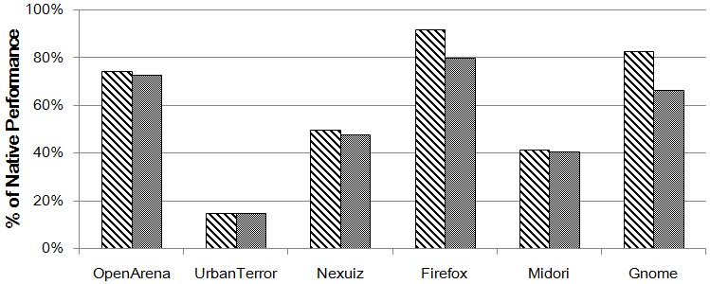
Evaluation: Performance (Throughput)
  μHV-only
  μHV + trusted display
Un-optimized μHV causes most overhead
Notes:
We also evaluate the performance overhead to the commodity OS/Apps.
We measure the performance overhead under two cases …. We compare their performances to reveal the overhead solely caused by our trusted-display service.
As shown in the figure, our trusted display service adds less than 10% performance overhead in average. <click> Most performance overhead is caused by the un-optimized micro-hypervisor.
(“low performance” in firefox, gnome: our current evaluation shows they incur higher trap frequency due to GGTT access. However, for a thorough analysis, we must perform “white-box” analysis on these benchmarks. That work is left for our future system research.)

Slide 24
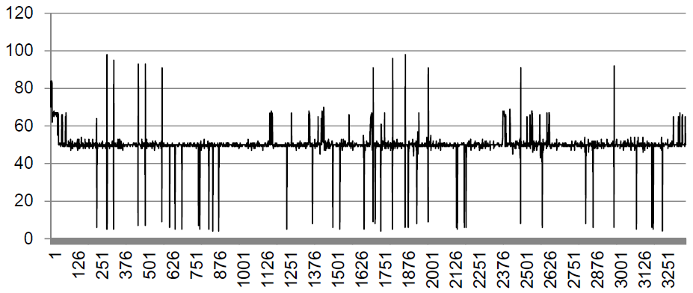
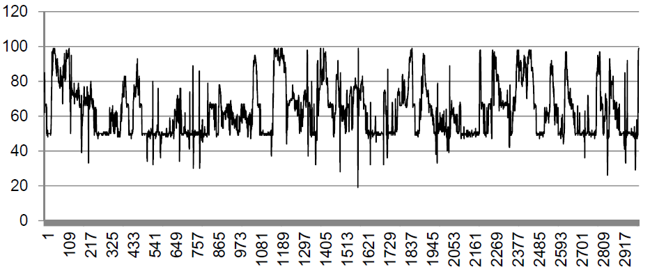
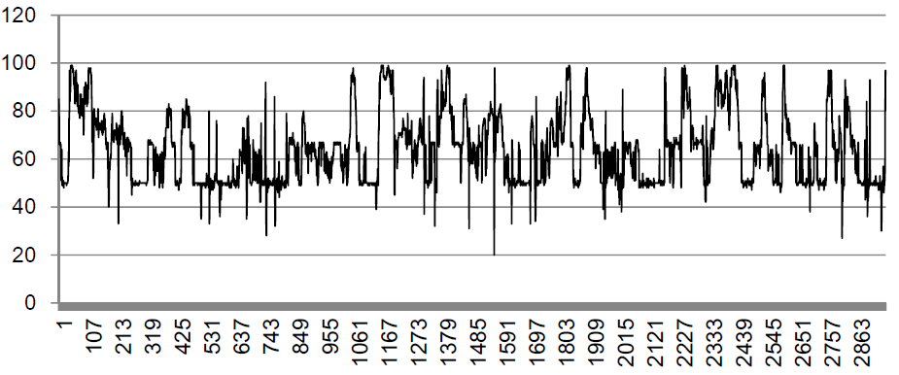
Evaluation: Performance (Latency)
(ms)
Native
(ms)
(frame)
μHV only
(ms)
(frame)
μHV +
trusted display
(frame)
Un-optimized μHV causes most frame jitters
Notes:
We further evaluate the frame latency. As shown in the figures, (1) the un-optimized uHV incurs most of the frame jitters, and (2) our trusted display service incurs inevitable additional latency.

Slide 25
Take-Away Points
Trusted display:
  Secure
  Compatible with commodity software/hardware
  Preserve assurance of underlying trusted code
  Maintain a typical user's perception
Approach:
  Separate → Mediate → Emulate GPU accesses
  Screen overlay
Notes:
In summary.
(introduces) ideal trusted display
(in our approach)

Slide 26
Backup

Slide 27


Security Protection
App
Sec-
App
Sensitive
App (SecApp)
…
Network (w/ crypto)
Server
Operating
System (OS)
!
Keyboard
Graphic
Controller
Notes:
This figure reviews security protections nowadays
(1) Even if the network is secure with cryptography support, the attacker can still read/modify sensitive app’s confidential data by compromising OS/Apps or providing his own SecApps
(2) Existing approaches isolate sensitive applications from other programs
(3) Existing approaches provide isolated I/O channels from sensitive applications to devices
However, such I/O isolation is inadequate to provide trusted display.

Slide 28
Discussion
SecApps require GPU acceleration
  Need to extend the scope of sensitive GPU objects
  Still simpler than full GPU virtualization
GPU hardware enhancement
  Separate sensitive and insensitive GPU registers and memory into different aligned pages
  Support R/W access control in all GPU page tables
Notes:
Trusted display in virtual desktop:
- Unsupported currently, because virtual desktop may not use GPU.

Slide 29
Screen Sharing
OS/App
frame buffer₁
…
SecApp
frame buffer₂
SecApp
frame buffer₃
Screen
Challenge: Ideal Trusted Display
when Screen & GPU are Shared at Any Time
(not exclusively)
Notes:
The GSK further displays SecApps over untrusted OS/Apps.
In order to do that, the GSK always merges SecApps’ frame buffer over OS/Apps frame buffer. As a result, the user can see that the SecApps are displayed over untrusted OS/Apps.
Thus, the GSK achieves “”

Slide 30
Evaluation: Performance (Latency)
(ms)
Native
max
acceptable
latency
(ms)
(frame)
μHV only
(ms)
(frame)
μHV +
trusted display
(frame)
Un-optimized μHV further degrades user experience
Notes:
We further evaluate the frame latency.
The figure shows that (1) the uHV incurs most of the frame jitters, and (2) uHV + trusted display achieves similar latency with uHV only. Thus, it demonstrates that our trusted display service incurs inevitable additional latency.
Besides, the blue dashed line highlights the maximum acceptable latency for this evaluation. Although the native case fail to provide a good user experience, the un-optimized uHV degrades user experience in further.

