Slide 1
Vis Virtualization Enhanced Live Acquisition for Native System
Miao Yu, Qian Lin, Bingyu Li,
Zhengwei Qi, Haibing Guan
Shanghai Jiao Tong University

Slide 2
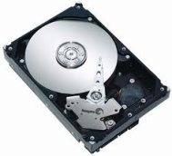
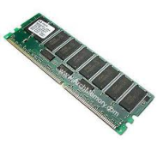
Motivation
Acquisition is the most important step in a typical computer forensics scenario. Missing evidence leads to an incomplete or wrong investigation result.
Static Acquisition
Live Acquisition
 | Static Acquisition | Live Acquisition
In-Disk Evidence
In-Memory Evidence
24/7 Availability Servers
Notes:
A typical computer forensics scenario has three steps: Acquisition, analyzing and reporting. Focusing on the stages of acquisition and analyzing, computer forensics proposes 2 key challenges:
1) How to obtain the complete system state 2) How to analyze the retrieved image effectively.
In the past days… → Static acquisition
Static Acquisition 定义：Static Acquisition tools concentrate on the data in file systems. It tries to get files on disks accurately and hence it always shuts down the target computer first.
Static Acquisition 缺点：However, Static acquisition is insufficient Nowadays!
1)Evidence in memory → It has been reported that some trojan servers existing in memory only.
2)Enterprise servers require 24/7 availability → In this situation, applying static acquisition in these servers would cause financial losses.
Live Acquisition 定义：Live Acquisition tools focus on obtaining the evidence in memory while keeping the target system running.

Slide 3
Problem - Live Acquisition
In-OS Introspection
Live Acquisition
Target System requiring in VM Already
Late
Virtualization
Virtualization Introspection
Low Result Accuracy
Virtual
Snapshot
Vis provides accurate retrieving of native system physical memory while preserving the execution of target.
Notes:
Virtualization Introspection assumes the target system is running in a VM. Thus the acquisition tool only needs to run outside and suspending the target VM when obtaining the memory contents
1) (Advantage) No modification to the target system’s running env.
2) (Weak point) Previous virtualization methods need to start the hypervisor first. It is inapplicable for native systems.
2) (Weak Point) Because the target system is not static, some of the prior virtualization approaches do not provide accurate acquisition result.
In-OS Introspection tools run applications or load kernel modules in the target OS to get the memory content.
1)(Advantage) Incurs a little impact to the target system
2)(Disadvantage) it also produces inaccurate result unless using additional hardware to suspend the machine.
Thus we say …

Slide 4
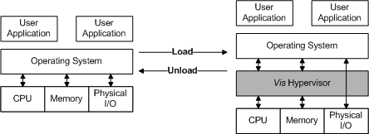
Late Virtualization
Insert a Drop-in Hypervisor after the target OS is started up.
1) Save the host state 2)Fill the host state in
the virtual machine
Notes:
Late Virtualization tries to insert a hypervisor after the OS is started up.
Insert a Drop-in Hypervisor after the target OS is started up. Key steps:1) Save the host state 2)Fill the host state in the virtual machine

Slide 5
Late Virtualization
Virtual Machine
User App
User App
OS Kernel
Vis Driver
Event
Event
Vis Hypervisor
Event Handler
Hardware
Notes:
First, Vis Driver is loaded in the kernel of target OS.
(Click) Then, Vis Driver stores the host state and bootstraps the underlying hypervisor. At the same time, it creates the virtual machine and fills the stored host state in the VM.
(Click) Wrapping the target system into the VM, Vis hypervisor can intercept VM events. Events from the OS kernel can be intercepted and handled by Vis hypervisor
(Click) Certain event from application can also be intercepted by Vis hypervisor.

Slide 6
Virtual Snapshot
Acquisition Duration (>10 Seconds)
Time
Dump!
Finish!
Guest
Virtual Pages
Guest
Physical Pages
Legend
Unmodified
Machine
Physical Pages
Modified
Identical Mapping on Nested Page Table
Modified Pages ← Copy-on-Write mechanism on nested page table
Unmodified Pages ← Dump remaining pages when handling frequent event
Amortized ← Dump multiple pages per trap
Notes:
Virtual snapshot technology needs to point out which page is modifying and what is the original content. These problem are solved by implementing CoW mechanism on nested page table.
Vis implement the identical mapping of GPA and MPA on the nested page table in order to monitor page writing independently.

Slide 7
Virtual Snapshot
Acquisition Duration (>10 Seconds)
Time
Dump!
Finish!
Guest
Virtual Pages
Guest
Physical Pages
Legend
Unmodified
Machine
Physical Pages
Modified
Identical Mapping on Nested Page Table
Modified Pages ← Copy-on-Write mechanism on nested page table
Unmodified Pages ← Dump remaining pages when handling frequent event
Amortized ← Dump multiple pages per trap
Notes:
For the modified pages, These contents are dumped by implementing CoW mechanism on nested page table. Write Permission bit in Nested Page Table Entry controls interaction between Guest VM and memory pages. By setting Write Permission bit, Vis can intercept the writing page and get its original content. After that, the Write Permission bit for the corresponding page is cleared.
According to our observation, some of the pages are remained unmodified after tens of seconds. Thus, in order to obtain their contents, we need to dump these pages when handling frequent event.

Slide 8
Virtual Snapshot
Acquisition Duration (>10 Seconds)
Time
Dump!
Finish!
Guest
Virtual Pages
Guest
Physical Pages
Legend
Unmodified
Machine
Physical Pages
Modified
Dumping
Identical Mapping on Nested Page Table
Modified Pages ← Copy-on-Write mechanism on nested page table
Unmodified Pages ← Dump remaining pages when handling frequent event
Amortized ← Dump multiple pages per trap
Notes:
Besides, in order to keep the target running, Vis dumps these pages in an amortized manner. It dumps multiple pages per trap and avoids hypervisor from a high CPU usage or even suspending the machine. As a balance, it lengthens the total acquisition duration.

Slide 9
Implementation
Based on Techniques:
Intel® VT-x
EPT for Nested Paging
Vis Prototype
Support Windows 7 i386 (Uniprocessor)
Tailored from NewBluePill (Hypervisor based virus)

Slide 10
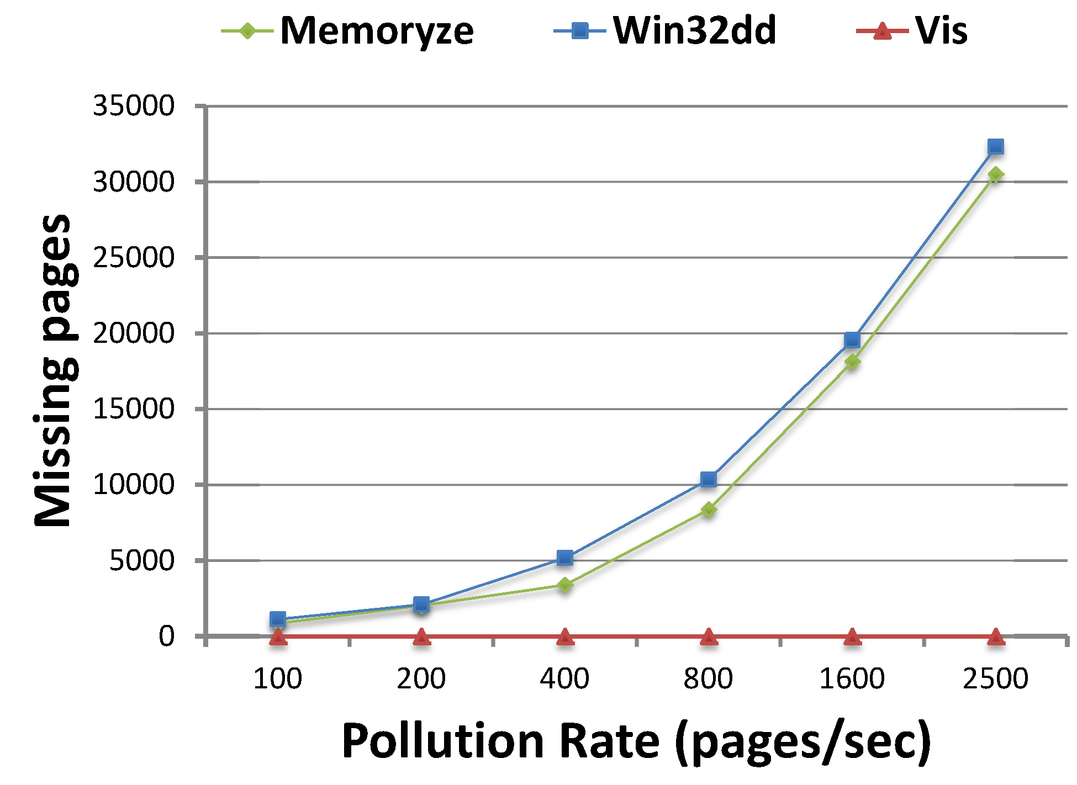
Effectiveness Evaluation
Win32dd and Memoryze recorded >50% polluted content in the result file
Vis recorded no polluted content.
Notes:
In order to prove Vis can accurately obtain the memory content, we use a pollution process to challenge the accuracy of acquisition result. The pollution process allocates and fills memory with unique pattern of content. Thus, an ideal live acquisition tool should dump none of the polluted content.
We load the acquisition process first, and then manually start pollution process immediately after beginning acquisition. Once acquisition finished, the in-file search reveals the amount of polluted content dumped.
We compare the result with Memoryze and Win32dd, another 2 real world In-OS live forensic tools. The result shows that…

Slide 11
Performance Evaluation
Normalized
Performance
Benchmarks
Virtualizing CPU and memory only, Vis incurs no I/O performance overhead.
High performance degradation on certain memory-intensive benchmark is imputed to EPT overhead.
Notes:
The major overhead is from CPU and memory virtualization. Vis incurs no I/O performance overhead because no I/O virtualization is introduced in.
The netperf performance result is under investigation.

Slide 12
Performance Evaluation
Normalized
Performance
Virtualizing CPU and memory only, Vis incurs no I/O performance overhead.
High performance degradation on certain memory-intensive benchmark is imputed to EPT overhead.
Notes:
From a detailed SPECint result, we can see that (mcf has the highest performance impact). Our investigation shows that (the total EPT traverse penalty mainly contributes to this overhead. )
(On the one hand, a high EPT Translation Look-aside Buffer (TLB) miss rate is incurred.) A poor space locality is observed in one for-loop. This hotspot causes higher probability in occupying EPT TLB due to the fact that TLB is shared by both nested paging and traditional paging in current implementation of hardware virtualization
(On the other hand, every EPT TLB Miss costs the guest machine a maximum 14 times of memory access overhead to complete the nested address translation on x86 platform)

Slide 13
Discussions
Trustworthy hypervisor
Hypervisor code can be attested before being loaded via Trusted Platform Module (TPM) (Martignoni et al, RAID’10)
No nested virtualization
The Turtles Project (Muli et al, OSDI’10)
For future work
A little invasion is acceptable
Locard’s exchange principle (Chisum, Journal of Behavioral Profiling, January 2000)
Notes:
1)Currently we assume
2) Besides, we don’t consider the .. Situation
No nested virtualization - Limited by current commercial virtualization solution
3) At last ..it has been claimed that
In-OS acquisition tools are considered to be necessary evil.

Slide 14
Summary
Vis achieved:
Virtualization for native system
Accurate acquisition
Virtualization for Native System
Late
Virtualization
Vis
Accurate Acquisition
Virtual
Snapshot
Notes:
Vis provides accurate retrieving of native system physical memory while preserving the execution of target.
.. technology to achieve ..

Slide 15
Vis Virtualization Enhanced Live Acquisition for Native System
Miao Yu, Qian Lin, Bingyu Li,
Zhengwei Qi, Haibing Guan
Shanghai Jiao Tong University

Slide 16
Backup

