Slide 1
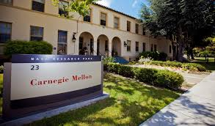
Library Resources
For the Silicon Valley Campus
Notes:
Hello, I’m Matt Marsteller, a Senior Librarian, Engineering and Science with the Carnegie Mellon University Libraries. I’m the liaison librarian for Carnegie Mellon Silicon Valley Campus. I want you to feel welcome to contact me regarding any aspect of library services. My contact information will be given on the closing slide.

Slide 2
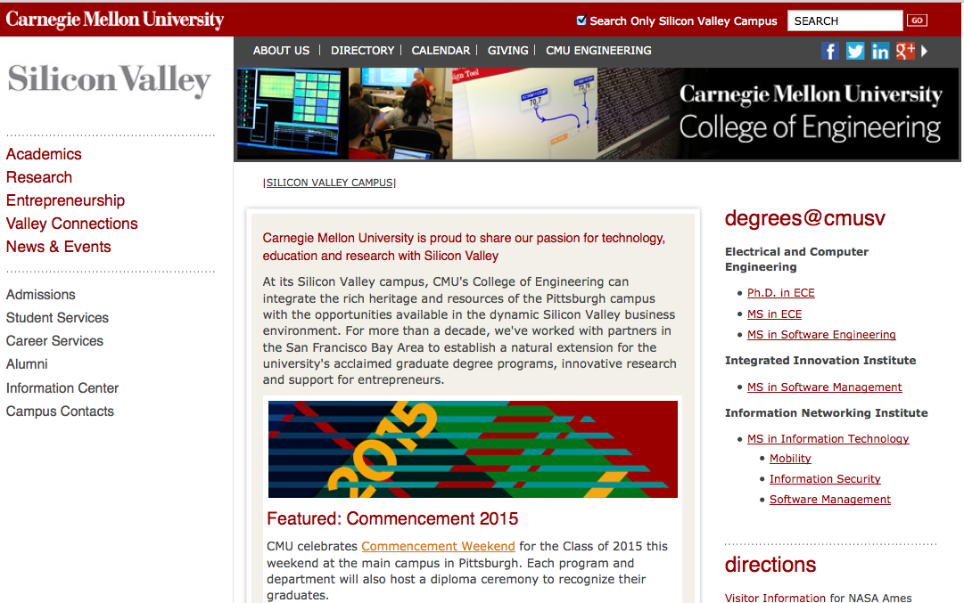
Notes:
By now you’ve likely seen the web page for CMU Silicon Valley. There is a link to Academics toward the upper left corner of the page. Select that link.

Slide 3
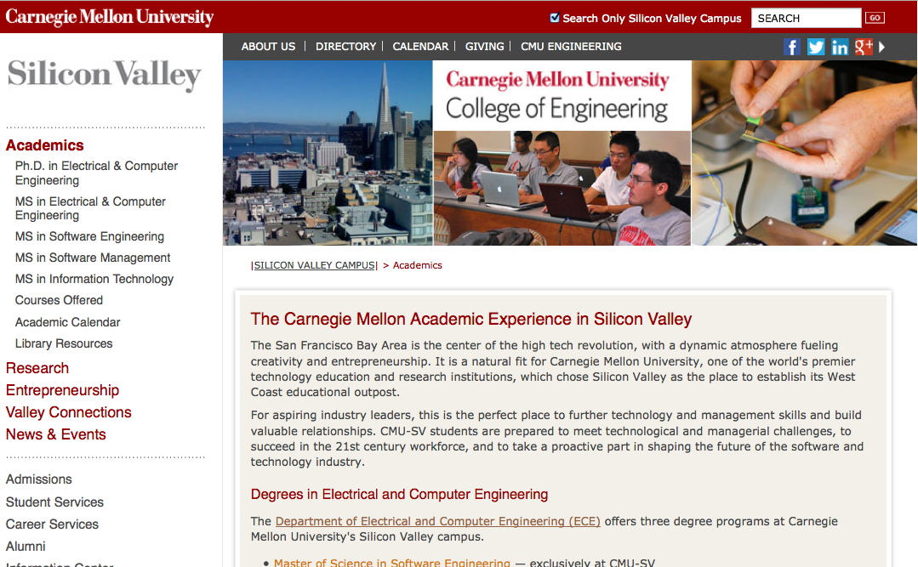
Notes:
On the Academics page you’ll see a link for Library Resources on the left side of your screen. Select this link.

Slide 4
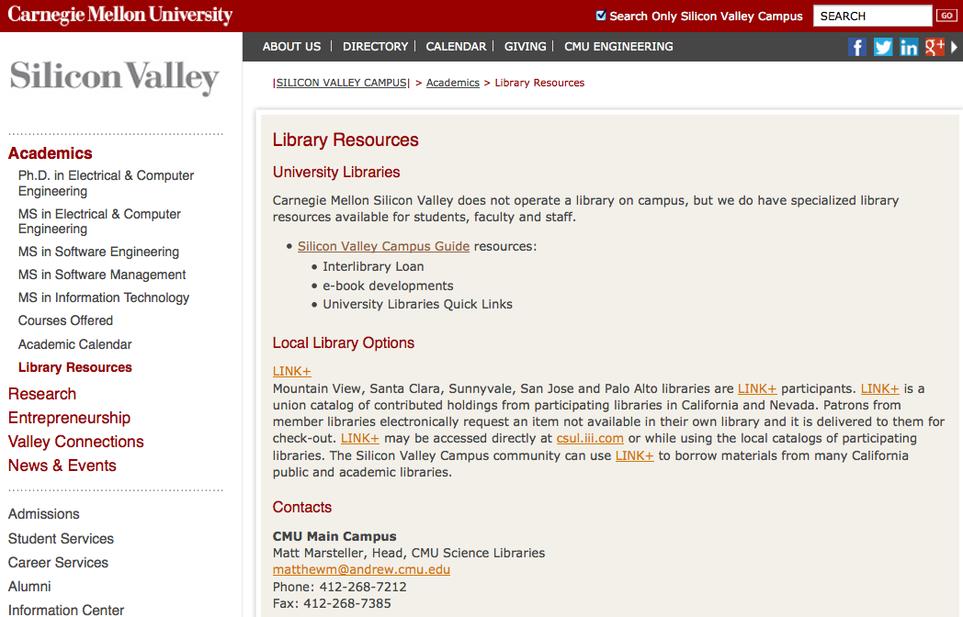
Notes:
On this page, you’ll find a link to a “Silicon Valley Campus Guide” that I’ve put together. I hope that you’ll find it to be helpful, but if you wish to suggest additional information or improvements to the presentation of the information, please don’t hesitate to contact me. My phone and E-mail address is given under Contacts. Please note the special Local Library Options section that refers to a service known as “LINK+.” You only need to use LINK+ to locate printed books that you can’t find in Carnegie Mellon’s vast collection of e-books or the print collections in our Pittsburgh Campus libraries.

Slide 5
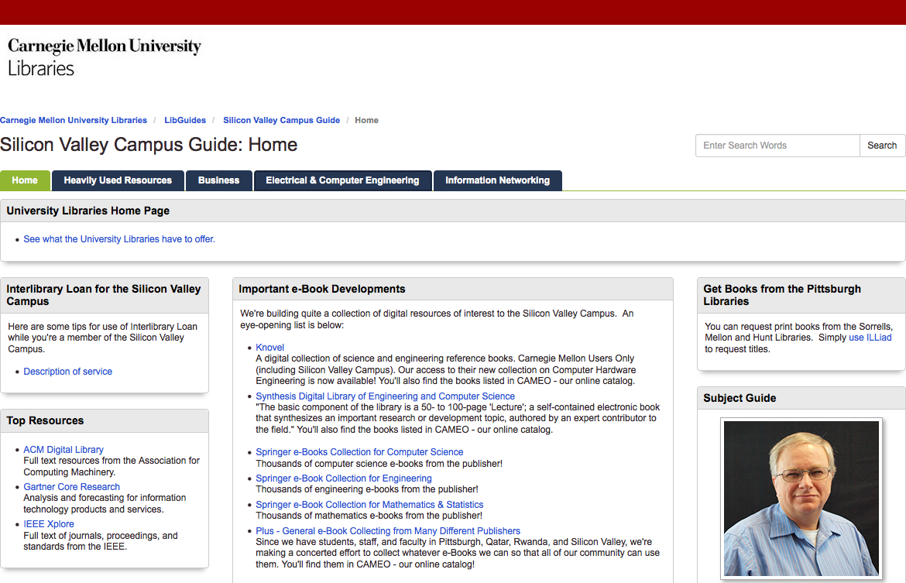
Notes:
This is a brief introduction to the Silicon Valley Campus Guide. Toward the top of the home page you’ll see a convenient link to the University Libraries. One thing that I need to add (and will do so very soon) would be a statement of purpose for the guide. What I’m trying to do is introduce you to the most useful information for your work at Carnegie Mellon. You’ll find a convenient link on the left to a description of Interlibrary Loan Services that is specific to people studying at our Silicon Valley Campus. On the right is a reminder that YES, you can get printed books from Carnegie Mellon’s Pittsburgh Libraries. You can borrow up to 100 items. The checkout period is 90 days with one online renewal. Need an item longer than that? Take it to Sari Smith in room #1060 of Building 19 so that we know you can still locate it and Sari will let the circulation staff in Pittsburgh know that it’s okay to renew it yet again. The unfortunate exception will be that sometimes another Carnegie Mellon user will want the same book that you just checked out – after you’ve had any particular book for 7 days, it is subject to a recall for another reader. So, early use of the book is strongly advised. If you suspect a book is experiencing heavy use, feel free to contact me and I’ll explore options such as a digital copy or a second print copy. Note that you can place a hold on a book that is checked out and the person that has it is subject to the same 7 day use rule that you are. In the center you’ll find a steadily growing list of e-book collections that I think you’ll find helpful. I also have a list of top full text databases that I think you’ll use a lot. There is also a more extensive list of “Heavily Used Resources on a tab toward the top of the page. Beside this tab are tabs that navigate to the Business, Electrical & Computer Engineering and Information Networking research guides.

Slide 6
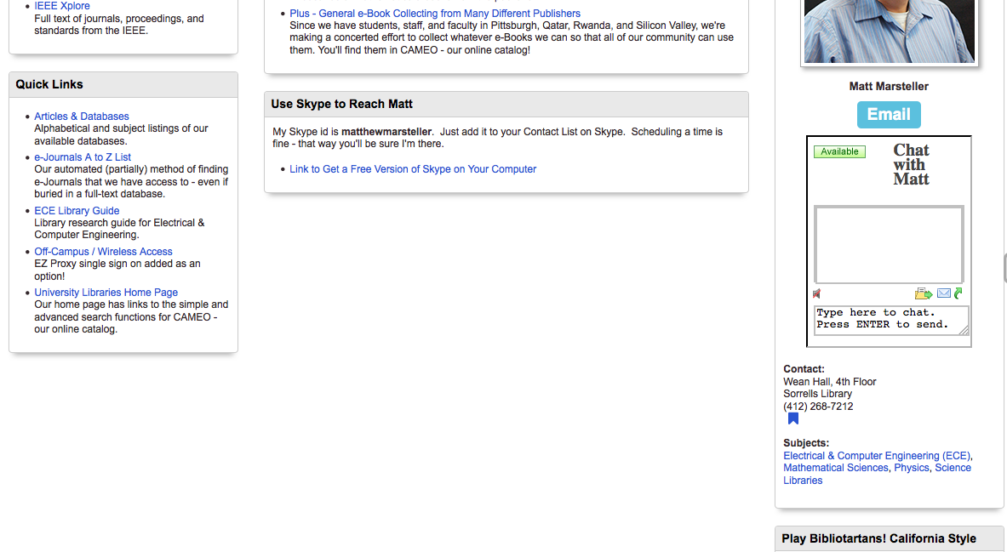
Notes:
Scrolling down on the guide, you’ll find Quick Links that I hope you would find helpful. In the center you’ll find some information if you would like to arrange a discussion via Skype. On the right you’ll find contact information including a photo that might be handy if you wish to scare small children and a chat box that you’ll likely find Available during your morning hours in California. Use the chat box if you wish to chat with me directly, but in a follow-up video I’ll show you the link to chat with any Carnegie Mellon Librarian that happens to be available (again … usually in your morning hours).

Slide 7
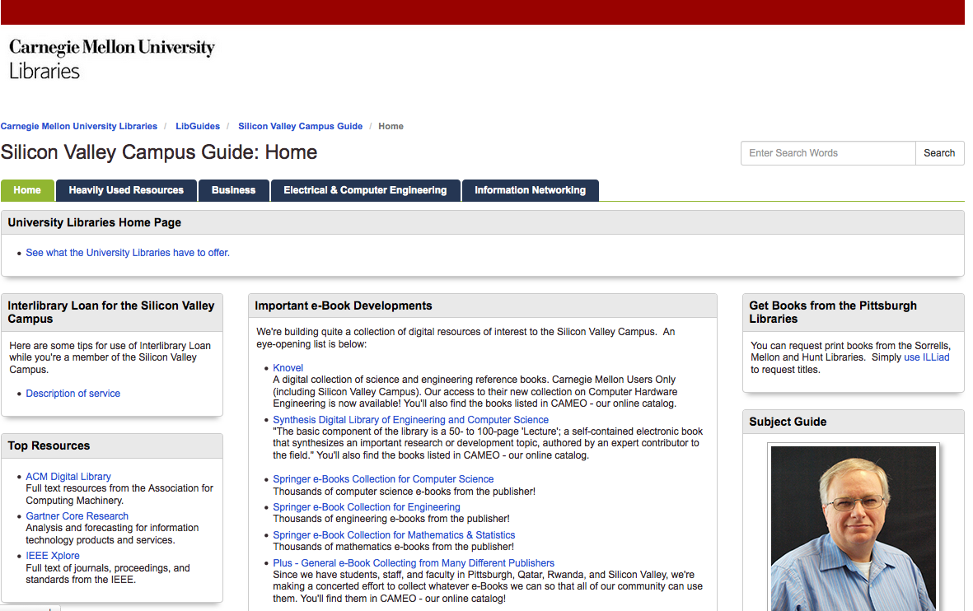
Notes:
In this segment, we’ll start from the Silicon Valley Campus Guide and use it to go to the main library page for Carnegie Mellon. I’ve conveniently put that link at the top of the page (after trying to explain the page to Sari Smith and Cindy Arnett and realizing I’d buried link way at the bottom of the page). So, select that link!

Slide 8
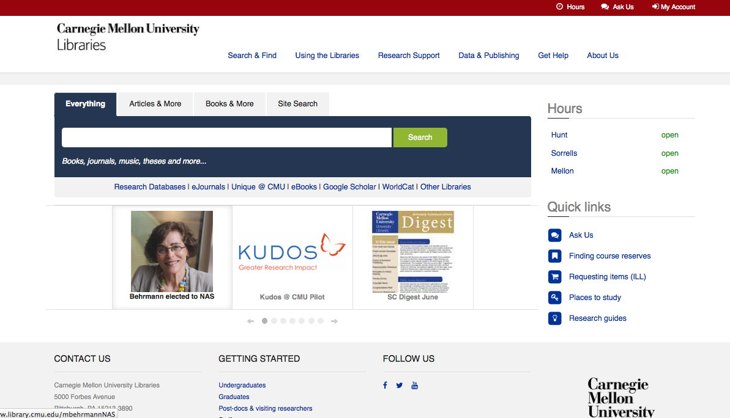
Notes:
So, here’s the home page for Carnegie Mellon University Libraries. There is a ton of information linked off of this page and I would like to encourage you to explore what is there. Let’s start with the area that I’ve marked and zoom in …

Slide 9
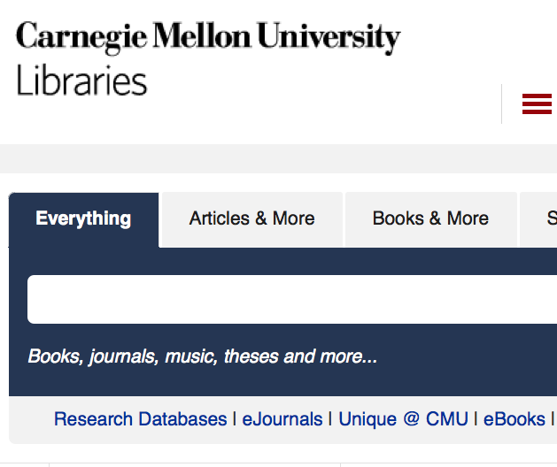
Notes:
Note that we’re set up to search “Everything.” What that basically means is that you’ll be trying to search for journal or magazine articles or chapters from e-books along with a search of books from our catalog. I’ll show you some examples in another segment “Everything Search Example.” For now, look just below the blue search box and locate the “Research Databases” link that I’ve circled.

Slide 10
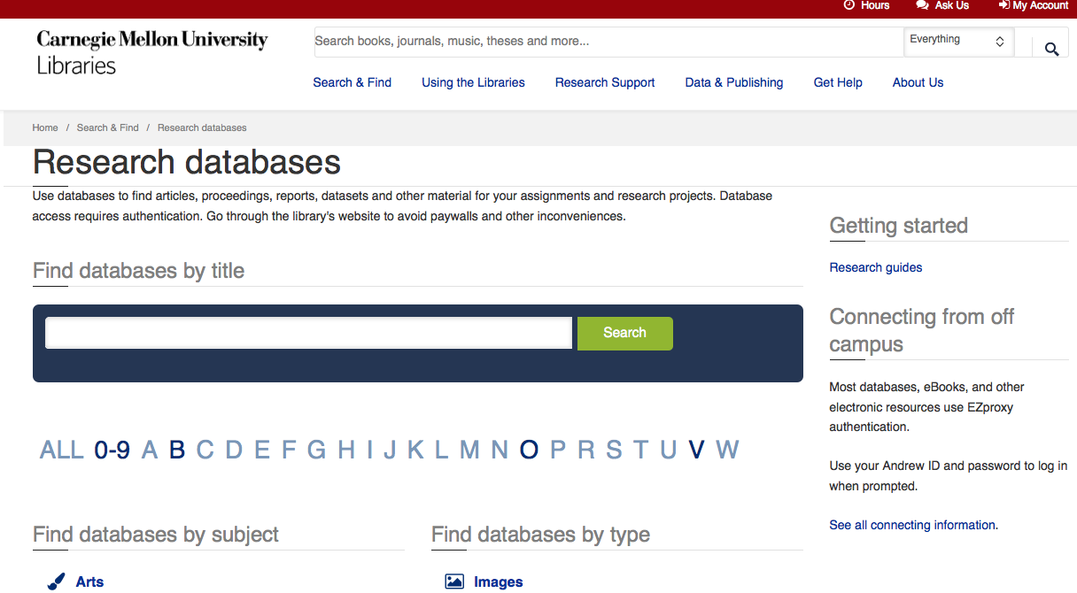
Notes:
The link leads us to this alphabetical list of databases – it’s a long list, but if you know the exact database of interest, navigation is easy. An alternative approach is to use the broad subject categories below. Suppose you needed to look at an IEEE standard … you can find those in the IEEE Xplore database. Simply choose the letter “I.”

Slide 11
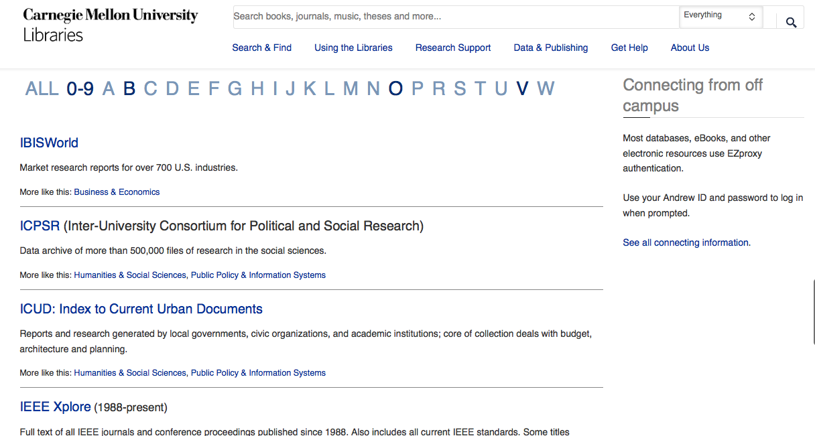
Notes:
There is your link to the database! Note that if you’re off campus you will be prompted for your Andrew id and password before gaining access (if this is your first database selection of your browser session).

Slide 12
Notes:
Another important link leads to our list of eJournals. Note that this includes magazines and trade journals in addition to scholarly journals.

Slide 13
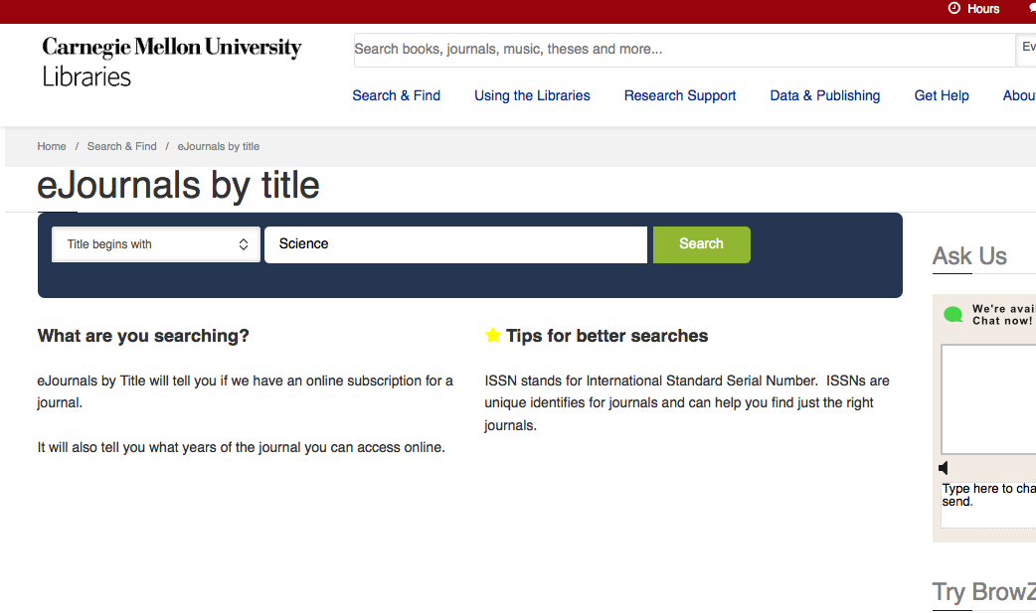
Notes:
Let’s try looking for the well known journal Science (sometimes referred to as Science Magazine) from the American Association for the Advancement of Science in New York.

Slide 14
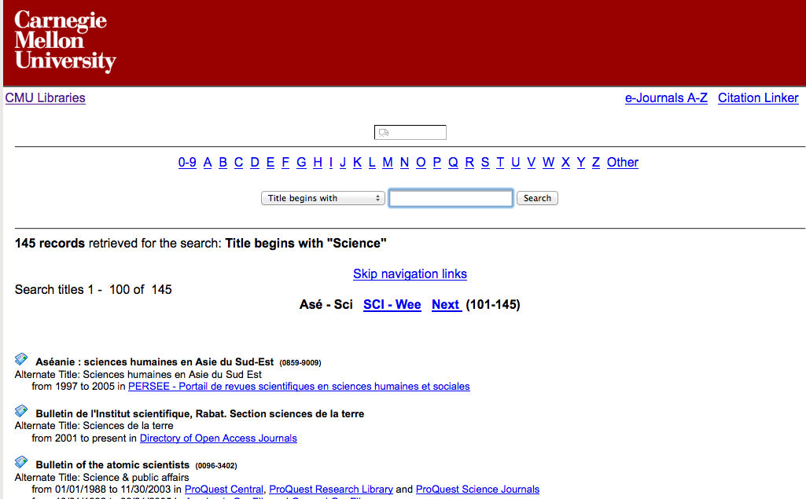
Notes:
Ugh! That’s a lot of records retrieved owing to that common word “science.” Just scroll down though and you’ll quickly come to …

Slide 15
Notes:
The entry that we want is “Science (New York, N.Y.) (0036-8075).” I know … that’s not a readily apparent listing. Our 360 Link product from Serials Solutions could use some enhancements. The most helpful links are the “JSTOR” link for the older issues of Science and the “from 01/01/1997 to the present in Science Magazine.” Don’t worry other titles are more understandable. The Serials Solution software is trying to surface where the titles are located in our vast eJournals collection.

Slide 16
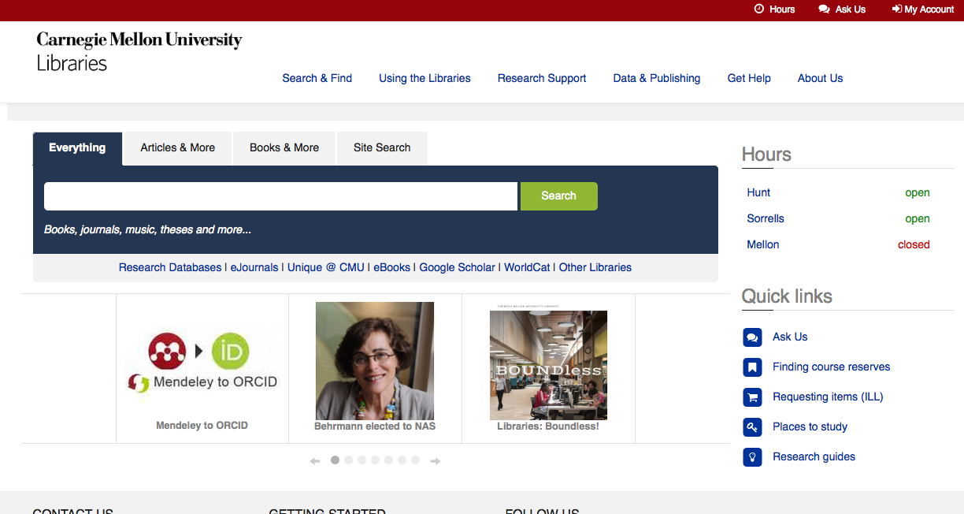
Notes:
There are other features on the University Libraries web site that you should be aware of.

Slide 17
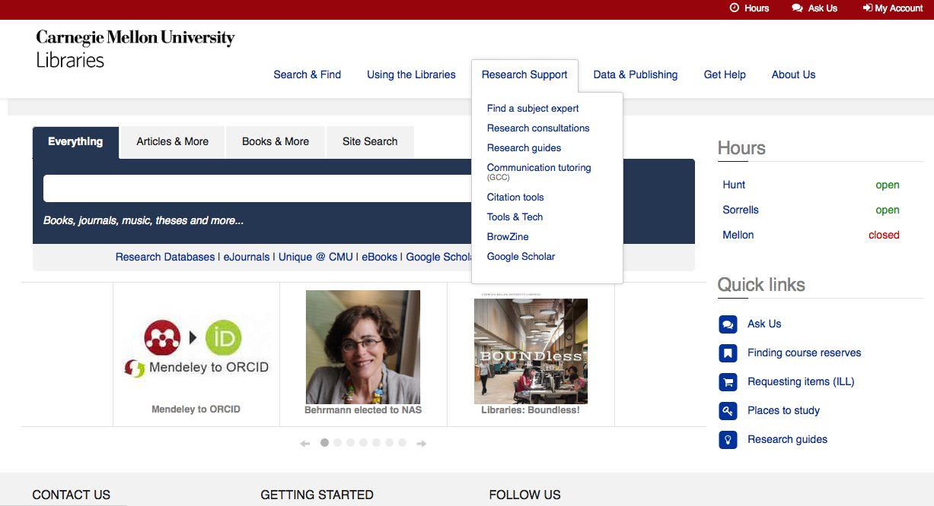
Notes:
The blue links near the top of the page will pull down menus if you hover over the link. This feature will help you to explore the available content that the University Libraries has put together for you. If it’s just too much information to sift through … always remember that I’m easy to contact. Drop me a line or give me a call.

Slide 18
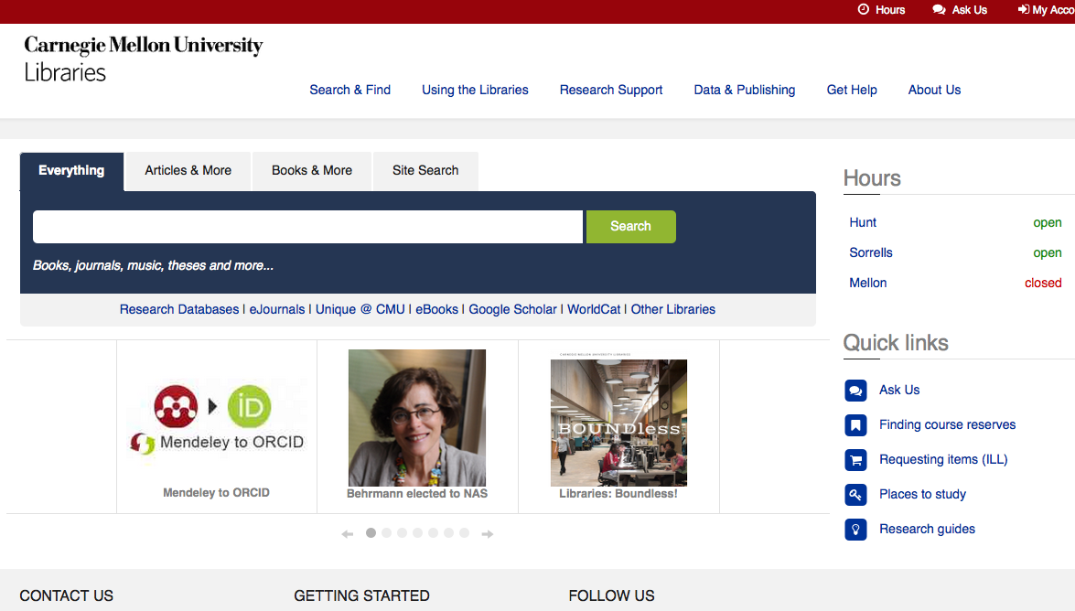
Notes:
There are “Quick links” on the right that you should find helpful. The Research guides link will take you to all of the guides that have been prepared by University Libraries (similar to our Silicon Valley Campus Guide in functionality).

Slide 19
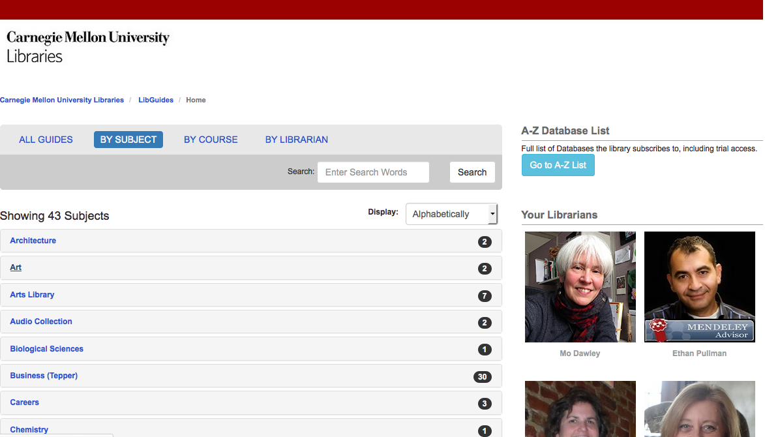
Notes:
The link will take you to this page – a subject listing that is alphabetically arranged. You might find this helpful if your work finds you exploring topics outside of computer engineering, network engineering or software management.

Slide 20
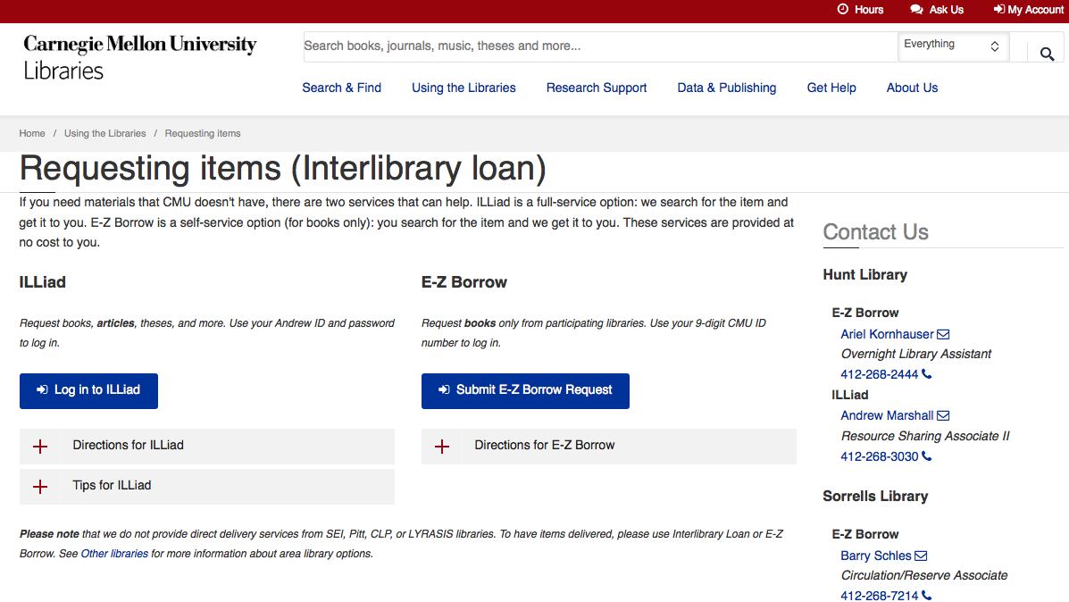
Link+
Journal articles
Conference papers
Anything digital in form
Books from the Carnegie Mellon Pittsburgh libraries
Notes:
The Requesting Items link will bring you here. Note that for books, you’ll only use ILLiad to request items from the Pittsburgh Carnegie Mellon libraries (plus anything digital). If you want a book that we don’t have, there is a service similar to the E-Z Borrow service that we have in Pennsylvania called Link+. Link+ can be accessed via whatever local public library is convenient to you in the Mountain View area. Note that you can use Link+ from home or campus and then only travel to the library to pick up the items that you borrow. Please note: I welcome your suggestions for new or core e-books that we ought to have.

Slide 21
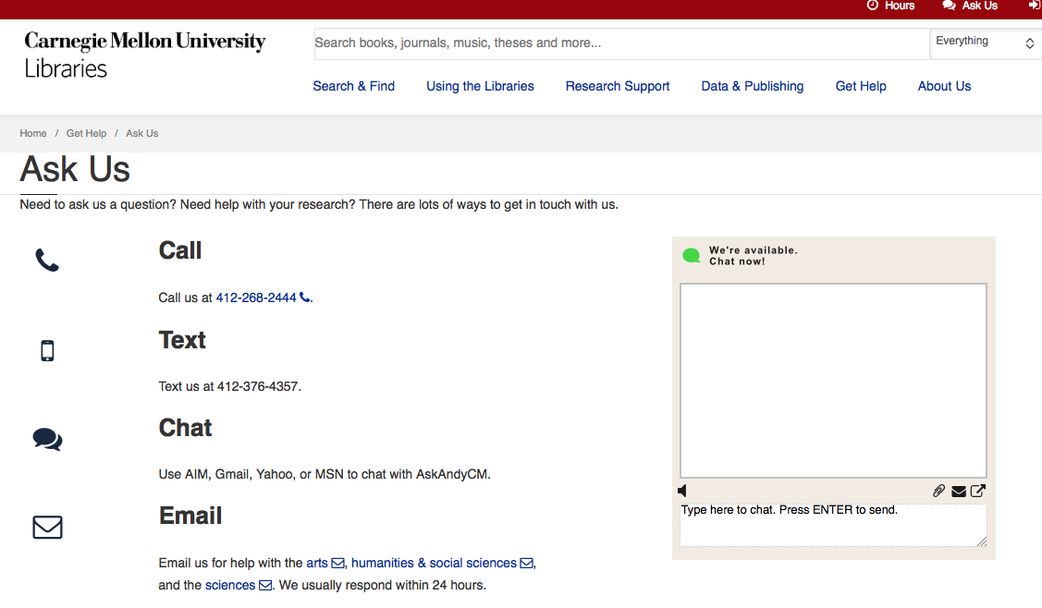
Notes:
The “Ask Us” link will provide you with a list of options for getting a hold of any public service librarian at Carnegie Mellon. Your phone call will be received at our Hunt Library in Pittsburgh … they may refer you to the Sorrells Library for help with engineering or science topics, but they will likely be of great help with business questions. Our text option actually work through our chat software, so use whichever is more convenient. Please note that the chat box to the right is the easiest way to chat with us – no old chat software download is required. Email is a convenient way to contact the libraries. You can always use the sciences email contact and the “humanities & social sciences” email will be good for business questions. The other option would be a consultation where you’d make an appointment – I’m glad to arrange to communicate with you via any medium that we can both use … but my wife has banned me from Second Life until I get my First Life in order.

Slide 22
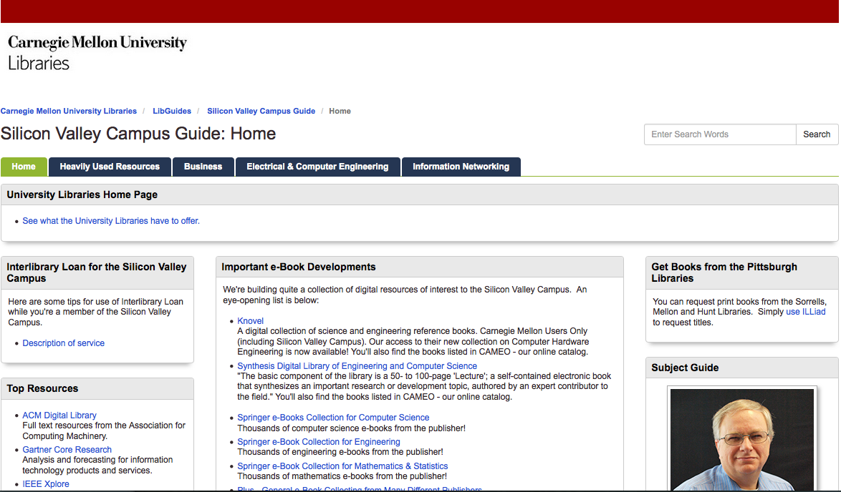
Notes:
In this segment, I’ll discuss the uniqueness of using Interlibrary Loan at the Silicon Valley Campus. Let me mention the reminder that the Silicon Valley Campus community can use our “ILLiad” interlibrary loan system to request printed books that are located in the Carnegie Mellon Pittsburgh Hunt, Mellon Institute and Sorrells Engineering & Science libraries. See the area on the right side of the screen. Items located in our offsite storage facility are available as well. Locations of these materials are given in the library catalog. On the left side of the screen you’ll see a link to a description of Interlibrary Loan service for the Silicon Valley Campus.

Slide 23
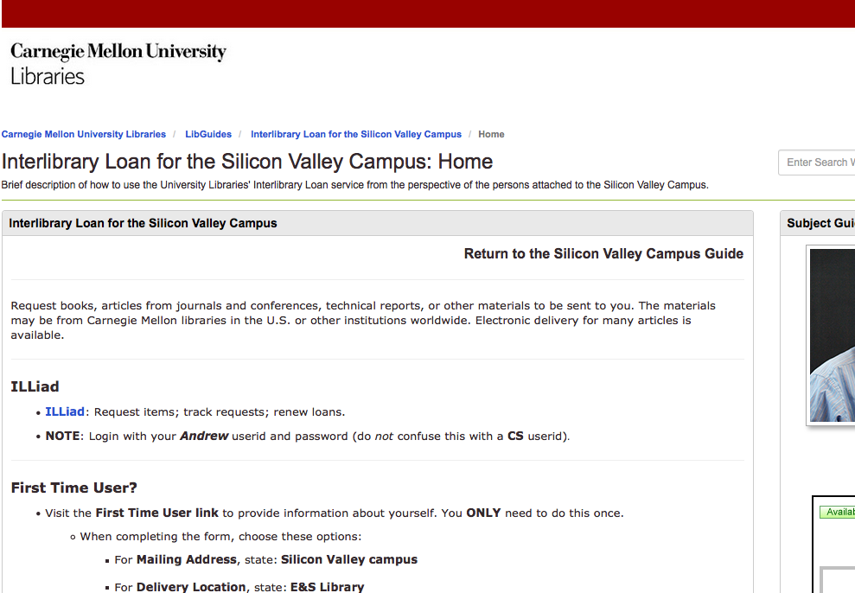
Notes:
In this slide, I’m showing the beginning of the description of service for Interlibrary Loan. Note the link for First Time Users. You will only need to follow this link once – it will set up preferences with how you wish to receive things. Usually most people will want an electronic copy of articles, papers, theses or whatever whenever it is available. Pay close attention to what you should enter for Mailing Address and Delivery Location.

Slide 24
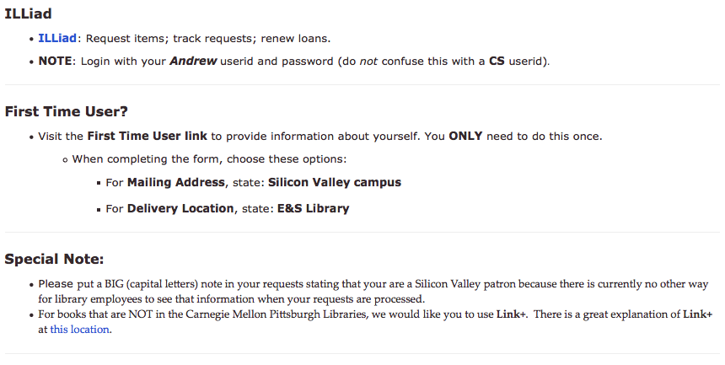
Notes:
If we scroll down a bit, you’ll see two Special Notes. The first is very important. We want you to add a note in all capital letters signaling that you are a Silicon Valley Campus Student or Employee. This is necessary because it’s the only way the system allows you to alert our Interlibrary Loan employees about your particular situation. The other special note is that you should not use ILLiad or our other system E-Z Borrow for requesting books that Carnegie Mellon doesn’t own. Link + is a system for a large number of academic and public libraries in California and the logistics should work out better for you to borrow the (hopefully small) number of printed books we don’t already have.

Slide 25
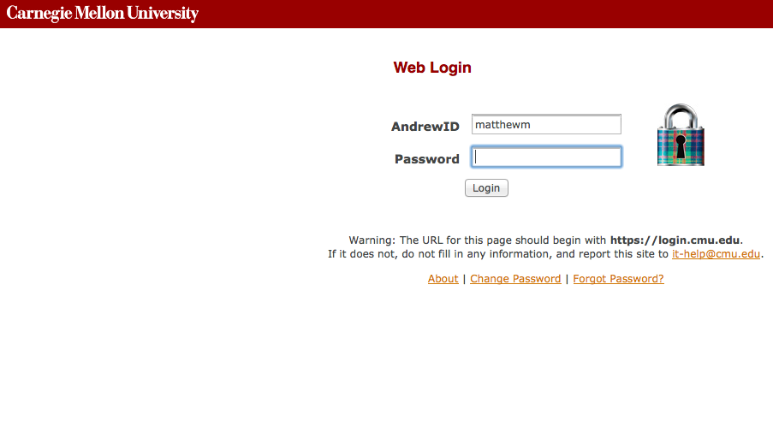
Notes:
When you login to ILLIad, you will find the familiar login screen that will prompt you for your AndrewID and Password.

Slide 26
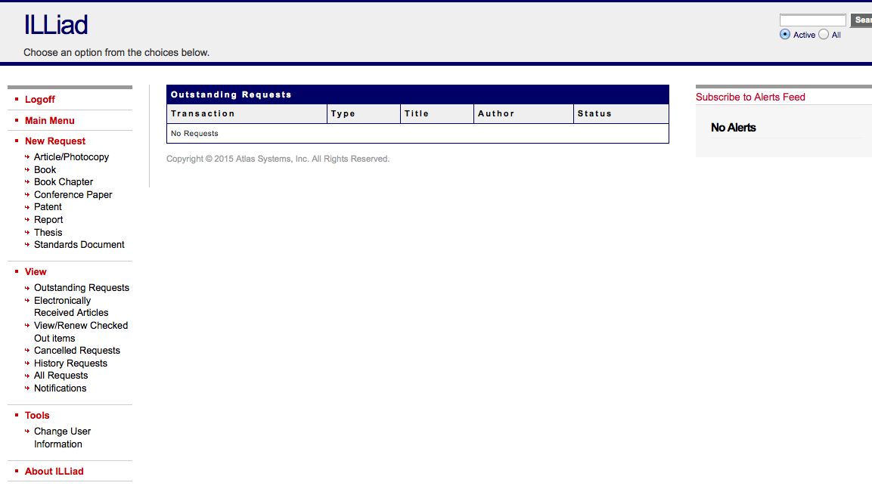
Notes:
This is what the entry view looks like in ILLiad. Suppose we choose to enter a new request for an “Article/Photocopy.” You can choose it on the left side of the screen.

Slide 27
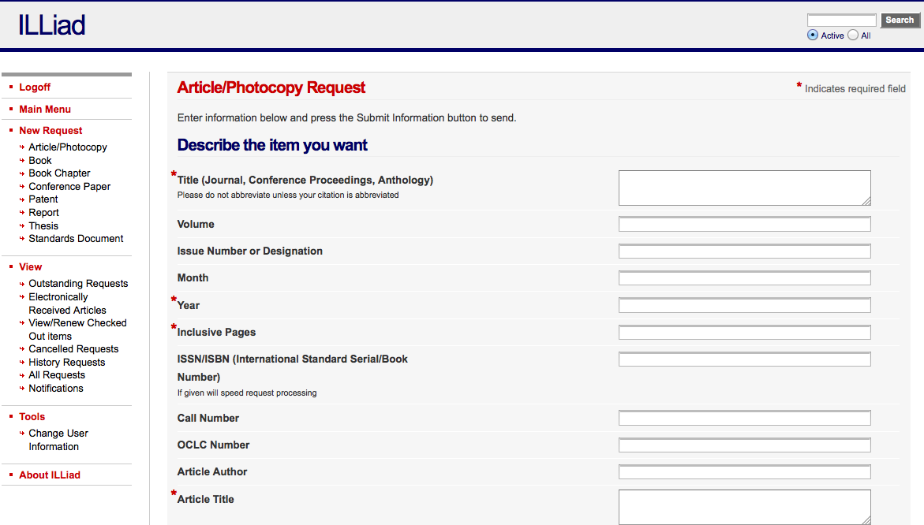
Notes:
This is what the Article/Photocopy Request looks like (note that this will typically arrive in a digital format). You can always just fill in a request form this way OR if you find something that we don’t own while using most of our research databases, you save yourself some data entry…

Slide 28
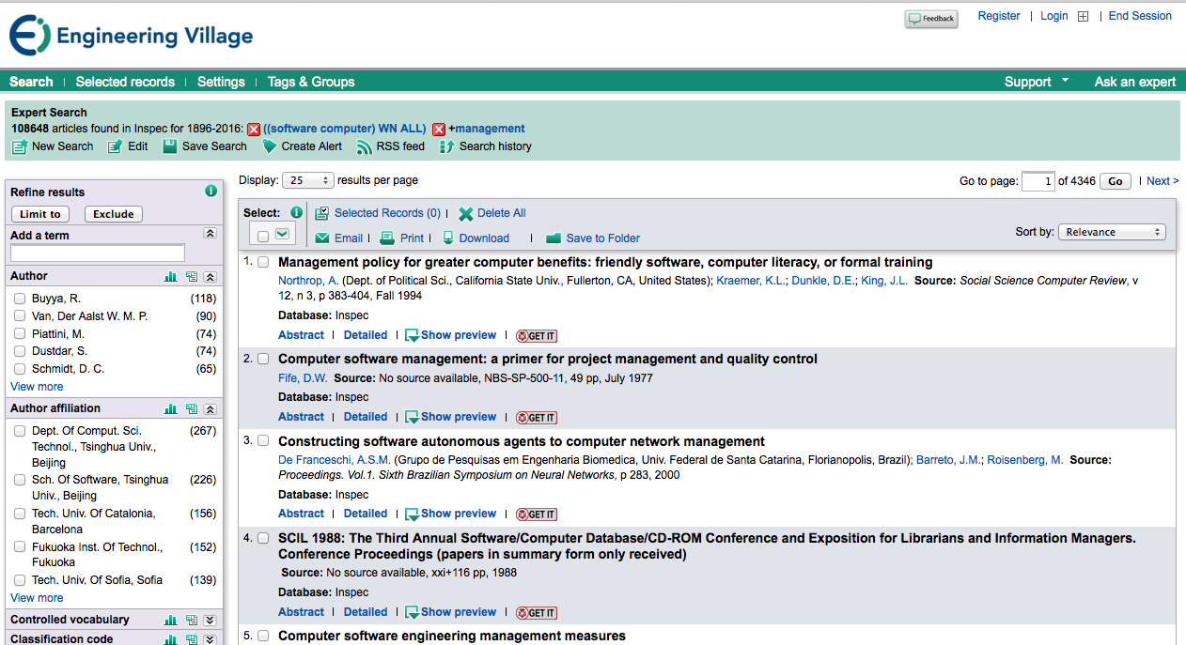
Notes:
Here’s an example of saving time by avoiding data entry. In this screen I’m searching the Inspec database (for computer & control engineering, electrical & electronics engineering, physics and a few other topics). Do you see the “GET IT” buttons to the right of each entry? When you click on it, our link resolving software tries to find the article in our digital collections. If it doesn’t find it, other options for obtaining will crop up.

Slide 29
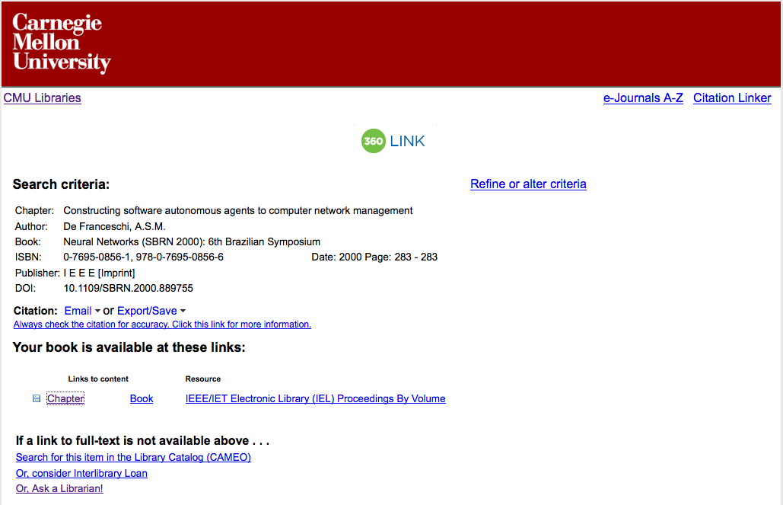
Notes:
I thought we would not have the first item that I chose, but it wound up being a book chapter that you can quickly obtain by clicking on the “Chapter” link – it will take you right into the IEEE Xplore library.

Slide 30
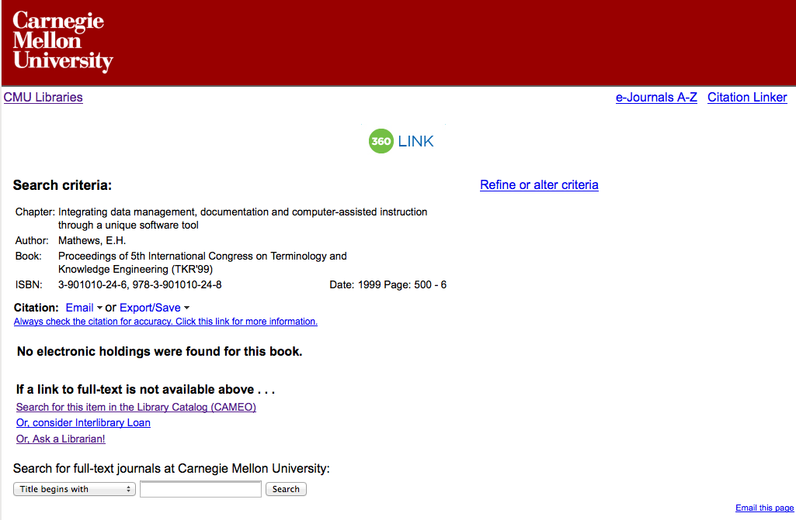
Notes:
I tried a different item (it seems to be getting harder to find items that we don’t already own or have access to). Note that we don’t appear to have any electronic holdings, I checked our catalog with that link and didn’t have any luck, so my last chance was Interlibrary Loan. When I choose “Or, consider Interlibrary Loan” …

Slide 31
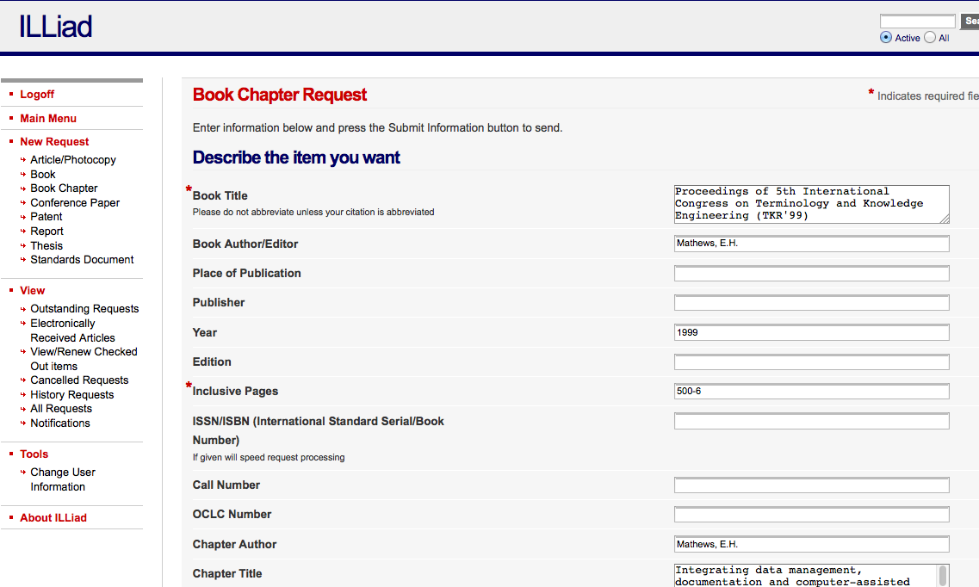
Notes:
Shazzam! ILLiad tries to populate the book chapter request for me. Book chapters can often be borrowed digitally. You should check the request to see if it filled in the required information for you. Let me scroll down …

Slide 32
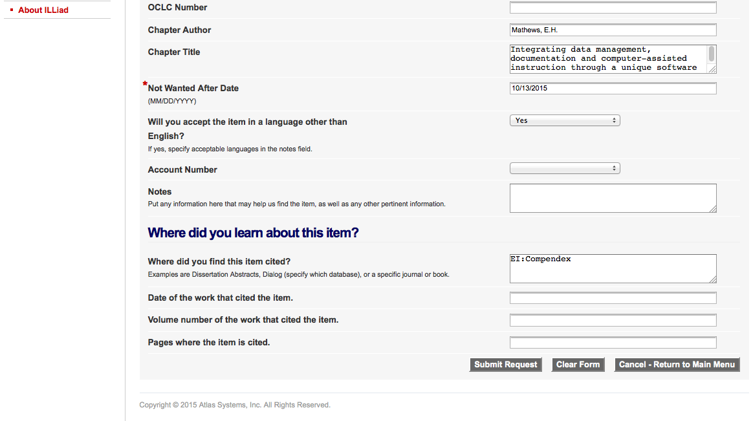
Notes:
I’ve circled the Notes field where we want you put the note indicating that you’re a Silicon Valley Campus patron. Note that I’d leave the Not Wanted After Date as is. The vast majority of requests are handled rather quickly. We should beat this date by a country mile!

Slide 33
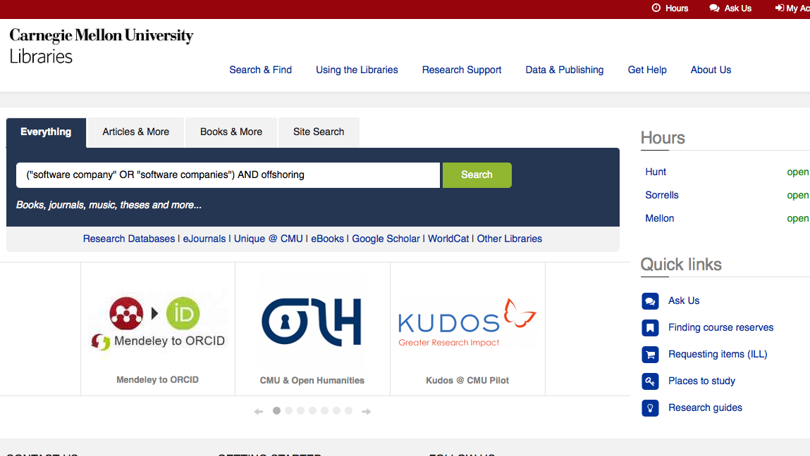
Notes:
Hello! In this segment we’ll be going through an example of an “Everything” search. In this case I’ve entered a bit of a compound query that searches for either the phrase software company or its plural, but only when the word offshoring also appears.

Slide 34
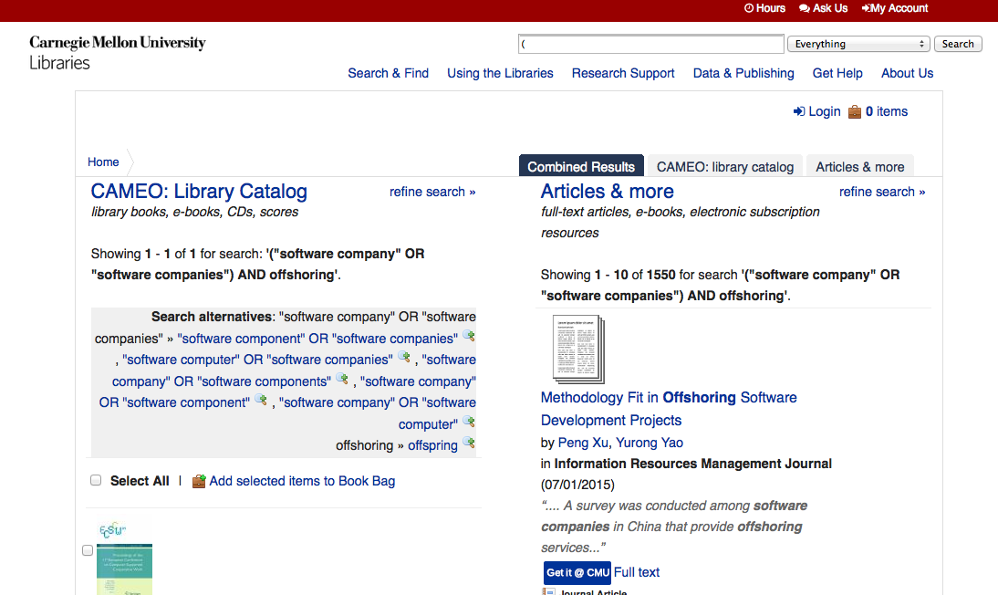
Notes:
The result of our query is a split screen of results. On the left you’ll find the results of a search of our online catalog. Since it’s primarily a book catalog and our query is a bit focused we’ve only found a single item. Since the record retrieved had a table of contents in it, the search actually found a book chapter that is on the topic. We’ll take a look in moment. On the right is the results of a search of many of the databases that are available via the University Libraries. A discovery tool like what we’ve dubbed “Articles & More” doesn’t search every database. For now we’ll click on “CAMEO: Library Catalog” and briefly look at our result.

Slide 35
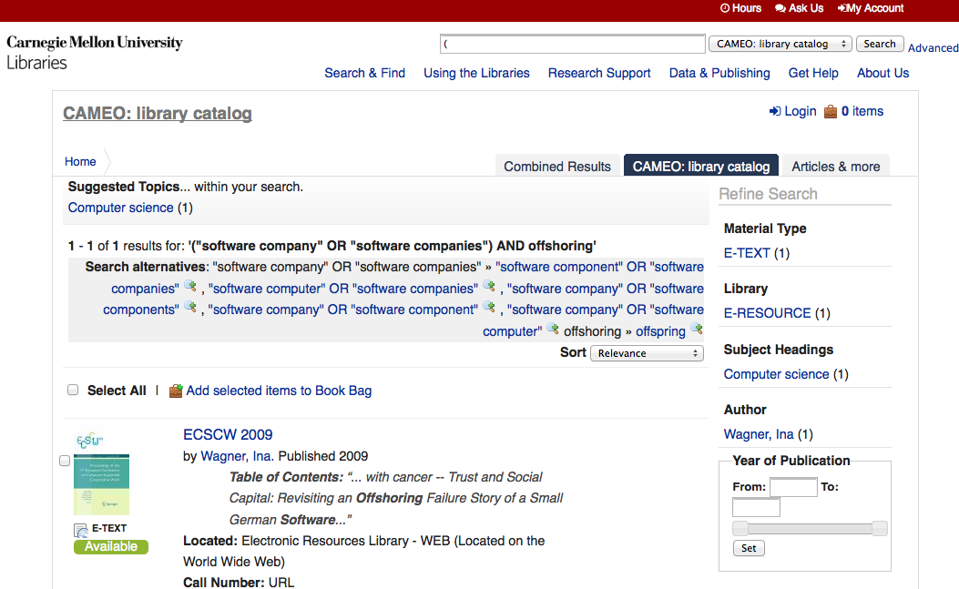
Notes:
It’s just one result, so it doesn’t make a great example for us. If we click on the title “ECSCW 2009,” we can view a more complete description.

Slide 36
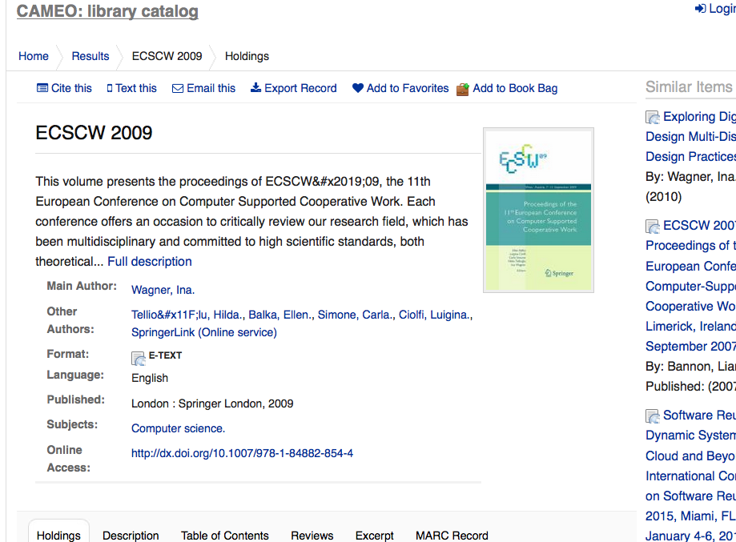
Notes:
Here is the more complete record. Note that you could get a full description if you like and “Online Access” indicates where to click to get to the full text of the Conference Proceedings. Also, unfortunately, note the totally unhelpful subject heading of “Computer science.” Many catalog records for engineering and science materials in libraries contain subject headings that were poorly chosen.

Slide 37
Notes:
Going back to our split screen, let’s take a look at “Articles & more.”

Slide 38
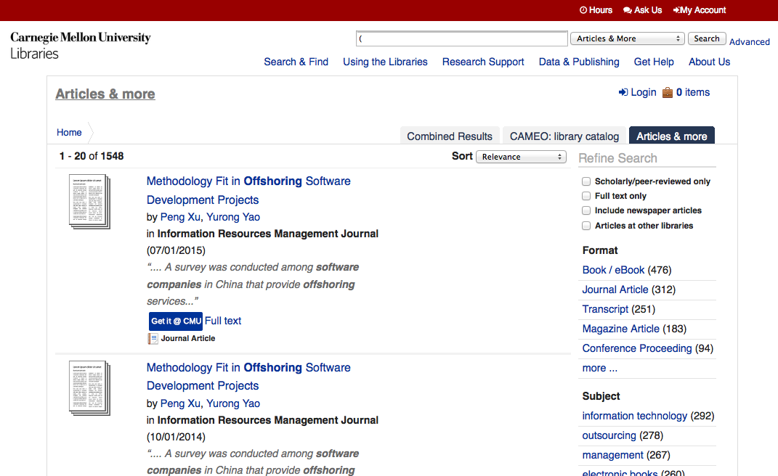
Notes:
In this case we’re searching more than just a description of a book. We’re searching entire articles, conference papers, book chapters and even entire books. We have a lot of literature to go through unless we were to change our strategy. Note that it’s sorted by relevance, so perhaps only the first few pages of results will make sense to look at. Let’s try retrieving the first article. To do that, I’m going to click on “Full text.”

Slide 39
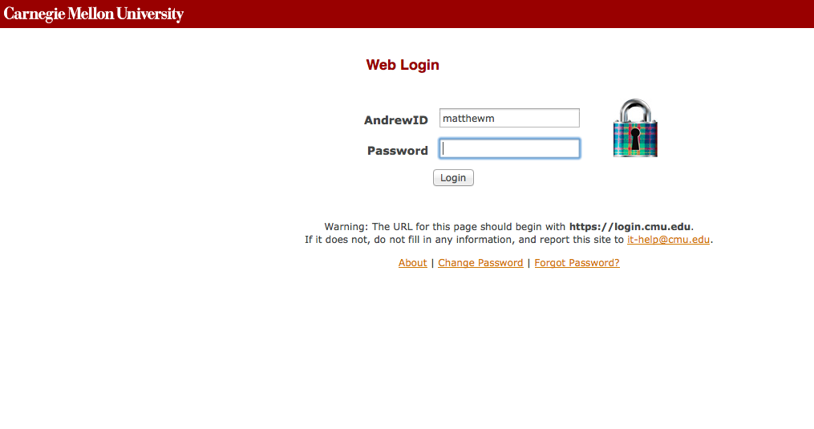
Notes:
At this point, I’m being prompted for my Andrew ID an password. So, I simply supply them.

Slide 40
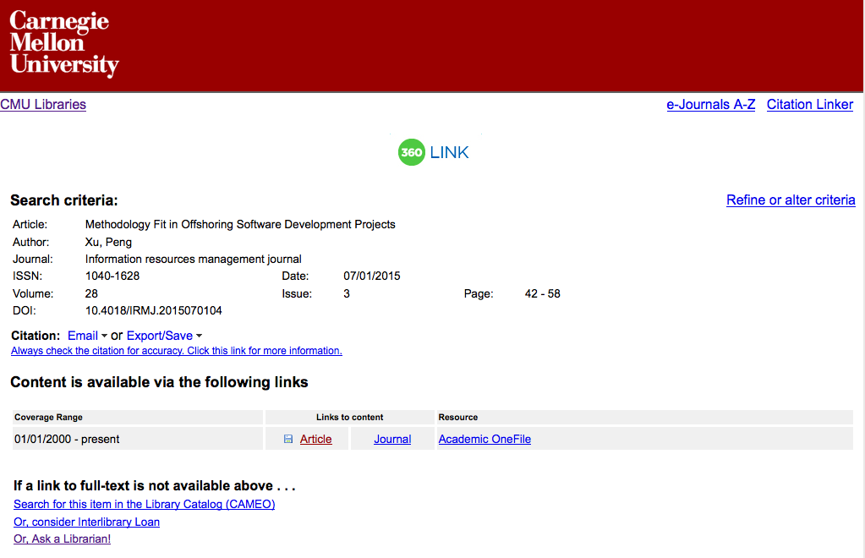
Notes:
That leads me to this summary of where “Articles & more” (our “discovery system”) found the full text of our article. Let’s try the “Article” link.

Slide 41
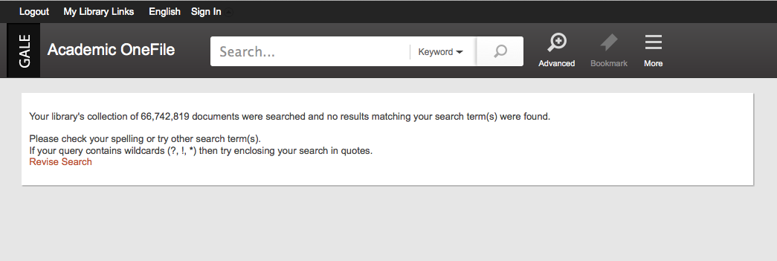
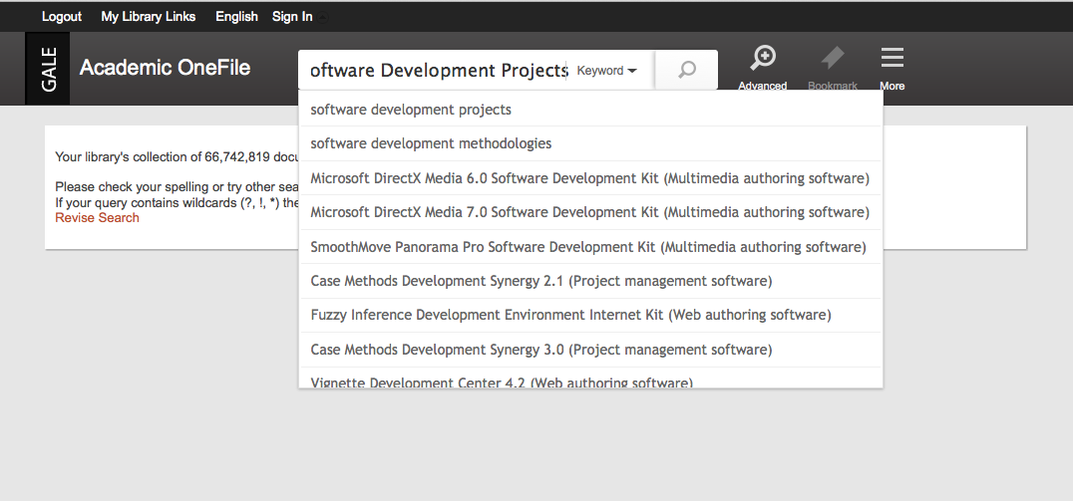
Notes:
Uh oh! The top part of the screen shows my initial results. Now the way this software works, it attempts to search the database with a certain field and for some databases it’s simply a poor choice that winds up with a null set for our results. When you run into this, I recommend not giving up. In the bottom part of the screen, I’ve pasted the title of the article that we want and proceed with the search.

Slide 42
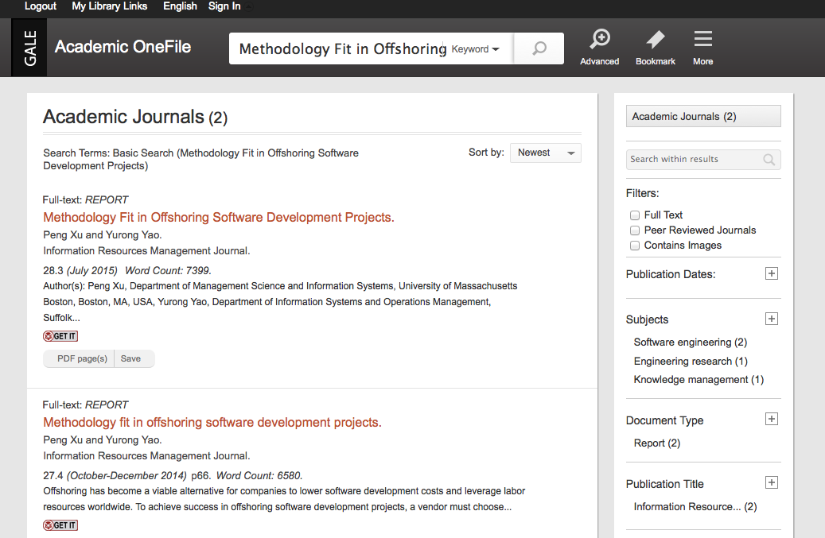
Notes:
It found our article, plus what appears to be an earlier article with great similarity. I guess we could only compare them to see what would be up, but for now I’ll just try the PDF link to the top article.

Slide 43
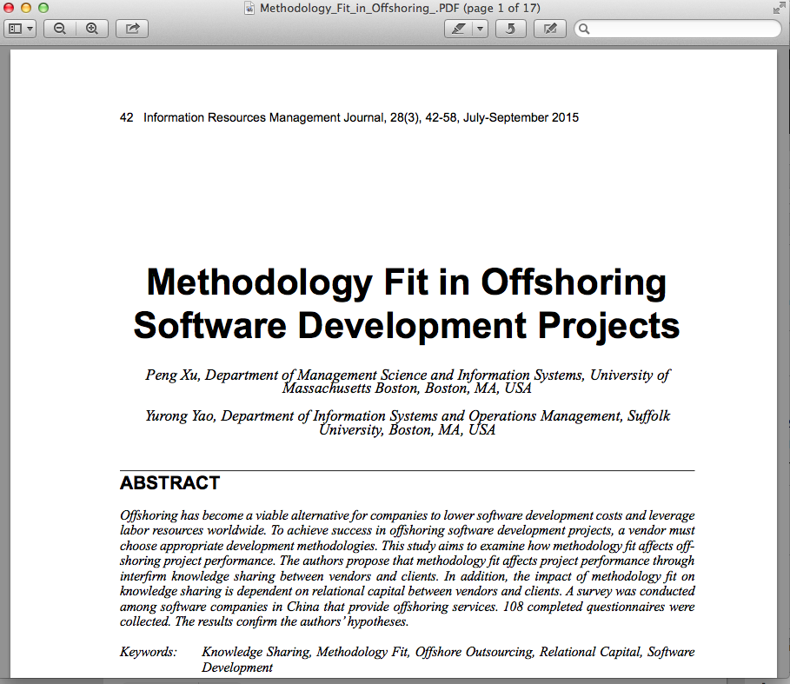
Notes:
We have met with success!

Slide 44
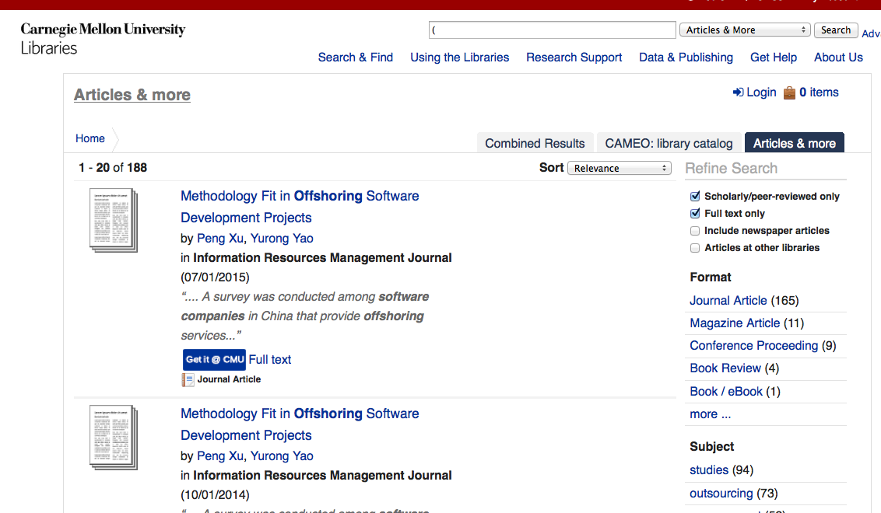
Notes:
In this screen, I’m back at the “Articles & more” results, but this time I’ve made use of our “Refine Search” options along the right. Note that this is a type of faceted searching that was developed at good ol’ Carnegie Mellon by Professor Raul Valdez-Peres and his graduate students (Vivisimo). I’ve limited the results to “Scholarly/peer-reviewed only” AND “Full text only.”

Slide 45
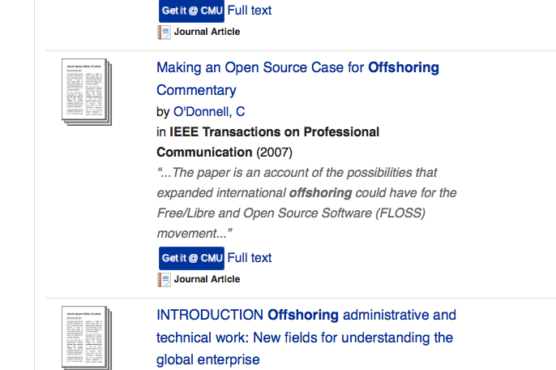
Notes:
I wanted to show you what happens when everything works with the link resolving software that works in conjunction with Articles & More. Let’s see what happens when we try this full text link.

Slide 46
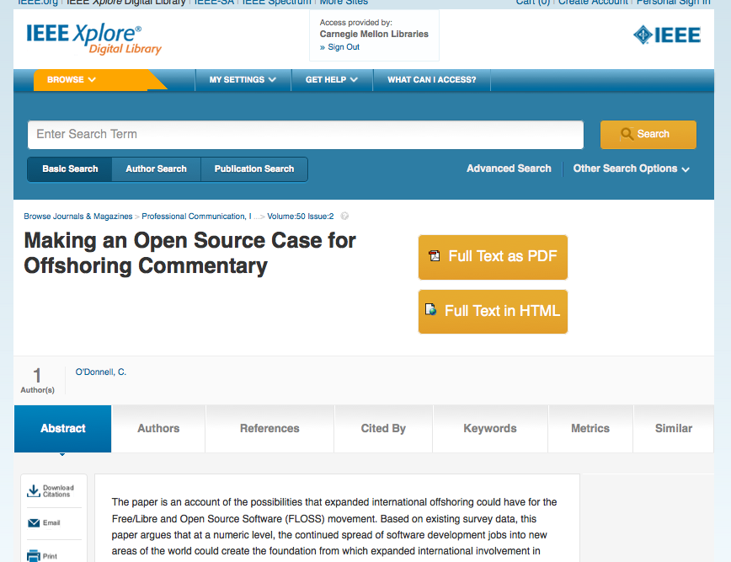
Notes:
In this case, the software has taken us to the proper record in the IEEE Xplore database. It’s great when it works and it frequently does. Note that the Full Text in HTML version is HTML5, so it will be displayed well on things like tablets and smart phones. Note the tabs across the page: Abstract, Authors, References etc. These are very interesting links that I would encourage you to explore if you’re in the IEEE Xplore database.

Slide 47
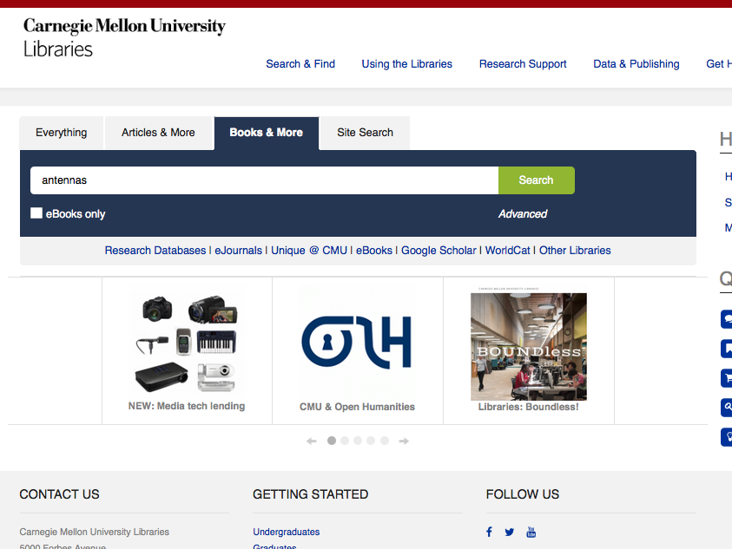
Notes:
[In this segment] I wanted to show you a more successful search of CAMEO, the library catalog. For that we’ll choose “Books & More.” Note that I’ve placed a search for the term “antennas” in the search box. Let’s look at our results.

Slide 48
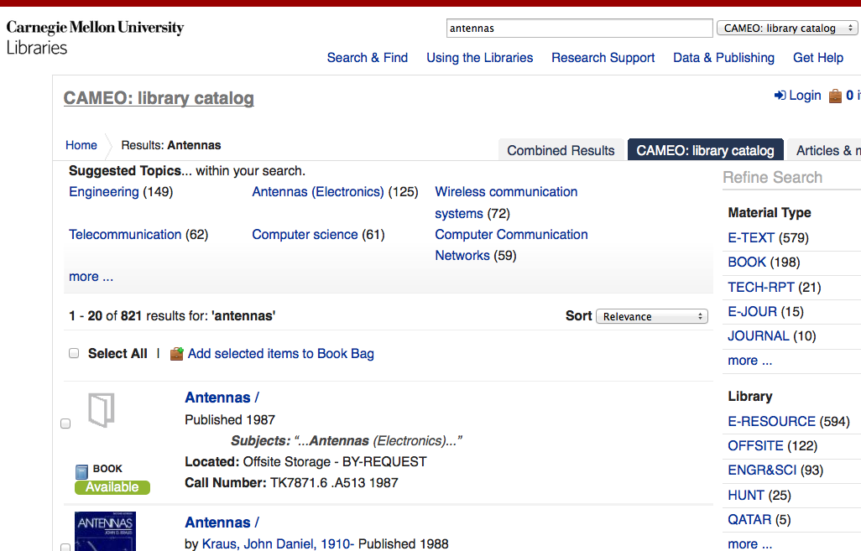
Notes:
We have many results to contend with. Note that we have a similar “Refine Search” function along the right. You might be most interested in what you can get at in digital format. I’ll click on the “E-TEXT” link to take a look at the 579 e-books that our search has found.

Slide 49
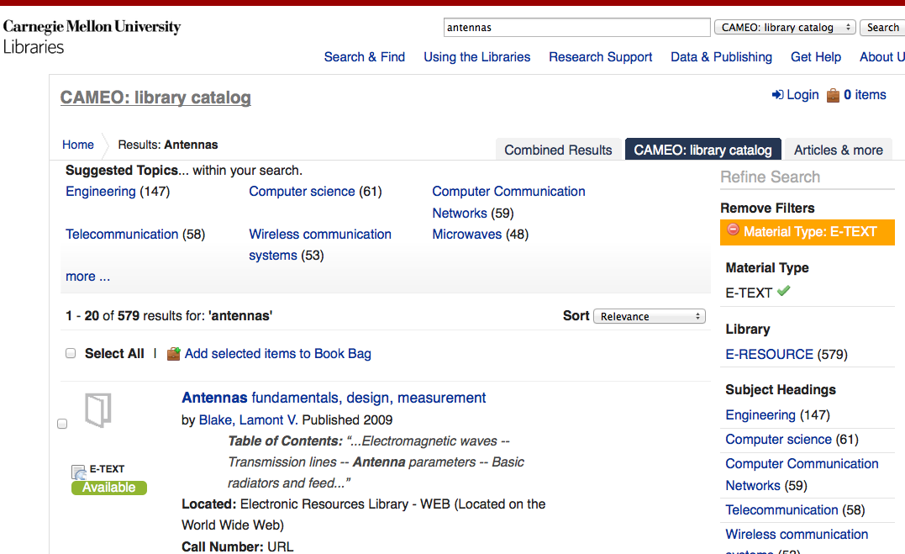
Notes:
That’s still a lot of stuff. I want to limit my results to the last few years. If I look on the right and scroll down, I’ll come to a place where I can limit the results by a range of years.

Slide 50
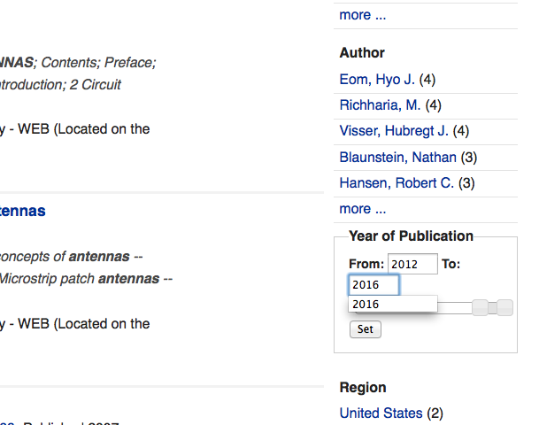
Notes:
I’ll try from 2012 to 2016. I know … it’s not 2016 yet. However, publisher often put out 2016 publications at this time of the year.

Slide 51
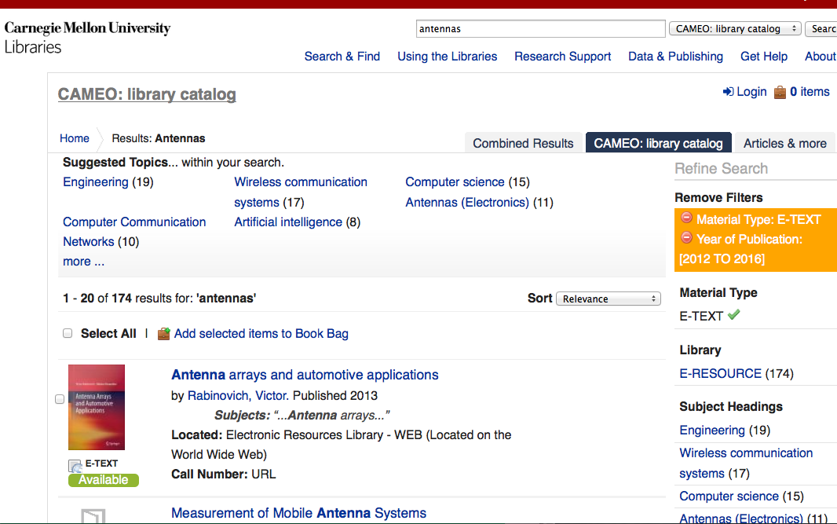
Notes:
Here are our results. Perhaps 174 is a manageable amount.

Slide 52
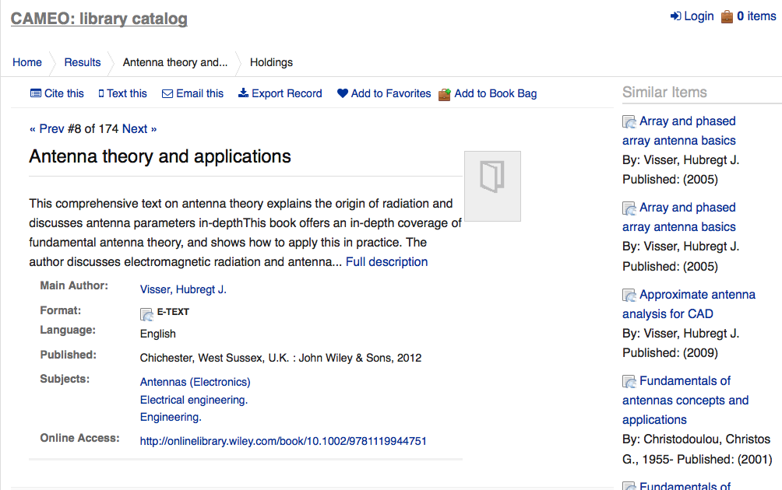
Notes:
The 8th record looks interesting if I’m looking for a somewhat general book. Let’s try the Online Access Link.

Slide 53
Notes:
Here we are – the link has successfully taken us to the proper e-book in the Wiley Online Library. Note the “unlocked” symbol in the upper right that I’ve circled. That means we should have access to this book.

Slide 54
Notes:
If I scroll down, I can see the same icon in front of each individual chapter. You can download them and read them offline if you like.

Slide 55
Notes:
[In this segment] I want to show you our access to individual databases. Note that “Articles & More” is a discovery tool that tries to search a bunch of databases all at once. When you do that you lose a little searching power and it doesn’t really search every database we have. Note the “Research Databases” link.

Slide 56
Notes:
This leads us to our “A-Z Databases” page and note that I’m making use of our subject listings to choose “Electrical & Computer Engineering (ECE)” databases.

Slide 57
Notes:
This leads to a carefully chose list of recommended databases that I’ve put together. Note that I’ve listed some “Best Bet’s” at the top and that is followed by an alphabetical listing of other ECE databases.

Slide 58
Notes:
Our Business & Economics Librarian has done the same thing with business databases.

Slide 59
Notes:
Her listing is simply alphabetical – she didn’t have any that she wanted to mark as “Best Bet’s,” but it’s a typical thorough list from Roye!

Slide 60
Notes:
I also wanted to note that Roye has put a tab on our Silicon Valley Campus Guide for “Business” now. It links to her impressive set of Business research guides.

Slide 61
Notes:
Oddly, Roye always recommends starting with her “Industries” page when you want to look for market research. Let’s take it for a quick spin.

Slide 62
Notes:
Note the recommendation to look up a NAICS (North American Industry Classification System) code. Let’s try that.

Slide 63
Notes:
I’m trying the term “software.”

Slide 64
Notes:
Interesting! Let’s use the NAICS Code for Software Publishers (511210)

Slide 65
Notes:
I’ll use the code in the IBISWorld database (one of the databases that Articles & More totally misses). Articles & More misses many great business databases.

Slide 66
Notes:
The first five of 71 results are displayed. “Software Publishing in the US” looks quite promising. What do these things have to offer?

Slide 67
Notes:
This is quite a report! Note the tabs across the top to the segments of the reporl

Slide 68
Notes:
Here is an interesting snippet from the Products & Markets segment. Know that these databases exist and that you should take advantage of your access to them. Keep in mind that you can always contact myself or Roye for guidance if needed. For those of you that need to explore the business literature for your studies, I would really encourage you to look over Roye’s research guides. Roye will be moving on to her next stage in her life in March and I will sorely miss her!

Slide 69
Liaison Librarian Contact Information
Matthew R. (Matt) Marsteller
Senior Librarian, Engineering and Science
Roger Sorrells Engineering & Science Library
4400 Wean Hall
5000 Forbes Avenue
Pittsburgh, PA 15213
E-mail: matthewm@andrew.cmu.edu
Phone: 412-268-7212
Notes:
That concludes the presentation. Here is my contact information in case you have ANY questions or input. Perhaps you wish to have the library purchase a book for the collection or you are struggling with how to approach a search for information. Note that if you contact me for guidance I’m going to do my best to conduct what we in the library biz call a Reference Interview. I’m going to try to open up our communication by trying to get you to articulate your information need. If your answers are short one word responses like “yes” or “no,” then my questions aren’t working. Getting you to open up can be difficult to do consistently, so feel free to help open up the conversation! A librarian should be in learning mode during this process (one cool thing about being a librarian) – that means in effect you are the teacher! Consider a reference interview to be a great opportunity to hone your teaching skills. A reference interview can be one of the most enjoyable human to human professional interactions that you’ll ever undertake. Only after the librarian has truly listened to (and hopefully understood) your need should they call upon their training and experience to guide you to the answers you seek. So, please don’t hesitate to call upon my services.

