Slide 1
Data Management Planning
Dissertation Boot Camp
Wednesday, May 14, 2014
Steve Van Tuyl
Data Services Librarian
CMU University Libraries
svantuyl@andrew.cmu.edu
www.cmu.edu/research/data-management
Matt Marsteller
Senior Librarian, Engineering & Science
CMU University Libraries
matthewm@andrew.cmu.edu

Slide 2
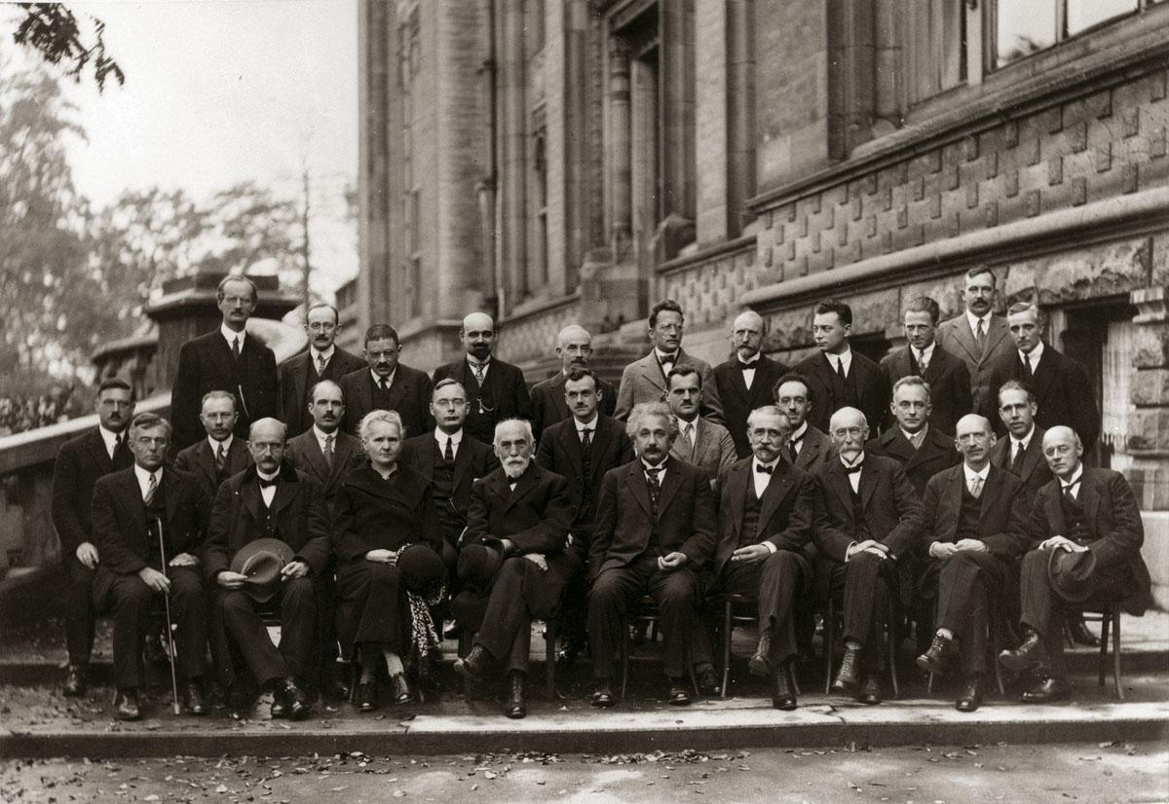
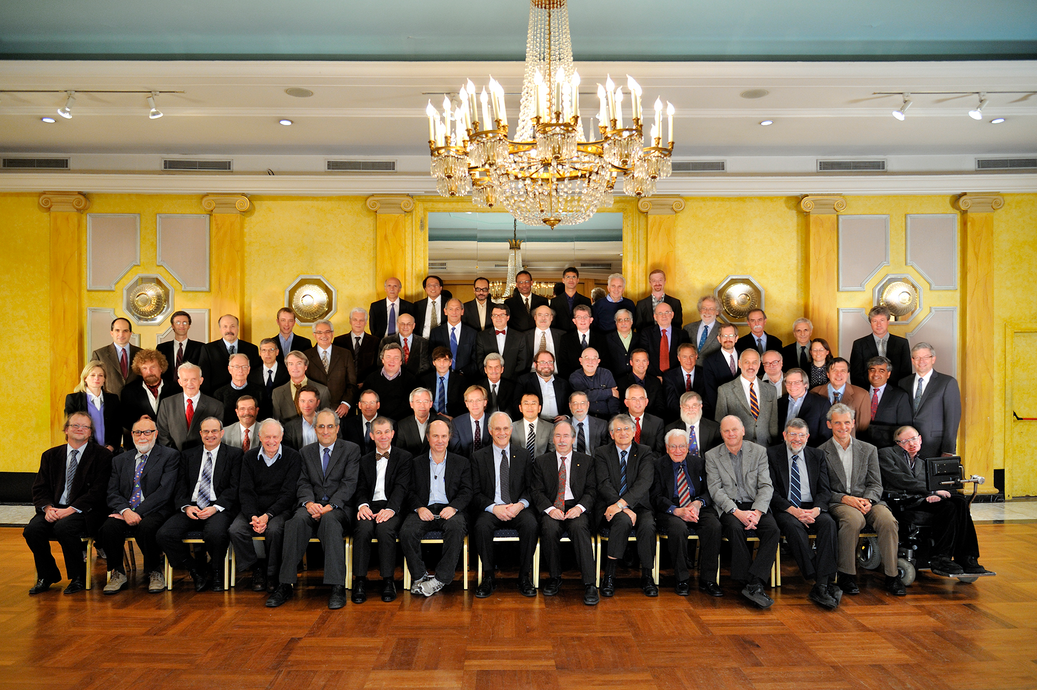
Why Data Management Planning?
What is different?
Mandates
Expectations
Scrutiny/Reproducability
Nothing?
Solvay Conference
1927 & 2012
Notes:
Why are we talking about Data Management Planning?

Slide 3
Why Research Data Management?
“One of the important advantages of releasing source code is that it allows replication of the results, which is a key concept in science (Aristotle, 350 BC).”
- Shamir et al. 2013. Practices in sharing source code in astrophysics. arXiv:1304.6780v1
Notes:
So why are we interested in research data management?
To a certain extent, we’re interested in facilitating the scientific process
And part of this process is concerned with openness

Slide 4
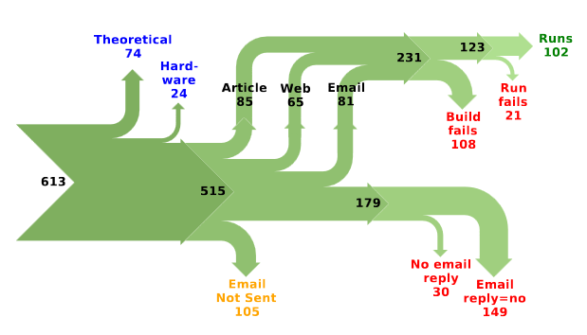
Why Research Data Management?
From: Collberg et al. 2013. Measuring reproducibility in computer systems research. http://cs.brown.edu/~sk/Memos/Examining-Reproducibility/measuring-tr.pdf
Notes:
Along with that openness comes reproducibility
There has been a fair bit of talk in the past few years about reproducibility of results
Open science can be one way to help solve the reproducibility problem
This example is from a recent paper…

Slide 5
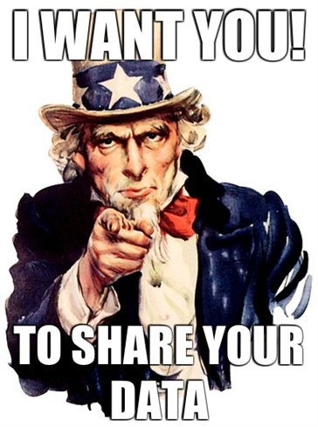
Why Research Data Management?
Notes:
The third reason, and the reason that is getting a lot of play lately,
Is because we have to:
NIH started this business back in 2003
With NSF following on in 2011

Slide 6
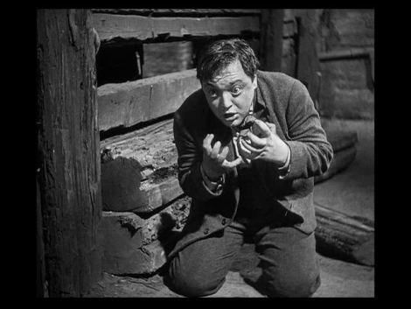
The Dreaded Data Request...
The Year: 2019
The Subject: Your Dissertation Data
Where is the data?
Can you still open the files?
Can you make sense of them?
Can you explain them to someone else?
Image Credit: M (1931) - Directed by Fritz Lang
Notes:
Imagine This:
- request for your data
- can you answer these questions?
- how many questions do you want to answer later?

Slide 7
Data Management Best Practices
Current state of DMP Requirements and Mandates
Introduction to DMP Tools and services
Notes:
Today we’re going to talk about these three items

Slide 8
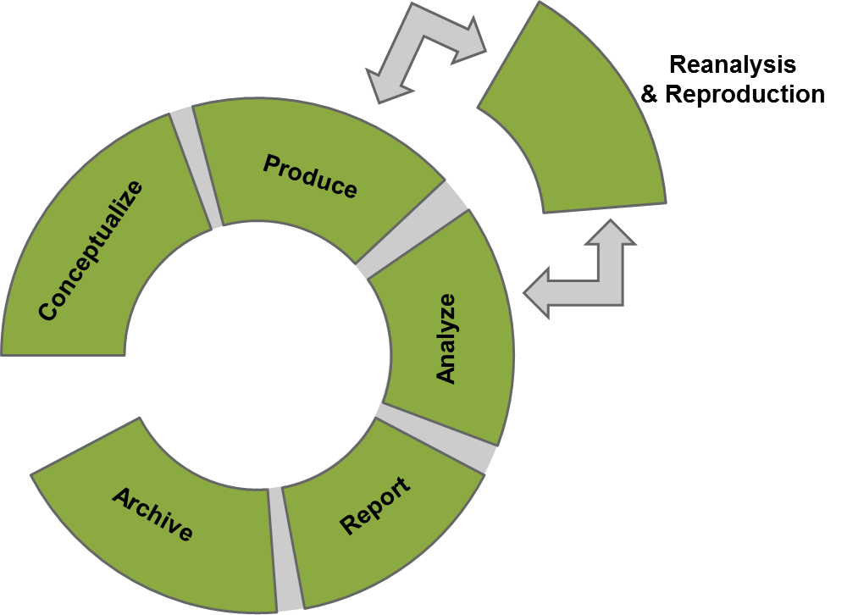
Notes:
Today we’re going to talk about these three items

Slide 9
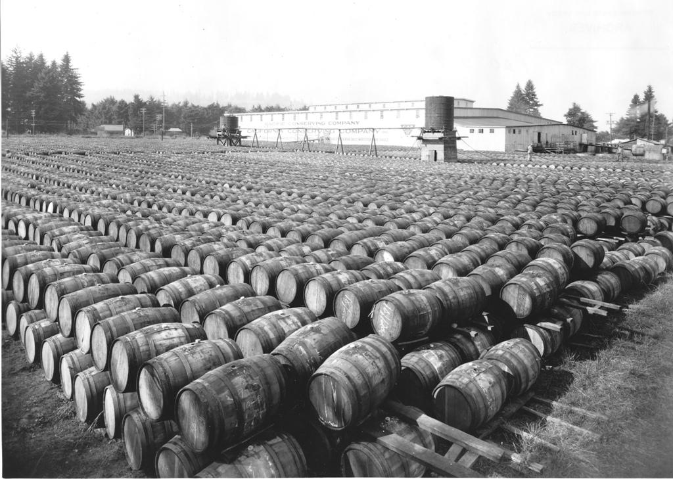
Data Management Best Practices
Collection & Documentation
Storage
Processing
Preservation & Sharing
Data Management Planning Tools
Image Credit: OSU Archives - http://www.flickr.com/photos/osucommons/5837433750/

Slide 10
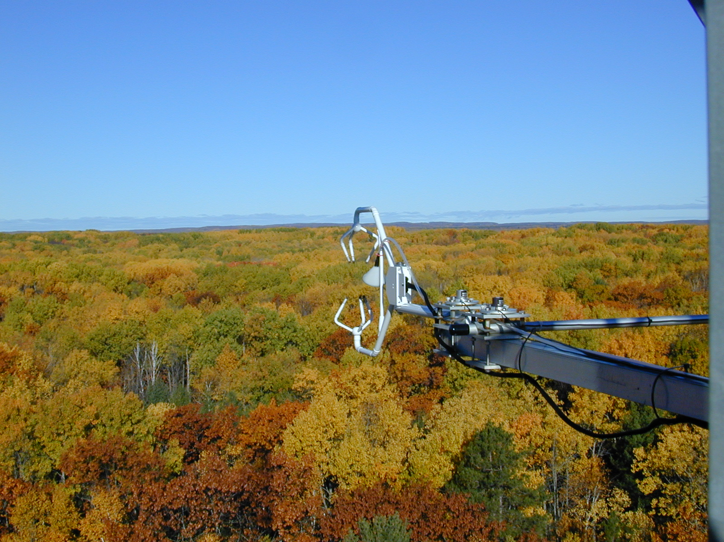
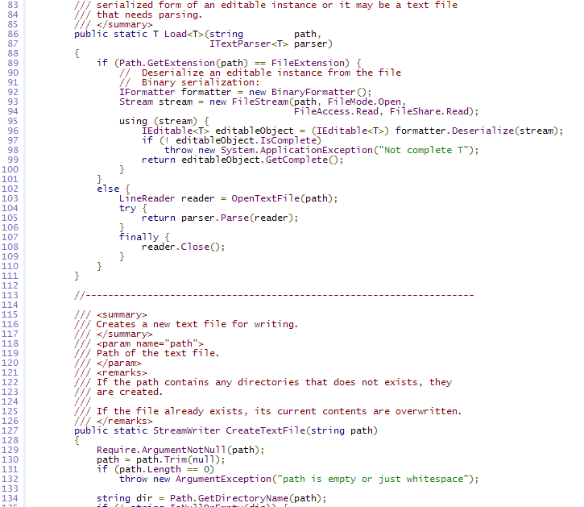
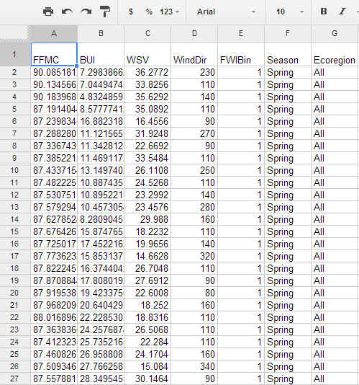
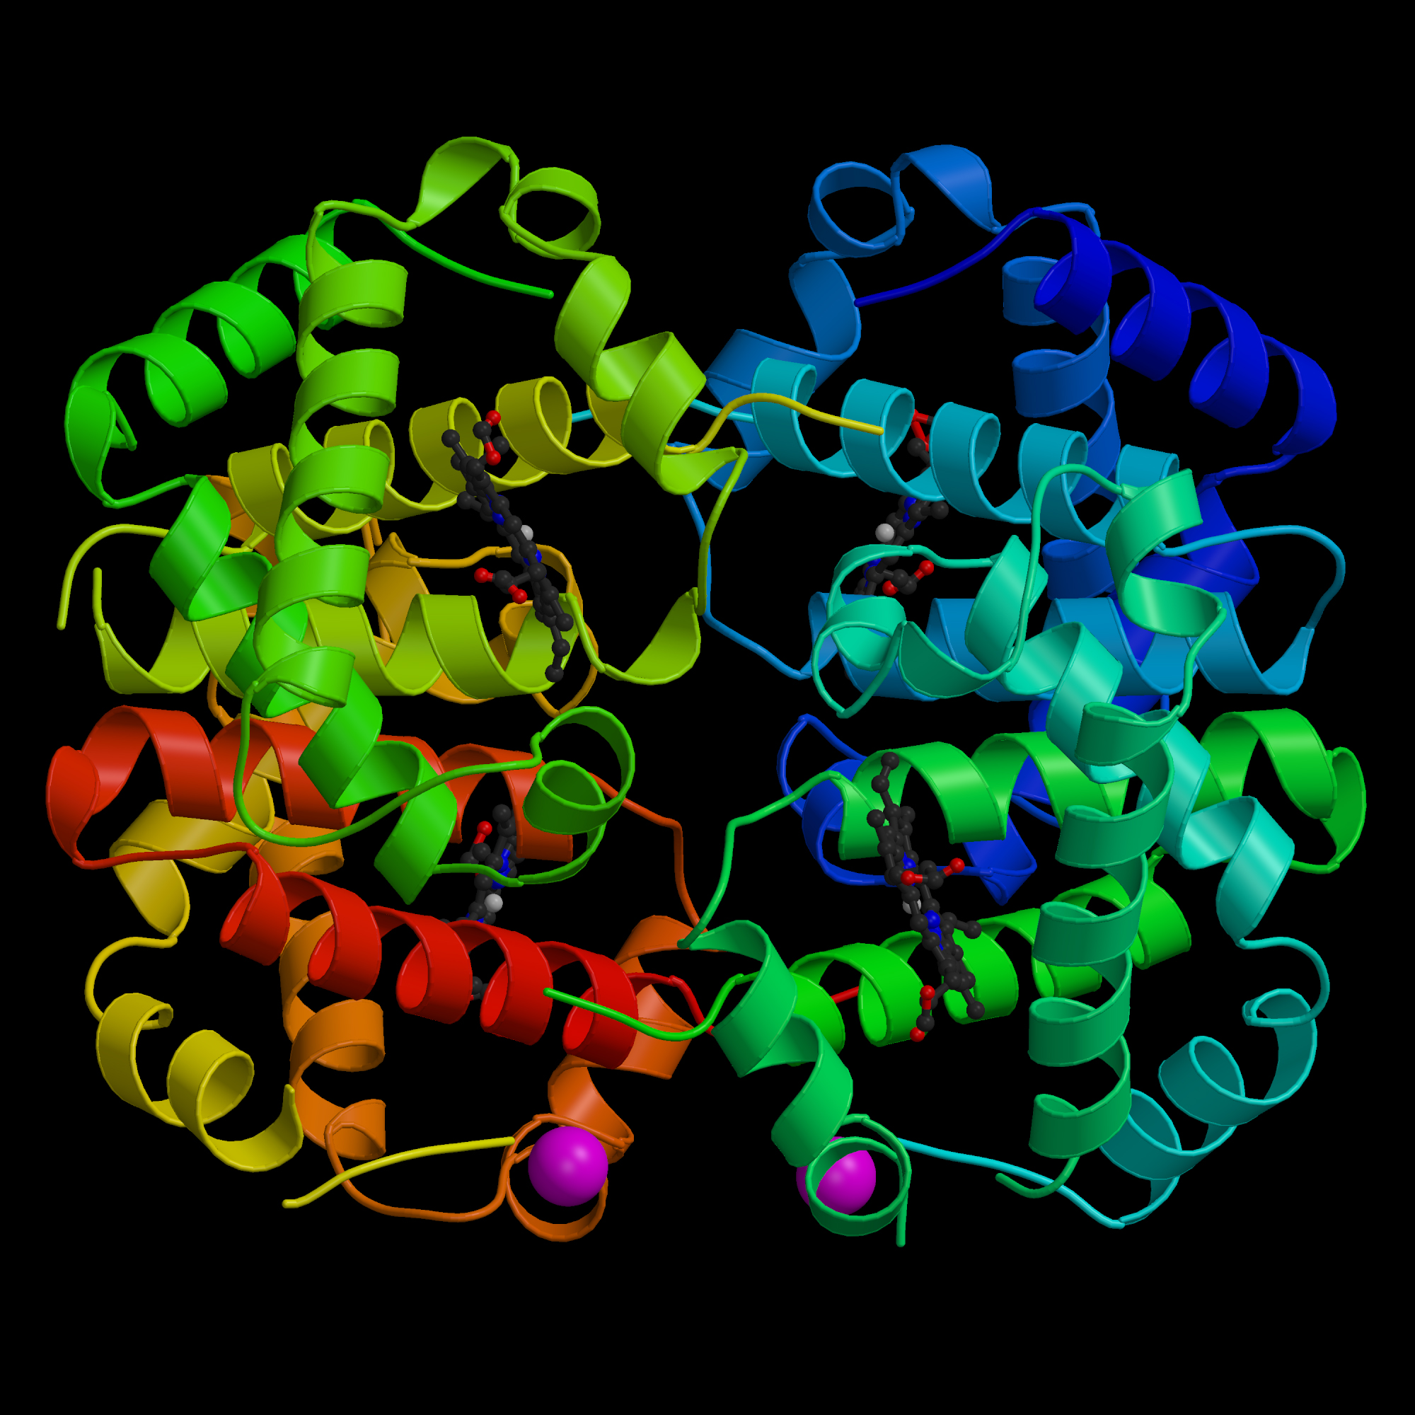
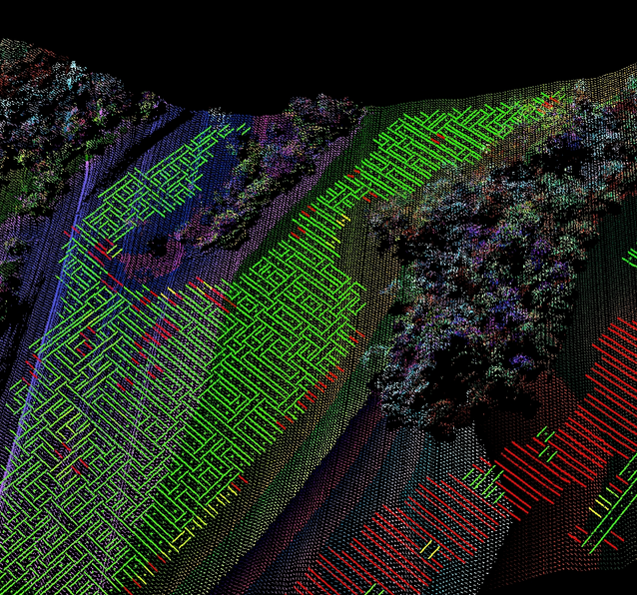
Data Management Best Practices
Notes:
Lots of different types of data
- for any of these, for any given field, the best practices for CREATING and USING the data are up to you
- There are, however, some overarching best practices that we can discuss

Slide 11
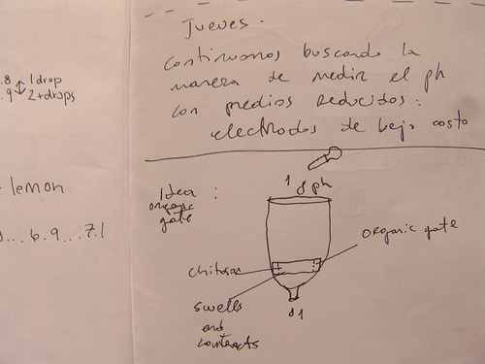
Data Management Best Practices
Collection and Documentation
Document your methods (and problems)
lab notebook
data diary
data dictionary
The Questions:
What changed?
Why?
How does this affect results?
Image Credit: http://www.flickr.com/photos/laimagendelmundo/3429375904/
Notes:
Collection and documentation
- decisions about collection start early in the project - even before the project begins
- crucial to document the decisions around methods early and often
- changes happen and it can be difficult to remember what you did and why later on
- find some method, whichever you find MOST CONVENIENT, to help you track these decisions

Slide 12
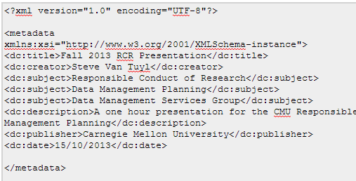
Data Management Best Practices
Collection and Documentation
Metadata
Why?
Description
Administration
How?
Online Tools (e.g. www.dublincoregenerator.com)
Consultation with DMSG
What?
Your field of research may have a standard
Provide something
Title: Spring 2014 RCR Presentation
Creator: Steve Van Tuyl
Creator: svantuyl@andrew.cmu.edu
Subject: Data Management Planning
Subject: Data Management Services Group
Description: one-hour presentation for the CMU Responsible Conduct of Research Seminar Series on Data Management Planning
…
...
Notes:
Metadata
- i just love metadata, don’t you?
- this is data that is going to help end-users understand what they’re looking at so they don’t have to call you on the phone twice a day
- also, this can help describe to the user HOW they may use your data
- The metadata doesn’t have to be super complex (though your field of research may have its own standards)
- We can help you sort out what is best for your research data

Slide 13
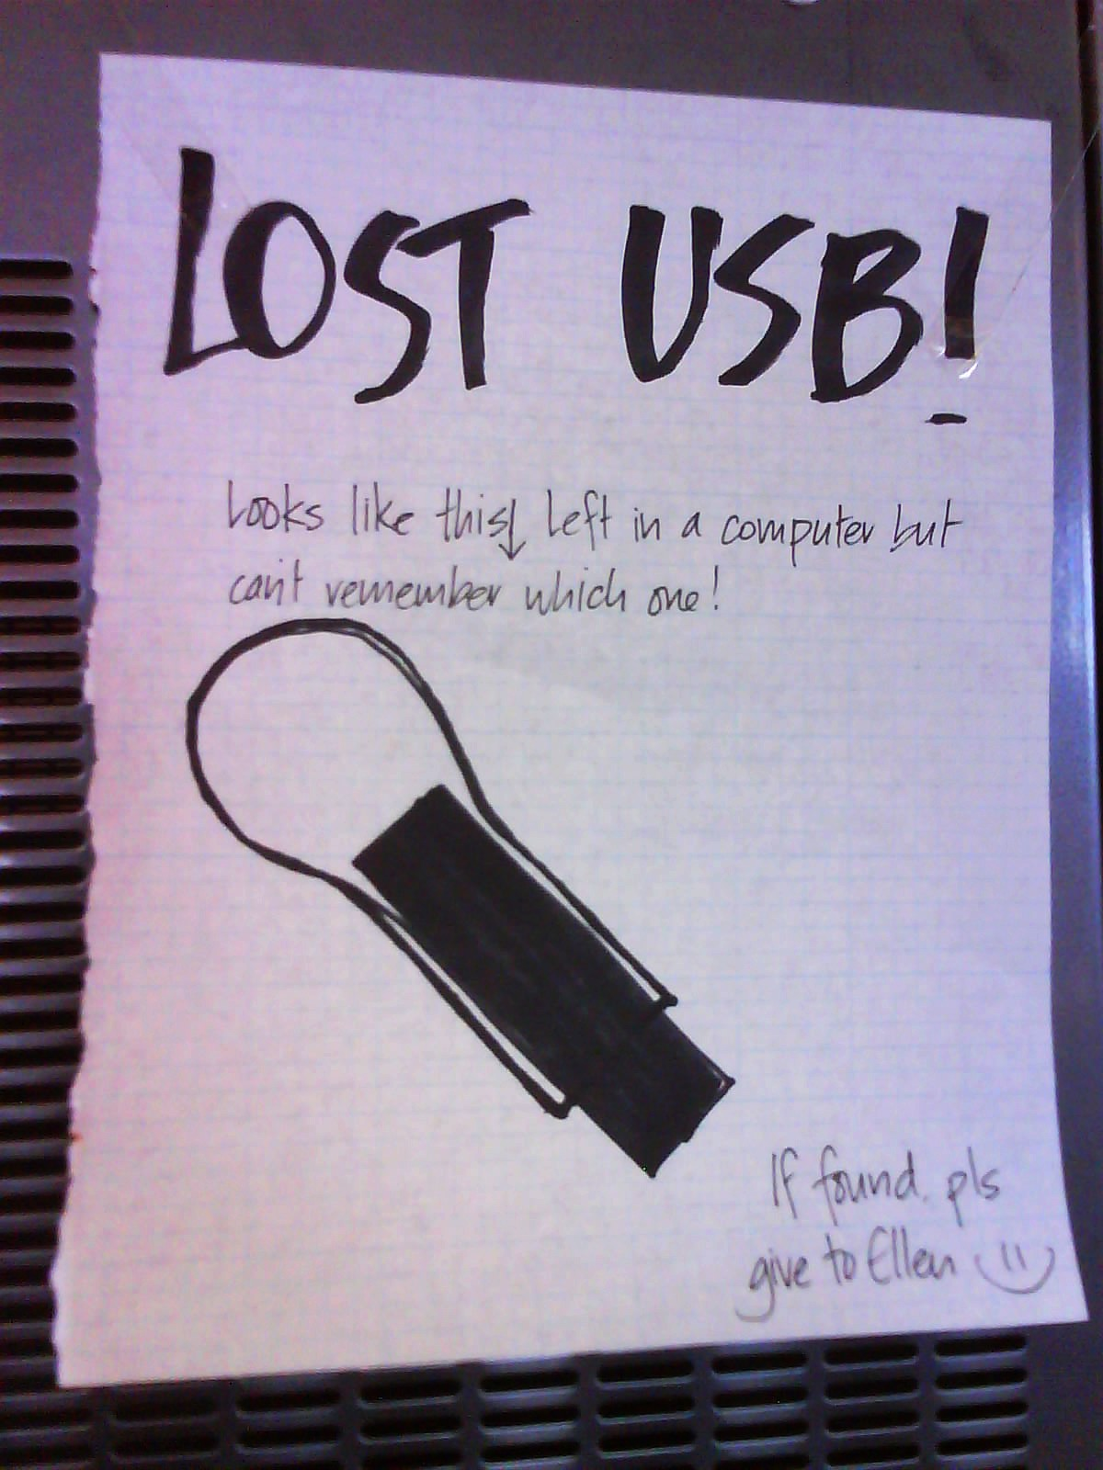
Data Management Best Practices
Storage
Local
University
External
Security:
Lab policies (lock the door, backup nightly)
Obvious policies (don’t leave your laptop on the table at the coffee shop)
Local policies (cf. www.cmu.edu/computing/iso)
Backups
LOCKSS
Assign Responsibility
Notes:
- You have many options for storage
- Some are better than others… USB - 25% for storage, 15% for BACKUP! 2% only use USB and 2% Dont Know if they have backup
- lots of copies keep stuff safe - but not all copies are equal?
- also, LOCKSS doesn’t work if you have them all in the same place (e.g. in your laptop bag)

Slide 14
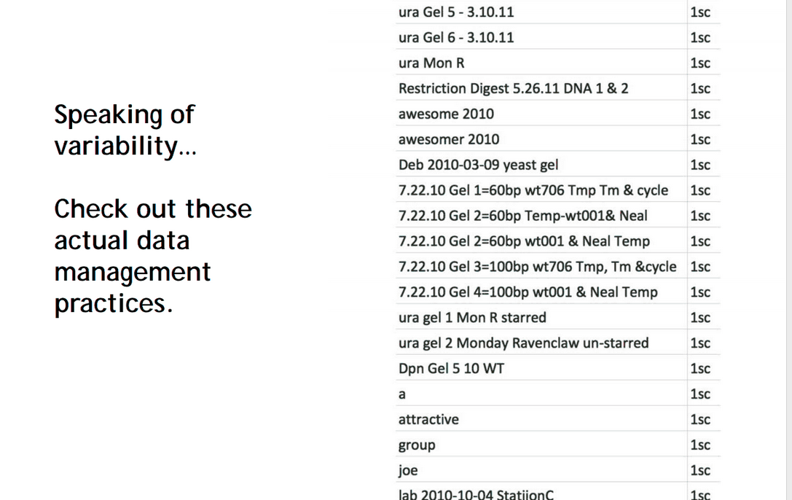
Data Management Best Practices
Processing
Consider processing issues ahead of time (if possible)
Data Validation
Filename/Directory Structure
Versioning
Cross-check in other programs (Excel Jockeys!)
Publication as benchmark
What was the data you used?
Can you replicate the process?

Slide 15
Data Management Best Practices
Preservation & Sharing
What should you preserve/share? It depends…
There are some clear benchmarks…
Raw data (though not always required by mandate)
Final data (leading to publication)
Intermediate data - necessary to get from raw to final
Look at your mandates and local requirements

Slide 16
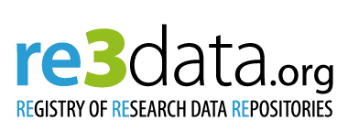
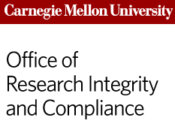
Data Management Best Practices
Preservation & Sharing
How to share?
Lab/Group Policy?
Local Repository (we’re working on this now!)
External Repository (see: www.re3data.org)
Publications (caveat emptor)
How not to share?
Personal website
USB drive via USPS
Do you own the data (i.e. are you allowed to share?)
What NOT to share?

Slide 17
So now what?

Slide 18
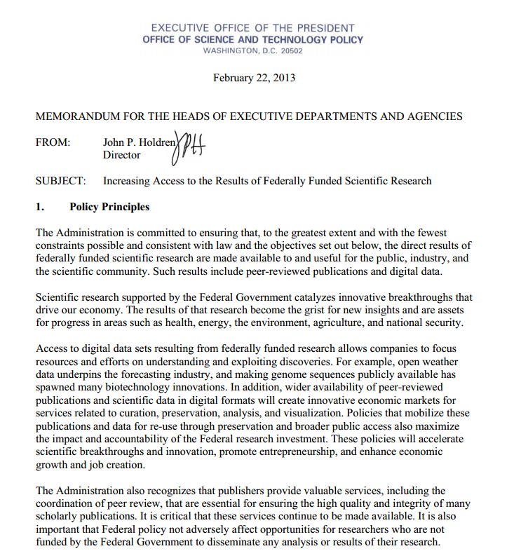
Data Management Plans
As of Now
Notes:
So this is the current state of affairs
- NIH started requiring data sharing about 5 years ago (give or take)
- NSF started requiring data management plans about 2 years ago
- Are they taking this seriously?
- it turns out YES
- Heinz College project and rumors of rejections
- Then...HOLDREN - six pages of glory

Slide 19
Data Management Plans
Soon (late 2014?)
Notes:
So the Holdren memo from OSTP says:
- any agency with more than $100million in R&D funding needs to have an open data and open publications policy
- Here are a few of the agencies included…
- Practically speaking - this means every single agency out there
- We still aren’t sure what is going to happen with this, BUT…
- The expectation is that these requirements will AT LEAST look like the NSF requirements, if not more strict

Slide 20
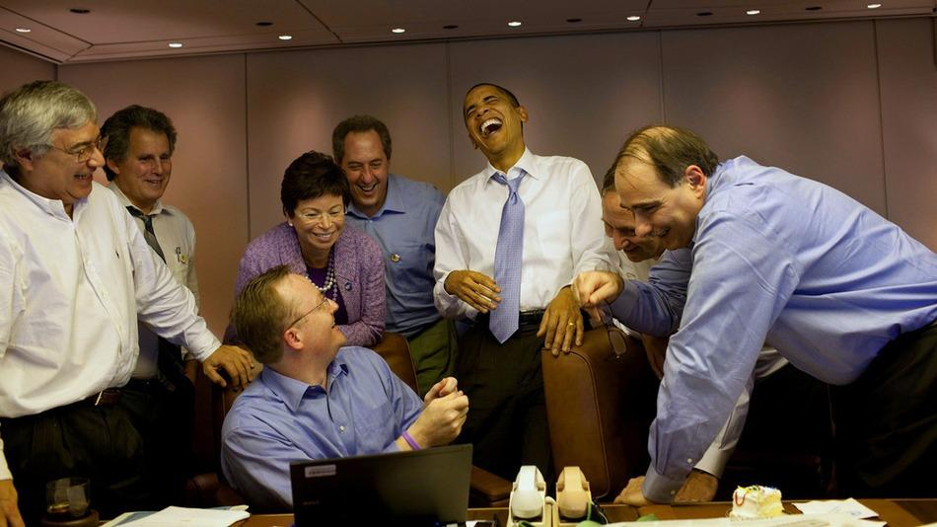
Notes:
- its not exactly this dire
- everyone is kind of on the same page, including the funding agencies
- but it is being taken seriously by the agencies and by the Office of Research Integrity and Compliance
- which is partly why I'm here and why we’re starting to stand up some services to help navigate...

Slide 21
Data Management Plans
What is a DMP?
Formal plan that outlines
Types of data
Metadata and format standards
Rights
Archiving and preservation planning
Access and sharing provisions
Transfer to long-term preservation
Requirements (and results) may vary
Notes:
What is a DMP?

Slide 22
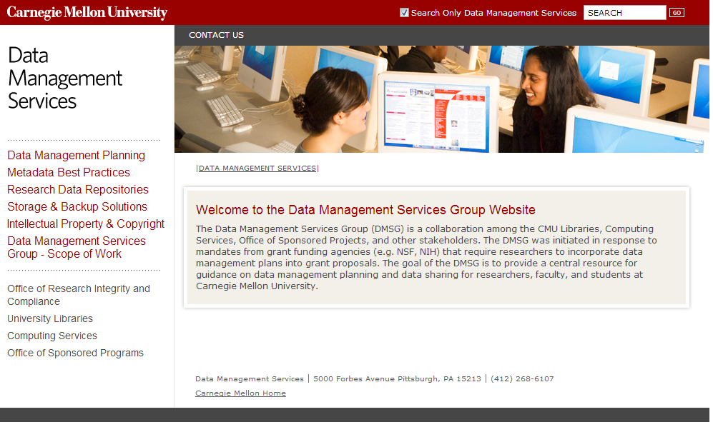
Data Management Plans
What now?
Notes:
Data Management Services is comprised of …
At this point, we’re providing some general guidance and tools, but will be putting together more robust services down the road

Slide 23
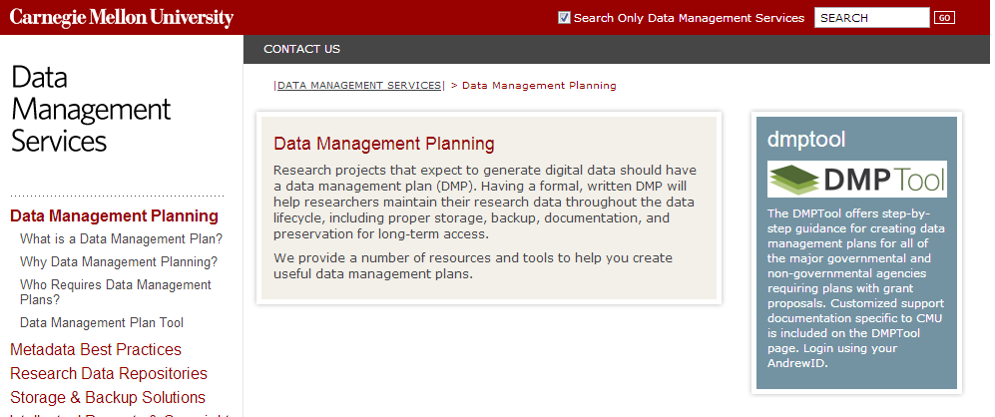
Data Management Plans
DMPTool
Notes:
One tool I want to point out now is the DMP Tool
California Digital Library and others put this together
Provides an easy way to put together a DMP that meets the criteria for requiring agencies (and others)
NOW FOR THE MOST DANGEROUS THING

Slide 24
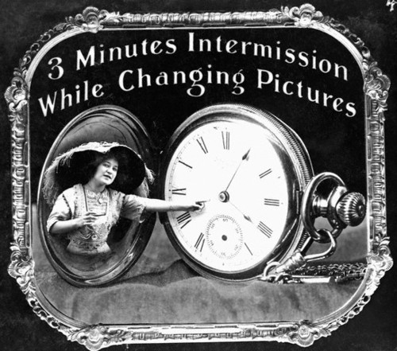
Notes:
Walkthrough of DMSG Website and DMPTool

Slide 25
Data Management Plans
DMPTool
Summary:
DMPTool is a great starting point for DMP - especially for your grant proposal
BUT…
...we can probably do better
consider a one-on-one consultation to expand your DMP to a more meaningful document

Slide 26
Questions?
Steve Van Tuyl
Data Services Librarian
CMU University Libraries
svantuyl@andrew.cmu.edu
www.cmu.edu/research/data-management
Matt Marsteller
Senior Librarian, Engineering & Science
CMU University Libraries
matthewm@andrew.cmu.edu

Slide 27
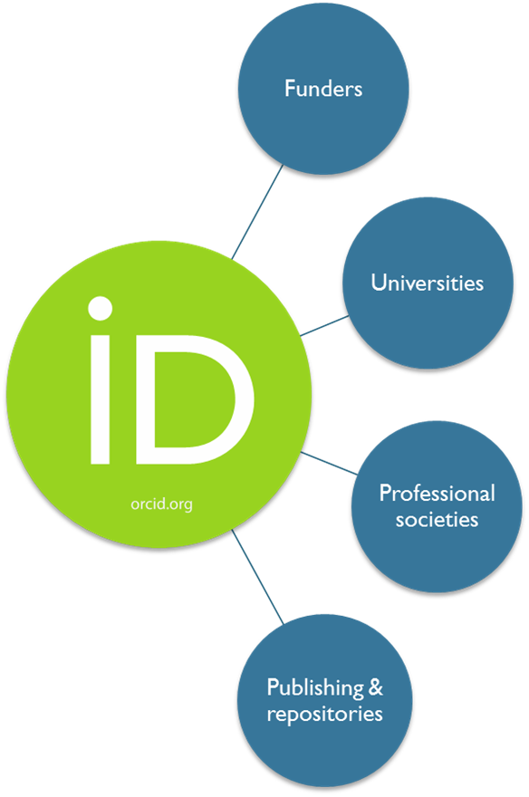
What is ORCID?
Unique, persistent identifier for researchers & scholars
Non-profit organization supporting linkages between systems
Benefits to you?
Improves discoverability
Connects your work
Eliminates name ambiguity
Stays with you throughout your career
Get your free ORCID iD at http://orcid.org

