Slide 1
18-100 Introduction to Electrical and Computer Engineering
Lecture 18
Data Communications

Slide 2
Outline
Today
Physical Layer
Link Layer
Network Layer
Transport Layer
Application Layer

Slide 3
Physical Layer: A Few Odds and Ends
Application
The messages sent and received by application programs
The end-to-end connection as seen by a programmer
The decision making needed to steer a message from source to destination through an inter-network
The management of the physical channel for communication
The specification for the hardware that enables the signaling between or among devices
Transport
Network
Link
Physical

Slide 4
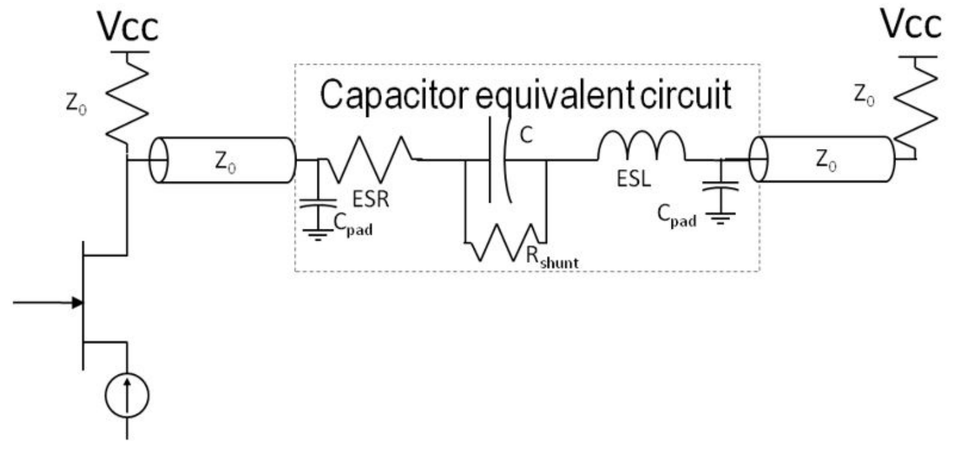
A wire isn’t a just wire anymore!
https://ww1.microchip.com/downloads/en/Appnotes/VPPD-02901.pdf
Everything from the board to the wire adds capacitance, inductance, resistance, etc.
Acts as big RLC filter

Slide 5
Encoding
Too many ones or zeros in a row are hard to “clock”
Sender and receiver might time long sequence of high or low voltage differently
Made worst by AC Coupling, e.g. use of capacitance as high-pass noise filter
Capaciters have charge-discharge curves. They aren’t flat. Rounding, esp. at edges.
Transitions synchronize clocks
Need a coding that guarantees transitions

Slide 6
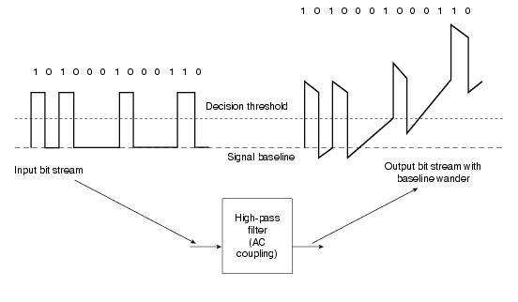
Baseline Wander From Capacitance
http://docwiki.cisco.com/wiki/Ethernet_Technologies
“AC Coupling” is used for transmission, e.g. a capacitor-like filtering of the low-frequency DC bias leaving only the higher frequency data.
But, a DC bias can slowly creep in over time. It isn’t completely eliminated

Slide 7
Old Solution: Manchester Encoding
0 = rising transition
1 = falling transition
0
1
1
0
1 transitions per bit, but twice as much bandwidth
High-low pattern has good electrical properties
Balanced signal – no net DC voltage.
This allows AC coupled power supply on receiver.
If code had a DC bias, it would be lost in the transformer on the receiver side.

Slide 8
Challenges To Manchester Encoding
Requires a clock rate of 2x data rate
Just can’t work for higher data rates
The frequency space isn’t high enough
Modern ethernets, e.g. gigabit use specific bit encodings
Specific bit patterns are encoded in larger patterns to guarantee transitions
But, not 2x as long

Slide 9
Outline
Today
Physical Layer
Link Layer
Network Layer
Transport Layer
Application Layer

Slide 10
Link Layer
Application
The messages sent and received by application programs
The end-to-end connection as seen by a programmer
The decision making needed to steer a message from source to destination through an inter-network
The management of the physical channel for communication
The specification for the hardware that enables the signaling between or among devices
Transport
Network
Link
Physical

Slide 11

Link Layer Framing is critically important
Framing breaks data into manageable units
Easily identifiable beginning and end
Identify sender and receiver
Carry data
Provide a way to verify the data
Preamble
Destination MAC Address
Source MAC Address
DT
NH
TH
Data (Payload)
FCS
1010 1011
Preamble: A sequence of alternating 1 and 0 to alert computer with “11” to indicate the frame is next.
DT: Data Type
FCS: Frame Check Sequence
Using Cyclic Redundancy Code to Check the Fidelity of the Data Sent
Media access control (MAC) address: Hardware address

Slide 12
A Lesson In Sharing: Pure Aloha
Circa 1970
Originally developed for terrestrial radio at Univ. of Hawaii, it illustrates the principles of a contention-based MAC protocol on any broadcast media.
Senders transmit whenever they want
If any two transmission over lap – even by one bit, they are garbled. This is called a collision.
Unlike I²C, collisions destroy both frames.
The distance makes it impossible for them to align. The bit time would need to be too long.
Collisions are detected by listening and verifying checksum.
Garbled frames are resent after a random delay.
Resent frames may also collide.
Resending frames does, of course, waste the channel

Slide 13
A Lesson In Sharing: Pure Aloha
A
B
C
D
E

Slide 14
A Lesson in Sharing: Slotted Aloha
Circa 1972
Stations agree on slot boundaries. These might be maintained by a special station that produces a timing signal.
Tolerance needs to be built in for timing signal’s transmission latency
Send only at beginning of slot.
This reduces the window of vulnerability to a single frame’s transmission time (1 slot)
Of course, if contention is low and collision is not likely, it will increase average transmission latency.

Slide 15
Quick History: Slotted Aloha
tic
tic
tic
tic
tic
tic
tic
tic
tic
tic
tic
tic
tic
A
B
C
D
E

Slide 16
Carrier Sense Multiple Access (CSMA)
What if, instead of using slots, we just “listen” first, and only transmit if no one else is?
This means that collisions would only occur in the event that two messages sent concurrently crosses paths after being started
The vulnerability to collisions is related to the latency
More soon

Slide 17
CSMA/CD
Another level of sophistication is the addition of collision detection.
Stations listen while transmitting
If a station hears something different than what it is sending, it immediate stops
What it hears is different from what it sends, if another transmission garbles the original.
Additionally, if any station detects a collision, it sends a jamming signal to make sure that the colliding signals don’t cancel each other out, preventing detection after attenuation.
This reduces the time wasted in the event of a collision sending already garbled packets.
IEEE 802.3 (including Ethernet) protocols are use CSMA/CD.

Slide 18
Minimum Frame Size for CSMA/CD
Because of latency, collisions cannot be detected immediately. This signal from one transmitter much reach the other transmitter.
In practice, this imposes a minimum size on the length of a frame. The frame must be long enough to permit a collision to be detected.
If the frame is too short, it will be gone before the signal from one transmitter reaches another.
The frames will be corrupted as the “cross in the mail”
But neither sender will be able to detect it, until the whole frame has been sent, which defeats the purpose.

Slide 19
Minimum Frame Size for CSMA/CD
The frame needs to be sufficiently long to require more than a round-trip time for transmission.
We must consider the bit-rate of the channel as well as its length to determine the round trip time.
The frame must require more than this round-trip time for transmission.
B*S
B bits/second
S seconds
B*S bit time
Sender1
Sender2
Sender 1 must wait for its frame to (almost) make it to Sender2, when the collision occurs, and then for the energy from Sender2’s frame to make it back, before detecting the collision.
Sender2 detects the Collision almost immediately

Slide 20
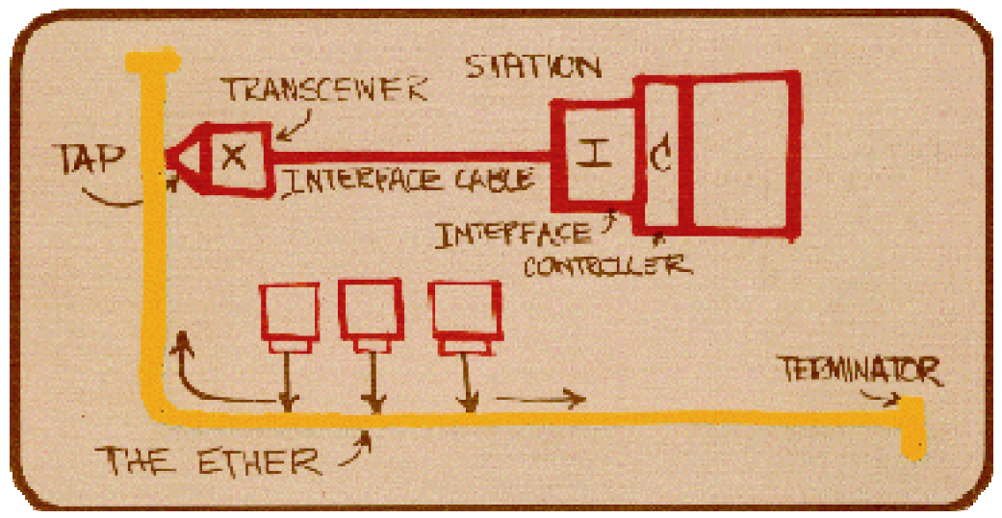
Aside: “Ether” Net
http://www.ieee802.org/3/ethernet_diag.html
Circa 1973
Robert Metcalf’s Memo @ Xerox PARC
Presented at 1976 National Computer Conference
CSMA/CD
3 Mbps
Key improvement of satellite based Aloha Net
Backoff was exponential random, not just random
More load = more retries = more delay

Slide 21
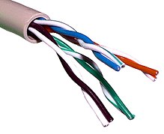
Aside: Ethernet Evolution Milestones
https://en.wikipedia.org/wiki/Twisted_pair
1988: Twisted Pair (Among other cabling)
1995: 100Mbps
10 years after 1st standard
1997: Full duplex
1998: Gigabit (1000Mbps)
2002: 10 Gps (10,000Mbps)
2010: 40Gps and 100Gps standards
2017: 400Gps

Slide 22
Gigabit Ethernet: Frame Size Challenge
Detecting Collision requires a frame size = RTT bit distance
Without this a collision cannot be “heard” by the sender
As data rate increases
Either minimum frame sizes increases
Or maximum segment length decreases
Prior solutions cut network length
20m wouldn’t quite cut it for gigabit ethernet

Slide 23
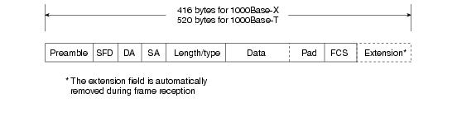
Gigabit Ethernet Frame: Solution, Part 1
http://docwiki.cisco.com/wiki/Ethernet_Technologies
Add “extension” bits to make small frames larger

Slide 24
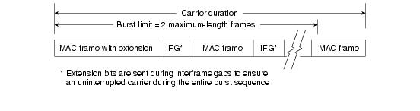
Gigabit Ethernet Frame: Solution, Part 2
http://docwiki.cisco.com/wiki/Ethernet_Technologies
Allow a “burst” of frames
An extension in only required after the first one, so it is compliant
The IFG is filled with bits, so the carrier is never quiet.

Slide 25


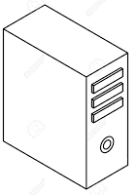
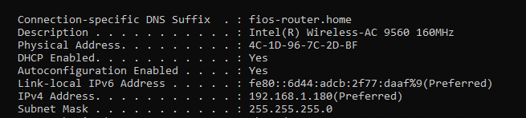
Addressing in Wired LANS: Ethernet Example
Local Area Network (LAN)
Each device connected to the network has a unique identification number given by the manufactory:
Media access control (MAC) address
1a:2b:3c:4d:5e:6f
Six 2-digit hex numbers
(Six 8-bit binary numbers)
MAC address is also called as :
hardware address
physical address
machine address
MAC Address on a Printer
On a PC: Example

Slide 26
Sending a Message in Wired LANS
Wired Local Area Network (LAN)
1a:2b:3c:4d:5e:6f
MAC Address Data
A
1a:2b:3c:4d:5e:6f
Computer A sends a document to the printer to print via local network.

Slide 27
Broadcast to Everyone on the LAN
Local Area Network (LAN)
1a:2b:3c:4d:5e:6f
MAC Address Data
A
1a:2b:3c:4d:5e:6f
It actually is broadcasted to all the devices connected to the network.

Slide 28
Message Acceptance
Local Area Network (LAN)
1a:2b:3c:4d:5e:6f
MAC Address Data
A
1a:2b:3c:4d:5e:6f
MAC address is used to have destination device accept the document and all other devices reject.

Slide 29
Message Collision
Local Area Network (LAN)
A
1a:2b:3c:4d:5e:6f
On this network, only one message is allowed at a time. Otherwise a “collision” happens. During a message on the network, others have to wait.

Slide 30
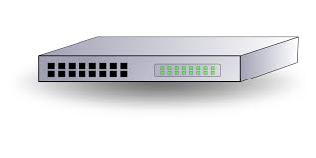
Managing Collison with Switches
A
Local Area Network (LAN)
bb:bb:bb:bb:bb:bb
128.20.21.2
aa:aa:aa:aa:aa:aa Data
Switch
aa:aa:aa:aa:aa:aa
bb:bb:bb:bb:bb:bb Data
Switches can forward messages from one network leg to another without flooding the whole network.
For example, learning switches pay attention to the location of each station when it transmits and learn its location
Then they send messages destined for that host to only the associated leg.
Flooding to all legs only happens if the location of the host is unknown.
The internal design of the “switch fabric” can be very complex with shared memory, buffers, locking, etc.
Different designs have different performance characteristics.

Slide 31
Internally Buffered Crossbar Switches (IBCS)
One common baseline switch fabric architecture
N ports require N² connections
Buffers can be placed in various locations to manage contention and avoid dropping messages due to collision
Input queues
Output queues
Each point of connection
Input
Ports
Output
Ports

Slide 32
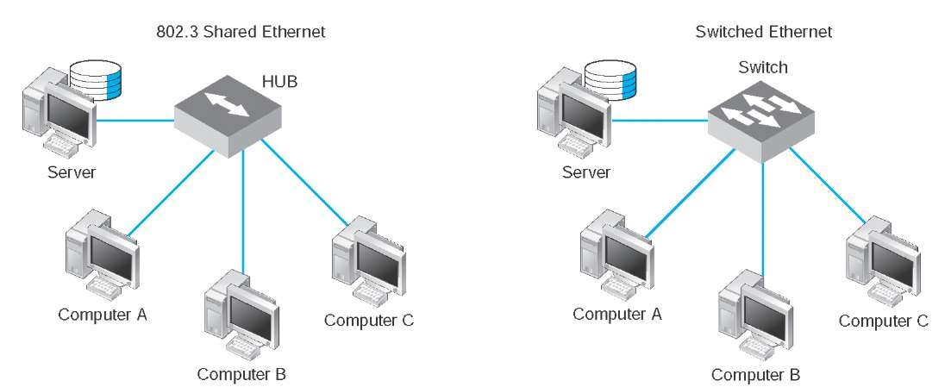
Difference Between Hub and Switch
Local Area Network (LAN)
Hub links devices together with Ethernet cables.
Still a collision domain.
A switch forwards message only to the destination MAC address.
Can avoid collisions in many cases

Slide 33
Outline
Today
Physical Layer
Link Layer
Network Layer
Transport Layer
Application Layer

Slide 34
The Network Layer
Application
Transport
The decision making needed to steer a message from source to destination through an inter-network
Network
Link
Physical

Slide 35
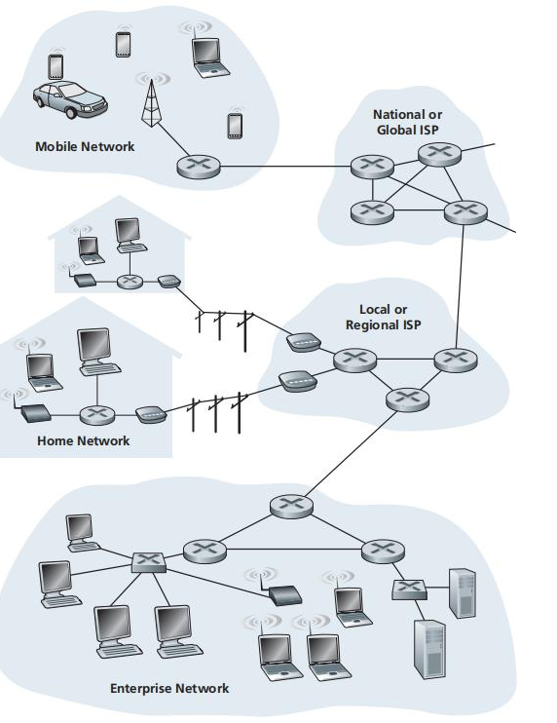
Computer Network: Internet
Internet Service Provider (ISP)
The Internet is a computer network
Interconnects billions of computing devices referred to as hosts or end systems.
End systems connected by a network of communication links, such as coaxial cable, copper wire, optical fiber, and radio.
Transmission rate of a link measures in bits/second. E.g. Fiber: ~1Tbits/second.
Server
Routers and switches forward messages towards their ultimate destination.
End systems access internet through ISPs (Internet Service Providers).
Kurose & Ross, “Computer Networking”

Slide 36
The Network Layer: Addressing
Hierarchical addressing
Venerable IPv4 addresses: 32-bits: Network# + Host Number
IPv6 addresses: 128-bits and more structured
Host number translated to LAN station ID, e.g by ARP between IPv4 and 802.11
Routing selects path to take from one network to another, often on a hop-by-hop basis
Does this packet belong on one of my LANs? If so ARP and deliver
If not, send upstream (or to a peer, or…)
This provides for an order of magnitude more hosts

Slide 37
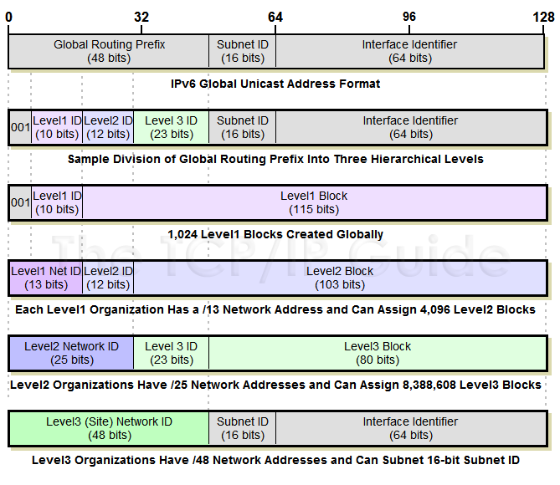
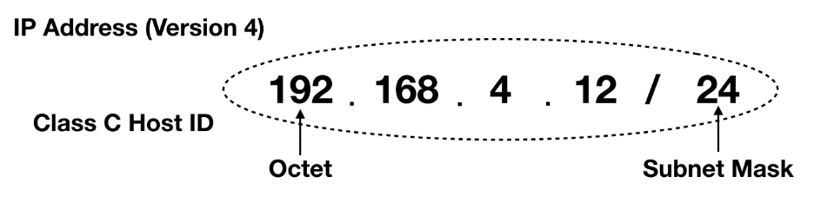

Network Layer: Addressing
https://medium.com/hd-pro/cidr-addressing-and-subnet-masking-on-ip-networks-part-i-3054e3fbb0a1
http://www.tcpipguide.com/free/t_IPv6GlobalUnicastAddressFormat-4.htm

Slide 38
The Network Layer: Address Assignment
Old school: Go to system administrator and trade MAC address for IP address
Today: DHCP server automates this. Broadcast of request with MAC is answered with assigned IP
Assigned IP is leased and needs to be renewed
Assigned IP can be from dynamic pool
Assigned IP can also be according to a pre-configured rule, such as to give a server a well-known address
DHCP can also communicate other configuration information
DHCP isn’t technically part of the link layer.
It is an Application Layer Service that supports it.

Slide 39
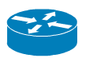
Routing Among Networks
B
A

Slide 40
Routing Among Networks
B
A

Slide 41
Routing Among Networks
B
A

Slide 42
Routing Among Networks
B
A

Slide 43
Routing Among Networks
B
4
3
1
2
A

Slide 44
Routing Among Networks
4
3
2
1
B
A

Slide 45
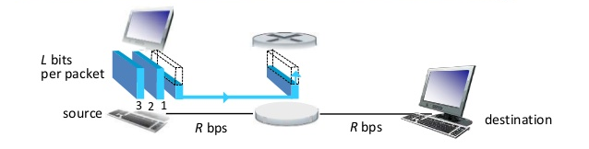
Packet Switching: Store-and-Forward Transmission
Switch
Store-and-forward transmission:
Classically, a packet switch must receive the entire packet before it can begin to transit the first bit of the pack onto the outbound link.
Modern switches can actually begin after receiving and processing only the needed portions of the header
bits in each packet
Time for the switch to receive the entire packet:
transmission rate (bits per second)
Time for the switch to forward the entire packet after receiving:
Total switch delay:
Total switch delay for N links:

Slide 46
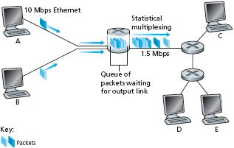
Packet Switching: Queuing Delays and Packet Loss
Each packet switch has multiple links attached to it. For each attached link, the packet switch has an output buffer (also called output queue), which stores packets that the router is about to send into that link.
Queuing Delay: Output link is busy for transmitting an arriving packet.
Packet Loss: When output buffer is full, either the arriving packet or one of the already-queued packet will be dropped.

Slide 47
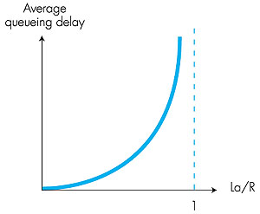
Queuing Delay
Link transmission rate (bits per second)
a
Packet arrival rate: Number of packets arriving per second
Traffic intensity
Queueing delay = 0
Queueing delay diverges…

Slide 48
Outline
Today
Physical Layer
Link Layer
Network Layer
Transport Layer
Application Layer

Slide 49
The Transport Layer
Application
The messages sent and received by application programs
The end-to-end connection as seen by a programmer
The decision making needed to steer a message from source to destination through an inter-network
The management of the physical channel for communication
The specification for the hardware that enables the signaling between or among devices
Transport
Network
Link
Physical

Slide 50
Transport Layer: Meaningful Endpoints
Hosts don’t communication – various aspects of software systems do
Consider how many different sessions your Web browser has with servers. Now add for your IM sessions, upgrades-in-progress, music streaming, etc.
Endpoints enable the establishment of sessions
Classic model is <<IP:port>:<IP:port>>
Client: Ephemeral port
Host: Well-known port

Slide 51
Transport Layer: Meaningful Paradigm
Character of communication
Reliable/session-oriented, e.g. TCP
Unreliable/datagram, e.g. UDP
Etc.
The transport layer exists once we have the ability to establish communication from end-point to end-point with well-understood properties

Slide 52
Transport Layer: User Datagram Protocol (UDP)
Reminder: Port numbers in addition to IP addresses
Best effort = Unreliable
Messages can be lost or reordered
Message corruption is assumed to be detected at the link layer
Message oriented. Max message size
Simple
Used for timely updates, e.g. send audio or video for teleconferencing

Slide 53
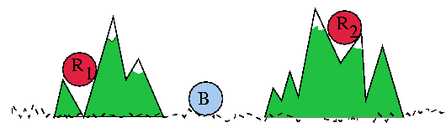
Background: Reliable Protocol vs Reliable Media The Two Armies Parable
Red army in the hills, but divided.
Blue army in the valley.
Red army can defeat blue army, but only if the two elements coordinate an attack at the same time, otherwise it will be defeated
All communication is by messenger (in the challenging environment of war)
“Attack at dawn”?

Slide 54
Transport Layer: Reliable Protocols
Keeps trying to send data until it succeeds or times out
Used acknowledgements to determine that it does not need to resent
Buffers to ensure in-order delivery, which allows head-of-line blocking
Messages are assumed to be correct or undelivered via checksums at link layer
“Byzantine Failures” are possible, occur commonly at Internet scale, but infrequent enough to be (mostly) ignored. Maybe.
Can’t guarantee delivery.
At best can trade timeliness for delivery

Slide 55
Transport layer: Stop-And-Wait Protocols
Send a message. Wait one fully network latency for it to get to the recipient. Wait for the recipient to process it. Wait another full network latency to send back the acknowledgement
In one round-trip time (RTT), only one message is sent.
RTT sec * bits/sec = total bits we can send in that time.
Size of message is what we actually sent. Rest of time is wasted waiting.

Slide 56
Transport layer: Sliding Window
Buffer enough data on sender to keep sending for the entire RTT.
Treat sending buffer as circular: As ACKs come back, “slide window” to buffer new data, releasing old data and keep sending.
If ACK doesn’t come back in time, resend data.
Head-of-line blocking is possible
Keep buffer an receiver in sync with sender to buffer, releasing segments up the stack in order.
Requires segments, segment numbers

Slide 57
Transport Layer: Sliding Window
Acknowledged packets
Packets not acknowledged yet
LAR
LFS
seq. numbers
LAR (last ACK received)
LFS (last frame sent)

Slide 58
Transport layer: Sliding Window, Cont.
Sender
Receiver
Max ACK received
Next seqnum
Next expected
Max acceptable
…
…
…
…
Sender window
Receiver window
Credit:
Hui Zhang
Sent & Acked
Sent Not Acked
Received & Acked
Acceptable Packet
OK to Send
Not Usable
Not Usable

Slide 59
Transport Layer: Transmission Control Protocol (TCP)
Reminder: Port numbers in addition to IP addresses
Used for transmissions that need to be correct, but not timely
Streaming audio or video, e.g. recorded movies
Bulk data transfer, e.g. uploads or downloads
Requires overhead of establishing a session to maintain shared state between sender and receiver to coordinate.
Different schemes for ACKs
Delayed ACKs, Cumulative ACKs, Selective ACKs

Slide 60
Transport Layer: Transmission Control Protocol (TCP)
Congestion Control
Packet loss can be due to many types of failure, including congestion
If congestion, desire is to slow down.
Slowing down can be achieved by shrinking window, which leaves network time unused
TCP has different strategies it can use to determine when to slow down and how to speed back up.
3-Way Handshake: SYN, SYN-ACK, ACK-SYN
Establishes session, negotiates window sizes and other options, e.g. SACK, window sizes, etc.

Slide 61
Application Layer: Purposeful Communication
Defined by the messaging we, as programs, bake into our applications, shaped by our applications,
e.g. client-server interactions, peer-to-peer interactions, etc.
E.g.
HTTP: PUT, GET, POST, etc
E.g DNS: queries, responses, updates, etc.
MIME, VOIP protocols, etc.
Application protocols exist when applications can communicate

Slide 62
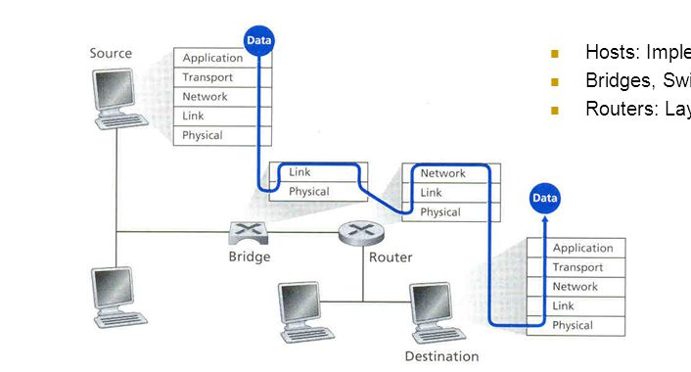
Computer Network: Summary: Layered Structure

Slide 63
Application Layer
Application
The messages sent and received by application programs
The end-to-end connection as seen by a programmer
The decision making needed to steer a message from source to destination through an inter-network
The management of the physical channel for communication
The specification for the hardware that enables the signaling between or among devices
Transport
Network
Link
Physical

Slide 64
Hyper Text Transport Protocol (HTTP)
Unique name for a file: URL (Universal Resource Locator)
Example URL: http://www.cmu.edu:80/index.html
Clients use prefix (http://www.cmu.edu:80) to infer:
What kind (protocol) of server to contact (HTTP)
Where the server is (www.cmu.edu)
What port it is listening on (80)
Servers use suffix (/index.html) to:
Determine if request is for static or dynamic content.
No hard and fast rules for this
One convention: executables reside in cgi-bin directory
Find file on file system
Initial “/” in suffix denotes home directory for requested content.
Minimal suffix is “/”, which server expands to configured default filename (usually, index.html)

Slide 65
HTTP Requests
HTTP request is a request line, followed by zero or more request headers
Request line: <method> <uri> <version>
<method> is one of GET, POST, OPTIONS, HEAD, PUT, DELETE, or TRACE
<uri> is typically URL for proxies, URL suffix for servers
A URL is a type of URI (Uniform Resource Identifier)
See http://www.ietf.org/rfc/rfc2396.txt
<version> is HTTP version of request (HTTP/1.0 or HTTP/1.1)
Request headers: <header name>: <header data>
Provide additional information to the server
Notes:
Request header examples: brand name of the browser, domain name of the origin server

Slide 66
HTTP Responses
HTTP response is a response line followed by zero or more response headers, possibly followed by content, with blank line (“\r\n”) separating headers from content.
Response line:
<version> <status code> <status msg>
<version> is HTTP version of the response
<status code> is numeric status
<status msg> is corresponding English text
200 OK Request was handled without error
301 Moved Provide alternate URL
404 Not found Server couldn’t find the file
Response headers: <header name>: <header data>
Provide additional information about response
Content-Type: MIME type of content in response body
Content-Length: Length of content in response body

Slide 67
Example HTTP Transaction
whaleshark> telnet www.cmu.edu 80 Client: open connection to server
Trying 128.2.42.52... Telnet prints 3 lines to terminal
Connected to WWW-CMU-PROD-VIP.ANDREW.cmu.edu.
Escape character is '^]'.
GET /index.shtml HTTP/1.1 Client: request line
Host: www.cmu.edu Client: required HTTP/1.1 header
Client: blank line terminates headers
HTTP/1.1 200 OK Server: response line
Date: Wed, 05 Nov 2014 17:37:26 GMT Server: followed by 4 response headers
Server: Apache/1.3.42 (Unix)
Transfer-Encoding: chunked
Content-Type: text/html; charset=...
Server: empty line terminates headers
1000 Server: begin response body
<html ..> Server: first line of HTML content
…
</html>
0 Server: end response body
Connection closed by foreign host. Server: close connection

Slide 68
Domain Name System
Old school
Let “The Keeper of All Things” know about a hostname:IP assignment in your organization
The Keeper updates a “hosts” text file with the information
Periodically download this file to keep your system up to date
Obvious scalability problems, but /etc/hosts still exists vestigially and for special cases
Today
Domain Name System (DNS) is a distributed data base that delegates assignments for information to the responsible domains and can direct queries to the servers associated with those domains.
Uses caching for efficiency.
We’ll talk about it later in detail
DNS isn’t technically part of the network layer.
It is an Application Layer Service that supports it.

Slide 69
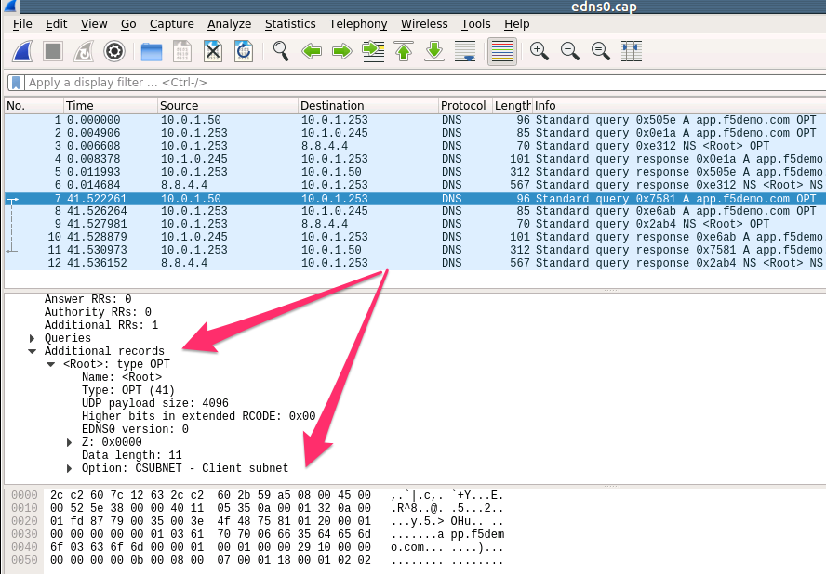
DNS Example
https://clouddocs.f5.com/training/community/dns/html/class4/module1/lab4.html

Slide 70
Wrapping Up
Application
The messages sent and received by application programs
The end-to-end connection as seen by a programmer
The decision making needed to steer a message from source to destination through an inter-network
The management of the physical channel for communication
The specification for the hardware that enables the signaling between or among devices
Transport
Network
Link
Physical

Slide 71
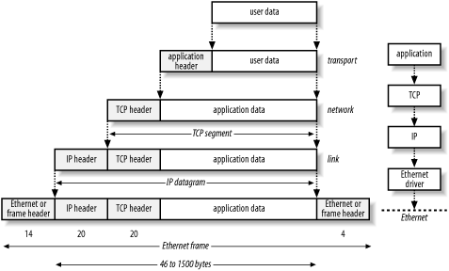
Computer Network: Summary: Layered Structure
http://books.gigatux.nl/mirror/snortids/0596006616/snortids-CHP-2-SECT-2.html

Slide 72
End-To-End Argument
“Functions placed at low levels of a system may be redundant or of little value when compared with the cost of providing them at that low level.”
“Low-level mechanisms to support these functions are justified only as performance enhancements.”
Unless there is a reason, do it at a higher layer: One might not need to do it at all.
Error Detection Example: Link Layer or Transport layer?
Probably link layer: Who wants bad data? Why pass it up?
Error Correction Example: Link Layer or Transport layer?
Probably transport layer: Late may be of no value. Redundancy may be too costly.
But, then there are very high error channels that wouldn’t be viable without forward error correction, e.g. redundancy baked in
Encryption Example: Link Layer or Transport Layer?
Probably transport layer: May not be needed + “Person In The Middle”, i.e. the messengers that can se it along the way.

Slide 73
Enjoy Carnival!
See you Tuesday!

