Slide 1

April 2014
Notes:
This presentation describes the state of the CS program at CMU-Q as of the date on this slide. More detail can be found in hidden slides and in the notes area of each slides.

Slide 2
Outline
Context: Qatar and Education City
Programs
Faculty
Students
Alumni
Other

Slide 3
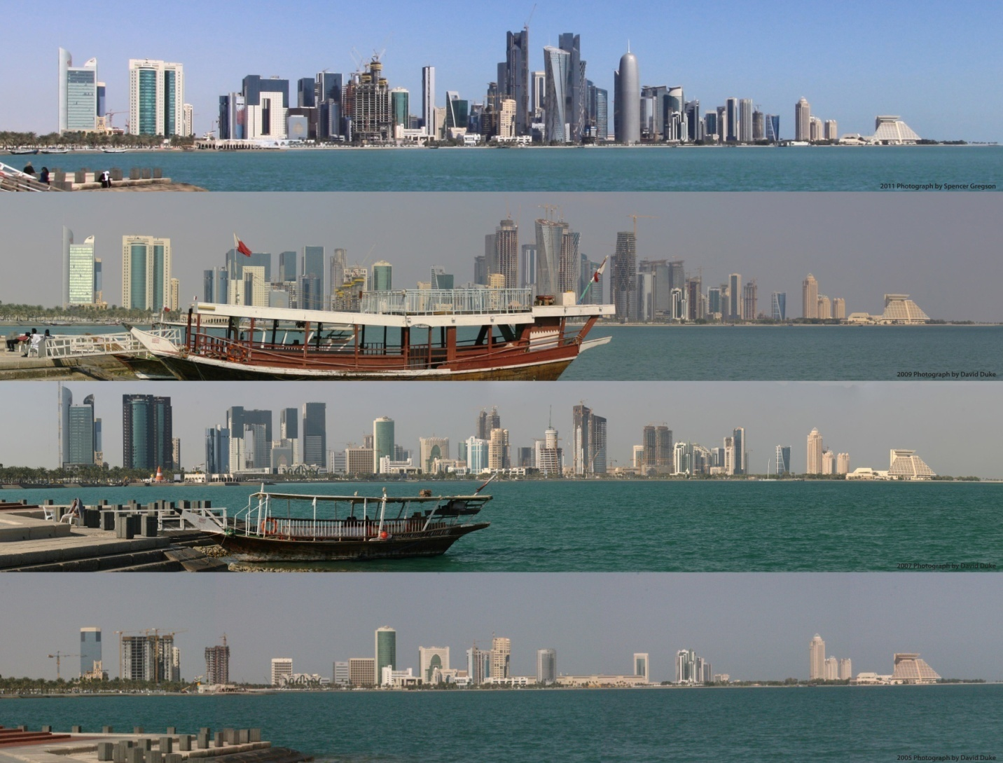
Qatar
2011
2009
2007
2005

Slide 4
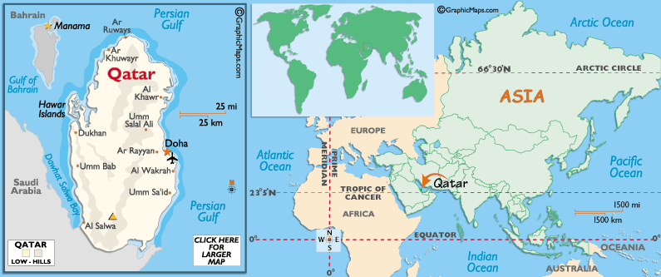
Qatar
~ 2.05M people (< 300,000 Qataris)
Highest GDP per capita ($145,300)
  19.4% real growth rate (2nd in the world)
  Oil and gas is 70% of GDP
Be a knowledge-based economy by 2030
  Huge investment in education
  2.8% of GDP committed to research
Source: CIA Factbook 2011

Slide 5
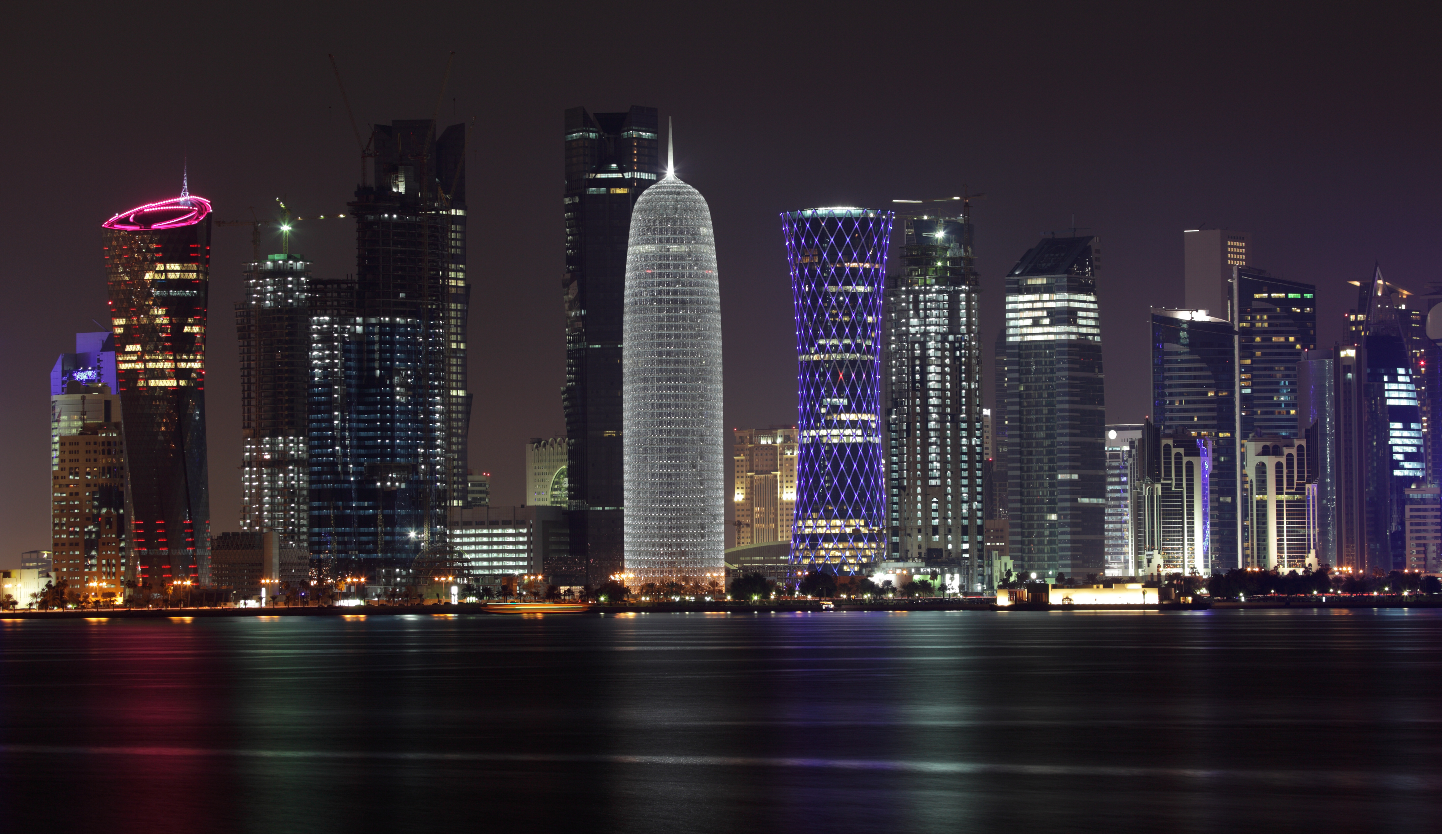
Doha

Slide 6
Qatar Foundation
An independent nonprofit organization committed to the developmengt of Qatar and its people
  Founded 1995
  Chaired by Sheika Moza

Slide 7
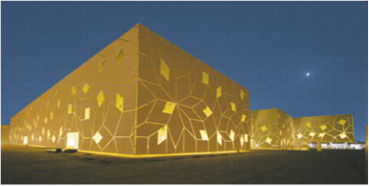
Qatar Foundation
QF
QEERI, QBRI ...
EC
VCU
…
QSTP
QNRF
Sidra
QCRI
WCMC
Applied
research,
startups
Research
funding
Medical
research
Computing
research
TAMU
CMU
Education & research
GU
NWU
Notes:
Virginia Commonwealth School of the Arts in Qatar [1997]
Graphic, Interior, and Fashion Design
Weill Cornell Medical College in Qatar [2002]
Pre Medical and Medical
Texas A&M University at Qatar [2003]
Chemical, Electrical, Mechanical, and Petroleum Engineering
Carnegie Mellon University in Qatar [2004]
Business Administration, Computer Science, Information Systems
Georgetown University School of Foreign Service in Qatar [2005]
International Politics
Northwestern University in Qatar [2008]
Journalism and Communication

Slide 8
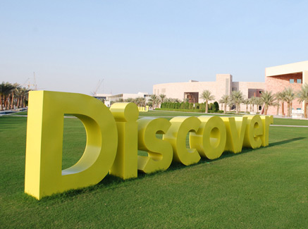
Education City
3700 acres
8 international branch campuses
~2,500 students
  30% live on campus
  90 students nationalities
  70 percent of students receive QF scholarships or loans
Notes:
New EC universities:
HEC Paris – Qatar: http://www.qf.org.qa/output/page1093.asp
executive education programs for mid-career and senior executives in Doha, including the HEC Executive MBA, non-degree certificate programs and in-house customized training
University College London – Qatar: http://www.ucl.ac.uk/news/news-articles/1010/10102803
masters degrees in archaeology, conservation and museum studies

Slide 9
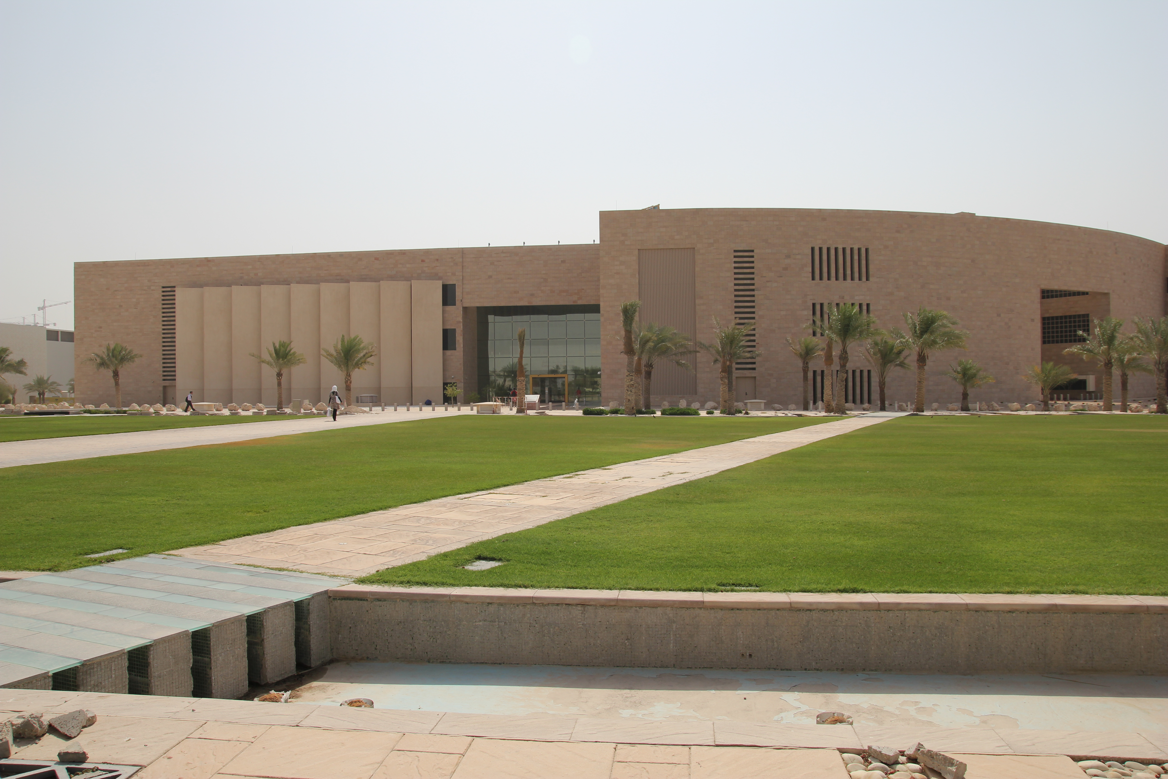
Carnegie Mellon University in Qatar
Started in 2004
  10th year Celebrations on March 18, 2014
Offer Undergraduate Degrees
  Biological Sciences (2011)
  Business Administration (2004)
  Computational Biology (2011)
  Computer Science (2004)
  Information Systems (2007)

Slide 10

Faculty
Business Administration – 14
Biology – 5
Computer Science – 10
Information Systems – 5
General Education – 20
  Math, Sciences, English, Humanities

Slide 11
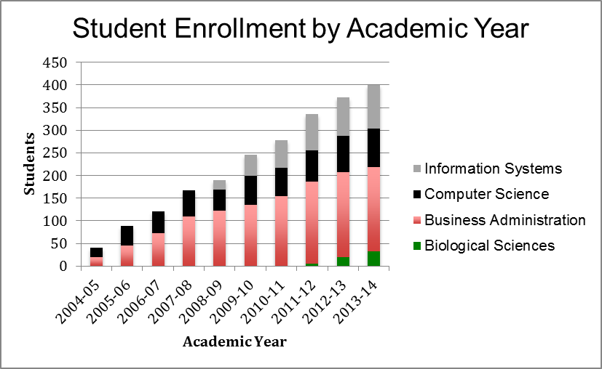
Students: 10 Year Summary

Slide 12
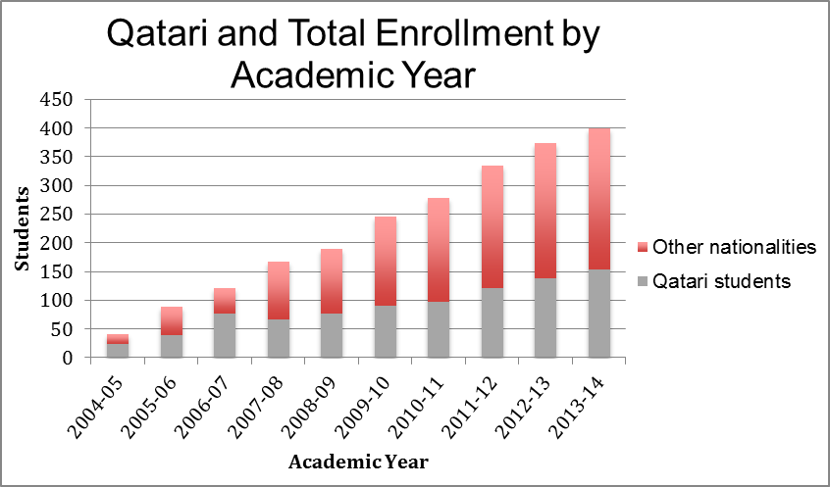
Students: 10 Year Summary

Slide 13
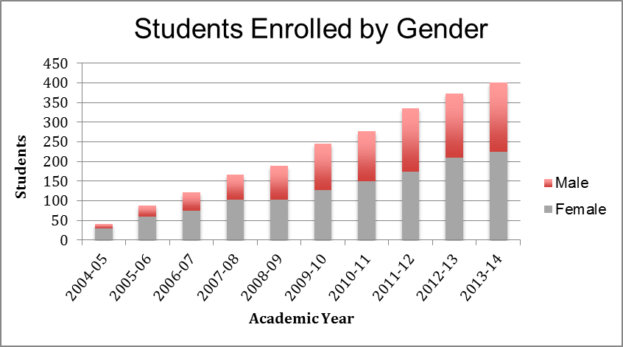
Students: 10 Year Summary

Slide 14
Students (As of Spring 2014)
Spring 2014 Enrollment |  |  | Qatari |  | Non-Qatari |  | Total by Gen |  | Total
 |  |  | Female | Male | Female | Male | Female | Male
 | QBA | Fresh | 18 | 3 | 11 | 13 | 29 | 16 | 45
 |  | Soph | 22 | 4 | 9 | 6 | 31 | 10 | 41
 |  | Junior | 20 | 6 | 13 | 13 | 33 | 19 | 52
 |  | Senior | 12 | 4 | 8 | 18 | 20 | 22 | 42
 |  | Total | 72 | 17 | 41 | 50 | 113 | 67 | 180
 | QBS | Fresh | 6 | 2 | 3 | 3 | 9 | 5 | 14
 |  | Soph | 2 | 0 | 9 | 2 | 11 | 2 | 13
 |  | Junior | 0 | 1 | 1 | 2 | 1 | 3 | 4
 |  | Senior | 1 | 1 | 1 | 0 | 2 | 1 | 3
 |  | Total | 9 | 4 | 14 | 7 | 23 | 11 | 34
 | QCS | Fresh | 1 | 2 | 9 | 19 | 10 | 21 | 31
 |  | Soph | 0 | 1 | 6 | 12 | 6 | 13 | 19
 |  | Junior | 0 | 2 | 2 | 11 | 2 | 13 | 15
 |  | Senior | 1 | 1 | 3 | 5 | 4 | 6 | 10
 |  | Total | 2 | 6 | 11 | 47 | 22 | 53 | 75
 | QIS | Fresh | 12 | 2 | 7 | 5 | 19 | 7 | 26
 |  | Soph | 8 | 1 | 3 | 6 | 11 | 7 | 18
 |  | Junior | 10 | 2 | 6 | 10 | 16 | 12 | 28
 |  | Senior | 8 | 0 | 6 | 13 | 14 | 13 | 27
 |  | Total | 38 | 5 | 22 | 34 | 60 | 39 | 99
 | Total |  | 121 | 32 | 88 | 138 | 218 | 170 | 388

Slide 15
Student Exchange
Pittsburgh / Doha Exchange
Semester | Pitt > Doha | Doha > Pitt
2006 Fall | 0 | 1
2007 Fall | 0 | 1
2007 Spring | 0 | 1
2008 Fall | 5 | 12
2008 Spring | 8 | 2
2008 Sum 1 | 0 | 7
2008 Sum 2 | 0 | 5
2009 Fall | 0 | 8
2009 Spring | 10 | 7
2009 Sum 1 | 1 | 14
2009 Sum 2 | 0 | 7
2010 Fall | 3 | 9
2010 Spring | 12 | 5
2010 Sum 1 | 0 | 14
2010 Sum 2 | 0 | 7
2011 Fall | 1 | 6
2011 Spring | 6 | 8
2011 Sum 1 | 0 | 20
2011 Sum 2 | 0 | 15
2012 Fall | 0 | 18
2012 Spring | 5 | 8
2012 Sum 1 | 0 | 25
2012 Sum 2 | 0 | 28
2013 Fall | 1 | 14
2013 Spring | 0 | 10
2013 Sum 1 | 0 | 43
2013 Sum 2 | 0 | 26
2014 Spring | 0 | 13
2014 Sum 1 | 0 | 30
2014 Sum 2 | 0 | 4
Total | 52 | 368
*Does not include IMPAQT students

Slide 16
Graduates
Graduation Data
Date | QBA | QBS | QCS | QIS | Total
05/18/08 | 18 | 0 | 10 | 0 | 28
08/12/08 | 3 | 0 | 0 | 0 | 3
12/18/08 | 3 | 0 | 2 | 0 | 5
05/17/09 | 18 | 0 | 7 | 0 | 25
08/11/09 | 6 | 0 | 0 | 0 | 6
12/17/09 | 2 | 0 | 0 | 0 | 2
05/16/10 | 20 | 0 | 4 | 4 | 28
08/10/10 | 3 | 0 | 0 | 0 | 3
12/16/10 | 4 | 0 | 0 | 1 | 5
05/15/11 | 30 | 0 | 4 | 6 | 40
08/09/11 | 1 | 0 | 0 | 0 | 1
12/22/11 | 7 | 0 | 2 | 5 | 14
05/20/12 | 25 | 0 | 5 | 9 | 39
08/14/12 | 3 | 0 | 3 | 1 | 7
12/20/12 | 4 | 0 | 3 | 2 | 9
05/19/13 | 33 | 6 | 10 | 15 | 64
08/13/13 | 6 | 0 | 2 | 1 | 9
12/19/13 | 3 | 0 | 1 | 1 | 5
Total | 189 | 6 | 53 | 45 | 293

Slide 17

Graduate Employment
Top 10 Sectors
Oil and Gas Industries
Banking & Finance
Education
Technology
Non-Profit Orgs
Telecommunications
Industrial Goods
Government
Research and Development
Arts and Culture
Top Ten Industrial Sectors

Slide 18

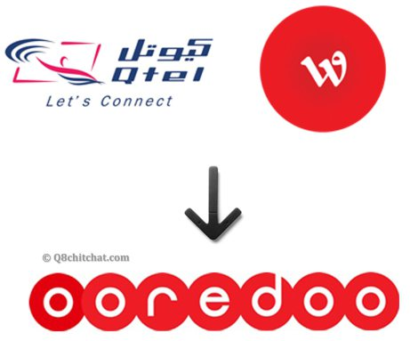








Graduate Employment
Top 10 Employers
Top Ten Recruiters

Slide 19
Graduate Employment
KPMG
PWC
Ernest & Young
RasGas
Qatar Olympic Committee
Qatar Petroleum
Dolphin Energy
Northwestern Univ. Qatar
Conoco Phillips
MS Research
Exxon Mobil
Qatar Gas
ICT Qatar
CMU-Q
Google
Microsoft
Disney World
Qatar Foundation
Nestle
Citi
HSBC
Qatar National Bank
Qatar Central Bank
Commercial Bank of Qatar
GE
Qtel/Ooredoo
Shell
QWIC
Fuego
QCRI
Doha Int. Airport
vodafone

Slide 20
Graduate Schools
PhD, RI at SCS, CMU-P
MS, HCII at SCS, CMU-P
MS, CS at SCS, CMU-P
MS, CS at University of Michigan (2)
PhD, CS at UC Irvine
MS, MISM at Heinz College, CMU-P
MS, Public Policy at Heinz College, CMU-P
MS, Oxford University
MS, UC London
MS, Univ. of Liverpool
MS, VCU
MS, Duke University
MS, Leipzig Graduate school of Management
MS, King’s College
MS, London School of Economics
MS, Cass Business School London
Accepted this year
M.Sc., CS CMU-P
5th Masters, RI, CMU-P
M.Sc., HCI, CMU-P
M.Sc., CS, Stanford
M.Sc., CS, G Tech
M.Sc., HCI, Univ. Mich.
M.Sc., MIS, Univ. Arizona

Slide 21
Student Achievements (QCS)
Google Anita Borg Scholarships
  Keghani Kouzoujian (’09)
  Samreen Anjum (’10)
  Hanan Alshishabubakr (’13)
  Sidra Alam (’13)
Phi Beta Kappa
  Hend Geddawy (’09)
SCS Alumni Thesis Awards (’08, ’09)
  Noura El’Moughny (’09)
  Hatem Alismail (’09)
Grace Murray Hopper Undergraduate Research Award (2013)
  Amna AlZeyara (‘14)
Qatar Annual Research Award
  Amna AlZeyara (‘14) – won in 2011
  Dania Abedabbou (‘12) – won in 2012
Andrew Carnegie Scholar (’09)
  Qatar Andrew Carnegie Scholar (’10, ’11)
Student papers at international conferences
  IEEE ICRA’07, IEEE/RSJ IROS’09, ACM DEV 2010 (x2)
  ICTD 2010, student monograph
5th Year Scholar
  Keghani Kouzoujian (’09)
Afnan Fahim (‘13)

Slide 22
Student Achievements (QIS)
Founding of the first students’ chapter of the AIS association in the GCC
AIS student chapter won the best communication award in 2011
First place in AIS students competition in 2012, for IT risk management
    Aamir Masood (‘12)
1st Prize GCC Henkel competition in 2014
  Jaasim Polin, Sarah Mustafa (‘14)
Best paper award, UCIS, 2014
    Daniel Cheweiky (‘14)
Andrew Carnegie Scholar
  Qatar Andrew Carnegie Scholar (‘13)
Senior honors thesis
  Fatema Akbar (’13), Marwa Al-Fakhri (’13)
  Seven in progress (‘14)
Student papers at international conferences, Book Chapters
  Procedia Technology, Elsevier, The International Journal of Telemedicine and Applications
  Information Systems and Technologies for Enhancing Health and Social Care, IGI
  ISDOC’12, The Hamlyn Symposium on Medical Robotics’12
  Keynote speech Ellucian Live Middle East conference on technology and education
  UCIS’11,’12,’13,’14

Slide 23
Outreach Activities
Distinguished Lectures
Dean’s Lecture Series
Dignitaries
Seminars
Executive Ed, Public Workshops and Tutorials
  E-business strategies
  Natural Language Processing
  Cyber Security
  Conflict Resolution
  Qatari Law
  Dynamic organizational leadership
  Bioinformatics…
Educational Outreach
Conferences

Slide 24
Distinguished Lectures
A. Nico Habermann Distinguished Lectures
  Raj Reddy, Randy Bryant, Kurt Mehlhorn, Takeo Kanade, Tom Mitchell
Richard Cyert Distinguished Lectures
  Kannan Srinivasan, Finn Kydland, Jerome Apt III
Patrick Crecine Distinguished Lectures
  John P. Lehoczky,

Slide 25
Dignitaries
Hillary Clinton – Sec. of State
Steven Chu – Sec. of Energy
Bill Gates

Slide 26
Conferences
ICTD
LPAR 2008
ASIAN ‘07

Slide 27



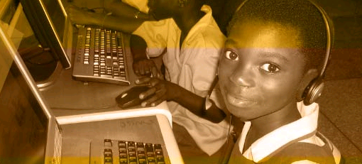
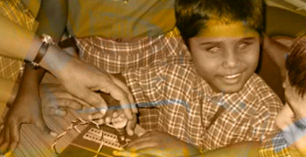
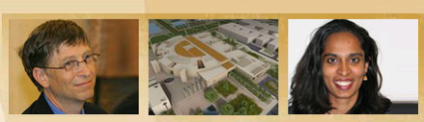

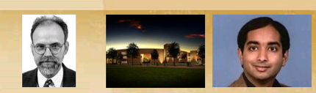
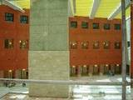
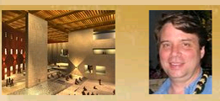
Keynotes by Bill Gates and Carlos Braga
100+ registrations to date plus ~100 scholarship applications
18 papers accepted for
oral presentation
27 papers accepted for
poster presentation
4 panels, 3 workshops,
~40 demos

Slide 28
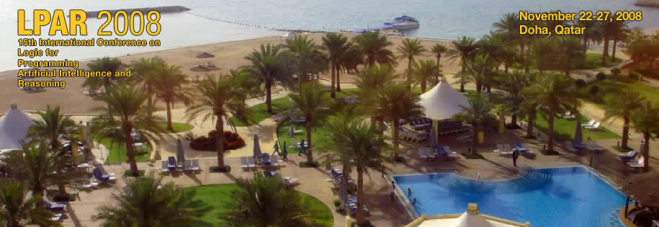
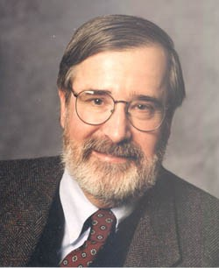
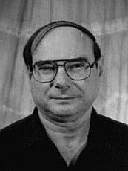
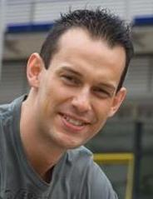
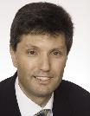






http://www.qatar.cmu.edu/lpar08
Edmund Clarke Carnegie Mellon University (USA) 2007 Turing Award Recipient | Amir Pnueli New York University (USA) 1996 Turing Award Recipient | Michael Backes Saarland University and MPI-SWS (Germany) | Thomas Eiter Technical University of Vienna (Austria)
Top conference in computational logic
  154 submissions (all times record), 45 papers accepted
  4 prestigious invited speakers
  Peer-reviewed
  Proceedings
Notes:
Who chaired this?

Slide 29

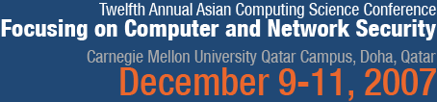
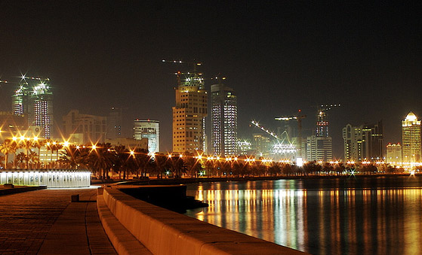

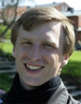
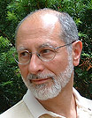
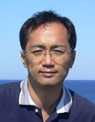
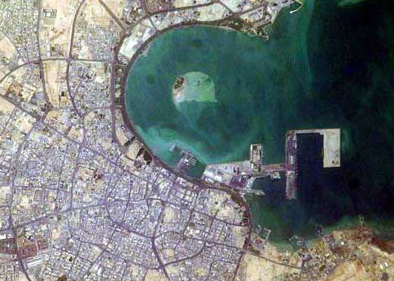


“provide a forum for researchers in computer science from the Asian continent and to promote interaction with researchers in other regions”
http://www.qatar.cmu.edu/asian07
A. Sabelfeld
J. Guttman
K. Kato
First Technical conference in Doha
  112 submissions, 15 full papers accepted
  3 prestigious invited speakers
  Peer-reviewed
  proceedings
Notes:
Who chaired this?

Slide 30
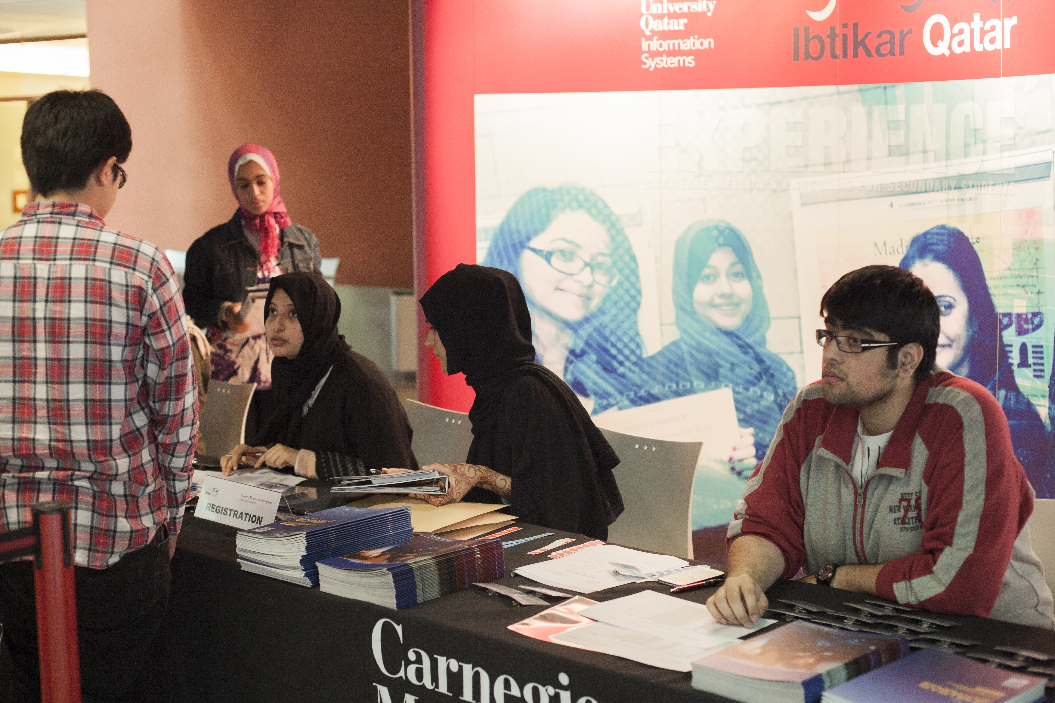
Educational Outreach
CS4Qatar
  Computer Science for High School Students
High School Programming Competition
Botball
Ibtikar – Innovation
Live the Information Systems experience
Tajer-Day – Commerce Day (BA)
Biotechnology Explorer
Summer College Preview Program

Slide 31
Pittsburgh – Qatar Interaction in Education
67-329: Contemporary themes in global systems: Joint global projects
Architecture: Joint videoconference course
15-213 Computer Systems (Summers)
15-389 Cloud Computing (Springs)
15-418 Parallel Computer Architecture and Programming (Springs)
15-384 Robotic Manipulation
Misc. History Courses

Slide 32
Research
Since 2008, Qatar National Research Fund (QNRF) has been funding projects
  NPRP – National Priorities Research Program
  YSREP – Young Scientists Research Experience Program
  UREP – Undergraduate Research Experience Program
QNRF also supports Post-docs and PhD students.

Slide 33
Research
CMU-Q as submitting institution was awarded
  32 NPRP Projects (~$1M each)
    13 jointly with colleagues in CMU-P
  5 YSREP Projects (~$300K each)
  16 UREP Projects (~$10K each)
Numerous Post-docs and Research Associates/Engineers employed on these projects

Slide 34
Thanks
Questions?

