Slide 1
Simplicity Truth Zen
Kevin T. Kelly
Conor Mayo-Wilson
Hanti Lin
Department of Philosophy
Carnegie Mellon University
http://www.andrew.cmu.edu/user/kk3n/ockham/Ockham.htm

Slide 2
Theoretical Underdetermination
I dare you to choose one!
???

Slide 3
Western Epistemology
The demon undermines science, so defeat him.
I smite thee with scientific rationality!
R

Slide 4
Western Epistemology
The demon undermines science, so defeat him.
Portray him as weak.
You can’t fool me!
R

Slide 5
Zen Epistemology
The demon justifies science with his strength.
Stronger demons justify weaker inferences!

Slide 6
Zen Epistemology
How is this supposed to work, eh?

Slide 7
Zen Epistemology
If you could do better, you should.
But because of me, you can’t.
So you are optimal and, hence, justified.

Slide 8
Zen Epistemology
Isn’t that how computer scientists routinely evaluate algorithms?
Yes.

Slide 9
Zen Epistemology
But computing is deduction.
Isn’t induction a completely different animal?
No. That’s what formal learning theory is about.

Slide 10
Zen Epistemology
Cool.
But how does it apply to science?

Slide 11
Ockham’s Razor

Slide 12
Astronomy 1543
Planetary retrograde motion
Mars
Earth
Sun
Only at solar opposition

Slide 13
Ptolemaic Explanation
Retrograde path is due to an epicycle.
Can happen regardless of the position of the sun
epicycle
θ

Slide 14
Copernican Explanation
“Lapped” competitor appears to backtrack against the bleachers.
epicycle
θ
lapping

Slide 15
Copernicus Victorious
Explains the data rather than merely accommodating them.
Has fewer adjustable parameters.
Is more falsifiable (failure of correlation would rule it out).
Is more unified.
Is simpler.

Slide 16
More Victories for Simplicity
universal gravitation vs. divided cosmos
wave theory of light vs. particles and aether
oxygen vs. phlogiston
natural selection vs. special creation
special relativity vs. classical electrodynamics
Dirac’s equation
chaos vs. infinite series of random variables

Slide 17
Puzzle
An indicator must be sensitive to what it indicates.
simple

Slide 18
Puzzle
An indicator must be sensitive to what it indicates.
complex

Slide 19
Puzzle
But Ockham’s razor always points at simplicity.
simple

Slide 20
Puzzle
But Ockham’s razor always points at simplicity.
complex

Slide 21
Puzzle
How can a broken compass help you find something unless you already know where it is?
complex

Slide 22
Metaphysicians for Ockham
Somehow, I don’t like the sound of that…

Slide 23
Information Channel
Simplicity bias
Simple reality
Mystical vision
Natural selection??

Slide 24
Pre-established Harmony
G
Simplicity bias
Simple reality

Slide 25
Idealism
Simplicity bias
Simple reality

Slide 26
Metaphysicians for Ockham
So before you can use your razor to eliminate
Metaphysical causes, you have to assume metaphysical causes.

Slide 27
Theoretical “Virtues”
Simpler theories:
Are more unified;
Explain better;
Are more falsifiable.
But the truth might not be virtuous.
Wishful thinking to assume otherwise.

Slide 28
Statistical Explanations
1. Prior Simplicity Bias
Bayes, BIC, MDL, MML, etc.
2. Risk Minimization
SRM, AIC, cross-validation, etc.

Slide 29
Prior Simplicity Bias
I am inclined to believe the simpler theory because I am inclined to believe that the world is simple.

Slide 30
More Subtle Version
Simple data are a miracle in the complex theory but not in the simple theory.
Has to be!
P
C

Slide 31
However…
correlation would not be a miracle given P(θ);
Why not this?
θ
P
C

Slide 32
The Real Miracle
C
P
Ignorance about model:
p(C) ≈ p(P);
+ Ignorance about parameter setting:
p’(P(θ) | P) ≈ p(P(θ’ ) | P).
= Knowledge about worlds.
p(P(θ)) << p(C).
θ
θ
θ
θ
θ
θ
θ
θ
Ignorance is knowledge.

Slide 33
= Paradox of Indifference
Ignorance of red vs. not-red
+ Ignorance over not-red:
= Knowledge about red vs. white.
θ
θ
Knognorance =
All the priveleges of knowledge
With none of the responsibilities
I’m for it!

Slide 34
In Any Event
The coherentist foundations of Bayesianism have nothing to do with short-run truth-conduciveness.
Not so loud!

Slide 35
Ockham Bayesians Converge
T₂
T₁
T₃

Slide 36
Ockham Bayesians Converge
T₂
T₁
T₃

Slide 37
Ockham Bayesians Converge
T₂
T₁
T₃

Slide 38
Ockham Bayesians Converge
T₂
T₁
T₃

Slide 39
Ockham Bayesians Converge
Oops!
T₂
T₁
T₃

Slide 40
Ockham Bayesians Converge
T₂
T₁
T₃

Slide 41
Ockham Bayesians Converge
T₂
T₁
T₃

Slide 42
Ockham Bayesians Converge
T₂
T₁
T₃

Slide 43
Ockham Bayesians Converge
T₂
Oops!
T₁
T₃

Slide 44
Ockham Bayesians Converge
T₂
Oops!
T₁
T₃

Slide 45
But So Would Other Methods
T₂
Oops!
T₁
T₃

Slide 46
Summary of Bayesian Approach
Prior-based explanations of Ockham’s razor are circular.
Convergence-based explanations of Ockham’s razor fail to single out Ockham’s razor.

Slide 47
2. Risk Minimization
Ockham’s razor minimizes expected distance of empirical estimates from the true value.
Truth

Slide 48
Unconstrained Estimates
are Centered on truth but spread around it.
Pop!
Pop!
Pop!
Pop!
Unconstrained aim

Slide 49
Constrained Estimates
Off-center but less spread.
Truth
Clamped aim

Slide 50
Constrained Estimates
Off-center but less spread
Overall improvement in expected distance from truth…
Pop!
Pop!
Pop!
Pop!
Truth
Clamped aim

Slide 51
Doesn’t Find True Theory
False theories that aren’t too false theory typically predict more accurately than the true theory.
Four eyes!
Clamped aim

Slide 52
When Theory Doesn’t Matter
Predicting lung cancer from ash trays.

Slide 53
When Theory Does Matter
Predicting effectiveness of a ban on ash trays.

Slide 54
Great News
Correlation does imply causation if there are multiple variables, some of which are common effects. [Pearl, Spirtes, Glymour and Scheines, etc.]
Protein A
Protein C
Cancer protein
Protein B

Slide 55
Core assumptions
Joint distribution p is causally compatible with causal network G iff:
Causal Markov Condition: each variable X is independent of its non-effects given its immediate causes.
Faithfulness Condition: no other conditional independence relations hold in p.

Slide 56
Tell-tale Correlations
C
H
C
F1
F2
F
Given C,
F1 gives no further
info about F2
(Markov)
Given F,
H gives
some info about C
(Faithfulness)

Slide 57
Standard Applications
Linear Causal Case: each variable X is a linear function of its parents and a normally distributed hidden variable called an “error term”. The error terms are mutually independent.
Discrete Multinomial Case: each variable X takes on a finite range of values.

Slide 58
The Catch
Protein A
Protein C
Cancer protein
Protein B
English Breakfast?
It’s full of protein C!

Slide 59
As the Sample Increases…
Protein A
weak
Protein C
Cancer protein
Protein B
Protein D
This situation empirically
approximates the last one.
So who cares?
I do! Bon apetit!

Slide 60
As the Sample Increases Again…
Protein E
Protein A
weaker
weak
Protein C
Cancer protein
Protein B
weaker
Protein D
Wasn’t that last approximation
to the truth good enough?
Aaack!

Slide 61
Causal Flipping Theorem
For each convergent M and standard (G, p), there exists standard (G’, p’ ) such that:
p’ is indistinguishable from p at the current sample size and
consistent M flips the orientation of causal arrow X → Y in (G’, p’ ) at least n times as sample size increases.
oops
I meant
oops
I meant
oops
I meant

Slide 62
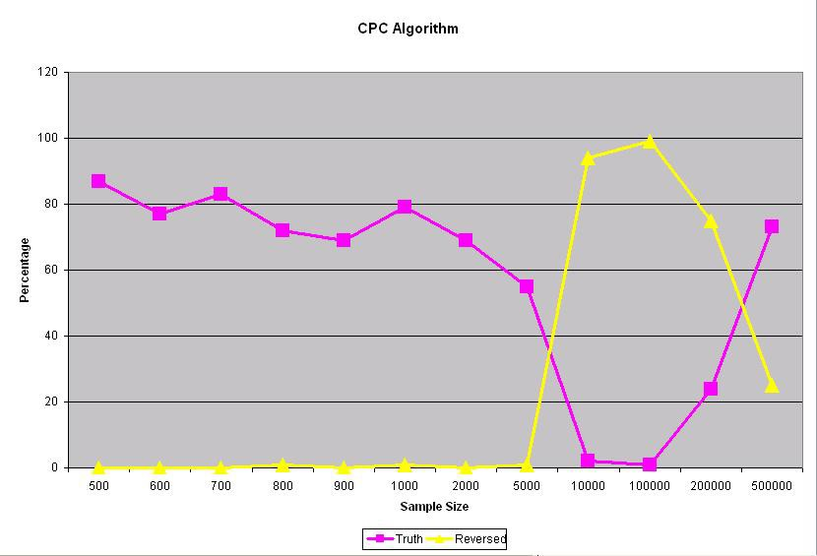
Simulation Using CPC Algorithm
Proportion of outputs out of 1000 trials at each sample size.

Slide 63
Zen Response
Many explanations have been offered to make sense of the here-today-gone-tomorrow nature of medical wisdom — what we are advised with confidence one year is reversed the next — but the simplest one is that it is the natural rhythm of science.
(Do We Really Know What Makes us Healthy, NY Times Magazine, Sept. 16, 2007).

Slide 64
Pursuit of Truth
Short-run Tracking
Too strong to be feasible when theory matters.

Slide 65
Pursuit of Truth
Long-run Convergence
Too weak to single out Ockham’s razor

Slide 66
The Middle Way
Straightest Convergence
Just right?

Slide 67
Ancient Roots
"Living in the midst of ignorance and considering themselves intelligent and enlightened, the senseless people go round and round, following crooked courses, just like the blind led by the blind." Katha Upanishad, I. ii. 5, c. 600 BCE.

Slide 68
II. Navigation by Broken Compass
simple

Slide 69
Asking for Directions
Where’s …

Slide 70
Asking for Directions
Turn around. The freeway ramp is on the left.

Slide 71
Asking for Directions
Goal

Slide 72
Best Route
Goal

Slide 73
Best Route to Any Goal

Slide 74
Disregarding Advice is Bad
Extra U-turn

Slide 75
Helpful A Priori Advice
…so fixed advice can help you reach a hidden goal
without circles, evasions, or magic.

Slide 76
Polynomial Laws
Data = open intervals around Y at rational values of X.

Slide 77
Polynomial Laws
No effects:

Slide 78
Polynomial Laws
First-order effect:

Slide 79
Polynomial Laws
Second-order effect:

Slide 80
In Step with the Demon
There yet?
Maybe.
Cubic
Quadratic
Linear
Constant

Slide 81
In Step with the Demon
There yet?
Maybe.
Cubic
Quadratic
Linear
Constant

Slide 82
In Step with the Demon
There yet?
Maybe.
Cubic
Quadratic
Linear
Constant

Slide 83
In Step with the Demon
There yet?
Maybe.
Cubic
Quadratic
Linear
Constant

Slide 84
Passing the Demon
There yet?
Maybe.
Cubic
Quadratic
Linear
Constant

Slide 85
Passing the Demon
I know you’re coming!
Cubic
Quadratic
Linear
Constant

Slide 86
Passing the Demon
Maybe.
Cubic
Quadratic
Linear
Constant

Slide 87
Passing the Demon
!!!
Hmm, it’s quite nice here…
Cubic
Quadratic
Linear
Constant

Slide 88
Passing the Demon
You’re back!
Learned your lesson?
Cubic
Quadratic
Linear
Constant

Slide 89
Ockham Violator’s Path
See, you shouldn’t run ahead
Even if you are right!
Cubic
Quadratic
Linear
Constant

Slide 90
Ockham Path
Cubic
Quadratic
Linear
Constant

Slide 91
Empirical Problems
Set K of infinite input sequences.
Partition of K into alternative theories.
K
T1
T2
T3

Slide 92
Empirical Methods
Map finite input sequences to theories or to “?”.
T3
K
T1
T2
T3
e

Slide 93
Method Choice
Output history
At each stage, scientist can choose a new method (agreeing with past theory choices).
T1
T2
T3
e1
e2
e3
e4
Input history

Slide 94
Aim: Converge to the Truth
T3
?
T2
?
T1
T1
T1
T1
T1
T1
T1
. . .
K
T1
T2
T3

Slide 95
Retraction
Choosing T and then not choosing T next
T
T’
?

Slide 96
Aim: Eliminate Needless Retractions
Truth

Slide 97
Aim: Eliminate Needless Retractions
Truth

Slide 98
Aim: Eliminate Needless Delays to Retractions
theory

Slide 99
Aim: Eliminate Needless Delays to Retractions
theory
application
application
application
application
corollary
application
application
application
corollary
application
corollary

Slide 100
An Epistemic Motive
Future retraction is Gettier situation even if current belief is true.
If Gettier situations are bad, more of them are worse.

Slide 101
Easy Retraction Time Comparisons
Method 1
T1
T1
T2
T2
T2
T2
T4
T4
T4
. . .
T1
T1
T2
T2
T2
T3
T3
T4
T4
. . .
at least as many
at least as late
Method 2

Slide 102
Worst-case Retraction Time Bounds
(1, 2, ∞)
. . .
. . .
. . .
T1
T2
T3
T3
T3
T3
T4
. . .
T1
T2
T3
T3
T3
T4
T4
. . .
T1
T2
T3
T3
T4
T4
T4
. . .
T1
T2
T3
T4
T4
T4
T4
. . .
Output sequences

Slide 103
IV. Ockham Without Circles, Evasions, or Magic

Slide 104
Empirical Effects

Slide 105
Empirical Effects

Slide 106
Empirical Effects
May take arbitrarily long to discover

Slide 107
Empirical Effects
May take arbitrarily long to discover

Slide 108
Empirical Effects
May take arbitrarily long to discover

Slide 109
Empirical Effects
May take arbitrarily long to discover

Slide 110
Empirical Effects
May take arbitrarily long to discover

Slide 111
Empirical Effects
May take arbitrarily long to discover

Slide 112
Empirical Effects
May take arbitrarily long to discover

Slide 113
Empirical Theories
True theory determined by which effects appear.

Slide 114
Empirical Complexity
More complex

Slide 115
Assume No Short Paths
Weaker results if some path is shorter than some other path.

Slide 116
Ockham’s Razor
Don’t select a theory unless it is uniquely simplest in light of experience.

Slide 117
Stalwartness
Don’t retract your answer while it is uniquely simplest.

Slide 118
Stalwartness
Don’t retract your answer while it is uniquely simplest.

Slide 119
Timed Retraction Bounds
r(M, e, n) = the least timed retraction bound covering the total timed retractions of M along input streams of complexity n that extend e
M
. . .
Empirical Complexity
0
1
2
3
. . .

Slide 120
Efficiency of Method M at e
M converges to the truth no matter what;
For each convergent M’ that agrees with M up to the end of e, and for each n:
r(M, e, n) ≤ r(M’, e, n)
M
M’
. . .
Empirical Complexity
0
1
2
3
. . .

Slide 121
M is Beaten at e
There exists convergent M’ that agrees with M up to the end of e, such that
r(M, e, n) > r(M’, e, n), for each n.
M
M’
. . .
Empirical Complexity
0
1
2
3
. . .

Slide 122
Basic Idea
Ockham efficiency: Nature can force arbitary, convergent M to produce the successive answers down an effect path arbitrarily late, so stalwart, Ockham solutions are efficient.

Slide 123
Basic Idea
Unique Ockham efficiency: A violator of Ockham’s razor or stalwartness can be forced into an extra retraction or a late retraction at the time of the violation, so the violator is beaten by each stalwart, Ockham solution.

Slide 124
Ockham Efficiency Theorem
Let M be a solution.
The following are equivalent:
M is henceforth Ockham and stalwart;
M is henceforth efficient;
M is henceforth never beaten.

Slide 125
Some Applications
Polynomial laws
Conservation laws
Causal networks

Slide 126
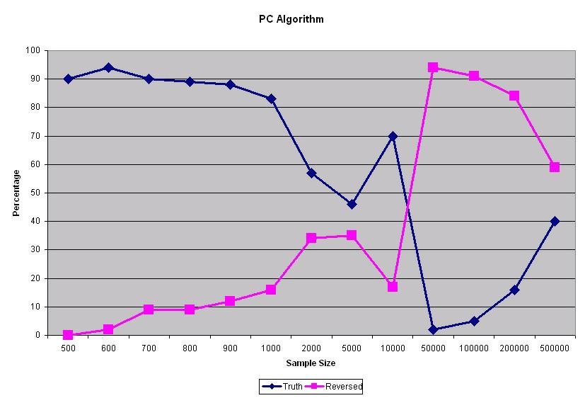
Concrete Recommendations
Extra retraction by PC algorithm

Slide 127
Generalizations
Generalized Simplicity
Bayesian retractions
Mixed Strategies
Times of retractions in chance
Expected retraction times
Drop the no short paths assumption…
Retractions weighted by content…
Statistical inference…

Slide 128
Conclusions
Ockham’s razor is necessary for staying on the straightest path to the true theory but does not point at the true theory.
A priori justification---no evasions or circles are required.
Analogous to computational complexity theory.

Slide 129
IV. Simplicity

Slide 130
Approach
Empirical complexity reflects nested problems of induction posed by the problem.
Hence, simplicity is question-relative but topologically invariant.

Slide 131
Empirical Problems
Topological space (W, T)
Countable partition Q of W into alternative theories.
W
T1
T2
T3

Slide 132
Why Topology?
Topology is the pure mathematics of (ideal) verifiability.
Proof:
The tautology and contradiction are verifiable;
If A, B are verifiable, A & B is verifiable;
If A₁, A₂, … are verifiable, A₁ v A₂ v… is verifiable.

Slide 133
Simplicity Concepts
c = 1
c = 0

Slide 134
Simplicity Concepts
c = 2
c = 1
c = 0

Slide 135
Simplicity Concepts
c = 2
c = 1
c = 0

Slide 136
Simplicity Concepts
A simplicity concept (without short paths) for (W, T, Q) is just an assignment c of natural numbers to worlds such that:
The condition c < n is closed;
Each answer is clopen given that c = n;
the condition A & (c = n) is in the boundary of the condition not-A & (c = n + 1) , for each answer A and non-terminal complexity n.

Slide 137
Virtues
Can still prove the Ockham efficiency theorem.
Grounds simplicity in the logic of the question.
Topologically invariant---grue-proof relative to question.
Generalizes dimension---works for continuous and discrete spaces.

Slide 138
AGM Belief Revision
No induction without refutation.
After refutation, almost anything goes.
Greedy---leaps to new theory immediately.
No concern with truth-conduciveness.
Not much like science or even standard Bayesians

Slide 139
Stalwart Ockham Method
Can delay expansion to new Ockham theory after a surprise, as a Bayesian would.
Converges to truth with optimal efficiency.
Scientifically natural.
More like Bayesian with standard prior.

Slide 140
V. Bayesian Efficiency

Slide 141
Anti-Simplicity Bayesian
T₂
T₁
T₃

Slide 142
Simplicity-biased Bayesian
T₂
T₁
T₃

Slide 143
Greedy Ockham
T₂
T₁
T₃

Slide 144
Focus on Retractions
Euclidean distance measures retractions + expansions.
Charge for retractions only.

Slide 145
Not Entropy Increase
T₂
Retractions can’t
be increase in a
scalar field.
0
T₁
T₃

Slide 146
Not Kullback Leibler Divergence
T₂
> 0
Still charges for
expansions.
T₁
T₃

Slide 147
Classical Logic
p v q v r
p v q
q v r
p v r
p
r
q
T

Slide 148
Logical Retractions
1
1

Slide 149
Code Disjunctions
(1,1,1)
(1,1,0)
(0,1,1)
(1,0,1)
(0,1,0)
(1,0,0)
(0,0,1)
(0,0,0)

Slide 150
Fuzzy Disjunctions
p v q v r = (1, .8, .2).
Valuation in assignment (0, 1, 0) is just the inner product: (0, 1, 0) . (1, .8, .2) = .8.
Entailment: p entails q iff b . q > b . p, for all Boolean b.

Slide 151
Geologic on Euclidean Cube
(1, .8, .2)

Slide 152
Geological Retractions
.5
0
(0, 1, .5)
(.5, 1, 0)

Slide 153
Probability Lives in Geologic
q
p
p(q) = p . q

Slide 154
Classical Principle of Indifference
= perspective projection of corners

Slide 155
General Principle of Indifference
= perspective projection in general
φ

Slide 156
Bayesian Retractions
= shadow of geological retractions
φ

Slide 157
Bayesian Retractions
1
0
1
0

Slide 158
“Retraction Cones”
Retraction-free
Mixed
Mixed
Pure retraction

Slide 159
Efficient Bayesian
0
<1
0
<1
0
0

