Slide 1
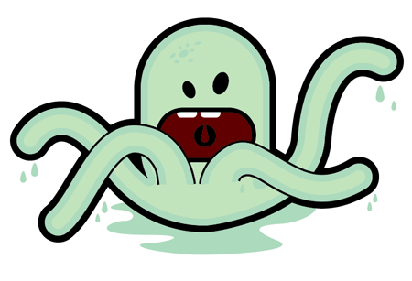
!!!!MALICIOUS ATTACKS!!!!

Slide 2
What are malicious attacks?
They are scams created by other internet users in an attempt to access another person’s personally identifiable information.
There are a few different types of malicious attacks to look for, and many ways to prevent them.

Slide 3
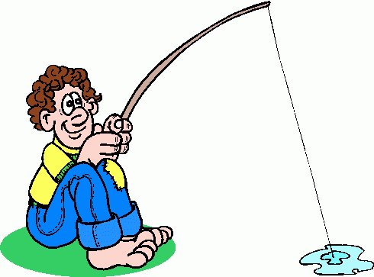
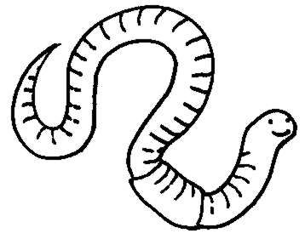
*Examples*
Phishing
  Email
  Instant Messages
  Phone calls
  Dumpster Diving
Malware (Virus, Trojan Horses, Worms)
  Email
  Instant Messages
  USB Devices

