Slide 1
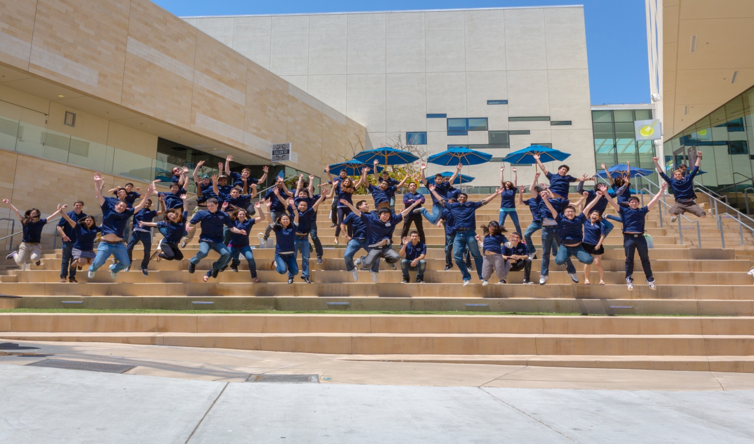
Resume Writing Workshop & Team Internship Program (TIP) Overview
Presented by Paula Kreger, CAP Services Manager

Slide 2


The Jacobs School Resume
Database
Used by nearly 70 corporate partners for recruitment
Requirement to apply for TIP
6 months of post-graduation exposure
www.jacobsschool.ucsd.edu/student/resume
Resume Writing Overview
Notes:
very easy to fill out & Edit & We ask you to put in information that you may not have thought about/ known was important to include

Slide 3
What is the Team Internship Program (TIP)?
Employers Want
Technical skills
New and innovative ideas
Collaboration
Teamwork
Creativity
What You Get
Real-world experience
Top-notch Employers
Access to industry leaders
Team building
AND…
AND…
Notes:
Having a team of people means you can get larger and more complex problems solved, New and Innovative ideas from students, job offers
**give them free reign to come up with their own engineering solutions

Slide 4
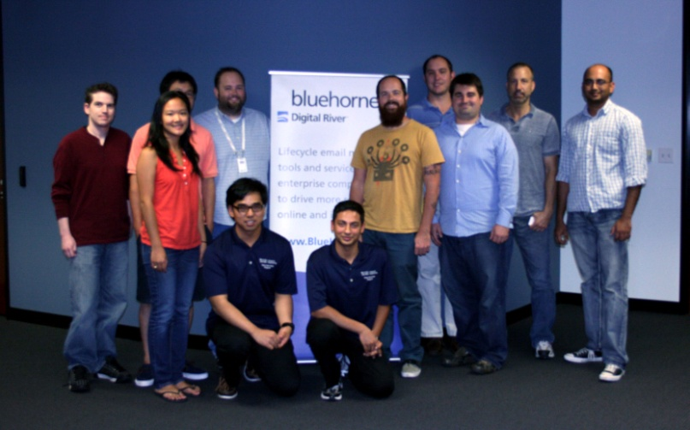
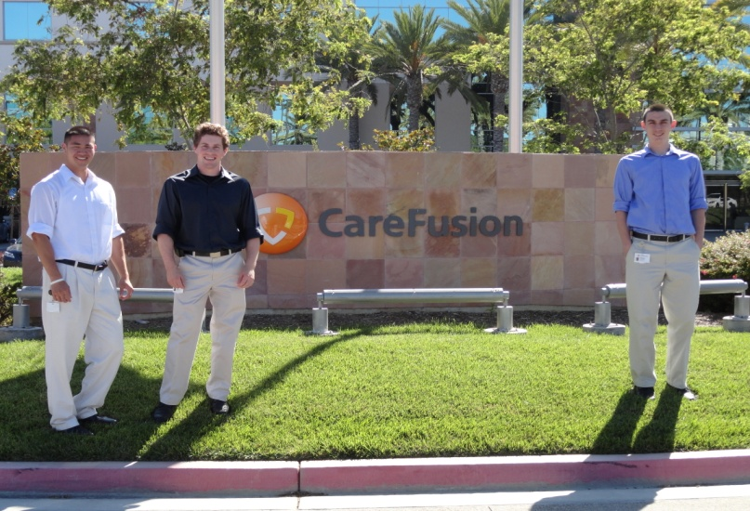
Details of TIP….
10-12 weeks over the summer
Full-time
2-5 member teams with unique technical experience and training
All degree levels welcome
Open to engineering majors

Slide 5
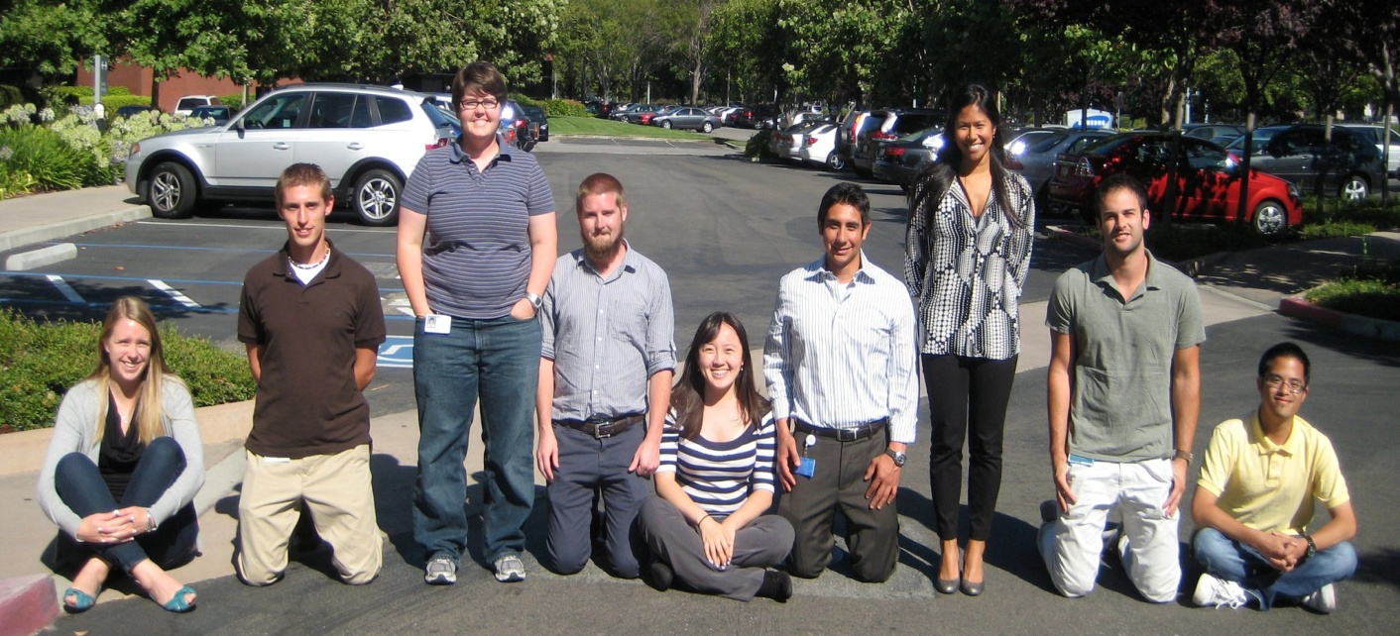
Timeline
October-December: Companies include TIP in budget planning
January-February: Projects posted & Student applications accepted
March: Last chance to apply & Candidate screening begins
April: Candidate screenings continue & Interviews begin
May: Team selections & Pre-deployment training
June-September: Internship period

Slide 6
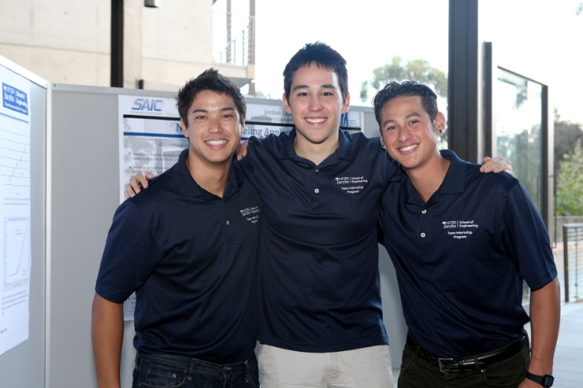
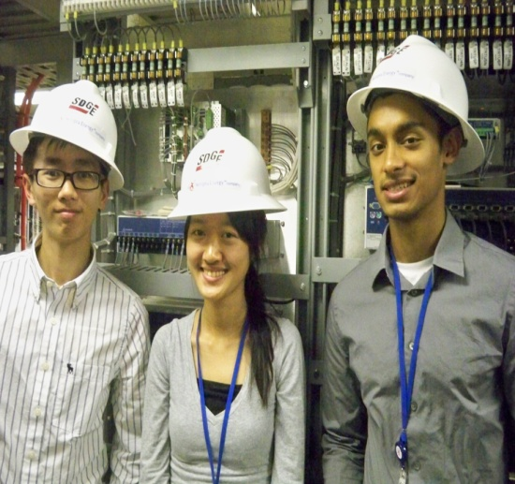
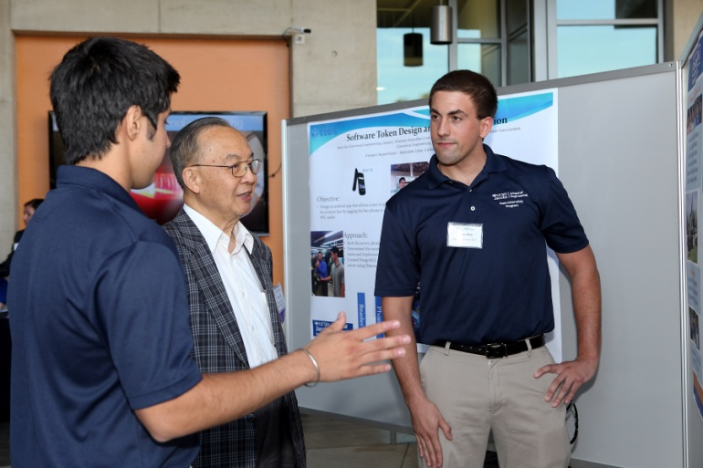
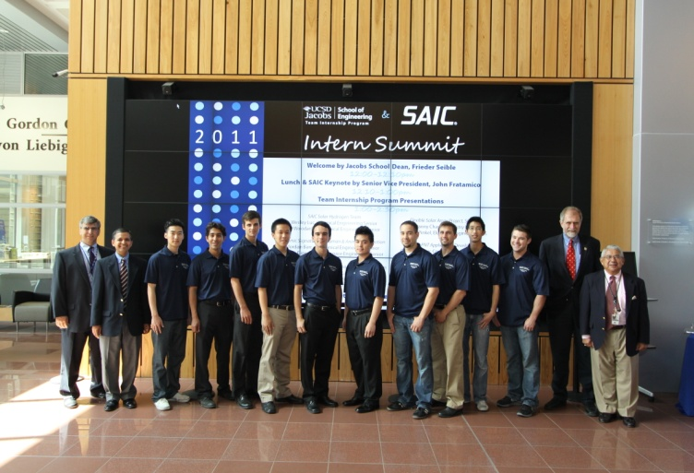
TIP 2015
354 Students
85 Teams
1 International
53 companies
Notes:
We have had international teams in Germany Liechtenstein Australia, India, Japan, Korea, China, Israel and maybe a couple of other places as well

Slide 7

What does TIP mean for your Future?
Unique opportunity to meet & work with a wide variety of team members.
Build great networking opportunities through current industry professionals.
The majority of students involved in a TIP summer position were hired by the company at which they worked.

Slide 8
How do I apply?
Apply using the Team Internship Website:
http://www.jacobsschool.ucsd.edu/tip
Review the project list to identify which projects you want to apply for.
Ensure you have a resume on file in the Jacobs School Resume Database.
Complete the team internship application.
Apply for each project via the Jacobs link.
Notes:
Apply to projects as soon as they are posted, apply for multiple team internships

Slide 9


















Some Participating Companies…

Slide 10

Like our CAP Facebook Page to Keep Up to Date!
Get updated on events like Tech Talks, Hack-a-thons, company office hours, etc.
Also check out our website for our public events calendar
www.facebook.com/Jacobs
www.Jacobsschool.ucsd.edu/CAP

Slide 11

Foundation of Resume
Main purpose is to help you
get an interview
Present your accomplishments and skills in an interesting and efficient manner
Your resume is a marketing tool
  Know your product (you!)
  Know your customer (the employer)
Your resume must sell you to the employer!

Slide 12

The Basics
What do you want to do?
What skills, abilities, and qualities are employers looking for in candidates?
  Search Job Posts & Linkedin
  Highlight keywords
  Include them in your
resume
Educational achievements
  Class work, projects, etc.
  Show off the fact that you attend a top ranked engineering school

Slide 13

Things to Include
Internships and work experience
  Focus on achievements versus just listing your duties
  How you contributed to the company or project
Paid or unpaid unrelated experience
  Focus on transferable skills
www.jacobsschool.ucsd.edu/student/resume
    Great place to start
Notes:
Is there any one at square one? Great place to start is in resume database tool.. Will help you fill in individual pieces of a resume…..

Slide 14
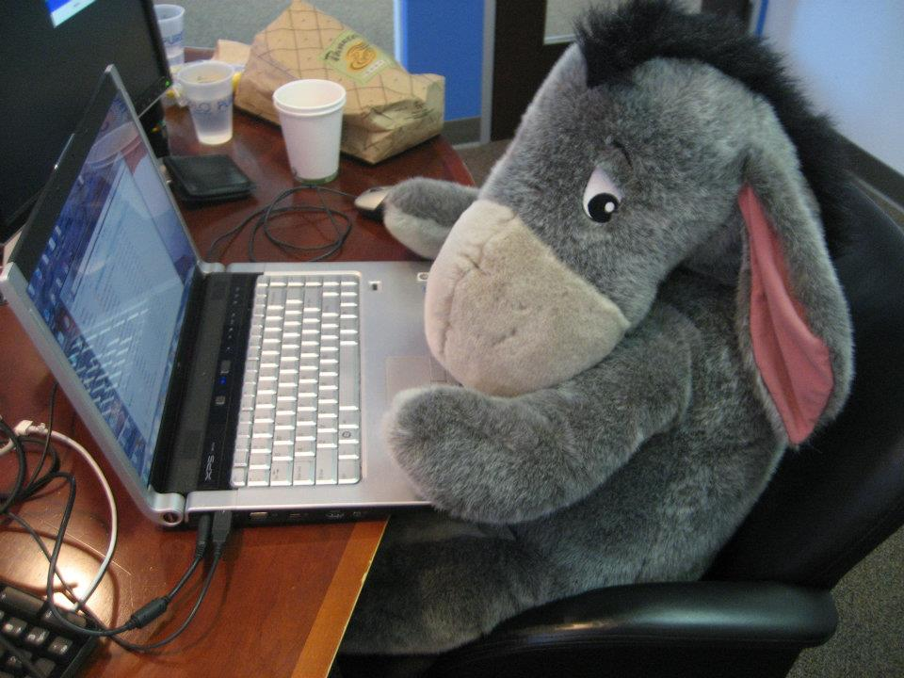
Make Yourself Marketable
Student Organizations
Internships
Technical Experience
Community Service/ Volunteer

Slide 15

On Campus Organizations
Triton Engineering Student Council (TESC)
Computer Science Engineering Society (CSES)
Women in Computing (WIC)
Diversity Orgs: Society of Women Engineers (SWE)
National Society of Black Engineers (NSBE)
Society of Hispanic Professional Engineers (SHPE)
Honor Societies: Tau Beta Pi & Eta Kappa Nu

Slide 16
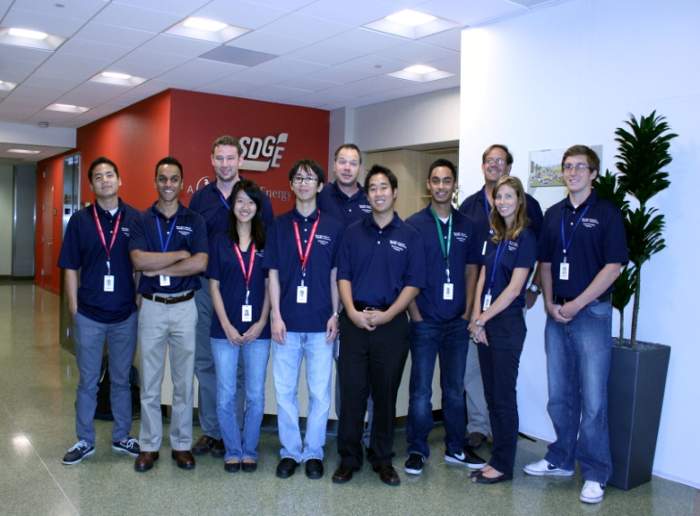
Internships & Technical Experience
Internship options:
TIP
TIES
Academic Internship Program (AIP)
CSE 197 - Field Study in CSE
Technical experience outside of an internship:
Volunteer with a professor
Become a CSE tutor
Classroom projects
Student organization projects
Participate in Hack-a-thons, competitions
Moxie Center Projects
Notes:
Moxie center within comp. engineering dept where students take their own ideas and have support to create start ups etc

Slide 17
What Recruiters Look For:
Technical Skills that match the job description
Transferrable Skills
Engineering Experience
Internships
Student Involvement
GPA 3.0+ (In Major & Out Major)

Slide 18
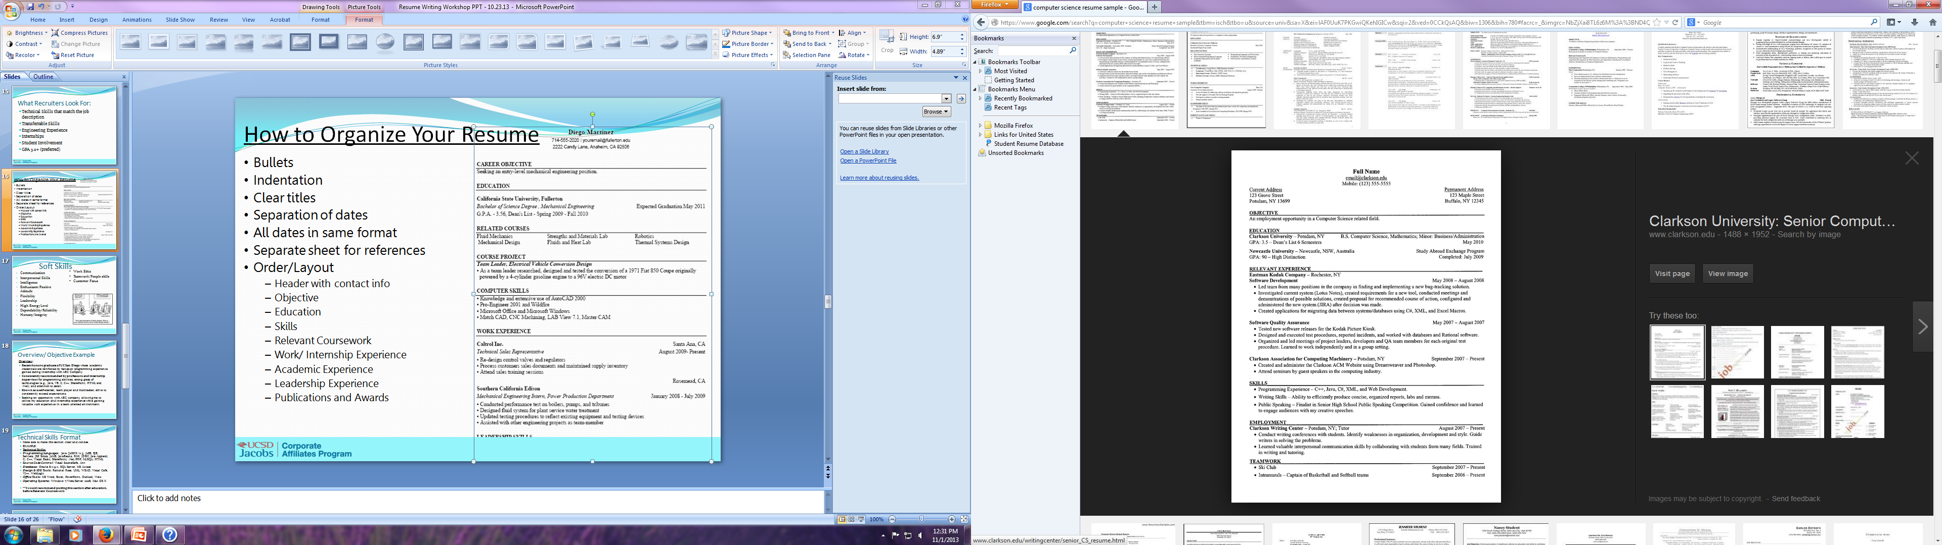
Resume Organization
Bullets
Indentation
Clear titles
Separation of dates
All dates in same format
Separate sheet for references
Order/Layout
  Header with contact info
  Objective
  Education
  Skills
  Relevant Coursework
  Work/ Internship Experience
  Academic Experience
  Leadership Experience
  Publications and Awards
Notes:
Resume database will create template that looks similar to this for you to create personalized version/ whereas jacobs profile isnt meant to be final polished resume it’s a very great starting point. Employers know where to look for info consistently in the system. ** also integrated with the jacobs school job posting board

Slide 19
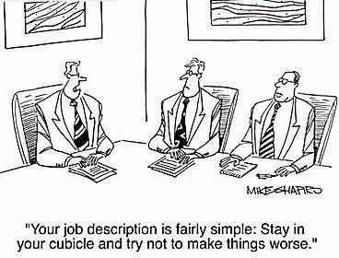
What are Soft Skills?
Unlike hard skills, they relate to a persons ability to interact effectively with coworkers and customers
  Communication
  Customer Focus
  Enthusiasm
  Positive Attitude
  Flexibility
  Leadership
  Dependability/Reliability
  Work Ethic
  Teamwork
Notes:
Unlike hard skills, which are about a person's skill set and ability to perform a certain type of task or activity, soft skills relate to a person's ability to interact effectively with coworkers and customers

Slide 20

Format: Overview vs. Objective
Overview:
Explain Who you are and what you Want to do
  Recent Honors graduate of UC San Diego with hands-on programming and internship experience.
  Consistently recommended by professors and internship supervisor for programming abilities; strong grasp of technologies (e.g., Java, VB, C, C++, SharePoint, HTML and .Net); and attention to detail.
  Self-starter, team player, and multi-tasker who consistently exceeds expectations.
  Seeking an opportunity with ABC company, allowing me to utilize my education and internship experience while gaining valuable work experience in a team oriented environment.

Slide 21
Format: Technical Skills
Make sure to make this section clear and concise
    **Put this section after education, before Relevant Coursework
EXAMPLE:
  Programming/Languages: Java (J2SDK v1.3, J2EE, EJB, Servlets, JSP, Struts, J2ME, JavaBeans, RMI, JDBC, Java Applets); C; C++; Visual Basic; SharePoint; .Net; PHP; MySQL; HTML
  Source Code Control: Visual SourceSafe, Ant
  Databases: Oracle 8.x/9.x, SQL Server, MS Access
  Design & IDE Tools: Rational Rose, UML, WSAD, Visual Café, VJ++, WebLogic
  Office Tools: MS Word, Excel, PowerPoint, Outlook, Visio
  Operating Systems: Windows 7/Vista/Server 2008, Mac OS X

Slide 22
Format: Skills & Qualifications
Highlight soft skills
EXAMPLE:
  Proven ability to diagnose, troubleshoot, and resolve technical problems.
  Exemplary academic record. Graduated with 3.36 G.P.A.
  Quick learner with strong working knowledge of software, hardware, networking, operating systems, and security applications.
  Outstanding communication skills; demonstrated background working well with students and co-workers in one-on-one and group settings.
  Superior analytical and problem-solving abilities, with track record of improving operations.

Slide 23
Format: Internship/ Work Experience
*What did you bring uniquely?
Experience:
ABC Company San Diego, CA
Computer Programmer Intern 2011 - 2012
Selected for ten month internship out of more than 150 applicants.
Handled database and Web site programming tasks (primarily using Java, C, C++, HTML and SharePoint), working an average of 20 hours per week while maintaining a 3.5 GPA.
Redesigned Internet and intranet pages. Used SEO best practices to optimize Web site for search engine rankings and improved functionality of company database.
Resolved memory corruption and other technical issues by leveraging strengths in coding, debugging and integration testing.

Slide 24
Tips & Tricks
Bullet points showcase what you accomplished
Show how you made a positive impact
Convince the reader to give you a shot
  Use clear, concise, and active language
STAND OUT!

Slide 25


Polish & Perfect
Making your resume work for you!
  Action verbs
  Accomplishment driven statements vs. job duties
  Highlight transferable skills
  Show me, don’t just tell me!

Slide 26


Frequently Asked Questions
What if I don’t have any engineering experience?
How long can my resume be?
Do I need a cover letter?
What other questions do you have?

Slide 27

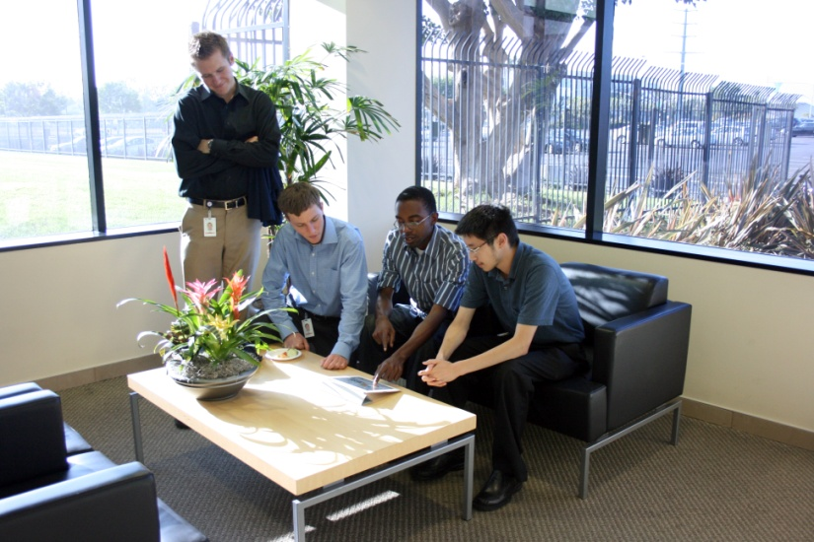
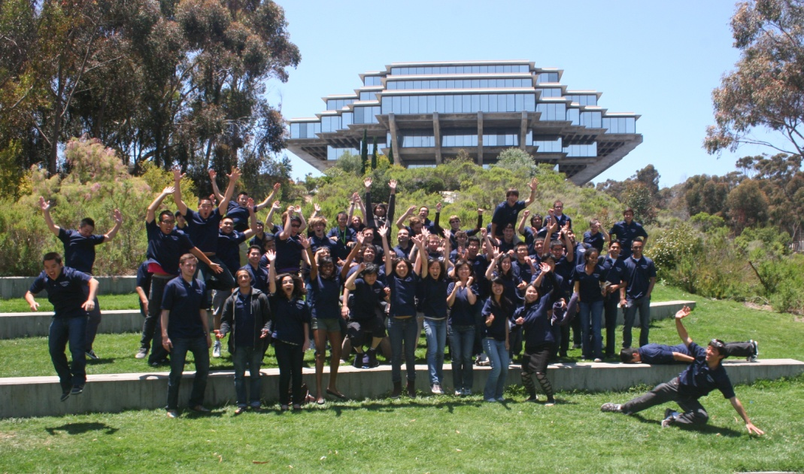
Thank you!
Contact Loren:
lemetzger@ucsd.edu
858 822 6772
http://www.jacobsschool.ucsd.edu/TIP
APPLY! You won’t regret it!
Contact Paula:
Pkreger@ucsd.edu

