Slide 1

Adjusting to Life in the U.S. and Managing Stress
Presenters:
Fengqin Lian, Ph.D.
Niyatee Sukumaran, Ph.D.
858-534-3755
(CAPS Appt & 24/7 Crisis Line)
Notes:
Both

Slide 2
Objectives
Learn about what psychological counseling is in the U.S.
Know what services are offered at CAPS (Counseling And Psychological Services).
Become aware of cultural adjustment stages.
Identify and practice stress management strategies.
Notes:
Fengqin
Ask “What else do you want to get out of this workshop?”

Slide 3
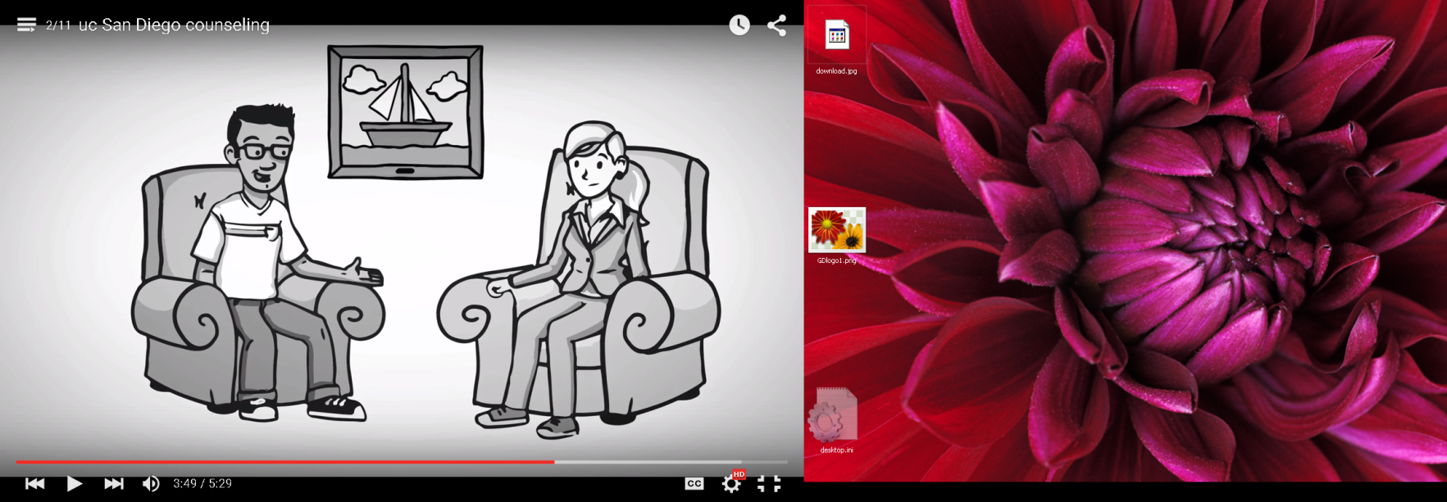
George’s experience of going to counseling at UCSD
Notes:
Fengqin

Slide 4

What is Individual Counseling?
Meet & talk to a psychologist 1-1
Maybe do some exercises inside
and outside of these meetings
May recommend other types of services:
Group & Support Forums
Online anxiety reduction program
Medication consultation, etc.
Confidential, a few exceptions!
Notes:
Niyatee

Slide 5

Barriers to Seeking Help!
  Lack of information about counseling
  Fear of family knowing & cultural factors
  Fear of being
  misunderstood
  discriminated against
  Stigma about mental health
Notes:
Niyatee

Slide 6
Common Topics In Counseling
Counseling
Relationships
Feelings (e.g., Anxiety, sadness, loneliness, depression)
Career/ Future and Personal Concerns
Adjustment Difficulties
Notes:
Niyatee- *Imposter Syndrome

Slide 7

Counseling and Psychological Services (CAPS)
Free and Confidential Counseling and Psychiatry
Brief, intermittent and focused services: Individual, Group, and Couples Counseling for Registered Students
Offices located at 190 Galbraith Hall, all six colleges, the Women’s Center, and Student Health Services
Notes:
Fengqin

Slide 8
How do you access CAPS services?
Routine appointments:
For Call CAPS CENTRAL (front desk) at 858-534-3755
Brief telephone appointment
Schedule initial evaluation with CAPS
  Other campus resources
  Treatment off-campus
Office hours : 8:00am - 4:30pm, Monday-Friday
Urgent Care: Call or Walk-in to CAPS CENTRAL at 858-534-3755
Notes:
fengqin

Slide 9
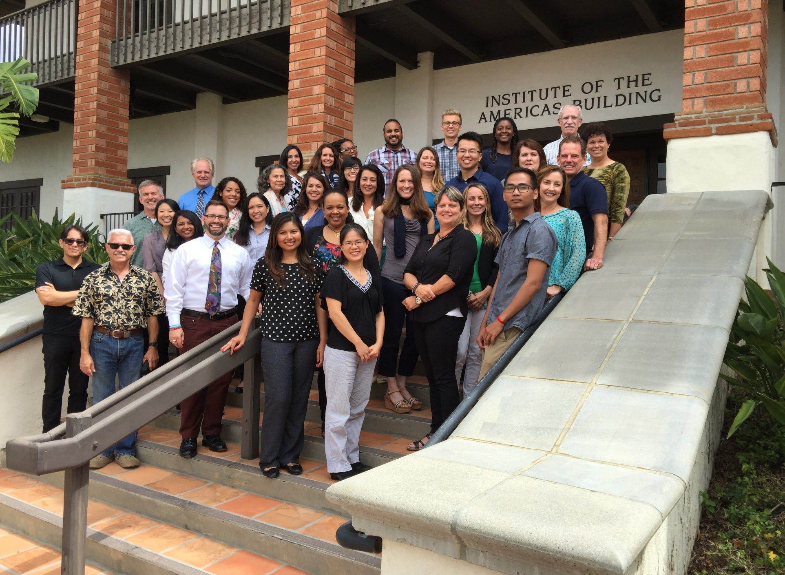
CAPS Staff
Notes:
Niyatee: website and learn more about our services

Slide 10
UCSD CAPS Mobile
Download the UCSD mobile app from AppStore (Apple), PlayStore (Android), or Blink
Click on the Campus Services icon
CAPS will be listed first
Or access the mobile site online at http://caps.ucsd.edu/m
Notes:
fengqin

Slide 11



Only For Graduate Students
Women’s Relationship Group (for same-gender-loving-women)
  Kind Mind (Tame the inner critic with mindfulness)
Questioning Career Transition
  Women in Science and Engineering
Notes:
Fengqin

Slide 12

Special Drop-in Service for You (Engineering Grad Students)!
Drop in to talk.
No appointment needed.
Time: Fridays, noon-2pm (except 11/11/2016 and 11/25/2016)
Location: Jacobs Hall, Butterfly Room
w/ Fengqin Lian, PhD

Slide 13

Notes:
Niyatee

Slide 14
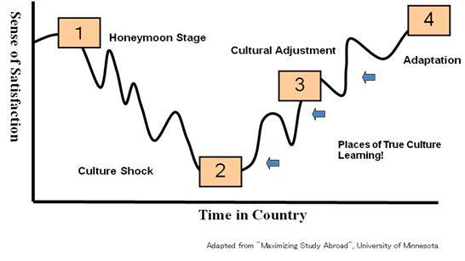
Cultural Adjustment
Notes:
Fengqin

Slide 15
Relationship of Performance & Stress
High

Boredom
Overwhelmed
Performance
Low


Low
Moderate
High
Level of Stress
Notes:
Niyatee

Slide 16
Understanding the Stress We Experience
Resources
=
Demands
Balanced / right amount of ‘stress’
Notes:
Niyatee: Think about resources vs demands

Slide 17
Understanding the Stress We Experience
Resources
<
Demands
STRESS
Notes:
Niyatee:

Slide 18
Two Approaches to Regain Balance
Resources
Demands
Notes:
Fengqin

Slide 19
Reduce Demands
or
Enhance Resources
Good Plan
… but what do I change & how??
Notes:
Fengqin

Slide 20
Four Types of Stress Management
STRESS
Cognitive
Behavioral
Support/ Social
Physical
Notes:
Niyatee

Slide 21

Physical
Breathe, Breathe, Breathe !
Exercise
Sleep
Eat well (… monitor caffeine & sugar intake,
And monitor alcohol/ drug use)
Relaxation & Meditation
Massage, Yoga, Tai Chi, etc.
Notes:
Niyatee
Practice deep breathing and muscle relaxation.

Slide 22
Cognitive: Effective Self Talk
“Positive”
When challenges occur, acknowledge it’s tough
..and yet state that “this too shall pass”
Flexibility
Allow for Flexibility in your life & career
Realistic
Set REALISTIC Goals
(… having Plans B, C, D, …)
(… and plan accordingly)
Notes:
fengqin

Slide 23
Behavioral
Do things You Usually Do!
Notes:
Niyatee: Re-assess Time Use Efficiency
Have a to-do list
Do things you like, and like the things you do.

Slide 24
Covey Time Management System
Urgency
High
Low
High
Plans & Interests
Crises
Importance
I
II
III
IV
TV, www, & other distractions
Email & Voicemail
Low
Notes:
Fengqin

Slide 25

Social
Find Your Own Support / Consultation Groups
Mentoring
Express / Experience Cultural Options
Notes:
Fengqin

Slide 26
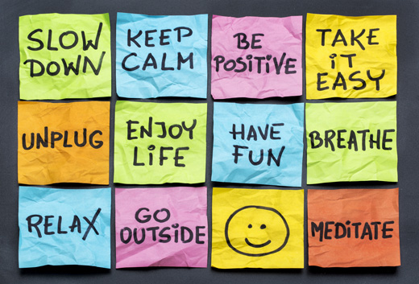
While you are here to enhance you Professional Self & Career, make sure to
Notes:
Niyatee: to summarize!!!

Slide 27





Other Services that Support Student Well-being
Assistant Dean
April Bjornsen
\CARE at SARC: Center for Advocacy, Resources, and Education (formerly SARC)
Notes:
fengqin

Slide 28

Let’s take a moment to relax!

Slide 29

Your Feedback is Appreciated!
Smartphone: UCSD mobile app > Campus Services → CAPS → and then select “CAPS Program Evaluation”
Web: http://caps.ucsd.edu/survey
Presenters: Drs. Fengqin Lian & Niyatee Sukumaran
Topic: Adjusting to the Life in the U.S. and Managing Stress
Notes:
Fengqin

