Slide 1





CSE 120
Principles of Operating
Systems
Spring 2016
Deadlock

Slide 2

Deadlock
Synchronization is a live gun – we can easily shoot ourselves in
the foot
  Incorrect use of synchronization can block all processes
  You have likely been intuitively avoiding this situation already
More generally, processes that allocate multiple resources
generate dependencies on those resources
  Locks, semaphores, monitors, etc., just represent the resources that they protect
If one process tries to allocate a resource that a second process holds, and vice-versa, they can never make progress
We call this situation deadlock, and we’ll look at:
  Definition and conditions necessary for deadlock
  Representation of deadlock conditions
  Approaches to dealing with deadlock

Slide 3

Deadlock Definition
Deadlock is a problem that can arise:
  When processes compete for access to limited resources
  When processes are incorrectly synchronized
Definition:
  Deadlock exists among a set of processes if every process is waiting for an event that can be caused only by another process in the set.
Process 1
Process 2
lockA->Acquire();
…
lockB->Acquire();
lockB->Acquire();
…
lockA->Acquire();

Slide 4

Conditions for Deadlock
Deadlock can exist if and only if the following four
conditions hold simultaneously:
  Mutual exclusion – At least one resource must be held in a non-sharable mode
  Hold and wait – There must be one process holding one resource and waiting for another resource
  No preemption – Resources cannot be preempted (critical sections cannot be aborted externally)
  Circular wait – There must exist a set of processes [P₁, P₂, P₃,…,P_{n}] such that P₁ is waiting for P₂, P₂ for P₃, etc.

Slide 5

Resource Allocation Graph
Deadlock can be described using a resource allocation
graph (RAG)
The RAG consists of a set of vertices P={P₁, P₂, …,
P_{n}} of processes and R={R₁, R₂, …, R_{m}} of resources
  A directed edge from a process to a resource, P_{i}→R_{i}, means that P_{i} has requested R_{j}
  A directed edge from a resource to a process, R_{i}→P_{i}, means that R_{j} has been allocated by P_{i}
  Each resource has a fixed number of units
If the graph has no cycles, deadlock cannot exist
If the graph has a cycle, deadlock may exist

Slide 6

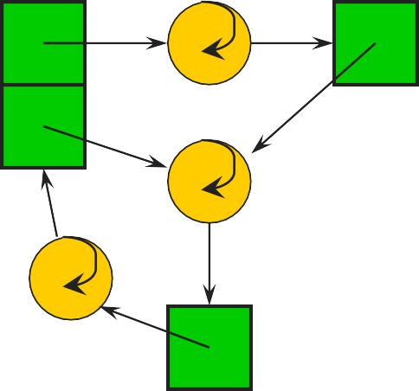
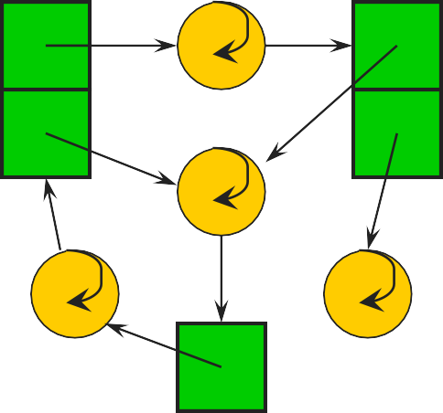
RAG Example
A cycle…and deadlock!
Same cycle…but no deadlock. Why?

Slide 7

A Simpler Case
If all resources are single unit and all processes make single requests, then we can represent the resource state with a simpler waits-for graph (WFG)
The WFG consists of a set of vertices P={P₁, P₂, …,
P_{n}} of processes
  A directed edge P_{i}→P_{j} means that P_{i} has requested a resource that P_{j} currently holds
If the graph has no cycles, deadlock cannot exist
If the graph has a cycle, deadlock exists

Slide 8

Dealing With Deadlock
There are four approaches for dealing with deadlock:
  Ignore it – how lucky do you feel?
  Prevention – make it impossible for deadlock to happen
  Avoidance – control allocation of resources
  Detection and Recovery – look for a cycle in dependencies

Slide 9

Deadlock Prevention
Prevention – Ensure that at least one of the necessary
conditions cannot happen
  Mutual exclusion
» Make resources sharable (not generally practical)
  Hold and wait
» Process cannot hold one resource when requesting another
» Process requests, releases all needed resources at once
  Preemption
» OS can preempt resource (costly)
  Circular wait
» Impose an ordering (numbering) on the resources and request them in order (popular implementation technique)

Slide 10

Deadlock Avoidance
Avoidance
  Provide information in advance about what resources will be needed by processes to guarantee that deadlock will not happen
  System only grants resource requests if it knows that the
process can obtain all resources it needs in future requests
  Avoids circularities (wait dependencies)
Tough
  Hard to determine all resources needed in advance
  Good theoretical problem, not as practical to use

Slide 11

Banker’s Algorithm
The Banker’s Algorithm is the classic approach to
deadlock avoidance for resources with multiple units
Assign a credit limit to each customer (process)
  Maximum credit claim must be stated in advance
Reject any request that leads to a dangerous state
  A dangerous state is one where a sudden request by any customer for the full credit limit could lead to deadlock
  A recursive reduction procedure recognizes dangerous states
In practice, the system must keep resource usage well below capacity to maintain a resource surplus
  Rarely used in practice due to low resource utilization

Slide 12

Banker’s Algorithm Simplified
OK
OK
OK
UNSAFE
3
3
3
3
3
3
3
3
October 28, 2014
12

Slide 13

Detection and Recovery
Detection and recovery
  If we don’t have deadlock prevention or avoidance, then deadlock may occur
  In this case, we need to detect deadlock and recover from it
To do this, we need two algorithms
  One to determine whether a deadlock has occurred
  Another to recover from the deadlock
Possible, but expensive (time consuming)
  Implemented in VMS
  Run detection algorithm when resource request times out
13

Slide 14

Deadlock Detection
Detection
  Traverse the resource graph looking for cycles
  If a cycle is found, preempt resource (force a process to release)
Expensive
  Many processes and resources to traverse
Only invoke detection algorithm depending on
  How often or likely deadlock is
  How many processes are likely to be affected when it occurs
14

Slide 15

Deadlock Recovery
Once a deadlock is detected, we have two options…
Abort processes
  Abort all deadlocked processes
» Processes need to start over again
  Abort one process at a time until cycle is eliminated
» System needs to rerun detection after each abort
Preempt resources (force their release)
  Need to select process and resource to preempt
  Need to rollback process to previous state
  Need to prevent starvation
15

Slide 16

Deadlock Summary
Deadlock occurs when processes are waiting on each
other and cannot make progress
  Cycles in Resource Allocation Graph (RAG)
Deadlock requires four conditions
  Mutual exclusion, hold and wait, no resource preemption, circular wait
Four approaches to dealing with deadlock:
  Ignore it – Living life on the edge
  Prevention – Make one of the four conditions impossible
  Avoidance – Banker’s Algorithm (control allocation)
  Detection and Recovery – Look for a cycle, preempt or abort
16

Slide 17

Deadlock and Resources
There are two kinds of resources: consumable and
reusable
  Consumable resources are generated and destroyed by processes: e.g., a process waiting for a message from another process
  Reusable resources are allocated and released by processes: e.g., locks on files
Deadlock with consumable resources is usually treated as a correctness issue (e.g., proofs) or with timeouts
From here on, we only consider reusable resources
October 28, 2014
17

Slide 18
Deadlock Prevention
Consider a database system in which a user submits
commands that read and update tables.
Tables that are read or updated need to be locked when
accessed.
How would you do each of the following?
  Don't enforce mutex?
  Don't allow hold and wait?
  Allow preemption?
  Don't allow circular waiting?
October 28, 2014
18

