Slide 1




CSE 120
Principles of Operating
Systems
Spring 2017
Lecture 3: Processes

Slide 2

Processes
This lecture starts a class segment that covers
processes, threads, and synchronization
  These topics are perhaps the most important in this class
  (They will be covered in the exams)
Today’s topics are processes and process management
  What are the units of execution?
  How are those units of execution represented in the OS?
  How is work scheduled in the CPU?
  What are the possible execution states of a process?
  How does a process move from one state to another?
2

Slide 3

The Process
The process is the OS abstraction for execution
  It is the unit of execution
  It is the unit of scheduling
  It is the dynamic execution context of a program
A process is sometimes called a job or a task or a sequential process
A sequential process is a program in execution
  It defines the sequential, instruction-at-a-time execution of a
program
  Programs are static entities with the potential for execution
3

Slide 4

Process Components
A process contains all state for a program in execution
  An address space
  The code for the executing program
  The data for the executing program
  An execution stack encapsulating the state of procedure calls
  The program counter (PC) indicating the next instruction
  A set of general-purpose registers with current values
  A set of operating system resources
» Open files, network connections, etc.
A process is named using its process ID (PID)
4

Slide 5

Basic Process Address Space
0xFFFFFFFF
Stack
Heap (Dynamic Memory Alloc)
Static Data (Data Segment)
Code (Text Segment)
SP
Address Space
PC
0x00000000
5

Slide 6

Process State
A process has an execution state that indicates what it
is currently doing
  Running: Executing instructions on the CPU
» It is the process that has control of the CPU
» How many processes can be in the running state simultaneously?
  Ready: Waiting to be assigned to the CPU
» Ready to execute, but another process is executing on the CPU
  Waiting: Waiting for an event, e.g., I/O completion
» It cannot make progress until event is signaled (disk completes)
As a process executes, it moves from state to state
  Unix “ps”: STAT column indicates execution state
  What state do you think a process is in most of the time?
  How many processes can a system support?
6

Slide 7

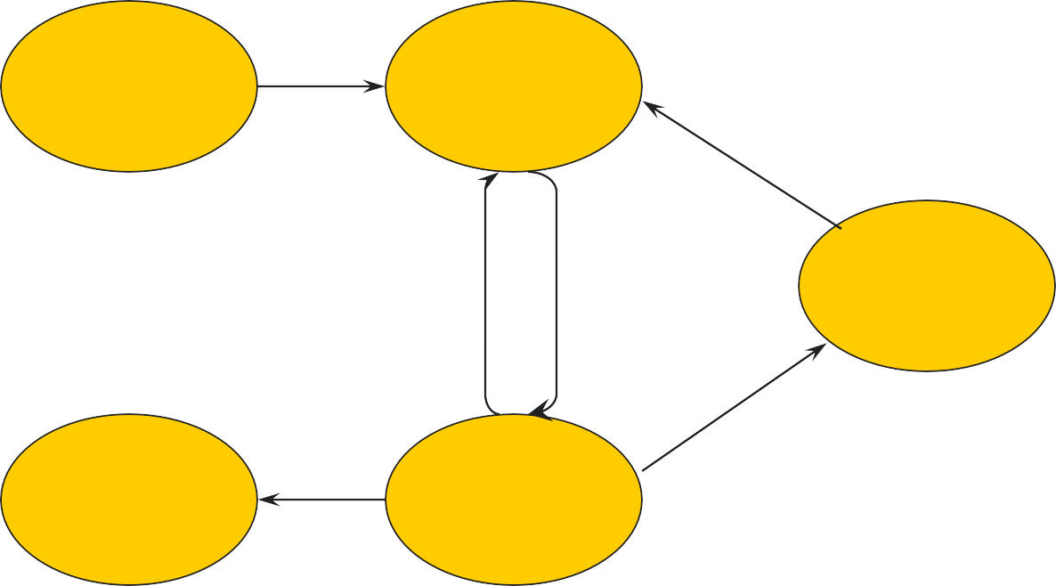
Process State Graph
Create Process
New
Ready
I/O Done
Unschedule
Process
Schedule Process
Waiting
I/O, Page
Fault, etc.
Terminated
Running
Process Exit
7

Slide 8

Process Data Structures
How does the OS represent a process in the kernel?
At any time, there are many processes in the system, each in its particular state
The OS data structure representing each process is
called the Process Control Block (PCB)
The PCB contains all of the info about a process
The PCB also is where the OS keeps all of a process’ hardware execution state (PC, SP, regs, etc.) when the process is not running
  This state is everything that is needed to restore the hardware to the same configuration it was in when the process was switched out of the hardware
8

Slide 9

PCB Data Structure
The PCB contains a huge amount of information in
one large structure
» Process ID (PID)
» Execution state
» Hardware state: PC, SP, regs
» Memory management
» Scheduling
» Accounting
» Pointers for state queues
» Etc.
It is a heavyweight abstraction
9

Slide 10

struct proc (Solaris)
/*
One structure allocated per active process. It contains all
data needed about the process while the process may be swapped
out. Other per-process data (user.h) is also inside the proc structure.
Lightweight-process data (lwp.h) and the kernel stack may be swapped out.
*/
typedef struct proc {
/*
* Fields requiring no explicit locking
*/
*p_pglink; struct proc struct sess struct pid struct pid
/*
/* process group hash chain link next */
/* process group hash chain link prev */
/* session information */
/* process ID info */
/* process group ID info */
*p_ppglink;
*p_sessp;
*p_pidp;
*p_pgidp;
* Fields protected by p_lock
*/
kcondvar_t p_cv;
/* proc struct's condition variable */
/* waiting for some lwp to exit */
/* process is waiting for its lwps */
/* to to be held. */
/* unused */
/* protected while set. */
struct vnode *p_exec; struct as *p_as; struct plock *p_lockp; kmutex_t p_crlock; struct cred *p_cred;
/*
/* pointer to a.out vnode */
/* process address space pointer */
/* ptr to proc struct's mutex lock */
/* lock for p_cred */
/* process credentials */
kcondvar_t p_flag_cv; kcondvar_t p_lwpexit; kcondvar_t p_holdlwps;
ushort_t p_pad1;
uint_t p_flag;
* Fields protected by pidlock
*/
/* flags defined below */ clock_t p_utime; clock_t p_stime; clock_t p_cutime; clock_t p_cstime; caddr_t *p_segacct; caddr_t p_brkbase; size_t p_brksize;
/*
* Per process signal stuff.
*/
k_sigset_t p_sig; k_sigset_t p_ignore; k_sigset_t p_siginfo;
int p_swapcnt; char p_stat; char p_wcode;
/* number of swapped out lwps */
/* user time, this process */
/* system time, this process */
/* sum of children's user time */
/* sum of children's system time */
/* segment accounting info */
/* base address of heap */
/* heap size in bytes */
/* status of process */
ushort_t p_pidflag; int p_wdata; pid_t p_ppid;
/* current wait code */
/* flags protected only by pidlock */
/* current wait return value */
/* process id of parent */
/* forward link */
/* ptr to parent process */
struct proc struct proc struct proc struct proc struct proc struct proc struct proc struct proc struct proc struct proc struct proc struct proc
*p_link;
*p_parent;
*p_child;
*p_sibling;
/* ptr to first child process */
/* ptr to next sibling proc on chain */
*p_psibling; /* ptr to prev sibling proc on chain */
*p_sibling_ns; /* prt to siblings with new state */
*p_child_ns; /* prt to children with new state */
/* signals pending to this process */
/* ignore when generated */
/* gets signal info with signal */ struct sigqueue *p_sigqueue; /* queued siginfo structures */
/* hdr to sigqueue structure pool */
/* hdr to signotify structure pool */
/* jobcontrol stop signal */
*p_next;
*p_prev;
/* active chain link next */
/* active chain link prev */
*p_nextofkin; /* gets accounting info at exit */
*p_orphan;
*p_nextorph;
struct sigqhdr *p_sigqhdr; struct sigqhdr *p_signhdr; uchar_t p_stopsig;
10

Slide 11

struct proc (Solaris) (2)
/*
Special per-process flag when set will fix misaligned memory
references.
*/
char p_fixalignment;
/*
Per process lwp and kernel thread stuff
*/
hrtime_t p_mlreal;
/* elapsed time sum over defunct lwps */
hrtime_t p_acct[NMSTATES]; /* microstate sum over defunct lwps */
struct lrusage p_ru; /* lrusage sum over defunct lwps */
struct itimerval p_rprof_timer; /* ITIMER_REALPROF interval timer */ uintptr_t p_rprof_cyclic; /* ITIMER_REALPROF cyclic */
uint_t p_defunct; /* number of defunct lwps */
/*
profiling. A lock is used in the event of multiple lwp's
using the same profiling base/size.
*/
/* protects user profile arguments */
/* profile arguments */
id_t p_lwpid; int p_lwpcnt;
int p_lwprcnt; int p_lwpwait; int p_zombcnt;
int p_zomb_max; id_t *p_zomb_tid;
/* most recently allocated lwpid */
/* number of lwps in this process */
/* number of not stopped lwps */
/* number of lwps in lwp_wait() */
/* number of zombie lwps */
/* number of entries in p_zomb_tid */
/* array of zombie lwpids */
/* circular list of threads */
kmutex_t p_pflock; struct prof p_prof;
kthread_t *p_tlist;
/*
/*
* The user structure
*/
struct user p_user;
* /proc (process filesystem) debugger interface stuff.
*/
k_sigset_t p_sigmask; /* mask of traced signals (/proc) */ k_fltset_t p_fltmask; /* mask of traced faults (/proc) */
/* (see sys/user.h) */
struct vnode *p_trace; struct vnode *p_plist; kthread_t *p_agenttp;
/* pointer to primary /proc vnode */
/*
* Doors.
*/
kthread_t
struct door_node struct door_node kcondvar_t
char
/* list of /proc vnodes for process */
/* thread ptr for /proc agent lwp */
struct watched_area *p_warea; /* list of watched areas */ ulong_t p_nwarea; /* number of watched areas */
struct watched_page *p_wpage; /* remembered watched pages (vfork) */
*p_server_threads;
*p_door_list; /* active doors */
*p_unref_list; p_server_cv;
p_unref_thread; /* unref thread created */
int p_nwpage; int p_mapcnt;
struct proc *p_rlink;
/* number of watched pages (vfork) */
/* number of active pr_mappage()s */
/* linked list for server */
kcondvar_t p_srwchan_cv;
size_t p_stksize; /* process stack size in bytes */
/*
* Microstate accounting, resource usage, and real-time profiling
*/
/*
* Kernel probes
*/
uchar_t
hrtime_t p_mstart;
/* hi-res process start time */
/* hi-res process termination time */
p_tnf_flags;
hrtime_t p_mterm;

Slide 12

struct proc (Solaris) (3)
/*
* C2 Security (C2_AUDIT)
*/
caddr_t p_audit_data;
#if defined( ia64)
caddr_t size_t uchar_t
#endif
void struct task
p_upstack; /* base of the upward-growing stack */
p_upstksize; /* size of that stack, in bytes */ p_isa; /* which instruction set is utilized */
/* resource control extension data */
/* our containing task */
/* ptr to previous process in task */
/* ptr to next process in task */
/* number of TP_DAEMON lwps */ p_lwpdwait; /* number of daemons in lwp_wait() */
**p_tidhash; /* tid (lwpid) lookup hash table */ struct sc_data *p_schedctl; /* available schedctl structures */
} proc_t;
kthread_t *p_aslwptp;
/* per process audit structure */
/* thread ptr representing "aslwp" */
#if defined(i386) || defined( i386) || defined( ia64)
/*
* LDT support.
*/
*p_rce;
*p_task;
kmutex_t p_ldtlock; struct seg_desc *p_ldt;
/* protects the following fields */
/* Pointer to private LDT */
struct proc *p_taskprev; struct proc *p_tasknext;
struct seg_desc p_ldt_desc; /* segment descriptor for private LDT */
int int
kthread_t
p_lwpdaemon;
int p_ldtlimit;
#endif
size_t p_swrss;
/* highest selector used */
struct aio *p_aio;
/* resident set size before last swap */
/* pointer to async I/O struct */
/* interval timers */
/* signals in notification set */
/* notif cv to synchronize with aslwp */
/* alarm's timeout id */
struct itimer **p_itimer;
k_sigset_t kcondvar_t timeout_id_t
p_notifsigs; p_notifcv; p_alarmid;
uint_t p_sc_unblocked; /* number of unblocked threads */ struct vnode *p_sc_door; /* scheduler activations door */
caddr_t uint_t model_t
p_usrstack; /* top of the process stack */ p_stkprot; /* stack memory protection */
p_model;
/* data model determined at exec time */
struct lwpchan_data *p_lcp; /* lwpchan cache */
/*
* protects unmapping and initilization of robust locks.
*/
kmutex_t p_lcp_mutexinitlock;
utrap_handler_t *p_utraps;
/* pointer to user trap handlers */
refstr_t
*p_corefile; /* pattern for core file */

Slide 13

PCBs and Hardware State
When a process is running, its hardware state (PC,
SP, regs, etc.) is in the CPU
  The hardware registers contain the current values
When the OS stops running a process, it saves the
current values of the registers into the process’ PCB
When the OS is ready to start executing a new process, it loads the hardware registers from the values stored in that process’ PCB
  What happens to the code that is executing?
The process of changing the CPU hardware state from
one process to another is called a context switch
  This can happen 100 or 1000 times a second!

Slide 14

State Queues
How does the OS keep track of processes?
The OS maintains a collection of queues that represent the state of all processes in the system
Typically, the OS has one queue for each state
  Ready, waiting, etc.
Each PCB is queued on a state queue according to its current state
As a process changes state, its PCB is unlinked from one queue and linked into another

Slide 15
State Queues
Ready Queue Firefox PCB
X Server PCB
Idle PCB
Disk I/O Queue
Emacs PCB
ls PCB
Console Queue
Sleep Queue
.
.
.
There may be many wait queues, one for each type of wait (disk, console, timer, network, etc.)

Slide 16

PCBs and State Queues
PCBs are data structures dynamically allocated in OS
memory
When a process is created, the OS allocates a PCB
for it, initializes it, and places it on the ready queue
As the process computes, does I/O, etc., its PCB moves from one queue to another
When the process terminates, its PCB is deallocated

Slide 17

Process Creation
A process is created by another process
  Parent is creator, child is created (Unix: ps “PPID” field)
  What creates the first process (Unix: init (PID 0 or 1))?
The parent defines (or donates) resources and
privileges for its children
  Unix: Process User ID is inherited – children of your shell execute with your privileges
After creating a child, the parent may either wait for it
to finish its task or continue in parallel

Slide 18

Process Creation: Windows
The system call on Windows for creating a process is
called, surprisingly enough, CreateProcess:
BOOL CreateProcess(char *prog, char *args) (simplified)
CreateProcess
  Creates and initializes a new PCB
  Creates and initializes a new address space
  Loads the program specified by “prog” into the address space
  Copies “args” into memory allocated in address space
  Initializes the saved hardware context to start execution at main (or wherever specified in the file)
  Places the PCB on the ready queue

Slide 19
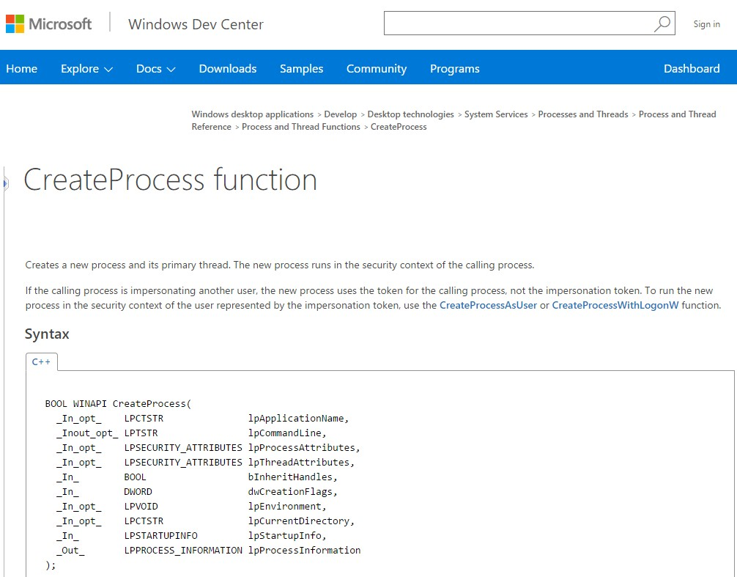
January 16, 2007 CSE 120 – Lecture 3 – Processes 19

Slide 20

Process Creation: Unix
In Unix, processes are created using fork()
int fork()
fork()
  Creates and initializes a new PCB
  Creates a new address space
  Initializes the address space with a copy of the entire contents of the address space of the parent
  Initializes the kernel resources to point to the resources used by parent (e.g., open files)
  Places the PCB on the ready queue
Fork returns twice
  Huh?
  Returns the child’s PID to the parent, “0” to the child
October 1, 2015
CSE 120 – Lecture 3 – Processes
20

Slide 21
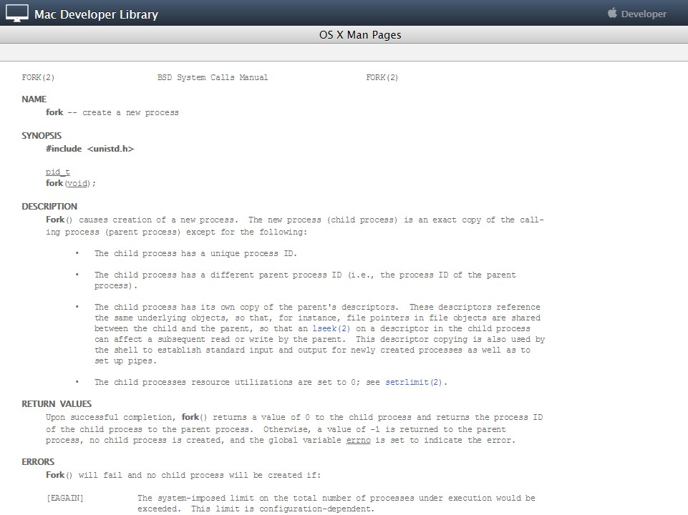
January 16, 2007 CSE 120 – Lecture 3 – Processes 21

Slide 22

fork()
int main(int argc, char *argv[])
{
char *name = argv[0]; int child_pid = fork(); if (child_pid == 0) {
printf(“Child of %s is %d\n”, name, getpid()); return 0;
} else {
printf(“My child is %d\n”, child_pid); return 0;
}
}
What does this program print?
October 1, 2015
CSE 120 – Lecture 3 – Processes
22

Slide 23

Example Output
alpenglow (18) ~/tmp> cc t.c alpenglow (19) ~/tmp> a.out My child is 486
Child of a.out is 486

Slide 24


Duplicating Address Spaces
child_pid = 486
child_pid = 0
child_pid = fork();
if (child_pid == 0) {
printf(“child”);
} else { printf(“parent”);
}
child_pid = fork();
if (child_pid == 0) {
printf(“child”);
} else { printf(“parent”);
}
PC
PC
Parent
Child

Slide 25

Divergence
child_pid = 486
child_pid = 0
child_pid = fork();
if (child_pid == 0) {
printf(“child”);
} else { printf(“parent”);
}
child_pid = fork();
if (child_pid == 0) {
printf(“child”);
} else { printf(“parent”);
}
PC
PC
Parent
Child

Slide 26

Example Continued
alpenglow (18) ~/tmp> cc t.c alpenglow (19) ~/tmp> a.out My child is 486
Child of a.out is 486
alpenglow (20) ~/tmp> a.out Child of a.out is 498
My child is 498
Why is the output in a different order?

Slide 27

Why fork()?
Very useful when the child…
  Is cooperating with the parent
  Relies upon the parent’s data to accomplish its task
Example: Web server
while (1) {
int sock = accept();
if ((child_pid = fork()) == 0) {
Handle client request
} else {
Close socket
}
}

Slide 28

Process Creation: Unix (2)
Wait a second. How do we actually start a new
program?
int exec(char *prog, char *argv[])
exec()
  Stops the current process
  Loads the program “prog” into the process’ address space
  Initializes hardware context and args for the new program
  Places the PCB onto the ready queue
  Note: It does not create a new process
What does it mean for exec to return?

Slide 29
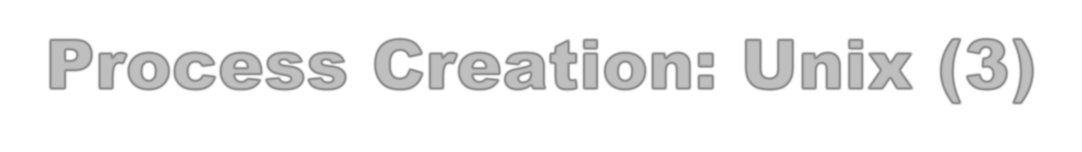
Process Creation: Unix (3)
fork() is used to create a new process, exec is used to
load a program into the address space
  Why does Windoes have CreateProcess while Unix uses fork/exec?
What happens if you run “exec csh” in your shell?
What happens if you run “exec ls” in your shell? Try it.
fork() can return an error. Why might this happen?
30

Slide 30

Process Termination
All good processes must come to an end. But how?
  Unix: exit(int status), Windows: ExitProcess(int status)
Essentially, free resources and terminate
  Terminate all threads (next lecture)
  Close open files, network connections
  Allocated memory (and VM pages out on disk)
  Remove PCB from kernel data structures, delete
Note that a process does not need to clean up itself
  Why does the OS have to do it?

Slide 31

wait() a second…
Often it is convenient to pause until a child process
has finished
  Think of executing commands in a shell
Unix wait() (Windows: WaitForSingleObject)
  Suspends the current process until any child process ends
  waitpid() suspends until the specified child process ends
Wait has a return value…what is it?
Unix: Every process must be “reaped” by a parent
  What happens if a parent process exits before a child?
  What do you think a “zombie” process is?

Slide 32

Unix Shells
while (1) {
char *cmd = read_command(); int child_pid = fork();
if (child_pid == 0) {
Manipulate STDIN/OUT/ERR file descriptors for pipes, redirection, etc.
exec(cmd);
panic(“exec failed”);
} else {
waitpid(child_pid);
}
}

Slide 33

Process Summary
What are the units of execution?
  Processes
How are those units of execution represented?
  Process Control Blocks (PCBs)
How is work scheduled in the CPU?
  Process states, process queues, context switches
What are the possible execution states of a process?
  Running, ready, waiting
How does a process move from one state to another?
  Scheduling, I/O, creation, termination
How are processes created?
  CreateProcess (NT), fork/exec (Unix)

Slide 34

Announcements…
Read Chapters 26, 27
Project 0 due (Due by noon tomorrow)
Project 1 starts (Out by midnight)
HW #1 out tonight

Slide 35





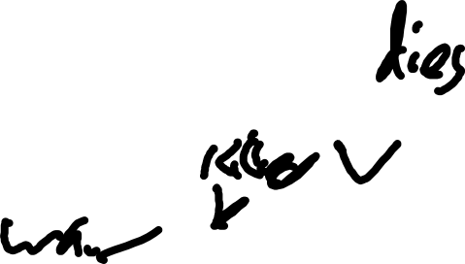






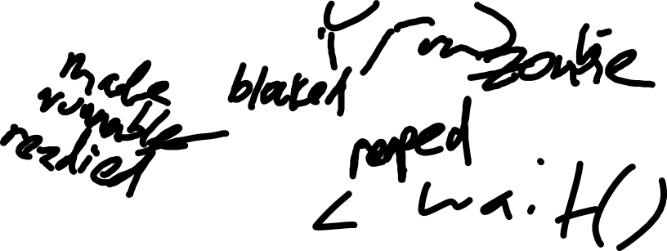

Slide 36
