Slide 1


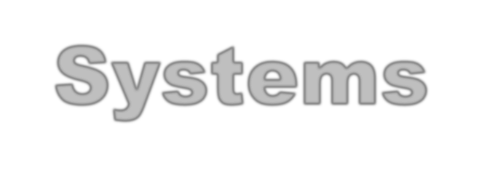


CSE 120
Principles of Operating
Systems
Spring 2017
Lecture 2: Architectural Support for Operating Systems

Slide 2

Administrivia
Project 0
  Good time to get started!
Homework #1
  Out Tuesday
2

Slide 3

Why Start With Architecture?
Operating system functionality fundamentally depends
upon the architectural features of the computer
  Key goals of an OS are to enforce protection and resource sharing
  If done well, applications can be oblivious to HW details
  Unfortunately for us, the OS is left holding the bag
Architectural support can greatly simplify – or complicate – OS tasks
  Early PC operating systems (DOS, MacOS) lacked virtual memory in part because the architecture did not support it
  Early Sun 1 computers used two M68000 CPUs to implement virtual memory (M68000 did not have VM hardware support)
3

Slide 4

Architectural Features for OS
Features that directly support the OS include
  Protection (kernel/user mode)
  Protected instructions
  Memory protection
  System calls
  Interrupts and exceptions
  Timer (clock)
  I/O control and operation
  Synchronization
4

Slide 5

Types of Arch Support
Manipulating privileged machine state
  Protected instructions
  Manipulate device registers, TLB entries, etc.
Generating and handling “events”
  Interrupts, exceptions, system calls, etc.
  Respond to external events
  CPU requires software intervention to handle fault or trap
Mechanisms to handle concurrency
  Interrupts, atomic instructions
5

Slide 6

Protected Instructions
A subset of instructions of every CPU is restricted to
use only by the OS
  Known as protected (privileged) instructions
Only the operating system can …
  Directly access I/O devices (disks, printers, etc.)
» Security, fairness (why?)
  Manipulate memory management state
» Page table pointers, page protection, TLB management, etc.
  Manipulate protected control registers
» Kernel mode, interrupt level
  Halt instruction (why?)
6

Slide 7
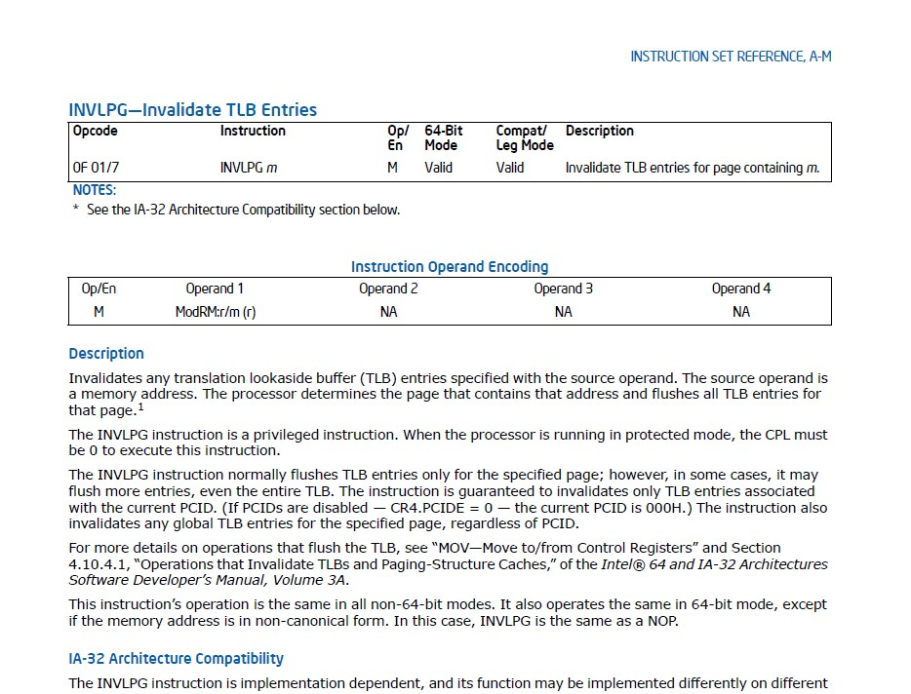
CSE 120 – Lecture 2 – Architectural Support for OSes 7

Slide 8

OS Protection
How do we know if we can execute a protected
instruction?
  Architecture must support (at least) two modes of operation: kernel mode and user mode
» VAX, x86 support four modes; earlier archs (Multics) even more
» Why? Protect the OS from itself (software engineering)
  Mode is indicated by a status bit in a protected control register
  User programs execute in user mode
  OS executes in kernel, privileged mode (OS == “kernel”)
Protected instructions only execute in kernel mode
  CPU checks mode bit when protected instruction executes
  Setting mode bit must be a protected instruction
  Attempts to execute in user mode are detected and prevented
8

Slide 9

Memory Protection
OS must be able to protect programs from each other
OS must protect itself from user programs
May or may not protect user programs from OS
  Raises question of whether programs should trust the OS
  Untrusted operating systems? (Intel SGX)
Memory management hardware provides memory protection mechanisms
  Base and limit registers
  Page table pointers, page protection, segmentation, TLB
Manipulating memory management hardware uses
protected (privileged) operations
9

Slide 10

Events
An event is an “unnatural” change in control flow
  Events immediately stop current execution
  Changes mode, context (machine state), or both
The kernel defines a handler for each event type
  Event handlers always execute in kernel mode
  The specific types of events are defined by the machine
Once the system is booted, all entry to the kernel
occurs as the result of an event
  In effect, the operating system is one big event handler
10

Slide 11

Categorizing Events
Two kinds of events, interrupts and exceptions
Exceptions are caused by executing instructions
  CPU requires software intervention to handle a fault or trap
Interrupts are caused by an external event
  Device finishes I/O, timer expires, etc.
Two reasons for events, unexpected and deliberate
Unexpected events are, well, unexpected
  What is an example?
Deliberate events are scheduled by OS or application
  Why would this be useful?

Slide 12

Categorizing Events (2)
This gives us a convenient table:
 | Unexpected | Deliberate
Exceptions (sync) | fault | syscall trap
Interrupts (async) | interrupt | software interrupt
Terms may be used slightly differently by various OSes, CPU architectures…
Software interrupt – a.k.a. async system trap (AST), async or
deferred procedure call (APC or DPC)
Will cover faults, system calls, and interrupts next
  Does anyone remember from CSE 141 what a software interrupt is?

Slide 13

Faults
Hardware detects and reports “exceptional” conditions
  Page fault, unaligned access, divide by zero
Upon exception, hardware “faults” (verb)
  Must save state (PC, regs, mode, etc.) so that the faulting process can be restarted
Modern OSes use VM faults for many functions
  Debugging, distributed VM, garbage collection, copy-on-write
Fault exceptions are a performance optimization
  Could detect faults by inserting extra instructions into code (at a significant performance penalty)

Slide 14

Handling Faults
Some faults are handled by “fixing” the exceptional
condition and returning to the faulting context
  Page faults cause the OS to place the missing page into memory
  Fault handler resets PC of faulting context to re-execute instruction that caused the page fault
Some faults are handled by notifying the process
  Fault handler changes the saved context to transfer control to a user-mode handler on return from fault
  Handler must be registered with OS
  Unix signals or Win user-mode Async Procedure Calls (APCs)
» SIGALRM, SIGHUP, SIGTERM, SIGSEGV, etc.

Slide 15

Handling Faults (2)
The kernel may handle unrecoverable faults by killing
the user process
  Program fault with no registered handler
  Halt process, write process state to file, destroy process
  In Unix, the default action for many signals (e.g., SIGSEGV)
What about faults in the kernel?
  Dereference NULL, divide by zero, undefined instruction
  These faults considered fatal, operating system crashes
  Unix panic, Windows “Blue screen of death”
» Kernel is halted, state dumped to a core file, machine locked up

Slide 16
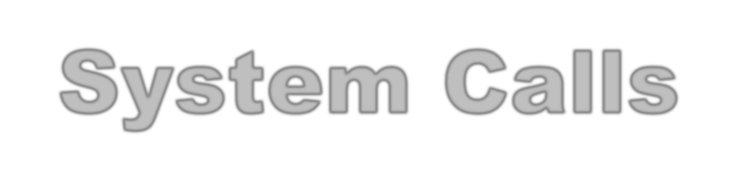
System Calls
For a user program to do something “privileged” (e.g.,
I/O) it must call an OS procedure
  Known as crossing the protection boundary, or protected procedure call, or protected control transfer
CPU ISA provides a system call instruction that:
  Causes an exception, which vectors to a kernel handler
  Passes a parameter determining the system routine to call
  Saves caller state (PC, regs, mode) so it can be restored
» Why save mode?
  Returning from system call restores this state
Requires architectural support to:
  Verify input parameters (e.g., valid addresses for buffers)
  Restore saved state, reset mode, resume execution

Slide 17
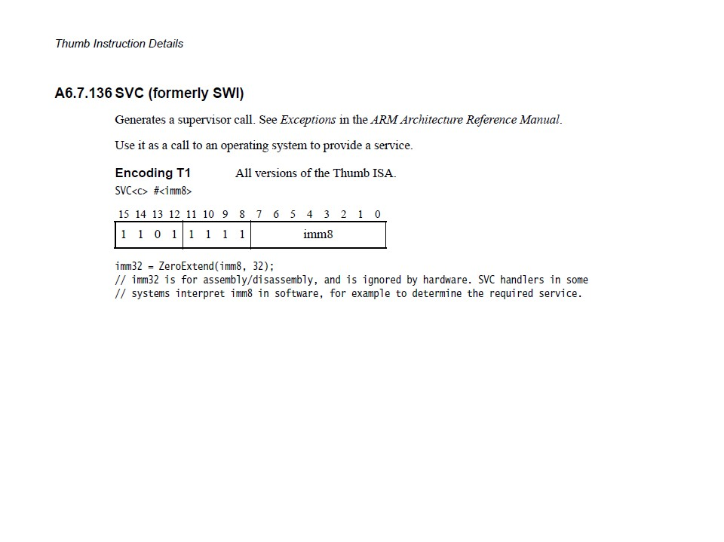
CSE 120 – Lecture 2 – Architectural Support for OSes 17

Slide 18
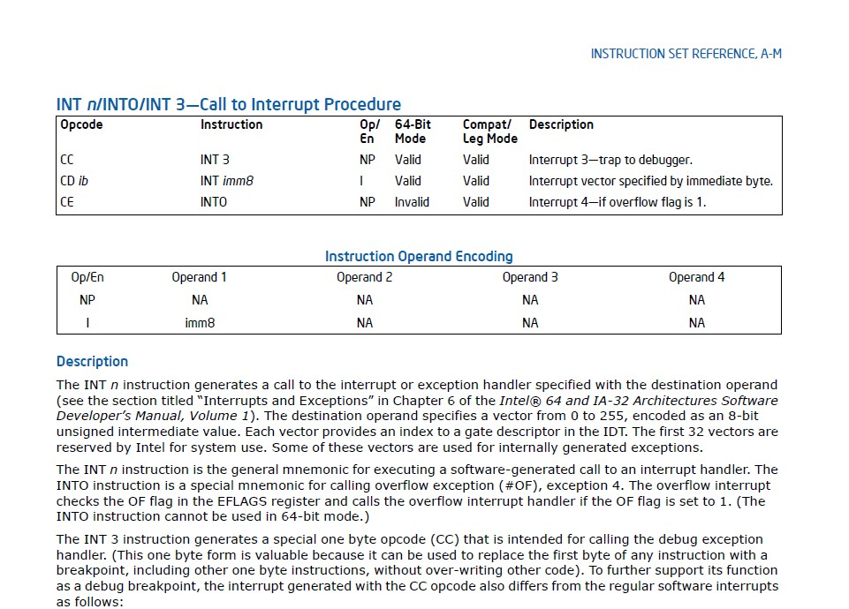
CSE 120 – Lecture 2 – Architectural Support for OSes 18

Slide 19

System Call
Firefox: read()
Trap to kernel mode, save state
User mode
Kernel mode
Restore state, return to user level, resume execution
Trap handler
Find read handler in vector table
read() kernel routine
September 29, 2015
CSE 120 – Lecture 2 – Architectural Support for OSes
19

Slide 20
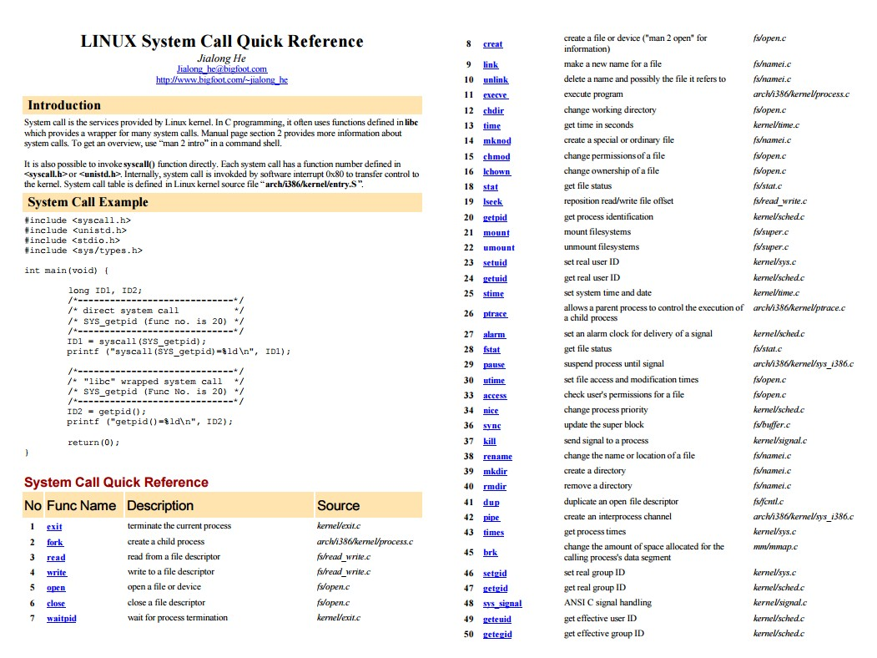
CSE 120 – Lecture 2 – Architectural Support for OSes 20

Slide 21

System Call Questions
What would happen if the kernel did not save state?
What if the kernel executes a system call?
What if a user program returns from a system call?
How to reference kernel objects as arguments or
results to/from system calls?
  A naming issue
  Use integer object handles or descriptors
» E.g., Unix file descriptors, Windows HANDLEs
» Only meaningful as parameters to other system calls
  Also called capabilities (more later when we do protection)
  Why not use kernel addresses to name kernel objects?

Slide 22

Interrupts
Interrupts signal asynchronous events
  I/O hardware interrupts
  Software and hardware timers
Two flavors of interrupts
  Precise: CPU transfers control only on instruction boundaries
  Imprecise: CPU transfers control in the middle of instruction execution
» What the heck does that mean?
  OS designers like precise interrupts, CPU designers like imprecise interrupts
» Why?

Slide 23

Timer
The timer is critical for an operating system
It is the fallback mechanism by which the OS reclaims control over the machine
  Timer is set to generate an interrupt after a period of time
» Setting timer is a privileged instruction
  When timer expires, generates an interrupt
  Handled by kernel, which controls resumption context
» Basis for OS scheduler (more later…)
Prevents infinite loops
  OS can always regain control from erroneous or malicious programs that try to hog CPU
Also used for time-based functions (e.g., sleep())

Slide 24

I/O Control
I/O issues
  Initiating an I/O
  Completing an I/O
Initiating an I/O
  Special instructions
  Memory-mapped I/O
» Device registers mapped into address space
» Writing to address sends data to I/O device

Slide 25

I/O Completion
Interrupts are the basis for asynchronous I/O
  OS initiates I/O
  Device operates independently of rest of machine
  Device sends an interrupt signal to CPU when done
  OS maintains a vector table containing a list of addresses of kernel routines to handle various events
  CPU looks up kernel address indexed by interrupt number, context switches to routine
If you have ever installed earlier versions of Windows, you now know what IRQs are for

Slide 26

I/O Example
Ethernet receives packet, writes packet into memory
Ethernet signals an interrupt
CPU stops current operation, switches to kernel mode,
saves machine state (PC, mode, etc.) on kernel stack
CPU reads address from vector table indexed by interrupt number, branches to address (Ethernet device driver)
Ethernet device driver processes packet (reads descriptors to find packet in memory)
Upon completion, restores saved state from stack

Slide 27

Interrupt Questions
Interrupts halt the execution of a process and transfer
control (execution) to the operating system
  Can the OS be interrupted? (Consider why there might be different IRQ levels)
Interrupts are used by devices to have the OS do stuff
  What is an alternative approach to using interrupts?
  What are the drawbacks of that approach?

Slide 28

Synchronization
Interrupts cause difficult problems
  An interrupt can occur at any time
  A handler can execute that interferes with code that was interrupted
OS must be able to synchronize concurrent execution
Need to guarantee that short instruction sequences execute atomically
  Disable interrupts – turn off interrupts before sequence,
execute sequence, turn interrupts back on
  Special atomic instructions – read/modify/write a memory address, test and conditionally set a bit based upon previous value
» XCHG instruction on x86

Slide 29

Summary
Protection
  User/kernel modes
  Protected instructions
System calls
  Used by user-level processes to access OS functions
  Access what is “in” the OS
Exceptions
  Unexpected event during execution (e.g., divide by zero)
Interrupts
  Timer, I/O

