Slide 1






CSE 120
Principles of Operating
Systems
Spring 2017
Lecture 1: Course Introduction
Gregory Kesden

Slide 2

Lecture 1 Overview
Class overview, administrative info
What is an operating system?
2

Slide 3

Personnel
Instructor
  Gregory Kesden
» Office hours: http://cseweb.ucsd.edu/~gkesden/schedule.html
Tas + Tutors + Instructor
  cse-120-staff@googlegroups.com
3

Slide 4

CSE 120 Class Overview
Course material taught through class lectures,
textbook readings, and handouts
Course assignments are
  Homework questions (primarily from the book)
  Three large programming projects in groups
Discussion sections are a forum for asking questions
  Lecture material and homework
Other forums
  Discussion board (http://piazza.com)
4

Slide 5

Homeworks
There will be 4-5 homeworks throughout the quarter
  Reinforce lecture material…no better practice
Collaboration vs. cheating
  I encourage you to discuss homework problems with others
» You can learn a lot from each other
  But there is a distinction between collaboration and cheating
  Rule of thumb: Discuss together in library, walk home, and write up answers independently
  Cheating is copying from other student’s homeworks or solution sets, searching for answers on the Web, etc.
  Suspicious homeworks will be flagged for review
5

Slide 6




Textbook
Remzi Arpaci-Dusseau and Andrea Arpaci-Dusseau, Operating
Systems: Three Easy Pieces, Version 0.90, March 2015
6

Slide 7
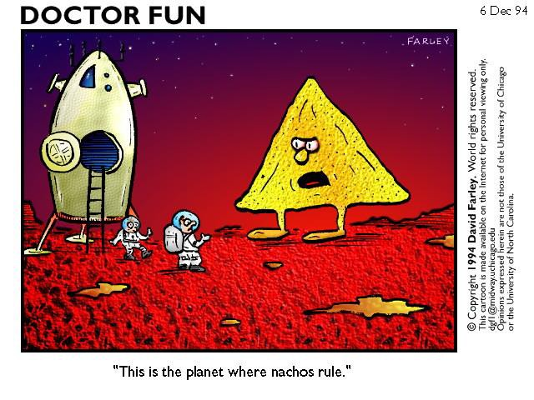
Nachos Project
7

Slide 8

Nachos
Nachos is an instructional operating system
  It is a user-level operating system and a machine simulator
» Not unlike the Java runtime environment
» Will become abundantly clear (or not so clear) very soon
  Programming environment will be Java on Unix (Linux)
  The projects will require serious time commitments
» Waiting until the last minute is not a viable option
You will do three+ projects using Nachos
  Concurrency and synchronization
  System calls, processes, multiprogramming
  Virtual memory
You will work in groups of 1-2 on the projects
  Start thinking about partners
8

Slide 9

Labs
We will use the labs in the CSE basement
  Linux running on x86 machines
You may also use your home machine
  The same project source will work on Windows (mostly)
  Note: We will test and grade on uAPE machines
  Be sure to test your projects there as well
Why work in the labs?
  TAs there to help
  Classmates there to help (and have fun)
  I will visit the labs to help
9

Slide 10

Exams
Midterm
  Covers first half of class
Final
  Covers second half of class + selected material from first part
» I will be explicit about the material covered
No makeup exams
  Unless absolute dire circumstances
Crib sheet
  You can bring one double-sided 8.5x11” page of notes to
each exam to assist you in answering the questions
  Not a substitute for thinking
10

Slide 11

Grading
Homeworks: 15%
  Think of these collectively as a take-home midterm
Midterm: 25%
Final: 30%
Projects: 30%
◆ Breakdown: 1.5%, 7.5%, 9%, 12%

Slide 12



How Not To Pass CSE 120
Do not come to lecture
  Lecture is far too early, the slides are online, and the material is in the book anyway
  Lecture material is the basis for exams and directly relates to
the projects
Do not do the homework
  It’s only 15% of the grade
  Excellent practice for the exams, and some homework problems are exercises for helping with the project
  15% is actually a significant fraction of your grade (could be difference between at least one letter grade)

Slide 13

How Not To Pass (2)
Do not ask questions in lecture, office hours, or online
  It’s scary, I don’t want to embarrass myself
  Asking questions is the best way to clarify lecture material at the time it is being presented
  Office hours and email will help with homeworks, projects
Wait until the last couple of days to start a project
  We’ll have to do the crunch anyways, why do it early?
  The projects cannot be done in the last few days
  Repeat: The projects cannot be done in the last few days
  Each quarter groups learn that starting early meant finishing all of the projects on time…and some do not
  (p.s. The projects cannot be done in the last few days)

Slide 14

Class Web Page
http://www.cse.ucsd.edu/classes/sp17/cse120-a/
Serves many roles…
  Course syllabus and schedule (updated over quarter)
» Lecture slides
  Homework handouts
  Project handouts
Supplemental readings on Unix, monitors, and threads
  e.g., seminal research paper describing the early Unix system
  FYI only, but you might find it interesting
  Concepts in paper might seem obvious and familiar, but they were new at one time

Slide 15

Questions
Before we start the material, any questions about the
class structure, contents, etc.?

Slide 16

Why Operating Systems?
Why are we making you sit here today, having to
suffer through a core course in operating systems?
  It’s not like everyone will become OS developers, after all
Understand what you use
  Understanding how an OS works helps you develop apps
  System functionality, performance, efficiency, etc.
Pervasive abstractions
  Concurrency: Threads and synchronization are common
modern programming abstractions (Java, .NET, etc.)
Complex software systems
  Many of you will go on to work on large software projects
  OSes serve as examples of an evolution of complex systems

Slide 17

CSE 120 Course Material
This course addresses classic OS concepts
  Services provided by the OS
  OS implementation on modern hardware
  Co-evolution of hardware and software
  Techniques for implementing software systems that are
» Large and complex
» Long-lived and evolving
» Concurrent
» Performance-critical
System software tends to be mysterious
  Virtual memory? Wazzat?
Our goal is to reveal all mysteries

Slide 18

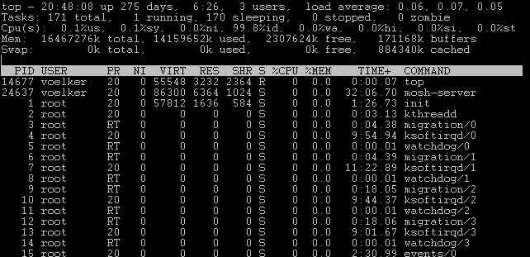

Slide 19
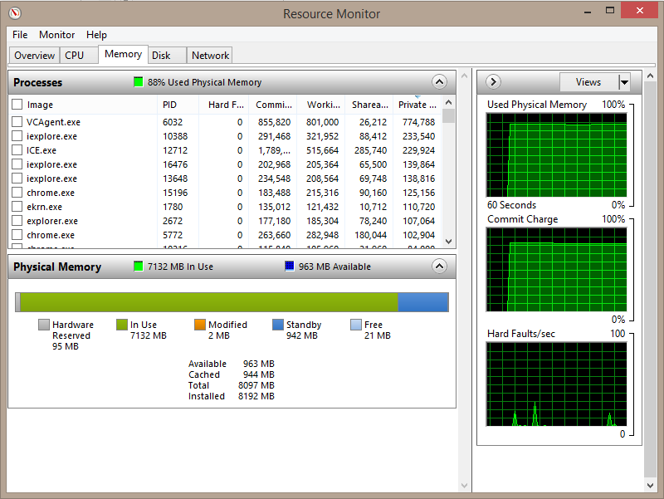

Slide 20

Fundamental OS Issues
The fundamental issues/questions in this course are:
  Structure: how is an operating system organized?
  Sharing: how are resources shared among users?
  Naming: how are resources named (by users and programs)?
  Protection: how are users/programs protected from each other?
  Security: how can information access/flow be restricted?
  Communication: how to exchange data?
  Reliability and fault tolerance: how to mask failures?
  Extensibility: how to add new features?
20

Slide 21

Fundamental OS Issues (2)
Concurrency: how to control parallel activities?
Performance: how to make efficient use of resources, reduce OS overhead?
Scale and growth: how to handle increased demand?
Compatibility: can we ever do anything new?
Distribution: how to coordinate remote operations?
Accountability: how to charge for/restrict use of resources?
And the principles in this course are the design methods, approaches, and solutions to these issues
21

Slide 22

March 30, 2009 CSE 120 – Lecture 1 – Course Intro 22

Slide 23

What is an Operating System?
How would you answer?
  (Yes, I know that’s why you’re taking the course…)
  (Note: There are many answers…)

Slide 24

What is an operating system?
The operating system is the software layer between
user applications and the hardware
Applications
Operating System
Hardware
The OS is “all the code that you didn’t have to write” to
implement your application

Slide 25

The OS and Hardware
The OS abstracts/controls/mediates access to
hardware resources
  Computation (CPUs)
  Volatile storage (memory) and persistent storage (disk, etc.)
  Communication (network, modem, etc.)
  Input/output devices (keyboard, display, printer, camera, etc.)
The OS defines a set of logical resources (objects) and a set of well-defined operations on those objects (interfaces)
  Physical resources (CPU and memory)
  Logical resources (files, programs, names)
  Sounds like OO…

Slide 26

The OS and Hardware (2)
Benefits to applications
  Simpler (no tweaking device registers)
  Device independent (all network cards look the same)
  Portable (across Win95/98/ME/NT/2000/XP/Vista/7/8/10/…)
  Transportable (same program across different OSes (Java))

Slide 27

The OS and Applications
The OS defines a logical, well-defined environment…
  Virtual machine (each program thinks it owns the computer)
…for users and programs to safely coexist, cooperate,
share resources
  Concurrent execution of multiple programs (timeslicing)
  Communication among multiple programs (pipes, cut & paste)
  Shared implementations of common facilities
» No need to implement the file system more than once
  Mechanisms and policies to manage/share/protect resources
» File permissions (mechanism) and groups (policies)

Slide 28

Other Questions to Ponder
What is part of an OS? What is not?
  Is the windowing system part of an OS?
  Is the Web browser part of an OS?

Slide 29
Other Questions to Ponder
What is part of an OS? What is not?
  Is the windowing system part of an OS?
  Is the Web browser part of an OS?
Popular OSes today are Windows, Linux, and OS X
  How different/similar do you think these OSes are?
  How would you go about answering that question?
OSes change all of the time
  Consider the series of releases of Windows, Linux, OS X…
  What are the drivers of OS change?
  What are the most compelling issues facing OSes today?

Slide 30

Pondering Cont’d
How many lines of code in an OS?
◆ Win7 (2009): 40M
◆ OS X (2006): 86M
◆ Linux (2011): 15M
  What is largest kernel component?
What does this mean (for you)?
  OSes are useful for learning about software complexity
  OS is just one example of many complex software systems
» Chrome (2015): 17M
» Apache (2015): 1.7M
» JDK (2015): 6M
» Unreal Engine 3: 2M
  If you become a developer, you will face complexity
30

Slide 31

For next class…
Browse the course web
http://www.cse.ucsd.edu/classes/sp17/cse120-a/
Read Chapters 1 and 2
  Start exploring Nachos documentation
Start thinking about partners for project groups
Let the fun begin!
31

Slide 32

OS Metaphors
Service provider
  The OS provides a standard set of facilities/services that enable programs to be simple and portable
Executive/bureaucrat/big brother/juggler
  The OS controls access to shared resources, and allocates resources for the greater good
Caretaker
  The OS monitors and recovers from exceptional conditions
Cop/security guard
  The OS mediates access to resources, granting or denying requests to use resources
September 23, 2004
CSE 120 – Lecture 1 – Course Intro
32

