Slide 1




Improving Datacenter Performance and Robustness with Multipath TCP
Costin Raiciu
Department of Computer Science
University Politehnica of Bucharest
Sebastien Barre (UCL-BE), Christopher Pluntke (UCL), Adam Greenhalgh (UCL), Damon Wischik (UCL) and Mark Handley (UCL)
Thanks to:
Presented by Gregory Kesden

Slide 2
Motivation
Datacenter apps are distributed across thousands of machines
Want any machine to play any role
To achieve this:
Use dense parallel datacenter topologies
Map each flow to a path
Problem:
Naïve random allocation gives poor performance
Improving performance adds complexity
This is the wrong place to start

Slide 3
Contributions
Multipath topologies need multipath transport
Multipath transport enables better topologies

Slide 4
To satisfy demand, modern datacenters provide many parallel paths
Traditional Topologies are tree-based
Poor performance
Not fault tolerant
Shift towards multipath topologies: FatTree, BCube, VL2,
Cisco, EC2
…

Slide 5
Fat Tree Topology [Fares et al., 2008; Clos, 1953]
K=4
Aggregation Switches
1Gbps
K Pods with
K Switches
each
1Gbps
Racks of
servers
Notes:
Show multiple paths between servers
Say that network is rearrangeably non blocking
Clos
5

Slide 6
Fat Tree Topology [Fares et al., 2008; Clos, 1953]
K=4
Aggregation Switches
K Pods with
K Switches
each
Racks of
servers
Notes:
Show multiple paths between servers
Say that network is rearrangeably non blocking
Clos
6

Slide 7
Collisions
Notes:
Show multiple paths between servers
Say that network is rearrangeably non blocking
Clos
7

Slide 8
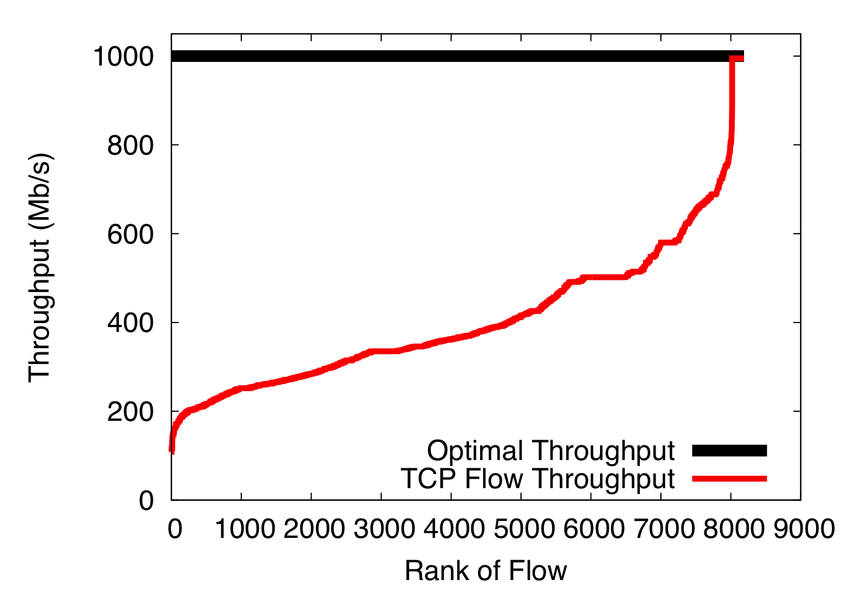
Single-path TCP collisions reduce throughput

Slide 9
Collision

Slide 12
Not fair

Slide 13
Not fair

Slide 14




Slide 16
No matter how you do it,
mapping each flow to a path is the wrong goal

Slide 17
Instead, we should pool capacity from different links

Slide 18
Instead, we should pool capacity from different links

Slide 19
Instead, we should pool capacity from different links

Slide 20
Instead, we should pool capacity from different links

Slide 21
Multipath Transport

Slide 22
Multipath Transport can pool datacenter networks
Instead of using one path for each flow, use many random paths
Don’t worry about collisions.
Just don’t send (much) traffic on colliding paths

Slide 23
Multipath TCP Primer [IETF MPTCP WG]
MPTCP is a drop in replacement for TCP
MPTCP spreads application data over multiple subflows

Slide 24
Multipath TCP: Congestion Control [NSDI, 2011]

Slide 25
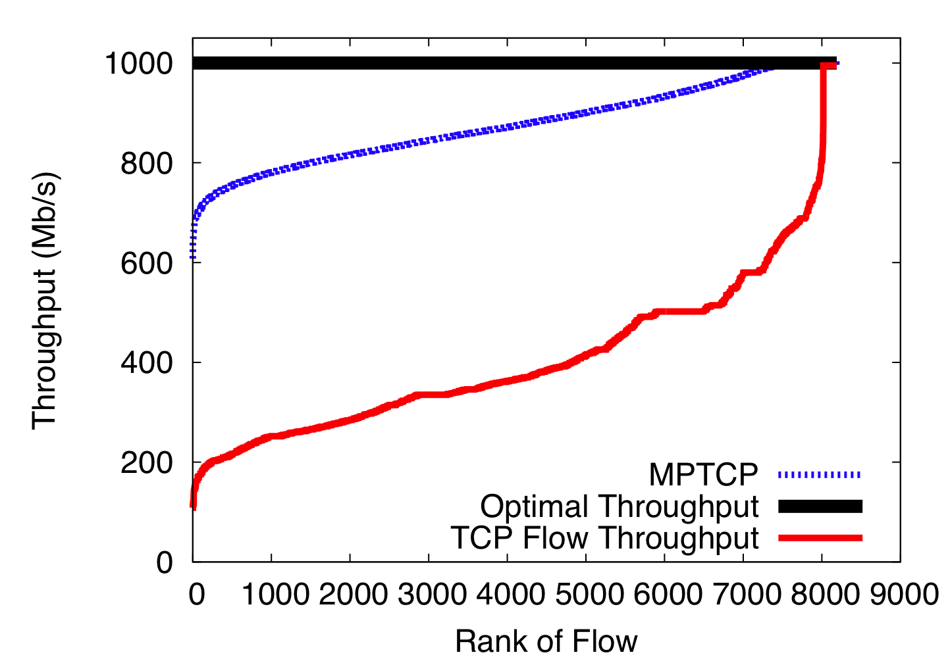
MPTCP better utilizes the FatTree network
Notes:
Fairness matters for apps!

Slide 26
MPTCP on EC2
Amazon EC2: infrastructure as a service
We can borrow virtual machines by the hour
These run in Amazon data centers worldwide
We can boot our own kernel
A few availability zones have multipath topologies
2-8 paths available between hosts not on the same machine or in the same rack
Available via ECMP

Slide 27
Amazon EC2 Experiment
40 medium CPU instances running MPTCP
For 12 hours, we sequentially ran all-to-all iperf cycling through:
TCP
MPTCP (2 and 4 subflows)

Slide 28
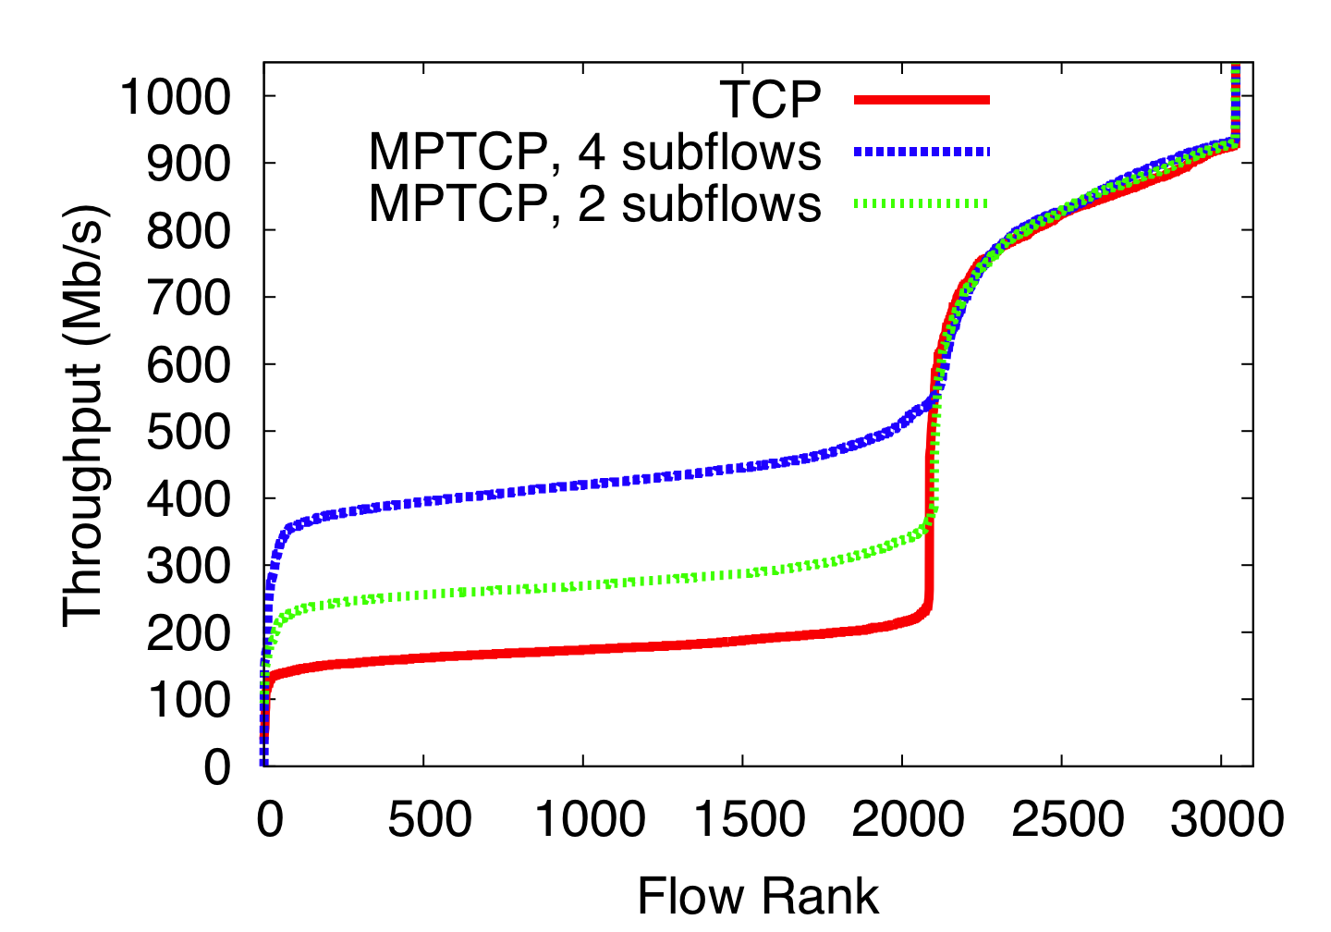
MPTCP improves performance on EC2
Same
Rack

Slide 29
What do the benefits depend on?

Slide 30
How many subflows are needed?
How does the topology affect results?
How does the traffic matrix affect results?

Slide 31
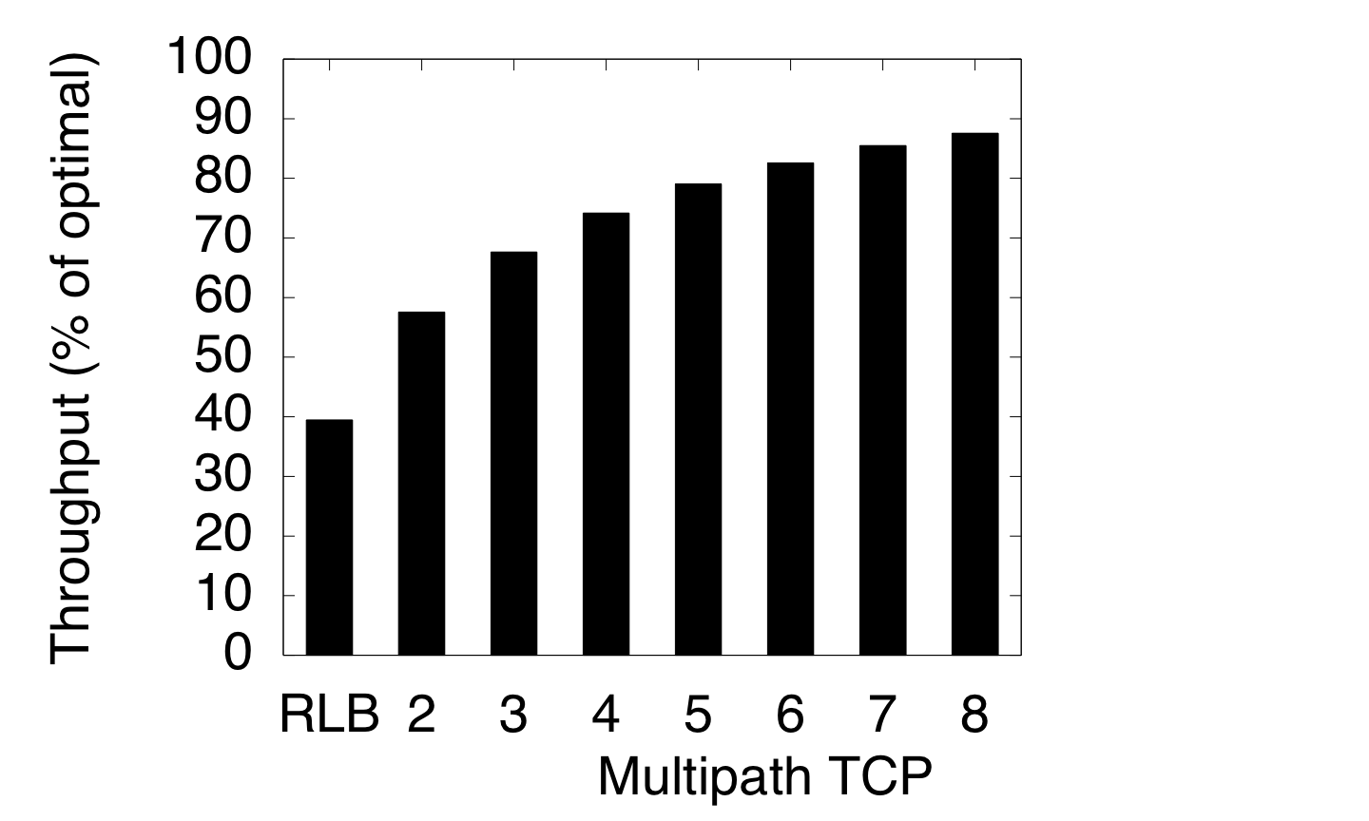
At most 8 subflows are needed
Total Throughput
TCP

Slide 32
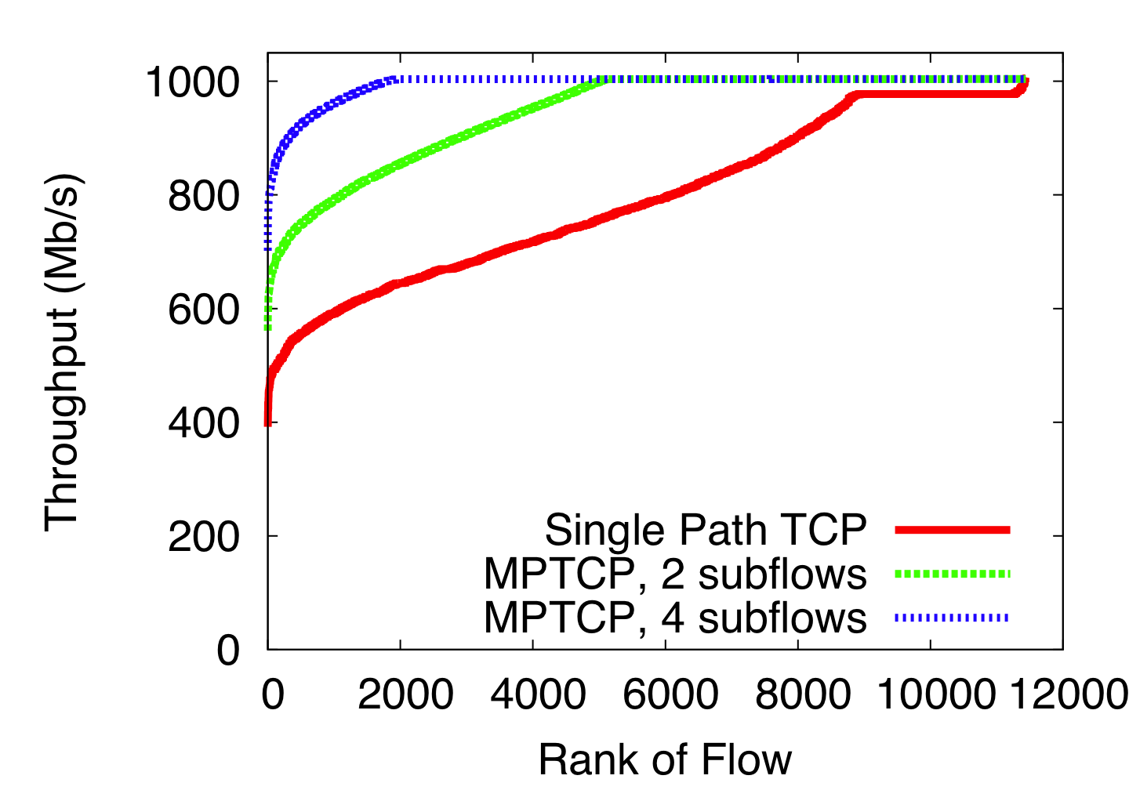
MPTCP improves fairness in VL2 topologies
VL2
Fairness is important:
Jobs finish when the slowest worker finishes

Slide 33
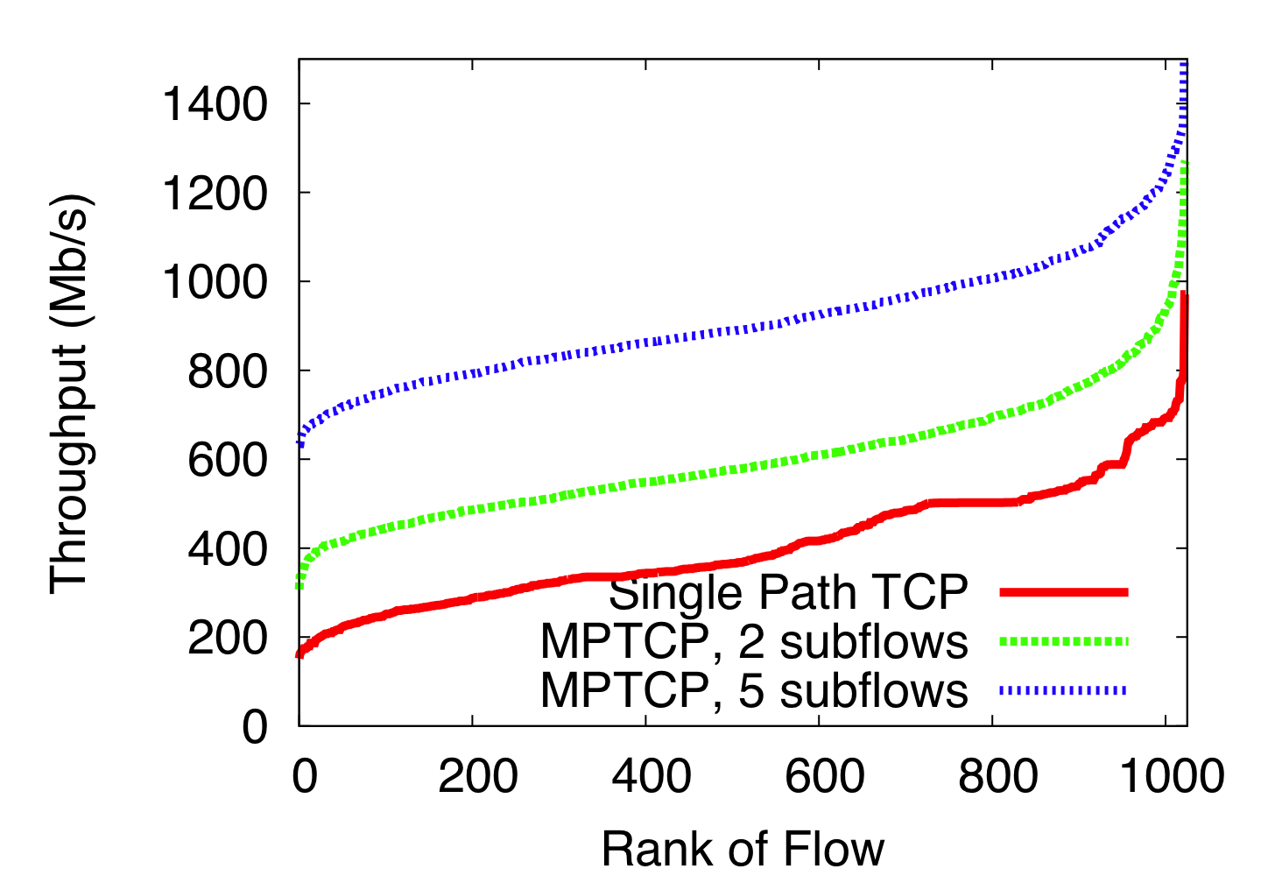
MPTCP improves throughput and fairness in BCube
BCube

Slide 34
Oversubscribed Topologies
To saturate full bisectional bandwidth:
There must be no traffic locality
All hosts must send at the same time
Host links must not be bottlenecks
It makes sense to under-provision the network core
This is what happens in practice
Does MPTCP still provide benefits?

Slide 35
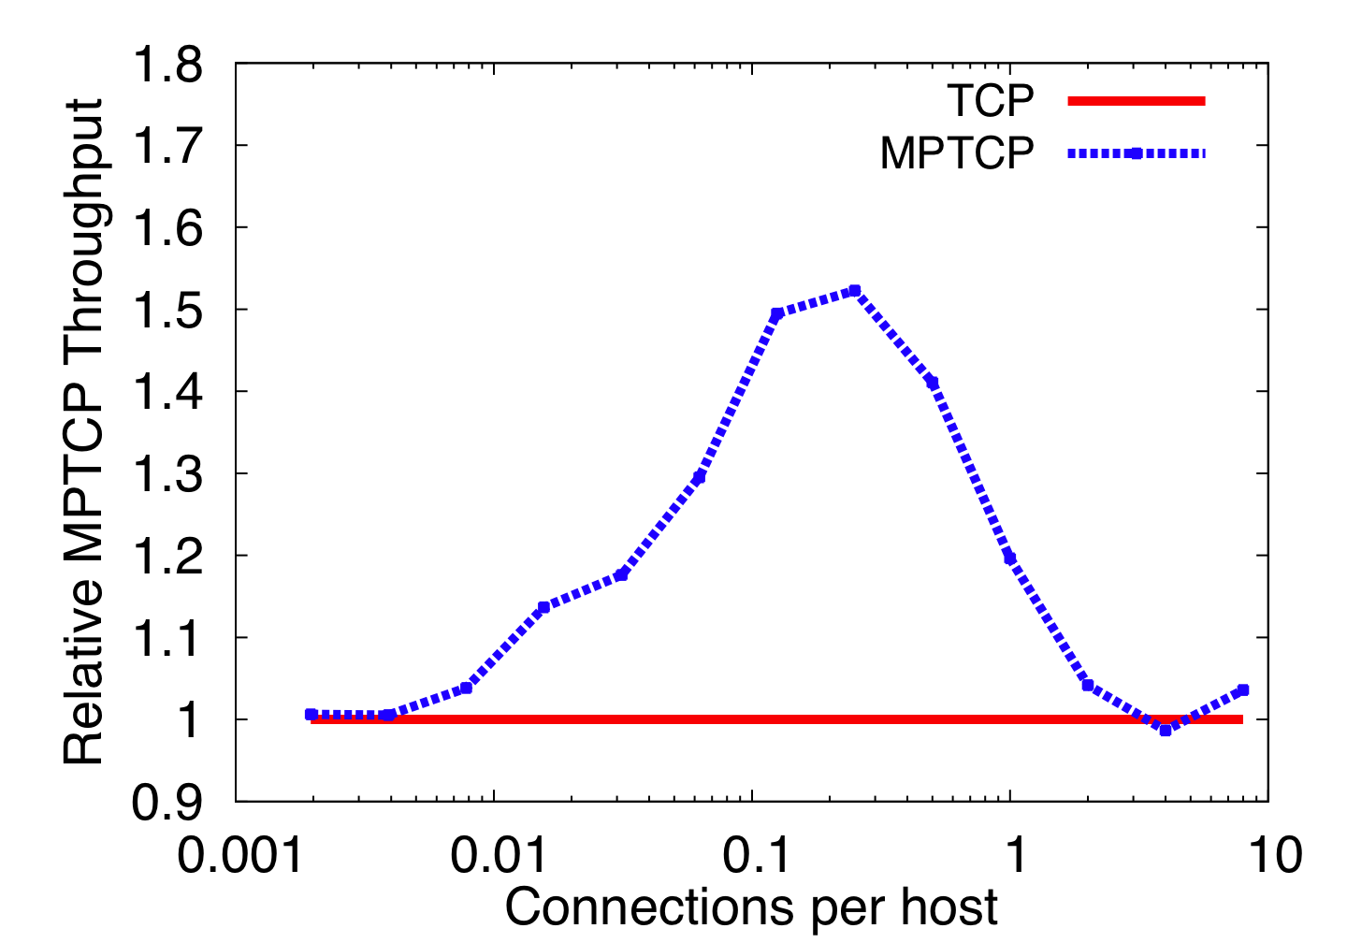
Performance improvements depend on traffic matrix
Underloaded
Overloaded
Sweet Spot
Increase Load

Slide 36
What is an optimal datacenter topology for multipath transport?

Slide 37
In single homed topologies:
Hosts links are often bottlenecks
ToR switch failures wipe out tens of hosts for days
Multi-homing servers is the obvious way forward
Notes:
Show multiple paths between servers
Say that network is rearrangeably non blocking
Clos
37

Slide 38
Fat Tree Topology
Notes:
Show multiple paths between servers
Say that network is rearrangeably non blocking
Clos
38

Slide 39
Fat Tree Topology
Upper Pod
Switch
ToR Switch
Servers

Slide 40
Dual Homed Fat Tree Topology
Upper Pod
Switch
ToR Switch
Servers

Slide 41
Is DHFT any better than Fat Tree?
Not for traffic matrices that fully utilize the core
Let’s examine random traffic patterns
Other TMs in the paper

Slide 42
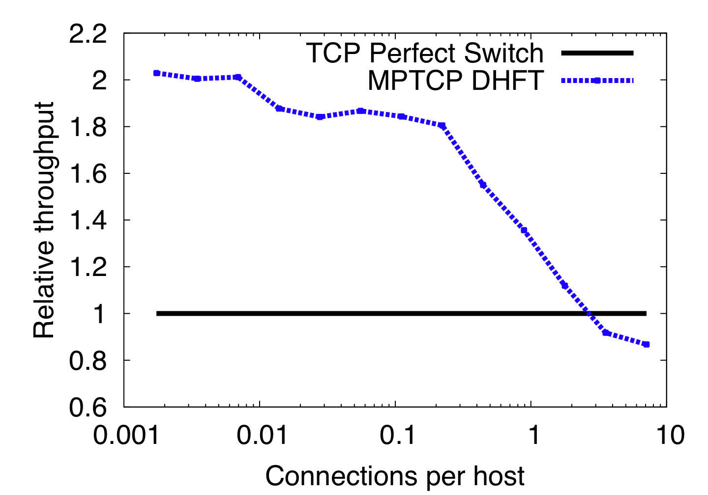
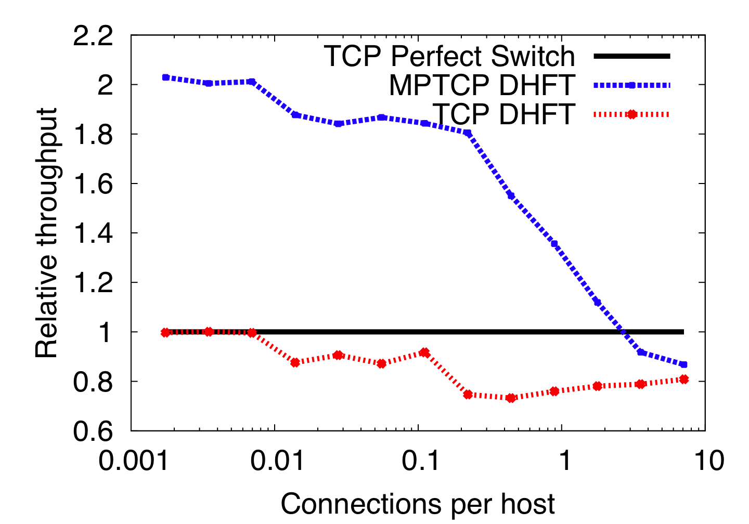
DHFT provides significant improvements when core is not overloaded
Core Overloaded
Core Underloaded

Slide 43
Summary
“One flow, one path” thinking has constrained datacenter design
Collisions, unfairness, limited utilization
Multipath transport enables resource pooling in datacenter networks:
Improves throughput
Improves fairness
Improves robustness
“One flow, many paths” frees designers to consider topologies that offer improved performance for similar cost

Slide 44
Backup Slides

Slide 45
Effect of MPTCP on short flows
Flow sizes from VL2 dataset
MPTCP enabled for long flows only (timer)
Oversubscribed Fat Tree topology
Results:
TCP/ECMP
Completion time: 79ms
Core Utilization: 25%
MPTCP
97ms
65%

Slide 46
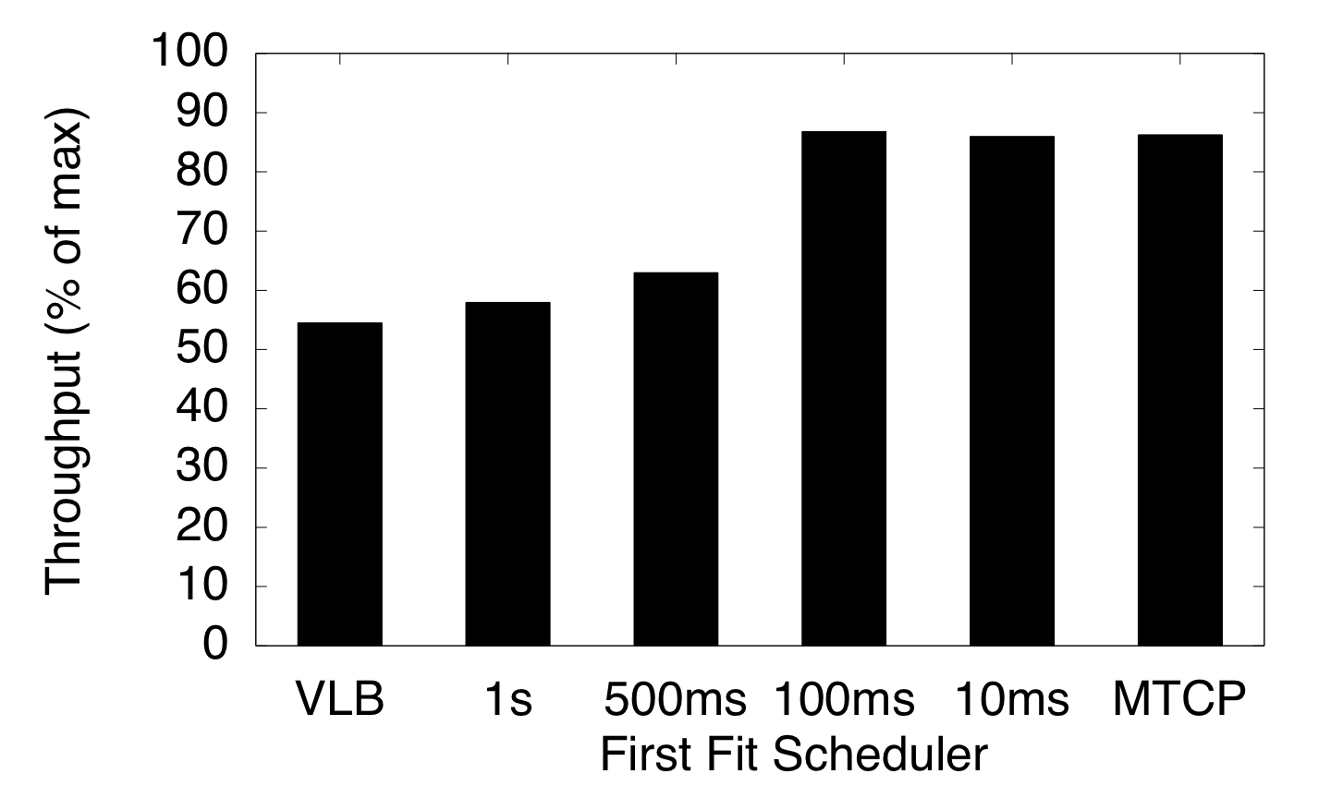
MPTCP vs Centralized Dynamic Scheduling
Centralized Scheduling MPTCP
Infinite
Scheduling Interval
Notes:
Animate tough part of the graph
46

Slide 47
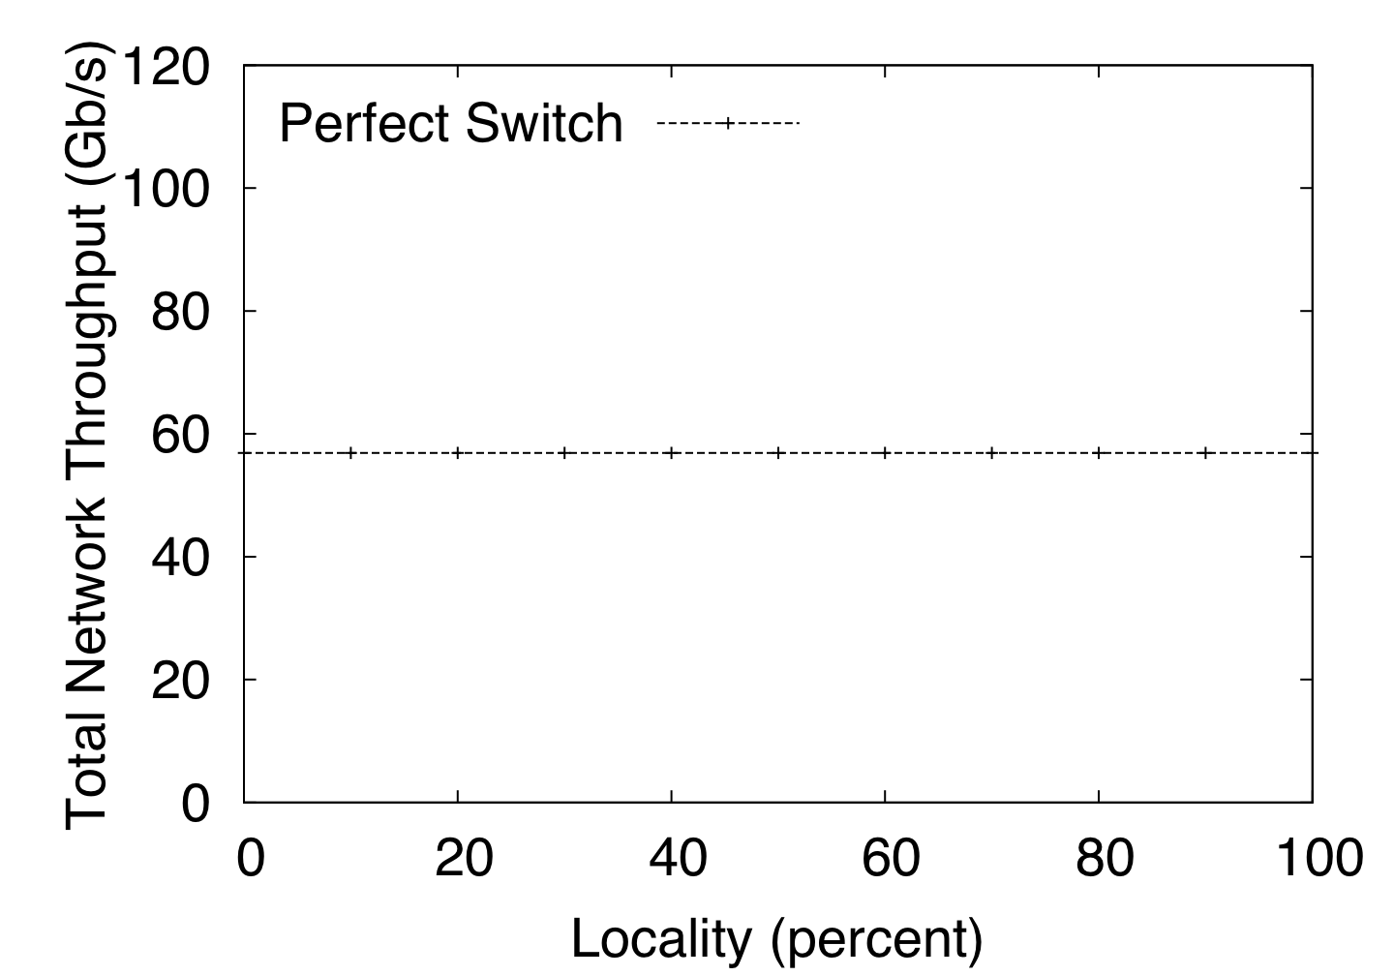
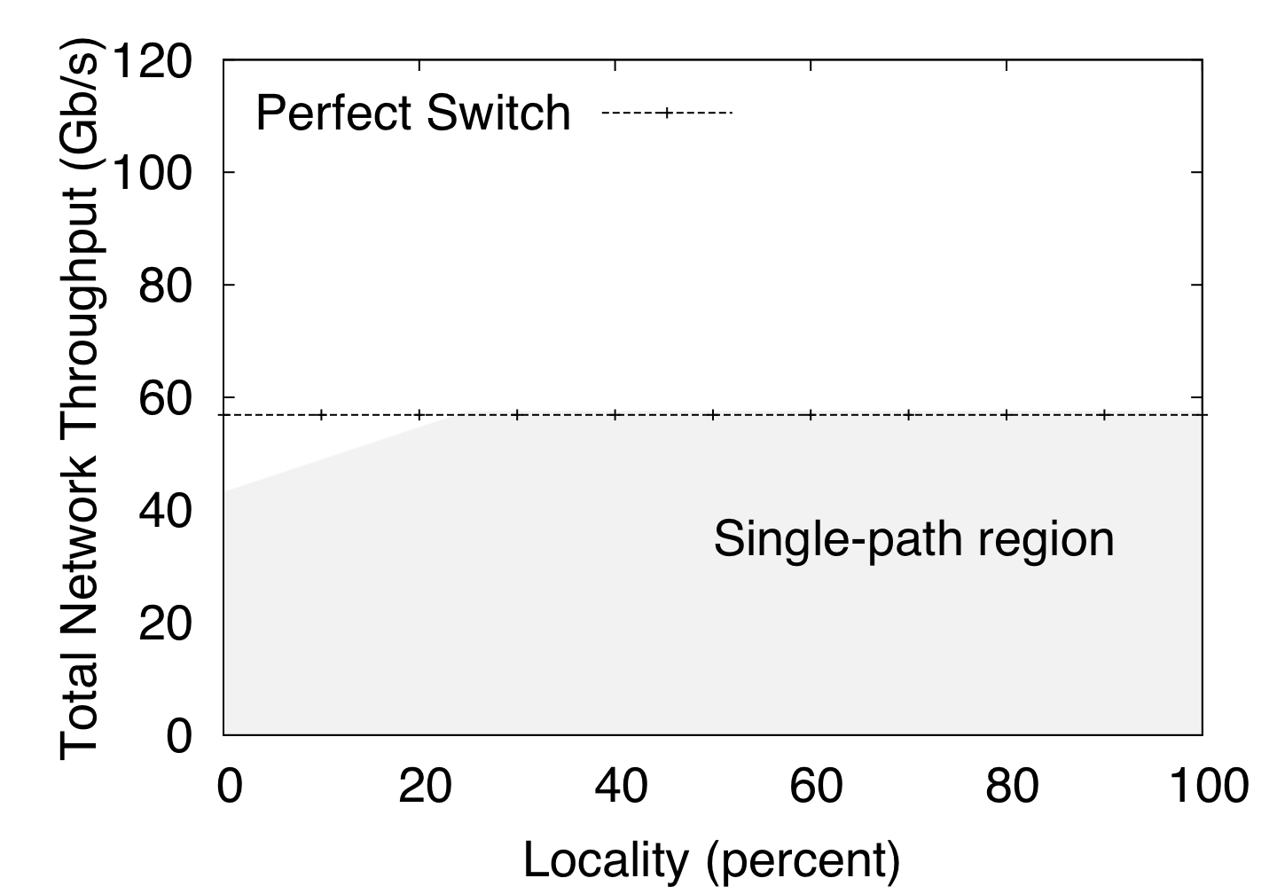
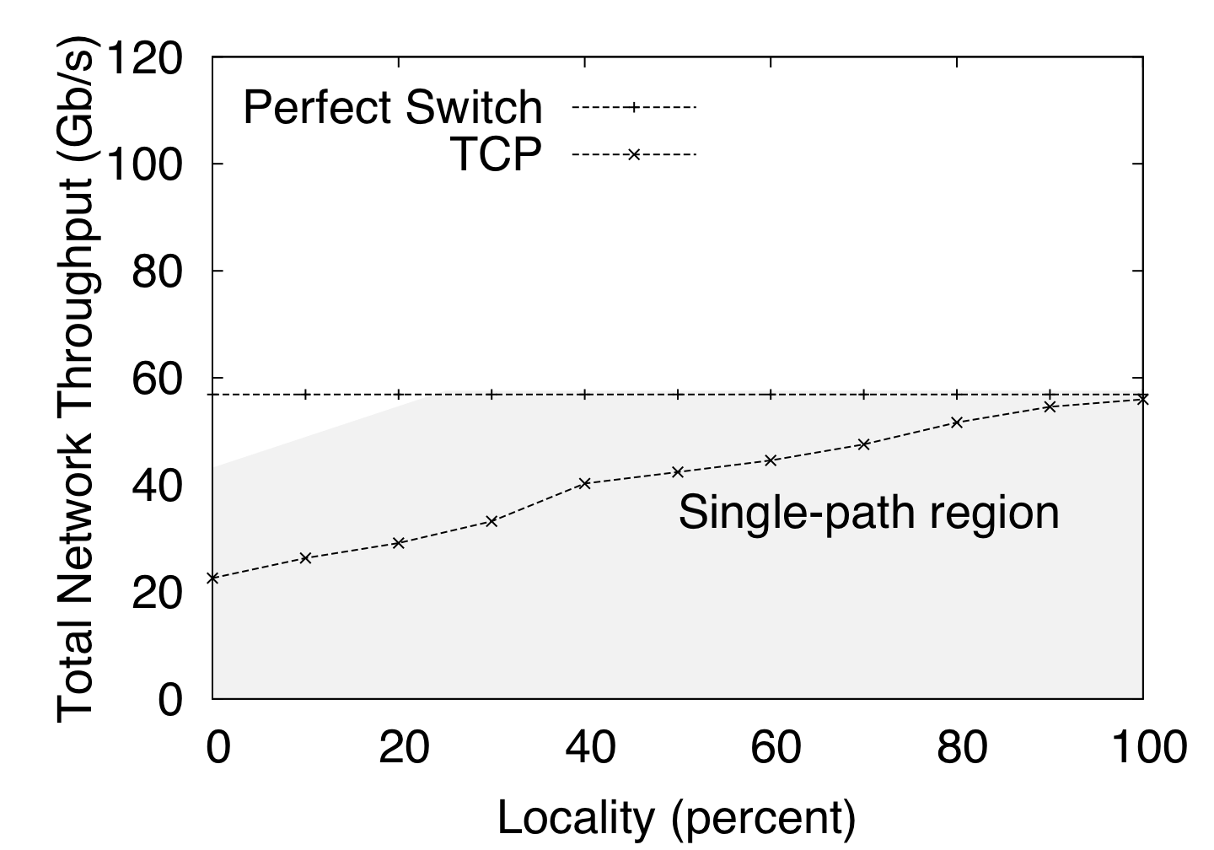
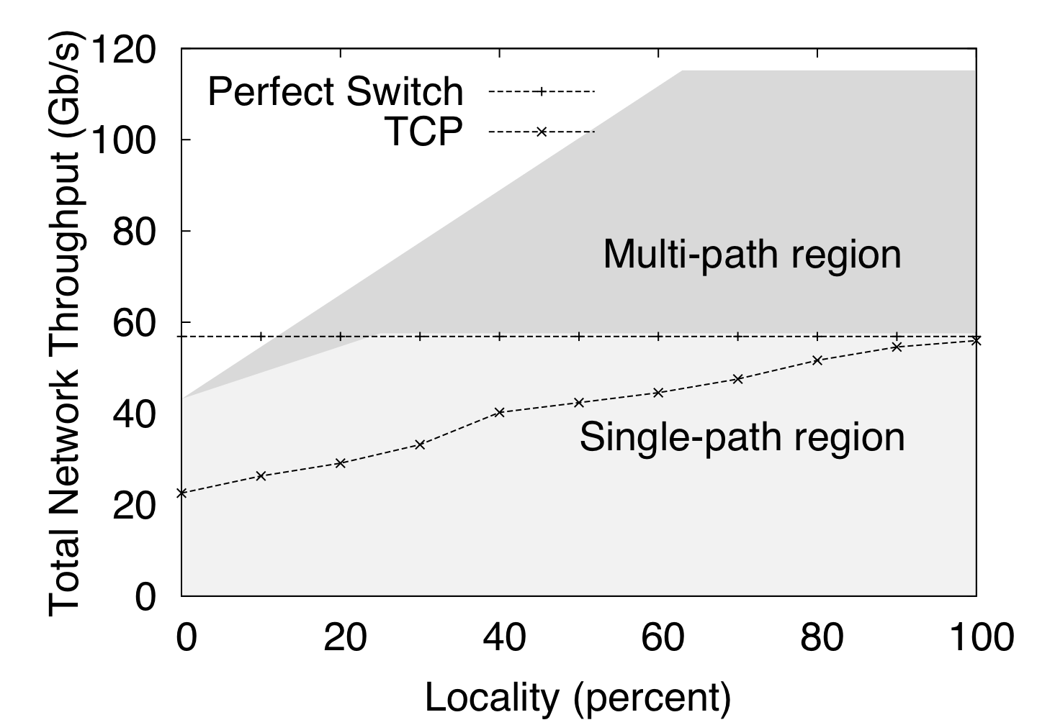
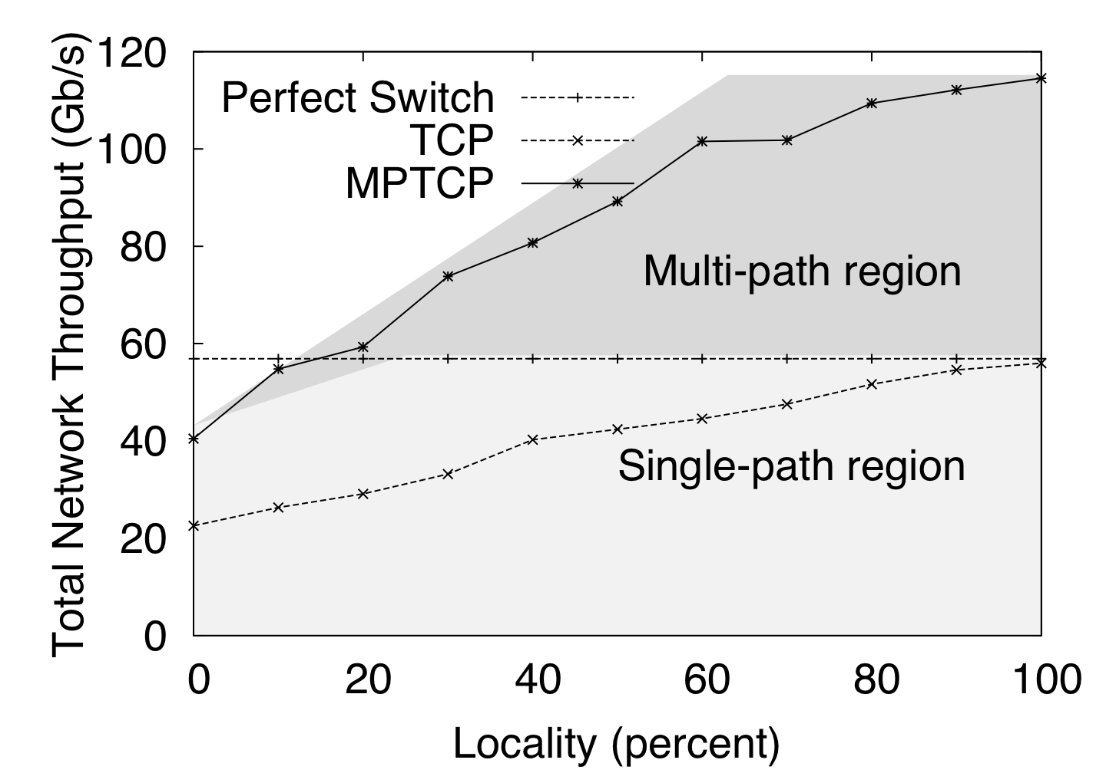
Effect of Locality in the Dual Homed Fat Tree
Notes:
47

Slide 48
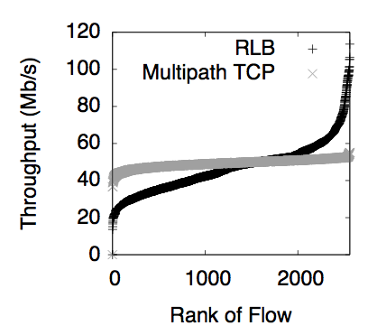
Overloaded Fat Tree: better fairness with Multipath TCP

