Slide 1
Data Center TCP
(DCTCP)
Mohammad Alizadeh, Albert Greenberg, David A. Maltz, Jitendra Padhye Parveen Patel, Balaji Prabhakar, Sudipta Sengupta, Murari Sridharan
Microsoft Research Stanford University
Presented by Greg Kesden

Slide 2

Data Center Packet Transport
Large purpose-built DCs
Huge investment: R&D, business
Transport inside the DC
TCP rules (99.9% of traffic)
How’s TCP doing?

Slide 3
TCP in the Data Center
We’ll see TCP does not meet demands of apps.
Suffers from bursty packet drops, Incast [SIGCOMM ‘09], ...
Builds up large queues:
Adds significant latency.
Wastes precious buffers, esp. bad with shallow-buffered switches.
Operators work around TCP problems.
Ad-hoc, inefficient, often expensive solutions
No solid understanding of consequences, tradeoffs

Slide 4
Roadmap
What’s really going on?
Interviews with developers and operators
Analysis of applications
Switches: shallow-buffered vs deep-buffered
Measurements
A systematic study of transport in Microsoft’s DCs
Identify impairments
Identify requirements
Our solution: Data Center TCP

Slide 5
Case Study: Microsoft Bing
Measurements from 6000 server production cluster
Instrumentation passively collects logs
Application-level
Socket-level
Selected packet-level
More than 150TB of compressed data over a month

Slide 6





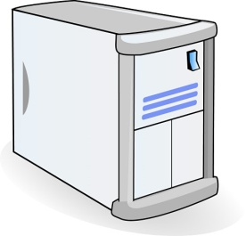








Partition/Aggregate Application Structure
TLA
1.
Picasso
Art is…
2. Art is a lie…
Deadline = 250ms
3.
…..
Picasso
Time is money
Strict deadlines (SLAs)
Missed deadline
Lower quality result
MLA
………
MLA
1. Art is a lie…
1.
2.
2. The chief…
Deadline = 50ms
…..
3.
…..
3.
Deadline = 10ms
Worker Nodes

Slide 7
Generality of Partition/Aggregate
The foundation for many large-scale web applications.
Web search, Social network composition, Ad selection, etc.
Example: Facebook
Partition/Aggregate ~ Multiget
Aggregators: Web Servers
Workers: Memcached Servers
Internet
Web
Servers
Memcached Protocol
Memcached Servers

Slide 8



Workloads
Partition/Aggregate
(Query)
Short messages [50KB-1MB]
(Coordination, Control state)
Large flows [1MB-50MB]
(Data update)
Delay-sensitive
Delay-sensitive
Throughput-sensitive
Notes:
Replace PDF

Slide 9
Impairments
Incast
Queue Buildup
Buffer Pressure

Slide 10

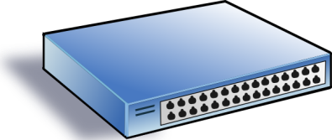
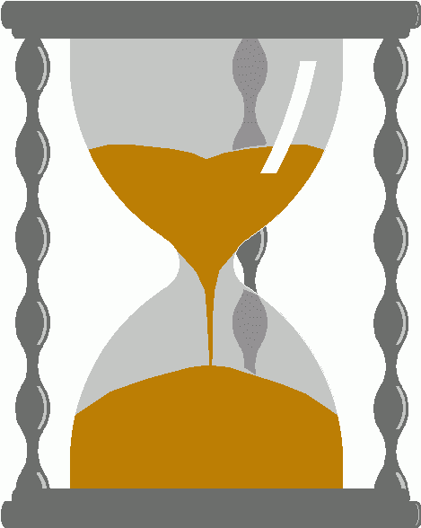
Incast
Worker 1
“Synchronized mice collide.”
Caused by Partition/Aggregate.
Aggregator
Worker 2
Worker 3
RTO_{min} = 300 ms
Worker 4
TCP timeout

Slide 11
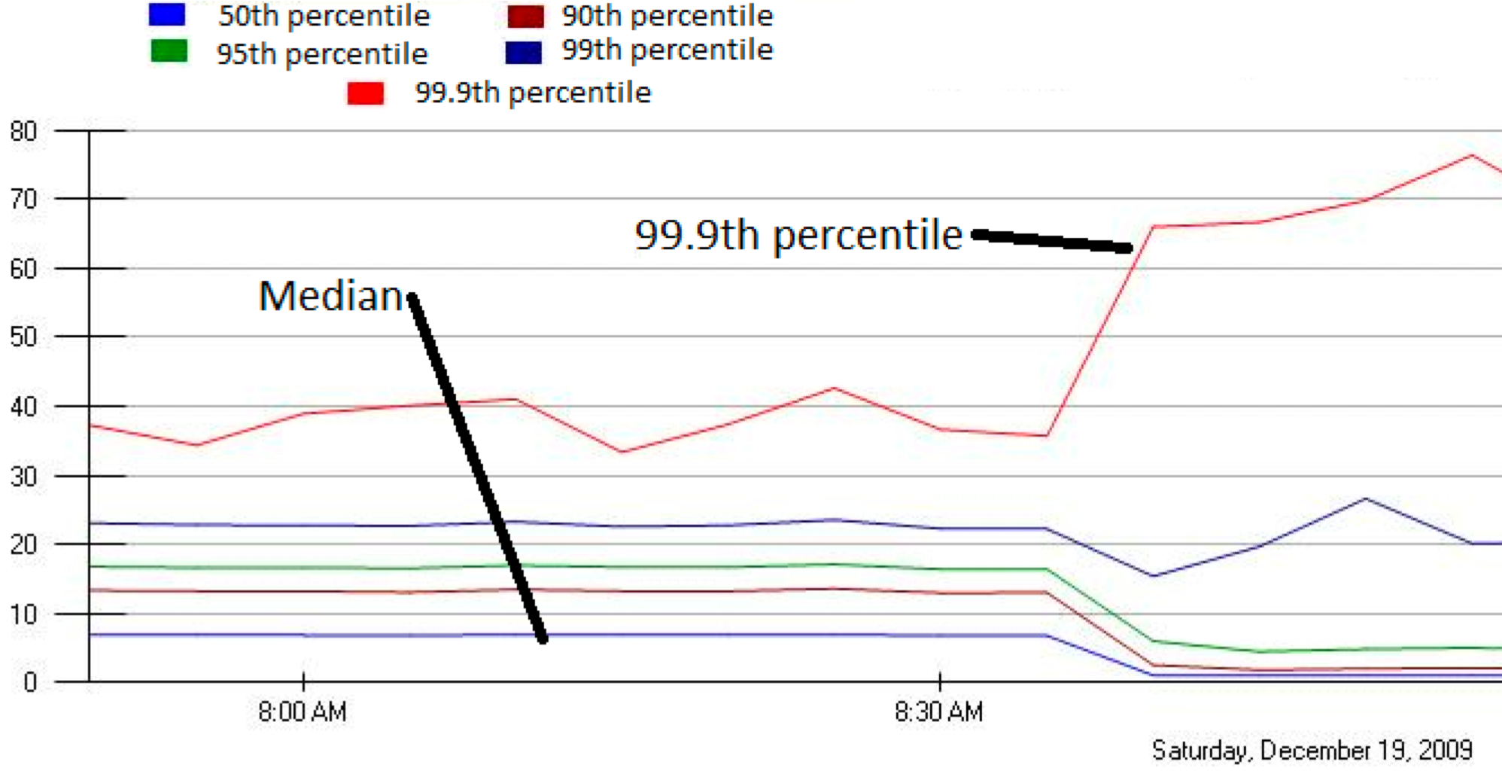
Incast Really Happens
MLA Query Completion Time (ms)
Requests are jittered over 10ms window.
Jittering switched off around 8:30 am.
99.9th percentile is being tracked.
Jittering trades off median against high percentiles.
Notes:
1. Incast really happens – see this actual screenshot from production tool
2. People care, they’ve solved it at application by jittering.
3. They care about the 99.9th percentile, 1-1000 customers

Slide 12
Queue Buildup
Sender 1
Big flows buildup queues.
Increased latency for short flows.
Receiver
Sender 2
Measurements in Bing cluster
For 90% packets: RTT < 1ms
For 10% packets: 1ms < RTT < 15ms

Slide 13
Data Center Transport Requirements
High Burst Tolerance
Incast due to Partition/Aggregate is common.
Low Latency
Short flows, queries
3. High Throughput
Continuous data updates, large file transfers
The challenge is to achieve these three together.

Slide 14
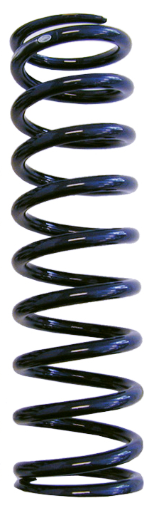
Tension Between Requirements
High Throughput
High Burst Tolerance
Low Latency
Deep Buffers:
Queuing Delays
Increase Latency
Shallow Buffers:
Bad for Bursts &
Throughput
DCTCP
Reduced RTO_{min} (SIGCOMM ‘09)
Doesn’t Help Latency
AQM – RED:
Avg Queue Not Fast
Enough for Incast
Objective:
Low Queue Occupancy & High Throughput
Notes:
Deep Buffers – bad for latency
Shallow Buffers – bad for bursts & throughput
Reduce RTO_{min} – no good for latency
AQM – Difficult to tune, not fast enough for incast-style micro-bursts, lose throughput in low stat-mux

Slide 15
The DCTCP Algorithm

Slide 16
Review: The TCP/ECN Control Loop
Sender 1
ECN = Explicit Congestion Notification
ECN Mark (1 bit)
Receiver
Sender 2
Notes:
DCTCP is based on the existing Explicit Congestion Notification framework in TCP.

Slide 17

Small Queues & TCP Throughput: The Buffer Sizing Story
Bandwidth-delay product rule of thumb:
A single flow needs buffers for 100% Throughput.
Cwnd
Buffer Size
B
Throughput
100%
Notes:
In the first part of the talk, we established that what we need from DCTCP is to maintain small queues, without loss of throughput
Now in the case of TCP, the question of how much buffering is needed for high throughput has been studied and is known in the literature as the buffer sizing problem.
… and I’ll show you how to get low var…

Slide 18

Small Queues & TCP Throughput: The Buffer Sizing Story
Bandwidth-delay product rule of thumb:
A single flow needs buffers for 100% Throughput.
Appenzeller rule of thumb (SIGCOMM ‘04):
Large # of flows: is enough.
Cwnd
Buffer Size
B
Throughput
100%
Notes:
In the first part of the talk, we established that what we need from DCTCP is to maintain small queues, without loss of throughput
Now in the case of TCP, the question of how much buffering is needed for high throughput has been studied and is known in the literature as the buffer sizing problem.
… and I’ll show you how to get low var…

Slide 19
Small Queues & TCP Throughput: The Buffer Sizing Story
Bandwidth-delay product rule of thumb:
A single flow needs buffers for 100% Throughput.
Appenzeller rule of thumb (SIGCOMM ‘04):
Large # of flows: is enough.
Can’t rely on stat-mux benefit in the DC.
Measurements show typically 1-2 big flows at each server, at most 4.
Notes:
In the first part of the talk, we established that what we need from DCTCP is to maintain small queues, without loss of throughput
Now in the case of TCP, the question of how much buffering is needed for high throughput has been studied and is known in the literature as the buffer sizing problem.
… and I’ll show you how to get low var…

Slide 20
Small Queues & TCP Throughput: The Buffer Sizing Story
Bandwidth-delay product rule of thumb:
A single flow needs buffers for 100% Throughput.
Appenzeller rule of thumb (SIGCOMM ‘04):
Large # of flows: is enough.
Can’t rely on stat-mux benefit in the DC.
Measurements show typically 1-2 big flows at each server, at most 4.
Real Rule of Thumb:
Low Variance in Sending Rate → Small Buffers Suffice
B
Notes:
In the first part of the talk, we established that what we need from DCTCP is to maintain small queues, without loss of throughput
Now in the case of TCP, the question of how much buffering is needed for high throughput has been studied and is known in the literature as the buffer sizing problem.
… and I’ll show you how to get low var…

Slide 21
Two Key Ideas
React in proportion to the extent of congestion, not its presence.
Reduces variance in sending rates, lowering queuing requirements.
Mark based on instantaneous queue length.
Fast feedback to better deal with bursts.
ECN Marks | TCP | DCTCP
1 0 1 1 1 1 0 1 1 1 | Cut window by 50% | Cut window by 40%
0 0 0 0 0 0 0 0 0 1 | Cut window by 50% | Cut window by 5%

Slide 22
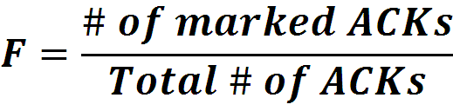

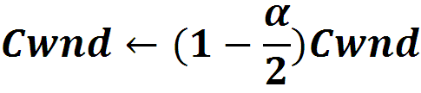
Data Center TCP Algorithm
B
K
Don’t
Mark
Switch side:
Mark packets when Queue Length > K.
Mark
Sender side:
Maintain running average of fraction of packets marked (α).
In each RTT:
Adaptive window decreases:
Note: decrease factor between 1 and 2.
Notes:
very simple marking mechanism
not all the tunings other aqms have
on the source side, the source is tryign to estimate the fraction of packets getting marked
using the obs that there is a stream of ecn marks coming back – more info in the stream than in any single bit
trying to maintain smooth rate variations to operate well even when using shallow buffers, and only a few flows (no stat mux)
F over the last RTT. In TCP there is always a way to get the next RTT from the window size. Comes from the self-clocking of TCP.
Only changing the decrease. Simplest version – makes a lot of sense. So generic could apply it to any algorithm – CTCP, CUBIC – how to cut its window leaving increase part to what it already does. Have to be careful here.

Slide 23
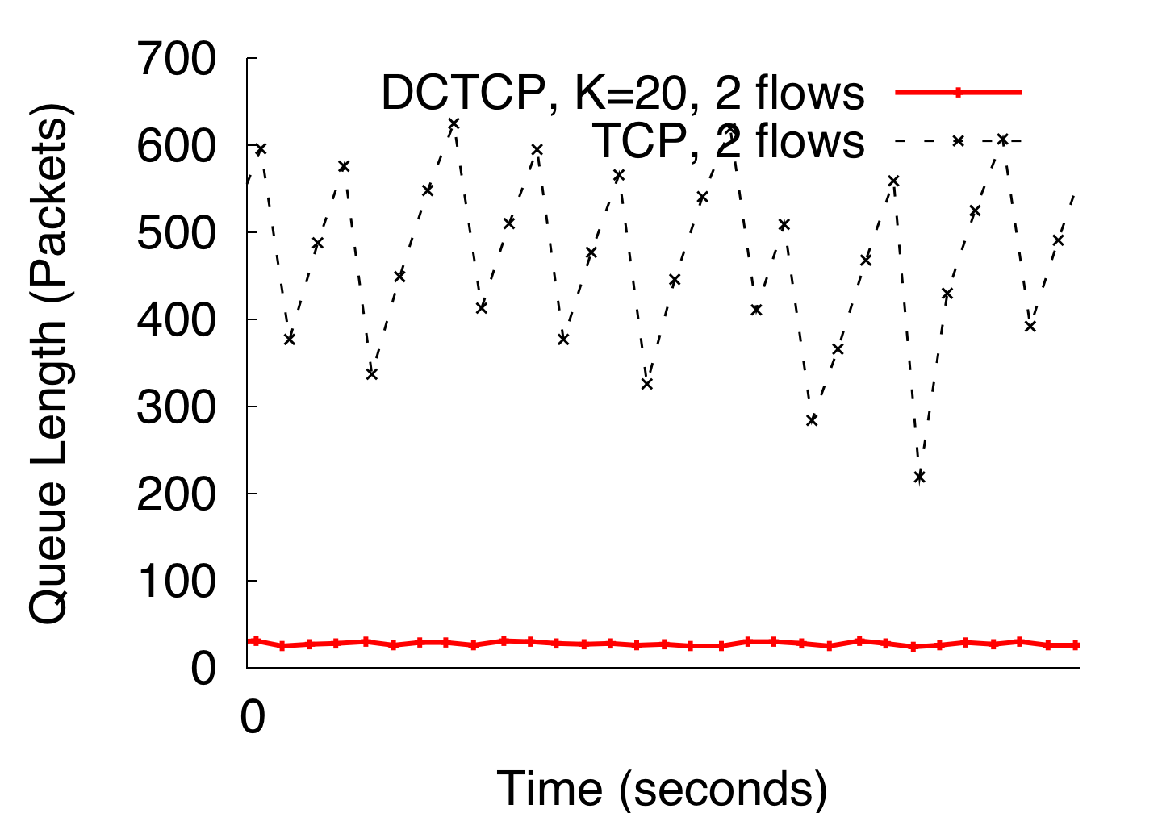
DCTCP in Action
(Kbytes)
Setup: Win 7, Broadcom 1Gbps Switch
Scenario: 2 long-lived flows, K = 30KB
Notes:
Not ns2.

Slide 24
Why it Works
High Burst Tolerance
Large buffer headroom → bursts fit.
Aggressive marking → sources react before packets are dropped.
Low Latency
Small buffer occupancies → low queuing delay.
3. High Throughput
ECN averaging → smooth rate adjustments, low variance.

Slide 25
Analysis
How low can DCTCP maintain queues without loss of throughput?
How do we set the DCTCP parameters?
Need to quantify queue size oscillations (Stability).
Window Size
W*+1
W*
(W*+1)(1-α/2)
Time

Slide 26
Analysis
How low can DCTCP maintain queues without loss of throughput?
How do we set the DCTCP parameters?
Need to quantify queue size oscillations (Stability).
Packets sent in this
RTT are marked.
Window Size
W*+1
W*
(W*+1)(1-α/2)
Time

Slide 27
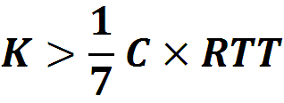
Analysis
How low can DCTCP maintain queues without loss of throughput?
How do we set the DCTCP parameters?
Need to quantify queue size oscillations (Stability).
85% Less Buffer than TCP

Slide 28
Evaluation
Implemented in Windows stack.
Real hardware, 1Gbps and 10Gbps experiments
90 server testbed
Broadcom Triumph 48 1G ports – 4MB shared memory
Cisco Cat4948 48 1G ports – 16MB shared memory
Broadcom Scorpion 24 10G ports – 4MB shared memory
Numerous micro-benchmarks
– Throughput and Queue Length
– Multi-hop
– Queue Buildup
– Buffer Pressure
Cluster traffic benchmark
– Fairness and Convergence
– Incast
– Static vs Dynamic Buffer Mgmt

Slide 29
Cluster Traffic Benchmark
Emulate traffic within 1 Rack of Bing cluster
45 1G servers, 10G server for external traffic
Generate query, and background traffic
Flow sizes and arrival times follow distributions seen in Bing
Metric:
Flow completion time for queries and background flows.
We use RTO_{min} = 10ms for both TCP & DCTCP.
Notes:
Put more details

Slide 30
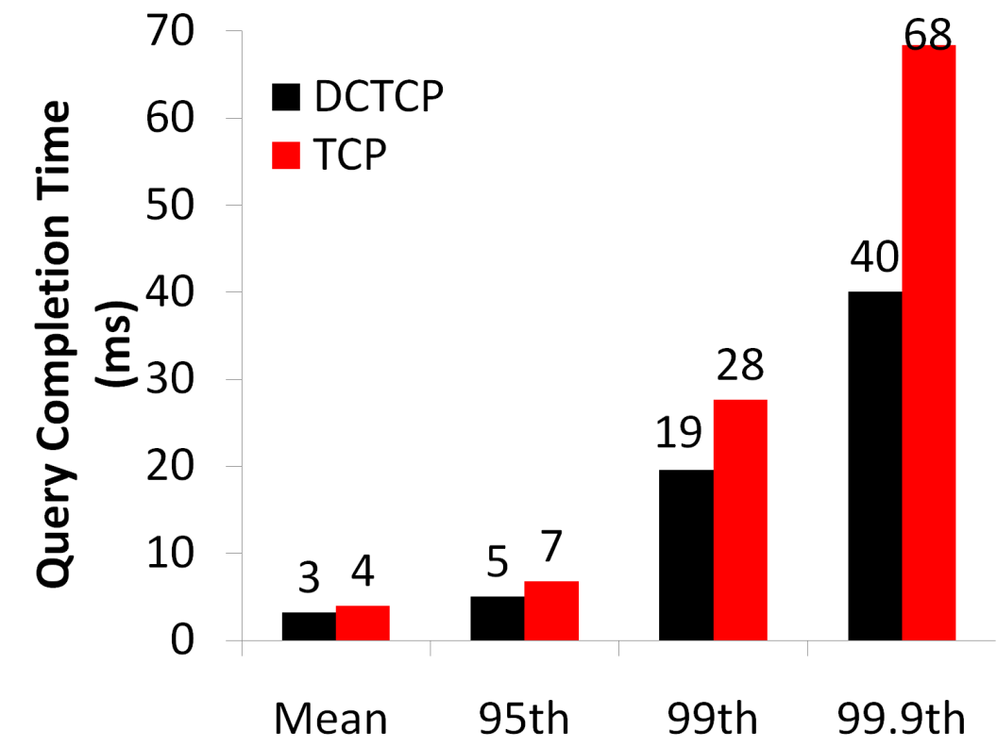
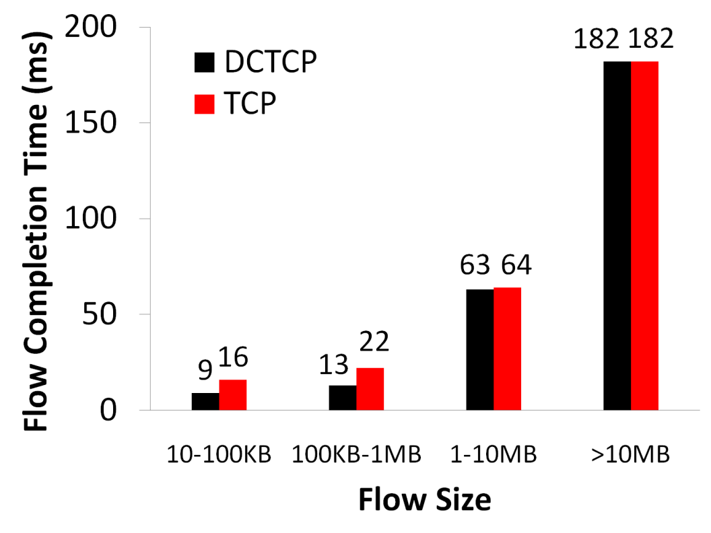
Baseline
Background Flows
Query Flows
Notes:
To transition to scaled traffic: people always want to get more out of their network.

Slide 31
Baseline
Background Flows
Query Flows
Low latency for short flows.
Notes:
To transition to scaled traffic: people always want to get more out of their network.

Slide 32
Baseline
Background Flows
Query Flows
Low latency for short flows.
High throughput for long flows.
Notes:
To transition to scaled traffic: people always want to get more out of their network.

Slide 33
Baseline
Background Flows
Query Flows
Low latency for short flows.
High throughput for long flows.
High burst tolerance for query flows.
Notes:
To transition to scaled traffic: people always want to get more out of their network.

Slide 34
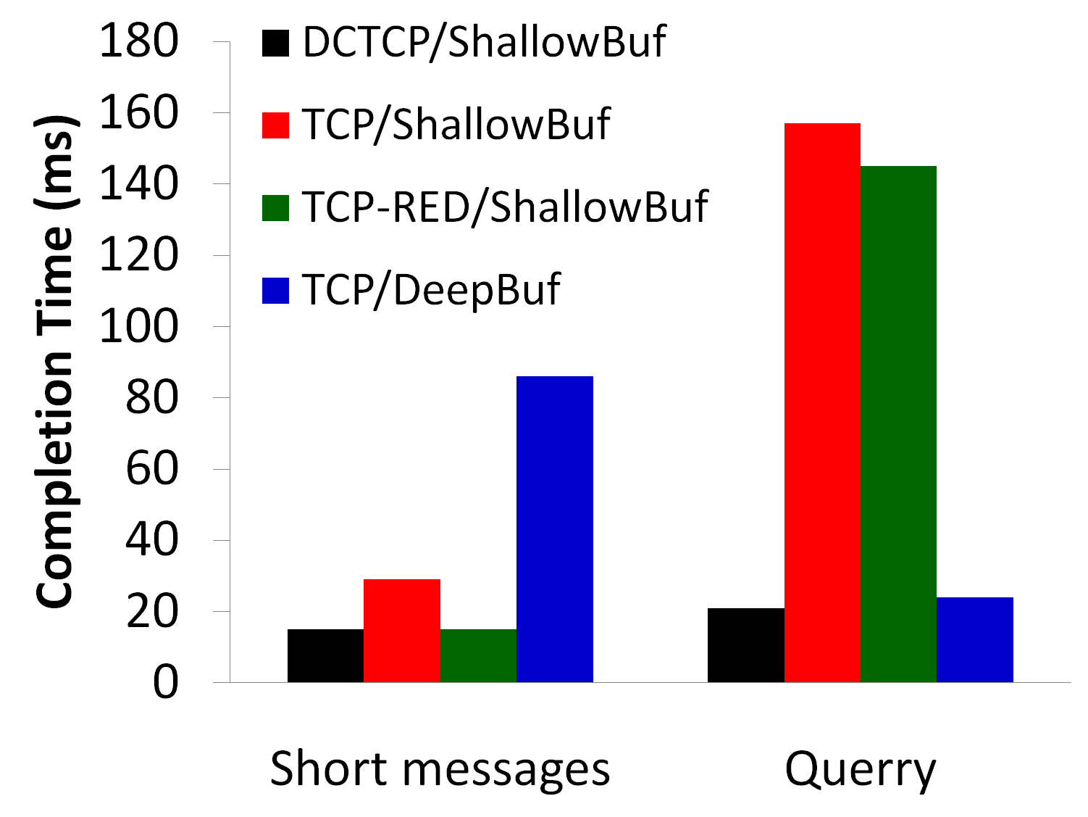
Scaled Background & Query 10x Background, 10x Query
Short messages
Query
Notes:
Need to put the take-aways on the slide, or at least have them in mind and slam them…
Deep buffer fixes incast, makes delay worse
RED, no good on the queries – doesn’t react fast enough

Slide 35
Conclusions
DCTCP satisfies all our requirements for Data Center packet transport.
Handles bursts well
Keeps queuing delays low
Achieves high throughput
Features:
Very simple change to TCP and a single switch parameter.
Based on mechanisms already available in Silicon.

