Slide 1
Cloud Computing
Lecture 2: Leaf-Spine and PortLand Networks

Slide 2
Leaf and Spine
Spanning Trees: Ewwww!
Layer 2: SPB or Trill
Layer 3: OSPF

Slide 3
Leaf and Spine
Type of Clos network
  Essentially folded, but still N-to-N connections
  Derived from old phone company architecture, invented in 1950s.
All paths are same length from edge to edge
Great for switch vendors
Need to pick path, as can choose any middle router
Very redundant
Can implement at layer-2 or layer-3

Slide 4
Networking over time
Flat – Gee whiz! We have a LAN!
  Ut-Oh! Too many addresses to remember what to do with them all, never mind to manage each one individually
Hierarchical – Look ma’! Global scale!
  Ut-Oh! Hierarchy requires management. Creates hot spots and fragments address space. IP addresses limit migration. Forwarding is painful.
Fat Tree – Many roots means many paths, relieves hot spots
  Still hierarchical. Still fragment. Still needs managing. Etc.

Slide 5
Goals
Connectivity – inside, outside, no loops, etc.
Efficiency – short paths, no hot spots, etc.
Self configuring – Humans effort can’t be scaled in this way
Robust – Consequences of failure aren’t disproportional; Failure is recoverable
VMs and Migration – Network structure doesn’t compartmentalize VMs
Commodity hardware – Certainly facilitates adoption

Slide 6
Implications
Connectivity – Scale and hierarchy requires big routing/forwarding tables or impossibly large flat space. Routing protocols adapt to change slowly, leaving temporary inconsistency, e.g. loops, from failure and other changes.
Efficiency – Look toward fat trees, clos networks
Self-configuring – Look toward a discovery protocol, p2p or coordinated
Robust – Rapidly learn changed, avoid single points of failure w/high responsibility
Migration – Want a flat address space to avoid compartmentalization. Trying to fix above IP layer is a mess as it all comes back down and has to find its way.
Commodity hardware – Services provided in off-switch software

Slide 7
Key Idea
Minimize use of distributed state, because coordination for recovery or change takes time
Maximize use of central state for lower volume services, because it can change/recover faster, and won’t bottleneck at low volume

Slide 8
Portland Solution
Use commodity switches and off-load services into software on commodity server
Start With Fat Tree for a topology without hot spots
Use layer-2 to avoid routing, forwarding, and related complexity
Separate host identifier from host location
  IP addresses identify host, but not location, just and ID
  Use “Pseudo MAC Address” to identify location at Level-2

Slide 9
PortLand Addresses
Normally MAC addresses are arbitrary – no clue about location
  IP normally is hierarchical, but here we are using it only as a host identifier
  If MAC addresses are not tied to location, switch tables grow linearly with growth of network, i.e. O(n)
PortLand uses hierarchical MAC addresses, called “Pseudo MAC” or PMAC addresses to provide for switch location
  <pod:port:position:vmid>

Slide 10
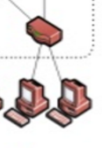
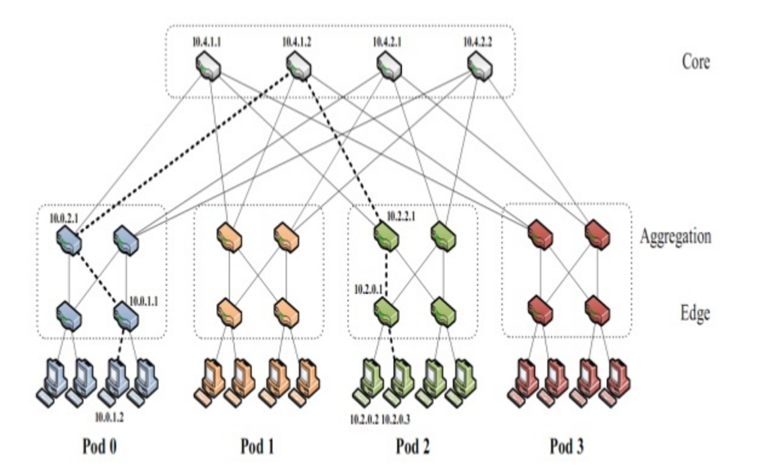
PortLand PMAC Addresses
0
1
2
3
Position
0
1
0
1
0
1
PMAC: <pod.position.port.vmid> 48 bits: <16-bits.8-bits.8-bits.16-bits>

Slide 11
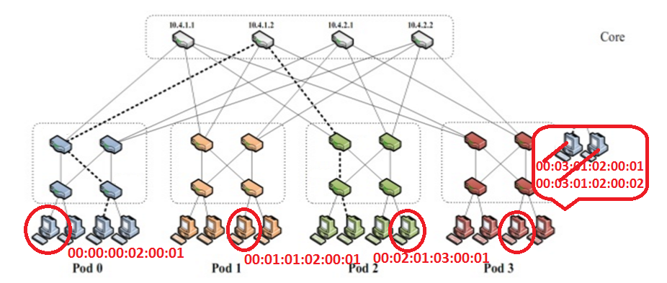
Portland PMAC Addresses

Slide 12
VM Migration
Flat address space.
IP address unchanged after migration, higher level doesn’t see state change
After migration IP<->PMAC changes, as PMAC is location dependent
VM sends gratuitous ARP with new mapping.
Fabric Manager receives ARP and sends invalidation to old switch
Old switch sets flow table to software, causing ARP to be sent to any stray packets
  Forwarding the packet is optional, as retransmit (if reliable) will fix delivery

Slide 13
Location Discovery: Configuring Switch IDs
Humans = Not right Answer
Discovery = Right Answer
Send messages to neighbors – Get Tree Level
  Hosts don’t reply, so edge only hears back from above
  Aggregate hears back from both levels
  Core hears back only from aggregate
Contact Fabric Manager with tree level to get ID
  Fabric Manager is service running on commodity host
  Assigns ID

Slide 14
Name Resolution: MAC→PMAC→IP
End hosts continue to use Actual MAC (AMAC) addresses
  Switches convert PMAC<->AMAC for the host
Edge switch responsible for creating PMAC:AMAC mapping and telling Fabric Manager
  Software on commodity server, can be replicated, etc. Simplicity is a virtue.
  Mappings timed out of Fabric Manager’s cache, if not used.
ARPs are for PMACs
  First ask fabric manager which keeps cache. Then, if needed, broadcast.

Slide 15
No loops, No Spanning Trees
Forwarding can only go up the tree.
Cycles not possible.

Slide 16
Failure
Keep-alives like the link discovery messages
Miss a keep alive? Tattle to the Fabric Manager
Fabric manager tells effected switches, which adjust own tables.
O(N) vs O(N²) for traditional routing algorithms (Fabric Manager tells every switch vs every switch tells every switch)

Slide 17
Looking Back
Connectivity – Hosts can talk! No possibility of loops
Efficiency – Much less memory needed in switches, O(N) fault handlingh
Self configuring – Discovery protocol + ARP
Robust – Failure handling coordinated by FM
VMs and Migration – Each has own IP address, each has own MAC address
Commodity hardware – Nothing magic.

