Slide 1
Lecture 2:
Cloud Computing
Data Center Network Architecture

Slide 2
Cloud Computing, Common Needs
Elasticity
  Resources only when needed, on-demand utility/pay-per-use
Multi-tenancy
  Independent users result in need for security and isolation, while shring and amortizing costs for efficiency.
Resilience and Manageability
  Isolate failures, replication and migration.

Slide 3
Service Models
Infrastructure as a Service (IaaS)
  Supply virtualized resources, e.g. S3 or EC2
Platform as a service (PaaS)
  Let users focus on what they are delivering, not the resources needed to deliver it, e.g. Google’s AppEngine, Salesforce, Microsoft Azure, Amazon Web Services
Software as a Service (SaaS)
  Software is delivered via the cloud, e.g. fee for use. Consider GoogleApps, Microsoft 360, etc.

Slide 4
DC Networking vs Long Haul Network
Long haul: Speed of light is significant source of latency, unlikely to be resolved soon
  With a DC, distances are short, the speed of light is less of a factor
  Serialization/Deserialization delay (bits/second) is a factor
Long haul: Shortest path is not uncommon and likely best
  Within a DC, tree-like topologies can concentrate traffic, generating bottle necks
DCs have unique concerns: Multiple tenants and elastic demand, resulting in need for security and efficient provisioning and security.

Slide 5
From Many Comes One
Scaling, Robustness, Availability improved when service is provide by many aggregating interchangeable parts, rather than queuing for one, or a small number, of whole providers
  Easier to add more parts
  Easier to service parts
  Easier to dial up and dial down

Slide 6
Virtualization is Key Enabler
Use independent of physical resources
Multiple users per machine
Isolation
Migration
Virtual Heterogeneity or Homogeneity
Virtual CPUs, storage volumes, networks, etc.

Slide 7
Tiered Architecture
The old standby
Redundant “core” routers connect DC to Internet
“Aggregation” layer cross-connects to core routers and “Access” switches
  Hence Levels 2 and 3
“Access layer”, such as top of rack, connects to servers and cross-connects to “Aggregation” layer
  Layer 2

Slide 8
Tiered Architecture Attributes
Redundancy at the top
Massive scale at the bottom
Manageable complexity
Fail soft for most important, higher level resources

Slide 9
Tiered Architecture Limitations
Higher up gets over-subscribed since everything passes through
Over-subscription increases with scale
Most important paths are most over-subscribed

Slide 10
Level-2 vs Level-3
Level 2 is faster, cheaper, and easier to manage
Level 3 scales better, because it is hierarchical
Level 3 can manage potential congestion through routing
  Multipath routing via equal cost multipath

Slide 11
Fat Tree
Each layer has the same aggregate bandwidth
Communication within a pod stays within a pod
Need to be careful about purely equal-cost paths or there will be reordering
Pre-bakes the paths to ensure diversity, while maintaining ordering

Slide 12
Fat Tree Details
K-ary fat free: three layers (core, aggregation, edge)
Each pod consists of (K/2)² servers and 2 layers of K/2 K-port switches.
Each edge switch connects (K/2) servers to (K/2) aggregator switches
Each aggregator switch connects (K/2) edge and (K/2) core switches
(K/2)² core switches, each ultimately connecting to K pods
  Providing K different roots, not 1. Trick is to pick different ones
K-port switches support K³/4 servers/host:
    (K/2 hosts/switch * K/2 switches per pod * K pods)

Slide 13
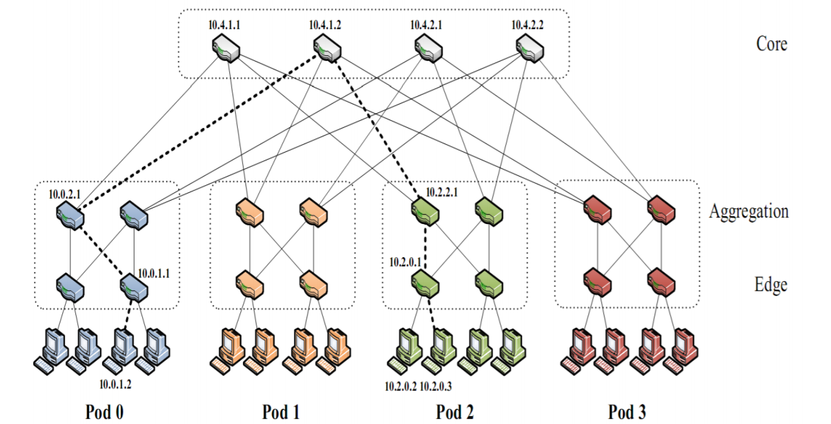
Fat Tree

Slide 14
Path Diversity
Path diversity is good, in that it distributed hot spots, enabling, for example, equal cost.
  But, if equal cost is only goal, there could be a lot or reordering. Ouch!
Fat Tree uses a special IP addressing and forwarding scheme to address this (pardon the pun), and additionally, allow intra-pod traffic to stay intra-pod

Slide 15
“Special IP” Addressing
“10.0.0.0/8” private addresses
Pod-level uses “10.pod.switch.1“
  pod,switch < K
Core-level uses "10.K.j.i“
  K is the same K as elsewhere, the number of ports/switch
  View cores as logical square. i, j denote position in square.
Hosts use “10.pod.switch.ID" addresses
  2 <= ID <= (K/2)
  K=1 is pod-level switch; ID > 2 is too many hosts
  8-bits implies K < 256

Slide 16
Static Routing Via Two-Level Lookups
First level is prefix lookup
  Used to route down the topology to end host
Second level is a suffix lookup
  Used to route up towards core
Diffuses and spreads out traffic
Maintains packet ordering by using the same ports for the same endhost

Slide 17
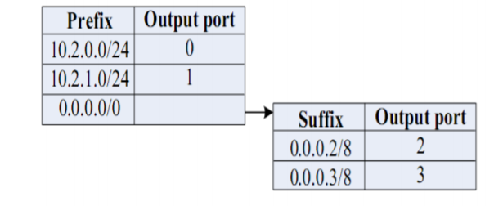
Lookup Tables

Slide 18
Flow Classification
Type of “diffusion optimization”
Mitigate local congestion
Assign traffic to ports based upon flow, not host.
  One host can have many flows, thus many assigned routings
Fairly distribute flows
(K/2)² shortest paths available – but doesn’t help if all pick same one, e.g. same root of multi-rooted tree
Periodically reassign output port to free up corresponding input port

Slide 19
Flow Scheduling
Also a “Diffusion Optimization”
Detect and deconflict large, long-lived flows
  Threshholds for throughput and longevity

Slide 20
Fault tolerance
Can reject flows by setting cost to infinity.
Plenty of paths, if failure
Maintain sessions across switches to monitor

