Slide 1
Xen and the Art of Virtualization
CSE-291 (Cloud Computing)
Fall 2016

Slide 2
Why Virtualization?
Share resources among many uses
Allow heterogeneity in environments
Allow differences in host and guest
Provide a mechanism for migration, checkpointing, etc
Recovery, maintenance
Provide for elasticity

Slide 3
Challenges to Virtualization
Isolation
Performance w.r.t. resource sharing (CPU, memory, network, disk)
Protection w.r.t. resource use
Support multiple operating systems
Minimal performance penalty

Slide 4
Granularity
Multiplex processes
Finely grained, but forces symmetric execution environment
Multiplex OSes
Allows heterogeneous environments
High overhead of OS, runtime wastage and start-up latency

Slide 5
Full Virtualization
Can be expensive
Time might not be a resource that it is desirable to virtualize
Timeouts, etc
Real network addresses allow better integration with real-world
Much easier with hardware support

Slide 6
Paravirtualization
“Good enough” virtualization
Very similar to fully virtualized machine, but some differences that can be leveraged by knowledgeable OS
OS needs to be tweaked
Apps do not need to be changed

Slide 7
Xen Design Principles
Support for unmodified application binaries is essential, or users will not transition to Xen. Hence we must virtualize all architectural features required by existing standard ABIs.
Supporting full multi-application operating systems is important, as this allows complex server configurations to be virtualized within a single guest OS instance.
Paravirtualization is necessary to obtain high performance and strong resource isolation on uncooperative machine architectures such as x86.
Even on cooperative machine architectures, completely hiding the effects of resource virtualization from guest OSes risks both correctness and performance

Slide 8
Memory Management: Hardware Support
Hardware Support: Software Managed TLB (Not available on x86)
Easiest option
Not available on x86
Hardware Support: Tagged TLB (Not available on x86)
Use one tag per address space
Also a good option
x86
Hardware managed page table
Flushed upon context switch

Slide 9
Virtualizing Memory Management On x86
Implication: All valid page translations must be in page table
Guest OSes allocate and manage page tables
Xen needs to be mapped into all address spaces, so entering and leaving it doesn’t require a flush or load.
But protected from Guest OS
Guest OS allocates pages from own memory, but asks Xen to map it
Xen can validate/protect page tables
OS can batch updates for performance (amortize hypervisor overhead)

Slide 10
Virtualizing CPU: Privlege
In model with only two privilege levels, hypervisor would need to be at OS’s normal level of privilege
OS would need to run at app level, in its own context
Hypervisor would need to handle transitions, setting page tables, etc
Insert whole discussion about TLBs here
X86 supports 4 privilege levels (“rings”)
0 normally for OS, 3 normally for apps
With Xen, Xen uses Ring-0, OS uses Ring-1
Isolates OS from Apps
Ensures only Xen can run privileged instructions

Slide 11
Virtualizing CPU: Privileged Instructions
Paravirtualized Instructions
Validated and executed within Xen (Ring-0)
Processor fails or faults attempts other than from Ring-0
Guest OS can’t directly execute
Exceptions (Faults, Traps, etc)
Handled by Xen, which copies exception frame to Guest OS
Adjustment needed for page fault handler, since OS can’t read address from CR2 register
Xen copies to an extended stack frame.
OS Needs to be modified to look there.

Slide 12
SysCalls and Page Faults
Common enough to affect performance
Syscalls
Guests register “fast interrupt handler” (top half)
Validated by Xen for install
Page Faults
Can’t be optimized. Address is in CR2 and needs to be propagated by Xen

Slide 13
Device I/O
Fully abstracted by Xen
Simple interface
Shared memory ring-buffers
Callbacks via bit-maps replace interrupts
Xen flips bit and calling Guest OS event handler
Can also be blocked by OS

Slide 14
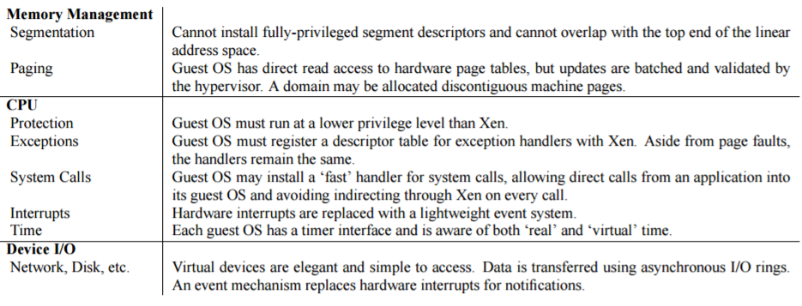
The Paravirtualized X86 Interface

Slide 15
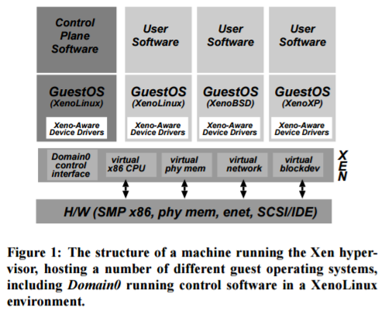
Overall Structure

Slide 16
Control and Management
Separation of Policy and Mechanism
Xen exports interfaces
Domain-0 created at boot time
Able to create new domains
Creates and deletes virtual network and block devices and associated access controls
Manages the resources associated with each domain
Guest OSes use interfaces to manage resources
Exports application management interface
Manage all of the resources

Slide 17
Hypercalls and Events
Hypercall
Synchronous calls from domain into Xen
Basically a trap into the hypervisor, e.g. to request page table updates
Events
Notifications to domain from Xen, e.g. to replace interrupts
Per domain bitmask is updated, followed by notification

Slide 18
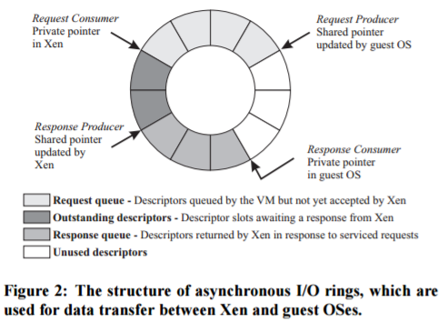
Data Transfer: I/O Rings
Circular ring
Allocated by domain
Accessible by Xen
2 pairs of producer-consumer pointers

Slide 19
CPU Scheduling
Schedule domains via Borrowed Virtual Time (BVT)
Balances context switches, dispatch time, and fairness
Borrows from future time to allow warm threads to favor recently woken domains

Slide 20
Time and Timers
Real time
Seconds since machine’s boot to the accuracy of processor’s cycle counter
Virtual time
Advances only when VM is running
Wall-clock time
Real time plus offset
Allows adjustment to real-time, without messing it up

Slide 21
Physical Memory
Memory is statically partitioned to domains
Memory can later be released
Virtualized physical pages need to be mapped to physical pages for page tables
Xen provides this via a globally readable array
Can also be used to optimize for cache locality, etc.

Slide 22
Network
Provides Virtual Firewall Router (VFR)
Each domain has one or more Virtual Network Interfaces (VIF) attached to VFR
Each VIF has two rings of buffer descriptors: transmit and receive
Rules managed by Domain-0
Transmit: Enqueue packet descriptor
Packet payload via scatter-gather DMA
Simple round-robin packet scheduler
Receive: Exchange packet-buffer for empty frame on ring

Slide 23
Disk
Only Domain-0 can access the actual disks
Disks are represented as Virtual Block Devices (VBDs)
Translation table from VBD offset to physical offset
VBDs keep extents and access control information
Guest scheduler may order requests going onto ring
Xen can reorder after that, knowing more about storage
Requests from competing domains are batched and round-robin scheduled
Fairness, but minimize overhead
Domains can specify reorder barriers to preserve higher-level semantics, e.g write-ahead log

