Slide 1
Networking Recap Storage Intro
CSE-291 (Cloud Computing), Fall 2016
Gregory Kesden

Slide 2
Networking Recap Storage Intro

Slide 3
Long Haul/Global Networking
Speed of light is limiting; Latency has a lower bound (.)
Throughput is a cost, but not otherwise a limitation
Running more fiber optic is technologically reasonable, within reason
Demand will drive growth

Slide 4
Vs. Networking Within A Data Center
Speed of light not limiting, short distance
Serialization can be limiting, as bits clocked into and off of media
Parallelization helps, but quickly limited in practice
Bandwidth (Throughput) needs to be managed, both by distributing load and relieving bottlenecks
Task drives access pattern, drives hot spots

Slide 5
Traditional 3-Tier Network
Convenient for distribution
All links same width
More links at lower layers = More bandwidth lower layers
Works if strong locality at leaf (access layer)
Challenged if leaf-to-leaf up-and-down patterns
Challenged if request distributed and wait reply (inflow)
Maximizing work within time budget means replies at same time collide

Slide 6
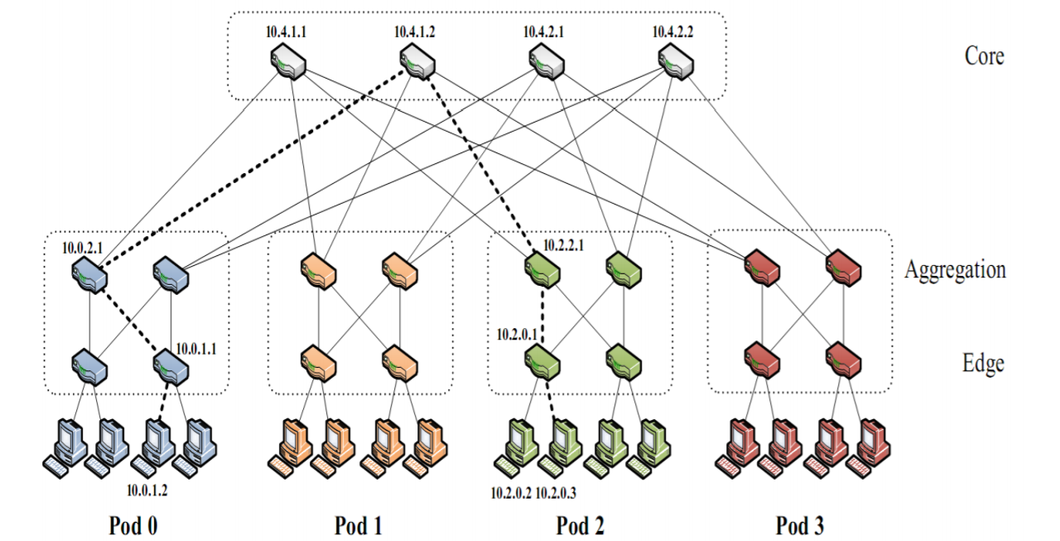
Fat Tree Topology
Multi-Rooted Tree = All paths same width
Only useful if load distributed
Doesn’t work if all pick same spanning tree
Can distribute via Layer-1,-2, or -3 techniques

Slide 7
Utilizing Multiple Paths
Layer-2
Forwarding tables; Consider PortLand
Hard to be adaptive
Layer-3
ECMP; Can do via routing
Suffer collision of paths under load
Slow to adapt, slow implementation
Handles failure slowly
Layer-4
Schedule flows
Not all flows are equal
Can change
Big vs small can’t be balance
DCTCP; Multiplex flows
Positive Feedback to balance, not based upon interpreting drops.
Adaptive, balanceable

Slide 8
PortLand
Uses FatTree Topology
Provides way of using multiple paths
Separates Identifier (IP address) from Locator (PMAC)
Facilitates migration (Benefit over other solutions)
Fabric Manager enables failure management, mapping, etc
Link Discovery enables Auto-Configuration

Slide 9
Clos Networks
Obvious benefit to flatter, all-to-all Connectivity
Presently enables 2-Layer topologies in many cases
Fabric has limits. Only possible to a point.
Scale may more commonly outgrow fabric in near future leading to migration b ack to 3-Tier
Manage scale limitations by using locally within pods, among cores, etc.
Provides local density where needed, without blowing up interconnectivity scale globally

Slide 10
Software Defined Networks (SDNs)
Separate Control Plane (Management) from Data Plane (Forwarding)
Enable central management of entire control plane
Essentially makes a programmable network
Enables management applications with appropriate abstraction for use case (enterprise, public cloud, etc) and management goal (traffic management, isolation, etc)
Dramatically reduces management overhead, correctness, and security
This is a “killer app”, by itself, at scale
Critically important for virtualization
Enable on-demand management, and real-time adaptation to failure.
Replace multiple types of devices with single, generic, programmable devices

Slide 11
Networking Recap Storage Intro

Slide 12
Types of Storage
General Purpose File System
Special Purpose File System
NoSQL Database (Key-Value Store, Column-oriented, Etc)
Relational Databases, i.e. SQL
In Memory (Critical)

Slide 13
General Purpose File System
Emulate traditional file systems at larger scale and/or distributing near users
E.g., Manage named user data with hierarchical access and protections,
Andrew File System (AFS) is classical global example, many more like NFS approximate at DC or campus scale
Friendly for end users, but how useful?
Commonness of global use case
Can be very distant with reasonable latency.
Disk = 10mS; Network = 10mS/1,000mi (very approximate)
High cost
Synchronization, concurrency, etc

Slide 14
Special Purpose File System
Relax constraints to limit complexity
Accessing programmatically? Use index, drop directory hierarchy.
Upload-based creation? Version and don’t support edits. Limits concurrency problem to version number
Logging? Append-only writes. Limits concurrency problem to allocation.
Single application? Access model limited to roles, let app manage permissions
Stale okay? Easier replication.
Etc.
Relieving concurrency problems
Improves caching, replication
Decreases latency

Slide 15
NoSQL Databases
Break up limitations associated with table (relation)
CAP: Trade consistency for accessibility and partition tolerance.
Speed at scale
Not likely ACID
Can do some SQL-like things, but some are hard, e.g. generalized join
Many kinds, e.g. key-value, column-oriented, etc

Slide 16
In-Memory
When reacting to human users in real time, time budget is limited
Trip from client to service, trip from front-end to back-ends, processing, trip from back-ends to front-end, processing, trip back to client, etc.
There isn’t time to constantly hit disk in many ways
Would need a huge amount of disk time to be able to sustain throughout at scale
What is reasonable response time for human user? 0.5 second (500 mS)?
75mS round trip to east coast
The rest is data center latency, queuing for services, and actual work
Best solution is to have the answer waiting
Or, at least the components of the answer
Sadly, sometimes block for slowest component

