Slide 1
BigTable
CSE-291 (Cloud Computing)
Fall 2016

Slide 2
Data Model
Sparse, distributed persistent, multi-dimensional sorted map
Indexed by a row key, column key, and timestamp
Values are uninterpreted arrays of bytes
(row:string, column:string, time:int64) → string

Slide 3
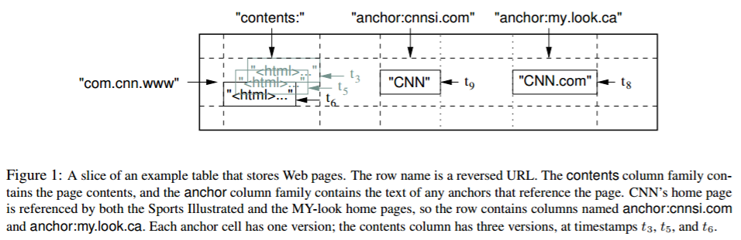
Slice of an Example Table

Slide 4
Rows
Arbitrary strings
Reads and writes of rows are atomic (even across columns)
Makes it easier to reason about results
Data is lexicographically sorted by row
Row range partitioned into tablets
Used for distribution and load balancing
Reads of short row ranges are efficient
If data has good locality w.r.t. tablets, efficiency boost

Slide 5
Column Families
Not columns, groups of columns
Unit of access control, disk and memory accounting
Column families group column keys
Data within column family is usually same type, compressed together
Columns within column family rarely change
Relatively few column families

Slide 6
Timestamps
Cells are versioned
Timestamps are times in microseconds
Or, alternately, user can assign, e.g. version number, etc
Need user-assigned unique timestamps, if want to avoid collisions
Automated garbage collection
Most recent n
Within m amount of time

Slide 7
API
Create and destroy tables and column families
Change metadata, e.g. access control, etc
Write or delete values
Iterate across rows
Iterate over subset of data
Single row transactions (read-update-write)
Cells to be used as counters
Client-provided server-side scripts for transformation, filtering, summarizationetc.

Slide 8
Building blocks
Uses GFS for log and data files
Shares servers with other applications

Slide 9
Building blocks: SSTables
SSTable file format used to store tables
Sorted String Table
Key-value pairs, sorted by key
Blocks of data followed by binary-searchable index at end
Index in memory, one seek to data
Or, load all into memory
Lookup value by key, iterate over key/value pairs in range

Slide 10
Building Blocks: Chubby
Distributed lock service
5 active replicas, one is master
Only master serves requests
Needs majority to work
Paxos based
Namespace is directories and tiny files
Directories and files can be used as locks
Locks are leased and callbacks can be requested
Used to ensure one active master, location of tablet servers, schema information, access control lists

Slide 11
Master Server
Master server
Assigns tablets to tablet servers
Detecting and managing changes to tablet servers
Load balancing across tablet servers

Slide 12
Tablet Server
Tablet server
Can be dynamically added and removed
Manages read and writes
Split tablets that are too large

Slide 13
BigTable Cluster
Cluster stores Tables
Tables store Tablets
Tablets store Row Range
Initially, one Tablet per Table, then split with growth

Slide 14
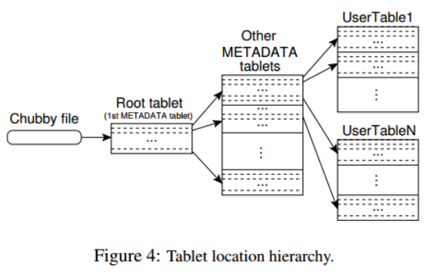
Tablet Location

Slide 15
Tablet Assignment
Each tablet lives on one server at a time
Master keeps track of live tablet servers and assignments
Chubby used to keep track of tablet servers
Master monitors Chubby directory
Tablet servers can’t serve if they lose exclusive lock on tablet
Tablets reassigned when not reachable
Notify master if lost lock
Master heartbeats (asks for status of lock from tablet server)

Slide 16
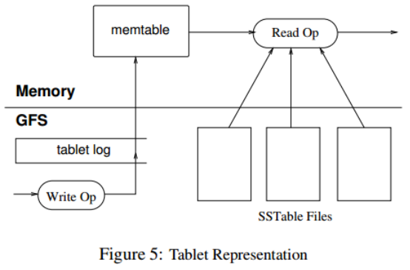
Tablet Serving
Persistent stores redo record stored in GFS
Commit log
Recent updates in in-memory memtable
Older updates in sstable

Slide 17
Locality Groups
Grouping of multiple column families together
Separate SSTable for each locality group
Makes it faster to access data that is accessed together

Slide 18
Compression
Per block or across blocks
Per block enables small portions to be read without decompression of larger block
Sometimes 2 pass schemes
Want to emphasize speed over compression

Slide 19
Read Caching
Scan cache
Key-value pairs from sstable
Block cache
Sstable blocks read from GFS

Slide 20
Bloom Filters
Reads need to read from all SStables that make up table
Bloom filters reduce the number that are accessed by don’t have matching row/column pair.
Ditto for non-existent pairs

Slide 21
Commit Log
Logs are written concurrently
Different purposes
Different files would mean different locations on disk
Use one per tablet server, not one per tablet
Reduces the number of files written, improves seek locality, reduces overhead, etc.
Complicates recovery
Few log entries relate to any one tablet server
Parallel sort by key first, then entries for one server are together.

Slide 22
Tablet Migration
Process
Compact
Freeze
Compact
Migrate
Log is clean for move with only a short freeze time

Slide 23
Immutability
Only memtable allows reads and writes
Everything else is versioned
Allows asynchronous deletes
Mitigates need for locking.

