Slide 1
The Seven Steps of the Research Process
#1 Identify and Develop Your Topic

Slide 2
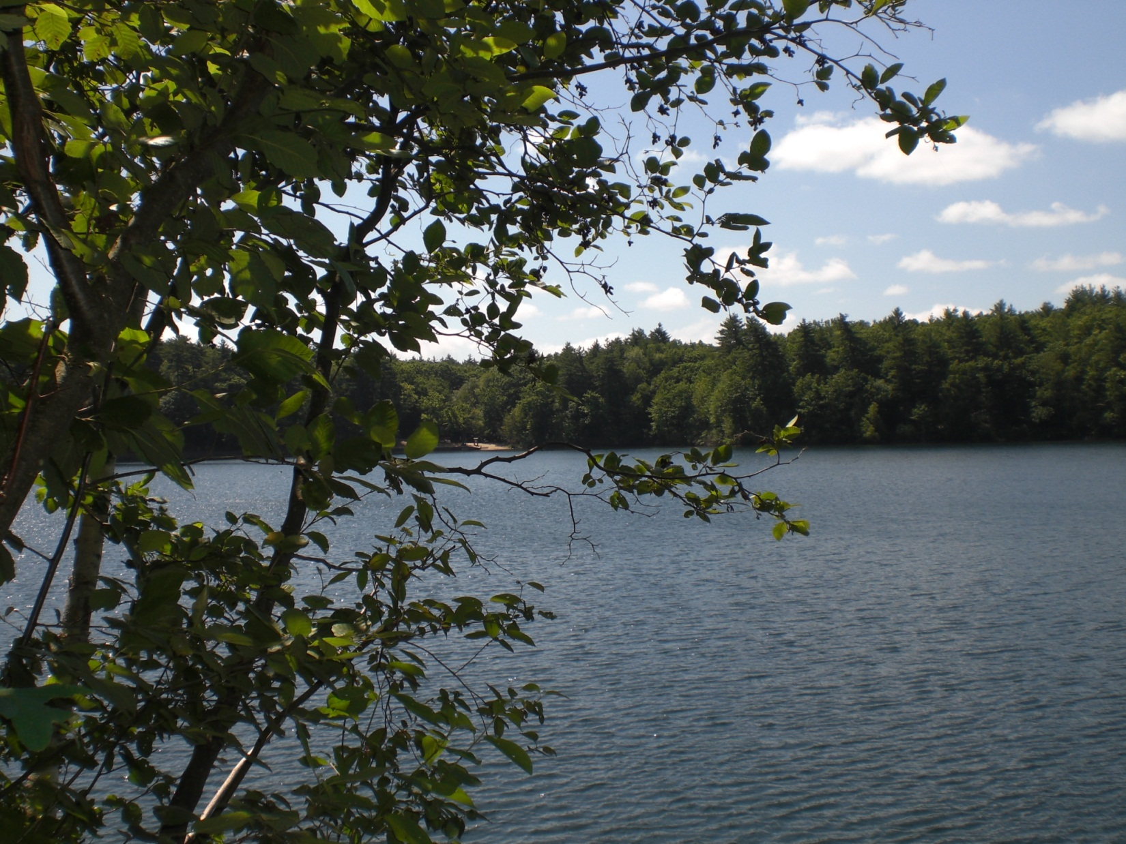
Walden Pond State Reservation, MA
View of Walden Pond, Walden Pond State Reservation, Concord, Massachusetts. 2012. Personal photograph by author. JPEG file.
Found my topic while on vacation

Slide 3
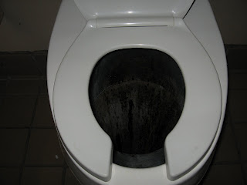
Waterless Toilet
Poopin’ Around Town. 2007. Photograph. Walden Pond toilet. Web. 18 July 2012.
Energy-related topic?

Slide 4
MA seems to have a lot of WATERLESS TOILETS!
What happens to the waste?
How does the environment benefit?
How expensive would it be to put a waterless toilet in my house?
How much energy is saved by conserving water?
Visiting Massachusetts:
Think of your topic in the form of questions

Slide 5
How do waterless
toilets work &
how are they odorless?
State your topic as a question

Slide 6
The Seven Steps of the Research Process
#2 Find Background Information

Slide 7
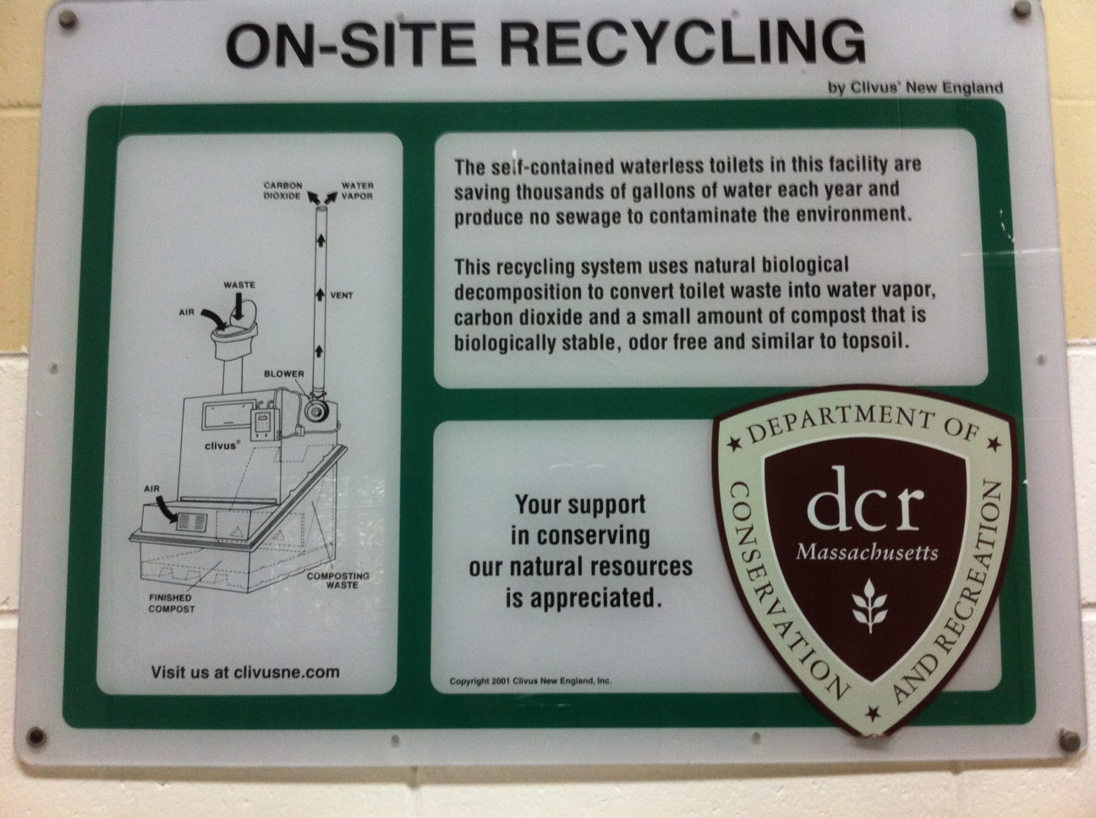
Background Info
Sign in the bathroom at Walden Pond
Watt Now. 2011. Photograph. Recycling. Clivus New England. Web. 18 July 2012.

Slide 8

Encyclopedias

Slide 9
The Seven Steps of the Research Process
#3 Use Catalogs to find Books and Media (like DVDs)

Slide 10


Use Catalogs like Carnegie Library to find Books
and Media

Slide 11
The Seven Steps of the Research Process
#4 Use Indexes to Find Periodical Articles

Slide 12
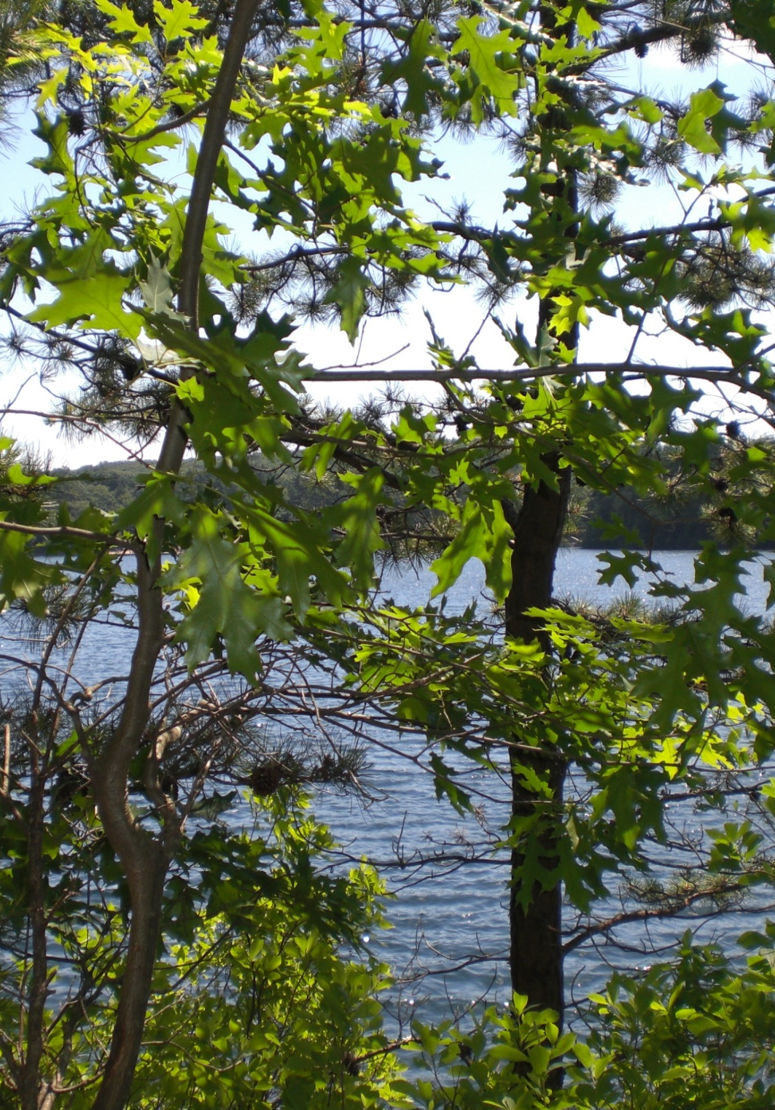
Use Indexes to find periodical articles
What does this mean?
Magazine & journal & newspaper articles
find them in
RESEARCH DATABASES
Trees at Walden Pond, Walden Pond State Reservation, Concord, Massachusetts. 2012. Personal photograph by author. JPEG file.
Academic OneFile
GreenFile

Slide 13
recycle human waste
plumbing
wastewater treatment system
TOILET
composting toilet
sanitation
urinal
water conservation
sewage disposal
futurist toilets
biological decomposition
waterless latrine

Slide 14
The Seven Steps of the Research Process
#5 Find Internet Resources

Slide 15


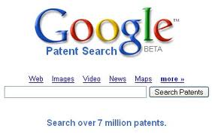
Composting toilet blog
Watt Now blog
Internet Resources
Search box: How do waterless toilets work?

Slide 16
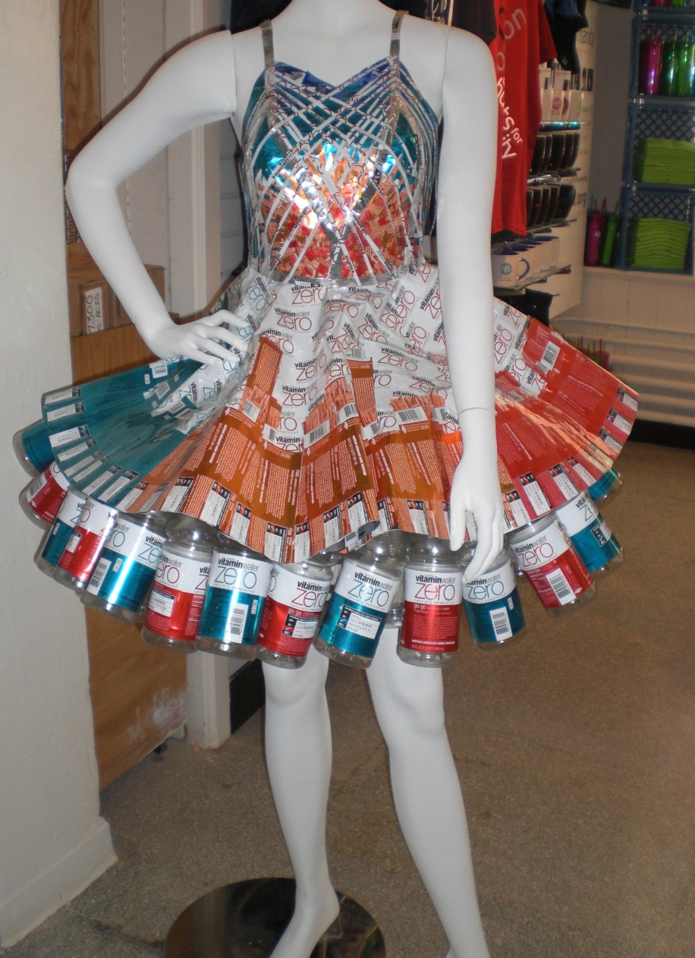
The Seven Steps of the Research Process
Would
you
wear
this
dress?
Would
you
use
that
website?
Mannequin at Faneuil Hall Marketplace, Boston. 2012. Personal photograph by author. JPEG file.
# 6 Evaluate What You Find

Slide 17
The Seven Steps of the Research Process
MLA format
# 7 Cite what you find using a standard format

Slide 18
Works Cited
Mannequin at Faneuil Hall Marketplace, Boston. 2012. Personal
photograph by author. JPEG file.
Poopin’ Around Town. 2007. Photograph. Walden Pond toilet. Web.
18 July 2012.
Trees at Walden Pond, Walden Pond State Reservation, Concord,
Massachusetts. 2012. Personal photograph by author. JPEG file.
View of Walden Pond, Walden Pond State Reservation, Concord,
Massachusetts. 2012. Personal photograph by author. JPEG file.
Watt Now. 2011. Photograph. Recycling. Clivus New England. Web. 18 July
2012.

