Slide 1

Multimedia Portals for Video Oral Histories:
A Case Study from The HistoryMakers and Harrisburg PA Highmark Blue Shield Living Legacy Series
Mike Christel
christel@cs.cmu.edu
Entertainment Technology Center
Carnegie Mellon University
March 24, 2011

Slide 2
Talk Outline
Slides plus demonstrations from www.idvl.org
  Context regarding Informedia research at CMU
  A few examples of current state for automated metadata production describing digital audio and video
Why digital audio and video is “different”
  Difficult to annotate manually
  Deep annotation saves time for future users
Directions taken for 2 corpora:
  HistoryMakers: clean transcripts, clean source data, extra inferential indexing added by archivists
  Harrisburg: clean transcripts, clean source data, beginnings of synchronizing other multimedia types

Slide 3
CMU Informedia Digital Video Research
Details at: http://www.informedia.cs.cmu.edu
Speech recognition and alignment
Image processing
Named entity tagging
Synchronized metadata for search and navigation
Fast, direct video access to oral histories, news, surveillance video, YouTube video, etc.
This talk: emphasis on oral histories and the web site http://www.idvl.org

Slide 4
Intellectual Property Considerations
The HistoryMakers work is in beta test, with strict limitations on copying and distribution: “All content is the property of The HistoryMakers™: all proposed uses must be submitted in a proposal in advance to The HistoryMakers for approval before anything can be used and approval is totally at our discretion.” – Julieanna Richardson, Founder & Executive Director, The HistoryMakers, Chicago, IL
The Highmark Blue Shield Living Legacy Series, Harrisburg, PA has similar terms and conditions
Both collections have Terms and Conditions (and Privacy Policy) pages linked from www.idvl.org

Slide 5
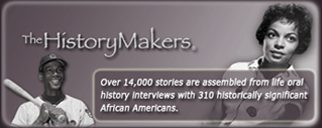
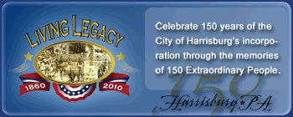
Corpora Characteristics
The HistoryMakers
  Current digital archive contains 310 interviews covering over 14,000 stories and nearly 700 hours of content
  Life oral histories with historically significant African Americans, interviewed between 1999 and 2005
  Additional interviews will be added in 2011 and beyond
Highmark Blue Shield Living Legacy Series, Harrisburg
  Current digital archive contains 150 interviews covering 2130 stories, 144.4 hours of content
  Life oral histories recording the memories of 150 Harrisburg-area residents in celebration of the city of Harrisburg's 150 years of
  incorporation; interviews were
  conducted in 2009 and 2010

Slide 6
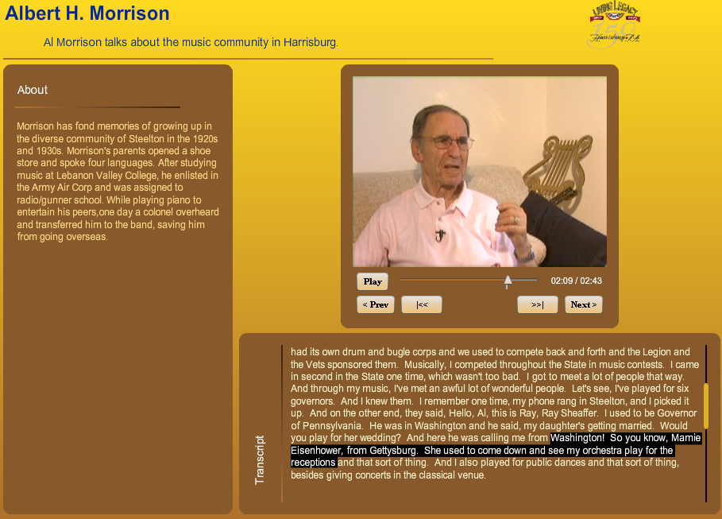
Speech Alignment Example

Slide 7
Automated Video Processing
Produces descriptive metadata for video libraries
Metadata has errors greater than metadata produced by a careful, human-provided annotation
Errors in metadata can be reduced:
  By more computation-intensive algorithms
  By taking advantage of video frame-to-frame redundancy
  By folding in context, e.g., probable text sizes in video
  By folding in extra sources of knowledge, e.g., a dictionary for cleaning up VOCR, or labeled data revealing patterns for named entity detection
  By human review and correction, which can generate additional labeled data for machine learning

Slide 8
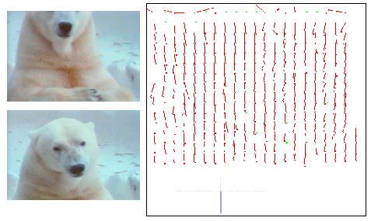

Camera and Motion Detection
Pan
Success through Lucas-Kanade optical flow algorithm
Right object motion (not pan left)

Slide 9
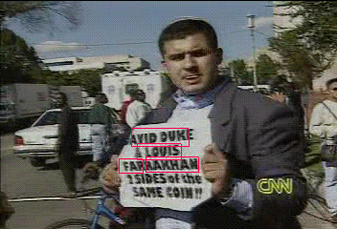
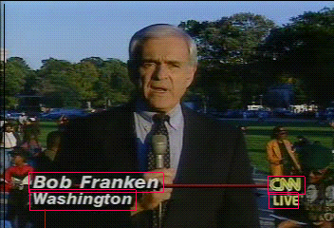

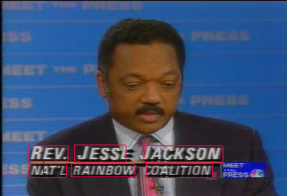
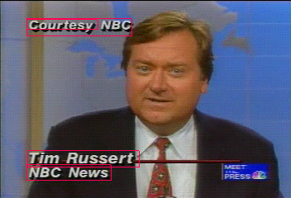
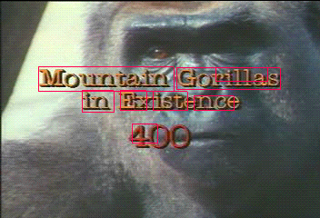
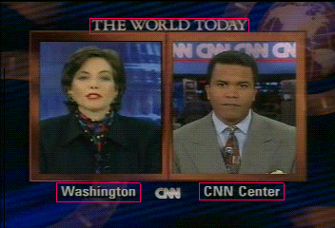
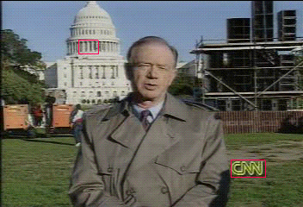
Text and Face Detection

Slide 10
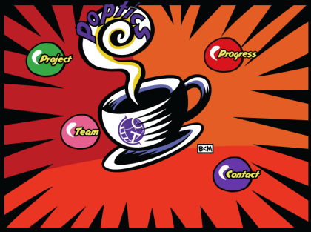
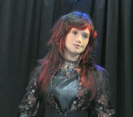
Face Detection: A Success Story
Many deployments
  Digital cameras to remove red-eye and improve focus
  Interactive art: see ETC “Poptics” Project, www.etc.cmu.edu/projects/burtonmorris
  More believable actroid
  named “Yume”:
  ETC Yume Project,
  www.etc.cmu.edu/projects/actroid/
Henry Schneiderman, PhD from Carnegie Mellon who worked with Informedia group at CMU
  Founder of Pittsburgh Pattern Recognition (pittpatt)
  Test out state of the art yourself at www.pittpatt.com

Slide 11
Text Processing
Leveraging work from the Language Technologies Institute, CMU (Alex Hauptmann et al.)
Lemur indexing (CMU and UMass) for full-content text search, www.lemurproject.org
Named entity extraction
CNN national correspondent John Holliman is at Hartsfield International Airport in Atlanta. Good morning, John. …But there was one situation here at Hartsfield where one airplane flying from Atlanta to Newark, New Jersey yesterday had a mechanical problem and it caused a backup that spread throughout the whole system because even though there were a lot of planes flying to the New York area from the Atlanta area yesterday, ….
Key: Place, Time, Organization/Person

Slide 12
Case Study: The HistoryMakers
Describing oral history materials is complex: no single standardized approach, so librarians, archivists, historians, and technology professionals each approach description of oral history materials differently
The HistoryMakers combines manual transcription and provenance information with automated speech alignment and named entity extraction from CMU
New work is ongoing regarding “thematic” or “inferential” indexing to create access points across time periods, places, and cultures

Slide 13
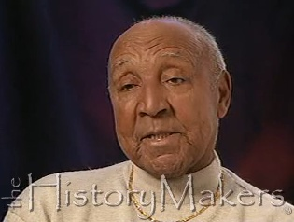
The HistoryMakers: Media Creation
Best practices for interview collection
New (established 2009) recording infrastructure to capture high definition high quality video primary source material
Surrogates produced for faster,
less encumbered distribution (e.g.,
the lower quality flv videos you can
play with the watermark of
“The HistoryMakers”)

Slide 14
The HistoryMakers: Decisions on Quality
After field tests with automated speech recognition (ASR), decision to go with manual transcription of audio
  SHOAH (Survivors of the Holocaust) also notes difficulties of ASR for audio of accented speech
  Densho (www.densho.org) also has manual transcripts
Corrective action also taken to better specify locations and time (human annotator marks tied to transcripts)
Tedious time-alignment of spoken words to audio and video left to automated speech alignment program
Decisions on inferential/thematic indexing are ongoing

Slide 15
Case Study: Harrisburg PA Living Legacy
Also makes use of ASR for synchronizing human-provided transcript information
No inferential indexing, but instead suggests possibilities with synchronized imagery
Shows generality of the Informedia processing and interfaces
  Schema regarding the collection and oral history interviewees
  Tailorability through data facets

Slide 16
Development History
Workshops to set requirements, 2007-2008
Stand-alone .NET Windows interface for The HistoryMakers, field-tested 2008-2009
  Users frustrated with closed delivery infrastructure
  Users wanted 24/7 access from their own computers
Flash application on openly accessible web site, www.idvl.org, with Harrisburg corpus added to test generality of the methods used
Case studies reported here have led to second generation Flash application, posted Feb. 2011

Slide 17
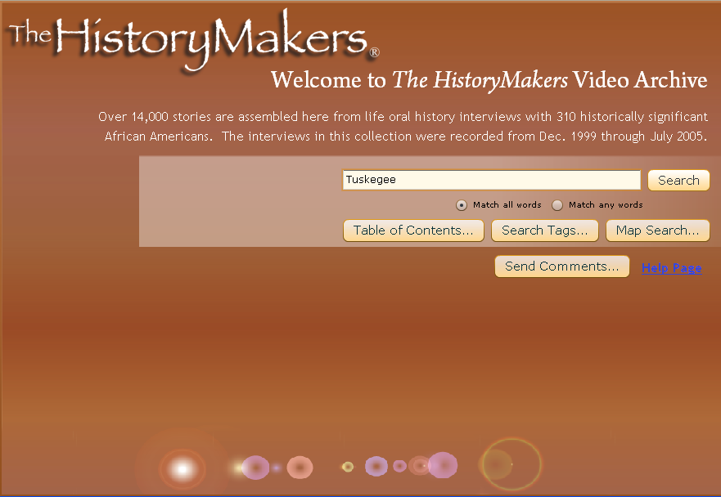
2010 Flash Interface – Intro Screen

Slide 18
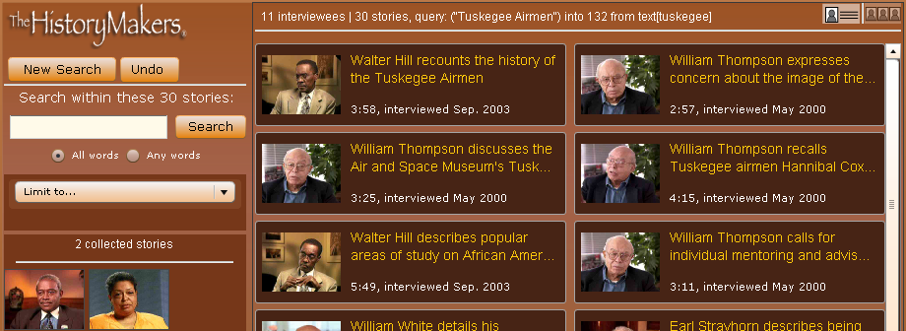
2010 Flash Interface – Search Results

Slide 19
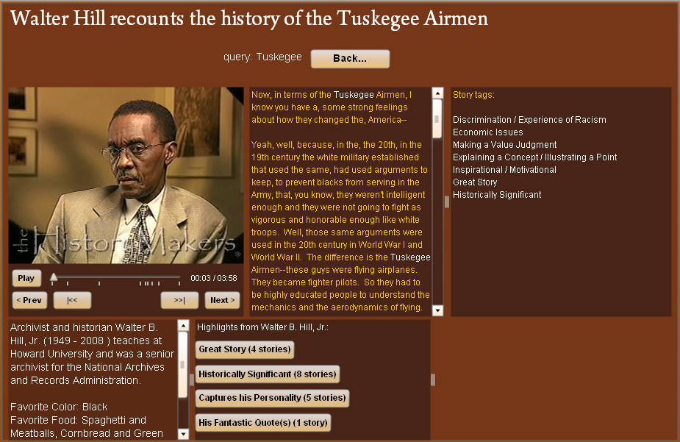
2010 Flash Interface – Video Story Playback

Slide 20
Metrics Collection
Transaction log data (24,940 actions logged for The HistoryMakers, 16,048 logged for Harrisburg during July-Dec. 2010)
Comments volunteered by users through email and through comments interface in the web portal
Novice and expert commentary at workshops and at the Oral History Association demonstration session

Slide 21
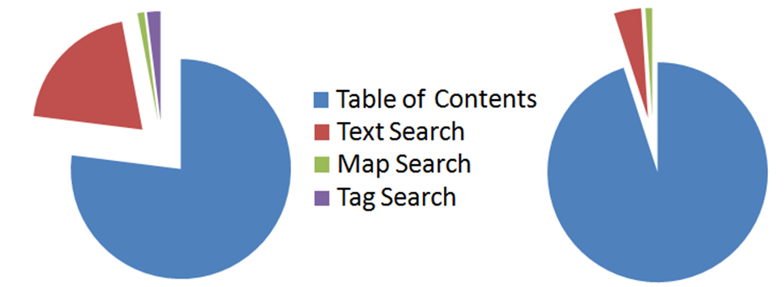
Transaction Log Breakdown
HistoryMakers logs
61% Play Video
2% Search-in-Search
<1% Personal Lists
<1% Filtering
Harrisburg logs
64% Play Video
<1% Search-in-Search
<1% Personal Lists
<1% Filtering
Method used to produce sets of video:

Slide 22
Simpler Navigation and Bookmarking
Three open source projects provide help for Flash
  swfaddress (provide deep linking)
  swfobject (embed Flash in html)
  swffit (resize Flash with browser window resize)
Utilizing these projects provides better URL bookmarking (users can share video sets and stories)
Menu bar added to provide breadcrumb-style navigation (promoting more search-in-search and filtering by keeping users informed of where they are)

Slide 23
Better Facet Communication
Facets are presented along with the data, rather than in separate control page
Table of contents updates dynamically based on facet interactions
Faceted interface to filter sets described with short descriptor

Slide 24
Improved Information Seeking
“Berrypicking” (gathering bit of info at a time) better supported with Play List area
Support for mixing analytic search strategy (e.g., text search to find a story) with temporal chaining (e.g., playing video one after the other in video interview)

Slide 25
Aesthetics for the Portal
Original interface suffered
  Lack of cohesion
  Multiple layouts
  Wasted space
  Poor navigation choices (e.g., “Back” button)
Redesigned Flash portal has:
  CSS style sheet (e.g., rose theme, gold theme)
  Menu bar
  Better video story page emphasizing synchronized metadata

Slide 26
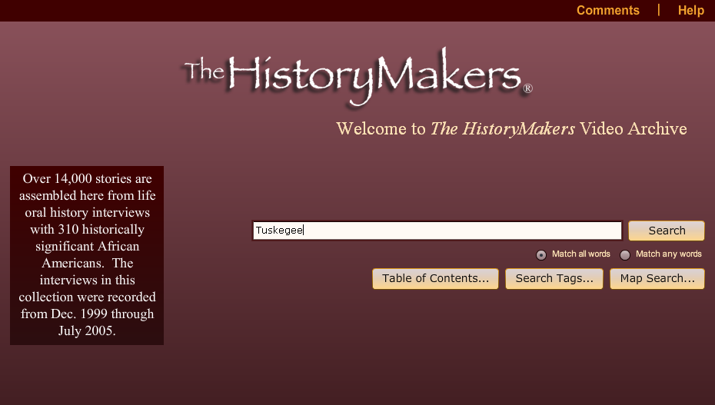
New Flash Interface – Intro Screen

Slide 27
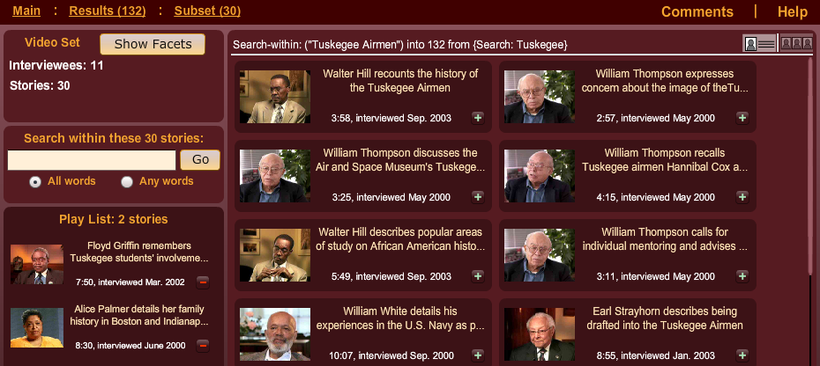
New Flash Interface – Search Results

Slide 28
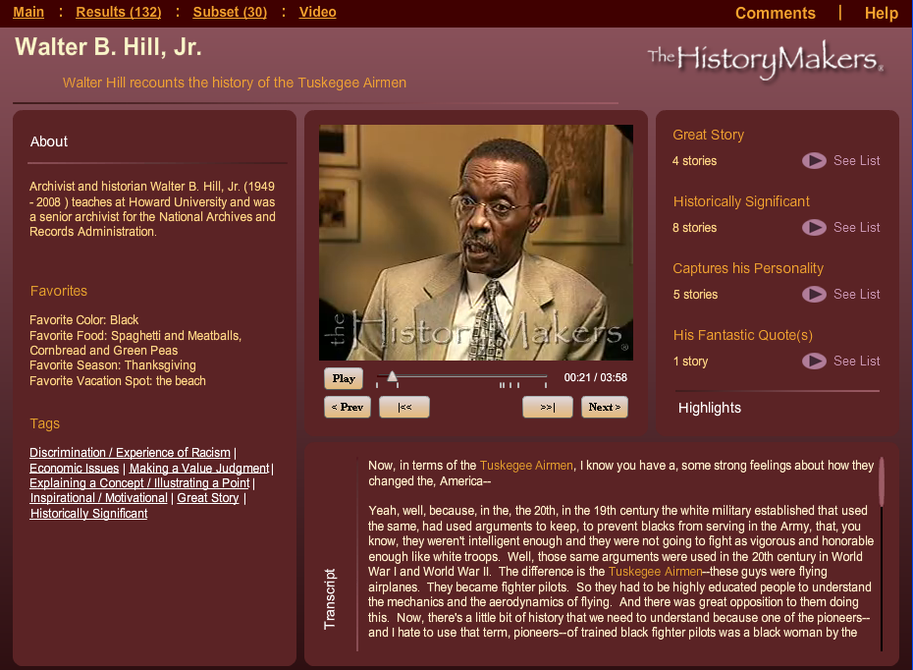
New Flash Interface – Video Story Playback

Slide 29
The HistoryMakers: Use of Standards
Interviews described according to the Society of American Archivists (SAA) approved Describing Archives: A Content Standard (DACS) and encoded following the RLG Best Practices for creating EAD (Encoded Archival Description) finding aids
www.thehistorymakers.com/programs/dvl/finding.asp
EAD provides an overview of the context of records creation, their creators, and detailed descriptions of the records themselves
EAD often fails to support the entry of biographical data regarding the roles that the creators of archival material (in this case, interviewees) have played in historical events, organizations, and communities

Slide 30
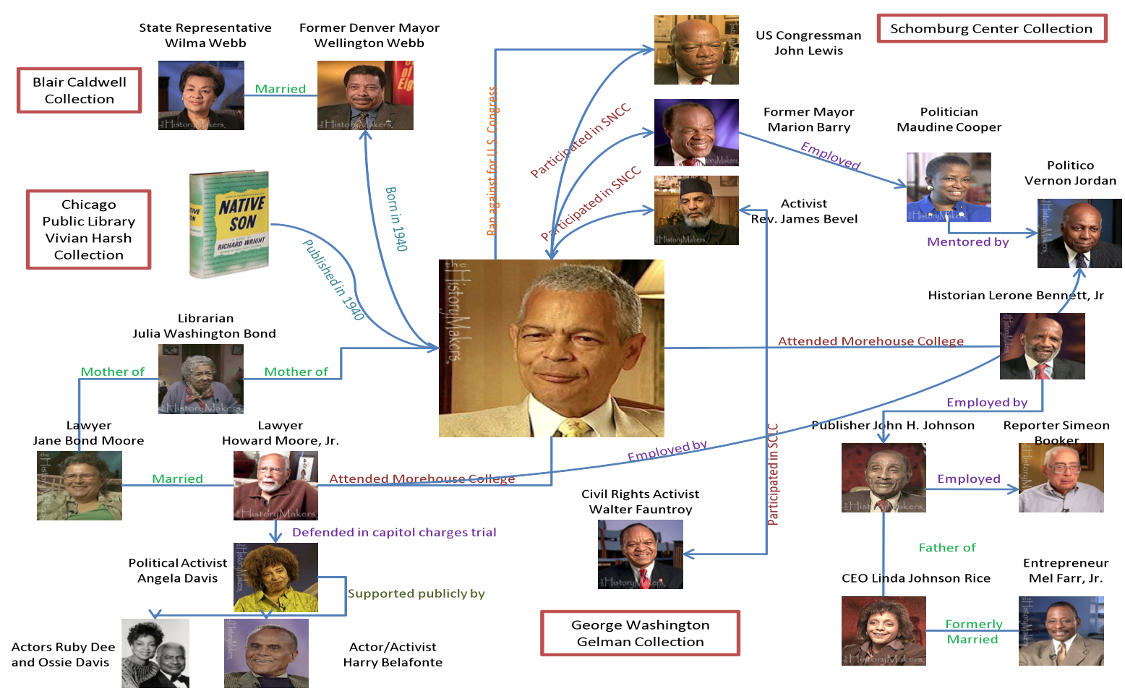
Future Work with Improved Metadata

Slide 31
Summary
Fielding collections and collecting metrics can iteratively improve the delivery of oral history digital video libraries
  Simpler navigation and bookmarking
  Better facet communication
  Improved information seeking
  Aesthetics for the portal
Sharing results and learning from others via the annual Oral History Association meeting
Please use the collections and help us improve them!

Slide 32
Credits
Many members of the Informedia Project, CMU research community, and The HistoryMakers contributed to this work, including:
Informedia Project Director: Howard Wactlar
The HistoryMakers Executive Director: Julieanna Richardson
Original HistoryMakers Beta Testers: Joe Trotter (CMU History Dept.), SUNY at Buffalo, University of Illinois (3 campuses), Drexel University
ETC Students: Andy Korzik, Xiaoxi “Cici” Liu, Srinavin Nair
HistoryMakers and Harrisburg Living Legacy Series Primary Contributors: Kathryn Stine, Dan Johnson, Julie McKenzie, Ellen Brown
Informedia Library Essentials: Bryan Maher
This work supported by the National Science Foundation
under Grant No. IIS-0705491

