Slide 1
Towards Explainable Compositional Reasoning
Isaac Amundson, Amer Tahat, David Hardin, Darren Cofer
3rd International Workshop on Explainability of Real-time Systems and their Analysis
December 10, 2024
Distribution Statement “A” (Approved for Public Release, Distribution Unlimited).
© 2024 Collins Aerospace. | This document does not include any export controlled technical data.

Slide 2
DARPA PROVERS
Pipelined Reasoning of Verifiers Enabling Robust Systems
Develop automated, scalable formal methods tools that are integrated into traditional development pipelines
Enable traditional product engineers to incrementally produce and maintain high-assurance national security systems
Barriers to formal methods adoption
Scalability to support real-world systems
Poorly designed UI and other usability factors
Lack of commercially licensed / supported tools
Formal methods skillset required
Property specification language
Explainable counterexamples
AEROSPACE & DEFENSE
2
© 2024 Collins Aerospace. | This document does not include any export controlled technical data.

Slide 3
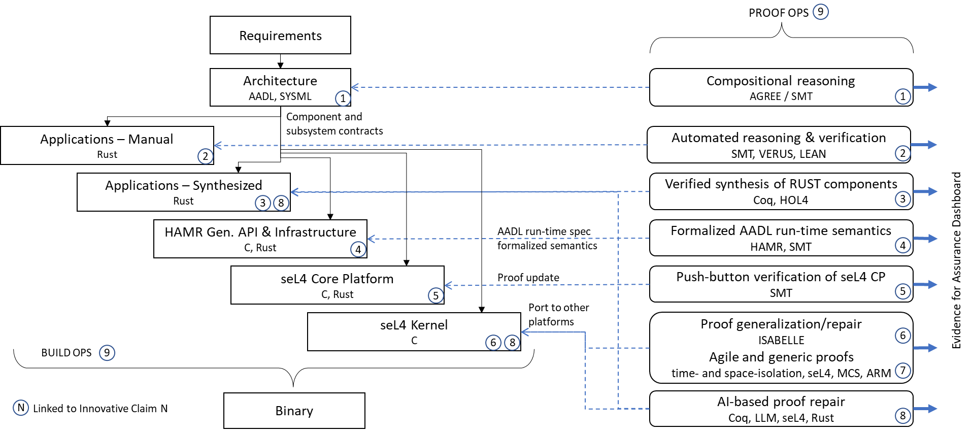
INSPECTA
Industrial-Scale Proof Engineering for Critical Trustworthy Applications
Cloud-based DevOps
3
© 2024 Collins Aerospace. | This document does not include any export controlled technical data.

Slide 4
Compositional Reasoning with AGREE
Assume Guarantee Reasoning Environment
Assume-Guarantee annex for AADL architecture models
Assumptions describe the expectations that a component has on the environment
Guarantees describe bounds on the behavior of the component when assumptions are valid
Compositional analysis to prove correctness of:
Component interfaces (component assumptions are satisfied by upstream guarantees)
Component implementations (component assumptions and subcomponent guarantees satisfy guarantees)
Input < 10 → Output < 18
Input < 20 → Output < 38
© 2024 Collins Aerospace. | This document does not include any export controlled technical data.

Slide 5
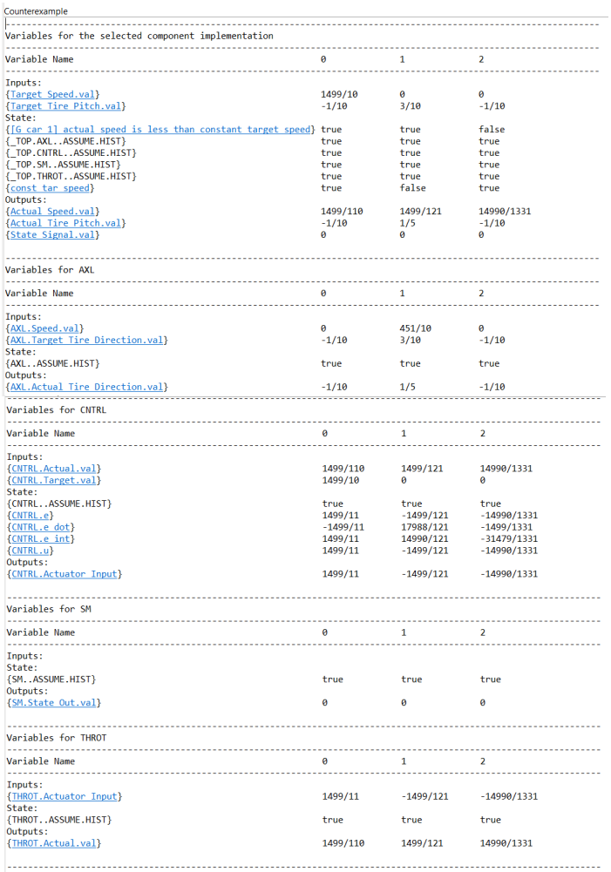
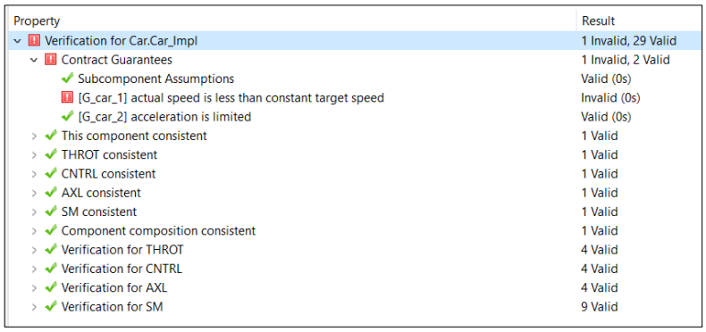
AGREE Counterexamples
How can we improve AGREE usability by making counterexamples more actionable?
How can we improve AGREE usability by making counterexamples more actionable?
Actionable: Determine and address the root cause of the counterexample more quickly
© 2024 Collins Aerospace. | This document does not include any export controlled technical data.

Slide 6
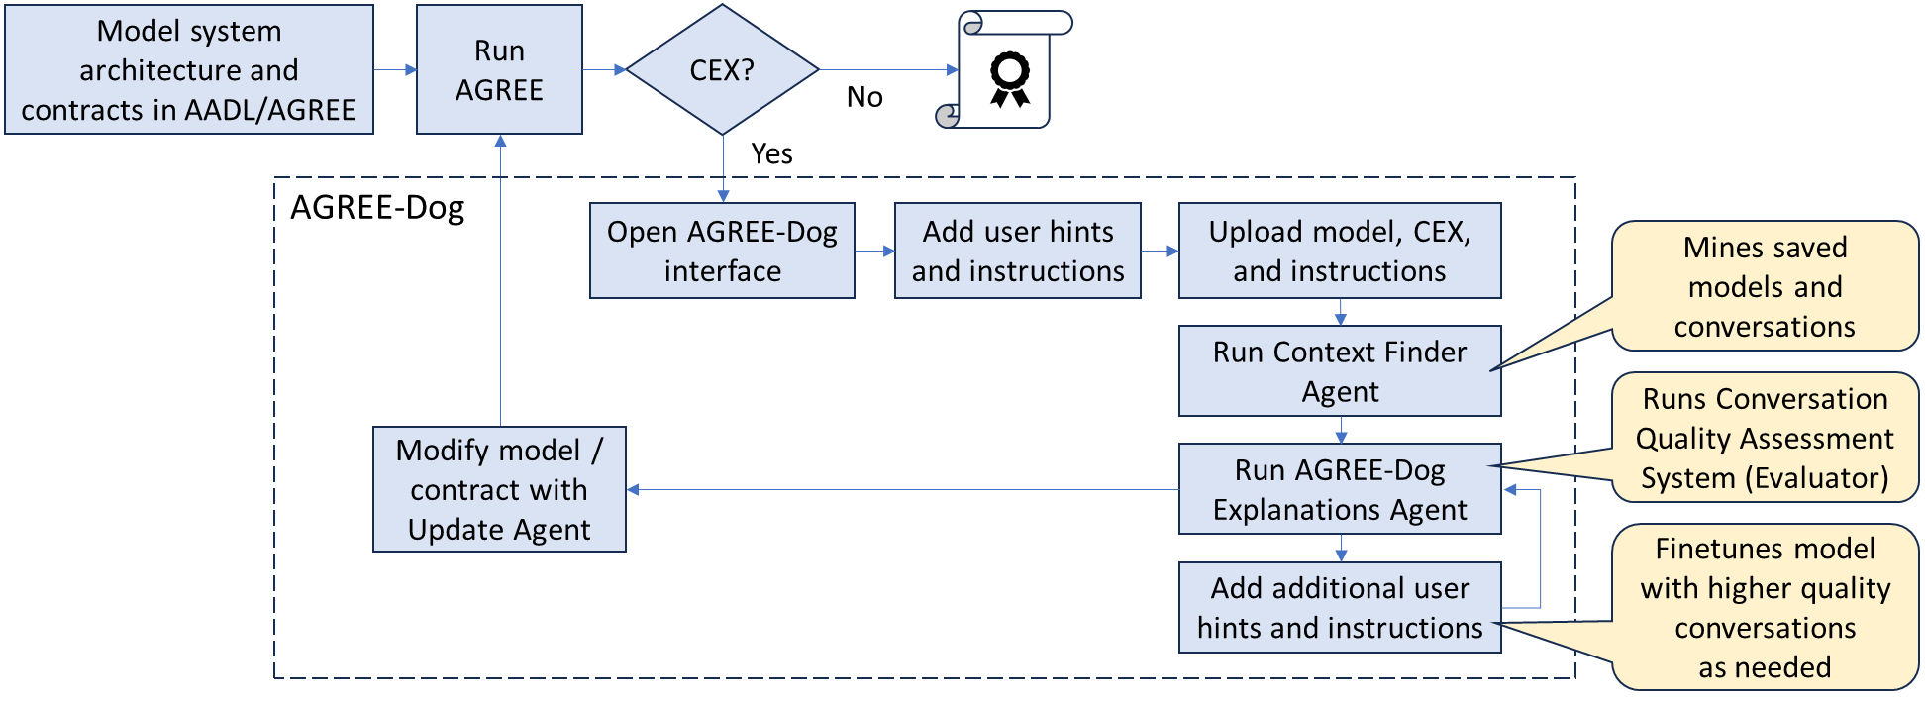
Towards Explainable Compositional Reasoning
We developed a novel conversational AGREE copilot (AGREE-Dog) to produce natural language explanations for AGREE counterexamples and assist with model repair
Based on the GPT-4o multi-modal model
This document does not include any export-controlled technical data.
© 2024 Collins Aerospace. | This document does not include any export controlled technical data.
Notes:
GPT-4o multi-modal model

Slide 7
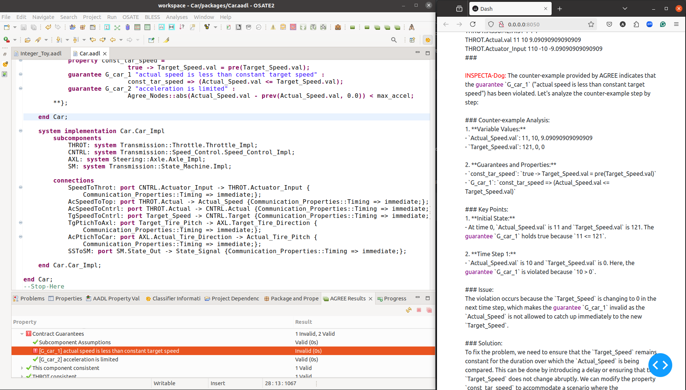
AGREE-Dog: Counterexample Analysis and Resolution
Analysis
Detection
Repair
7
© 2024 Collins Aerospace. | This document does not include any export controlled technical data.

Slide 8
Challenges
Contextual constraints
GenAI struggles with accurate AGREE model explanations due to limited context, causing hallucinations
AGREE-Dog Retrieval-Augmented Generation (RAG) System adjusts context dynamically, reducing hallucinations and improving explanation accuracy
Model repair
Repairs can generate multiple solutions, some of which violate system requirements
AGREE-Dog follows predefined requirements to ensure repairs respect system constraints
Evaluation
Manual evaluation limits scalability for large models
A Conversational Quality Assessment System (CQAS) automates performance tracking
8
© 2024 Collins Aerospace. | This document does not include any export controlled technical data.

Slide 9
Conclusion
Summary
Conversational copilot to generate actionable counterexamples
Up Next:
Conversational Quality Assessment System
Evaluation metrics instrumentation
Assurance patterns and dashboard
Check it out: https://github.com/loonwerks/AgreeDog
9
© 2024 Collins Aerospace. | This document does not include any export controlled technical data.

Slide 10
Thank You!
This work was funded by DARPA contract FA8750-24-9-1000.
The views, opinions and/or findings expressed are those of the authors and should not be interpreted as representing the official views or policies of the Department of Defense or the U.S. Government.
© 2024 Collins Aerospace. | This document does not include any export controlled technical data.

