Slide 1
The C Language
… you wouldn’t start from here!
Andrew Banks
Explainable Real-Time Systems and Their Analysis (ERSA) 2024

Slide 2
The Speaker
Andrew Banks
Andrew.Banks@LDRA.com
Software Engineer & Standards Evangelist
Focus: helping YOU to get your software right, first time!
Biography
Over 35 years' experience in developing real-time embedded software systems, across a number of industries
Chartered Fellow of the British Computer Society
Member of the Institution of Engineering & Technology
Standards
Chairman of MISRA C Working Group since June 2013... ... Working Group member since 2007
Chairman of the BSI Software Testing Working Group … UK Head-of-Delegation to ISO/IEC JTC1/SC7
Contributor to ISO 29119 “Software Testing”
Contributor to ISO 26262 2nd Edition “Functional Safety”
etc

Slide 3
Agenda
1
Functional Safety Standards … and how MISRA fits in
2
The C Language... ... and what is wrong with it
3
An introduction to MISRA C
4
MISRA C in an
... ISO 26262 context
5
Why Use MISRA… ... Or, in fact, any other Static Analysis

Slide 4
International Standards Safety, Security and AI

Slide 5
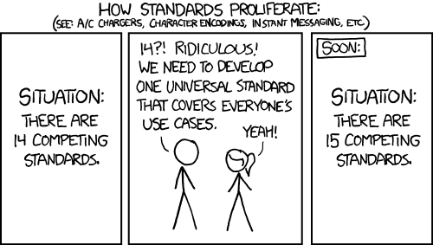
Setting the scene…
The nice thing about standards ... is that you have so many to choose from!
Andrew S. Tanenbaum

Slide 6
Functional Safety Standards
LDRA
IEC 61508 Functional Safety of E/E/PES X
IEC 61511 Industrial Process Equipment [X]
IEC 61513 Nuclear X
IEC 62304 Medical Devices X
ISO 13849 Machinery [X]
ISO 25119 Agriculture & Forestry [X]
ISO 26262 Road Vehicles X
EN 50126/7/8/9 Railway X
DO-178 Airborne Systems X
Notes:
Not forgetting IEC 61508 derivatives:
IEC 61511 Industrial process equipment
IEC 61513 Nuclear
IEC 62061 Machinery

Slide 7
Information Technology
SC7
Software & Systems Engineering
SC22
Programming Languages
SC42
Artificial Intelligence
ISO/IEC 12207
ISO/IEC 15288
ISO/IEC 29119
ISO/IEC 250xx
ISO/IEC 9899
ISO/IEC 14882
ISO/IEC 24772
Various!

Slide 8
Functional Safety and Security 1/2
TC22
Road Vehicles
TC/65
Industrial PMC&A
SC32
E&E Components & General System Aspects
SC27
Security
SC/65A
ISO 26262
ISO/SAE 21434
ISO 21448
ISO/IEC 270xx
IEC 61508 etc
PMC&A = Industrial process measurement, control and automation
Notes:
LDRA staff are actively engaged in a number of ISO, IEC and other international committees and working groups.
Relevant to the automotive domain is ISO TC22, for:
ISO 26262 Functional Safety
ISO 21434 Cybersecurity
ISO 21448 Safety of the Intended Functionality (or SOTIF)
And more generally, ISO/IEC JTC1
SC7
ISO/IEC 12207 Software Development Life Cycle
ISO/IEC 15288 Systems Development Life Cycle
ISO/IEC 250xx Software and Systems Quality
ISO/IEC 29119 Software Testing
SC22
ISO/IEC 9899 Programming Languages – C
ISO/IEC 14882 Programming Languages – C++
ISO/IEC 24773 Programming Languages – Vulnerabilities

Slide 9
Functional Safety and Security (2/2)
ISO 82304 etc
IEC 62304 etc
TC/210
QM & GA for MD
JWG7
TC/62
Med Equip,S/W&Sys
TC/215
Health Infomatics
JWG1,2,3
ISO 13485 etc
Various!
Notes:
LDRA staff are actively engaged in a number of ISO, IEC and other international committees and working groups.
Relevant to the automotive domain is ISO TC22, for:
ISO 26262 Functional Safety
ISO 21434 Cybersecurity
ISO 21448 Safety of the Intended Functionality (or SOTIF)
And more generally, ISO/IEC JTC1
SC7
ISO/IEC 12207 Software Development Life Cycle
ISO/IEC 15288 Systems Development Life Cycle
ISO/IEC 250xx Software and Systems Quality
ISO/IEC 29119 Software Testing
SC22
ISO/IEC 9899 Programming Languages – C
ISO/IEC 14882 Programming Languages – C++
ISO/IEC 24773 Programming Languages – Vulnerabilities

Slide 10
Artificial Intelligence Life Cycle Processes
JTC1/SC7
JWG2 JTC1/SC42 + SC7
JTC1/SC42
ISO/IEC 15288 System-engineering life cycle processes
ISO/IEC 12207 Software-engineering life cycle processes
ISO/IEC 5338 AI system life cycle processes
ISO/IEC TR 29119-1..5
Software Testing
ISO/IEC TR 29119-11
Testing of AI systems
ISO/IEC 42119 (TBC)
Testing of AI systems
ISO/IEC 25058
Guidance for Quality Eval’n of AI systems
ISO/IEC 25010
Software Quality Model
ISO/IEC 25059
Quality model for AI systems

Slide 11
Safety and Artificial Intelligence
JTC1/SC42
JWG
TC65/SC65A
ISO/IEC 5338 AI system life cycle processes
ISO/IEC DTR 5469 Functional safety and AI systems
IEC 61508 Functional safety
ISO TC22/SC32
ISO 26262 Functional safety
ISO PAS 8800 Safety and artificial intelligence
ISO DTS 5053 Safety for automated driving systems
ISO 21434 SOTIF

Slide 12
The C Language... ... and what is wrong with it

Slide 13
In the beginning, the Universe was created.
This has made a lot of people very angry … and been widely regarded as a bad move.
The Restaurant at the End of the Universe Book 2 of the Douglas Adams’ 5-part Trilogy The Hitch Hiker’s Guide To The Galaxy

Slide 14
Far back in the mists of ancient time…
1963 CPL Cambridge Programming Language Christopher Strachey et al of University of Cambridge Later known as the Combined Programming Language with the involvement of the University of London
1967 BCPL Bootstrap CPL (or Basic CPL) Martin Richards at the University of Cambridge
1969 B Ken Thompson and Dennis Ritchie at Bell Labs.
Notes:
MISRA-C:2004 was a paradigm shift – critical systems rather than just vehicle based

Slide 15
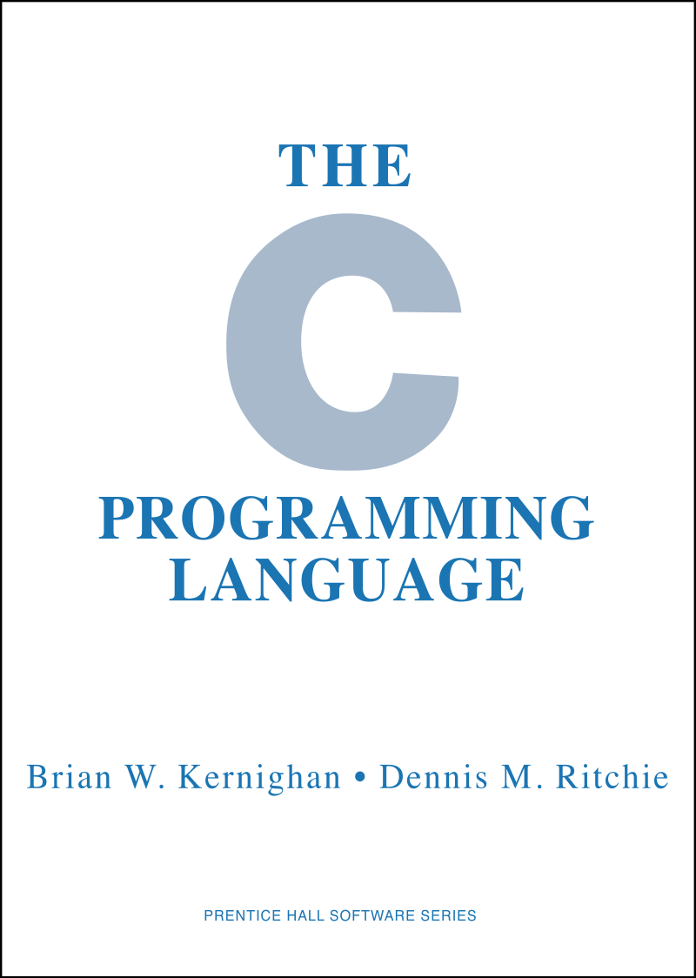
The C Language – A Quick History
K&R C
1972 First created by Dennis Ritchie
1976 Lint, the first C static analyser ... created by Stephen Johnson
1978 The C Programming Language published
ANSI C
1989 First standardized version ANSI X3.159-1989 (aka C89)
Notes:
MISRA-C:2004 was a paradigm shift – critical systems rather than just vehicle based

Slide 16
The C Language – A Quick History
ISO C
1990 ISO/IEC 9899:1990 aka C90 Equivalent to C89
1995 Amendment 1 aka C95
1999 ISO/IEC 9899:1999 aka C99
2011 ISO/IEC 9899:2011 aka C11
2018 ISO/IEC 9899:2018 aka C18 A “TC” in all but name (aka C17)
2024 ISO/IEC 9899:2024 aka C24 Also known as C23!
Very few (if any) of you will be using ANSI C any more!
Notes:
MISRA-C:2004 was a paradigm shift – critical systems rather than just vehicle based

Slide 17
We don't demand solid facts!
What we demand is a total absence of solid facts.
We demand rigidly defined areas of doubt and uncertainty!
Vroomfondel the Philosopher, in The Hitch Hiker’s Guide To The Galaxy by Douglas Adams

Slide 18
The C Language – What is the problem?
Despite its popularity, there are several drawbacks with the C language, eg:
The ISO Standard language definition is incomplete:
Behaviour that is Undefined 61 incidences
Behaviour that is Unspecified 211 incidences
Behaviour that is Implementation Defined 120 incidences
Behaviour that is Locale-dependant 15 incidences
Language misuse and obfuscation
Language misunderstanding
Run-time error checking
MISRA C is one solution...
C
18
Notes:
Mention: WG14 objective is to not break existing code, rather than fix problems

Slide 19
The C Language – What is the problem?
The ISO Standard language definition is incomplete
Undefined behaviour is behaviour, upon use of a nonportable or erroneous program construct or of erroneous data, for which the International Standard imposes no requirements
An example of undefined behaviour is the behaviour on integer overflow
211 instances
Unspecified behaviour invokes the use of an unspecified value, or other behaviour where the International Standard provides two or more possibilities and imposes no further requirements on which is chosen in any instance
An example of unspecified behaviour is the order in which the arguments to a function are evaluated.
61 instances
Notes:
Mention: WG14 objective is to not break existing code, rather than fix problems

Slide 20
If not C, then what?
So, if not C, then what?
1977 etc Modula, Modula-2
1980(?) Perspective Pascal
1983 Ada (also including SPARK)
1993 Lua
1995 Java
2010 Rust
2024 ?
There is another way…
Notes:
Mention: WG14 objective is to not break existing code, rather than fix problems

Slide 21
An introduction to MISRA C

Slide 22
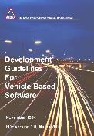
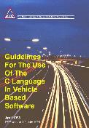
Original MISRA publications
November 1994
Development guidelines for vehicle based software (aka The MISRA Guidelines)
The first automotive publication concerning functional safety
Commenced more than 10 years before work started on ISO 26262
April 1998
Guidelines for the use of the C language in vehicle based software (aka MISRA C)
December 1998
IEC 61508 (first edition) published!

Slide 23
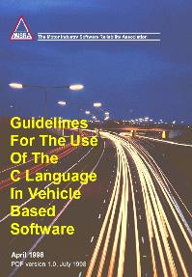
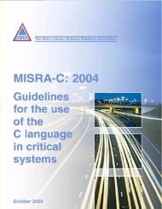
MISRA C – A Quick History
MISRA-C:1998
“Guidelines for the use of the C language in vehicle based software”
Compatible with ISO/IEC 9899:1990 (aka C90)
MISRA-C:2004
“Guidelines for the use of the C language in critical systems”
Remains compatible with ISO/IEC 9899:1990 (aka C90)
Notes:
MISRA-C:2004 was a paradigm shift – critical systems rather than just vehicle based

Slide 24
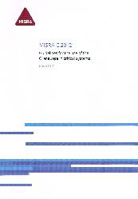
MISRA C – A Quick History
MISRA C:2012 (3rd Edition)
Adds compatibility with ISO/IEC 9899:1999 (aka C99)
Amendment 1 in 2016 included additional security guidelines
MISRA C:2012 (3rd Edition, 1st Edition) [published 2019]
Consolidated enhancements introduced by AMD1 and TC1
Further enhancements in 2020 (AMD2), 2022 (TC2, AMD3) and 2024 (AMD4)
MISRA C:2023 (3rd Edition, 2nd Revision)
Latest version, consolidating all recent work, to mark 25th anniversary!
Notes:
MISRA-C:2004 was a paradigm shift – critical systems rather than just vehicle based

Slide 25
The MISRA C Guidelines define a subset of the C language in which the opportunity to make mistakes is either removed or reduced.
Many standards for the development of safety-related software require, or recommend, the use of a language subset, and this can also be used to develop any application with security, high integrity or high reliability requirements.”

Slide 26
MISRA C in one slide!
221 Guidelines: 21 Directives (5 sections) and 200 Rules (23 sections)
Directives
The implementation
Compilation and build
Requirements traceability
Code design
Concurrency considerations
Rules
A standard C environment
Unused code
Comments
Character sets & lexical conventions
Identifiers
Types
Literals & constants
Declarations & definitions
Initialization
The essential type model
Pointer type conversions
Expressions
Side effects
Control statement expressions
Control flow
Switch statements
Functions
Pointers and arrays
Overlapping storage
Preprocessing directives
Standard libraries
Resources
Generic Selections

Slide 27
MISRA C in an
... ISO 26262 context
3

Slide 28
MISRA C – In an ISO 26262 Context
ISO 26262-6:2018, Section 5.4.3
Criteria for suitable modelling, design or programming languages that are not sufficiently addressed by the language itself shall be covered by the corresponding guidelines, or by the development environment, considering the topics listed in Table 1
Example 1: MISRA C is a coding guideline for the programming language C and includes guidance on automatically generated code
Notes:
MISRA-C:2004 was a paradigm shift – critical systems rather than just vehicle based

Slide 29
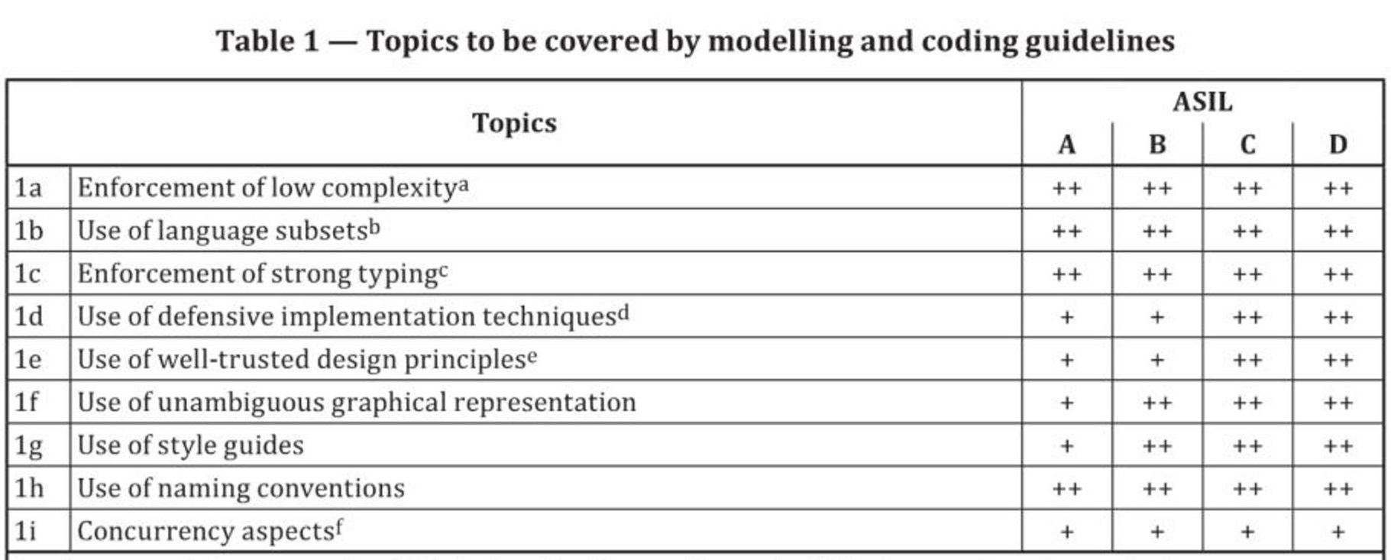
MISRA C – In an ISO 26262 Context
ISO 26262-6:2018, Table 1
Notes:
MISRA-C:2004 was a paradigm shift – critical systems rather than just vehicle based

Slide 30
MISRA C – In an ISO 26262 Context
ISO 26262-6:2018, Section 8.4.5
Design principles for software unit design and implementation at the source code level as listed in Table 6 shall be applied to achieve the following properties:
correct order of execution of subprograms and functions within the software units, based on the software architectural design;
consistency of the interfaces between the software units;
correctness of data flow and control flow between and within the software units;
simplicity;
readability and comprehensibility;
robustness;
suitability for software modification; and
verifiability
Notes:
MISRA-C:2004 was a paradigm shift – critical systems rather than just vehicle based

Slide 31
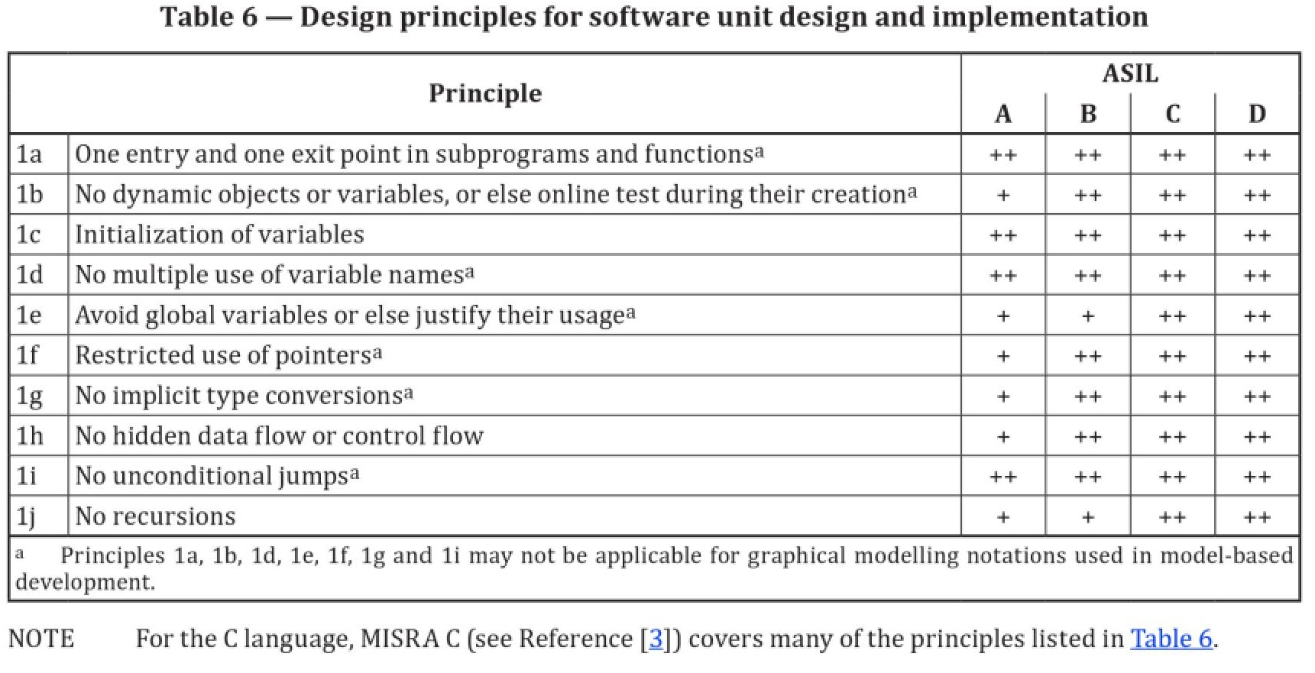
MISRA C – In an ISO 26262 Context
ISO 26262-6:2018, Table 6
Notes:
MISRA-C:2004 was a paradigm shift – critical systems rather than just vehicle based

Slide 32
MISRA C – In an ISO 26262 Context
Static Analysis, control flow analysis and data flow analysis are mentioned twice as a set:
Table 7 ... software unit verification
Table 10 ... verification of software integration
Control-flow and data-flow analysis are also mentioned in Table 4:
Table 4 ... verification of software architectural design

Slide 33
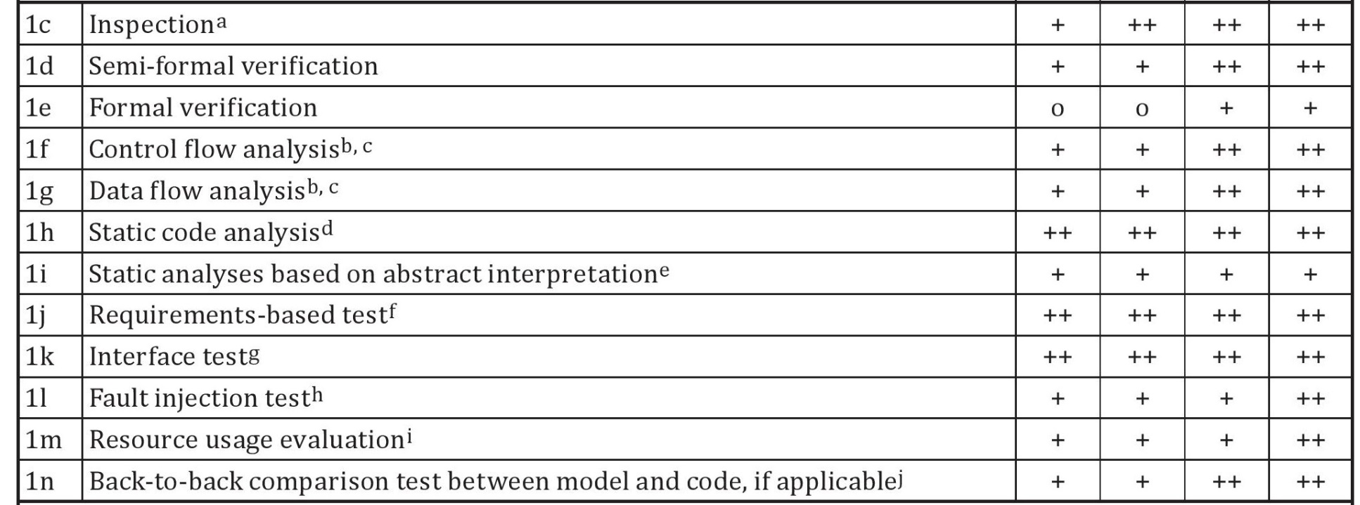
MISRA C – In an ISO 26262 Context
ISO 26262-6:2018, Table 7 (unit)
Notes:
MISRA-C:2004 was a paradigm shift – critical systems rather than just vehicle based

Slide 34
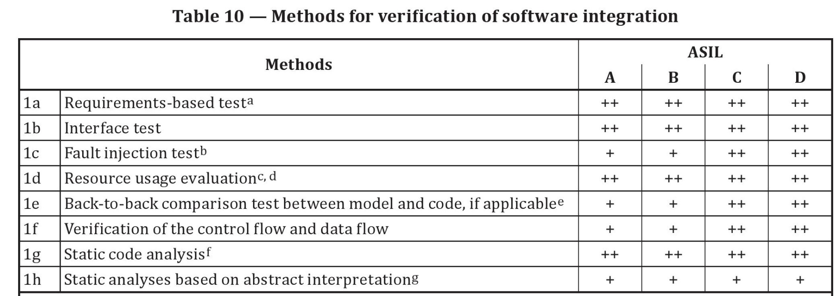
MISRA C – In an ISO 26262 Context
ISO 26262-6:2018, Table 10
This also maps to the MISRA C guideline scope:
Unit Verification Single-translation-unit guidelines
Integration System-wide guidelines
Notes:
MISRA-C:2004 was a paradigm shift – critical systems rather than just vehicle based

Slide 35
Why Use MISRA… ... Or, in fact, any other Static Analysis

Slide 36
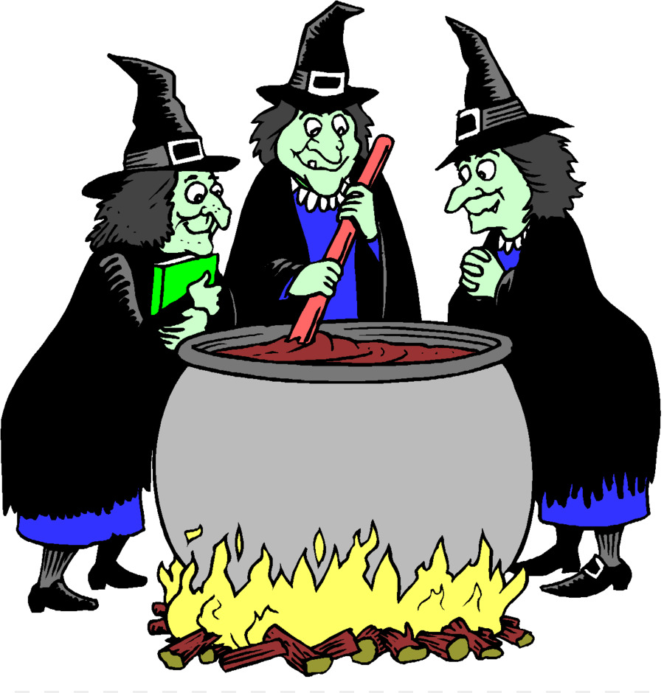
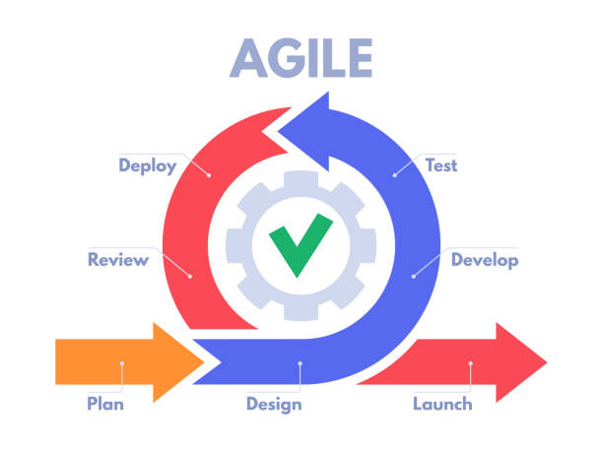
Introduction
Software Testing is…
An integral part of the software development life-cycle
Often reduced due to budget, resource, and timeline pressures
Frequently seen as a mystical black art

Slide 37
Caution!
Program testing can be used to show the presence of bugs, … but never to show their absence!
Edsger Dijkstra

Slide 38
Checking Compliance
Check the code manually
Needs to be done on MISRA C “undecidable” rules
But don’t really want to do it on all the code!
Use a lightweight tool, such as is often built into compilers
Fast (Checks just a subset)
Detects the easy to find defects
Tends to be “Optimistic” – False Negatives
Use a heavyweight tool
Slow (Deep analysis, Check all rules)
Detects the easy and hard to find defects (The “once a year” ones!)
Tends to be “Pessimistic” – False Positives
Notes:
When checking the compliance, we have a choice of doing it manually or using a tool.
Clearly using a tool makes a lot of sense, but since there are now “undecidable” rules, then some manual checking will still be necessary.
Detecting “defects” is like getting fruit off a tree, the low hanging fruit can be picked quickly and easily, however the high hanging fruit requires more time and effort.
Compilers often integrate “MISRA” checkers, that work by checking the rules that are simple and quick to do, without greatly impacting the compilation time. As a result they will often not check a number of rules and in case of doubt are generally “optimistic” indicating that there is no violation. For some developers, these “False Negatives” are good, since their code “appears” to be more MISRA compliant, than when using a more heavyweight tool.
With a heavyweight tool, a much deeper analysis can be done on the code, which can be very time consuming. Also these tools tend to be “Pessimistic” and in case there is doubt, generally indicate that there is possibly a violation. This may appear at first glance to the developer to be frustrating, but in fact is highly beneficial, since these “False Positives” generally occur with “undecidable rules” and give a clear indication where the developer needs to spend some time doing manual reviews.

Slide 39
Section 8.10 “The Essential Type Model”
The rules in this section collectively define the essential type model and restrict the C type system so as to:
Support a stronger system of type-checking;
Provide a rational basis for defining rules to control the use of implicit and explicit type conversions;
Promote portable coding practices;
Address some of the type conversion anomalies found within ISO C.
The essential type model does this by allocating an essential type to those objects and expressions which ISO C considers to be of arithmetic type.
For example, adding an int to a char gives a result having essentially character type rather than the int type that is actually produced by integer promotion.

Slide 40
Use of defensive implementation techniques
MISRA C has guidance relating to:
Control flow
If / else if / else
Switch / default
While / do
For loops
Unreachable code
There shall be no unreachable code
There shall be no unused code

Slide 41
Defensive Implementation Techniques
Consider the Required MISRA C:2012 Rule 2.1
A project shall not contain unreachable code
Consider the Required MISRA C:2012 Rule 15.6
The body of an iteration-statement or a selection-statement shall be a compound-statement. eg:
if ( condition )
{
action();
}
Some suggest that these Rules are (to be polite) unnecessary...
I wonder if Apple’s software team agree?
CVE-2014-1266

Slide 42
The Apple iPhone SSL Bug
if ( ( err = SSLFreeBuffer( &hashCtx ) ) != 0 )
goto fail;
if ( ( err = ReadyHash(&SSLHashSHA1, &hashCtx ) ) != 0 )
goto fail;
if ( ( err = SSLHashSHA1.update( &hashCtx, &clientRandom ) ) != 0 )
goto fail;
if ( ( err = SSLHashSHA1.update( &hashCtx, &serverRandom ) ) != 0 )
goto fail;
if ( ( err = SSLHashSHA1.final( &hashCtx, &hashOut ) ) != 0 )
goto fail;

Slide 43
The Apple iPhone SSL Bug
if ( ( err = SSLFreeBuffer( &hashCtx ) ) != 0 )
goto fail;
if ( ( err = ReadyHash(&SSLHashSHA1, &hashCtx ) ) != 0 )
goto fail;
if ( ( err = SSLHashSHA1.update( &hashCtx, &clientRandom ) ) != 0 )
goto fail;
if ( ( err = SSLHashSHA1.update( &hashCtx, &serverRandom ) ) != 0 )
goto fail;
if ( (err = SSLHashSHA1.update( &hashCtx, &signedParams ) ) != 0 )
goto fail;
goto fail;
if ( ( err = SSLHashSHA1.final( &hashCtx, &hashOut ) ) != 0 )
goto fail;
Now unconditional
Now unreachable!

Slide 44
The Apple iPhone SSL Bug
if ( ( err = SSLFreeBuffer( &hashCtx ) ) != 0 )
goto fail;
if ( ( err = ReadyHash(&SSLHashSHA1, &hashCtx ) ) != 0 )
goto fail;
if ( ( err = SSLHashSHA1.update( &hashCtx, &clientRandom ) ) != 0 )
goto fail;
if ( ( err = SSLHashSHA1.update( &hashCtx, &serverRandom ) ) != 0 )
goto fail;
if ( (err = SSLHashSHA1.update( &hashCtx, &signedParams ) ) != 0 )
{ ← would this have helped?
goto fail;
goto fail;
} ← not forgetting this one...
if ( ( err = SSLHashSHA1.final( &hashCtx, &hashOut ) ) != 0 )
goto fail;
← Now unreachable!
← Now reachable!

Slide 45
In Summary…

Slide 46
In Summary
The C Language is in widespread use, despite its limitations … many attempts have been made to supplant it, without success
MISRA C is
widely respected as guiding good practice
appropriate for use in all high-integrity and high-reliability environments
Writing high-integrity and high-reliability needs the right language … C, on its own, leaves a lot to be desired
You may not want to start from here, but at least with MISRA C, we offer you a guide.

