Slide 1
Parse

Slide 2
Parse
Parse is a ridiculously easy-to-use cloud service.

Slide 3
Parse
Parse is a ridiculously easy-to-use cloud service.
Owned by Facebook (bought in 2013)

Slide 4
Parse
Parse is a ridiculously easy-to-use cloud service.
Owned by Facebook (bought in 2013)
Tons of features with little-to-no setup
  Backend server with classes, keys, and values
  Cloud server with Node.js built right in
  Widespread push notification support

Slide 5
Parse
Parse is a ridiculously easy-to-use cloud service.
Owned by Facebook (bought in 2013)
Tons of features with little-to-no setup
  Backend server with classes, keys, and values
  Cloud server with Node.js built right in
  Widespread push notification support
Provides APIs for several platforms (iOS, Android, JavaScript)

Slide 6
Why Parse?
Parse is extremely easy to set up.
  Popular for quick projects and large apps alike

Slide 7
Why Parse?
Parse is extremely easy to set up.
  Popular for quick projects and large apps alike
Drag and drop a couple frameworks and write 3 lines of code in your app. That’s the entire setup process.

Slide 8
Why Parse?
Parse is extremely easy to set up.
  Popular for quick projects and large apps alike
Drag and drop a couple frameworks and write 3 lines of code in your app. That’s the entire setup process.
Takes no extra effort to make apps cross-platform.

Slide 9
Why Parse?
Parse is extremely easy to set up.
  Popular for quick projects and large apps alike
Drag and drop a couple frameworks and write 3 lines of code in your app. That’s the entire setup process.
Takes no extra effort to make apps cross-platform.
API is really simple regardless of platform.

Slide 10
Why Parse?
Parse is extremely easy to set up.
  Popular for quick projects and large apps alike
Drag and drop a couple frameworks and write 3 lines of code in your app. That’s the entire setup process.
Takes no extra effort to make apps cross-platform.
API is really simple regardless of platform.
Built-in support for users and encrypted passwords

Slide 11
Why Parse?
Parse is extremely easy to set up.
  Popular for quick projects and large apps alike
Drag and drop a couple frameworks and write 3 lines of code in your app. That’s the entire setup process.
Takes no extra effort to make apps cross-platform.
API is really simple regardless of platform.
Built-in support for users and encrypted passwords
  Easily upload and download several datatypes (numbers, strings, images, geopoints).

Slide 12
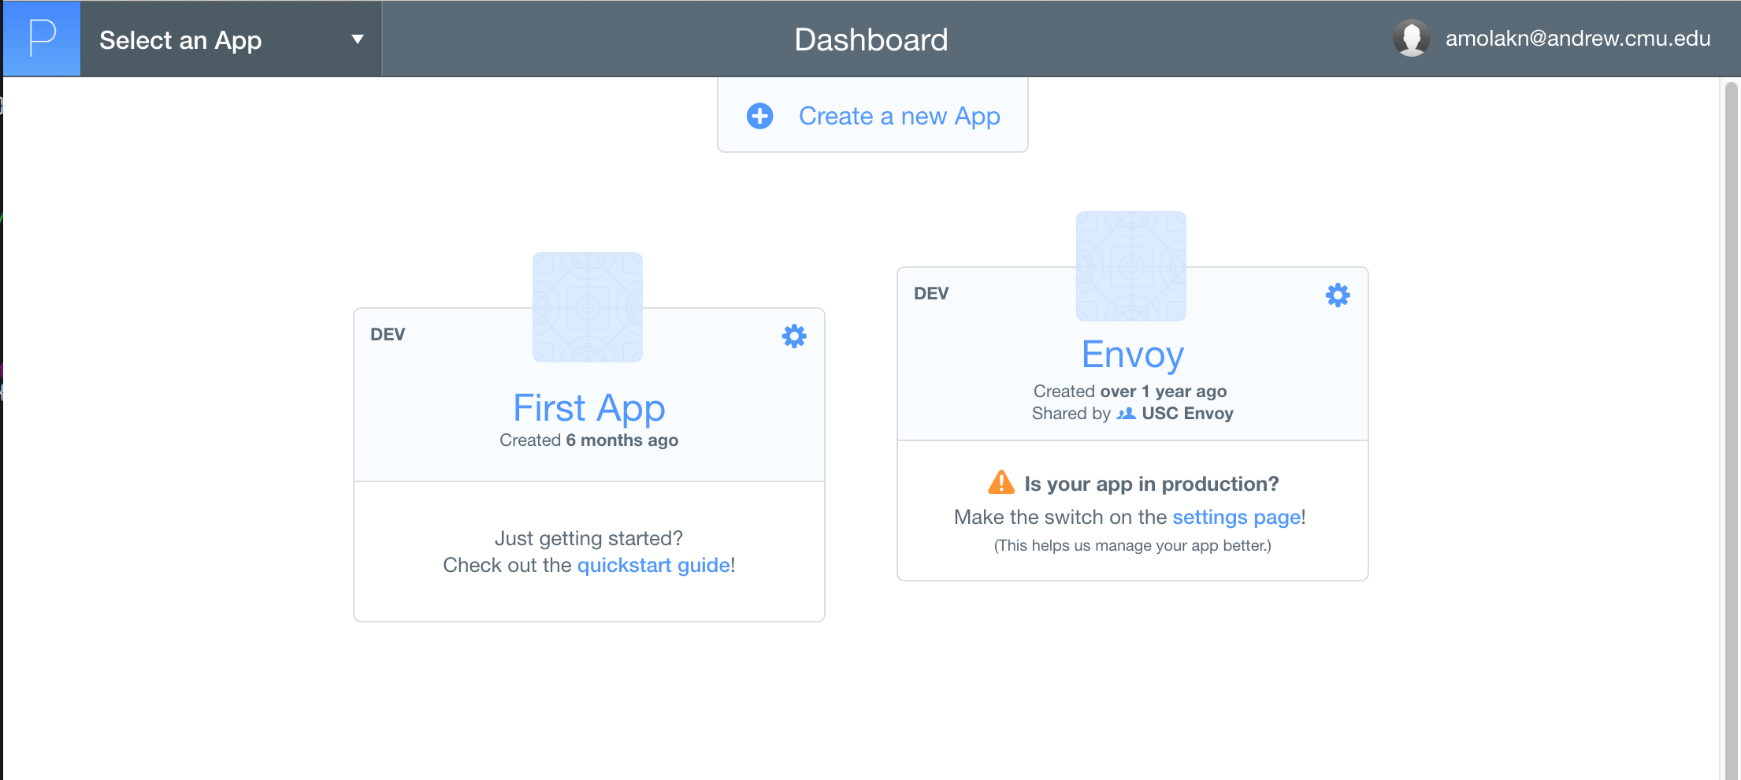
Parse: Setup Cloud
Go to Parse.com and login/signup
Click “Create a new App”

Slide 13
Parse: Setup Cloud
Go to Parse.com and login/signup
Click “Create a new App”
That’s it.

Slide 14
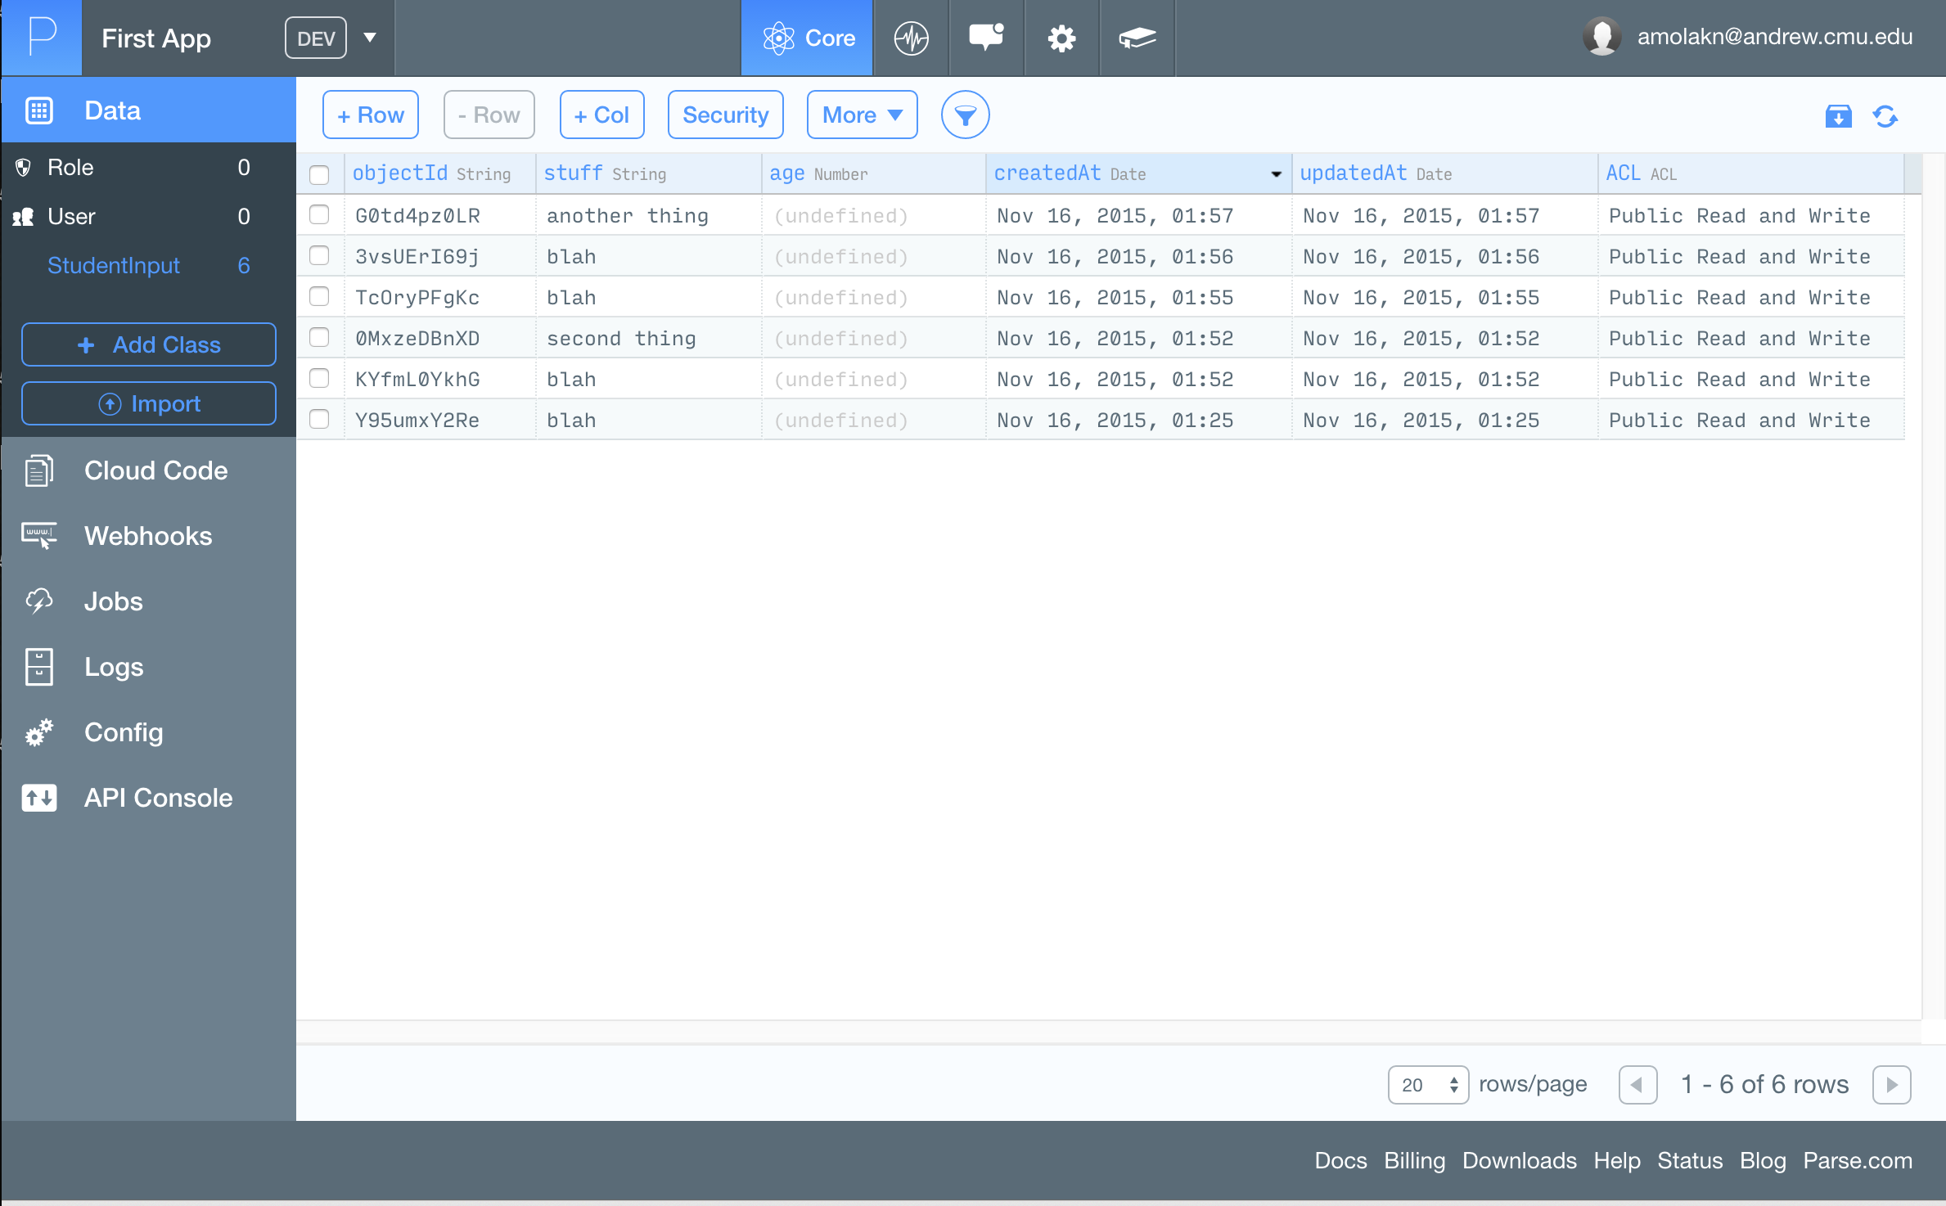
Go to Parse.com and login/signup
Click “Create a new App”
That’s it.

Slide 15
Go to Parse.com and login/signup
Click “Create a new App”
That’s it.
Keys for values (represented by columns)
Classes within the project
Values within this class (represented by rows)

Slide 16
Go to Parse.com and login/signup
Click “Create a new App”
That’s it.
Tabs for Node.js cloud server code (if you want to use it)

Slide 17
Go to Parse.com and login/signup
Click “Create a new App”
That’s it.
Tabs for Node.js cloud server code (if you want to use it)

Slide 18
Parse API
Anything that you want to store is a PFObject.
  A PFObject falls under some class, and it contains keys which can hold various types of data.
  Also more specific types of PFObjects (PFUser, PFGeopoint, PFData, PFFile)

Slide 19
Parse API
Anything that you want to store is a PFObject.
  A PFObject falls under some class, and it contains keys which can hold various types of data.
  Also more specific types of PFObjects (PFUser, PFGeopoint, PFData, PFFile)
Classes and keys can only be made on the Parse website.

Slide 20
Parse API
Anything that you want to store is a PFObject.
  A PFObject falls under some class, and it contains keys which can hold various types of data.
  Also more specific types of PFObjects (PFUser, PFGeopoint, PFData, PFFile)
Classes and keys can only be made on the Parse website.
Can remove PFObjects either in code or on the website.

Slide 21
Parse API
Anything that you want to store is a PFObject.
  A PFObject falls under some class, and it contains keys which can hold various types of data.
  Also more specific types of PFObjects (PFUser, PFGeopoint, PFData, PFFile)
Classes and keys can only be made on the Parse website.
Can remove PFObjects either in code or on the website.
Every PFObject has a unique objectID

Slide 22
Parse Queries
A query is a request for information from the database.

Slide 23
Parse Queries
A query is a request for information from the database.
For Parse queries, you initialize a query by specifying the class you want to search through.

Slide 24
Parse Queries
A query is a request for information from the database.
For Parse queries, you initialize a query by specifying the class you want to search through.
Can be as specific as you want
  I want a list of all users who are 18 years old
  I want the menu items from Chipotle
  I want an object with this Object ID

Slide 25
Parse Queries
A query is a request for information from the database.
For Parse queries, you initialize a query by specifying the class you want to search through.
Can be as specific as you want
  I want a list of all users who are 18 years old
  I want the menu items from Chipotle
  I want an object with this Object ID
Queries will get you PFObjects that match, and you can get whatever information you need from the PFObject.

Slide 26
Parse Queries
A query is a request for information from the database.
For Parse queries, you initialize a query by specifying the class you want to search through.
Can be as specific as you want
  I want a list of all users who are 18 years old
  I want the menu items from Chipotle
  I want an object with this Object ID
Queries will get you PFObjects that match, and you can get whatever information you need from the PFObject.
Queries can be done in the foreground or the background.

