Slide 1
Sign in on the attendance sheet!
Lecture 8
Rebasing

Slide 2
Schedule
March 29 | Rebasing
April 5 | When Things Go Wrong
April 12 | Visual Git Tools
April 19 | Carnival, no class
April 26 | Plumbing and Porcealin
May 3 | Final

Slide 3
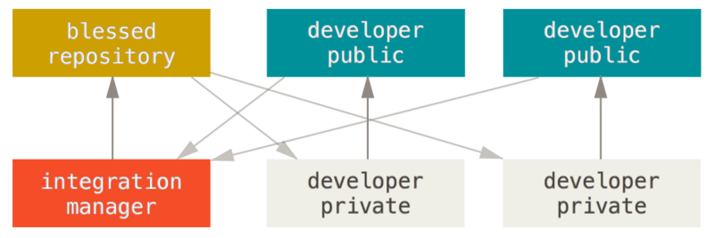
Last Time
Centralized Workflow
Integration Manager Workflow
Github/
“The cloud”
Local Computer

Slide 4
You need to keep your fork up to date
Blessed Repository
Developer Public Repository
Integration Manager Repository
Developer Private Repository

Slide 5
You need to keep your fork up to date
In the private developer repo
$ git remote add upstream
https://github.com/autolab/Autolab.git
$ git fetch upstream
$ git checkout master
$ git merge upstream/master
$ git push origin master

Slide 6
(Sometimes) Need to Get Changes from Master into Topic Branch 1. Ilan Makes a Bugfix
HEAD
B
master
origin/master
A
Ilan’s Computer

Slide 7
(Sometimes) Need to Get Changes from Master into Topic Branch 1. Ilan Makes a Bugfix
git fetch origin
C
origin/master
HEAD
B
master
A
Ilan’s Computer

Slide 8
(Sometimes) Need to Get Changes from Master into Topic Branch 1. Ilan Makes a Bugfix
git fetch origin
git merge origin/master
C
origin/master
HEAD
B
master
A
Ilan’s Computer

Slide 9
(Sometimes) Need to Get Changes from Master into Topic Branch 1. Ilan Makes a Bugfix
git fetch origin
git merge origin/master
HEAD
C
master
origin/master
B
A
Ilan’s Computer

Slide 10
(Sometimes) Need to Get Changes from Master into Topic Branch 1. Ilan Makes a Bugfix
HEAD
git fetch origin
git merge origin/master
git checkout –b bugfix git commit –m "D"
D
bugfix
C
master
origin/master
B
A
Ilan’s Computer

Slide 11
(Sometimes) Need to Get Changes from Master into Topic Branch 1. Ilan Makes a Bugfix
HEAD
master
git fetch origin
git merge origin/master
git checkout –b bugfix git commit –m "D“
git checkout master git merge bugfix
D
bugfix
C
origin/master
B
A
Ilan’s Computer

Slide 12
(Sometimes) Need to Get Changes from Master into Topic Branch 1. Ilan Makes a Bugfix
HEAD
master
git fetch origin
git merge origin/master
git checkout –b bugfix git commit –m "D“
git checkout master git merge bugfix
git push origin master
D
bugfix
origin/master
C
B
A
Ilan’s Computer

Slide 13
(Sometimes) Need to Get Changes from Master into Topic Branch 2. Aaron is working on a feature
HEAD
master
C
origin/master
B
A
Aaron’s Computer

Slide 14
(Sometimes) Need to Get Changes from Master into Topic Branch 2. Aaron is working on a feature
git checkout –b my-feature git commit –m "E"
HEAD
E
my-feature
master
C
origin/master
B
A
Aaron’s Computer

Slide 15
(Sometimes) Need to Get Changes from Master into Topic Branch 2. Aaron is working on a feature
HEAD
my-feature
git checkout –b my-feature git commit –m "E"
git fetch origin
E
D
origin/master
master
C
B
A
Aaron’s Computer

Slide 16
(Sometimes) Need to Get Changes from Master into Topic Branch 2. Aaron is working on a feature
F
my-feat
HEAD
git checkout –b my-feature git commit –m "E"
git fetch origin
git merge origin/master
ewww this sucks!
E
D
origin/master
master
C
B
A
Aaron’s Computer

Slide 17
(Sometimes) Need to Get Changes from Master into Topic Branch 2. Aaron is working on a feature
E'
my-feat
HEAD
much cleaner!
E' is the same as E but with a different parent
E
D
origin/master
master
C
origin/master
B
A
Aaron’s Computer

Slide 18
Rebasing
Rebasing rewrites your git history, replaying the diffs of your commits
Useful as an alternative to merging when you want to keep history neat

Slide 19
(Sometimes) Need to Get Changes from Master into Topic Branch 2. Aaron is working on a feature
HEAD
my-feature
git checkout –b my-feature git commit –m "E"
git fetch origin
E
D
origin/master
master
C
B
A
Aaron’s Computer

Slide 20
(Sometimes) Need to Get Changes from Master into Topic Branch 2. Aaron is working on a feature
E'
my-feature
HEAD
git checkout –b my-feature git commit –m "E"
git fetch origin
git rebase origin/master
D
origin/master
master
C
B
A
Aaron’s Computer

Slide 21
Activity/Homework
Rebase the changes you made a PR for last week on top of the new upstream/master and push to your branch. Your PR should update automatically.
push -f (force push)

