Slide 1
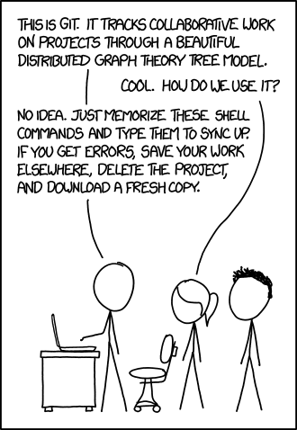
Lecture 7
More Remotes and Working with Github
Sign in on the attendance sheet!

Slide 2
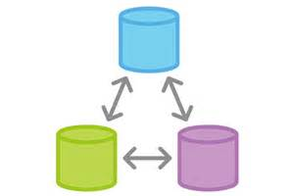
Today
Review of basic remotes
More practical explanation of remotes with GitHub
Practice using GitHub

Slide 3
Remote Tracking Branches
Usually, we create local branches that have the same names as remote branches.
Local branches can track remote branches. Git will tell you when they are “ahead”, “behind”, “diverged”, or “up-to-date”.
Use git push -u <remote> <branch> to setup.

Slide 4
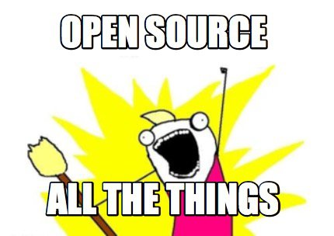
Centralized Git Workflow
Scenario: We want to contribute a change to a file in a repository on GitHub

Slide 5
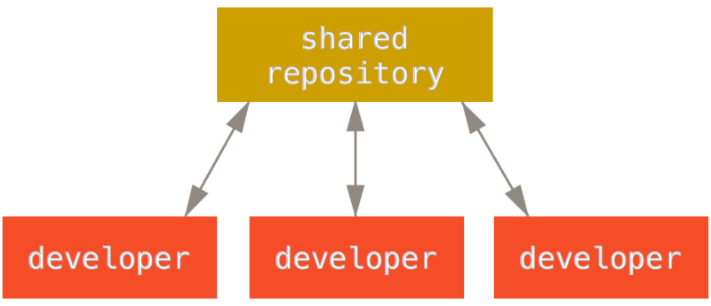
Centralized Git Workflow
WHAT?! I thought Git was a Distributed Version Control System!

Slide 6
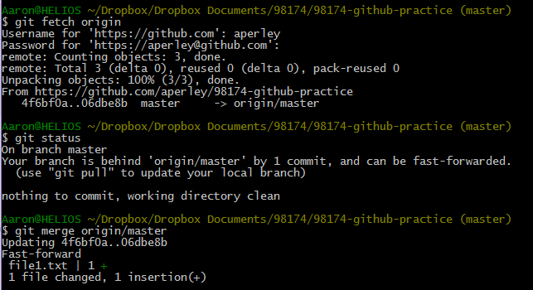
Centralized Git Workflow
Step 1: Make sure the master branch in your repository is up to date with origin/master

Slide 7
Centralized Git Workflow
Step 2: Create a new “topic branch” from master

Slide 8
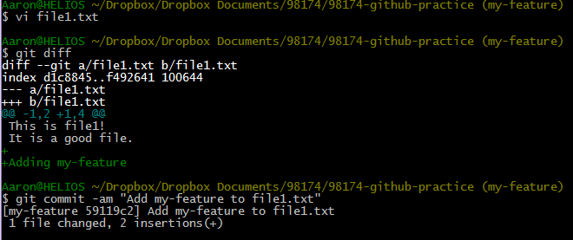
Centralized Git Workflow
Step 3: Work and make some commits on that branch

Slide 9
Centralized Git Workflow
Step 4: Merge the branch back into master

Slide 10
Centralized Git Workflow
Step 5: Push master to origin/master

Slide 11
What if someone else pushes to master before I do?
Your push will be rejected:

Slide 12
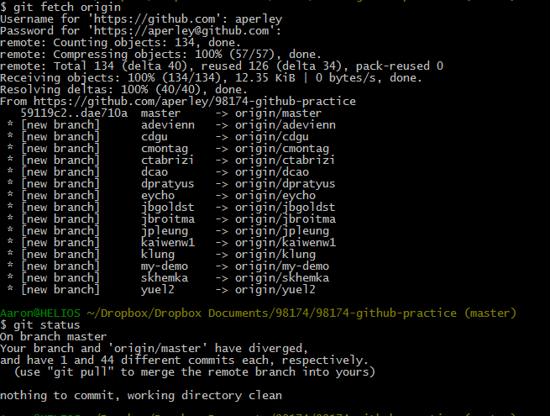
What if someone else pushes to master before I do?
git status will indicate that your branch and its remote tracking branch have diverged

Slide 13
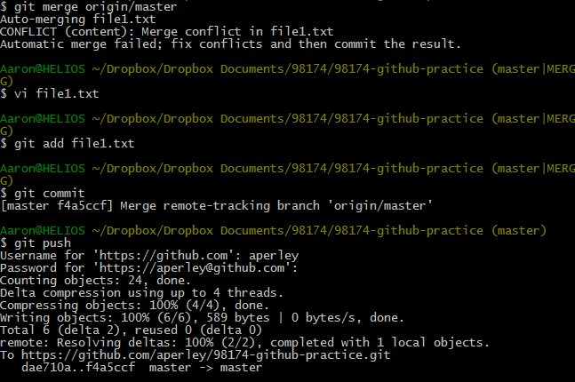
What if someone else pushes to master before I do?
We know how to fix diversions! git merge

Slide 14
Is there a better way?

Slide 15
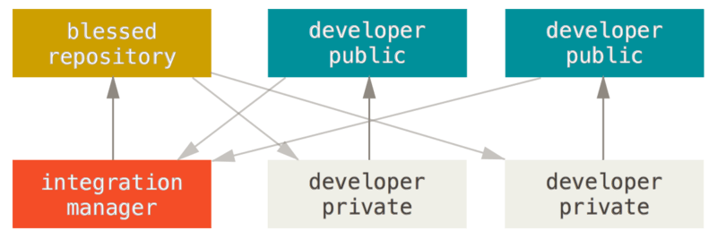
Integration-Manager Workflow
GitHub/
“The cloud”
Local Computer

Slide 16
Step 1. Fork the public repository
Blessed Repository
Developer Public Repository

Slide 17
Step 2. Clone your public repository
$ git clone https://github.com/aperley/Autolab.git
Blessed Repository
Developer Public Repository
Developer Private Repository

Slide 18
Step 3. Create a feature branch and make some commits
$ git checkout -b my-feature
$ <do some work>
$ git commit -am "add my feature"
Then push your feature branch to your public repository
$ git push origin my-feature
Developer Public Repository
Developer Private Repository

Slide 19
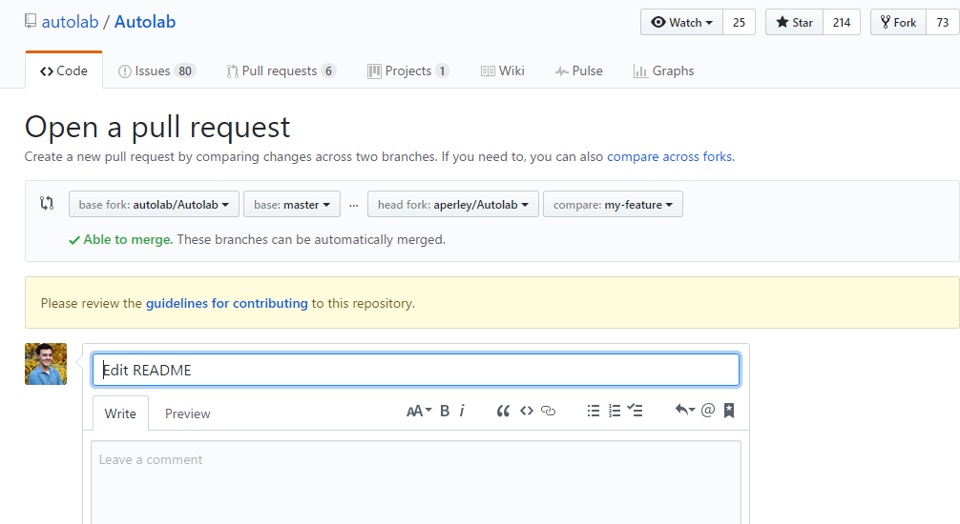
Step 4. Create a pull request

Slide 20
The integration manager can inspect and pull in your changes
As the integration manager:
$ git remote add aperleys-fork https://github.com/aperley/Autolab.git
$ git checkout aperleys-fork/my-feature
If it looks good:
$ git checkout master
$ git merge aperleys-fork/my-feature
$ git push origin master

Slide 21
The integration manager can inspect and pull in your changes
Blessed Repository
Developer Public Repository
Integration Manager Repository
Developer Private Repository

Slide 22
You need to keep your fork up to date
In the private developer repo
$ git remote add upstream
https://github.com/autolab/Autolab.git
$ git fetch upstream
$ git checkout master
$ git merge upstream/master
$ git push origin master

Slide 23
You need to keep your fork up to date
Blessed Repository
Developer Public Repository
Integration Manager Repository
Developer Private Repository

Slide 24
Activity/Homework
Create a fork of
https://github.com/ilanbiala/squirrel-story
Finish the story, push it to a branch named <ANDREWID> on your fork, and make a pull request to the blessed repository (ibiala/squirrel-story).

