Slide 1
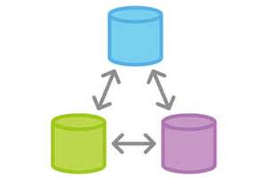
X
Lecture 5
Remotes

Slide 2
Midterm Next Week
No stressing allowed!
50 minutes in-class. You probably won’t need the whole time.
You can use the Git man pages and the lecture slides, but no googling
Questions very similar to the homework questions
Last year’s midterm (which didn’t include remotes):
https://www.andrew.cmu.edu/course/98-174/f17/midterm/midterm.html

Slide 3
Homework 4 Review

Slide 4
What We’ve Learned So Far
Creating and cloning repositories
git init, git clone
Linear commit histories and diffs
git log, git show, git diff
Using the working directory and staging area and making commits
git add, git reset, git checkout, git commit
Using branches
git branch, git checkout, git merge
How Git’s model for commit histories works

Slide 5
Today
Remotes
git remote
git fetch
git pull
git push
Github

Slide 6
Last Time: Branches
master, HEAD
db82ca7: Merge branch ‘featureA’ into master
featureA
db82ca7: Merge branch ‘featureA’ into master
b5f3729: Alice: even more work on feature A
8277e09: Bob: even more work on feature B
featureB
6f96cf3: Alice: more work on feature A
e167179: Bob: more work on feature B
8fc42c6: Alice: begin work on feature A
8b7d883: Bob: begin work on feature B
b4e2c29: initial commit

Slide 7
From the First Lecture: Git is a DVCS
HEAD
master
HEAD
master
aa2c35
aa2c35
push, pull, fetch
59a324
59a324
mybranch
mybranch
53acfb
53acfb
HEAD
master
aa2c35
Bob’s Repo
Alice’s Repo
59a324
mybranch
53acfb
Charlie’s Repo

Slide 8
Flashback: Cloning a Repo
Downloads the repo, puts you on the master branch
$ git clone https://github.com/aperley/dino-story.git

Slide 9
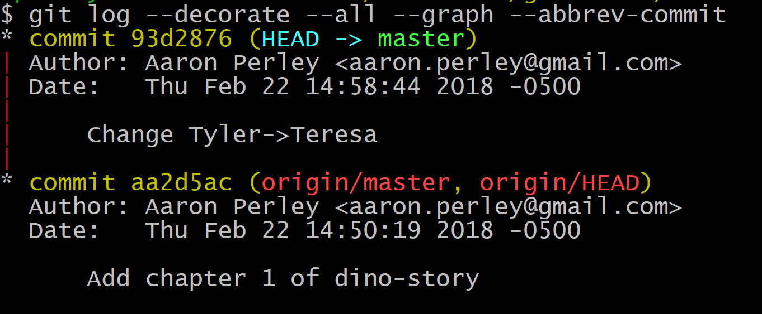
Committing and Pushing Back to Github

Slide 10
Committing and Pushing Back to Github
93d2876
“Change Tyler -> Teresa”
master
HEAD
aa2d5ac
“Add chapter 1 of dino story”
origin/master
aa2d5ac
“Add chapter 1 of dino story”
master
origin/HEAD
HEAD
Aaron’s Computer
Github’s Server

Slide 11
Listing Remote Branches

Slide 12
Pushing
$ git push origin master
Pushes the local branch called master to the branch called master on the remote named origin
This is how we move where remote branches point to

Slide 13
Pushing Back to Github
93d2876
“Change Tyler -> Teresa”
93d2876
“Change Tyler -> Teresa”
master
HEAD
aa2d5ac
“Add chapter 1 of dino story”
origin/master
aa2d5ac
“Add chapter 1 of dino story”
master
origin/HEAD
HEAD
Aaron’s Computer
Github’s Server

Slide 14
Fetching
origin/master
3cd86b0
“Add chapter 2 of dino story”
3cd86b0
“Add chapter 2 of dino story”
origin/HEAD
93d2876
“Change Tyler -> Teresa”
93d2876
“Change Tyler -> Teresa”
master
master
HEAD
HEAD
origin/master
aa2d5ac
“Add chapter 1 of dino story”
origin/HEAD
aa2d5ac
“Add chapter 1 of dino story”
Aaron’s Computer
Github’s Server

Slide 15
Keeping Local Branches Up To Date
3cd86b0
“Add chapter 2 of dino story”
origin/master
3cd86b0
“Add chapter 2 of dino story”
3cd86b0
“Add chapter 2 of dino story”
master
origin/HEAD
HEAD
93d2876
“Change Tyler -> Teresa”
93d2876
“Change Tyler -> Teresa”
master
HEAD
aa2d5ac
“Add chapter 1 of dino story”
aa2d5ac
“Add chapter 1 of dino story”
Aaron’s Computer
Github’s Server

Slide 16
Fetching and Merging
$ git fetch origin
Fetch all updates from the remote named origin
Downloads new commits, moves origin/<branch> pointers
Cannot move local branches!
$ git merge origin/master
Merges (fast-forwards, hopefully!) the local master to the commit pointed to by origin/master

Slide 17
How to get a local branch for another remote branch?
$ git checkout --track origin/experiment
Realizes that you don’t have a local branch called experiment, so creates it and switches to it.
--track will show information in git status about whether branches are “ahead” or “behind” each other

Slide 18
Summary
Configuring remotes:
git remote [-v] – lists remotes [verbosely]
git remote add <remotename> <remoteurl> - configure a new remote
git branch –r or –a – lists branches including remote tracking
Fetching:
git fetch <remotename> - downloads updates to all remote-tracking branches to match the remote
git pull <remotename> - runs `git fetch`, then merges in updates to the current branch
Pushing:
git push <remotename> <branchname> - uploads changes in your branches to the remote

Slide 19
Activity / Homework!
Create a GitHub account (if you don’t have one)
Fork my dino-story repo: https://github.com/aperley/dino-story (forking: https://help.github.com/articles/fork-a-repo/)
Clone your fork
Add your name to the byline (“By: Aaron”) and push the change to the master branch on your fork on GitHub
Checkout the chapter-2 branch and create a commit adding your own chapter 2
Merge the byline change from the master branch into the chapter-2 branch
Push the chapter-2 branch to the chapter-2 branch on your fork on GitHub

