Slide 1
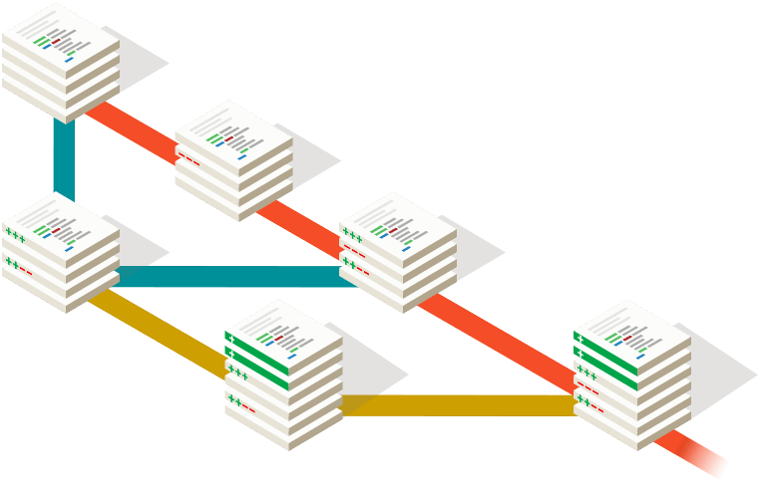
Lecture 4
More on Commits and Branches

Slide 2
Homework 3 Review

Slide 3
Review: The Git Commit Workflow (Edit, Add, Commit)
Working Directory
Staging Area
List of commits
file1.txt (v1)
file2.txt (v1)
file3.txt (v1)
file1.txt (v2)
file2.txt (v1)
file3.txt (v1)
file1.txt (v2)
file2.txt (v1)
file3.txt (v2)
file1.txt (v2)
file2.txt (v1)
file3.txt (v1)
bb2df1a
HEAD
file1.txt (v1)
file2.txt (v1)
file3.txt (v1)
782cb4f
HEAD
file1.txt (v1)
file2.txt (v1)
ab628cc
1. Make changes to files
vim file1.txt file3.txt
2. Add changes to the staging area
git add file1.txt
3. Commit changes in staging area
git commit -m “fixed bug in file1.txt”

Slide 4
What about new files?
Working Directory
Staging Area
List of commits
newfile.txt (v1)
file1.txt (v1)
file2.txt (v1)
newfile.txt (v1)
file1.txt (v1)
file2.txt (v1)
newfile.txt (v1)
file1.txt (v1)
file2.txt (v1)
bb2df1a (HEAD)
git add newfile.txt
file1.txt (v1)
file2.txt (v1)
782cb4f
file1.txt (v1)
ab628cc
No difference from an edit, use git add newfile.txt.

Slide 5
What about removing files?
Working Directory
Staging Area
List of commits
newfile.txt (v1)
file1.txt (v1)
file2.txt (v1)
___
file1.txt (v1)
file2.txt (v1)
file1.txt (v1)
file2.txt (v1)
bb2df1a (HEAD)
git rm newfile.txt
newfile.txt (v1)
file1.txt (v1)
file2.txt (v1)
782cb4f
file1.txt (v1)
ab628cc
git rm newfile.txt (also deletes newfile.txt from working directory!)

Slide 6
What if I want to undo changes in the Working Dir?
Working Directory
Staging Area
List of commits
coolfile.txt (v2)
coolfile.txt (v1)
file1.txt (v1)
file2.txt (v1)
coolfile.txt (v1)
file1.txt (v1)
file2.txt (v1)
bb2df1a (HEAD)
newfile.txt (v1)
file1.txt (v1)
file2.txt (v1)
782cb4f
file1.txt (v1)
ab628cc
git checkout -- coolfile.txt (Note staging area is unaffected)

Slide 7
What if I want to ‘unstage’ a file?
Working Directory
Staging Area
List of commits
coolfile.txt (v2)
file1.txt (v1)
file2.txt (v1)
coolfile.txt (v2)
coolfile.txt (v1)
file1.txt (v1)
file2.txt (v1)
coolfile.txt (v1)
file1.txt (v1)
file2.txt (v1)
git reset
HEAD coolfile.txt
bb2df1a (HEAD)
newfile.txt (v1)
file1.txt (v1)
file2.txt (v1)
782cb4f
file1.txt (v1)
ab628cc
git reset HEAD coolfile.txt (Note WD is unaffected)

Slide 8
What if I want to start over and go back to exactly what the HEAD looks like (in both WD and SA)?
Working Directory
Staging Area
List of commits
coolfile.txt (v2)
coolfile.txt (v1)
file1.txt (v2)
file1.txt (v1)
file2.txt (v1)
coolfile.txt (v2)
coolfile.txt (v1)
file1.txt (v2)
file1.txt (v1)
file2.txt (v1)
coolfile.txt (v1)
file1.txt (v1)
file2.txt (v1)
bb2df1a (HEAD)
git reset --hard HEAD
newfile.txt (v1)
file1.txt (v1)
file2.txt (v1)
782cb4f
file1.txt (v1)
ab628cc
git reset --hard HEAD (overwrites entire WD!)

Slide 10
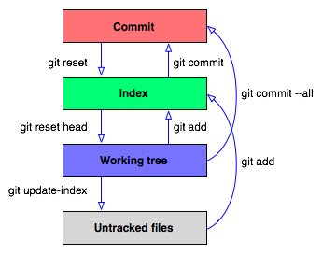
Summary

Slide 11
Last Time
Branches are pointers to specific commits
Branches allow us to create commit histories that diverge
We can merge diverged histories back together
E
wildidea
D
experiment
F
master
HEAD
C
B
A

Slide 12
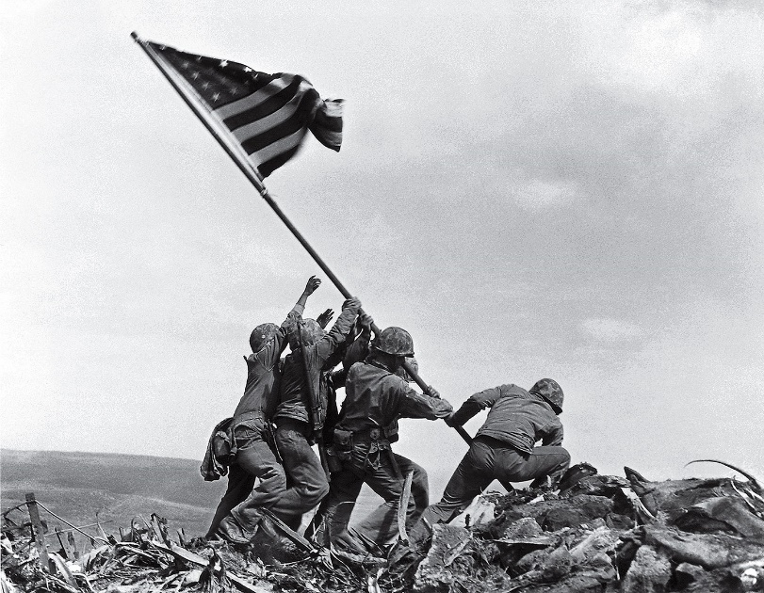
git branch <newbranchname>
Example use:
git branch experiment
Creates a new branch called “experiment” that points to wherever you are right now (i.e. wherever HEAD is right now)
B
master
HEAD
experiment
A

Slide 13
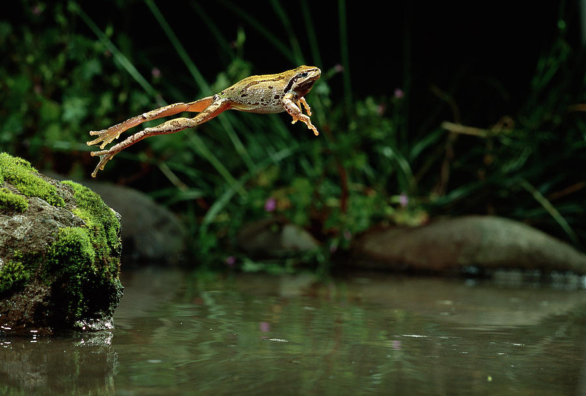
git checkout <branchname>
Example use:
git checkout experiment
Switches the HEAD to the branch named “develop”
B
master
HEAD
experiment
A

Slide 14
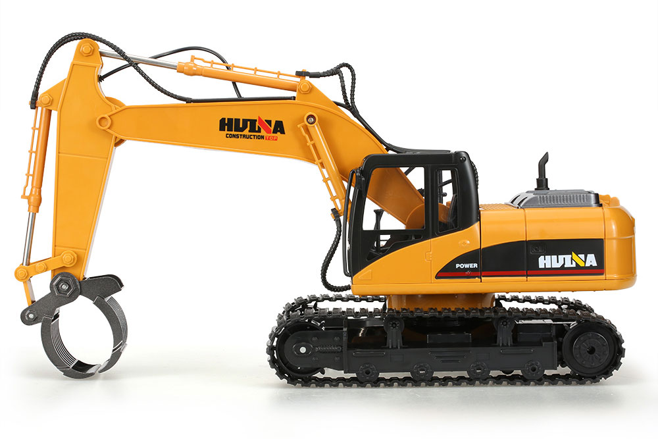
git reset --hard <commit_hash>
Example use:
git reset --hard HEAD~
Moves the current branch to point to a different commit
B
master
HEAD
experiment
A

Slide 15
Naming Commits Relative to the HEAD
<commit-ish>~: The parent of the commit
<commit-ish>~n: The nth parent of the commit
<commit-ish> is anything that is or points to a commit:
short hash a39dcf5
branch name
HEAD

Slide 16
Merging
E
wildidea
D
git merge experiment
“Will replay the changes made on the experiment branch since it diverged from master (i.e. B) until its current commit (D) on top of master, and record the result in a new commit along with the names of the two parent commits.” (from git help merge)
experiment
F
master
HEAD
C
B
A

Slide 17
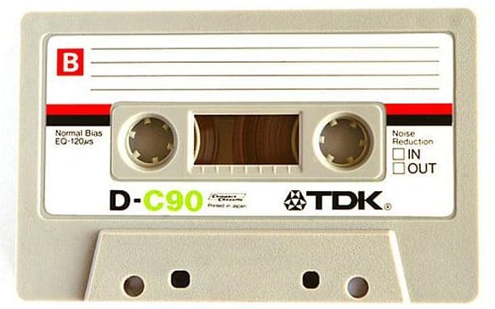
Fast Forward Merges
Occur when the branch being merged onto is an ancestor of the branch being in.
No merge commit is made unless --no-ff flag is used
Will never cause conflicts!
git merge experiment
E
wildidea
D
experiment
C
B
master
HEAD
A

Slide 18
Three-Way Merges
E
wildidea
D
Occur when the branch being merged onto is not a descendent of the branch being merged in.
The branch being merged onto has “moved on” since the split.
Creates a merge commit, can cause conflicts!
git merge experiment
Performs a “three way merge” between B, F, and D
experiment
F
master
HEAD
C
B
A

Slide 19
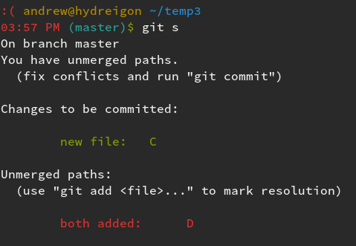
MERGE CONFLICT
master, HEAD
G
master, HEAD
F
goodidea
D
E
C
B
A

Slide 20
MERGE CONFLICT
This file is demo.txt
<<<<<<< HEAD
Here is another line. modified in master
=======
Here is another line. modified in goodidea
>>>>>>> goodidea

Slide 21
“How to fix a merge conflict”
Run `git status` to find the files that are in conflict.
For each of these files, look for lines like “<<<<<< HEAD” or “>>>>>> 3de67ca” that indicate a conflict.
Edit the lines to match what you want them to be.
After you finish doing this for each conflict in each file, `git add` these conflicted files and run `git commit` to complete the merge.

Slide 22
Activity!
Start the homework!

